Slide 1
Constraint Satisfaction Problems
Finding Values for a set of variables X from domain D, satisfying the conditions in constraints C

Slide 2
CSP Solving Techniques -
One-size-fits-all ?
• Backtracking
Forward Checking
Constraint Propagation
Heuristic-Based Search
Metaheuristic
Algorithm Selection with Machine Learning

Slide 3
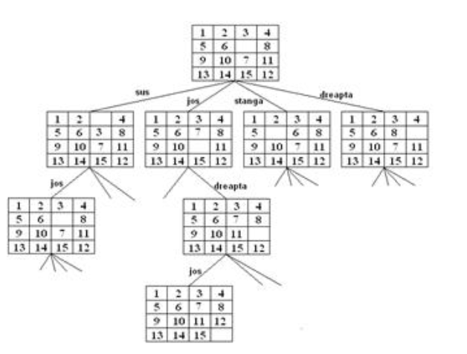
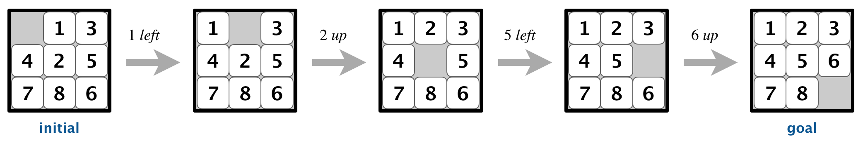
A CSP Application - Sliding Puzzle

Slide 4
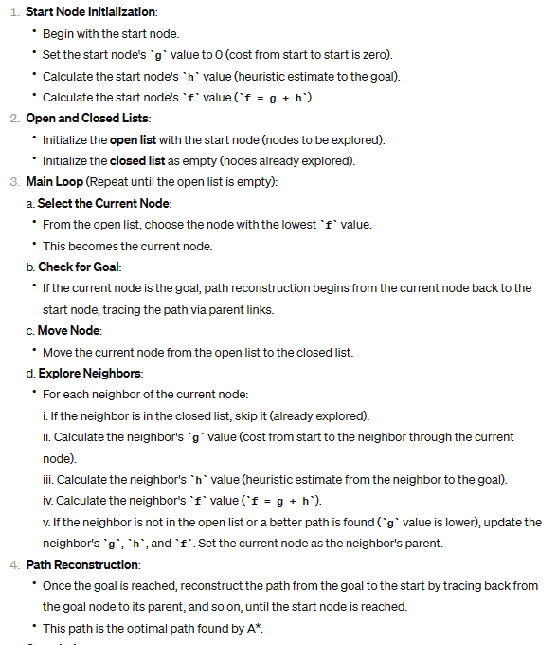
A*

Slide 5
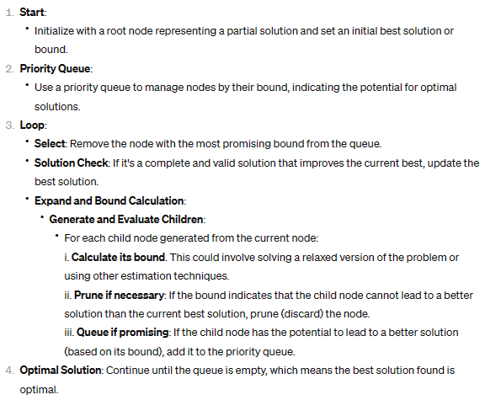
Branch and Bound

Slide 6
From Theory to problem solving - Exposure Detector
Objective problem:
Design a program that identifies the 30-pixel values in a grayscale image, provided by an image sensor, where each pixel value corresponds to a 16-bit word in memory. description of the problem is intentionally fuzzy.
Key Challenges:
Analysis for Optimal Solution:
Rigorous evaluation to ascertain the most effective method for high-value pixel detection.
performance, accuracy, and operational efficiency in a production environment.
Production Quality Assurance:
Ensuring the solution is robust, error-free, and ready for deployment in real-world setting.
Focus on maintainability and scalability to adapt to future requirements or enhancements.
Managing Ambiguities:
Accommodating for any ambiguities in problem description, while still delivering precise results.
Implementing a flexible approach that can handle variations in image quality or format.
Optimization of Resources:
Balancing space and time complexity to optimize performance without compromising the quality of the solution.
Designing an architecture that not only solves the problem efficiently but is also modular and reusable for similar future challenges.

Slide 7
Identification Challenge
Assumptions Made:
Positive Value Range: It's assumed all pixel values are positive, simplifying the search for maximum values.
Non-Sorting Requirement: The algorithm does not sort the entire set of pixel values; it is optimized to find the highest values directly.
Top Distinct vs. Top N Values: The solution assumes that finding the top 'N' values does not necessarily mean they must be distinct.
Handling Identical Values: In cases where multiple pixels share the same value within the top range, any solution is right no matter their order of occurrence in the data.
Performance Remarks:
Efficiency in Memory Utilization: Direct in-memory operations are employed to avoid unnecessary data duplication, enhancing performance.
Real-Time Data Consideration: The solution ensures that image data remains unaltered during processing to prevent inconsistencies.
Solution Extensibility: The modular design of the image processing logic allows for reusability in various contexts with minimal adjustments.
Performance Optimization Strategies:
For multiple queries on the same image: Consider pre-sorting the pixel values for repeated efficient top 'N' value extractions.
For single queries across multiple images: A direct heap data structure approach is utilized for optimal performance.
Considering the ratio of top 'N' values to total pixel count: Adjust the strategy based on whether the 'N' value is a small or large proportion of the total pixels, optimizing for either case.
Multi-Core Processing: The algorithm is adaptable for execution in multicore environments, distributing the workload for concurrent processing.

Slide 8
Applied Solution
Infrastructure/Architecture design:
The IImage interface manages the image data access, ensuring flexibility for future enhancements​​.
The ImageWrapper and VectorImage classes provide concrete implementations first for real-life image data manipulation and and second facilitate testing considering vector format, respectively​​.
The ImageProcessor is templated to work with any data type and relies on the IImage interface for accessing pixel values. This design allows it to be flexible and adaptable to various image formats.
In-memory processing for high performance, ensuring image data integrity during the process
Algorithm Selection:
Heap-based Algorithm: Efficiently manage pixel values using a heap data structure to identify the top pixels​​.
Optimized Heap Variations: Adjusted heap algorithm for improved performance in general scenarios.
Counting Sort Algorithm: A non-comparison-based sorting algorithm well-suited for sorting pixel values with a smaller range​​.
Set-based Algorithm: Unique pixel values management using a std set data structure(binary search red/black tree) to quickly retrieve the highest pixel values​​.
Parallel/distributed Processing: Exploring parallel algorithm variants to determine the most efficient approach for processing large images​​.
Testing and Simulation Overview
Performance and Functional Unit Testing:
Utilized the Google Test framework for comprehensive unit testing.
Conducted performance testing to gauge execution times and assess algorithm efficiency.
Validated the handling of edge cases, ensuring robust performance across images with both uniform and extreme pixel values.
Solution Evaluation & Systematic Benchmarking:
Performed simulations across a variety of image scenarios to rigorously benchmark the solution.
Tested against diverse pixel distributions including uniform, random, and those following gradient and Gaussian patterns.
Created matrices with variable regions to represent different imaging conditions realistically.
Performance Analysis and Data Generation:
Generated CSV data sets for a granular analysis of execution time and memory usage.
Benchmarked using data sets reflective of practical imaging conditions, such as uniformly distributed pixel values and sorted matrices, to ensure comprehensive solution evaluation.

Slide 9
Optimization Techniques
Unrolling: Reduces loop overhead by expanding the loop body.
Tiling: Organizing data in blocks for cache locality, achieving optimal cache usage.
Prefetching: Preloading data into cache.
Parallelization: Distributes tasks across multiple threads for multiprocessor execution.
Speculation: Anticipates instruction execution – branch prediction.
Loop Bound Analysis: Determining precise loop bounds.
Loop Fission: Breaks down loops to improve reference locality.
Loop Fusion: Merges adjacent loops with similar iteration counts.
Loop Interchange: Reorders loops to enhance data locality.
Loop Inversion: Converts while loops to reduce conditional jumps.
Code Motion: Moves unchanging calculations outside the loop.
Reversal: Inverts the iteration order to remove dependencies.
Loop Scheduling: Divides loops for concurrent multi-processor runs.
Loop Skewing: Adjusts nested loops to alleviate data dependencies.
Software Pipelining: Reorders operations for execution efficiency.
Loop Splitting: Segments loops to simplify or remove dependencies.
Vectorization: Runs iterations simultaneously on SIMD systems.
Loop Unswitching: Moves conditionals outside the loop to reduce duplication.
Loop Sectioning: Divides loops for SIMD processing and memory enhancement

Slide 10
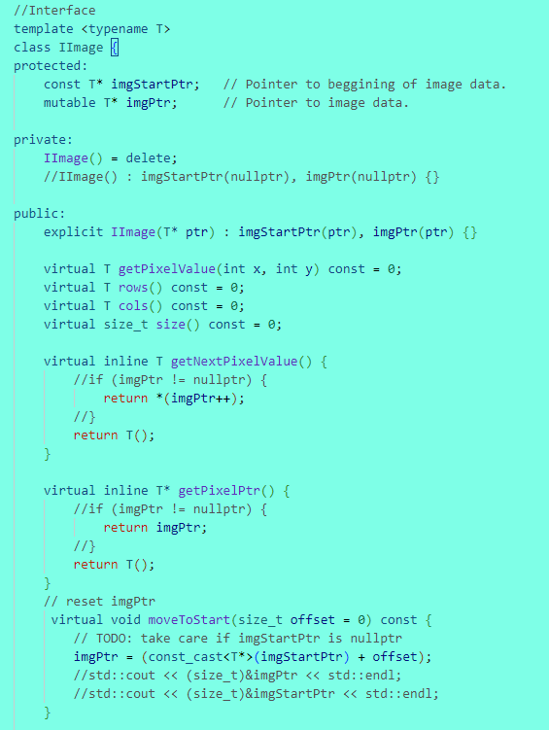
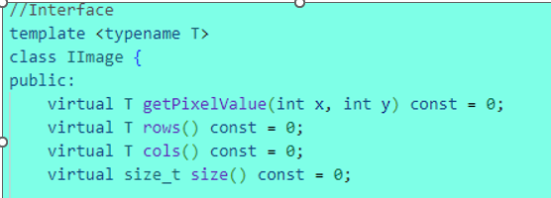
Optimization

Slide 11
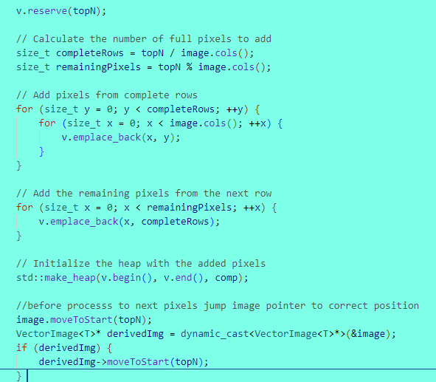
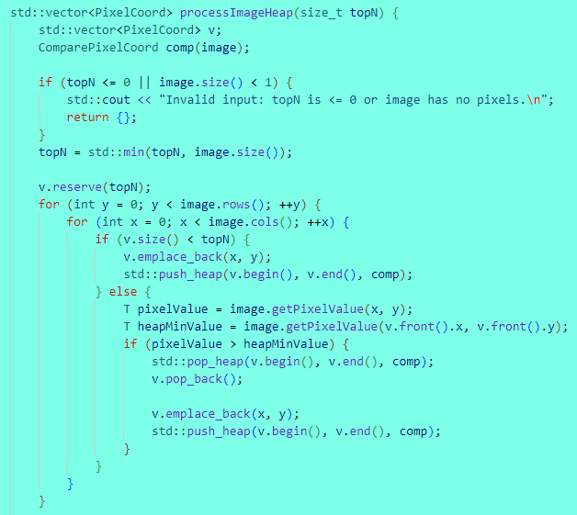
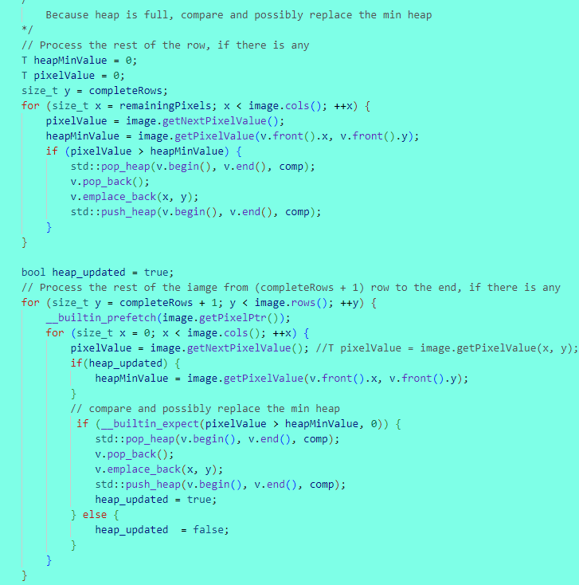
optimization

Slide 12
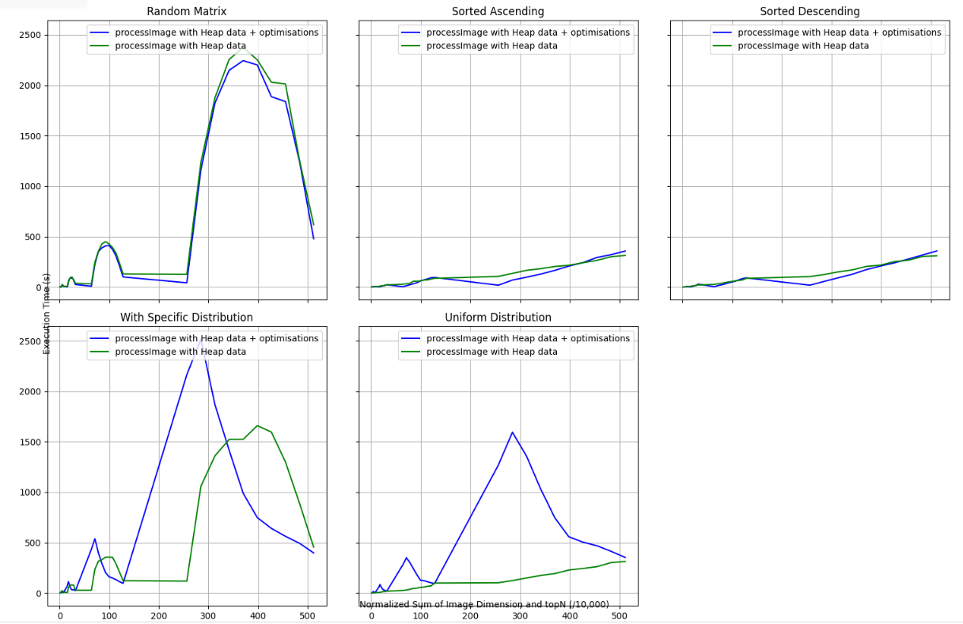
Graphic comparation

Slide 13
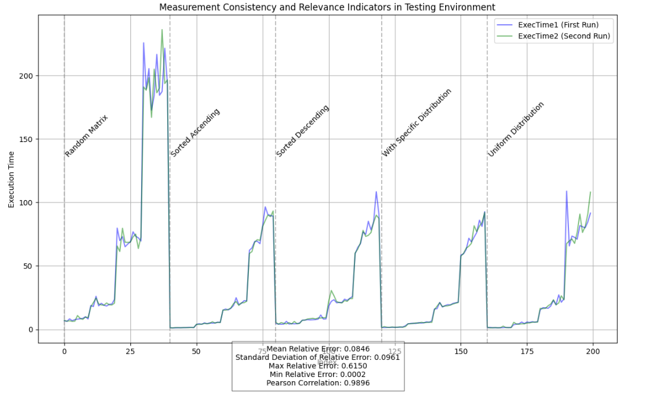
Validating Testing Environment Consistency

Slide 14


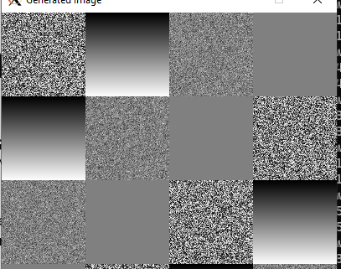
Synthetic data and data collection
Synthetic Image Data Generation:
Random image Matrix
Image matrix Sorted Ascending and Descending
With Specific Distribution
Uniform Distributions
Image with controlled region for pixel color distributions like uniform, Gradient, Gaussian(normal), or constant.​​...

Slide 15
Performance-Driven Algorithm Experimentation
Performance Benchmarking:
Executed each algorithm variant under various image conditions to get their performance and scalability.
Gathered metrics such as execution time and memory usage to inform the decision on the optimal algorithm choice
Experimentation with Variants:
Executed a suite of algorithms, including heap-based, counting sort, set-based, and parallel processing to address the pixel identification challenge.
Each variant was stress-tested under specific use cases to evaluate their performance edges and limitations.
Heap-Based Innovations:
Standard Heap: Implemented as a baseline for performance comparison.
Optimized Heap Variations: Introduced heap unrolling and priority queue merging for enhanced speed in different processing conditions.
Non-Heap Alternatives:
Counting Sort: Deployed for its linear time complexity in scenarios with limited pixel value range.
Set-Based Approach: Utilized for scenarios prioritizing the elimination of duplicate values and quick access to unique high-value pixels.
Concurrent Processing Techniques:
Explored multi-threading to take advantage of multicore processing capabilities, significantly cutting down processing time for large images.

Slide 16
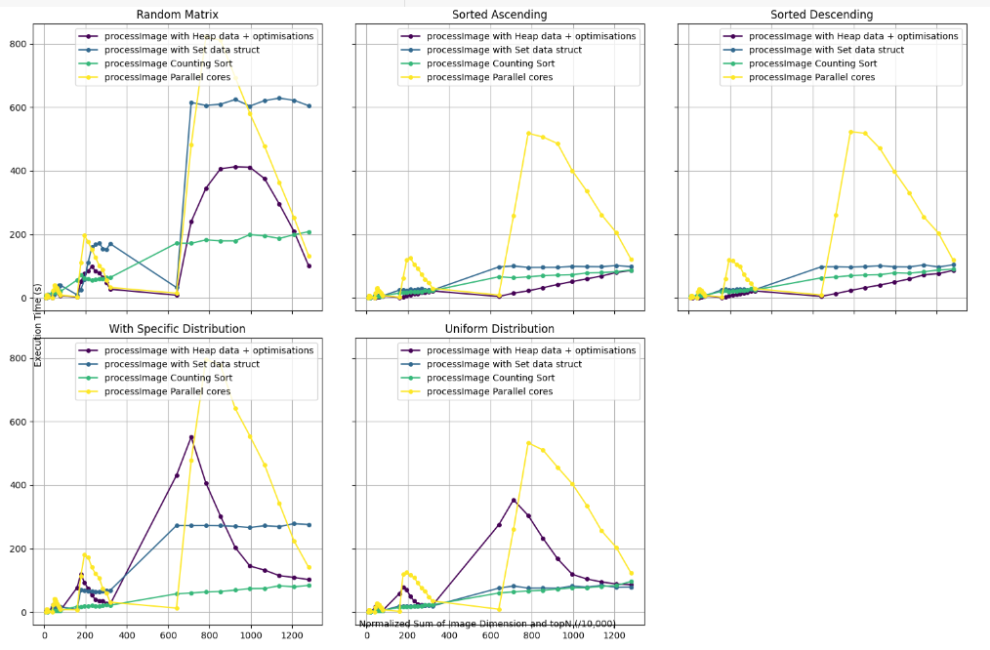
Data Analysis
CSV data generation for performance analysis, enabling a detailed examination of execution time
NP-complexity nature – regression can be outperformed

Slide 17
ML - predict best strategy.
The academic shows that ML-based algorithm selectors surpass traditional state-of-the-art methods in addressing CSP
Link publication: A General Framework Based on Machine Learning for Algorithm Selection in Constraint Satisfaction Problems
From synthetic data with feature definition to workflow process of ML

Slide 18
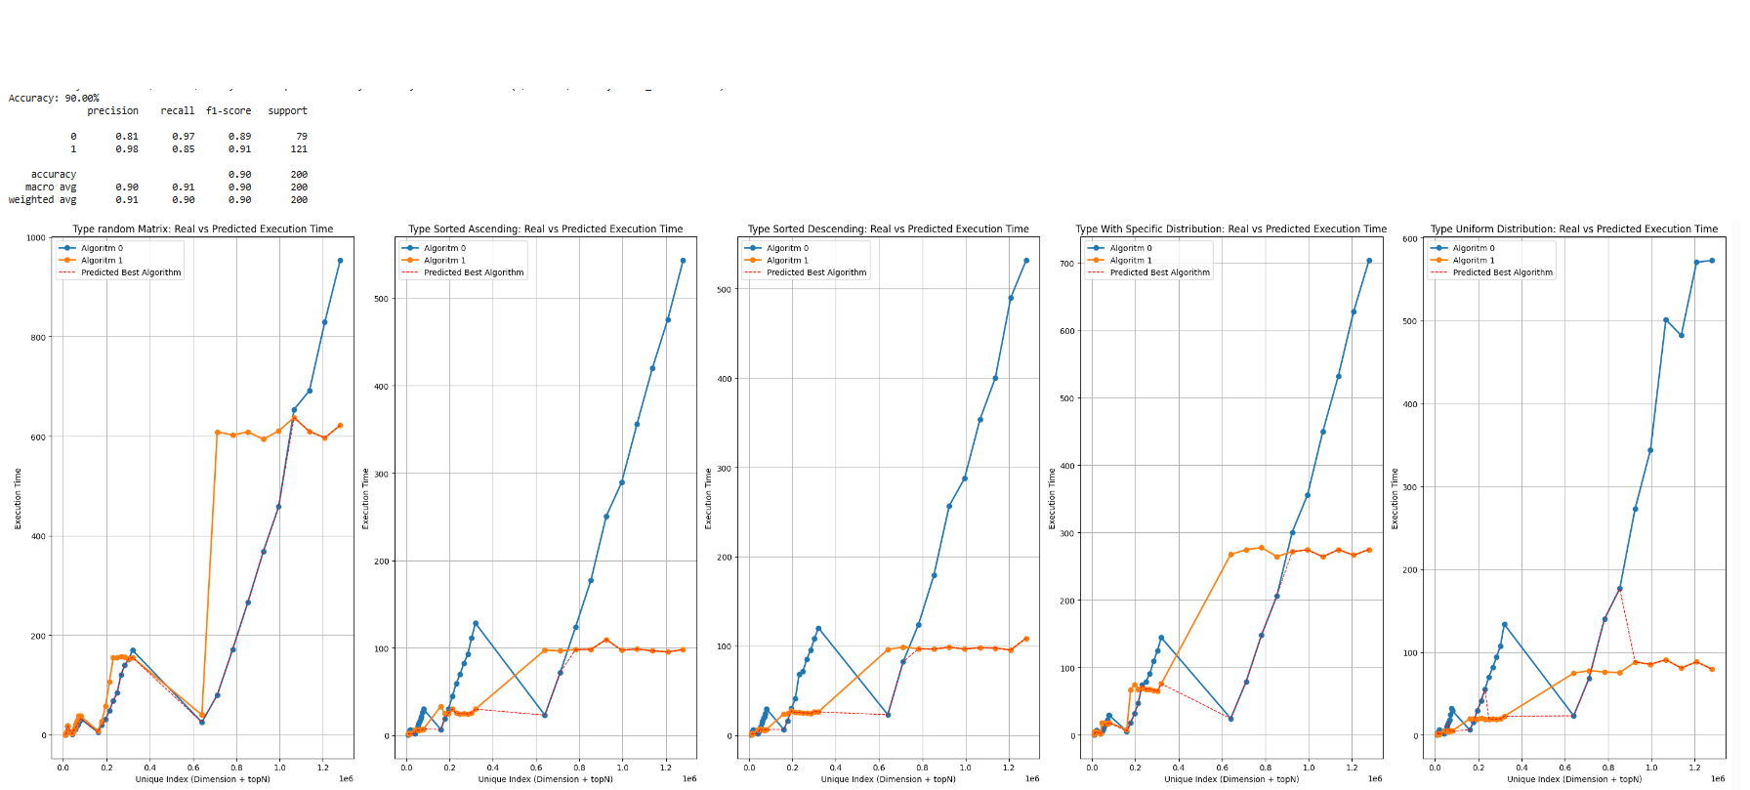
RandomForest
Prepare data for training
Red dash line depict the prediction.

Slide 19
RandomForest
Creates Prediction Trees
Makes Predictions
Combines Predictions

