Slide 1
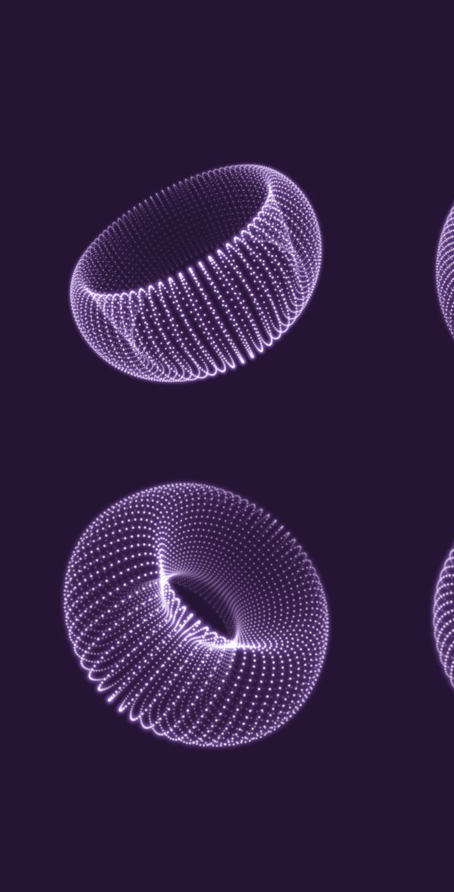
Image Processing Project Overview
An exploration of image manipulation techniques using OpenCV in Python

Slide 2
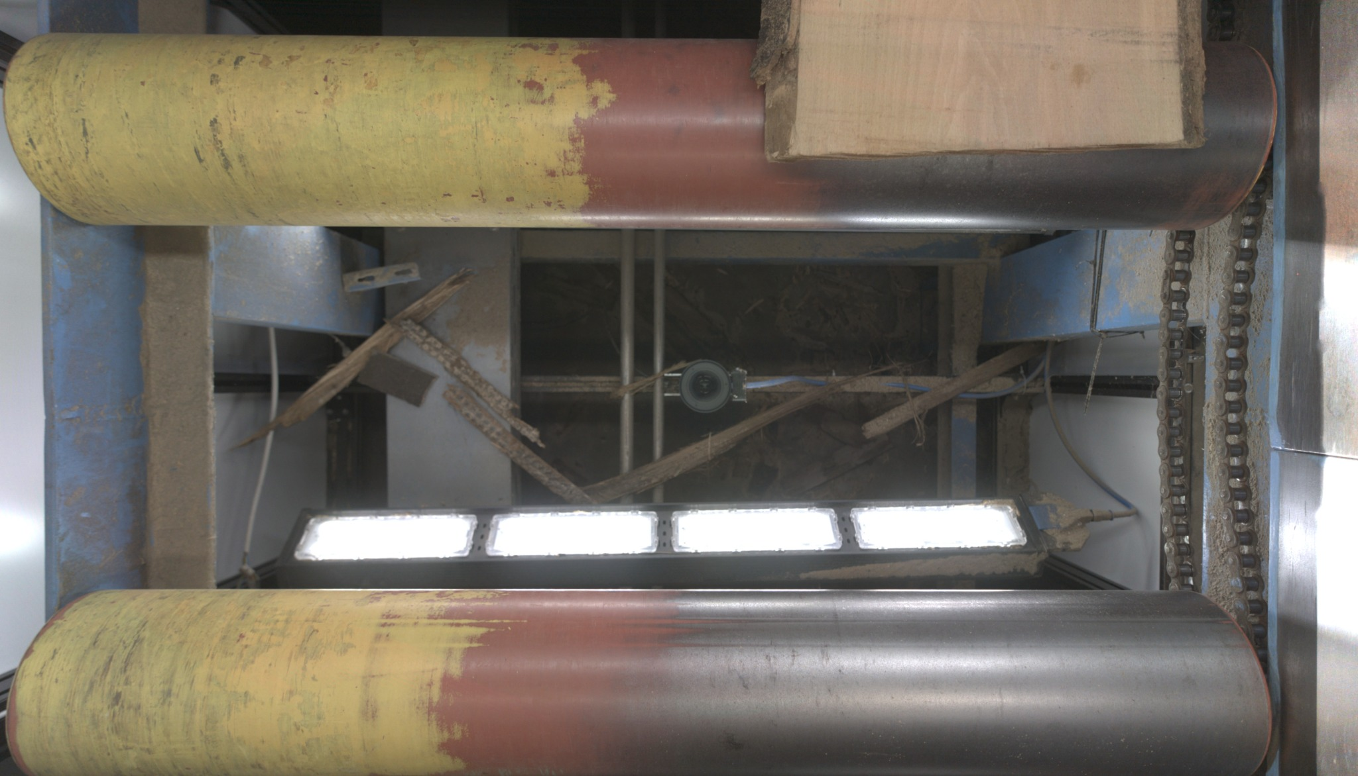
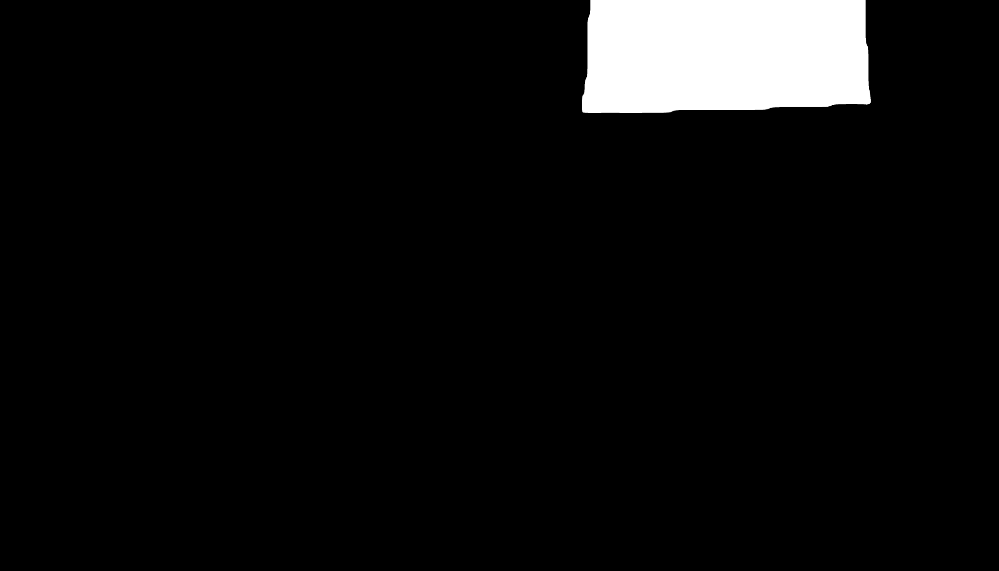
Example of input Wood and Mask

Slide 3
Code Overview
1. Load Images and Masks:
- For each image and mask path, load the corresponding image and mask.
2. Expand Masks:
- For each loaded mask, expand the white areas horizontally by a specified offset to include more of the image area.
3. Process Images:
- For each image-mask pair:
a. Apply the expanded mask to extract the relevant region from the image.
b. If the region is valid, store it for further processing.
4. Calculate Shifts (not used yet):
- Calculate vertical shifts by comparing the bottom-most white pixels in consecutive masks to align images vertically.
5. Combine Images:
- Sequentially combine extracted regions from processed images:
a. Adjust each region based on the calculated vertical shift.
b. Blend transitions between consecutive regions using a Gaussian blur for smoothness.
6. Output Combined Image:
- Save or display the final combined image with all regions aligned and transitions smoothed.

Slide 4
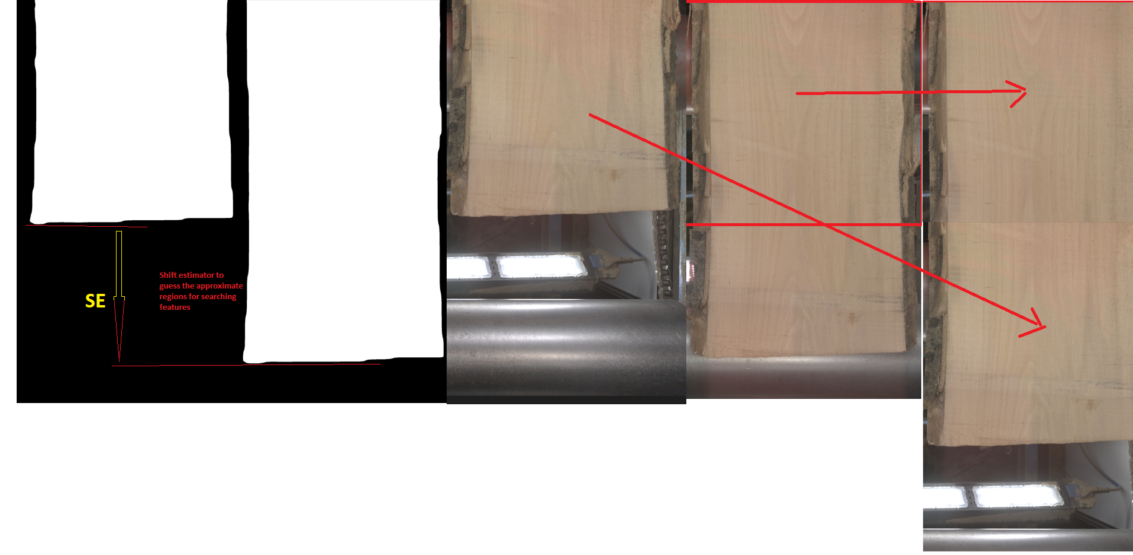
My base strategy on shift masks calculous

Slide 5
Challenge: Varying Speeds and Directions
Feature Detection:
Feature Matching:
Shift Calculation:
Motion Prediction Models:
Feedback Systems:

Slide 6
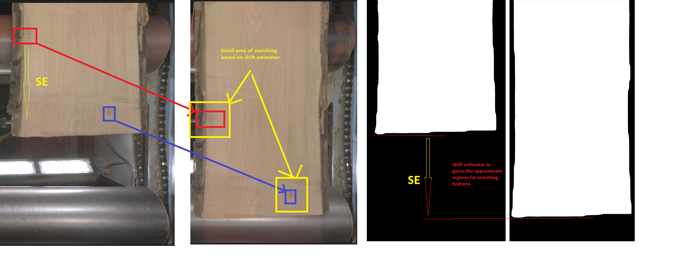
Features on color images

Slide 7
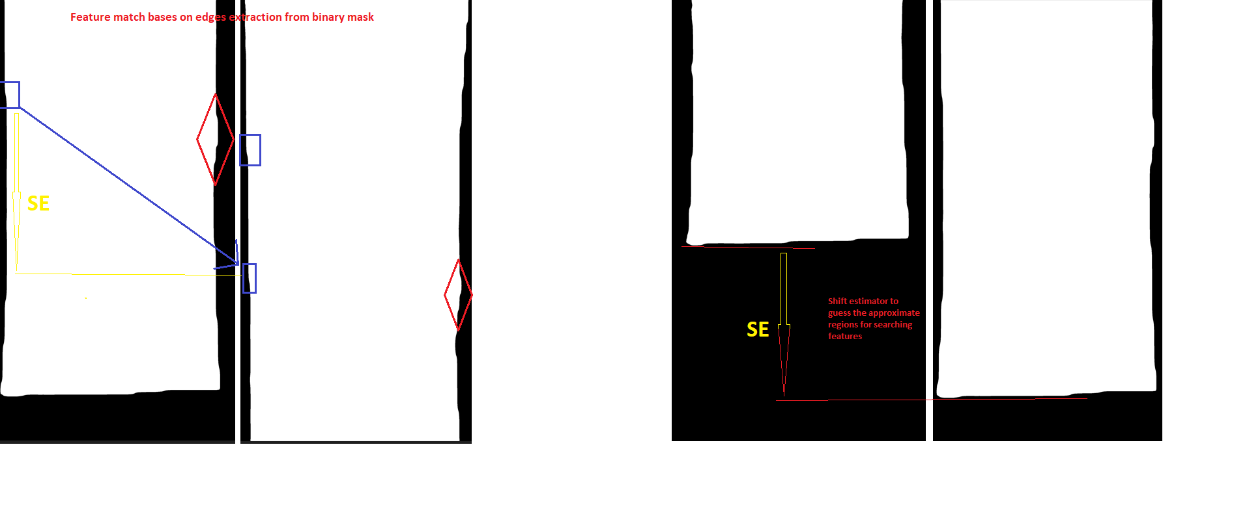
Features on binary masks

Slide 8
Proposed Improvement: Enhanced Transition Blending
Use of Overlapping Regions from Original Images: identify original image that overlap region over the merging zone where two images meet.
Identify Overlap and then Adjust Blending Zone more realist
Adjust Blend Zone: Modify the width of the transition zone to include larger portions from the edges of both overlapping images. This increases the area over which the blending occurs, allowing for a more gradual transition.
Advanced Blending Techniques:
Multi-scale Blending: Apply blending at multiple scales or layers. Start with a coarse adjustment for large features and progressively refine the blend for finer details.
Poisson Blending: Utilize gradient-domain blending techniques such as Poisson blending, which seamlessly combines images by solving a Poisson equation that minimizes the difference in gradient between the source and target images.

Slide 9
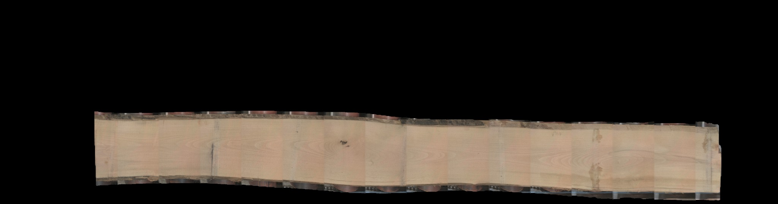
Final Rotated Image

Slide 10
Advanced Shift Calculation Method
For dynamic processing conditions, an advanced method involving feature detection and tracking is proposed. This method utilizes corner detection techniques to identify unique features in the visible area of the wooden plank within the frame. A region around these detected features is defined and then searched in the subsequent frame. By locating these features in the next frame, an accurate vertical shift (along the y-axis) can be computed, adapting to any changes in the speed of the moving plank. This method ensures precise alignment and tracking of the wooden plank across successive frames.

