Slide 1
DBMS Overview

Slide 2
Database: What
Database
  is collection of related data and its metadata organized in a structured format
  for optimized information management
    Avoid redundant storage of information
    Reducing Storage overhead
    Security (encryption etc)
Database Management System (DBMS)
  is a software that enables easy creation, access, and modification of databases
  for efficient and effective database management
    Faster search and access (query planning)
    Transaction
    Maintaining Integrtity
Notes:
End user data – raw facts of interests to the end user
Metadata – description of data characteristics and relationships
Organization of data helps:
improve data accuracy
improve timely access
correlation and comparison
DBMS: a collection of programs that manages the database structure, control access to data
- Makes data management more efficient and effective
- Query language allows quick answers to ad hoc queries
- Provides better access to more and better-managed data
- Promotes integrated view of organization’s operations
- Reduces the probability of inconsistent data

Slide 3
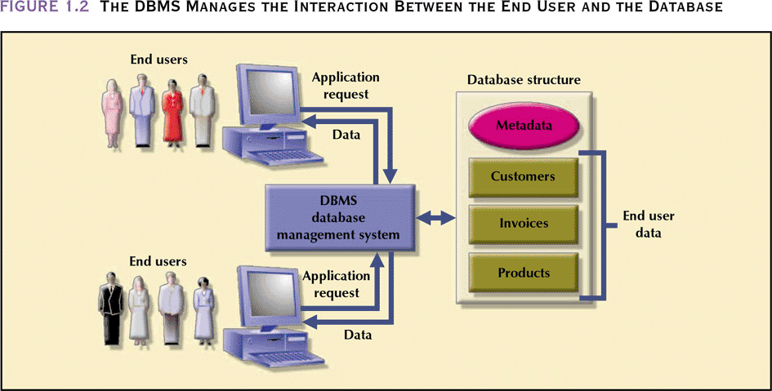
Database Management System
- manages interaction between end users and database
Database Systems: Design, Implementation, & Management: Rob & Coronel

Slide 4
Evolution of Data Models
Timeline
1960s
1970s
1980s
1990s
2000+
File-based
Hierarchical
Object-oriented
Network
Relational
Web-based
Entity-Relationship

Slide 5
Database: Historical Roots
Manual File System
  to keep track of data
  used tagged file folders in a filing cabinet
  organized according to expected use
    e.g. file per customer
  easy to create, but hard to
    locate data
    aggregate/summarize data
Computerized File System
  to accommodate the data growth and information need
  manual file system structures were duplicated in the computer
  Data Processing (DP) specialists wrote customized programs to
    write, delete, update data (i.e. management)
    extract and present data in various formats (i.e. report)

Slide 6
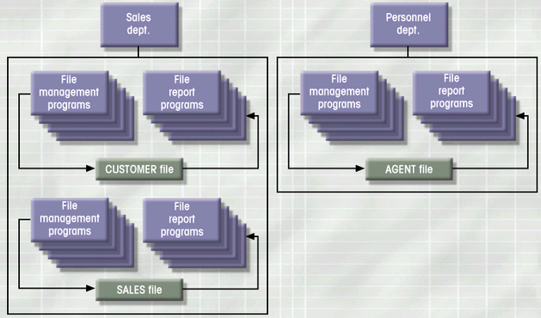
File System: Example
Database Systems: Design, Implementation, & Management: Rob & Coronel

Slide 7
File System: Weakness
Weakness
  “Islands of data” in scattered file systems.
Problems
  Duplication
    same data may be stored in multiple files
  Inconsistency
    same data may be stored by different names in different format
  Rigidity
    requires customized programming to implement any changes
    cannot do ad-hoc queries
Implications
  Waste of space
  Data inaccuracies
  High overhead of data manipulation and maintenance

Slide 8
File System: Problem Case
CUSTOMER file
AGENT file
SALES file
A_Name (15 char)
A_Name (20 char)
AGENT (20 char)
Carol Johnson
Carol T. Johnson
Carol J. Smith
- inconsistent field name, field size
- inconsistent data values
- data duplication

Slide 9
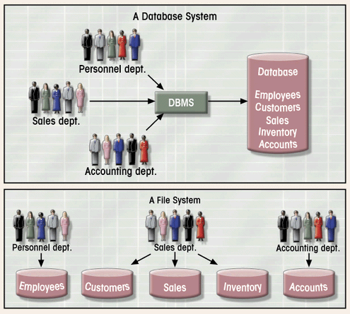
Database System vs. File System
Database Systems: Design, Implementation, & Management: Rob & Coronel

Slide 10
Hierarchical Database
Background
  Developed to manage large amount of data for complex manufacturing projects
  e.g., Information Management System (IMS)
    IBM-Rockwell joint venture
    clustered related data together
    hierarchically associated data clusters using pointers
Hierarchical Database Model
  Assumes data relationships are hierarchical
    One-to-Many (1:M) relationships
      Each parent can have many children
      Each child has only one parent
  Logically represented by an upside down tree

Slide 11
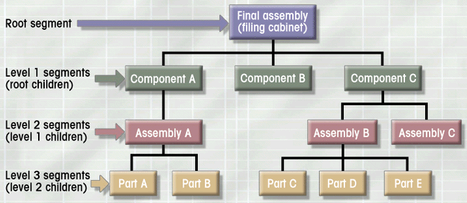
Hierarchical Database: Example
Database Systems: Design, Implementation, & Management: Rob & Coronel

Slide 12
Hierarchical Database: Pros & Cons
Advantages
  Conceptual simplicity
    groups of data could be related to each other
    related data could be viewed together
  Centralization of data
    reduced redundancy and promoted consistency
Disadvantages
  Limited representation of data relationships
    did not allow Many-to-Many (M:N) relations
  Complex implementation
    required in-depth knowledge of physical data storage
  Structural Dependence
    data access requires physical storage path
  Lack of Standards
    limited portability

Slide 13
Network Database: Pros & Cons
Advantages
  More data relationship types
  More efficient and flexible data access
    “network” vs. “tree” path traversal
  Conformance to standards
    enhanced database administration and portability
Disadvantages
  System complexity
    require familiarity with the internal structure for data access
  Lack of structural independence
    small structural changes require significant program changes
Notes:
disadvantages left over from hierarchical model

Slide 14
Relational Database
Problems with legacy database systems
  Required excessive effort to maintain
    Data manipulation (programs) too dependent on physical file structure
  Hard to manipulate by end-users
    No capacity for ad-hoc query (must rely on DB programmers).
Evolution in Data Organization
  E. F. Codd’s Relational Model proposal
    Separated the notion of physical representation (machine-view)
    from logical representation (human-view)
    Considered ingenious but computationally impractical in 1970
  Relational Database Model
    Dominant database model of today
    Tables
      flexible logical structure for data representation
      related by sharing common entity characteristic(s)

Slide 15
Some important RDBMS Terms
Attribute: Attributes are the properties that define a relation. e.g.; ROLL_NO, NAME
Relation Schema: A relation schema represents name of the relation with its attributes. e.g.; STUDENT (ROLL_NO, NAME, ADDRESS, PHONE and AGE) is relation schema for STUDENT.
Tuple: Each row in the relation is known as tuple. The above relation contains 4 tuples, one of which is shown as (12, John, Seattle, 9455123451, 18)
Cardinality: The number of tuples in a relation is known as cardinality. (sa) The STUDENT relation(table) has information about 4 students then its cardinality is 4.
Relation key − Each row has one or more attributes, known as relation key, which can identify the row in the relation (table) uniquely.

Slide 16
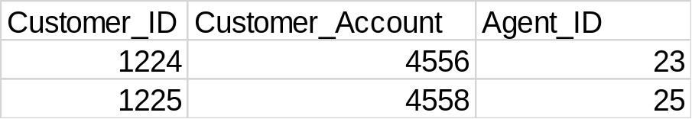
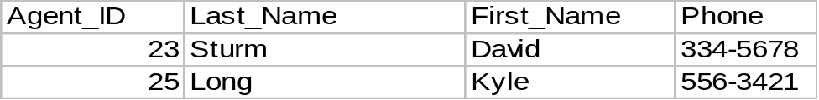
Relational Database: Example
Provides a logical “human-level” view of the data and associations among groups of data (i.e., tables)

Slide 17
Relational Database: Pros & Cons
Advantages
  Structural independence
    Separation of database design and physical data storage/access
    Easier database design, implementation, management, and use
  Ad hoc query capability with Structured Query Language (SQL)
    SQL translates user queries to codes
Disadvantages
  Substantial hardware and system software overhead
    more complex system
  Poor design and implementation is made easy
    ease-of-use allows careless use of RDBMS

Slide 18
DBMS and RDBMS recap
DBMS
  databases store sets of data that can be queried for use in other applications.
  A database management system supports the development, administration and use of database platforms.
RDBMS
  An RDBMS is a type of DBMS with a row-based table structure that connects related data elements
  It includes functions that maintain the security, accuracy, integrity and consistency of the data.

