Slide 1
PROFESSIONAL SERVICES STRATERGY

Slide 2
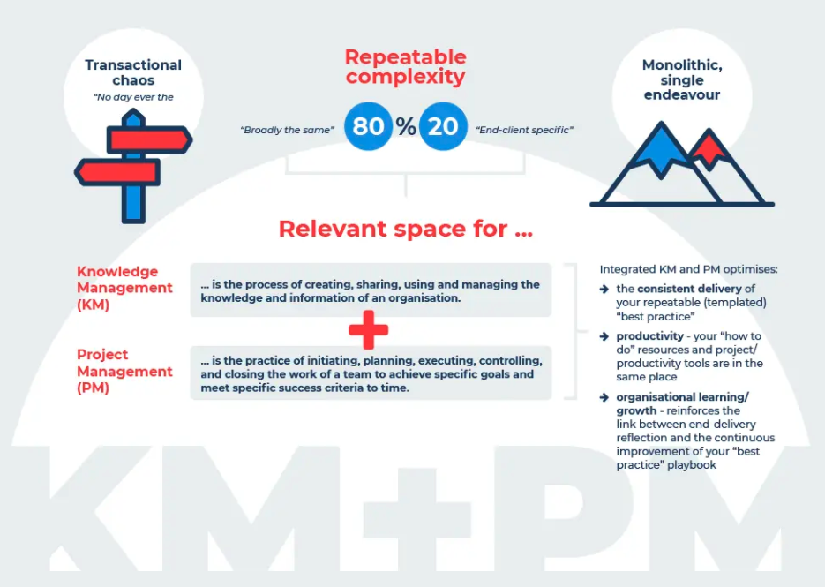
PROFESSIONAL SERVICES
Building repeatable complexity & successful delivery team = service excellence
Building systematic, integrated approach towards Knowledge Management (can be developed through a Center of Excellence) & EPMO
How I develop KM
Form a KM team
Run knowledge fairs
Develop who-knows-what directory (dictionary of your teams capabilities)
Develop a how to get there guide (training plan of how to get your team trained)
Develop Intellectual Property
Develop and curate knowledge repositories (each team member from Jr Analyst to Principal needs to contribute as part of their second job)
Do regular KM Audits
Communicate constantly!
3) How I developed a successful ePMO (see slide #15)

Slide 3
PROFESSIONAL SERVICES
Building repeatable complexity & successful delivery team = service excellence
KM team > rotating KM team lead / every level contributes (part of their quarterly goals)
Run knowledge fairs > Lunch & Learn / present White Papers / 1-3 hours per designated person on client knowledge transfer / lessons learned
Develop who-knows-what directory > dictionary of your teams capabilities / connect people-with-people / open door policy / juniors to shadow seniors / challenge 90:90 (90% of people knows 90% of company) - used Method Grid
Develop a how to get there guide (training plan of how to get your team trained) > have a plan to get people where they need to go
Develop Intellectual Property > Content (Blogs, Powerpoint / video / white papers), Methodology (Handbook, digital enterprise methodology, Standard Operating Procedures, Dataset, Diagnostic tools, Software - Smarthseet, Asana, Jira, etc.), Registered IP (URLs, trademark, Patents, registered media profiles)…it has to be intuitive, Dynamic, Empowering, Accessible and Secure.
Develop and curate knowledge repositories (each team member from Jr Analyst to Principal needs to contribute as part of their second job)
Do regular KM Audits
Communicate constantly!

Slide 4
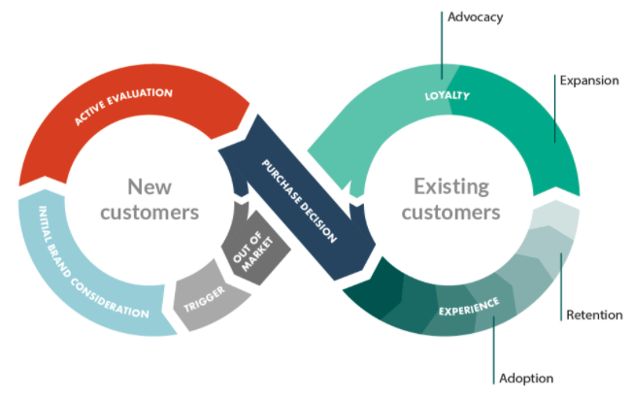
CUSTOMER SUCCESS
Marketing (S) Technical Support (TS)
Sales (S) Customer Success (CS)
Sales Engineering (SE) Professional Services (PS)
Product & Engineering (P&E)
From an internal point of view…
Adoption 🡪 Delivery > (PS) > Need to deliver flawlessly
Retention 🡪 Post-Sale Strategy
Sustainable funding model supported by premium offers > (CS) + (PS) + (TS) + (S) + (P&E) >Need to have a Growth-oriented charter to customer success > Need to have a Combination of free and fee-based Support SLAs
Clarity on capabilities to build internal capabilities (PS) + (CS) + (P&E)
Expansion 🡪 Advance Analytics > (S) + (SE) > Predict customer behavior and target new segments. Introduce Change Management methodology to be more agile in changing internal processes
Advocacy 🡪 Customer first focus > (All) > Promoting and adopting a Customer-success culture across the organization > Cross functional approach where all departments contribute

