Slide 1
PMO Build and experience
(concepts)

Slide 2



Vision
Maturity Level
Prescriptive (how to react)
Predictive (what will happen)
Discovery (how does it all relate)
Diagnostic (KPIs)
Descriptive (measurements)
Hindsight
Insight
Foresight
Value to Organization

Slide 3
Problem statement
How are we aligning our corporate strategy based on the demand generated by our clients?
How are we tracking customer success? What are the KPI’s
Which business capabilities are in trouble? Which ones could be next?
How is my portfolio / project delivery at client doing? How are we trending? How will my client portfolio end up doing?
What do I need to know, review, evaluate, and possibly act upon the feedback we get from our customers?
Is our internal knowledge being disseminated correctly throughout the company?
When are the first indications that something may be amiss? Or that there are opportunities?
Why didn’t I see this coming? Why did projects fail in the past? Statistically, are there root causes for cascading effects?
Who are the experts?

Slide 4
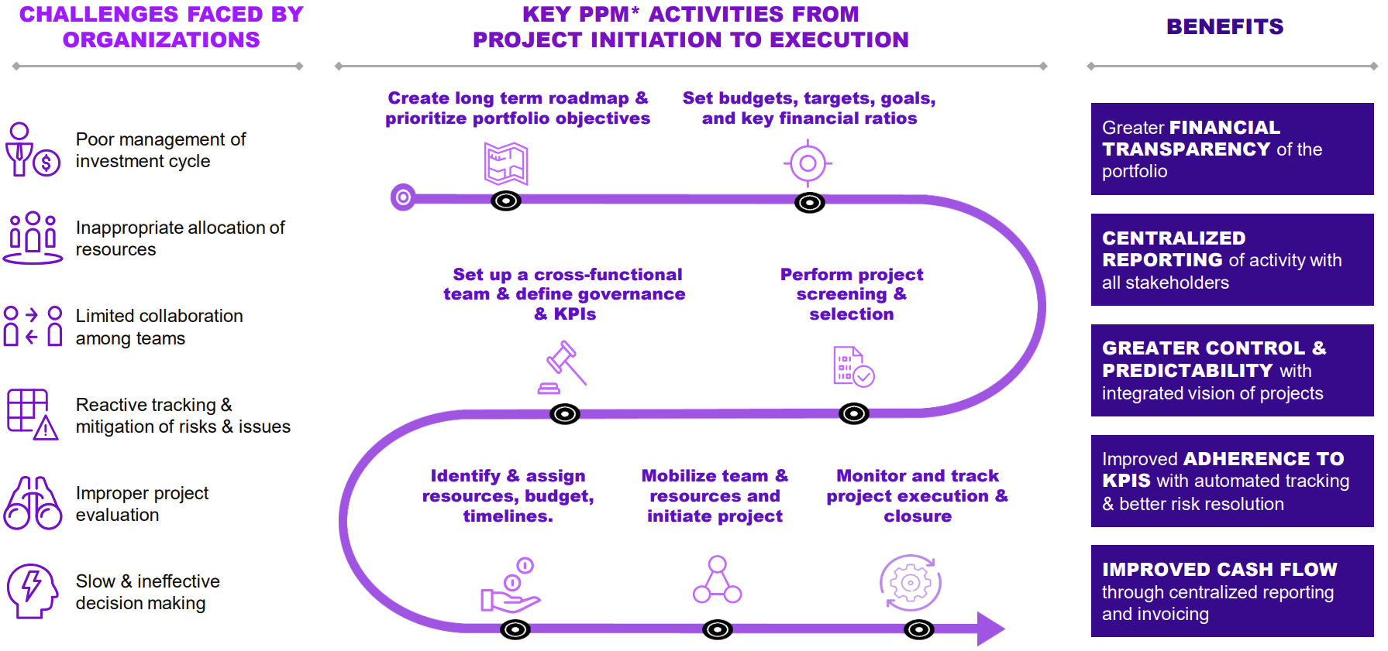
ePMO
Building PMOs and managing client Portfolios

Slide 5
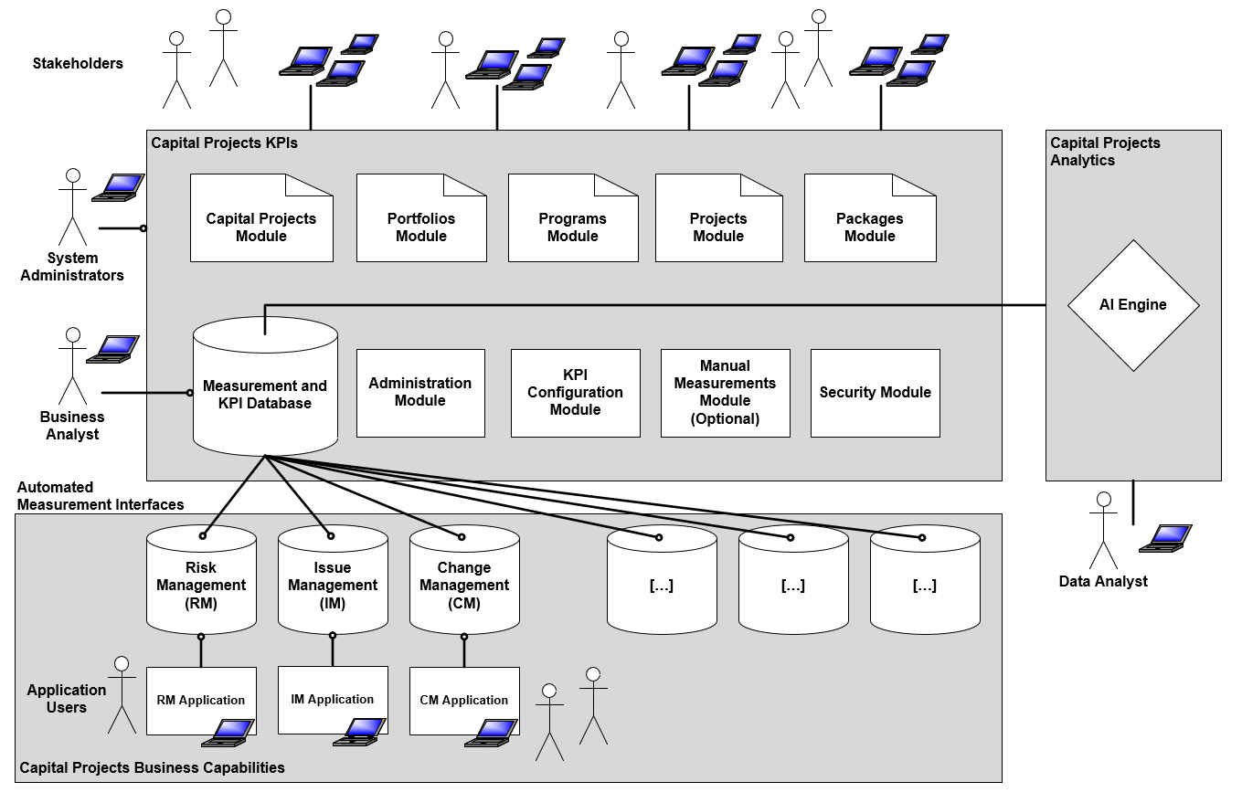
BASIC ARCHITECTURAL Blueprint
ePMO

Slide 6
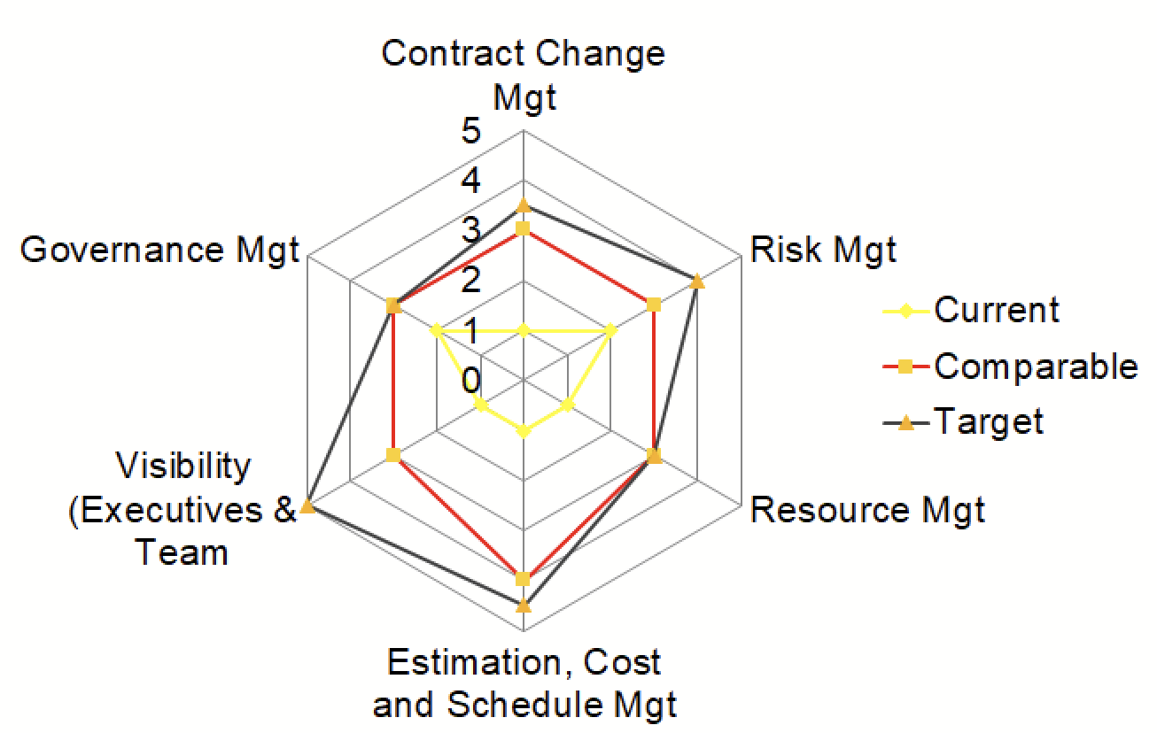
WHERE ARE WE NOW? Traditional Maturity LEVEL → 6 factors to look at…
Example of possible key challenges ?
Is it that there is no global adherence to PM Best practices / Tools / Discipline?
Is it that the is no single resource pool and no Resource Allocation done?
Is it that the projects never really have a proper Closeout phase?
Is it lack training or tools available? Or both?
Tools don’t support risk process and maturity
ETC…
20

Slide 7
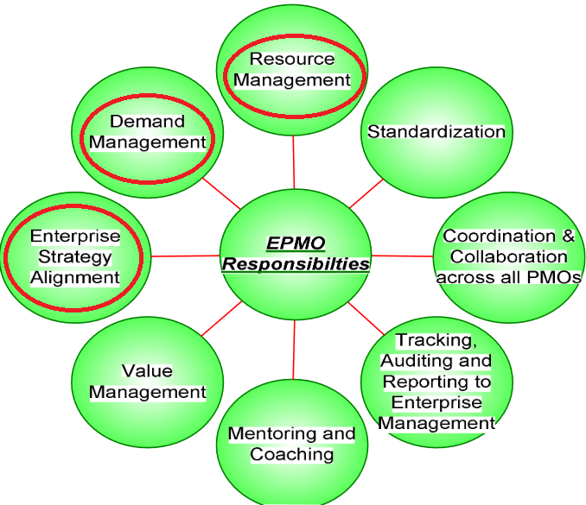
ePMO
Digital transformation as it relates to how to running Epmo
(1) Demand Management / (2) Enterprise Strategy Alignment / (3) Resource Management
There needs to be alignment between Division strategic initiatives and the PMO – that includes ranking, risk management / mitigation, determining dependencies and constraints → So moving towards an ePMO and not just a business Unit PMO
A system needs to be in place prioritize and rank the projects based on fair and impartial mechanisms, considering the following (NPV, ROI, CAPEX and OPEX $ request, Business Value both tangible and intangible, etc.)
I would make sure we implemented a process where the Program and Project Manager to lead the business case process from the initial stages and work with the Division’s functional and technical teams to determine the Business Value proposition (that way we can be held and measured against those)
This would ensure also that Program and Project Managers and the ePMO has visibility in the demand pipeline on a multiyear horizon planning (through Portfolio and Resource management tailored to specific divisions) and to be able to Resource allocate / plan accordingly

Slide 8
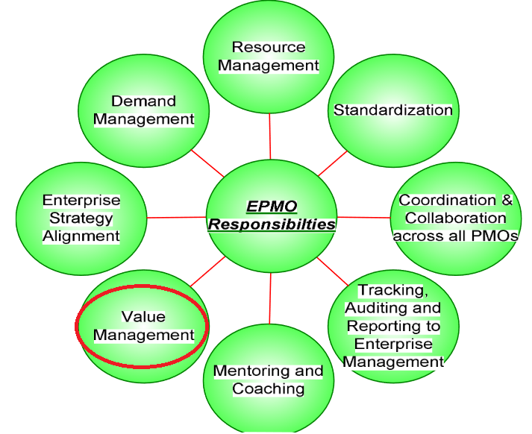
ePMO
Digital transformation as it relates to how to running ePMO
(3) Value Management
I would look at the opportunities to have the cost of the ePMO funded through the Division / Business Lines potentially as a “ePMO-as-a-Service”.
Typically, organizations are dealing with the costs of the PMO by absorbing them into the running of a head office function (cost of doing business = PMO leader’s budget is part of the overall central budget, and you must justify what you do with the money and be involved in budget negotiations…there is no cross-charging out to other departments. Any funding you need for the PMO is provided centrally.
Move away from the PMO being a pure cost center and want to be able to split the cost of running the group into a “project charge” aka the “cost of services provided” and apportion that cost between Divisions / Business Units.
High Level things that need to be worked out (metrics) in order to apportion the cost in a fair matter:
Number of projects each division is requiring
Resources Allocation used on the projects for each division
Financial value of the project (Business Value / Benefits from the Business Case).
We look at the PMO portfolio and establish what proportion of the cost of running the PMO should be allocated to each Division, based on their usage of services.
For ad-hoc requests from other departments, we could use the same mechanism for cross-charging staff and services.

Slide 9
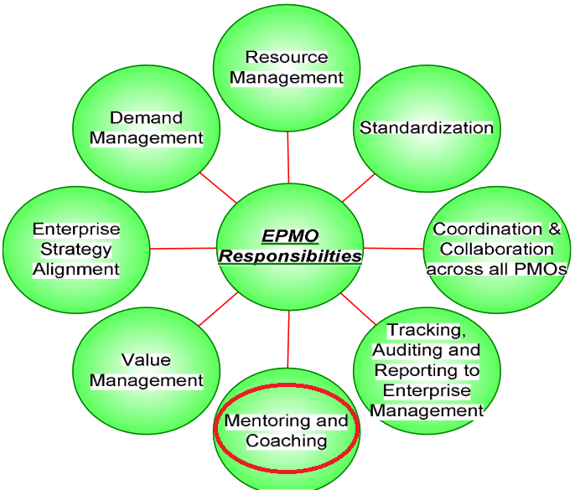
ePMO
Digital transformation as it relates to how to running ePMO
(4) Mentoring and Coaching (cont’d)
Implement 365 reviews
Performance plans as needed
Remediation plans as needed
Push for and support my team members in the 3 following facets:
Autonomy → People want to direct their own lives (self direction).
Mastery → People want to have a “Challenge”.
Purpose → People want to “Make a Contribution”. Organization needs to have a transcendence purpose / objective.

