Slide 1
CollectRelay
Platform Walkthrough
A detailed how-to guide for professionals and their clients

Slide 2
EVERYTHING YOU NEED
All-in-one document collection platform for professionals and their clients
Transaction Management
Create and track deals with checklists, milestones, partners, and status workflows
Document Collection
Secure client portal for uploading, reviewing, and approving documents
Templates
Save and reuse transaction templates with pre-built checklists and milestones
Reports & Analytics
Pipeline funnel, commission tracker, completion metrics, and activity trends with CSV export
Team Management
Invite team members, assign roles (owner/admin/member), and manage workspace access
Activity Dashboard
Real-time feed of submissions, reviews, and status changes across all transactions
Document Library
Searchable archive of all uploaded documents with filtering and bulk downloads
Bulk Actions
Select multiple transactions to archive, export, change status, or delete in batch
API & Webhooks
REST API with key management, plus webhook integrations for real-time event notifications
PWA & Push Notifications
Install as a native app on any device with real-time push notifications for updates
collectrelay.com

Slide 3
PRO SIDE
The agent/professional dashboard for managing transactions, reviewing documents, and tracking progress.

Slide 4
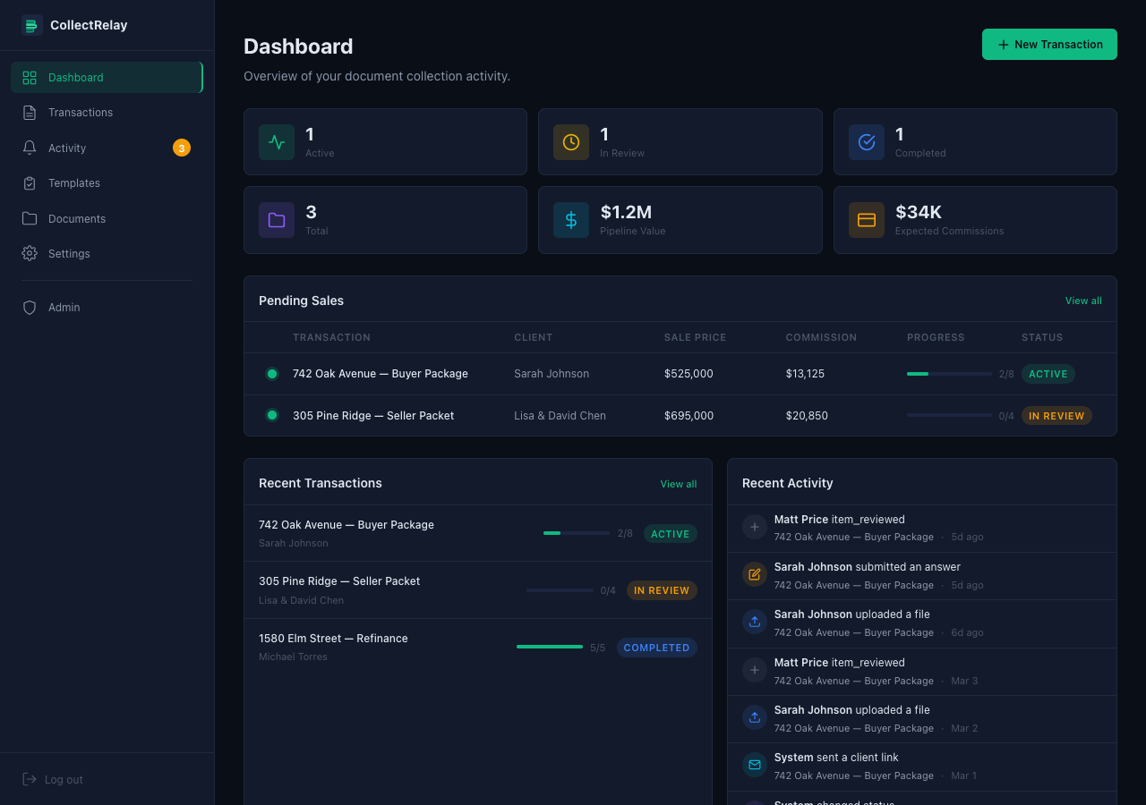
Dashboard
Your command center. Shows active/in-review/completed transaction counts, pipeline value, expected commissions, pending sales with progress bars, and a real-time activity feed of all client actions.
collectrelay.com

Slide 5
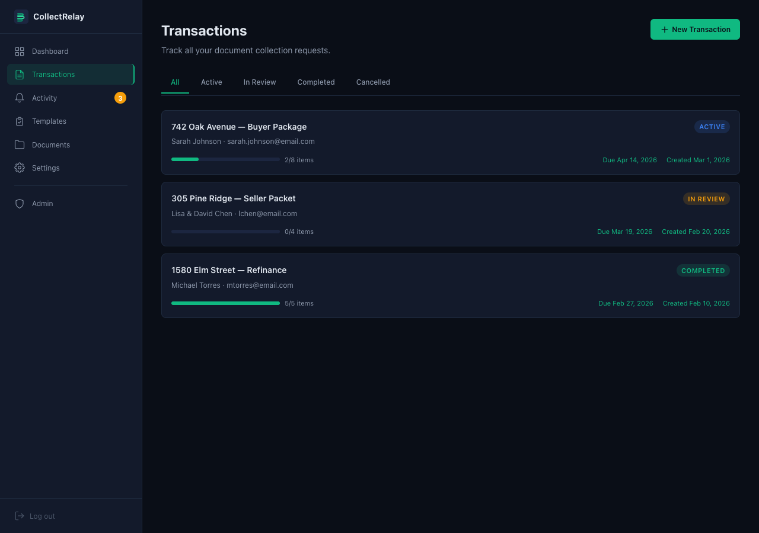
Transactions List
All your document collection requests in one place. Filter by status (Active, In Review, Completed, Cancelled). Each card shows client name, email, progress bar, due date, and status badge.
collectrelay.com

Slide 6
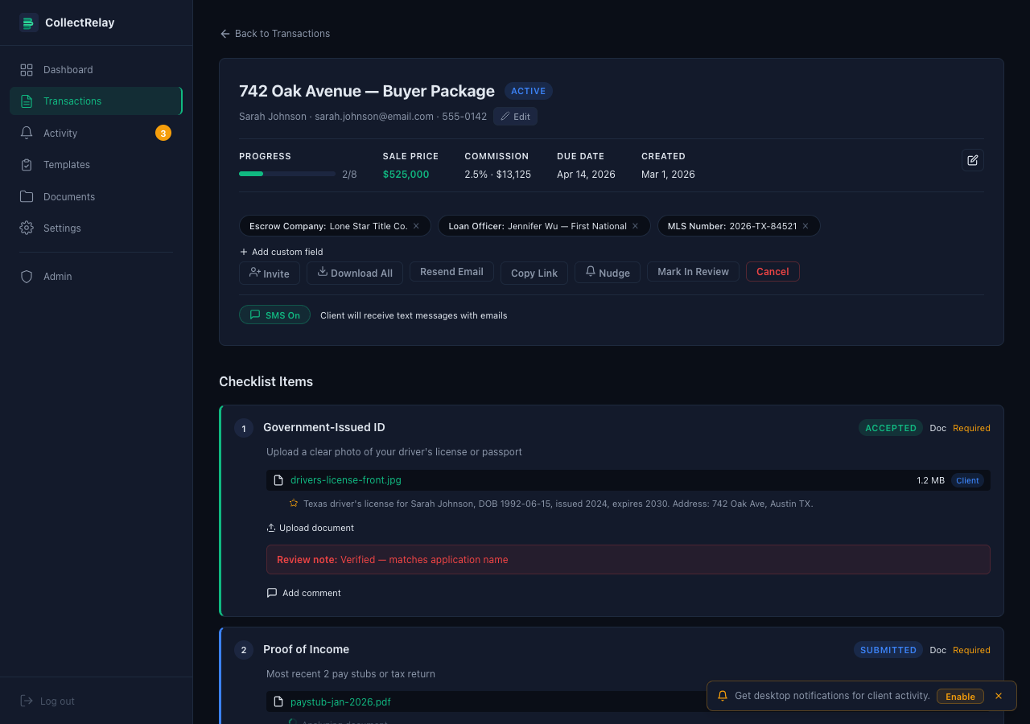
Transaction Detail — Header
Shows transaction title, client info, progress tracker (2/8 items), sale price, commission, due date, and custom fields (Escrow Company, Loan Officer, MLS#). Action bar: Invite, Download All, Resend Email, Copy Link, Nudge, Mark In Review, Cancel.
collectrelay.com

Slide 7
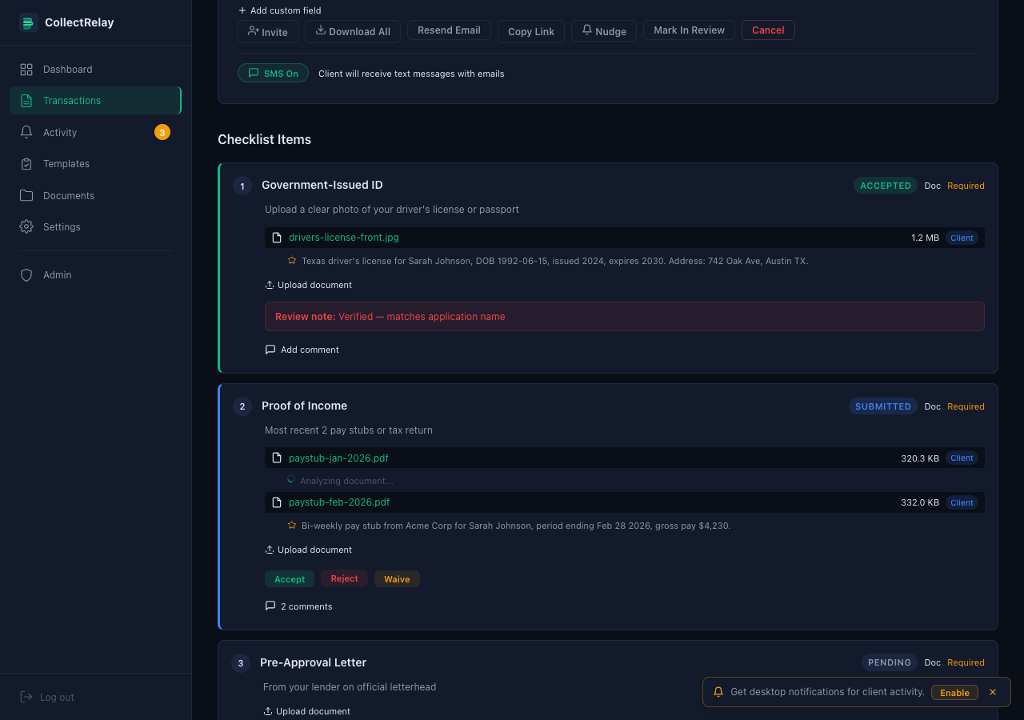
Checklist — Accepted Item
Item 1 shows ACCEPTED status with the uploaded file, AI-generated summary (star icon), and a green review note. The AI summary reads the document and produces a 1-2 sentence description so you can triage without opening every file.
collectrelay.com

Slide 8
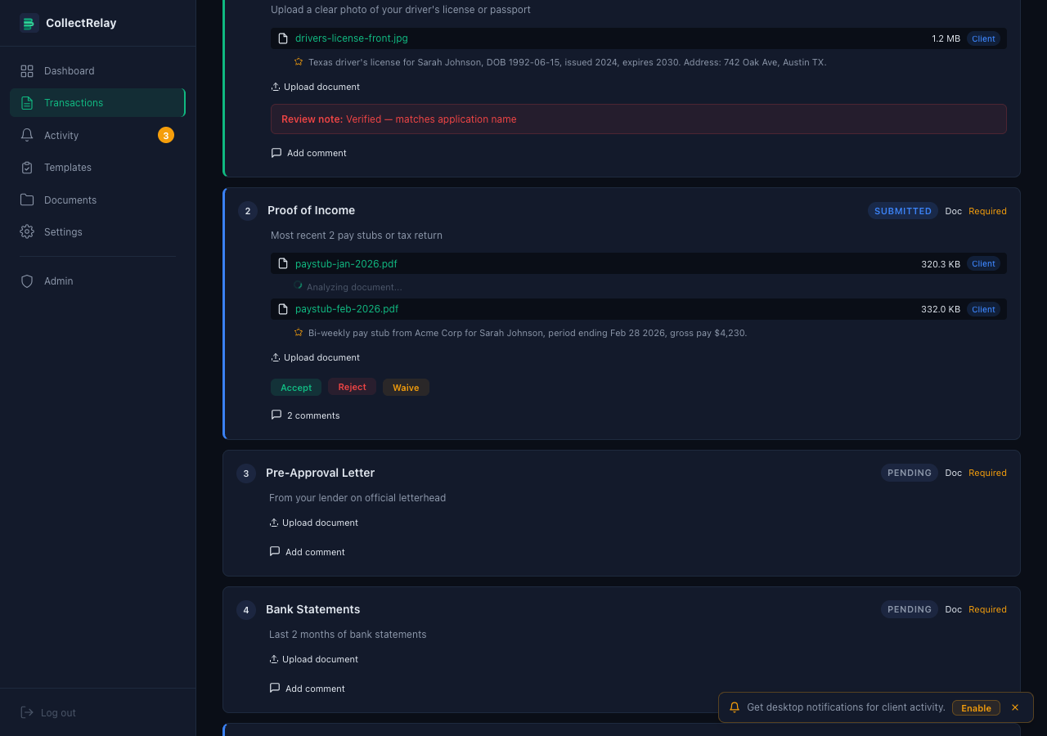
Checklist — Review Actions
Item 2 is SUBMITTED with two uploaded files. One file has a completed AI summary, the other shows "Analyzing..." (in progress). Three action buttons: Accept (green), Reject (red), Waive (blue). Click to review each submitted item.
collectrelay.com

Slide 9
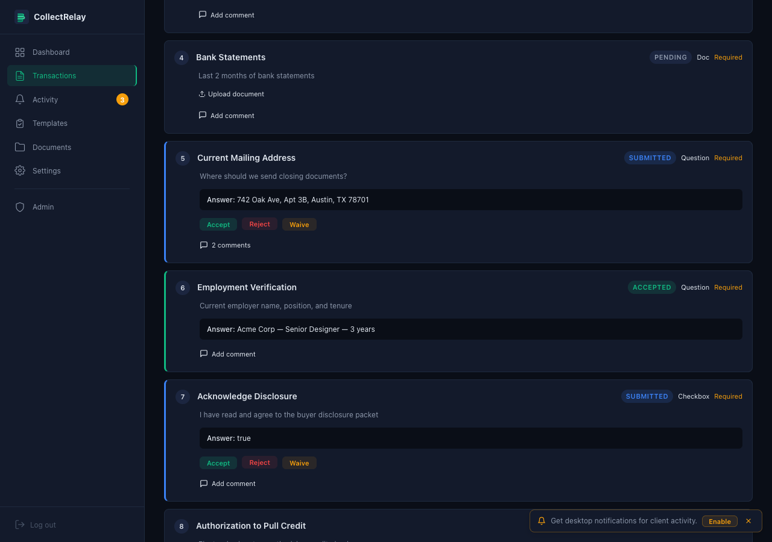
Checklist — Questions, Checkboxes & Signatures
Item 6: Question type showing the client's text answer. Item 7: Checkbox type showing the client's confirmation. Item 8: Signature type — awaiting the client's e-signature via draw or type mode.
collectrelay.com

Slide 10
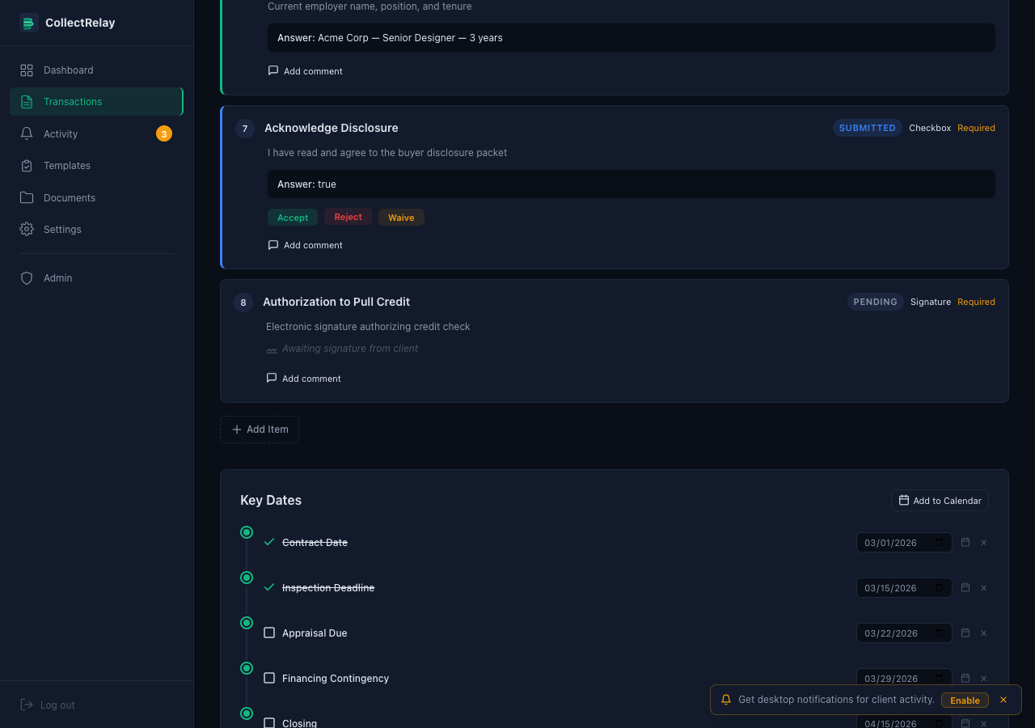
Key Dates & Milestones
Timeline of key dates: Contract Date, Inspection Deadline, Appraisal Due, Financing Contingency, Closing. Check off completed milestones. Add custom milestones with the form below. Click "Add to Calendar" to export.
collectrelay.com

Slide 11
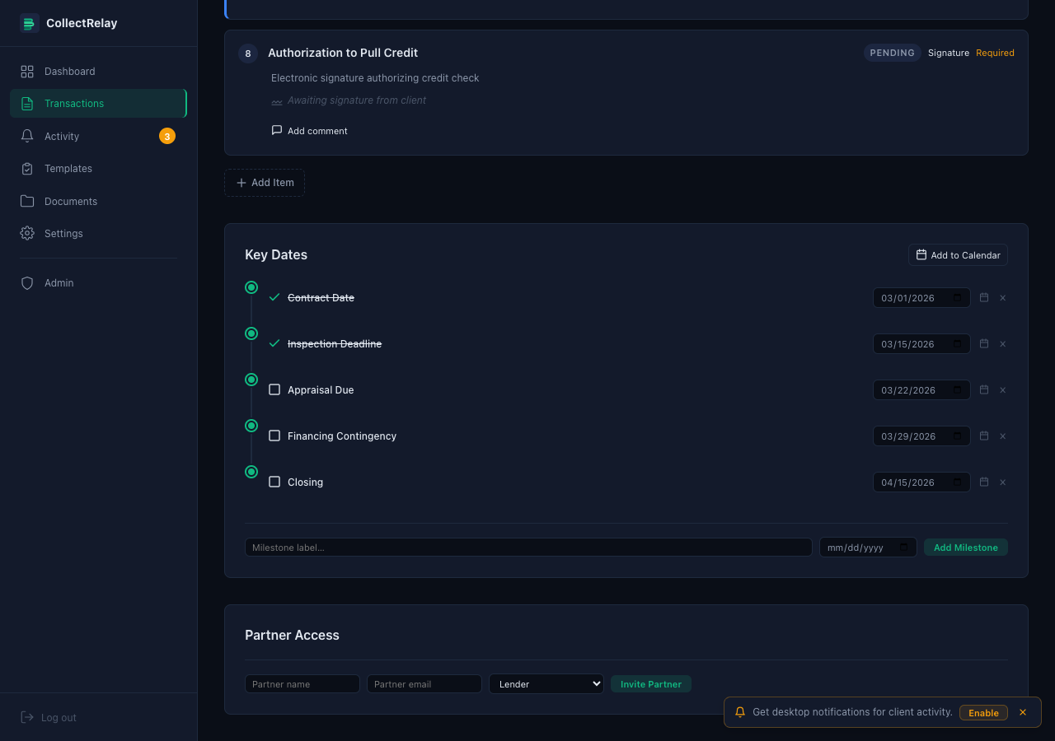
Partner Access
Invite partners (lenders, title companies, inspectors) to view transaction progress. Enter name, email, and role. Partners get read-only access to see checklist status without seeing private client documents.
collectrelay.com

Slide 12
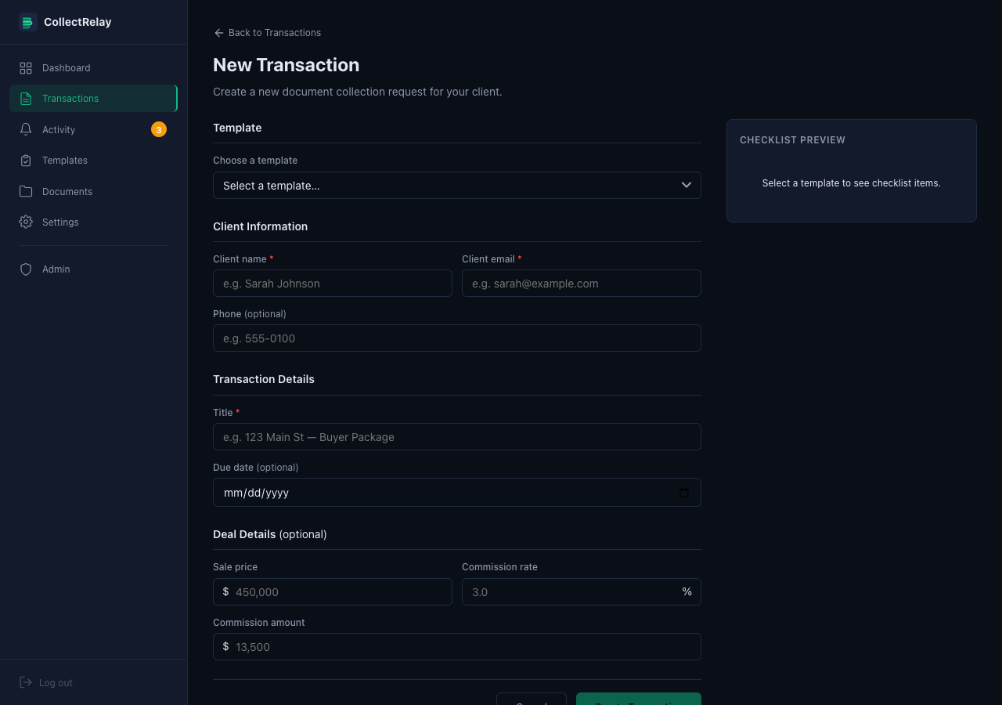
Create New Transaction
Start a new document collection request. Choose a template, enter client info (name, email, phone), set the transaction title, due date, and optional deal details (sale price, commission rate — auto-calculates commission amount).
collectrelay.com

Slide 13
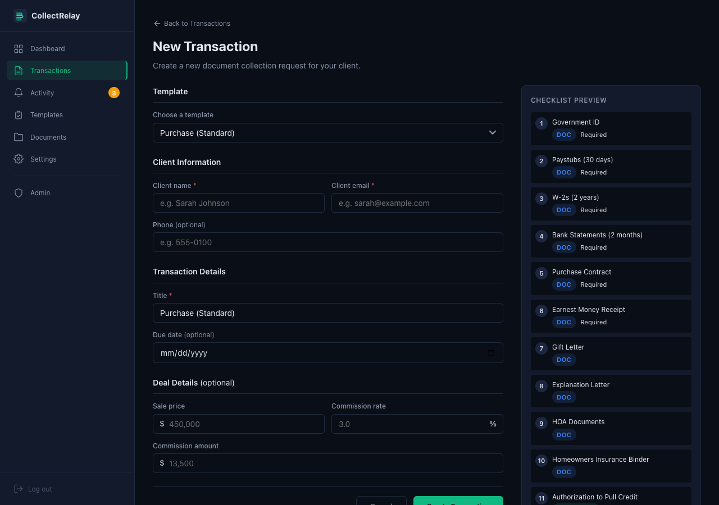
Template Selection + Preview
When you select a template (e.g., "Purchase Standard"), the right panel shows a live preview of all checklist items that will be created. Each item shows its type (Doc, Question, Signature) and whether it's required.
collectrelay.com

Slide 14
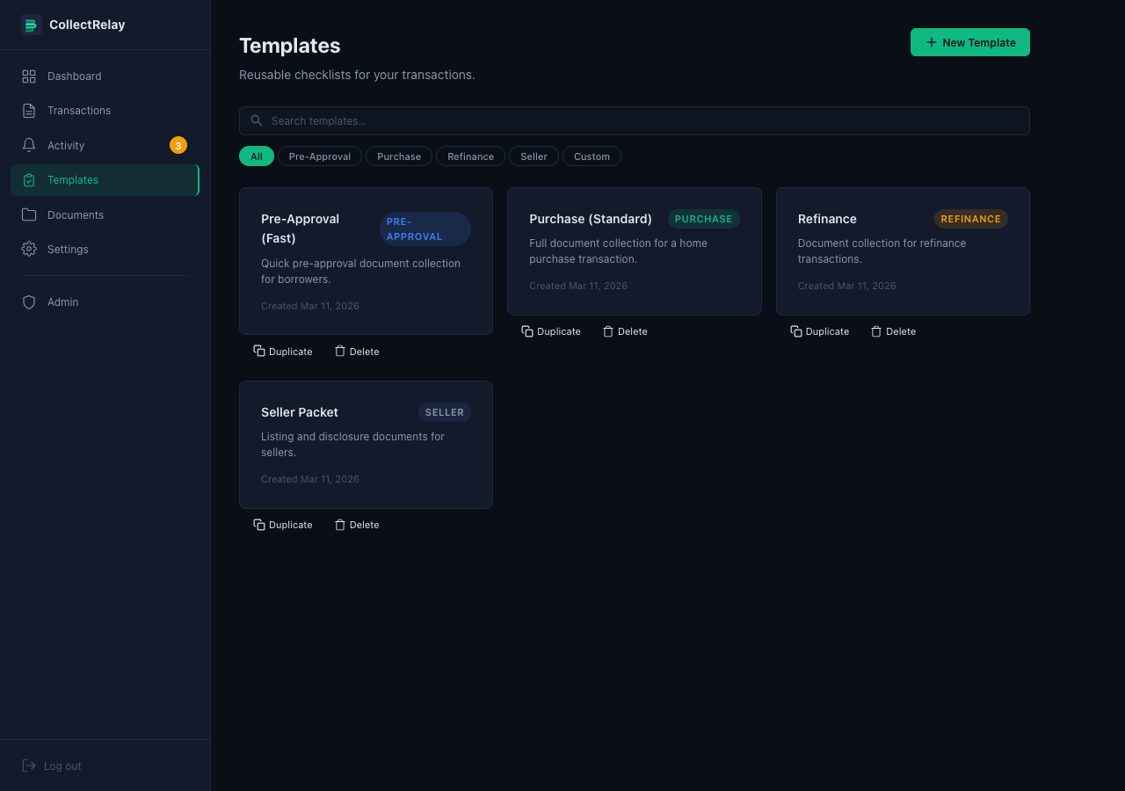
Templates Library
Manage reusable checklist templates. Four starter templates included: Pre-Approval, Purchase, Refinance, Seller Packet. Filter by category. Duplicate or delete any template. Click "+ New Template" to create custom ones.
collectrelay.com

Slide 15
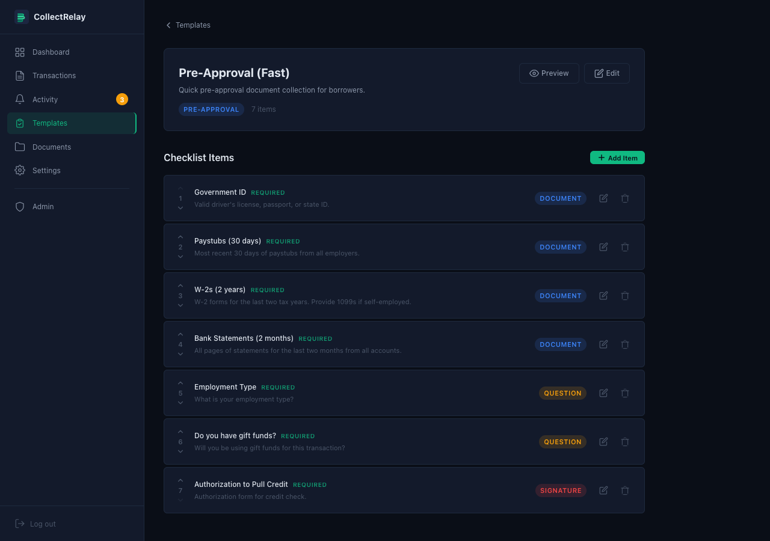
Template Editor
Edit a template's checklist items. Each item shows its name, description, type badge (Document, Question, Signature), and required status. Click the edit icon to modify, trash icon to remove, or "+ Add Item" to add new items.
collectrelay.com

Slide 16
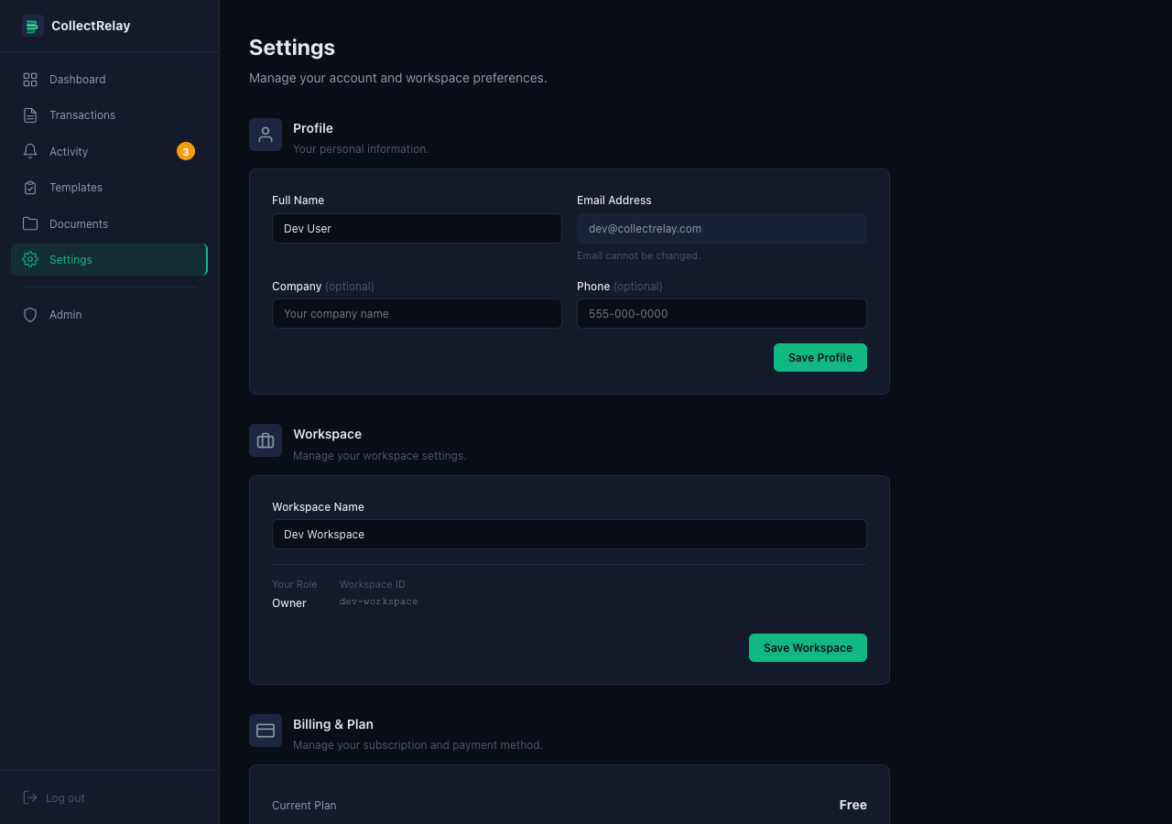
Settings — Profile & Workspace
Update your name, company, and phone number. Manage your workspace name and view your role (Owner). Email address is locked to your login credential.
collectrelay.com

Slide 17
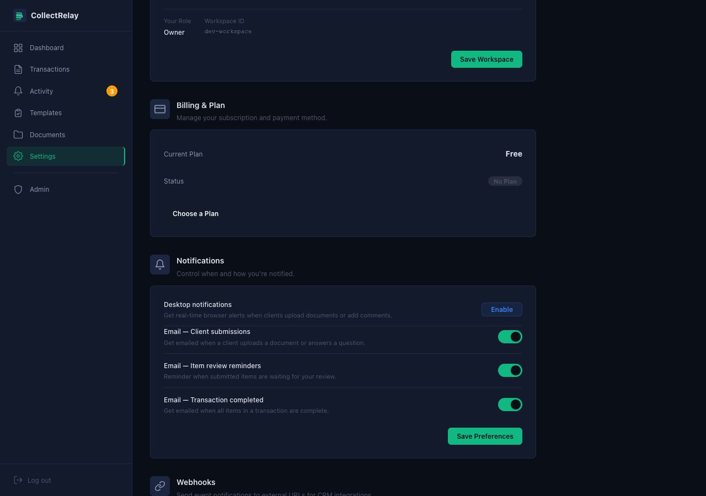
Settings — Billing & Notifications
View your current plan and subscription status. Toggle email notifications: Client Submissions (when files/answers arrive), Item Review Reminders (when items await your review), Transaction Completed (when all items are done).
collectrelay.com

Slide 18
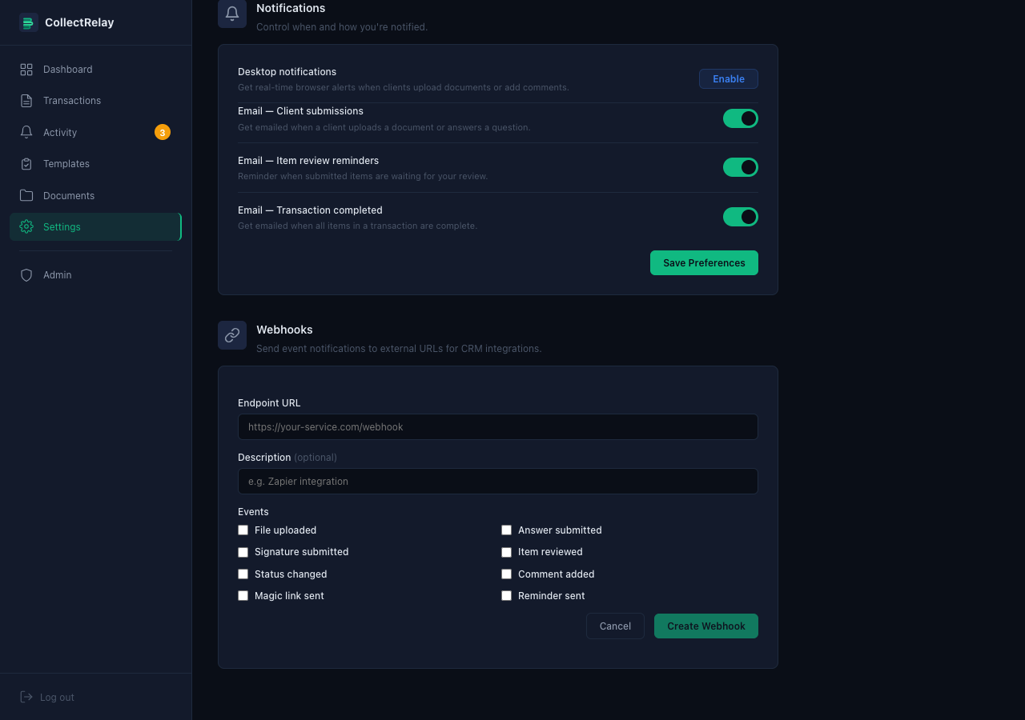
Settings — Webhooks
Connect CollectRelay to any external service (CRM, Zapier, etc.). Enter an endpoint URL, optional description, and select which events to listen for: File Uploaded, Answer Submitted, Signature Submitted, Item Reviewed, Status Changed, Comment Added, Magic Link Sent, Reminder Sent.
collectrelay.com

Slide 19
REPORTS & ANALYTICS
Pipeline funnel, commission tracking, completion metrics, activity trends, and CSV export for data-driven decision making.

Slide 20
Reports Dashboard
Pipeline Funnel
Visualize your transaction pipeline from Draft through Active, In Review, Completed, and Cancelled stages. See counts and dollar values at each stage.
Commission Tracker
Track earned, pending, and forecasted commissions. See a proportional breakdown bar showing your revenue pipeline at a glance.
Completion Metrics
Average days to close, average items per transaction, and total completed count. Measure efficiency and identify bottlenecks.
Activity Trends & Export
Weekly and monthly activity charts showing transaction volume. Filter by date range (7d, 30d, 90d, all). Export all data to CSV.
collectrelay.com

Slide 21
TEAM MANAGEMENT
Invite team members by email, assign roles, and manage workspace access with owner, admin, and member permissions.

Slide 22
More Platform Features
PWA & Push
Install as a native app on any device. Get real-time push notifications for new submissions and status updates.
REST API
Public API with key management for integrating CollectRelay into your existing tools and workflows.
Bulk Actions
Select multiple transactions to archive, export, change status, or delete in batch. Save time on routine operations.
Document Library
Searchable archive of all uploaded documents across transactions. Filter by type, date, or transaction. Download in bulk.
Activity Feed
Real-time dashboard of all activity across your workspace. Track submissions, reviews, approvals, and status changes.
Custom Branding
White-label the client portal with your logo, brand colors, and company name for a seamless client experience.
collectrelay.com

Slide 23
CLIENT SIDE
What your clients see when they open their magic link. No login required — they click the link in their email and land directly on their checklist.

Slide 24
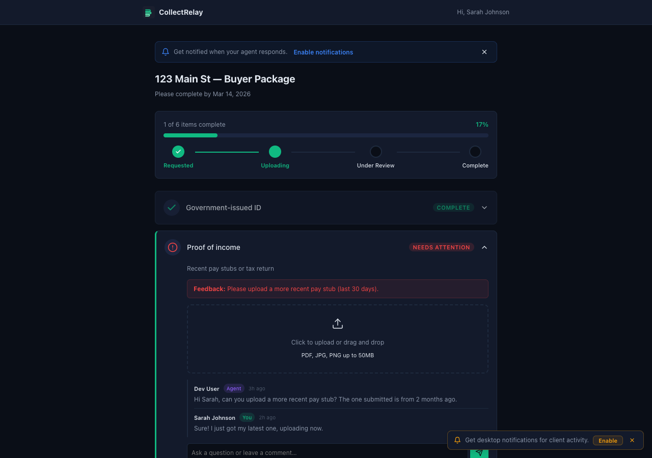
Client Portal — Overview
Clients see their transaction title, due date, a step-by-step progress tracker (Requested → Uploading → Under Review → Complete), and their checklist. Completed items collapse with a green checkmark. Items needing attention expand with instructions.
collectrelay.com

Slide 25
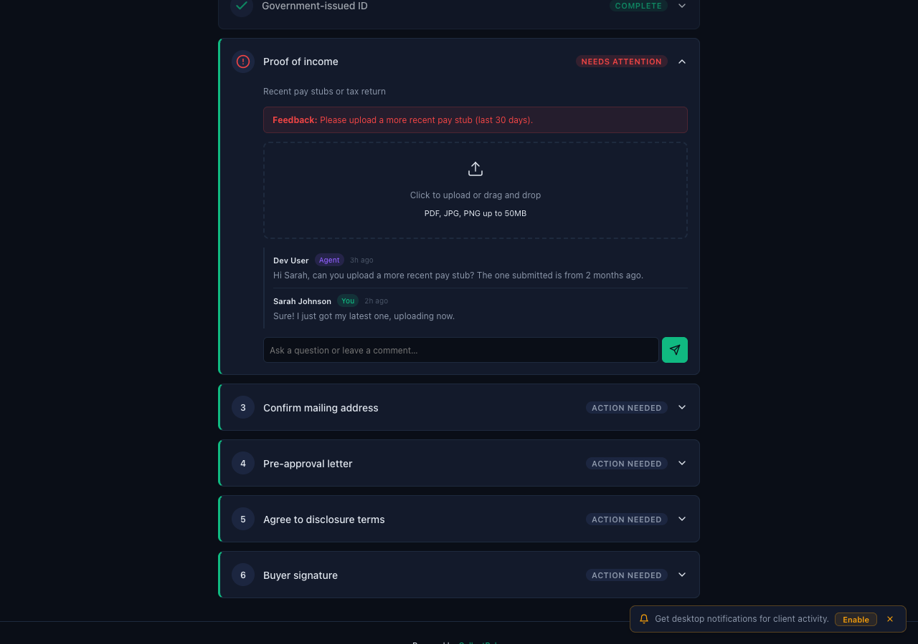
Client Portal — Upload & Comments
Expanded item shows: red feedback banner if the pro requested changes, a drag-and-drop upload zone (PDF, JPG, PNG up to 50MB), and a comment thread. Clients and pros can message back and forth on any checklist item in real time.
collectrelay.com

Slide 26
CollectRelay
Document collection, simplified.
collectrelay.com

