Slide 1
MIMIC_Data_Most_Common_Diagnoses
File created on: 2/10/2021 2:29:03 AM

Slide 2
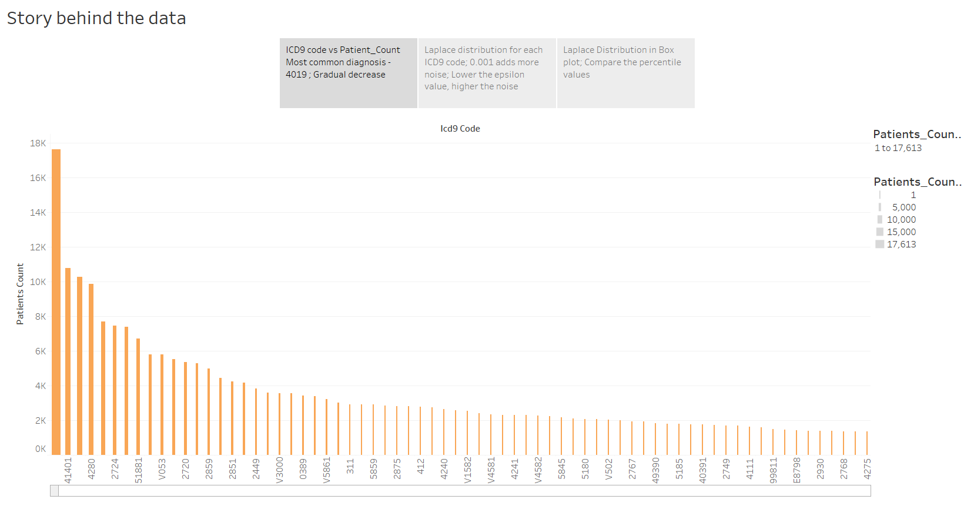

Slide 3
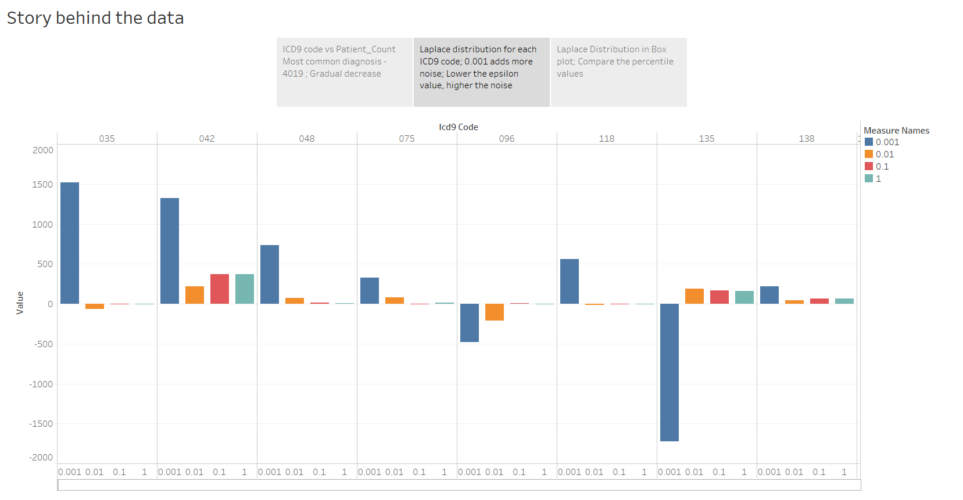

Slide 4
