Slide 1
Open Source LoRa Tracker

Slide 2




Design Idea
GPS
BT
Ship Equipment
433MHz
LoRA connections
Surface Equipment
Surface Equipment
e.g. attached to Alert Marker
Mobile Network Connection
Cable Assisted
Radio Connection, e.g. attached to spool
UW Equipment
Internet Backend
Diver on Deco
OSLT is intended to serve as a open source framework with a reference implementation for LoRa based GPS tracking. The above sketch illustrates a possible use case. While proprietary and commercial systems with a similar design are available, they are quite expensive and not used widely used in divers reality.
The framework is open source and shall allow for both free and commercial solutions. Intention is to reach a maximum distribution of compatible systems. The reference implementation does implement only a small part of the use cases that are possible and is targeting to be an in-expensive solution based on Arudino and easily-available inexpensive LoRa and GPS modules. Total cost for self-build is around 50 €.

Slide 3
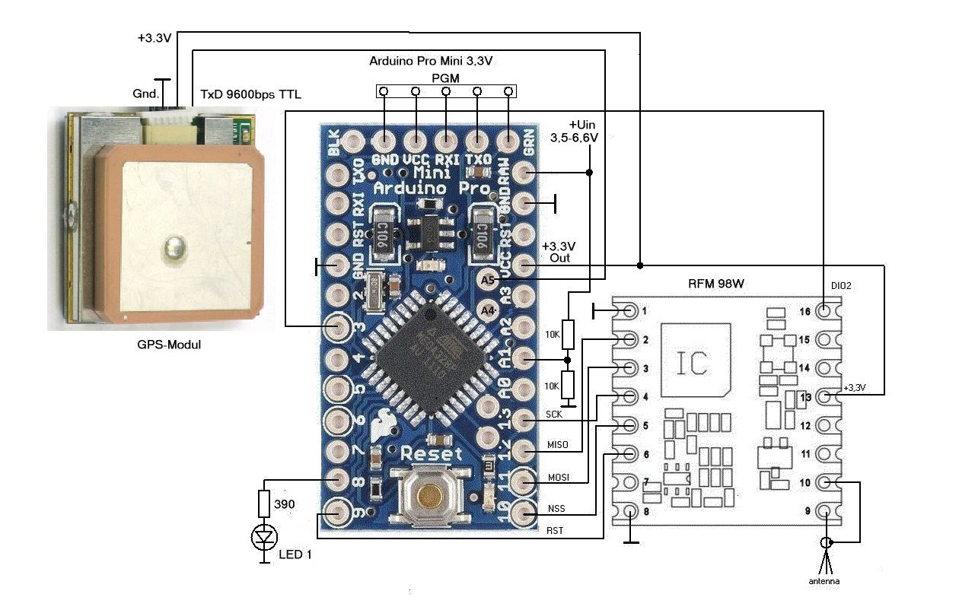
Hardware Surface Equipment

Slide 4
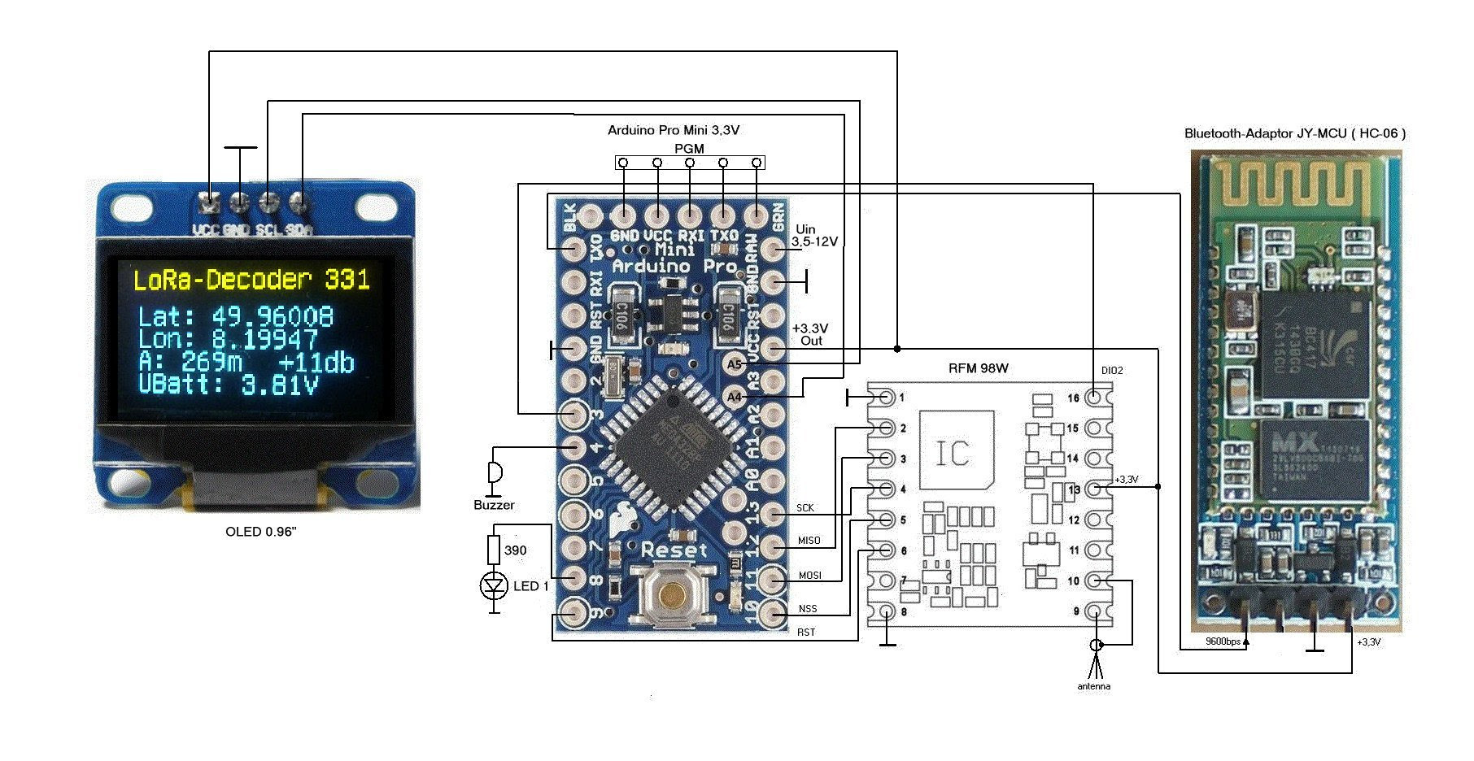
Hardware Surface Equipment w Display

Slide 5
Hardware Ship Equipment w BT and Display

Slide 6
OSLT Protocol
 | Emergency | N/A | N/A | N/A | MsgType | Sender | Target | Payload Length Byte | N/A | Lat | Lon | Payload 0-128 Byte | CRC
Bit | 1 | 1 | 1 | 1 | 4 | 24 | 24 | 7 | 1 | 32 | 32 | 1792 | 8

Slide 7

OSLT
Open Source LoRa Tracker

