Slide 1

mProv
The Improvised Multi Provisioner Jason Williams
Sr Systems Engineer
ARCH @ JHU
jasonw@jhu.edu

Slide 2

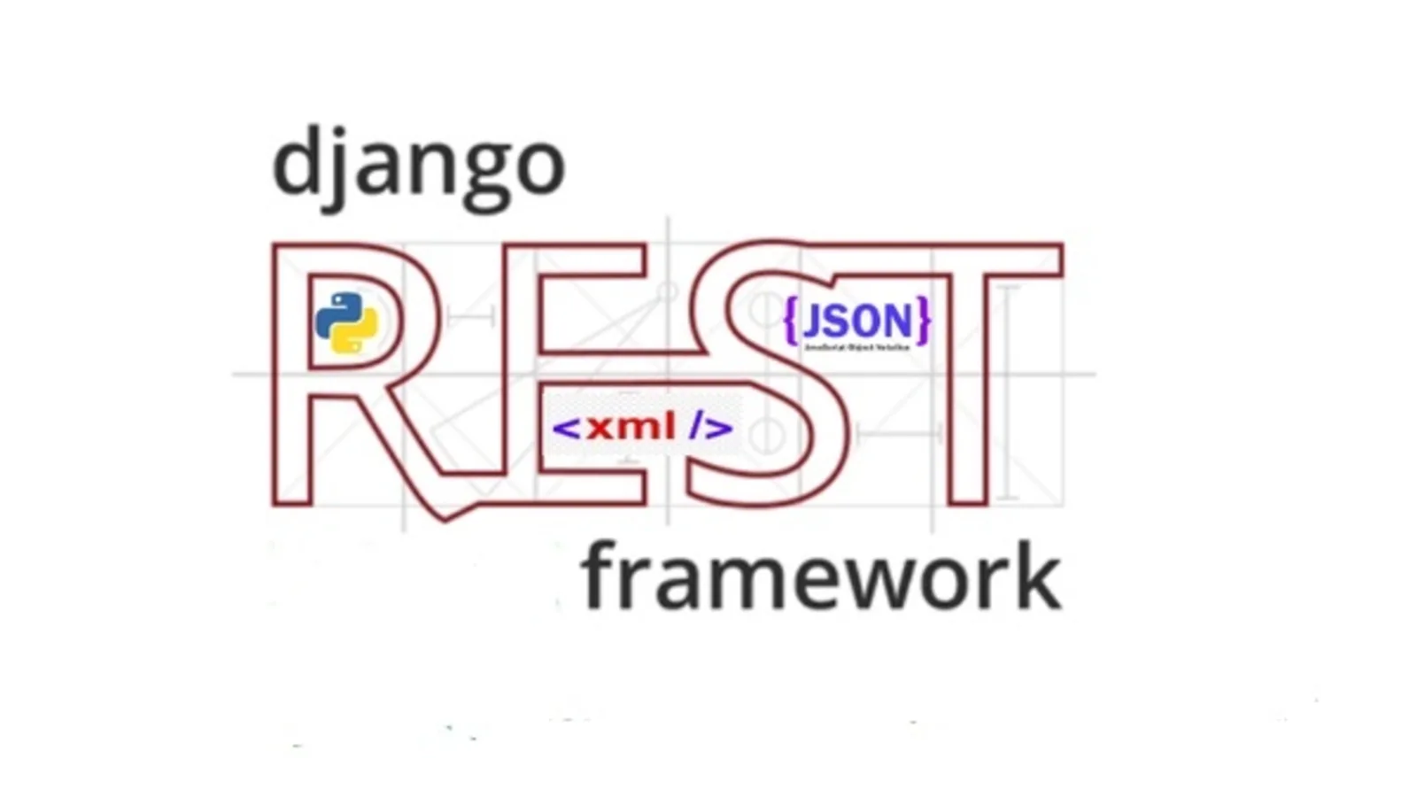
mProv – Overview
What is an 'improvised multi provisioner?'
Where did mProv come from?
How does it work?
What are future plans?

Slide 3
mProv - What is an 'improvised multi provisioner?'
mProv is a Multi-abbreviation (Because nested acronyms are so 2000) 'improvised multi provisioner' but what exactly does that mean?
Improvised - "done or made using whatever is available; makeshift."
Multi - "more than one; many"
Provisioner - "provider, supplier. someone whose business is to supply a particular service or commodity"
Clustered provisioner? Not hierarchical, but not one-to-many either... more like a web, or net, or... something.

Slide 4

mProv - Where did mProv come from?
HPC Cluster management, the bane of the HPC Systems Engineer.
The open source "Goldie Locks" effect. Too hot, too cold, just right.
Too much custom code, not enough open source "Legos"
Looking for:
Simple Extendable Fast | Auto Detection of Nodes Ability to boot an entire cluster, very fast.

Slide 5
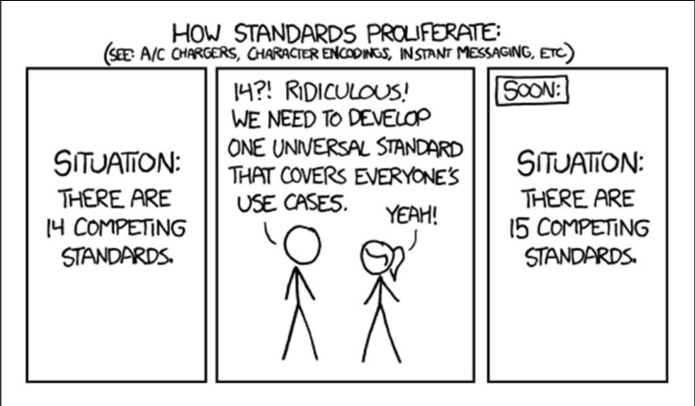
mProv - Where did mProv come from?

Slide 6
mProv - How does it work?
mProv Control Center
mProv Job Server
mProv Job Modules
mash (mProv Admin Shell)

Slide 7
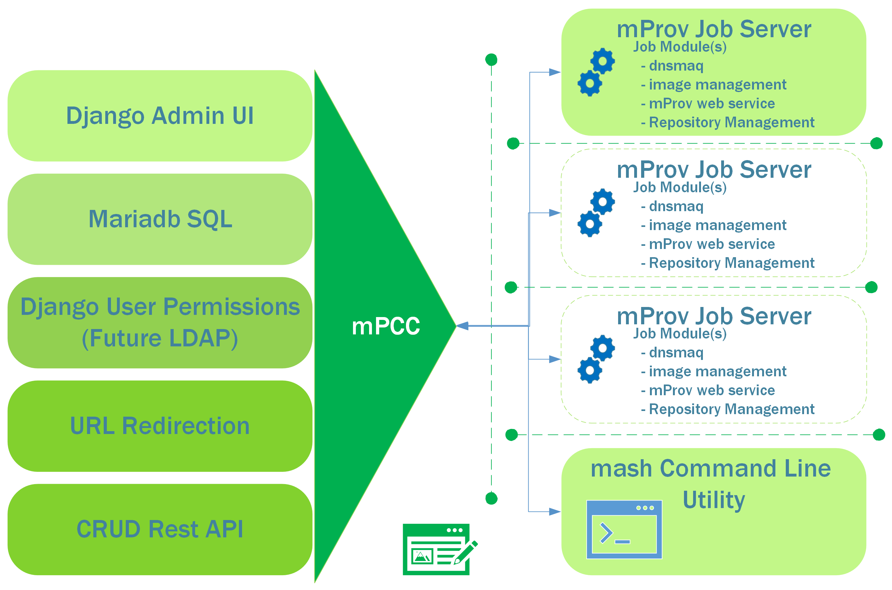
mProv - How does it work?

Slide 8
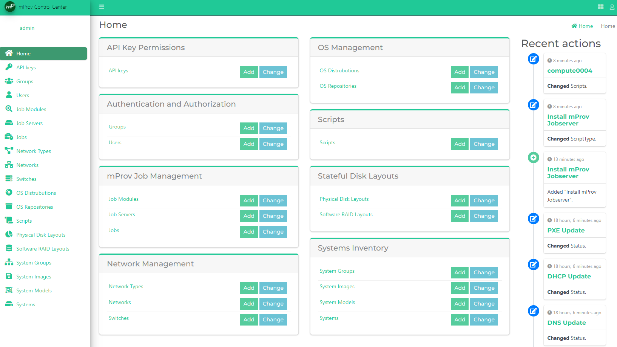
mProv - mProv Control Center
Based on Django, Django Admin Interface, Django Rest Framework, and a few other open source parts.
Easy to use, easy to navigate.
Central point for managing your entire cluster, network, and OS images.

Slide 9
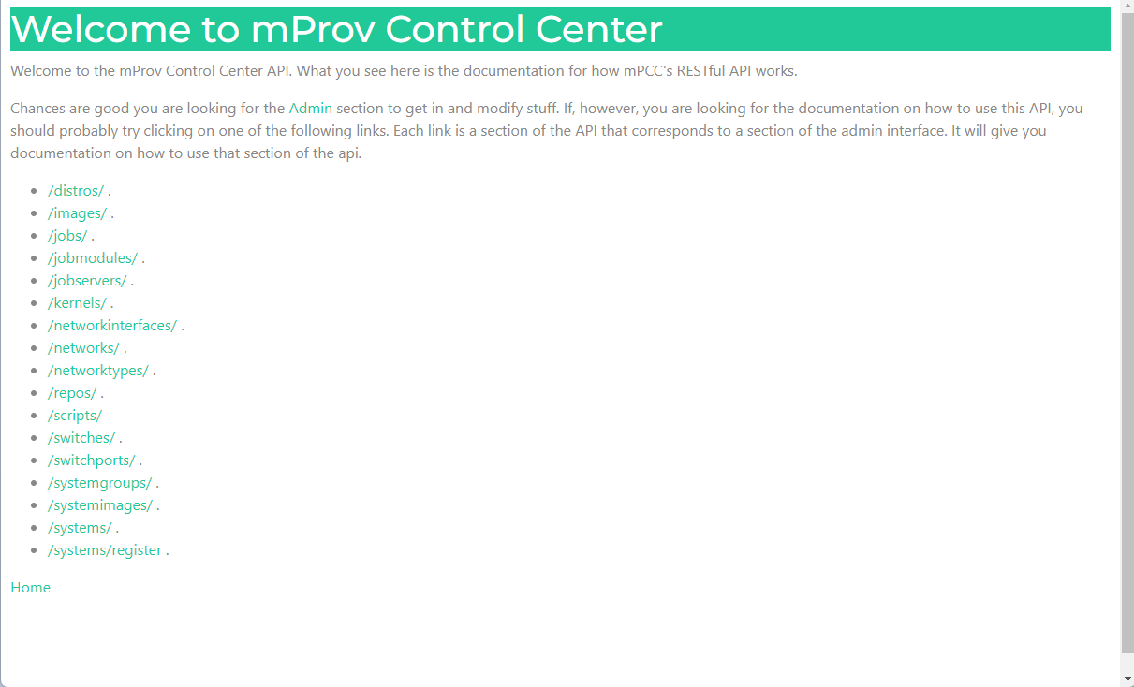
mProv - mProv Control Center (cont.)
CRUD API for almost all parts.
Documentation available from your browser.
JSON Exchange for ease of programming to the API and interacting with mProv's data.

Slide 10
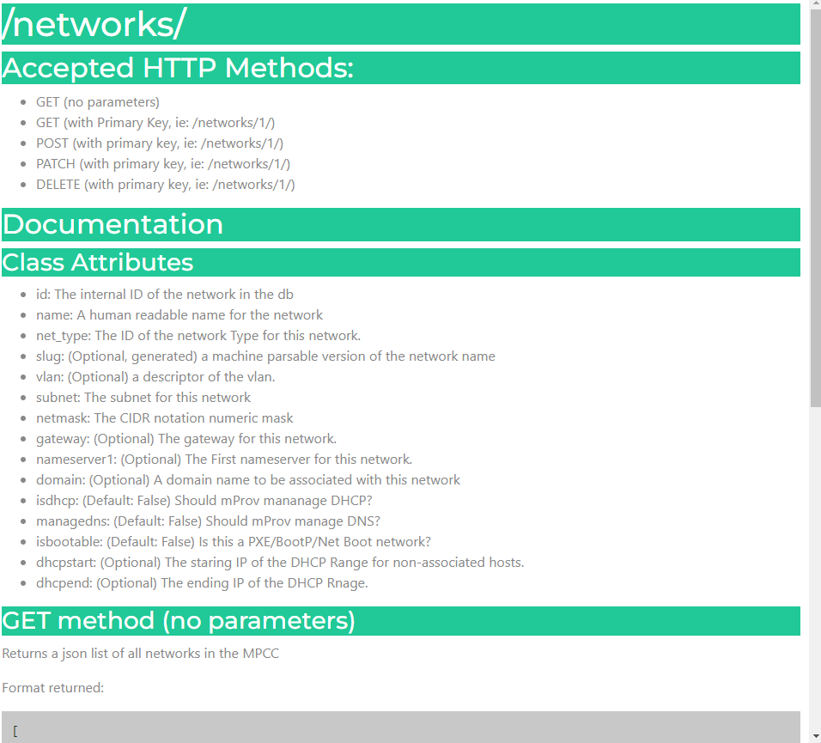
mProv - mProv Control Center (cont.)
Example documentation
Documentation accompanies the source, Python Doc Style.
Documentation pages generated from markdown in the Python Docs accompanying each API view.

Slide 11
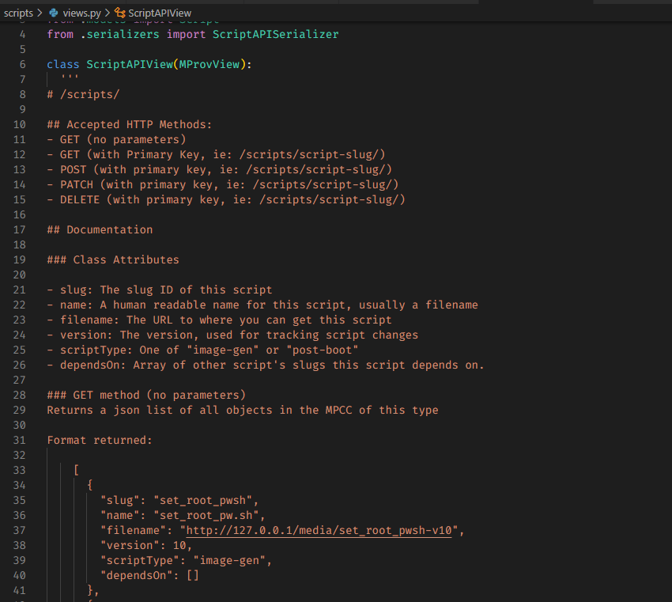
mProv - mProv Control Center (cont.)
Example documentation
Documentation accompanies the source, Python Doc Style.
Documentation pages generated from markdown in the Python Docs accompanying each API view.

Slide 12
mProv - Job Server
The work horse of mProv.
Contains Job Modules which manage the parts of the cluster (ie. DNS, DHCP, OS Images, running scripts, etc.)
Can run part or all the backend code on a single machine or multiple machines.
Easily extensible, written in Python.
Runs modules in parallel.

Slide 13
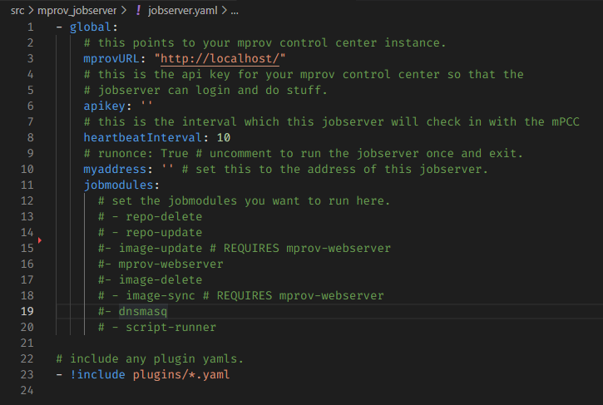
mProv - Job Module
Unit of management
DNS
DHCP
PXE
OS Image serving
Repo management
Specialized collection of code
Small, but highly modular.
Configurable, down to the job module.

Slide 14
mProv - Features
Node Auto Detection System
Uses LLDP
DNS/DHCP/PXE management through dnsmasq
Provision nodes over any network. (Even IPoIB?)
Provisioned nodes can become servers of OS Images to help provision other nodes. Exponentially growing its ability to provision with each group of nodes brought online.
Scripts with dependency resolution
Fine grained permissions through Django's Admin console.

Slide 15
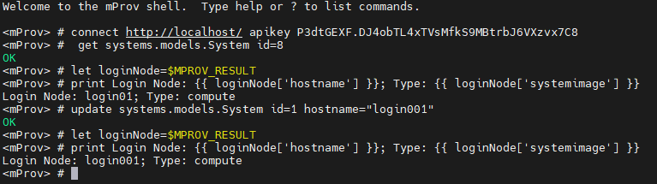
mProv - Features (cont.)
Open Source Licensed - Apache 2.0
mash (mProv Admin SHell) for talking to the mPCC and making scripting actions to the API easy (ie. For bulk creates)

Slide 16

mProv - Think About The FUTURE!
LDAP and SAML/SHIBBOLETH authentication
What does the future hold for mProv?
Monitoring
Mapping networks
Enhanced Node Auto Detection
Scheduler interfacing
Is it just for HPC Clusters?
Support for RHEL-based Kickstarts
Support for Debian-based Systems
Manage network devices and network configurations.
Tie with Ansible for even MORE POWER! *grunts*
The sky, and what you can do in Python, is really the limit!
What would you like to see in an HPC Cluster Provisioner?
What would you hate to see in an HPC Cluster Provisioner?

Slide 17
mProv
The Improvised Multi Provisioner
(Please sir, can we see a demo? Just a little demo?)
Open Source == Open to the Community!
https://github.com/mProv-ng/
https://mprov-ng.github.io/
mprov@jhu.edu

