Slide 1
Bootstrap

Slide 2
What is Bootstrap.
Bootstrap is a free front-end framework for faster and easier web development
Bootstrap includes HTML and CSS based design templates for typography, forms, buttons, tables, navigation, modals, image carousels.
Bootstrap also gives you the ability to easily create responsive designs (Responsive design is a graphic user interface (GUI) design approach used to create content that adjusts smoothly to various screen sizes.)

Slide 3
Why use bootstrap.
Easy to use: Anybody with just basic knowledge of HTML and CSS can start using Bootstrap
Responsive features: Bootstrap's responsive CSS adjusts to phones, tablets, and desktops
Mobile-first approach: In Bootstrap, mobile-first styles are part of the core framework

Slide 4
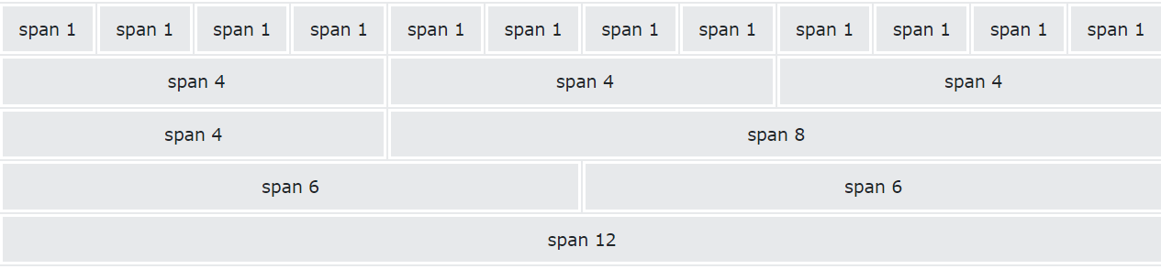
Bootstrap Grid System.
Bootstrap's has 12 columns across the page.

Slide 5
Grid Classes.
col- (extra small devices - screen width less than 576px, Portrait phones)
.col-sm- (small devices - screen width equal to or greater than 576px, Landscape phones)
.col-md- (medium devices - screen width equal to or greater than 768px) - Tablets
.col-lg- (large devices - screen width equal to or greater than 992px) - Laptops
.col-xl- (xlarge devices - screen width equal to or greater than 1200px) - Laptops and Desktops
.col-xxl- (xxlarge devices - screen width equal to or greater than 1400px) - Laptops and Desktops

Slide 6
Grid system.
Grid breakpoints are based on minimum width media queries, meaning they apply to that one breakpoint and all those above it (e.g., .col-sm-4 applies to small, medium, large, and extra large devices, but not the first xs breakpoint).
.col- → used for extra small and all other devices.

Slide 7
Display in 4 column and 4 column grid.
<!DOCTYPE html>
<html lang="en">
<head>
<title>Bootstrap Example</title>
<meta charset="utf-8">
<meta name="viewport" content="width=device-width, initial-scale=1">
<link href="https://cdn.jsdelivr.net/npm/bootstrap@5.1.1/dist/css/bootstrap.min.css" rel="stylesheet">
<script src="https://cdn.jsdelivr.net/npm/bootstrap@5.1.1/dist/js/bootstrap.bundle.min.js"></script>
</head>
<body>
<div class="container-fluid">
<h1>Hello World!</h1>
<p>Resize the browser window to see the effect.</p>
<p>The columns will automatically stack on top of each other when the screen is less than 768px wide.</p>
<div class="row">
<div class="col-sm-4" style="background-color:lavender;">.col-sm-4</div>
<div class="col-sm-8" style="background-color:lavenderblush;">.col-sm-8</div>
</div>
</div>
</body>
</html>

Slide 8
Display in 4 column and 4 column grid.
Charset=utf 8 is The charset attribute specifies the character encoding for the HTML document.
The HTML5 specification encourages web developers to use the UTF-8 character set, which covers almost all of the characters and symbols in the world!
Viewport - The viewport is the user's visible area of a web page.
<meta name="viewport" content="width=device-width, initial-scale=1.0">
The width=device-width part sets the width of the page to follow the screen-width of the device
The initial-scale=1.0 part sets the initial zoom level when the page is first loaded by the browser.

