Slide 1
Module – 3
CSS

Slide 2
CSS – Course content.
• CSS Selectors
• CSS Backgrounds
• CSS Text
• CSS Fonts
• CSS Links
• CSS Lists
• CSS Tables
• CSS Box Model
• CSS Border
• CSS Outline
• CSS Margin
• CSS Padding
• CSS Dimension
• CSS Display
• CSS Positioning

Slide 3
CSS
CSS stands for Cascading Style Sheets.
CSS is used to style the HTML web page / HTML elements.
Style for the HTML elements can be given in the HTML file using the <style> tag or it can be specified in another file with an extension of “.css”.

Slide 4
CSS-Selectors.
CSS selectors allows to select HTML elements and their style can be modified. The selectors can be tag, id, class or groups of elements.
<!DOCTYPE html><html><head><style>
p {
color: green;
font-weight: bold;
font-size : 30px} </style>
</head><body>
<p id="para1"> Cascading Style Sheets (CSS) is a style sheet language used for describing the look and formatting of a document written in a markup language. While most often used to change the style of web pages and user interfaces written in HTML and XHTML, </p>
<br/><br/><br/><br/>
This is the example for paragraph tag content is modified using css.</body>
</html>

Slide 5
Question.
What is the difference between HTML tag, id given in the tag.
Answer : Elements can be specified in the tag. An operation can be performed using a tag and id is the attribute of the tag. Id is used to identify an element.

Slide 6
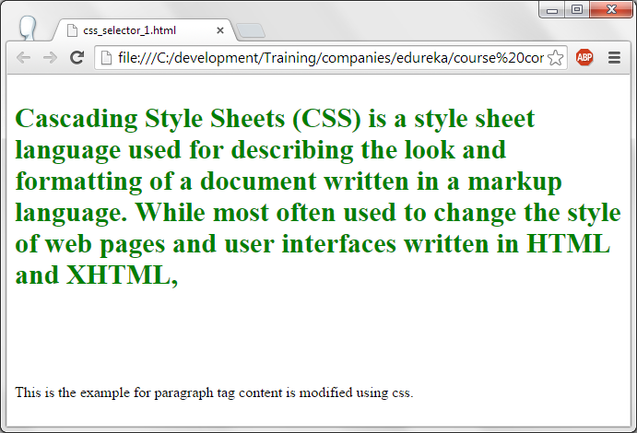
CSS- tag Selectors – .output.

Slide 7
CSS – id selector.
<!DOCTYPE html><html><head>
<style>
#para1 {
color: red;
font-weight: bold;
font-size : 20px
}
</style>
</head>
<body>
<p id="para1"> Cascading Style Sheets (CSS) is a style sheet language used for describing the look and formatting of a document written in a markup language. While most often used to change the style of web pages and user interfaces written in HTML and XHTML, </p>
<p> This is the paragaph which does not have any id. Since just p tag element style is not specified, it will display in default style. </p><br/><br/><br/><br/>
This is the example for paragraph id content is modified using css.
</body></html>
Style for the id content can be modified by giving the name of the id preceded by # symbol in style tag.

Slide 8
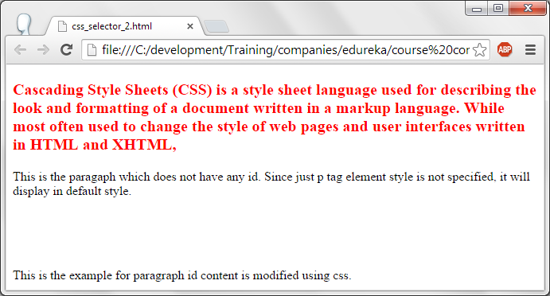
CSS-id selector – output.

Slide 9
Css-multiple selector.
<!DOCTYPE html><html><head><style>
h1, p {
color: green;
font-size: 50px;
}
</style>
</head>
<body>
<h1> This is a header </h1>
<p>This is the paragraph which is affected by the style of css.</p>
<p id="para1">This is another paragraph with id </p>
<p> This is the example for multiple selectors. </p></body></html>
Multiple tag elements style can be modified in css by specifying all of them seperated by commas and provide the requried style for those elements as required.

Slide 10
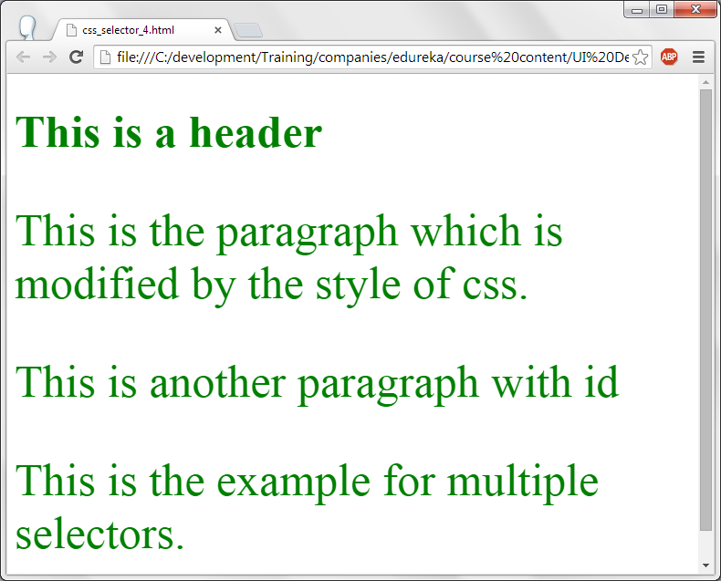
CSS-multiple selector.

Slide 11
CSS – Background.
<!DOCTYPE html>
<html>
<head>
<style>
body {
background-color: #c0c4de;
}
</style>
</head>
<body>
<h1>My CSS web page!</h1>
<p>Hello from Edureka. Welcome to world of CSS. Happy learning.</p>
</body>
</html>
In the abov code, web page body's background color is changed. Background-color property is used to change the back-ground color.

Slide 12
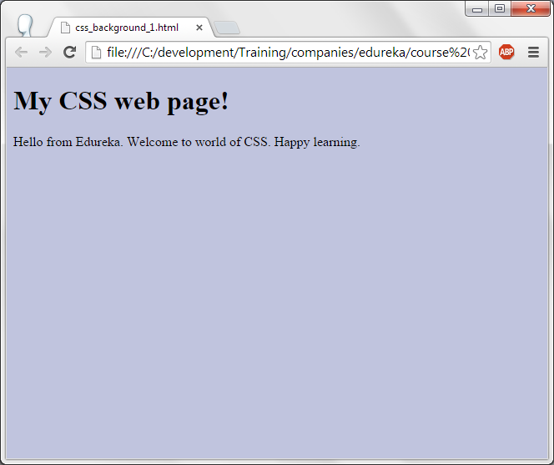
CSS – Background.

Slide 13
CSS-Background.
<!DOCTYPE html><html><head><style>
h1 { background-color: #8A2BE2;}
p { background-color: #87CEFA;}
div { background-color: #FF1493;}
</style>
</head><body>
<h1>My CSS web page with different color background</h1>
<div>
This is a text inside a div element.
<p>This paragraph has its own background color.</p>
We are still in the div element.</div>
</body></html>
For h1, div and p tags different background color are given using CSS selectors.

Slide 14
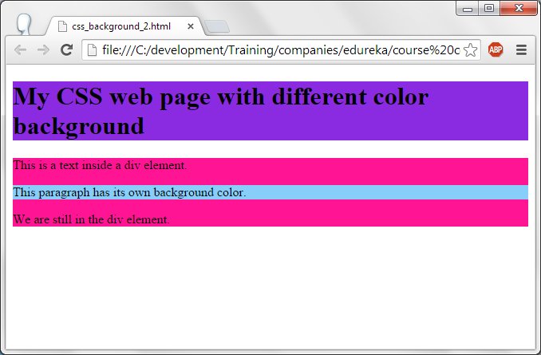
CSS-Background.

Slide 15
Css-image background.
<!DOCTYPE html><html><head>
<style>
body { background-image: url("background-image.jpg");}
h1{ text-align:center;}
</style>
</head>
<body><h1> MY CSS page!</h1>
<p>Here the image is used as a background...</p>
</body></html>
Here backgound-image for the body is specified by using the background-image property.

Slide 16
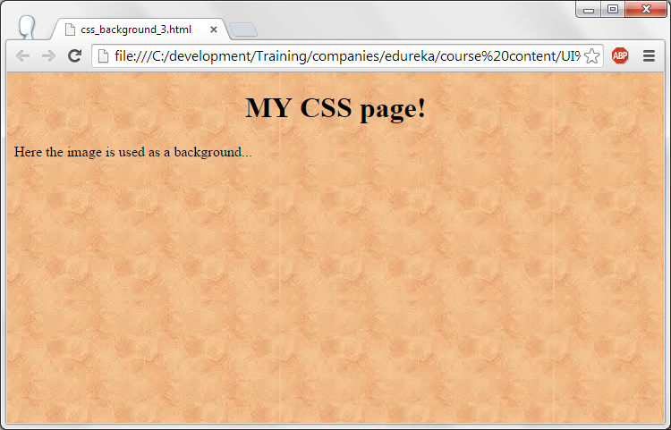
CSS-background image.

Slide 17
CSS-background image.
<!DOCTYPE html><html><head><style>
body {
background-image: url("css-image.jpg");
background-repeat: no-repeat;}
p{
position: absolute;
left : 100px;
top : 200px;
font-size:30px;
}
h1{ text-align:center;}
</style></head><body>
<h1> MY CSS page!</h1>
<p>If the image is smaller then the image is repeated for the entire web page. If you want to stop the repetition of this image on the screen then you can use the property </p>
</body></html>

Slide 18
CSS-background image.
Css-image.jpg is used as web page body's background image and this image will not be repeated by using the property background-repeat and no-repeat is specified for this property.
Content specified in paragraph <p> tag will display at 100,200 position with a font size of 30px.
Please remove background-repeat: no-repeat; from the HTML file and see the output. Here the image should be displayed multiple times as it gets repeated.

Slide 19
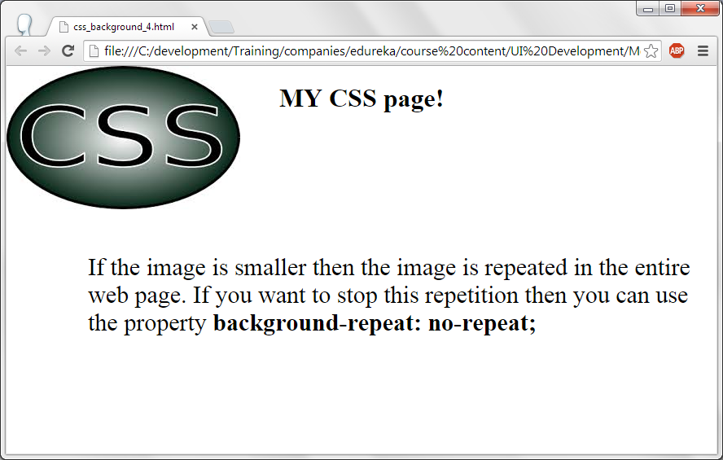
CSS-background image.

Slide 20
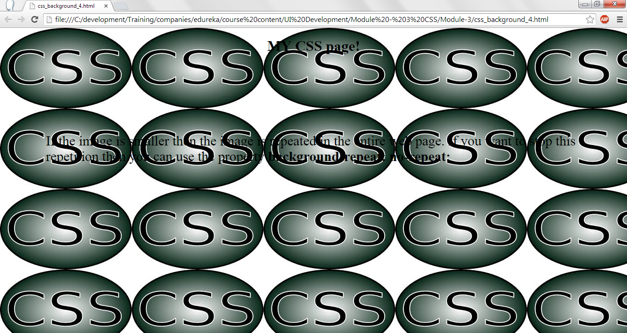
CSS-background image – without norepeat.

Slide 21
CSS-Text
Text color can be changed using color property of CSS.
It can be used in 3 ways (1) color name as Red, green, yellow, blue etc., (2) Providing the color number as ##9400D3 (3) Providing RGB values. RGB stands for Red, Green Blue. All the colors in computer can be generated using the combination RGB. Even color can take up 255 colors i.e., 255 x 255 x 255 colors can be generated in a computer.
Text can be aligned using text-align property. Center, left, right and justified can be used for this property. Text will be aligned as assigned to this property.
Text can be decorated using text-decoration property. None, underline, overline, line-through can be given for this property.
  None – no decoration for the text.
  Underline and overline : Name itself specifies the meaning of it.
  Line-through : strikes out the text. It is like <del> in html.
Text can be transformed into uppercase, lowercase and Capitalize. It can be done using the property text-transform.
  Uppercase – Text is converted to capital letters.
  Lowercase – text is converted to small letters.
  Capitalize – First letter of every work is converted to Capital letter and rest of the letters are in small letters.

Slide 22
CSS-text
<!DOCTYPE html><html><head>
<style>
body { color: Green;}
h1 { color: #ff0000;
text-align:center;
text-decoration:underline;}
p{text-align:justify;}
p.info { color: rgb(0,0,255);}</style>
</head>
<body>
<h1>Information: What is CSS</h1>
<p>Cascading Style Sheets (CSS) is a language for specifying how documents are presented to users.
A document is a collection of information that is structured using a markup language.</p>
<p class="info">Presenting a document to a user means converting it into a useable form for your audience. Browsers, like Firefox, Chrome or Internet Explorer, are designed to present documents visually, for example, on a computer screen, projector or printer.</p>
</body></html>
Body is in green color.
Header <h1> is in Red color, aligned to the center and it is underlined.
All the paragraphs are justified. i.e., left and right side is aligned by giving the proper space between the text.
Paragraph with info as class is displayed in blue color as RGB (0,0,255).

Slide 23
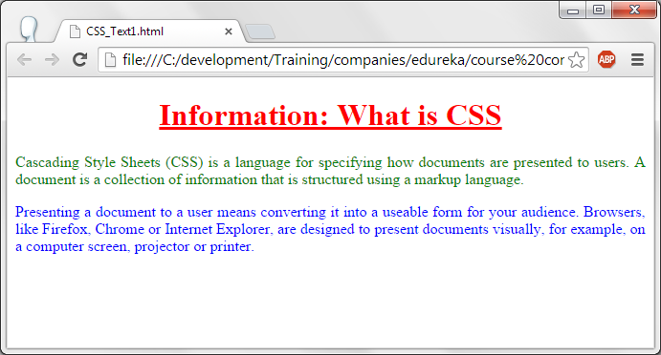
css-text

Slide 24
CSS-text
<!DOCTYPE html><html><head><style>
body { color: Green;}
h1 { text-transform:uppercase; color:#A52A2A;}
p{text-transform:lowercase;}
p.info { text-transform:capitalize; color : red; }
p.example { color : #9400D3;}
</style>
</head><body>
<h1>Information: What is CSS</h1>
<p>Cascading Style Sheets (CSS) is a language for specifying how documents are presented to users.
A document is a collection of information that is structured using a markup language.</p>
<p class="info">Presenting a document to a user means converting it into a useable form for your audience. Browsers, like Firefox, Chrome or Internet Explorer, are designed to present documents visually, for example, on a computer screen, projector or printer.</p><p class="example"> This is the example of text-transform. You can give uppercase, lowercase and capitalize as the options for this option. </p>
</body>
</html>

Slide 25
CSS-Font.
Font style can be changed using font-style property. Normal, italic, oblique can be assinged to this property.
  Normal – Displays text in a normal way.
  Italic – displays text in italics
  Oblique – It is like italics itself but slightly different.
Size of the font can be changed using font-size property. Any number can be given for this based on the requirement.
  Font-size:30px. Here px stands for pixels.

Slide 26
CSS-font
<!DOCTYPE html><html><head>
<style>
h1 { color : red;font-size:60px; text-decoration:underline;}
p.regular { font-style: normal; font-size:20px;}
p.italic_style { font-style: italic; font-size:30px;}
p.oblique_style { font-style: oblique; font-size:35px; }
</style></head>
<body>
<h1> Information: Why use CSS? </h1>
<p class="regular">NORMAL STYLE --> Use CSS to define styles for your documents, including the design, layout and variations in display for different devices and screen sizes. You can place your CSS in the <head> of a document with an embedded style sheet, or attach a separate file that defines your styles with an external style sheet. To link an external style sheet to your document, you'll simply add a link to the style sheet in the <head> of the document..</p>
<p class="italic_style">ITALICS STYLE --> An external style sheet has many advantages. Keeping the styles separate from your HTML content:</p>
<p class="oblique_style"> OBLIQUE STYLE -->
Helps avoid duplication, Makes maintenance easier, Allows you to make a site-wide change in one place</p>
</body>
</html>

Slide 27
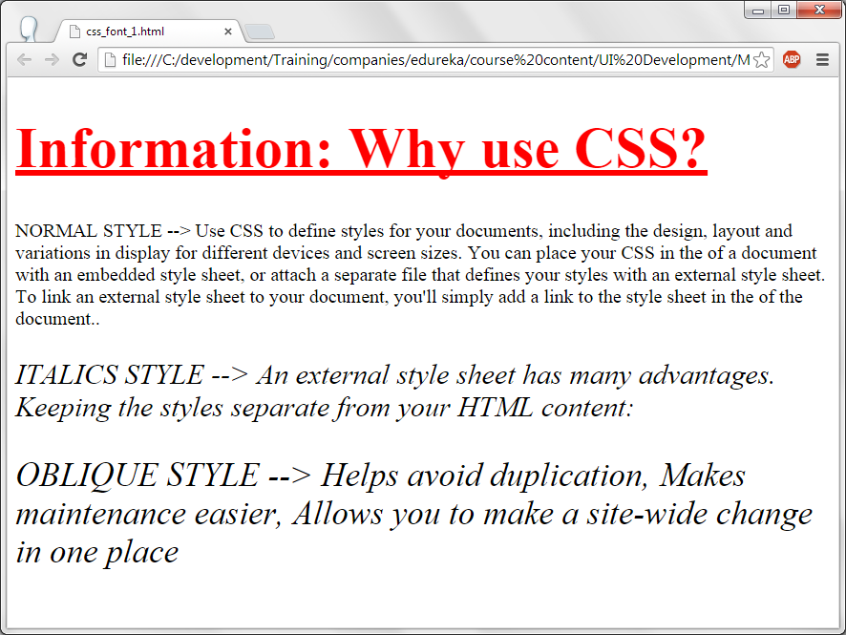
css-font

Slide 28
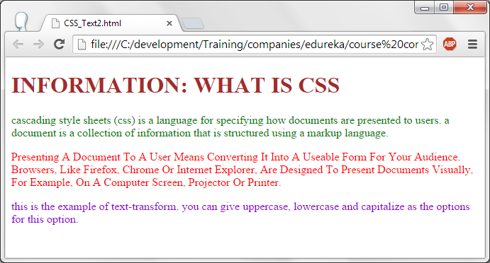
CSS-text

Slide 29
Css -font.
<!DOCTYPE html>
<html><head><style>
h1 { color : red; text-decoration:underline;}
body{font-size:75%;} --> Font size will be 75% of the original size.
p.regular { font-style: normal; }
p.italic_style { font-style: italic; }
p.oblique_style { font-style: oblique;}
</style></head><body>
<h1> Information: Why use CSS? </h1>
<p class="regular">NORMAL STYLE --> Use CSS to define styles for your documents, including the design, layout and variations in display for different devices and screen sizes. You can place your CSS in the <head> of a document with an embedded style sheet, or attach a separate file that defines your styles with an external style sheet. To link an external style sheet to your document, you'll simply add a link to the style sheet in the <head> of the document..</p><p class="italic_style">ITALICS STYLE --> An external style sheet has many advantages. Keeping the styles separate from your HTML content:</p>
<p class="oblique_style"> OBLIQUE STYLE --> Helps avoid duplication, Makes maintenance easier, Allows you to make a site-wide change in one place</p>
<p> This is the example of font-size: 75%. </p></body></html>

Slide 30
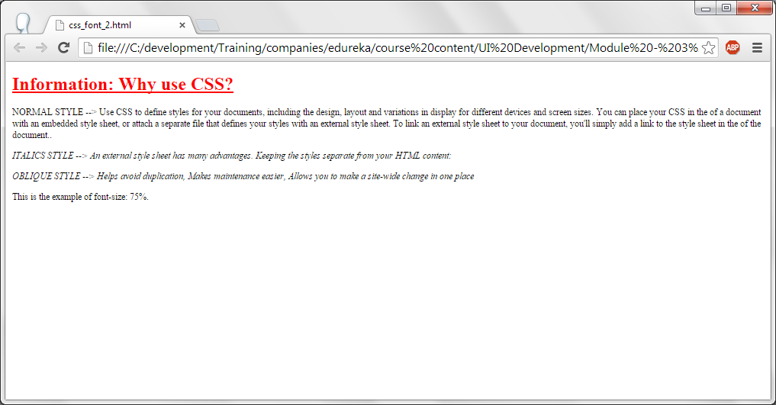
css-font

Slide 31
css-link
<!DOCTYPE html>
<html><head><style>
a:link { color: #0000ff;}
a:visited { color: #00ff00;}
a:hover { color: #00FF00;
background-color : #B22222;}
a:active { color: #FFD700;background-color: #B22222;}</style></head><body>
<p><b><a href="http://www.google.com" target="_blank">www.google.com</a></b></p>
<h3> Following options are used in style for changing the color and style of the links </h3>
<p> link is for unvisited link <p>
<p> Visited is this link which is already clicked/visited least once <p>
<p> hover is used when the mouse is moved on the link <p>
<p> active is when you click on this element/link <p></body></html>

Slide 32
Css-link.
To change the style of the link, following options has to be used in style tag.
  link is for unvisited link. We are displaying this link in blue color.
  visited is this link which is already clicked/visited atleast once. If the link is already visited then the link will be displayed in green color.
  hover is used when the mouse is moved on the link. On hovering foreground and background color of the link is changed.
  active is when you click on this element/link. On Active foreground and background color of the link is changed.

Slide 33
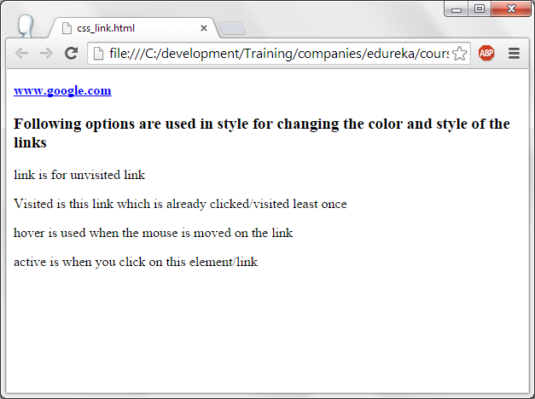
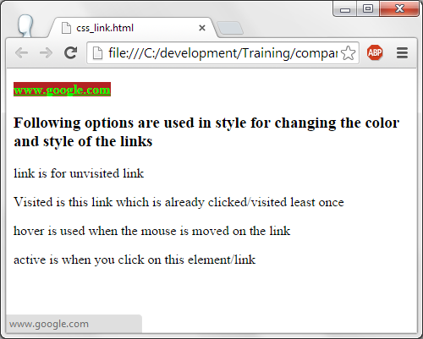
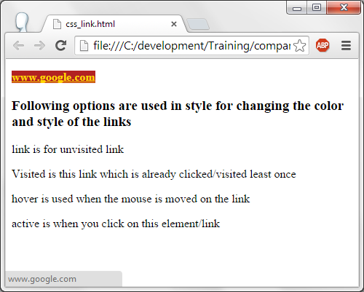
css-link

Slide 34
Question:
Why do we need hyperlinks.
Answer : It is a short cut way to visit a particular web page or part of a document.

Slide 35
Css-lists.
<!DOCTYPE html><html><head>
<style> list-style-type property is used to change the list style.
ul.circle { list-style-type: circle;} --> For unordered list, class circle, its list style is displayed in circle.
ul.square { list-style-type: square;} --> For unordered list, class sqaure, its list style is displayed in square.
ol.roman { list-style-type: upper-roman;} --> For ordered list, class roman, its list style is displayed in upper roman.
ol.alpha { list-style-type: lower-alpha;} --> For ordered list, class alpha, its list style is displayed in alphabets.
</style></head><body>
<h3>Example of unordered lists with list style as circle and square</h3>
<ul class="cicle"> <li>Cricket</li> <li>Football</li> <li>Volleyball</li></ul>
<ul class="square"> <li>Grapes</li> <li>Pineapple</li> <li>Banana</li></ul>
<h3>Example of Ordered lists with list style as Roman letters and Alphabets</h3>
<ol class="roman"> <li>Cricket</li> <li>Football</li> <li>Volleyball</li></ol>
<ol class="alpha"> <li>Grapes</li> <li>Pineapple</li> <li>Banana</li></ol>
</body></html>

Slide 36
Css-lists.
<!DOCTYPE html><html><head>
<style> list-style-type property is used to change the list style.
ul.circle { list-style-type: circle;} --> For unordered list, class circle, its list style is displayed in circle.
ul.square { list-style-type: square;} --> For unordered list, class sqaure, its list style is displayed in square.
ol.roman { list-style-type: upper-roman;} --> For ordered list, class roman, its list style is displayed in upper roman.
ol.alpha { list-style-type: lower-alpha;} --> For ordered list, class alpha, its list style is displayed in alphabets.
</style></head><body>
<h3>Example of unordered lists with list style as circle and square</h3>
<ul class="cicle"> <li>Cricket</li> <li>Football</li> <li>Volleyball</li></ul>
<ul class="square"> <li>Grapes</li> <li>Pineapple</li> <li>Banana</li></ul>
<h3>Example of Ordered lists with list style as Roman letters and Alphabets</h3>
<ol class="roman"> <li>Cricket</li> <li>Football</li> <li>Volleyball</li></ol>
<ol class="alpha"> <li>Grapes</li> <li>Pineapple</li> <li>Banana</li></ol>
</body></html>

Slide 37
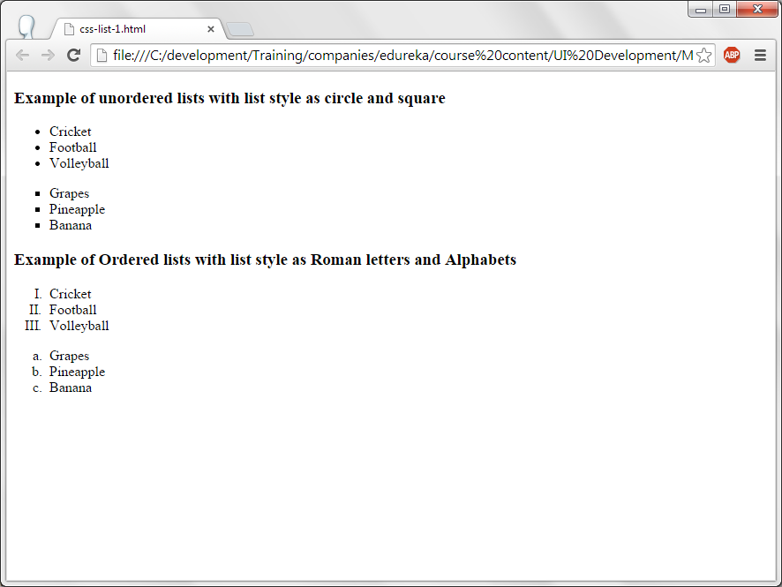
css-list

Slide 38
CSS-Tables
<!DOCTYPE html><html><head>
<style>
table, th, td { border: 1px solid blue;}
</style>
</head>
<body>
<table>
<tr> <th>Firstname</th> <th>Lastname</th> </tr>
<tr> <td>Charan</td> <td>Kumar</td> </tr>
<tr> <td>Pradeep</td> <td>Jain</td>
</tr>
</table>
</body>
</html>
Table border and its color for both table header and table data is specified in the style section.

Slide 39
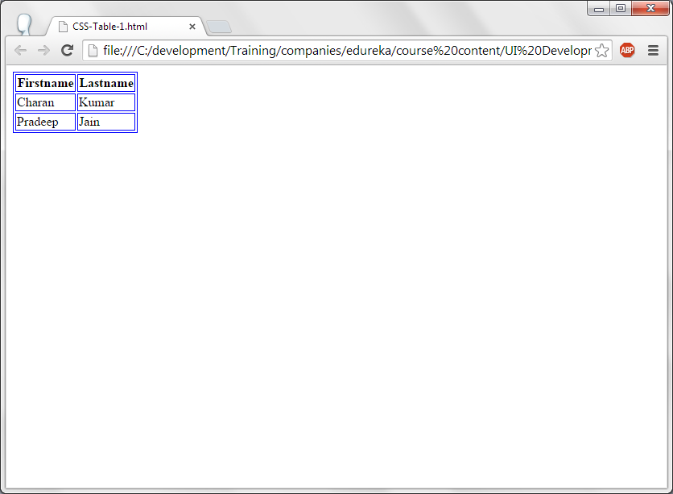
CSS-tables.

Slide 40
CSS-table.
<!DOCTYPE html><html><head>
<style>
table, td, th { border: 1px solid blue; text-align:center; height : 30px;}
table { width: 100%;}
th { height: 50px; background-color:#00BFFF}
h1 {color:red;}</style>
</head><body>
<h1> <Center> Employee information </Center></h1>
<table> <tr> <th>Employee id</th> <th>Name</th> <th>Department</th> </tr>
<tr> <td>1006</td> <td>Charan</td> <td>Technology</td> </tr>
<tr> <td>1007</td> <td>vinay</td> <td>Customer support</td> </tr>
<tr> <td>1008</td> <td>Kiran</td> <td>Administraion</td> </tr>
<tr> <td>1009</td> <td>Pradeep</td> <td>Personnel consultation</td></tr></table></body></html>
Table header and data will have the blue border, aligned to the center and height of each cell is 30 pixes.
Width of the table is set to full screen.
Table header height is 50 pixels and its back ground color is changed.

Slide 41
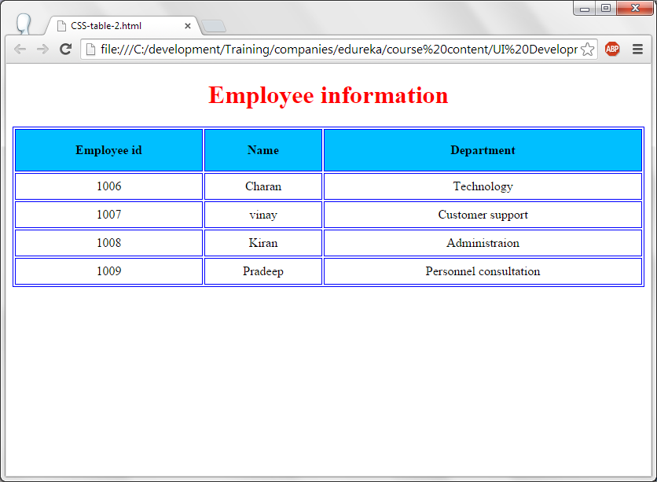
CSS-table

Slide 42
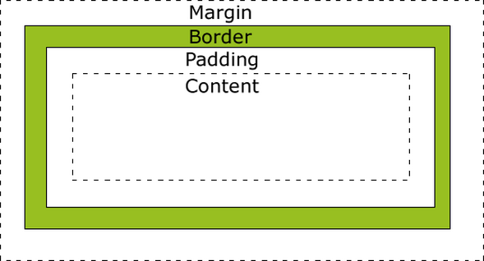
CSS- Box Model.
Content is the one which gets displayed on the screen.
Padding – This is the area around the content. If 10pixels are given as padding then all the sides of the content will pad 10 pixels.
Border – Border is the one which is shown to the user in the given color. Even border thickness also can be specified. If 10px is given for then border then 10 pixels border is drawn.
Margin – It is the area outside the border.

Slide 43
CSS- Box Model.
<!DOCTYPE html>
<html><head>
<style>
div {
background-color: #00CED1;
width: 400px;
padding: 25px;
border: 25px solid #8B0000;
margin: 25px;}
</style></head><body>
<div>When a browser displays a document, it must combine the document's content with its style information. It processes the document in two stages:
The browser converts the markup language and the CSS into the DOM (Document Object Model). The DOM represents the document in the computer's memory. It combines the document's content with its style.
The browser displays the contents of the DOM.
</div></body></html>

Slide 44
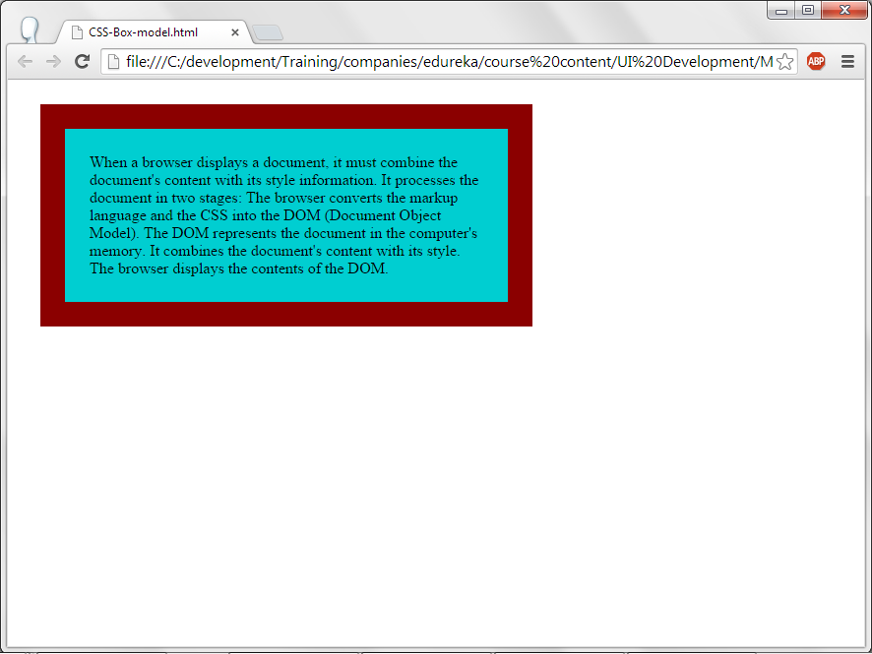
CSS- Box Model.

Slide 45
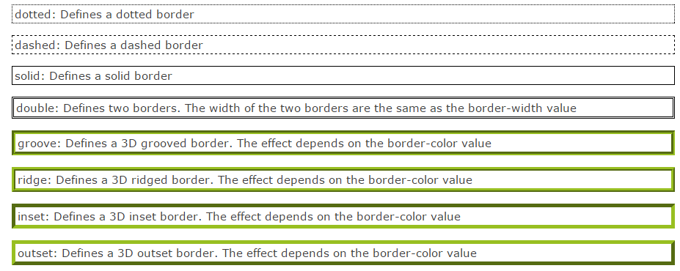
CSS-Border.
Please make it...
These are the border-styles available in CSS.

Slide 46
CSS-Border.
<!DOCTYPE html><html><head>
<style>
p{ font-size:60px; color:blue;}
p.one { border-style: ridge; border-width: 5px; border-color:red; }
p.two { border-style: dotted; border-width: medium; border-color : green;}
p.three { border-top-style: dotted; border-right-style: solid; border-bottom-style: double; border-left-style: groove; }
</style></head><body>
<p class="one">This is the text with border-width is 5 px and border color is red, border-style is ridge.</p>
<p class="two">This is the text with meidum border width, border is of green color and border-style is dotted. </p>
<p class="three">In this section, bordre for each is different..</p>
</body>
</html>

Slide 47
CSS-Border
For all the paragraphs – font size is 60 pixels and the text is displayed in blue color.
For paragraph, one and two classes, border-style, width and color is specified.
For class three, top border style is dotted, right border style is solid, bottom border style is double and left botton broder style is groove.

Slide 48
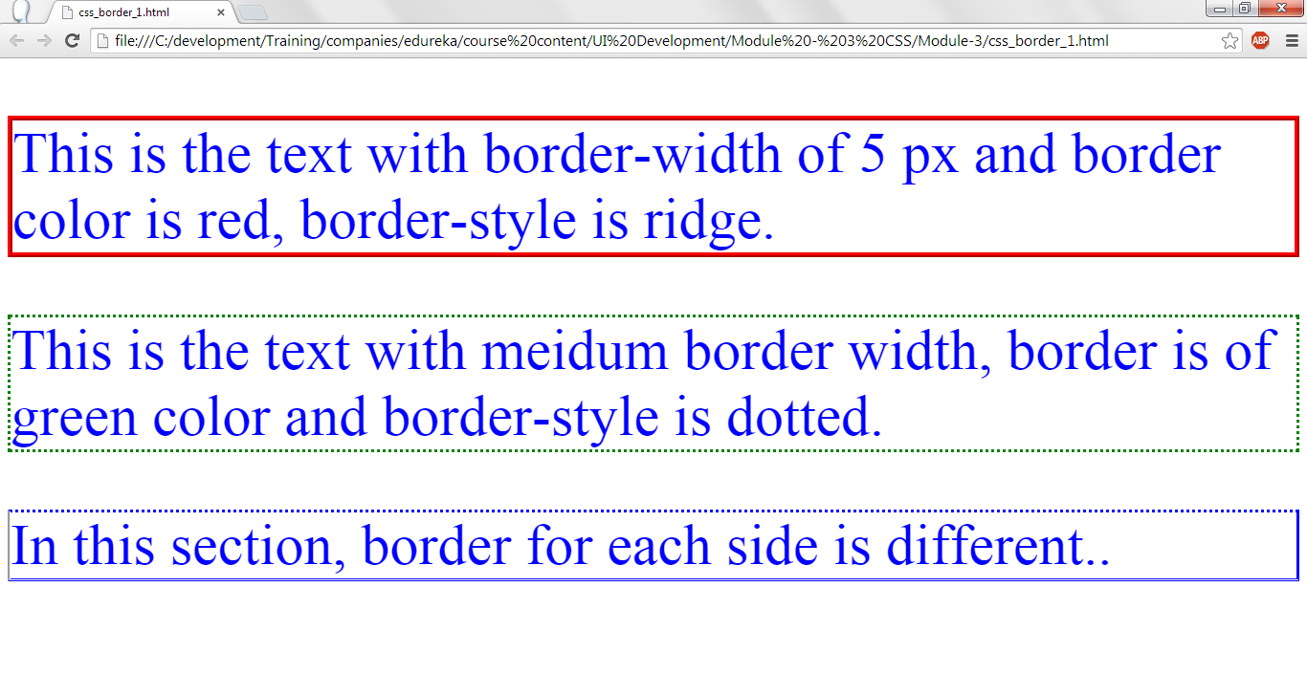
CSS-Border-Output.

Slide 49
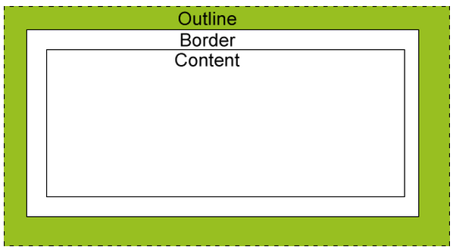
CSS – Outline.
Outlines are the lines outside the border. This is used to increase the visibility of the element to be displayed.
Outlines can have color, width and style.
Properties used to specify them are:
  Outline-style : Specifies the outline style. (Dotted, dashed, groove etc,.)
  Outline-color : Uses this color to draw the outline.
  Outline-width : specifies width of outline.

Slide 50
CSS-Outline
<!DOCTYPE html>
<html>
<head>
<style>
p {
border: 1px solid red;
outline-style: dashed;
outline-color: #C71585;
outline-width: 5px;
font-size : 50px;
}
</style>
</head>
<body>
<p> This is the example to demonstrate outline of CSS. Outline is used to highlight the content written... <br/>
outline-style, outline-color and outline-width can be used to specify the style, color and width of outline </p>
</body></html>

Slide 51
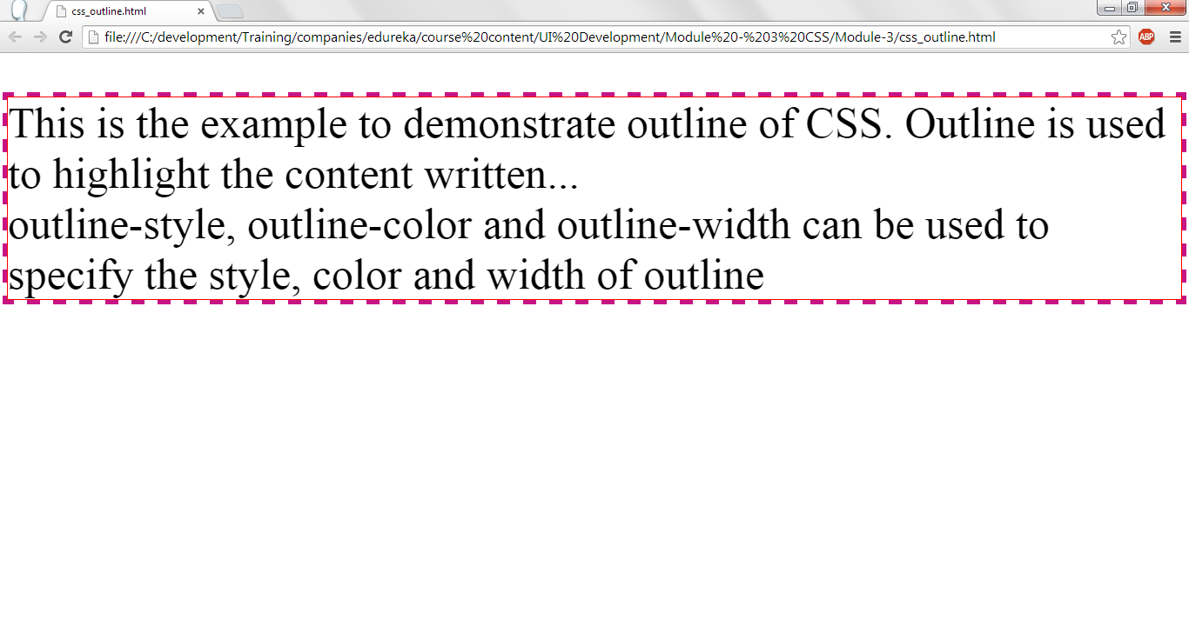
CSS-Outline.

Slide 52
CSS-Margin.
Margin is used to give the blank space and then displays the element.
4 margins can be given. They are:
  margin-top: Specifies the top margin.
  margin-bottom: Specifies bottom margin.
  margin-right: Specifies the right margin.
  margin-left: Specifies the left margin.

Slide 53
CSS-Margin.
<!DOCTYPE html><html><head><style>
body{ background-color: #C71585; }
p { margin-top: 5px; margin-bottom: 25px; margin-right: 15px; margin-left: 25px;
font-size:40px;
color:#FFE4E1;
border:3px solid red;
padding : 15px;
}</style></head><body>
<p>Margin is used to give the space and then displays the element. <br/><br/>
4 margins can be given. They are:<br/>
margin-top: Specifies the top margin.<br/>
margin-bottom: Specifies bottom margin.<br/>
margin-right: Specifies the right margin.<br/>
margin-left: Specifies the left margin.<br/>
</p></body></html>
Top, left, right and bottom margins are specified in p section.

Slide 54
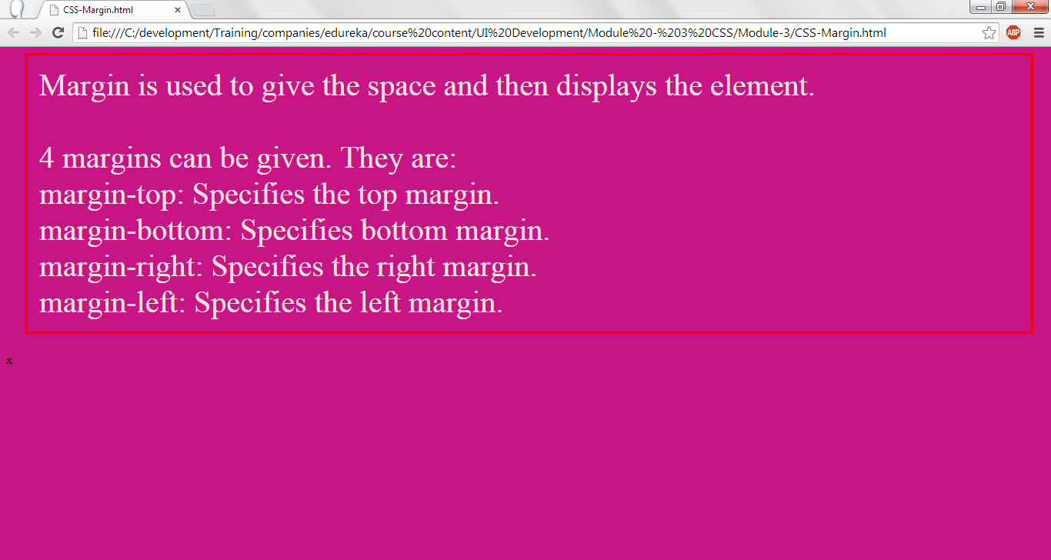
CSS-Margin.

Slide 55
CSS – padding.
Padding will give the space between the border and the element to be displayed.
Padding : 15px; will pad 15 pixes at all the sides of the text, i.e., left, top, right and bottom.
It can be specified individually too as given below:
  padding-top: 15px;
  padding-right: 15px;
  padding-bottom: 15px;
  padding-left: 15px;
Rather than 15px, required number of pixes can also be specified.

Slide 56
CSS-Padding.
body{ background-color: #FFA500; }
p {
padding-top: 25px;
padding-right: 50px;
padding-bottom: 25px;
padding-left: 50px;
font-size:30px;
color:blue;
border:3px solid red;
}</style></head><body>
<p> Padding will give the space between the border and the element to be displayed. <br/><br/>
Padding : 15px; will pad 15 pixes in all the sides of the text, i.e., left, top, right and bottom.<br/><br/>
It can be specified individually too as given below:<br/>
padding-top: 15px;
padding-right: 15px;
padding-bottom: 15px;
padding-left: 15px;
Rather than 15px, required number of pixes also can be specified. </p></body></html>

Slide 57
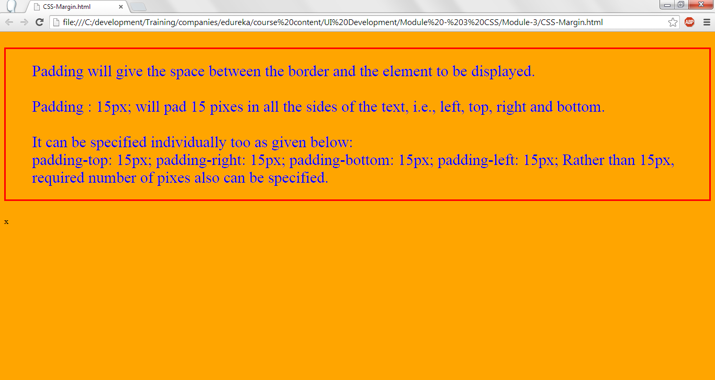
CSS-Padding.

Slide 58
CSS – Dimension.
Dimension property controls the height and width of the element to be displayed. Height and width properties are used to control the height and width of an element to be displayed.
Minimum height and maximum height of an element can be specified using min-height and max-height properties.
Minimum width and maximum width of an element can be specified using the properties min-width and max-width.

Slide 59
CSS-Dimensions.
<!DOCTYPE html><html>
<style>
img
{
min-height:50px;
max-height : 150px;
min-width:50px;
max-width:150px;
}
</style>
<body>
<img src="roses.jpg"/>
</body>
</html>
Image will be displayed with a maximum height and maximum width of 150 pixels.

Slide 60
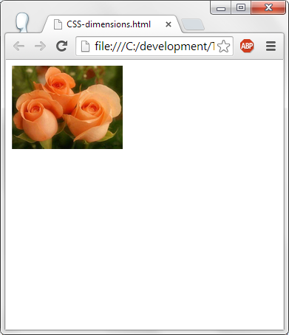
CSS-Dimension.

Slide 61
CSS-Visibility.
An element or image can be displayed or hidden by using either of the two properties
  visibility or display
For visibility property, set the value hidden to hide the element or image.
For display proerty, set the value to none to hide the element or image.
  visibility:hidden; or display:none;
The difference between properties visibility and display is, visibility will hide the element or image but will leave the blank lines which occupies element/image on the browser. Display will hide and will not leave any blank lines for the hidden element.

Slide 62
Css-visibility.
<!DOCTYPE html><html>
<style>
div { visibility:hidden; }
</style><body>
<p> This is before displaying the image. </p>
<div>
<img src="roses.jpg"/>
</div>
<p> This is after displaying the image. </p>
</body>
</html>
Image will not be shown but space occupied for the image will be shown when visibility property is used. To see the image, change the visibility to show.

Slide 63
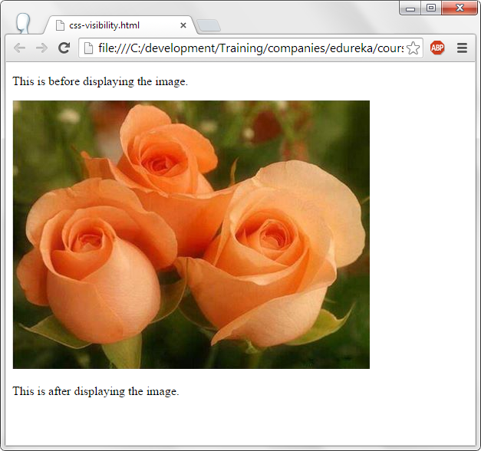
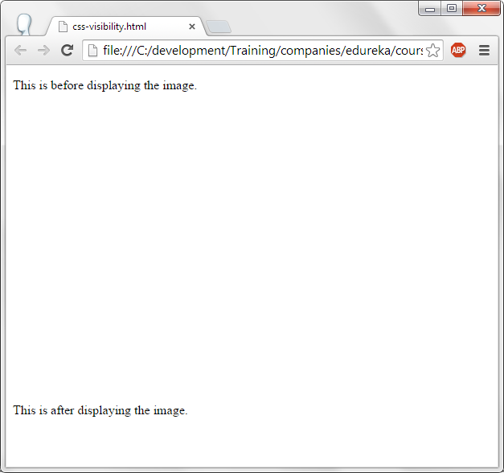
Css-visibility.

Slide 64
CSS-Positioning.
<!DOCTYPE html><html><style>
#show
{
position:Absolute;
left : 100px;
top:200px;
}
</style><body>
<div id="show">
<img src="roses.jpg"/><br/>
<fig-caption> Image is displayed at 100, 200 location </fig-caption>
</div></body></html>
The image roses.jpg is displayed at 100,200 pixel on the browser. Absolute option is given to position property which means to say the element or image can be displayed at the specified location.

Slide 65
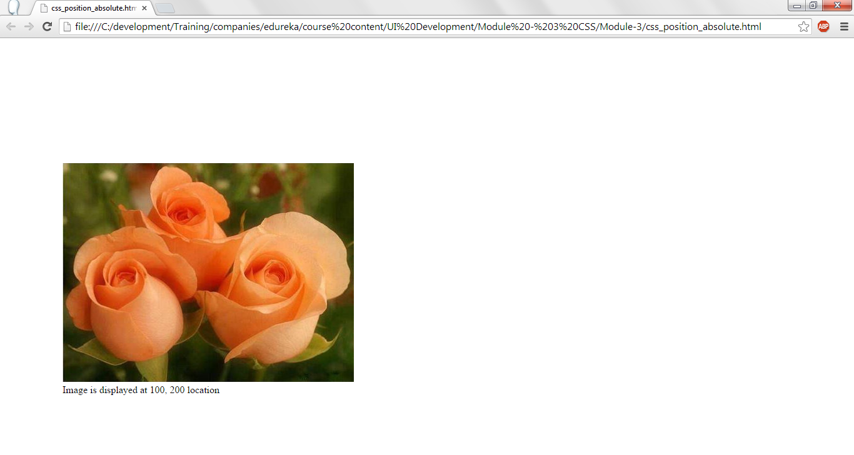
CSS-Positioning.

Slide 66
To test all attributes of CSS.
https://www.w3schools.com/cssref/playdemo.asp?filename=playcss_background-size

Slide 67
Thank You.

