Slide 1
Module-5
CSS – Part III.

Slide 2
Module-5 content.
• CSS3 Text Effects
• CSS3 Fonts
• CSS3 2D Transforms
• CSS3 3D Transforms
• CSS3 Transitions
• CSS3 Animations
• CSS3 Sprite Animations
• CSS3 Multiple Columns
• CSS3 User Interface

Slide 3
CSS3 – Text effects.
CSS3 has the following text effects:
  Text-shadow – Gives the text shadow effect.
  Word wrap – Wraps the word.

Slide 4
CSS3 – Text effects.
<!DOCTYPE html>
<html>
<head>
<style>
h1 {
text-shadow: 5px 5px 5px #FF00FF;
}
</style>
</head>
<body>
<h1>Observe the shadow effect..</h1>
<p> text-shadow property is used for shadow effect in CSS-3. </p>
<p> Syntax : text-shadow : horizontal_shadow vertical_shadow blur color_of_the_shadow; </p>
<p><b>Note:</b> IE9 and earlier versions does not support this feature... </p>
</body>
</html>

Slide 5
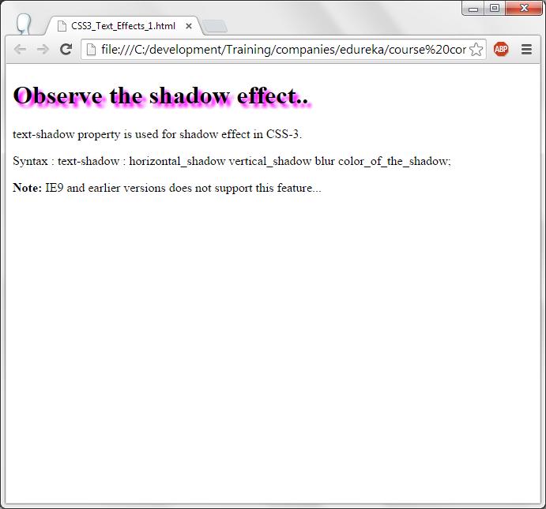
CSS3 – Text effects.

Slide 6
CSS3 – Text effects- text shadow.
Text-shadow property is used for giving the text-shadow effect in css-3.
Syntax is :text-shadow : horizontal_shadow vertical_shadow blur color_of_the_shadow;
Horizontal shadow is how much of horizontal shadow to be displayed in pixels. The same with vertical shadow. How much of blur has to be there and color of the shadow also can be specified.

Slide 7
CSS3 – Text effects – Word wrap
<!DOCTYPE html>
<html>
<head>
<style>
p.no_wordwrap {
width: 120px;
border: 1px solid #ff0000;
}
p.word_wrap {
width: 120px;
border: 1px solid #0000FF;
word-wrap: break-word;
}
p.info
{
font-size:40px;
color : #8A2BE2;
text-decoration:bold;
}

Slide 8
</style>
</head>
<body>
<p class="no_wordwrap">This paragraph contains very lengthy word. Seeeeeeeeeeeeeeeeeeeeeeeeeeeeeeeeeeeeeeeeeeeeeeee this...word-wrap property is <b>not</b> used to break the work inside the windows...</p>
<br/>
<p class="word_wrap">
This paragraph contains very lengthy word. Seeeeeeeeeeeeeeeeeeeeeeeeeeeeeeeeeeeeeeeeeeeeeeee this...word-wrap property is used to break the work inside the windows...</p>
<p class="info"> Example of word-wrap </p>
</body>
</html>

Slide 9
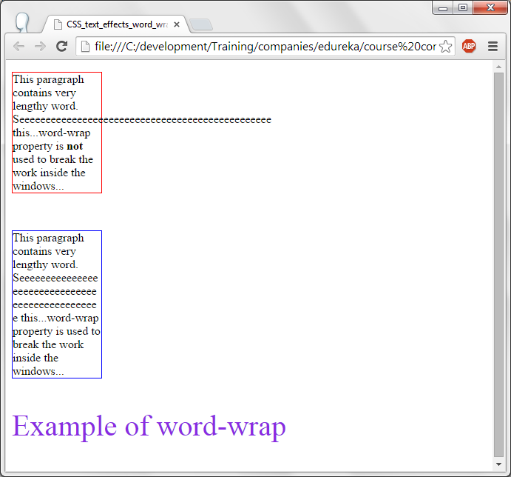
CSS-text effects – word wrap.

Slide 10
css3-word-wrap
In the first box, no word wrap is used.
In the second box, word-wrap property is used and the lengthy word is wrapped inside the box.
For both the paragraphs, width of the paragraph is set to 120 pixels.

Slide 11
CSS3 – Fonts.
Font-face is used to display the text in the which is not installed in the system.
A font file has to be downloaded and this font style can be applied to the text.
Font styles
  True type fonts (TTF file) – This is the standard font which is developed apple and microsoft.
  Open type Font (OTF file) – This type has advanced features for fonts and it is developed by Adobe and Microsoft.
  Web Open Font Format (WOFF file) – This is either TTF file or OTF file with addtional meta data. This is w3c recommendation.

Slide 12
CSS3 – Fonts.
<!DOCTYPE html>
<html>
<head>
<style>
@font-face {
font-family: myFirstFont;
src: url(Felipa-Regular.otf);
}
div.font_file,h1 {
font-size :40px;
font-family: myFirstFont;
color : #9400D3;
}
div.regular
{
font-size:20px;
font-family:sans serif;
}
h1
{
text-align:center;
font-size:90px;
color :#9400D3;
}
</style>

Slide 13
CSS3 – Fonts.
</head>
<body>
<h1> New Font </h1>
<div class="font_file">
I am writing it in caligraphy.
For this @font-face property of css-3 is used. In this block, name of the font family is mentioned and the font file is also given... This is Felipa-Regular font file. Which is downloaded from internet.
</div>
<br/>
<div class="regular">
I have changed the font style to regular...
</div>
</body>
</html>

Slide 14
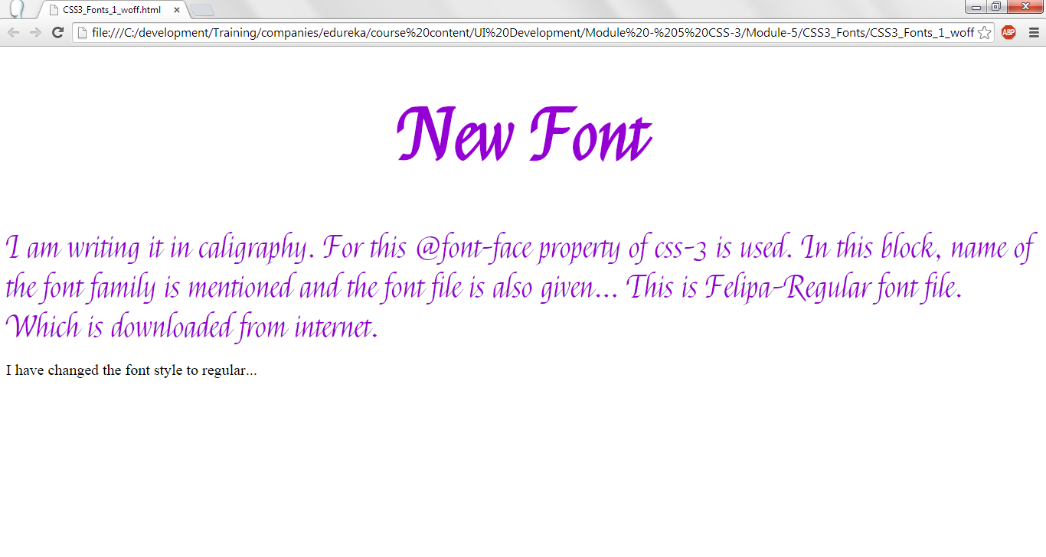
CSS3 – Fonts.

Slide 15
CSS3 - Font
Open Type Font (OTF) file is downloaded from net and stored in a directory. In this code, Felipa-Regular.otf is downloaded.
Using font-face, name of the font is defined and font file is loaded by using src:url (font file).
This font name can be used for the HTML elements to apply the font style.

Slide 16
CSS3 – 2D Transformation.
With 2D tansformation HTML elements can be stretched, spinned, moved, Scaled etc.,
Some of the methods of 2D transformation are:
  Scale() - Increases or decreases the size of the elements.
  Translate() - Moves the current elemen to another position.
  Rotate() - Rotates the element by taking a degree.
  Skew() - Turns the element by a given degree.
  Matrix() - Can combine all the 2D methods.

Slide 17
CSS3 – 2D Transformation.
<!DOCTYPE html>
<html>
<head>
<style>
div {
width: 200px;
height: 150px;
background-color: #00FFFF;
border: 1px solid black;
}
div#div2 {
-webkit-transform: translate(100px,100px);
}
</style>
</head>
<body>
<div>Element is displayed at 0,0</div>
<div id="div2">This is Traslate() of 2D Transformation..Has copied (tranlate) the element to 100px, 100px..</div>
</body>
</html>

Slide 18
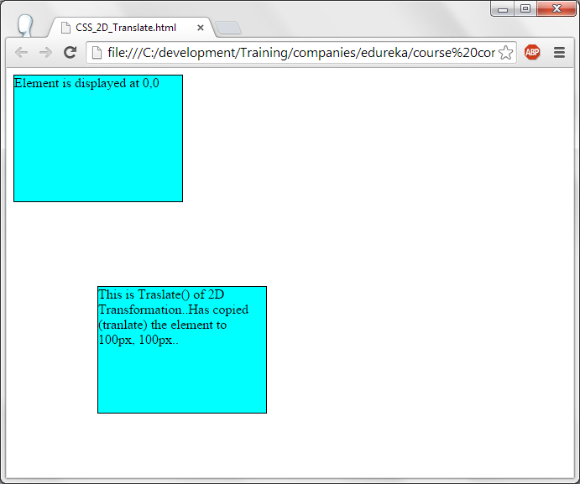

Slide 19
CSS3 – 2D Transformation – Tranlate()
A DIV element is specified with width, height, background color and border.
With translate of 2D Transformation, this element is copied to another location.

Slide 20
CSS3 – 2D Transformation - Rotate
<html><head><style>
body{
background-color: #92E978;
}
img{
width: 200px;
height: 200px;
background-color: #D9E6CF;
border: 1px solid black;
}
img#id1 {
position:absolute;
left: 600px;
top: 100px;
-webkit-transform: rotate(30deg); --> Rotates the element with the given degree. Here the element is image.
}
img#id2 {
position:absolute;
left: 300px;
top: 100px;
-webkit-transform: rotate(30deg); --> Rotates the element with the given degree. Here the element is image.
}

Slide 21
img#id3 {
position:absolute;
left: 800px;
top: 300px;
-webkit-transform: rotate(30deg);
}
img#id4 {
position:absolute;
left: 250px;
top: 400px;
-webkit-transform: rotate(30deg);
}
img#id5 {
position:absolute;
left: 550px;
top: 400px;
-webkit-transform: rotate(30deg);
}
img.id{
position:absolute;
top:225px;
left: 26px;
}

Slide 22
h1{ position:absolute; top:300px; left: 480px; color: blue; text-align:center;}
</style></head><body>
<h1> FRIENDS </h1>
<p id="id1"><a class="id1" href="http://hdwallpapercorner.com/5246/childhood-friends"><img id="id1" src="CSS3_2D-Transform_t1.1.png"></a></p>
<p id="id2"><a class="id2" href="http://www.chatelaine.com/health/how-your-childhood-friends-influence-your-happiness/"><img id="id2" src="CSS3_2D-Transform_t1.2.png"></a></p>
<p id="id3"><a class="id3" href="http://www.dreamstime.com/stock-image-teen-friends-image10971091">
<img id="id3" src="CSS3_2D-Transform_t1.3.png"></a></p>
<p id="id4"><a class="id4" href="http://connect.makerhood.com/2011/07/24/picnic-in-the-park/">
<img id="id4" src="CSS3_2D-Transform_t1.4.png"></a></p>
<p id="id5"><a class="id5" href="http://journalistsresource.org/studies/society/social-media/social-selection-peer-influence-online-social-network">
<img id="id5" src="CSS3_2D-Transform_t1.5.png"></a></p>
</body>
</html>

Slide 23
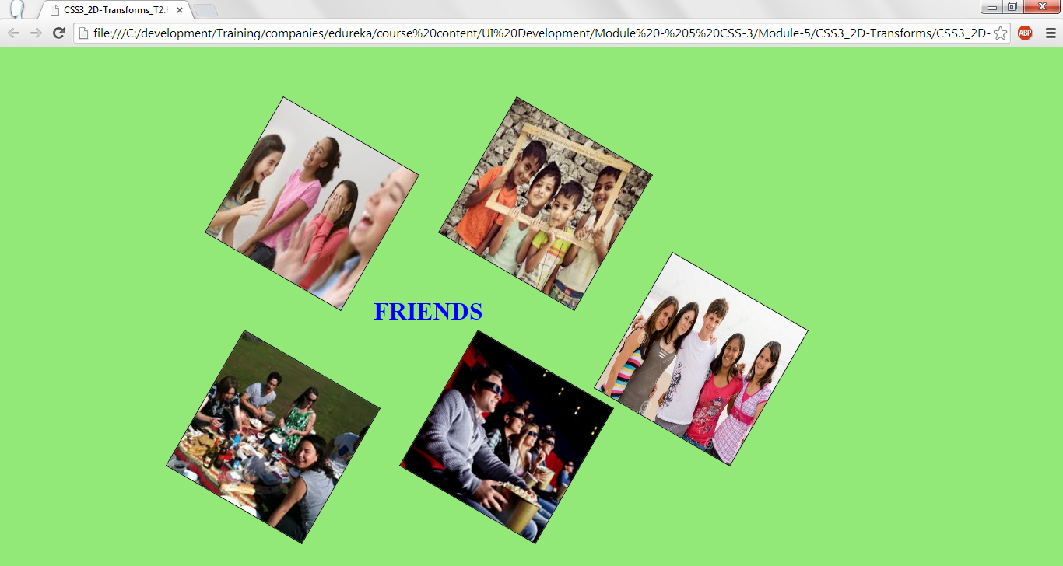

Slide 24
CSS2D-Transformation – scale.
Scale() method of 2D transformation will scale the element up/down .
Sytax of scale() is
  -webkit-transform: scale(x,y);
  Webkit-transform is used for chrome, safari and opera browsers.
  Scales the element to the x (horizontally) and y (vertically) position appropriately. If scale (2,2) is used the width and height is scaled twice as the original element / image.

Slide 25
<html><head><style>
body{
background-color: #92E978;
}
img.id{
visibility: hidden;
}
img#id1{
position: absolute;
left: 400px;
top: 100px;
-webkit-transform: scale(1,1);
}
img#id2 {
position: absolute;
left: 400px;
top: 300px;
-webkit-transform: scale(2,2);
}
img#id3 {
position: absolute;
left: 400px;
top: 550px;
-webkit-transform: scale(3,3);
}

Slide 26
h1{text-align: center;}
</style></head><body>
<h1> FRIENDS </h1>
<p><a class="id" href="https://endoraballweber.wordpress.com/2014/04/08/5-reasons-why-my-childhood-friends-are-awesome/"><img class="id" src="CSS3_2D-Transform_t1.png"></a></p>
<p><a class="id" href="https://endoraballweber.wordpress.com/2014/04/08/5-reasons-why-my-childhood-friends-are-awesome/"><img id="id1" src="CSS3_2D-Transform_t1.png"></a></p>
<p><a class="id" href="https://endoraballweber.wordpress.com/2014/04/08/5-reasons-why-my-childhood-friends-are-awesome/"><img id="id2" src="CSS3_2D-Transform_t1.png"></a></p>
<p><a class="id" href="https://endoraballweber.wordpress.com/2014/04/08/5-reasons-why-my-childhood-friends-are-awesome/"><img id="id3" src="CSS3_2D-Transform_t1.png"></a></p>
</body></html>

Slide 27
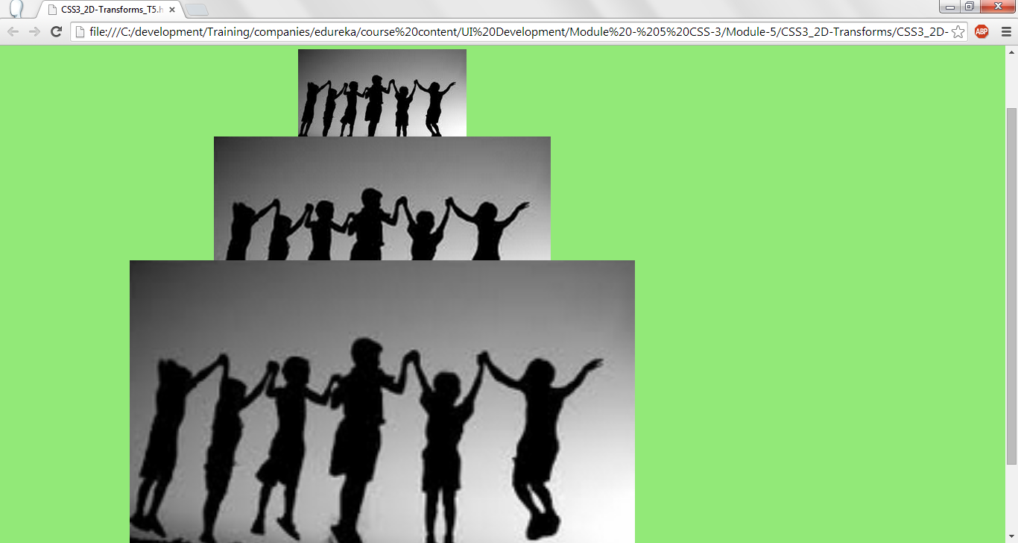

Slide 28
CSS-3- 2D tranformation – Skew.
Using skew, the element can be rotated by horizontal and vertical axis. Rotate() is only one angle but skew is 2 dimensional (x and y).
Sytax of skew is:
  -webkit-transform: skew(20deg,30deg);
  This will skew the image/element by 20 degrees horizontally (x-axis) and 30 degrees vertically (y-axis).

Slide 29
<html><head><style>
body{
background-color: #92E978;
}
img{
width: 200px;
height: 200px;
background-color: #D9E6CF;
border: 1px solid black;
}
img#id1 {
position:absolute;
left: 650px;
top: 200px;
-webkit-transform: skew(20deg,30deg);
}
img#id2 {
position:absolute;
left: 800px;
top: 100px;
-webkit-transform: skew(10deg,50deg);
}

Slide 30
img#id3 {
position:absolute;
left: 200px;
top: 200px;
-webkit-transform: skew(-40deg,10deg);
}
img#id4 {
position:absolute;
left: 10px;
top: 50px;
-webkit-transform: skew(-50deg,10deg);
}
img.id{
position:absolute;
top:300px;
left: 430px;
}
h1{
color: blue;
text-align:center;
}
</style></head><body>
<h1> FRIENDS </h1>
<p><a class=

Slide 31
<p><a class="id" href="https://endoraballweber.wordpress.com/2014/04/08/5-reasons-why-my-childhood-friends-are-awesome/"><img id="id2" src="CSS3_2D-Transform_t1.png"></a></p>
<p id="id1"><a class="id1" href="http://hdwallpapercorner.com/5246/childhood-friends"><img id="id1" src="CSS3_2D-Transform_t1.1.png"></a></p>
<p id="id2"><a class="id2" href="http://www.chatelaine.com/health/how-your-childhood-friends-influence-your-happiness/"><img class="id" src="CSS3_2D-Transform_t1.2.png"></a></p>
<p id="id3"><a class="id3" href="http://www.dreamstime.com/stock-image-teen-friends-image10971091">
<img id="id3" src="CSS3_2D-Transform_t1.3.png"></a></p>
<p id="id4"><a class="id4" href="http://connect.makerhood.com/2011/07/24/picnic-in-the-park/">
<img id="id4" src="CSS3_2D-Transform_t1.4.png"></a></p>
</body>
</html>

Slide 32
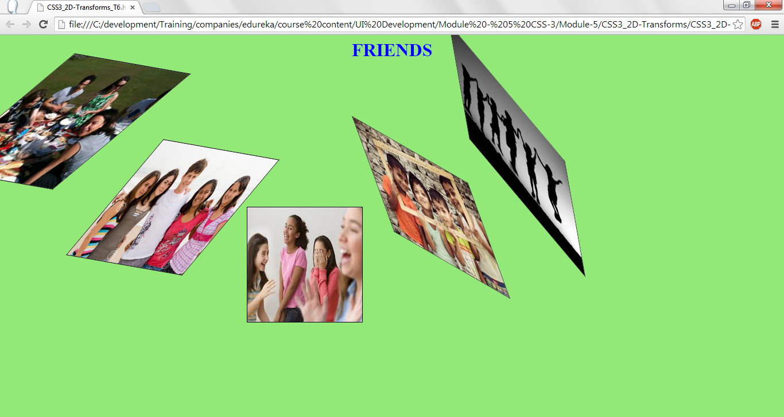
CSS-3- 2D tranformation – Skew.

Slide 33
CSS3 – 3D Tranformation.
In CSS3 – 3 dimension of the image/elements can be transformed.
RotateX() and rotateY() methods are used to rotate x and y axis of the image / element in 3 dimension.
Rotatex() and rotateY() takes the degree as the argument and rotates the element / image.

Slide 34
<html><head><style>
body{ background-color: #FCDEF2;}
h1{ color: black; text-align: center; }
h3 {
position: absolute;
left:250px;
width: 550px;
text-align:center;
height: 25px;
border: 1px solid black;
background-color: red;
color: white;
}
h3#start {
position: absolute;
top: 100px;
left:250px;
-webkit-transform: rotateX(60deg);
}
CSS3 – 3D Tranformation – x axis.

Slide 35
h3#start1 { position: absolute; top: 150px; left:250px;
-webkit-transform: rotateX(120deg);}
h3#start2 { position: absolute; top: 200px;
left:250px; -webkit-transform: rotateX(180deg);
}
h3#start3 { position: absolute; top:250px;
left:250px; -webkit-transform: rotateX(240deg);
}
h3#start4 { position: absolute; top: 300px;
left:250px; -webkit-transform: rotateX(300deg);
}
h3#start5 { position: absolute; top: 350px;
left:250px; -webkit-transform: rotateX(360deg);
}
</style></head><body>
<h3>The Amazing Spider-Man 3</h3>
<h3 id="start">The Amazing Spider-Man 3 - roated by 60 degree</h3>
<h3 id="start1">The Amazing Spider-Man 3 - roated by 120 degree </h3>
<h3 id="start2">The Amazing Spider-Man 3 - roated by 180 degree </h3>
<h3 id="start3">The Amazing Spider-Man 3 - roated by 240 degree </h3>
<h3 id="start4">The Amazing Spider-Man 3 - roated by 300 degree </h3>
<h3 id="start5">The Amazing Spider-Man 3 - roated by 360 degree </h3>
</html>
CSS3 – 3D Tranformation – x axis.

Slide 36
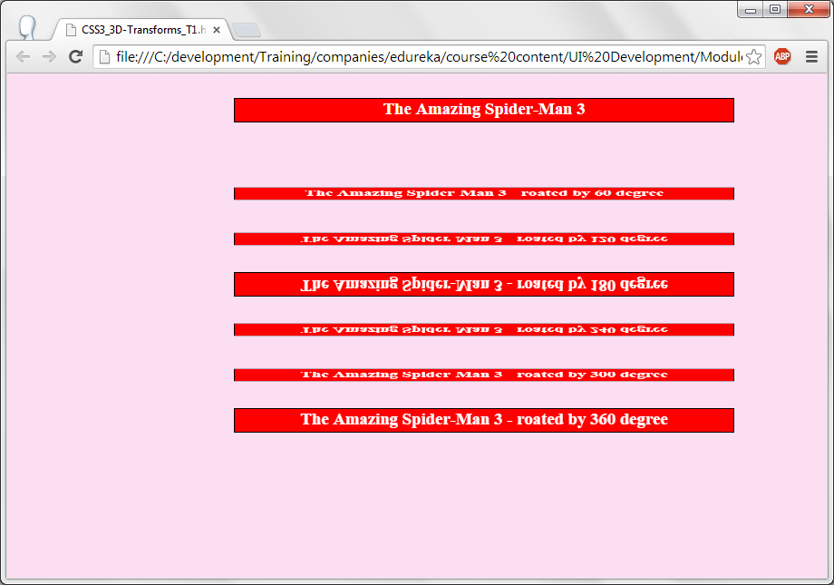
CSS3 – 3D Tranformation – x axis.

Slide 37
<html>
<head>
<style>
h1{
text-align: center;
}
a.id2{
position:absolute;
top: 430px;
left: 440px;
}
img {
top: 90px;
position: absolute;
left:20px;
width: 200px;
height: 300px;
}
img#a1 {
top: 90px;
position: absolute;
left:200px;
-webkit-transform: rotateY(30deg); --> Rotates the image 30 degree in y axis.
}
CSS3 – 3D Tranformation – Y axis.

Slide 38
<html>
<head>
<style>
h1{
text-align: center;
}
a.id2{
position:absolute;
top: 430px;
left: 440px;
}
img {
top: 90px;
position: absolute;
left:20px;
width: 200px;
height: 300px;
}
img#a1 {
top: 90px;
position: absolute;
left:200px;
-webkit-transform: rotateY(30deg); --> Rotates the image 30 degree in y axis.
}
CSS3 – 3D Tranformation – Y axis.

Slide 39
img#a2 {
top: 90px;
position: absolute;
left:350px;
-webkit-transform: rotateY(60deg);
}
img#a4 {
top: 90px;
position: absolute;
left:450px;
-webkit-transform: rotateY(120deg);
}
img#a5 {
top: 90px;
position: absolute;
left:600px;
-webkit-transform: rotateY(150deg);
}
img#a6 {
top: 90px;
position: absolute;
left:780px;
-webkit-transform: rotateY(180deg);
}
</style></head><body>

Slide 40
<h1> Kool Kart!!! </h1>
<figure>
<img src="CSS3_3D-Transforms_T1.2.png"
title="Chiffon Saree">
<fig-caption> original picture </fig-caption>
</figure>
<img id="a1" src="CSS3_3D-Transforms_T1.2.png" title="Chiffon Saree">
<img id="a2" src="CSS3_3D-Transforms_T1.2.png" title="Chiffon Saree">
<img id="a3" src="CSS3_3D-Transforms_T1.2.png" title="Chiffon Saree">
<img id="a4" src="CSS3_3D-Transforms_T1.2.png" title="Chiffon Saree">
<img id="a5" src="CSS3_3D-Transforms_T1.2.png" title="Chiffon Saree">
<img id="a6" src="CSS3_3D-Transforms_T1.2.png" title="Chiffon Saree">
<img id="a7" src="CSS3_3D-Transforms_T1.2.png" title="Chiffon Saree">
<p><b><a class="id2" href="http://www.myntra.com/printed-sari/triveni/triveni-pink--yellow-chiffon-printed-saree/445547/buy?src=search&uq=&q=saree&p=14">Chiffon Printed Saree</a></b></p>
</html>
CSS3 – 3D Tranformation – Y axis.

Slide 41
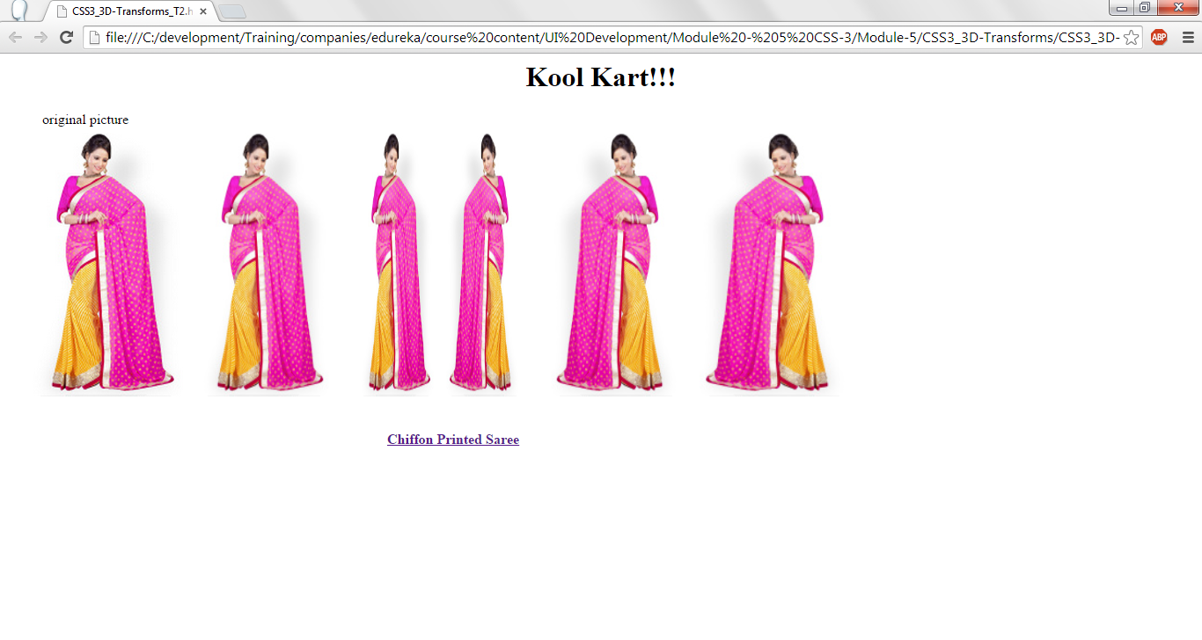
CSS3 – 3D Transformation.

Slide 42
CSS3 – Transition.
Style can be changed in CSS3 without using Java Script or flash.
-webkit-transition: width 2s, height 2s, -webkit-transform 2s; is used to have the transition.
  For transitioning, for width it taks 2 seconds, for height it takes 2 seconds and to show the effect of transformation will take 2 seconds.
-webkit-transform: rotate(360deg);
  Rotates the elements by 360 degree. Any degree can be given. If the degree is 720 then it take 360degress x 2. Complete rotation will take place twice. If the given degree is 3600 then the element will be rotated 10 times.

Slide 43
CSS3 – Transition.
<!DOCTYPE html>
<html>
<head>
<style>
div {
width: 100px;
height: 100px;
background: DeepPink;
-webkit-transition: width 2s, height 2s, -webkit-transform 5s;
}
div:hover {
width: 400px;
height: 400px;
-webkit-transform: rotate(3600deg); /* Chrome, Safari, Opera */
}
</style>
</head>
<body>
<div><p>Hover on this box to see the effect!!<p></div>
</body>
</html>

Slide 44
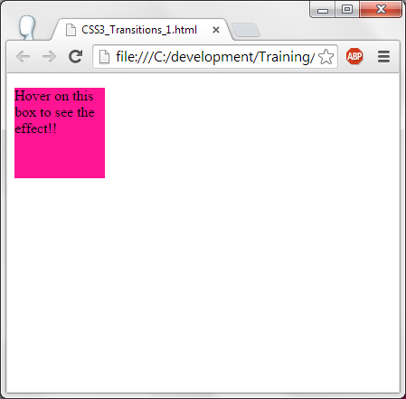
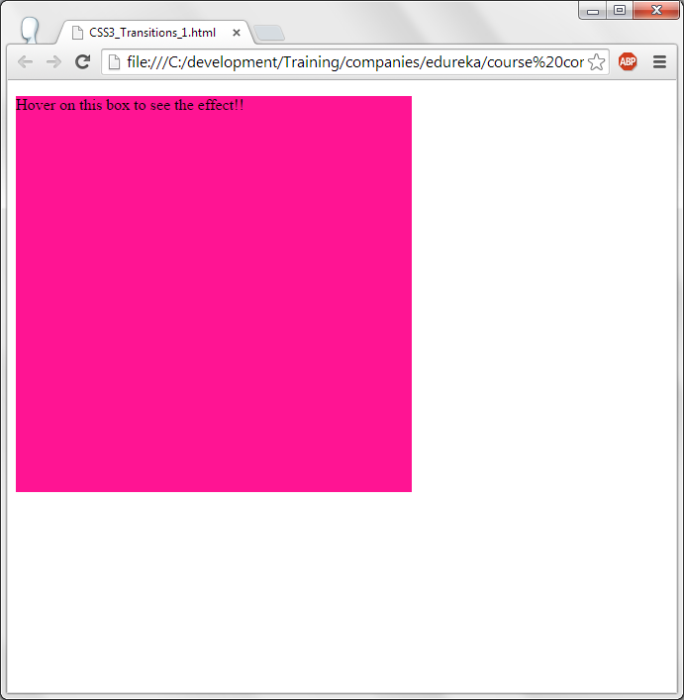
CSS3 – Transition.

Slide 45
CSS3 – animation.
With CSS3 animation properties, it is possible to replace flash and java script animations...
-webkit-animation: name 5s; --> Animation is defined under name and it displays in 5 seconds.
@-webkit-keyframes name { --> This is definition of the how the colors has to change and.
0% {background: red;} --> Initially red color is displayed.
25% {background: green;} --> After 25% of the animation, color changes to green and so on.
50% {background: blue;}
100% {background: yellow;}
}

Slide 46
CSS3 – animation.
<!DOCTYPE html>
<html>
<head>
<style>
div {
width: 100px;
height: 100px;
background: red;
-webkit-animation: myfirst 5s; /* Chrome, Safari, Opera */
}
/* Chrome, Safari, Opera */
@-webkit-keyframes myfirst {
0% {background: red;}
25% {background: green;}
50% {background: blue;}
100% {background: yellow;}
}
</style>
</head>
<body>
<div></div>
</body>
</html>

Slide 47
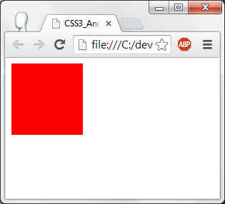
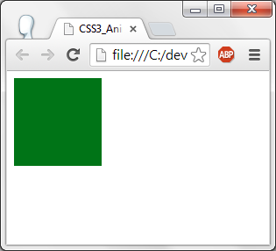
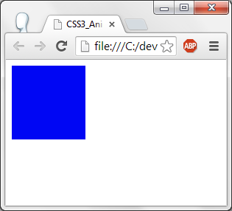
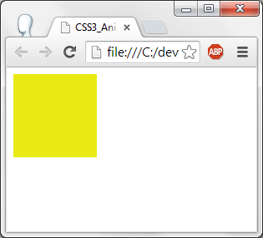
CSS3 – animation.

Slide 48
CSS3 – Animation.
<!DOCTYPE html>
<html>
<head>
<style>
div {
width: 100px;
height: 100px;
background: red;
position:relative;
-webkit-animation: myfirst 5s; /* Chrome, Safari, Opera */
}
/* Chrome, Safari, Opera */ From the previous exmple, location where the element shoudl be displayed is given.
@-webkit-keyframes myfirst {
0% {background: red;left:0px; top:0px;} --> Displays at 0,0
25% {background: green;left:500px; top:0px;} --> displays at 500,0 --> So the box moves from 0,0 to 500,0 as animation and so on.
50% {background: blue;left:500px; top:500px;}
75% {background: brown;left:0px; top:500px;}
100% {background: yellow;left:0px; top:0px;}
}
</style>
</head>
<body>
<div></div>
</body></html>

Slide 49
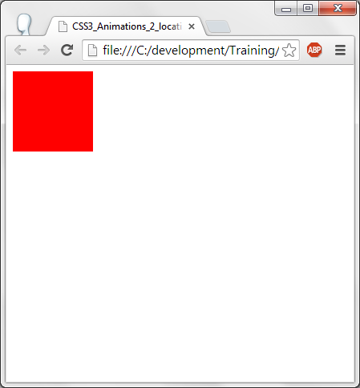
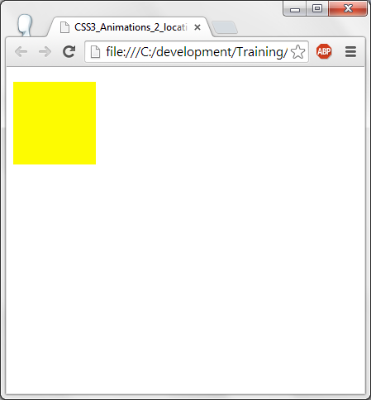

Slide 50
Sprite animation
Sprite animation is also another type of animation.
Create n number of frames of animation in a sheet (Sprite sheet) in an image (jpg / png) file.
Use the steps() function to display the number of frames and the duration of the display. This is will display as sprite animation.

Slide 51
CSS3 – Multiple Columns.
In CSS3, multiple columns can be displayed as in news paper.
Following properties can be used for multiple columns.
  Column-count : Number of columns to displays.
  Column-gap : How much of gap should be given between column to column.
  Column-rule : How much is the thickness of the column gap line , style of the line as dotted, dashed etc., and in which color should the line be displayed (The column seperator).

Slide 52
CSS3 – Multiple Columns.
<html>
<head>
<style>
h1{
color: #4350B2;
text-align:center;
}
h1 {
text-shadow: 5px 5px 5px #A9DCF2;
}
p{
-webkit-column-count: 3; --> There are 3 columns to be displayed.
-webkit-column-gap: 20px; --> Gap between column to column is 20 pixels.
text-align: justify;
}
</style>
</head>
<body>
<h1>CSS (Cascading Style Sheets)</h1>

Slide 53
CSS3 – Multiple Columns.
p>Cascading Style Sheets (CSS) is a style sheet language used for describing the look and formatting of a document written in a markup language. While most often used to change the style of web pages and user interfaces written in HTML and XHTML, the language can be applied to any kind of XML document, including plain XML, SVG and XUL. Along with HTML and JavaScript, CSS is a cornerstone technology used by most websites to create visually engaging webpages, user interfaces for web applications, and user interfaces for many mobile applications.
CSS is designed primarily to enable the separation of document content from document presentation, including elements such as the layout, colors, and fonts.This separation can improve content accessibility, provide more flexibility and control in the specification of presentation characteristics, enable multiple HTML pages to share formatting by specifying the relevant CSS in a separate .css file, and reduce complexity and repetition in the structural content, such as semantically insignificant tables that were widely used to format pages before consistent CSS rendering was available in all major browsers. CSS makes it possible to separate presentation instructions from the HTML content in a separate file or style section of the HTML file. For each matching HTML element, it provides a list of formatting instructions. For example, a CSS rule might specify that "all heading 1 elements should be bold," leaving pure semantic HTML markup that asserts "this text is a level 1 heading" without formatting code such as a <bold> tag indicating how such text should be displayed.
</html>

Slide 54
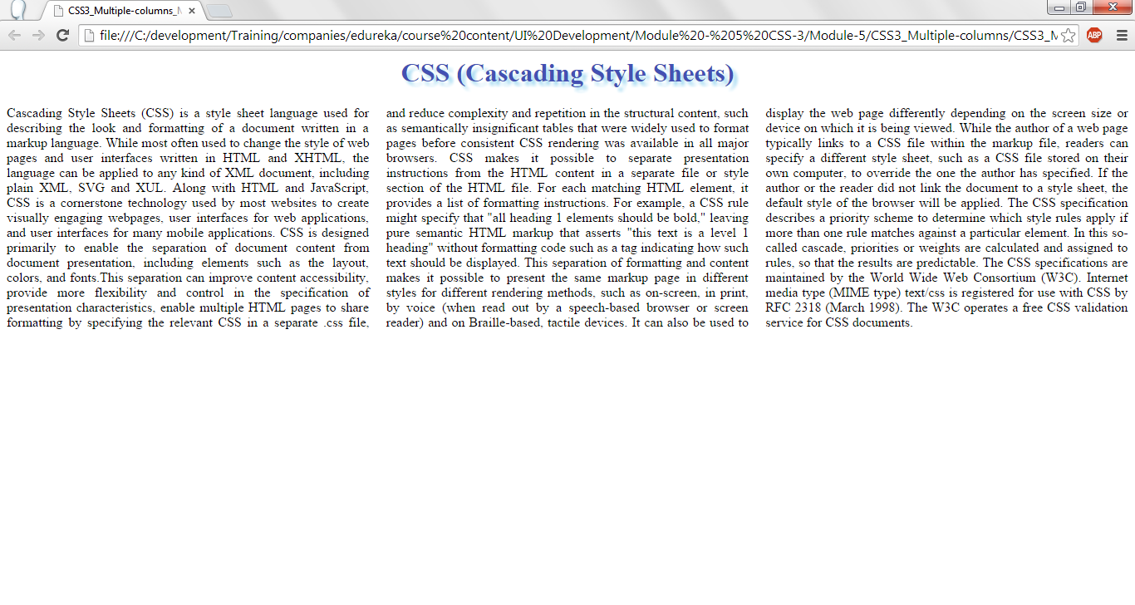
CSS3 – Multiple Columns.

Slide 55
CSS3 – Multiple Columns with image display.
<html><head><style>
h1{ color: #4350B2; text-align:center;}
h1 { text-shadow: 5px 5px 5px #A9DCF2;}
p{
-webkit-column-count: 4;
-webkit-column-gap: 20px;
text-align: justify;
}
img { display: block; float: right; width: 100%;
}
</style></head><body>
<h1>Are we conscious?</h1>
<p>How does the brain perceive things? And how does it make connections between the perception and the actual data processing? Read on to find out, says Michael S A Graziano.
Of the three most fundamental scientific questions about the human condition, two have been answered. First, what is our relationship to the rest of the Universe? Copernicus answered that one. We’re not at the centre. We’re a speck in a large place.
<img class="id" src="CSS3_Multiple-columns_M2.png">

Slide 56
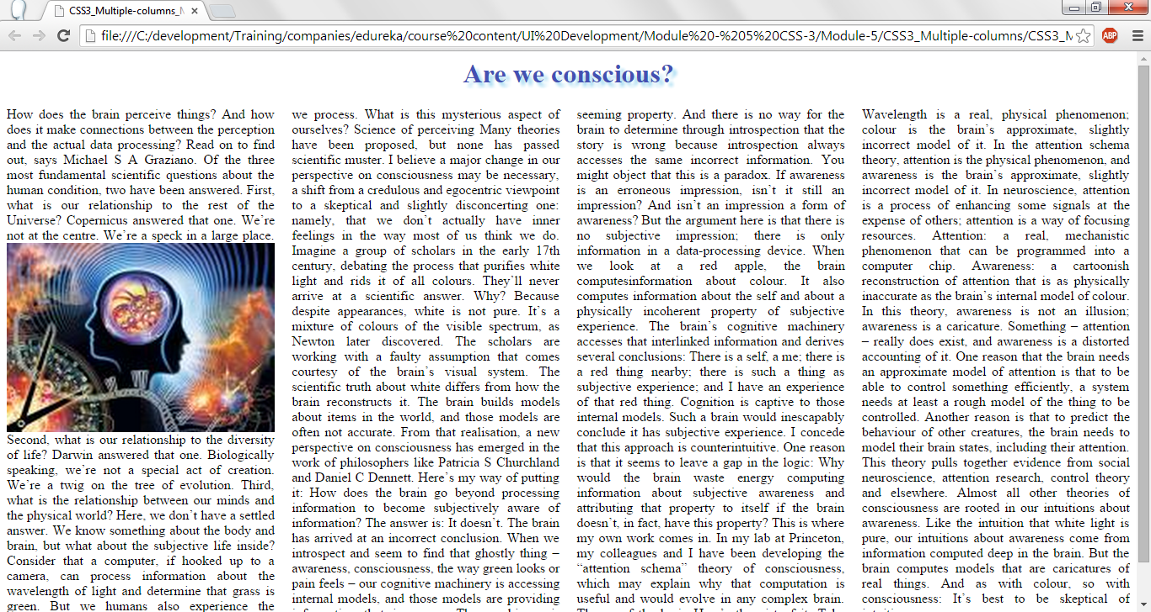
CSS3 – Multiple Columns with image display.

Slide 57
CSS3 – Multiple Columns with column rule.
<html>
<head>
<style>
h1{
color: #4350B2;
text-align:center;
}
h1 {
text-shadow: 5px 5px 5px #A9DCF2;
}
p{
-webkit-column-count: 3;
-webkit-column-gap: 20px;
-webkit-column-rule: 4px solid #ff00ff; --> Display the column gap as a line with a width of 4 pixels and in pink color.
text-align: justify;
}
img {
display: block;
float: left;
width: 100%;
}</style></head><body>

Slide 58
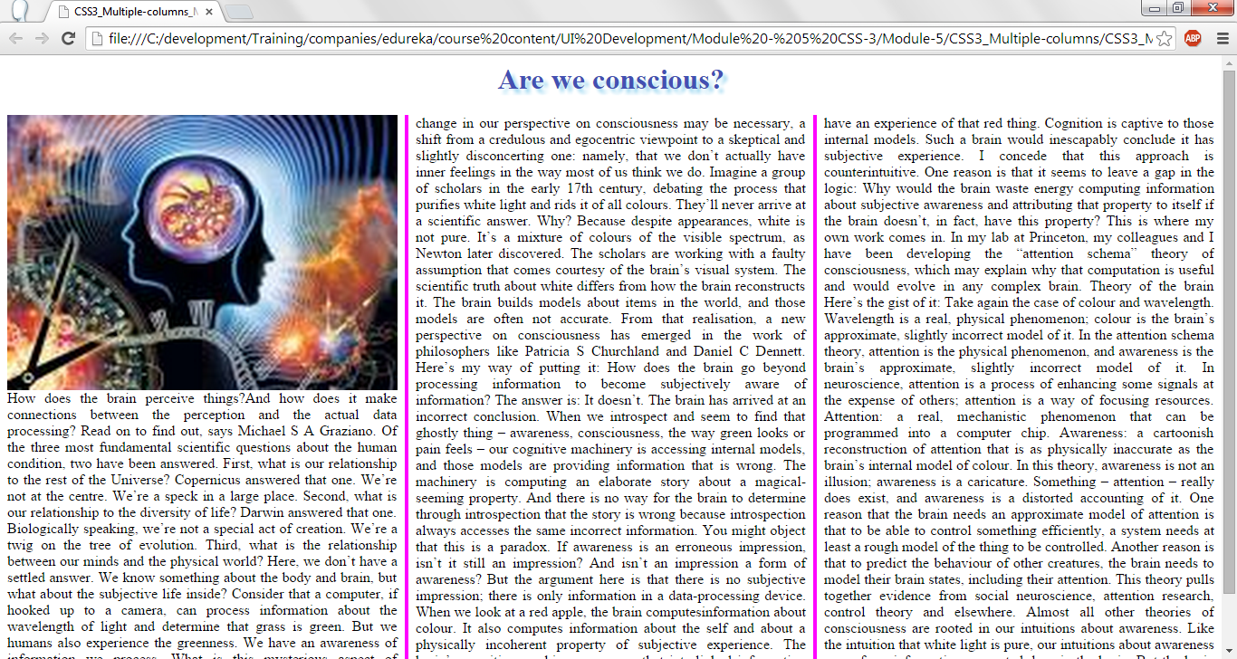
CSS3 – Multiple Columns with column rule.

Slide 59
CSS3 – New UI.
In CSS3, resizing elements have been introduced.
It is done through resize property.
Resize : both --> Specifies resizing can be done in both horizontal and vertical directions.
Overflow : auto --> If the text overflows in the given area then horizontal / vertical scroll bars are added automatically.

Slide 60
CSS3 – New UI resize.
<html>
<head>
<style>
p{
border: 2px solid;
padding: 10px 40px;
width: 710px;
resize: both;
overflow: auto;
}
h1 { text-align:left; color:red;}
</style></head>
<body>
<p><b> CONTRACT LETTER </b></br>
The Western Sydney Football Club is pleased to offer you a contract of employment with us as our Recruting Scout. The position is to commence from 1 December 2014 and will cease on 31st December 2017.</br>
Salary Offered is $100,000 per year with an increase per year of 5% until end of contract.</br>
We look forward to you becoming a part of the club.</br>
Yours Sincerely,</br>
George</br>
</p>
</body>
</html>

Slide 61
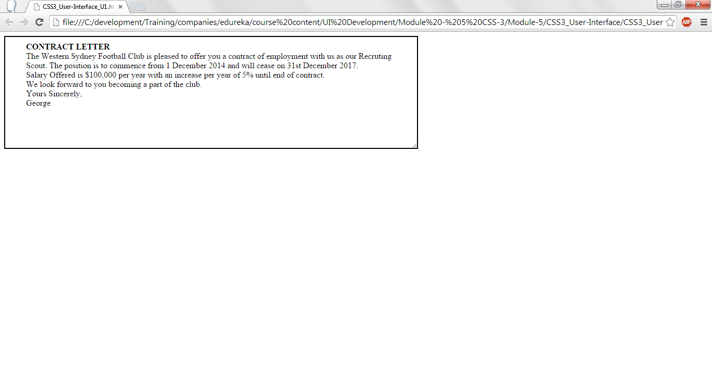
CSS3 – New UI resize.

Slide 62
Thank you!

