Slide 1
Docker

Slide 2
Docker - Introduction
Docker is a container management service. The keywords of Docker are develop, ship and run anywhere. The whole idea of Docker is for developers to easily develop applications, ship them into containers which can then be deployed anywhere.
Features of Docker
Docker has the ability to reduce the size of development by providing a smaller footprint of the operating system via containers.
With containers, it becomes easier for teams across different units, such as development, QA and Operations to work seamlessly across applications.
You can deploy Docker containers anywhere, on any physical and virtual machines and even on the cloud.
Since Docker containers are pretty lightweight, they are very easily scalable.

Slide 3
Docker – Architecture.
What is Docker daemon?
Docker daemon runs on the host operating system. It is responsible for running containers to manage docker services. Docker daemon communicates with other daemons. It offers various Docker objects such as images, containers, networking, and storage.
Docker architecture
Docker follows Client-Server architecture, which includes the three main components that are Docker Client, Docker Host, and Docker Registry.

Slide 4
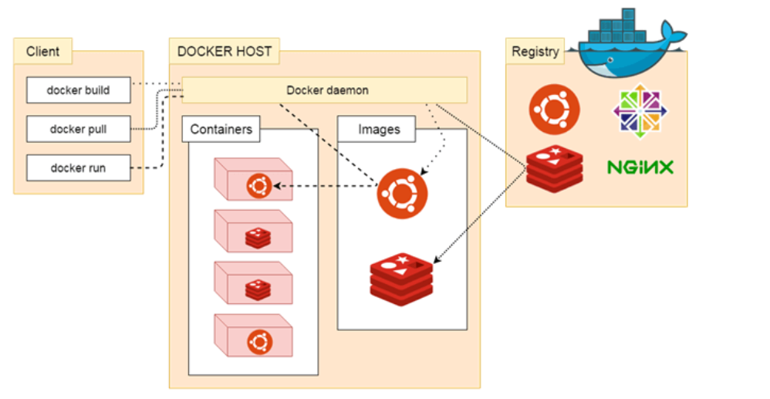
Docker – Architecture.

Slide 5
Docker – Architecture.
1. Docker Client
Docker client uses commands and REST APIs to communicate with the Docker Daemon (Server). When a client runs any docker command on the docker client terminal, the client terminal sends these docker commands to the Docker daemon. Docker daemon receives these commands from the docker client in the form of command and REST API's request.
2. Docker Host
Docker Host is used to provide an environment to execute and run applications. It contains the docker daemon, images, containers, networks, and storage.

Slide 6
Docker – Architecture.
3. Docker Registry
Docker Registry manages and stores the Docker images.
There are two types of registries in the Docker -
Pubic Registry - Public Registry is also called as Docker hub.
Private Registry - It is used to share images within the enterprise.
Docker Objects
There are the following Docker Objects -
Docker Images
Docker images are the read-only binary templates used to create Docker Containers. It uses a private container registry to share container images within the enterprise and also uses public container registry to share container images within the whole world. Metadata is also used by docket images to describe the container's abilities.
Docker Containers
Containers are the structural units of Docker, which is used to hold the entire package that is needed to run the application. The advantage of containers is that it requires very less resources.
In other words, we can say that the image is a template, and the container is a copy of that template.

Slide 7
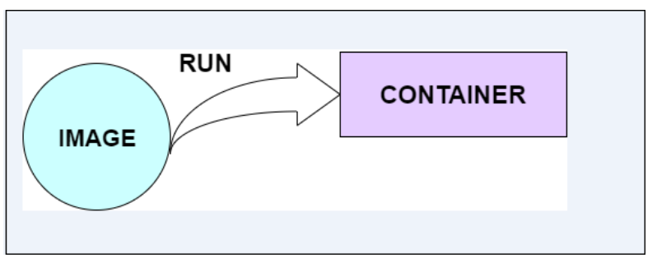
Docker – Architecture.
Image runs in a container...

Slide 8
Docker – Architecture.
Docker Networking
Using Docker Networking, an isolated package can be communicated. Docker contains the following network drivers -
Bridge - Bridge is a default network driver for the container. It is used when multiple docker communicates with the same docker host.
Host - It is used when we don't need for network isolation between the container and the host.
None - It disables all the networking.
Overlay - Overlay offers Swarm services to communicate with each other. It enables containers to run on the different docker host.
Macvlan - Macvlan is used when we want to assign MAC addresses to the containers.
Docker Storage
Docker Storage is used to store data on the container. Docker offers the following options for the Storage -
Data Volume - Data Volume provides the ability to create persistence storage. It also allows us to name volumes, list volumes, and containers associates with the volumes.
Directory Mounts - It is one of the best options for docker storage. It mounts a host's directory into a container.
Storage Plugins - It provides an ability to connect to external storage platforms.

Slide 9
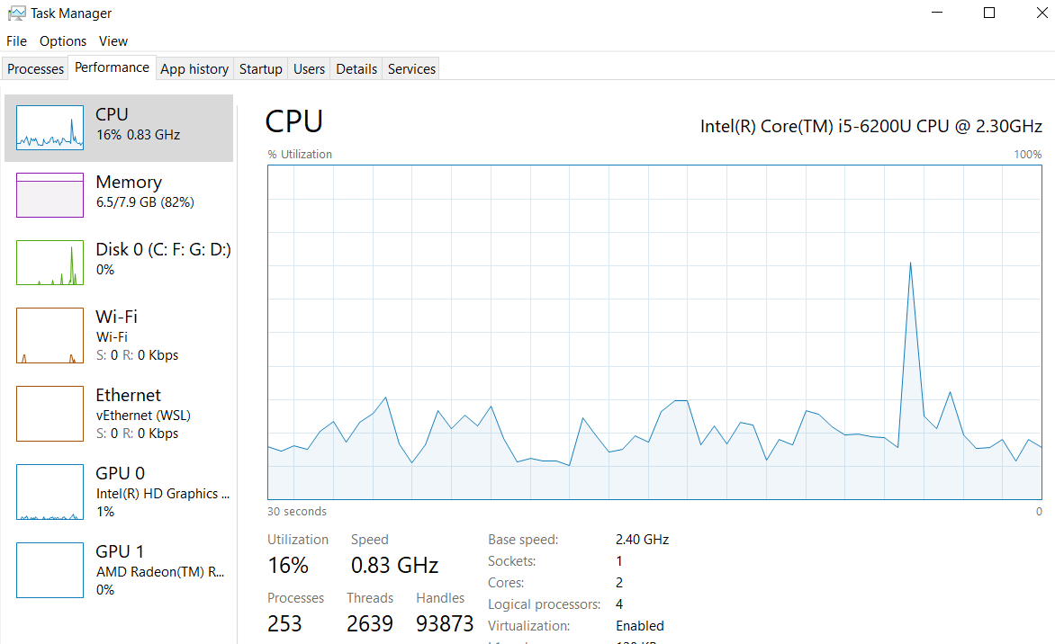
Docker - Installation
Download docker hub for desktop and install it.
Make sure that Virtualization is enabled in BIOS. After enabling, it shows as enabled in task manager. URL to follow the steps to enable to Virtulization: https://www.minitool.com/news/enable-virtualization-windows-10.html

Slide 10
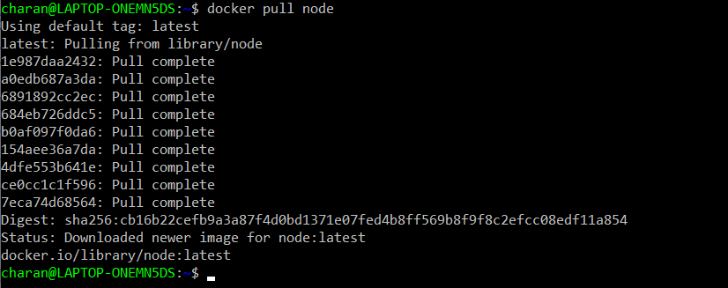
Docker – Installation and Docker hub.
Download docker desktop for windows from the link : https://docs.docker.com/desktop/install/windows-install/
After installing, create a user for docker hub.
Login with the credentials.
Docker Hub is a registry service on the cloud that allows you to download Docker images that are built by other communities. Let us download node.js from the community.
Get the node from docker dos command prompt.

Slide 11
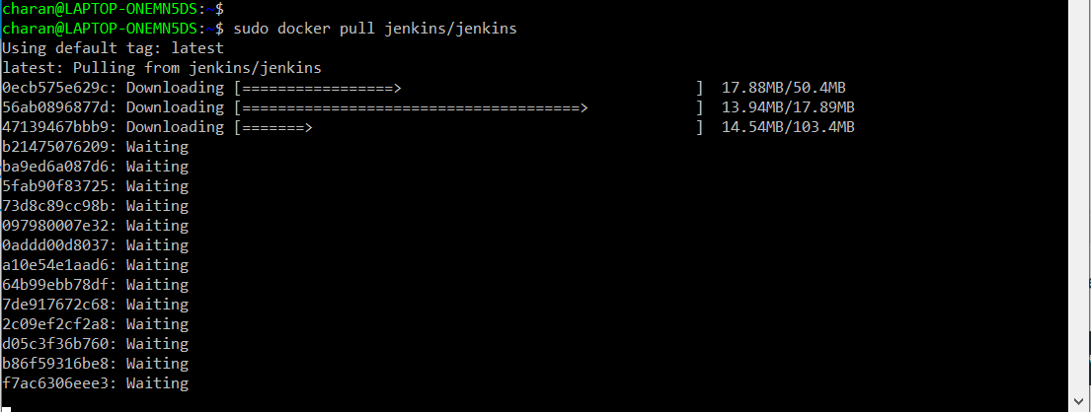
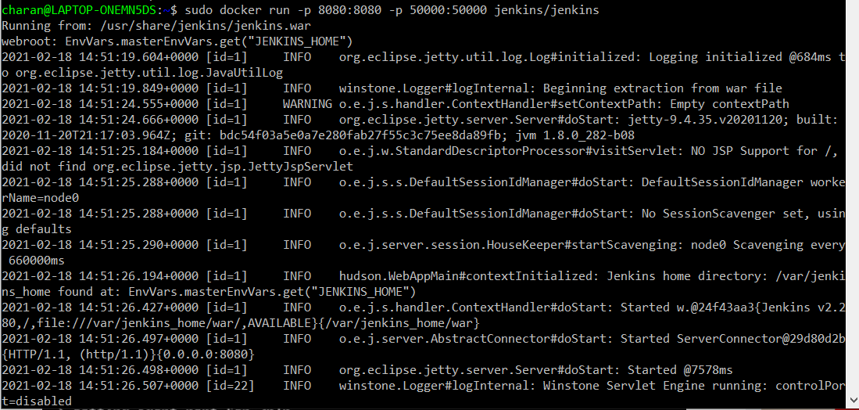
Docker hub – downloading jenkins image and run it.

Slide 12
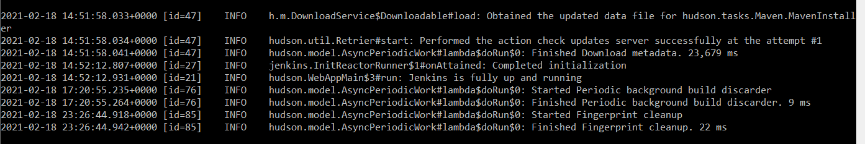
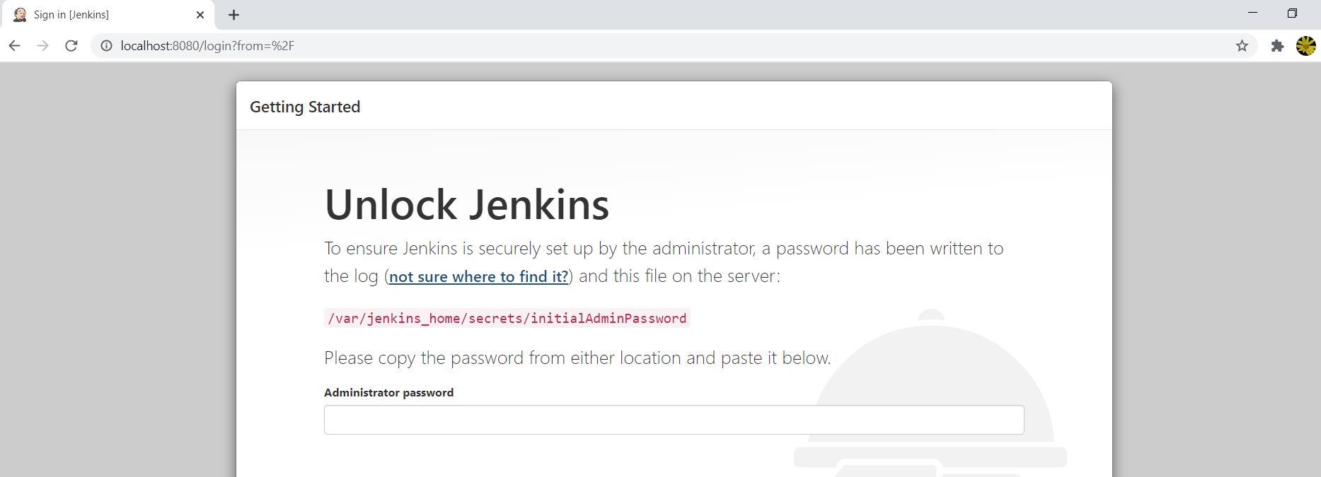
Docker – Jenkins is up and running.

Slide 13
Docker - Images
A Docker image is a read-only template that contains a set of instructions for creating a container that can run on the Docker platform.
A Docker container is a standard unit of software that stores up code and all its dependencies so the application runs fast and reliably from one computing environment to different ones.
In Docker, everything is based on Images. An image is a combination of a file system and parameters.
$ docker images → Will display all the images stored in the repository.
Docker run hello-world → Will the run the program hello-world.

Slide 14
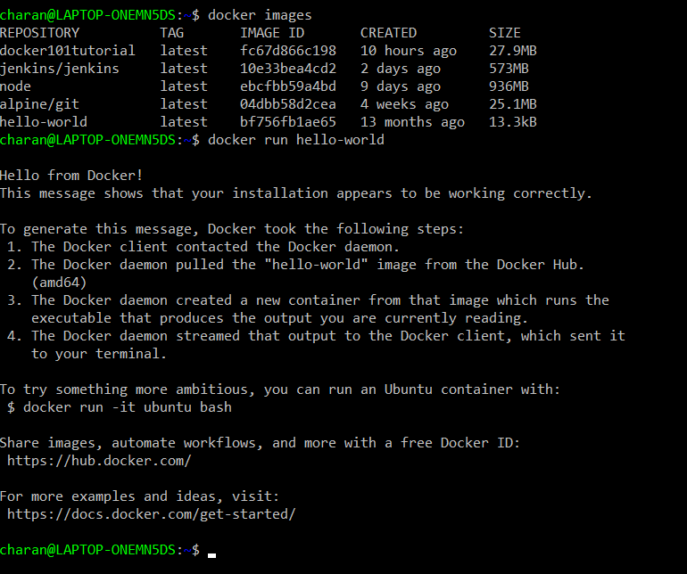
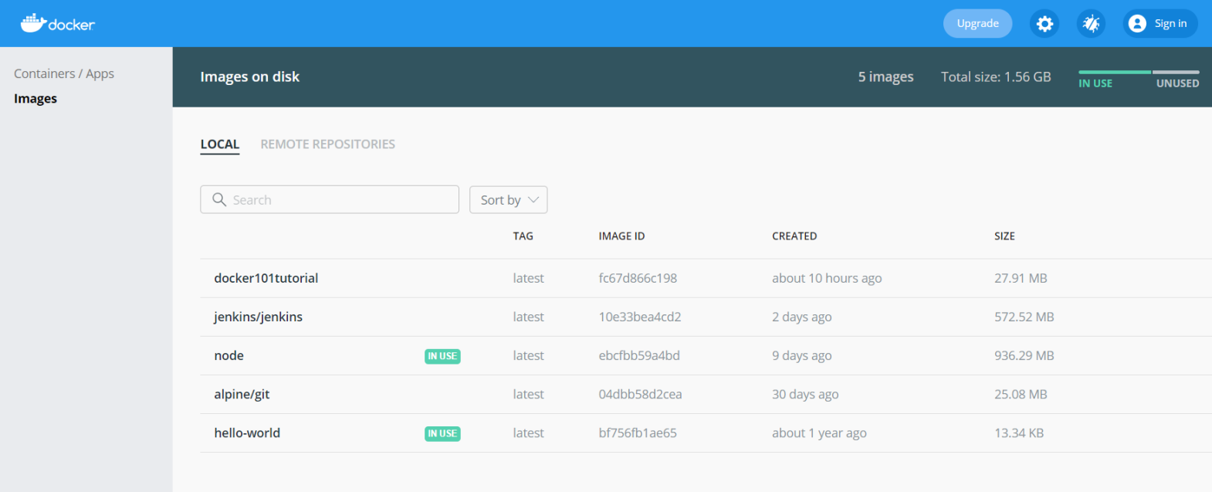
Docker - image

Slide 15
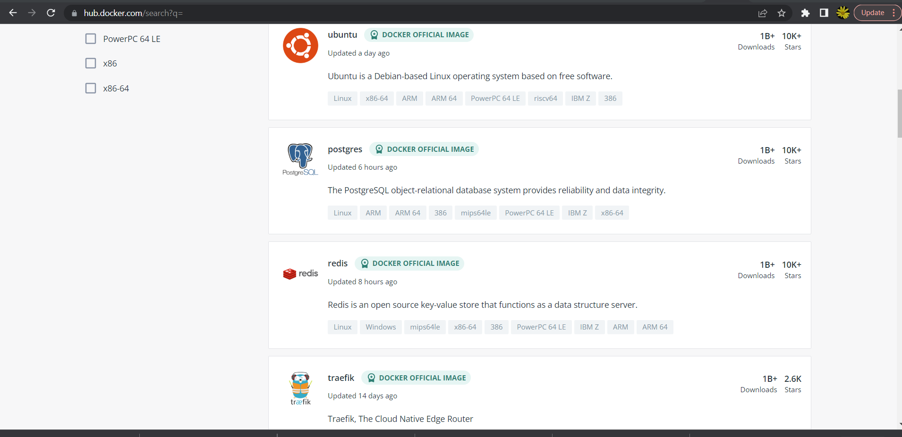
List of docker hub softwares...
To display all the docker software for downloading are :
https://hub.docker.com and click on explore menu item. Its a repoisotry which can be pulled as an image from docker hub.

Slide 16
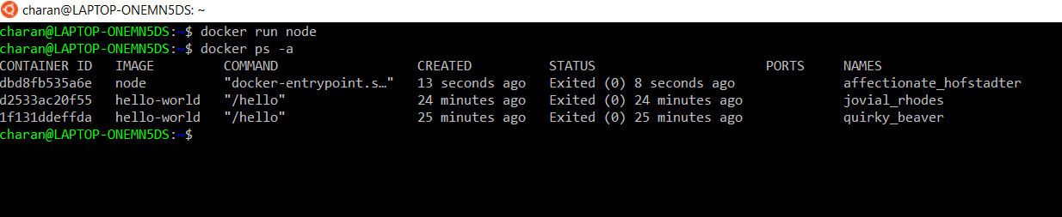
Docker - Containers
Containers are instances of Docker images that can be run using the Docker run command. The basic purpose of Docker is to run containers.
$ Docker ps –a → This commands will show all the containers in the docker hub.

Slide 17
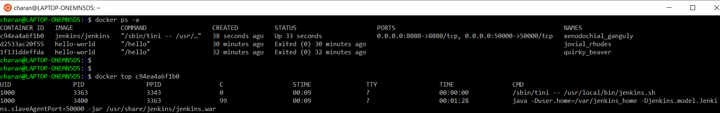
Docker – Working with containers
$ docker top <container id> → This command will show the list of processes running in that container.

Slide 18
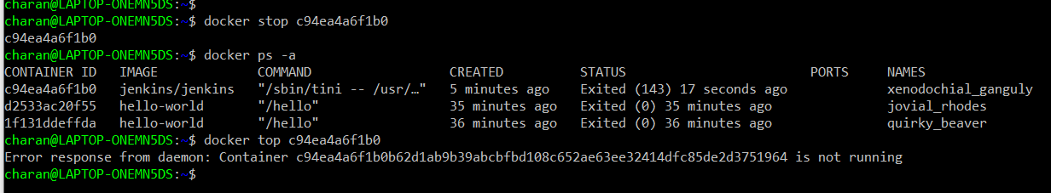
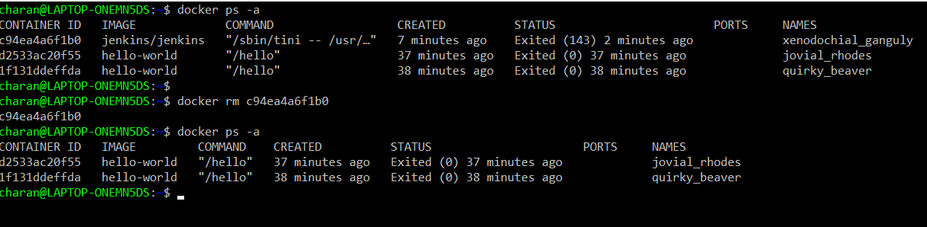
Docker – docker container commands.
$docker stop <container id> → Will stop running this container.
$docker rm <container id> → Will remove the container from the hub.

Slide 19
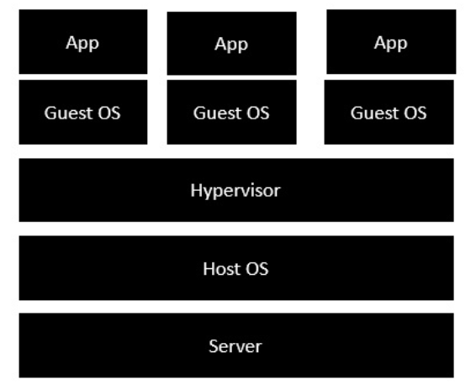
Docker – Architecture
The server is the physical server that is used to host multiple virtual machines.
The Host OS is the base machine such as Linux or Windows.
The Hypervisor is either VMWare or Windows Hyper V that is used to host virtual machines.
You would then install multiple operating systems as virtual machines on top of the existing hypervisor as Guest OS.
You would then host your applications on top of each Guest OS.

Slide 20
Docker – Public Repositories
Public repositories can be used to host Docker images which can be used by everyone else.
Visit the URL : https://hub.docker.com/ and login.
Create a repository.
Tag the image from local hub and push it in the created repository.
Result can be verified in the docker hub.
Created image can be run on a container.

Slide 21
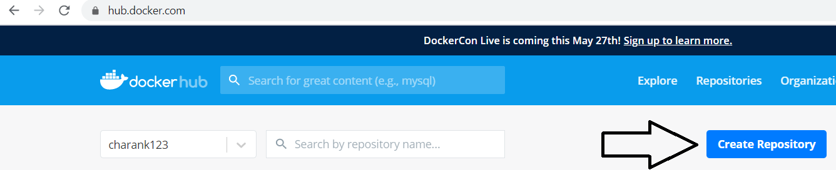
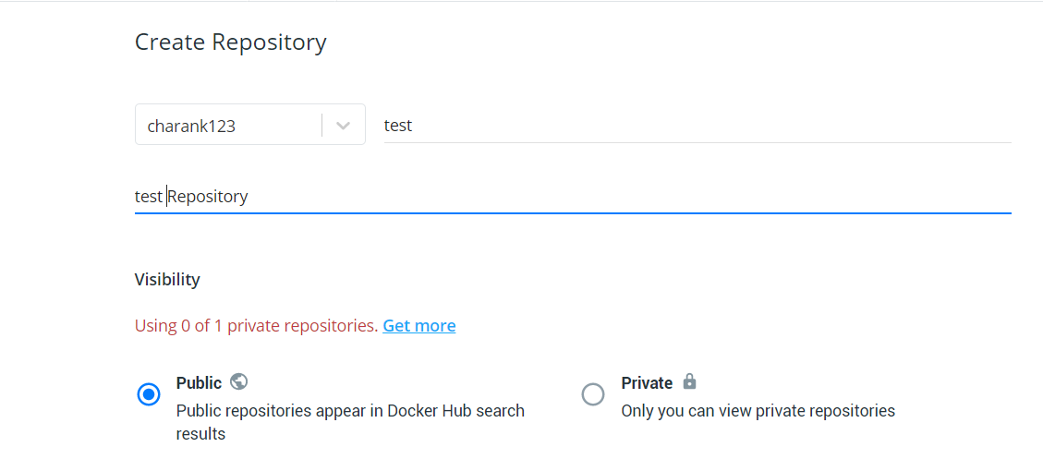
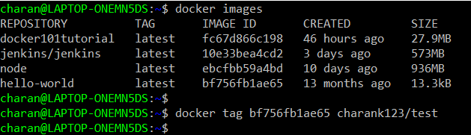
Docker – Public repository

Slide 22
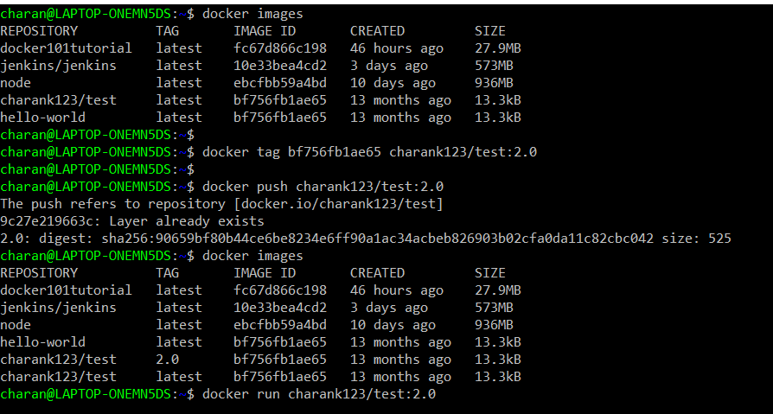
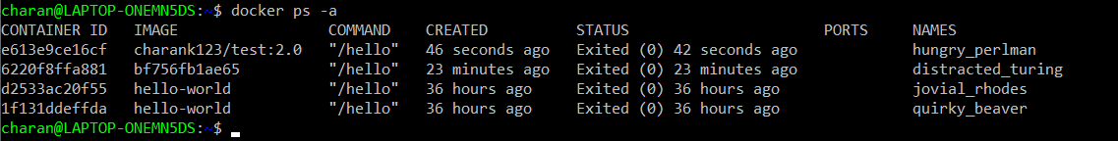

Slide 23
Docker – public repositories
$docker images → Will display all the images.
$docker tag bf756fb1ae65 charank123/test:2.0
Any image will have tag. Tag of the image can be seen in docker images command. This image tag has to be attached to created repository. Charank123 is the login, test is the name of the repository and 2.0 is the tag name.
$ docker push charank123/test:2.0
This command will push the image from local hub to test repository with a tag of 2.0
$docker images → Check whether a new image is created in test repository.
$ docker run charank123/test:2.0
This command will run the image with a tag of 2.0 under test repository in a container.

Slide 24
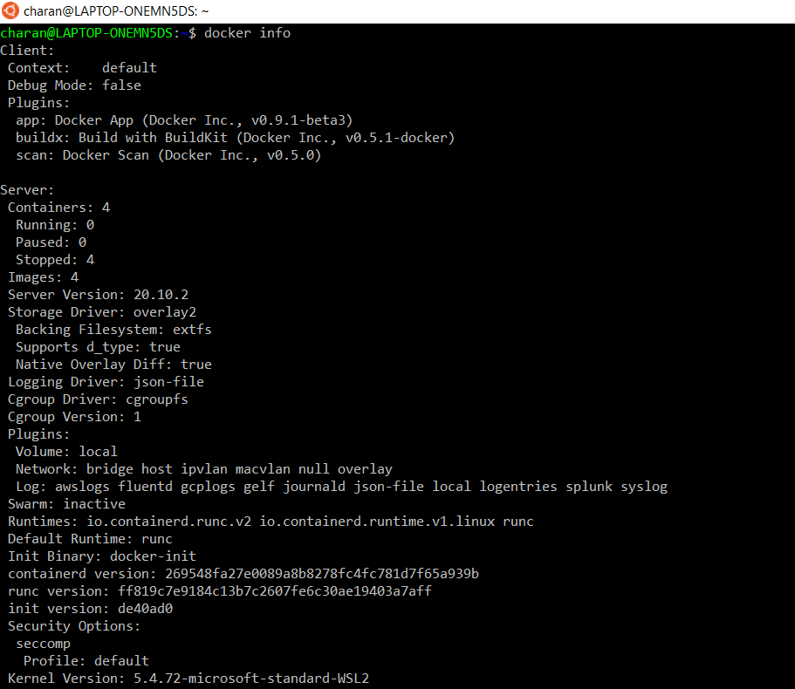
Docker - info
docker info command - displays system wide information regarding the Docker installation. Information displayed includes the kernel version, number of containers and images. The number of images shown is the number of unique images. The same image tagged under different names is counted only once.

Slide 25
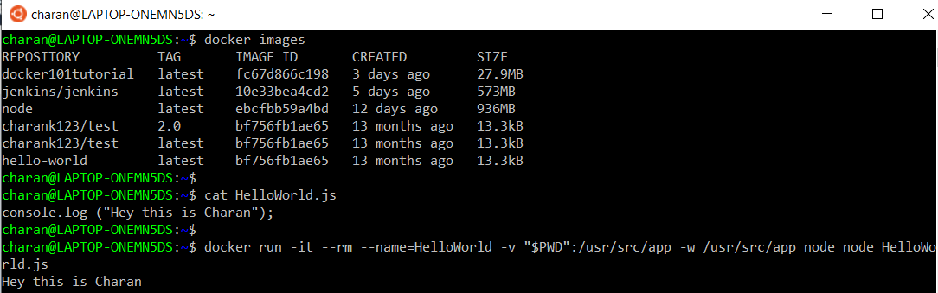
Docker – Setting Node.js
Pull the node image.
After that verify using the command docker images.
Create a HelloWorld.js and type the code.
Run this file in the node container.

Slide 26
Docker – run HelloWorld.js file.
$ docker run -it --rm --name=HelloWorld -v "$PWD":/usr/src/app -w /usr/src/app node node HelloWorld.js
-it – Runs in interactive mode.
-rm – Removes the node from container after running the code.
--name=HelloWorld → Giving the name “HelloWorld” to the container.
"$PWD":/usr/src/app → Setting the present working directory as /usr/src/app.
-w → Working directory used by node.js
First node is used to run the node image.
Second node is used to run the node and HelloWorld.js in the node container.

Slide 27
Docker - Cloud
The Docker Cloud is a service provided by Docker in which you can carry out the following operations −
Nodes − You can connect the Docker Cloud to your existing cloud providers such as Azure and AWS to spin up containers on these environments.
Cloud Repository − Provides a place where you can store your own repositories.
Continuous Integration − Connect with Github and build a continuous integration pipeline.
Application Deployment − Deploy and scale infrastructure and containers.
Continuous Deployment − Can automate deployments.

Slide 28
Docker – Continuous Integration
Docker has integrations with many Continuous Integrations tools, which also includes the popular CI tool known as Jenkins. Within Jenkins, you have plugins available which can be used to work with containers.

Slide 29
Docker – Kubernetes Architecture

Slide 30
Docker – Working of Kubernetes

Slide 31
Docker – CLI
All the docker commands can be seen in this site: https://docs.docker.com/engine/reference/commandline/docker/

Slide 32
Thank you!!

