Slide 1
Jenkins

Slide 2
What is Jenkins
Jenkins is an open source automation tool written in Java programming language that allows continuous integration.
Jenkins builds and tests our software projects which continuously making it easier for developers to integrate changes to the project, and making it easier for users to obtain a fresh build.
It also allows us to continuously deliver our software by integrating with a large number of testing and deployment technologies.

Slide 3
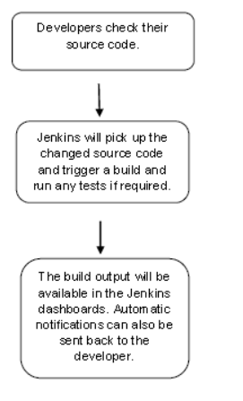
Steps in Jenkins
Possible steps executed by Jenkins are for example:
Perform a software build using a build system like Gradle or Maven Apache
Execute a shell script
Archive a build result
Running software tests.

Slide 4
History of Jenkins
Kohsuke Kawaguchi, who is a Java developer, working at SUN Microsystems, was tired of building the code and fixing errors repetitively. In 2004, he created an automation server called Hudson that automates build and test task.
In 2011, Oracle who owned Sun Microsystems had a dispute with Hudson open source community, so they forked Hudson and renamed it as Jenkins.
Both Hudson and Jenkins continued to operate independently. But in short span of time, Jenkins acquired a lot of contributors and projects while Hudson remained with only 32 projects. Then with time, Jenkins became more popular, and Hudson is not maintained anymore.

Slide 5
What is Contineous Integration (CI)
Continuous Integration (CI) is a development practice in which the developers are needs to commit changes to the source code in a shared repository at regular intervals. Every commit made in the repository is then built. This allows the development teams to detect the problems early.
Continuous integration requires the developers to have regular builds. The general practice is that whenever a code commit occurs, a build should be triggered.

Slide 6
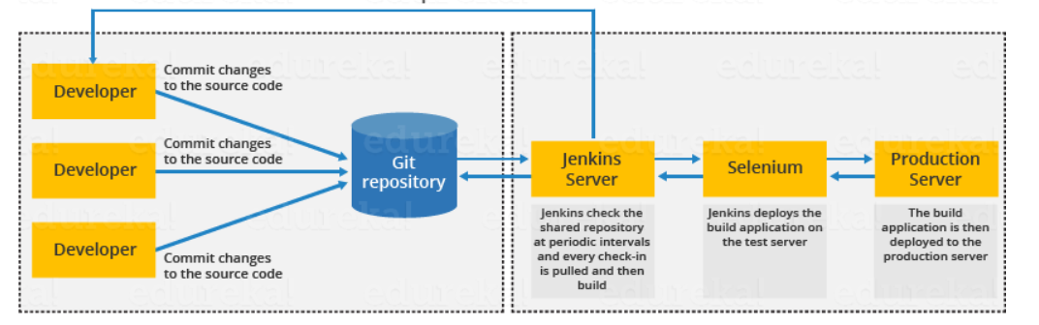
How Jenkins builds the code.
First of all, a developer commits the code to the source code repository. Meanwhile, the Jenkins checks the repository at regular intervals for changes.
Soon after a commit occurs, the Jenkins server finds the changes that have occurred in the source code repository. Jenkins will draw those changes and will start preparing a new build.
If the build fails, then the concerned team will be notified.
If built is successful, then Jenkins server deploys the built in the test server.
After testing, Jenkins server generates a feedback and then notifies the developers about the build and test results.
It will continue to verify the source code repository for changes made in the source code and the whole process keeps on repeating.

Slide 7
Benefits of Jenkins
It is an open source tool.
It is free of cost.
It does not require additional installations or components. Means it is easy to install.
Easily configurable.
It supports 1000 or more plugins to ease your work. If a plugin does not exist, you can write the script for it and share with community.
It is built in java and hence it is portable.
It is platform independent. It is available for all platforms and different operating systems. Like OS X, Windows or Linux.
Easy support, since it open source and widely used.
Jenkins also supports cloud based architecture so that we can deploy Jenkins in cloud based platforms.

Slide 8
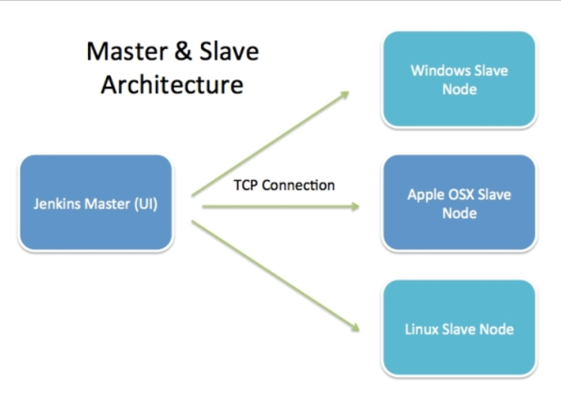
Jenkins Architecture

Slide 9
Jenkins Master
The main server of Jenkins is the Jenkins Master. It is a web dashboard which is nothing but powered from a war file. By default it runs on 8080 port. With the help of Dashboard, we can configure the jobs/projects but the build takes place in Nodes/Slave. By default one node (slave) is configured and running in Jenkins server.
The server's job or master's job is to handle:
Scheduling build jobs.
Dispatching builds to the nodes/slaves for the actual execution.
Monitor the nodes/slaves (possibly taking them online and offline as required).
Recording and presenting the build results.
A Master/Server instance of Jenkins can also execute build jobs directly.

Slide 10
Jenkins Slave
Jenkins slave is used to execute the build jobs dispatched by the master. We can configure a project to always run on a particular slave machine, or particular type of slave machine, or simple let the Jenkins to pick the next available slave/node.
As we know Jenkins is developed using Java is platform independent thus Jenkins Master/Servers and Slave/nodes can be configured in any servers including Linux, Windows, and Mac.

Slide 11
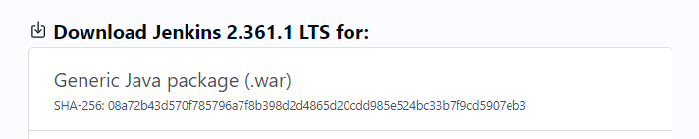
Jenkins Installation
Please ensure Java is already installed on your system.
Download jenkins from this site: http://www.jenkins.io/download/ and click on download button,.
Download Generic Java Package (war file) -->

Slide 12
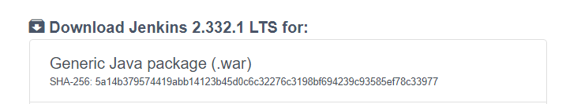
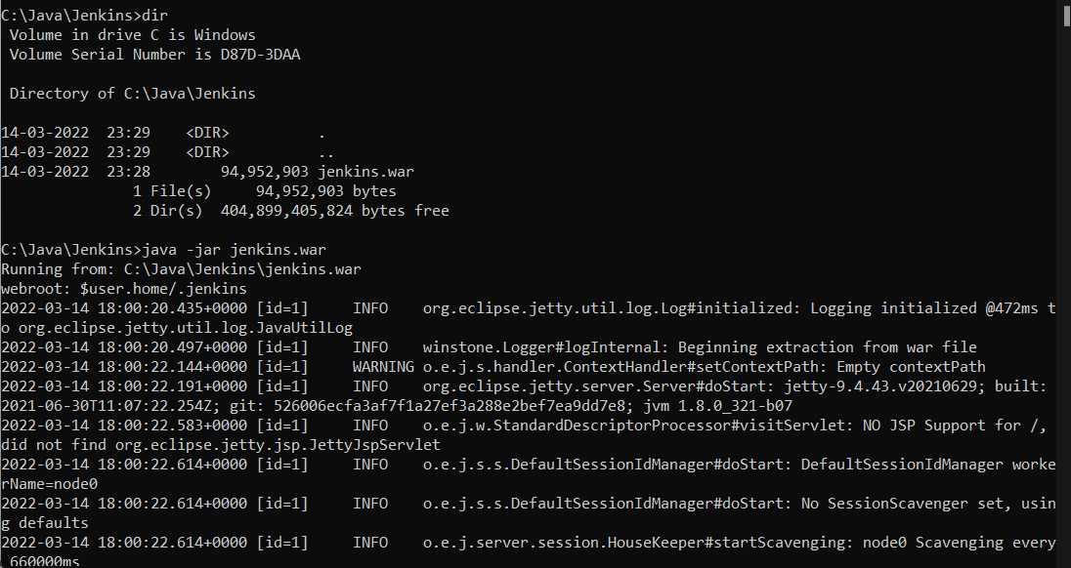
Jenkins Installation
Select
And it starts downloading automatically.
Copy this war file into a newly created folder named jenkins and run the following command : java -jar jenkins.war

Slide 13
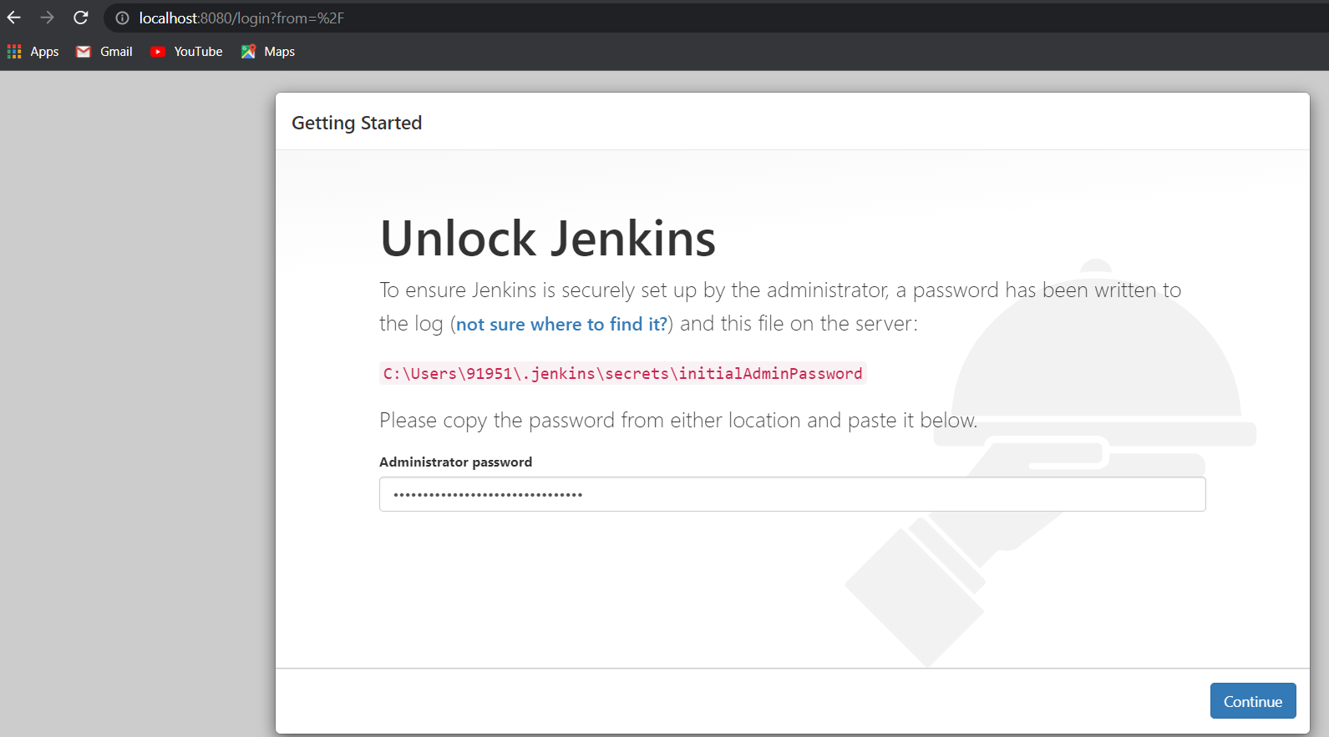
Jenkins Installation
When the jenkins is opened in the browser, it shows the following. Enter the password generated by the intstallation and select the first option of installation that is “most suited for industry”

Slide 14
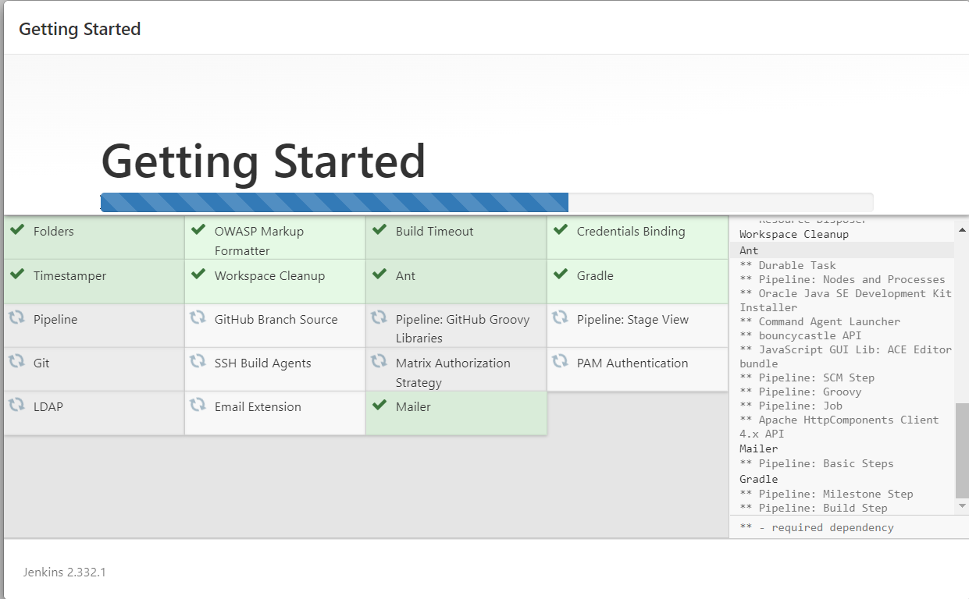
Jenkins will install these modules...

Slide 15
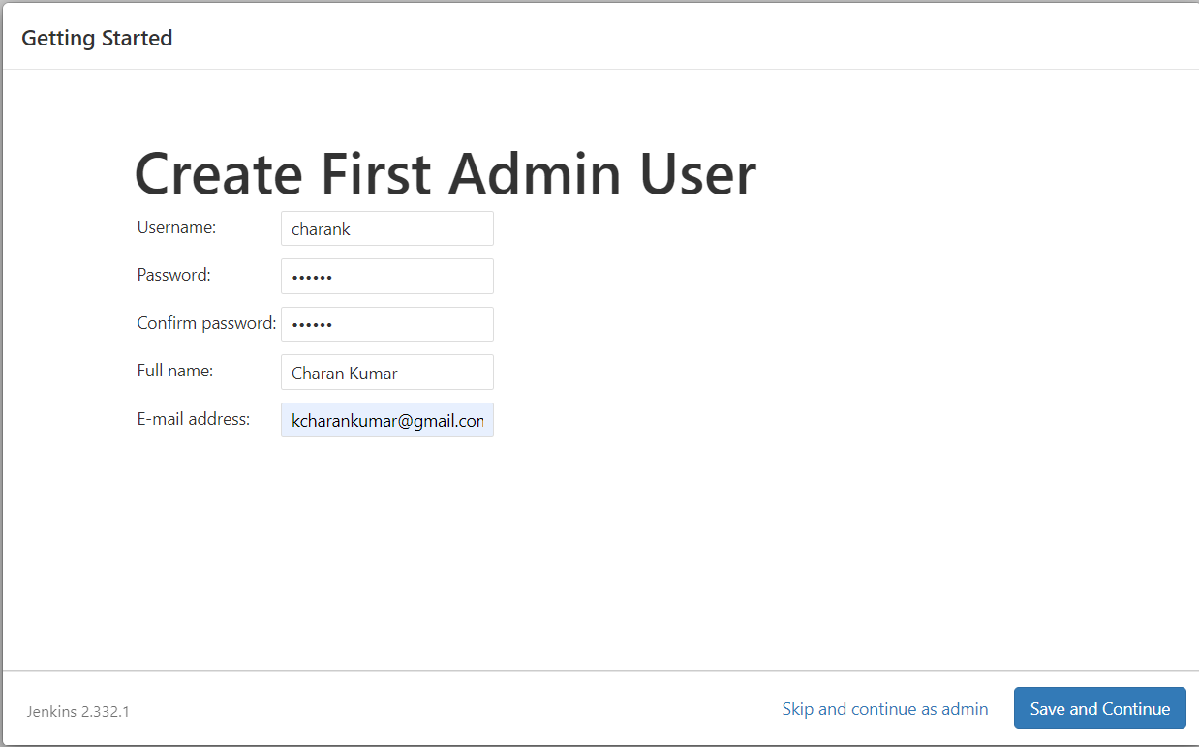
Registering a new user in jenkins.
Click on Save and Finish on configuration screen.

Slide 16
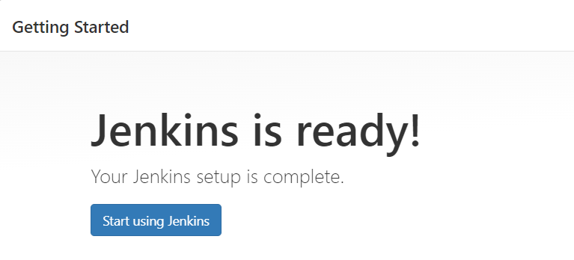
Jenkins installation is done and it is ready to use.

Slide 17
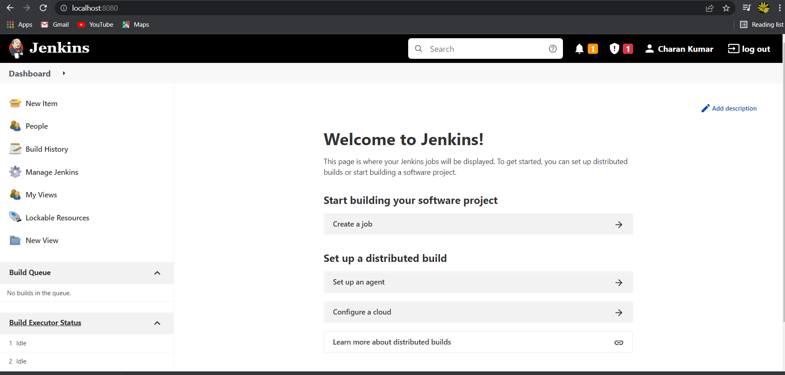
Jenkins dashboard looks like this.

Slide 18
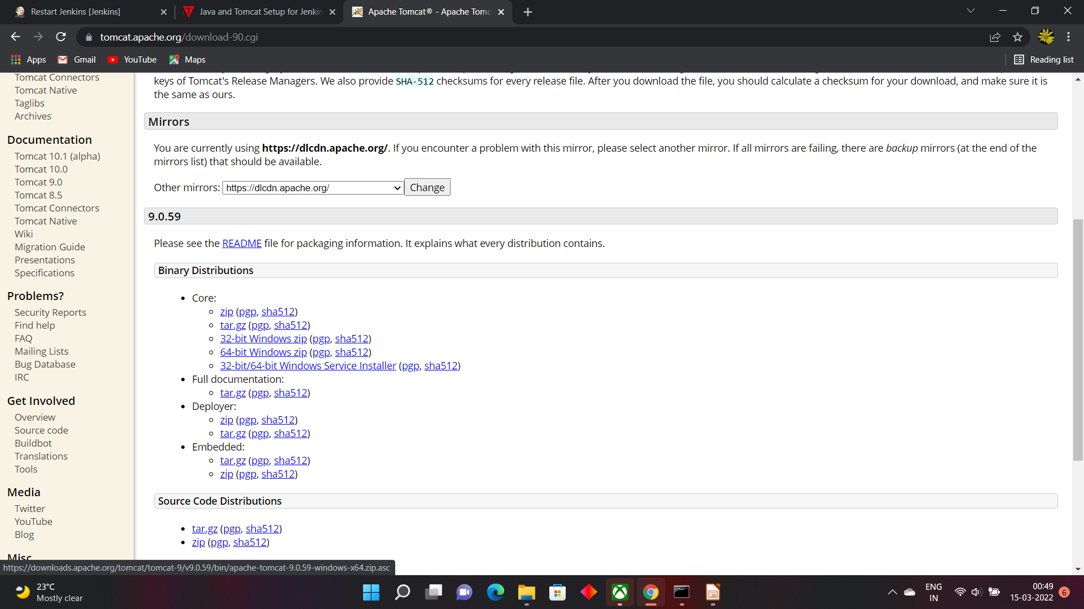
Install Tomcat for Jenkins
Go to tomcat site https://tomcat.apache.org/
and download tomcat binaries 64 bit zip.

Slide 19
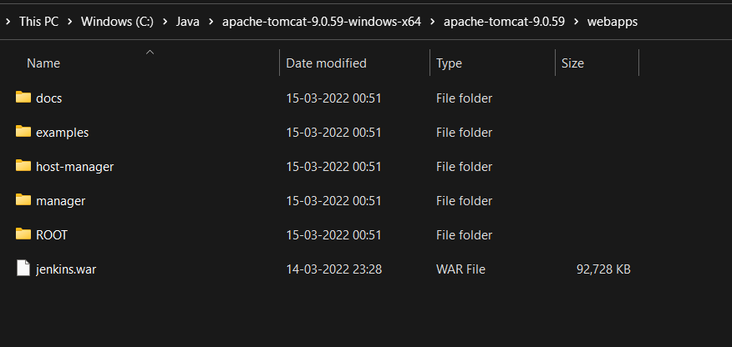
Install Tomcat for Jenkins
Unzip apache tomcat into a directory.
Go to WebApps directory of Apache Tomcat and copy jenkins.war over there.
Ensure the environmental variable JAVA_HOME is set. If not, set it.
From the bin directory, give the command startup.bat. With that apache tomcat is started and along with that jenkins also is started.

Slide 20
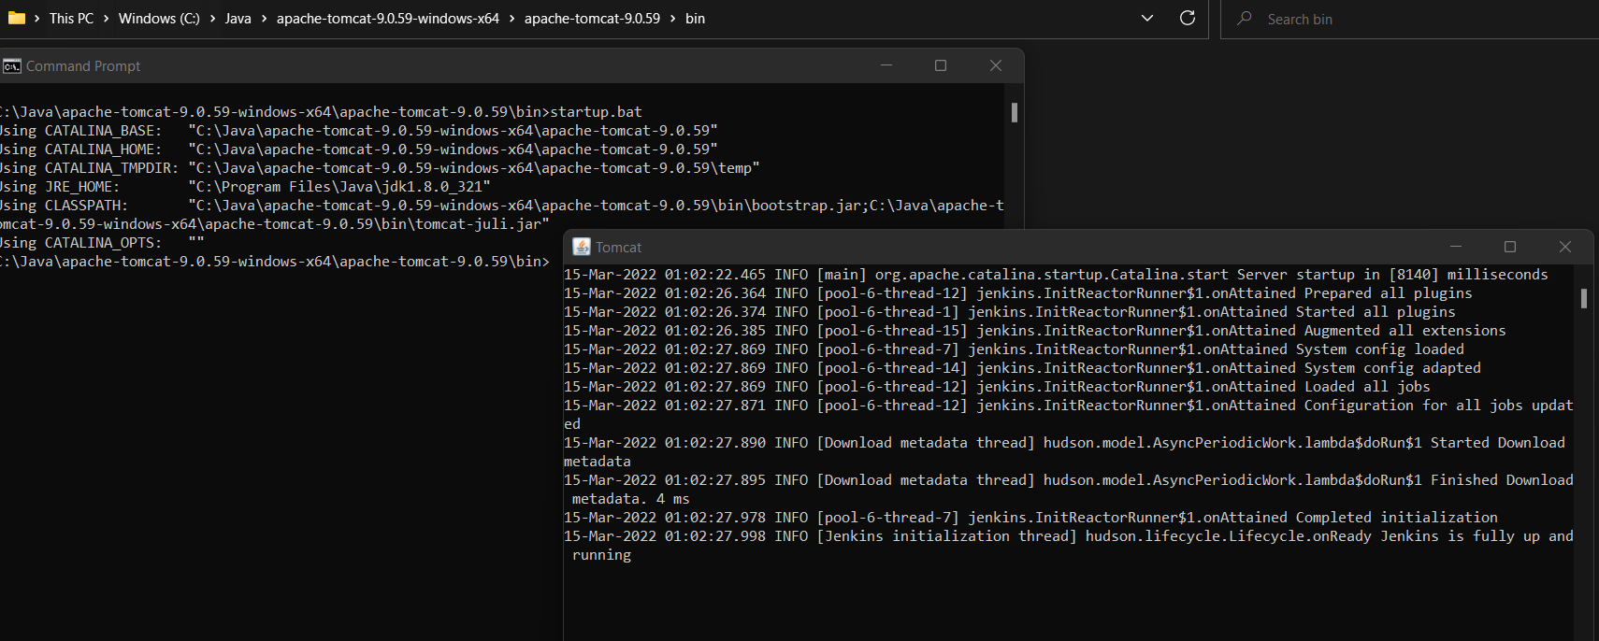
Install Tomcat for Jenkins

Slide 21
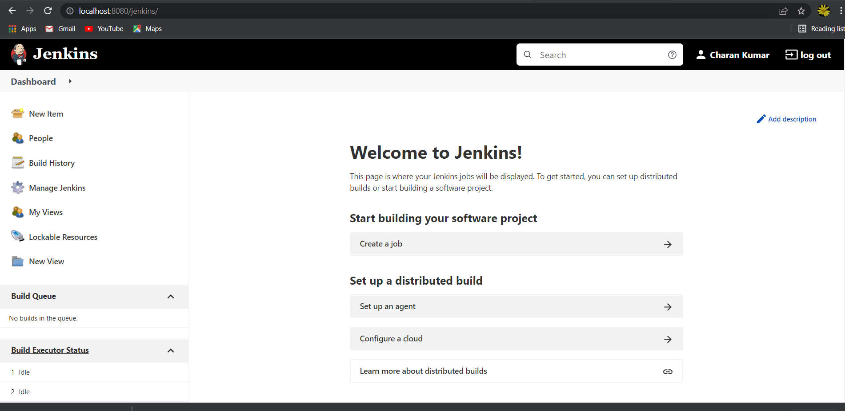
Install Tomcat for Jenkins
Jenkins dashboard can be started with http://localhost:8080/jenkins

Slide 22
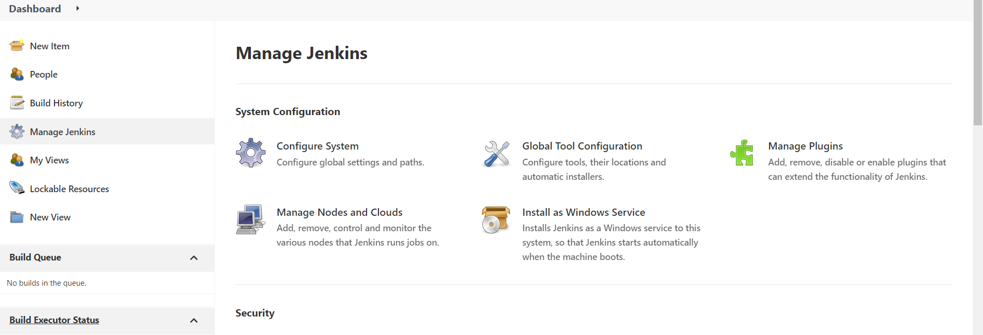
Git hub setup in Jenkins.
Click on Manage Jenkins in the main dashboard and click on Manage Plugins

Slide 23
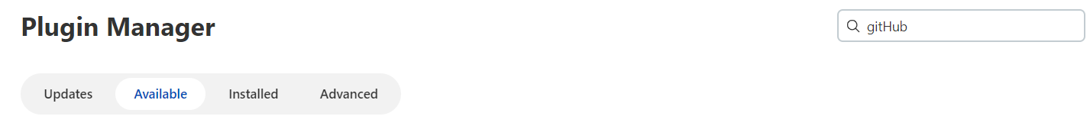
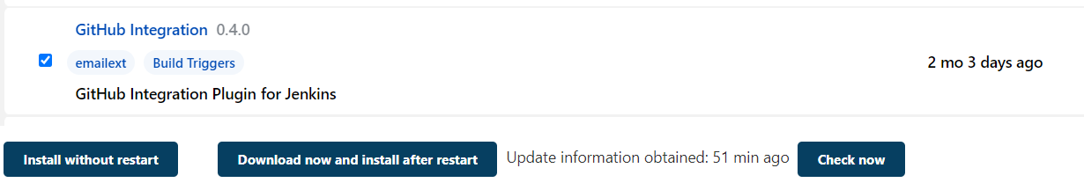
Git hub setup in Jenkins.
Click on Available tab and enter github and

Slide 24
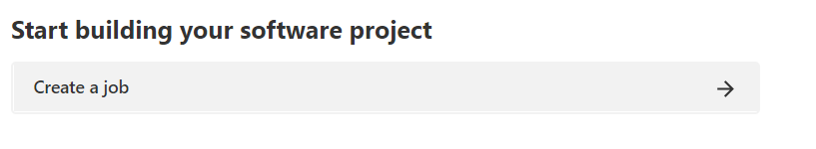
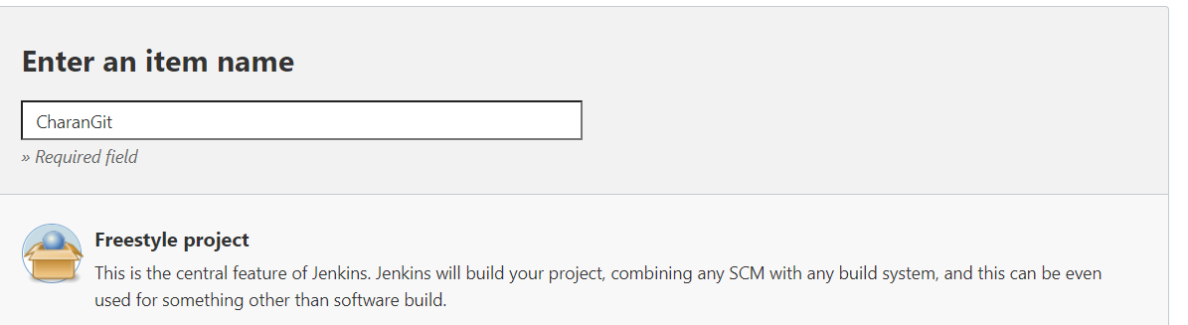
Git hub setup in Jenkins.
From the jenkins dashboard, select create a job.
Enter a name and select Free Style Project.

Slide 25
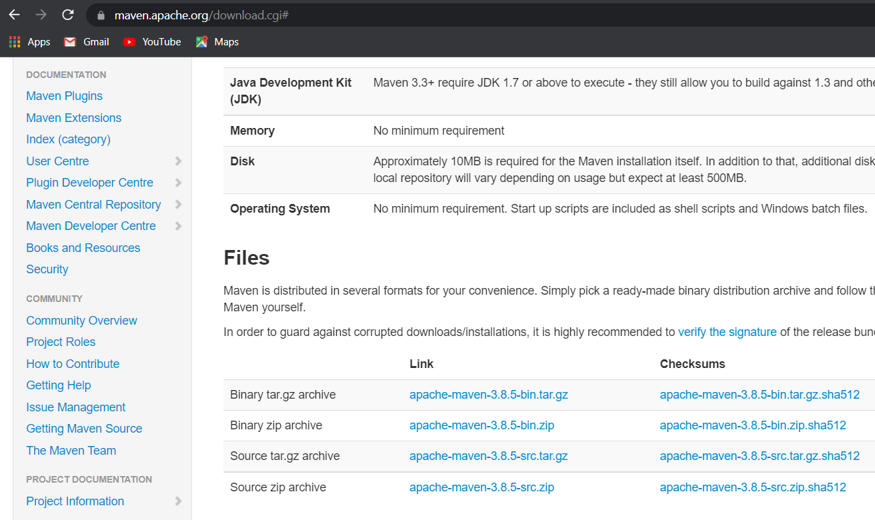
Maven setup in Jenkins.
Goto the url maven.apache.org and click on donwload and download the binaries in zip format. After downloading, extract to maven directory.

Slide 26
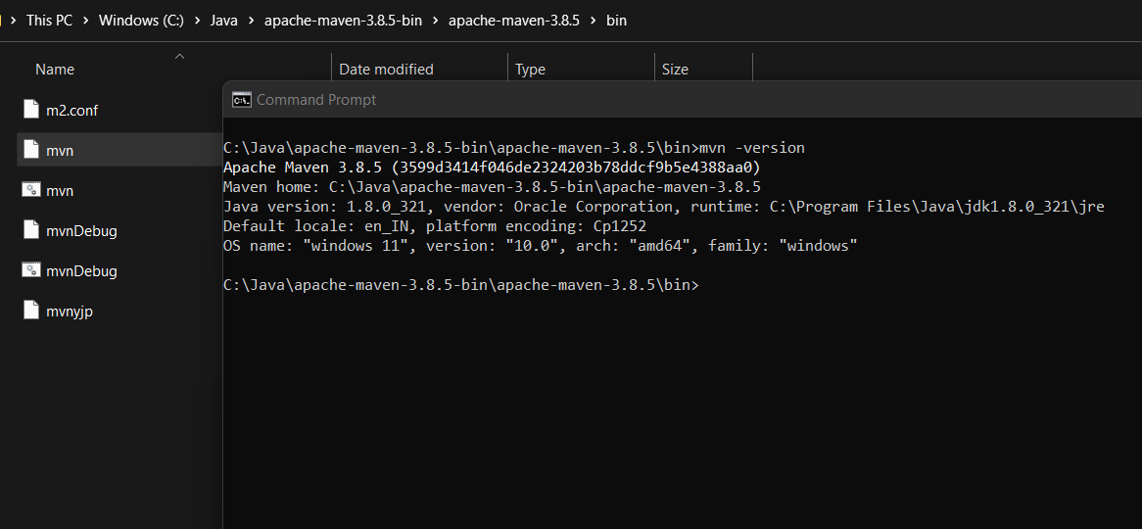
Maven setup in Jenkins.
Given mvn -version in the command prompt by going to bin directory of maven.

Slide 27
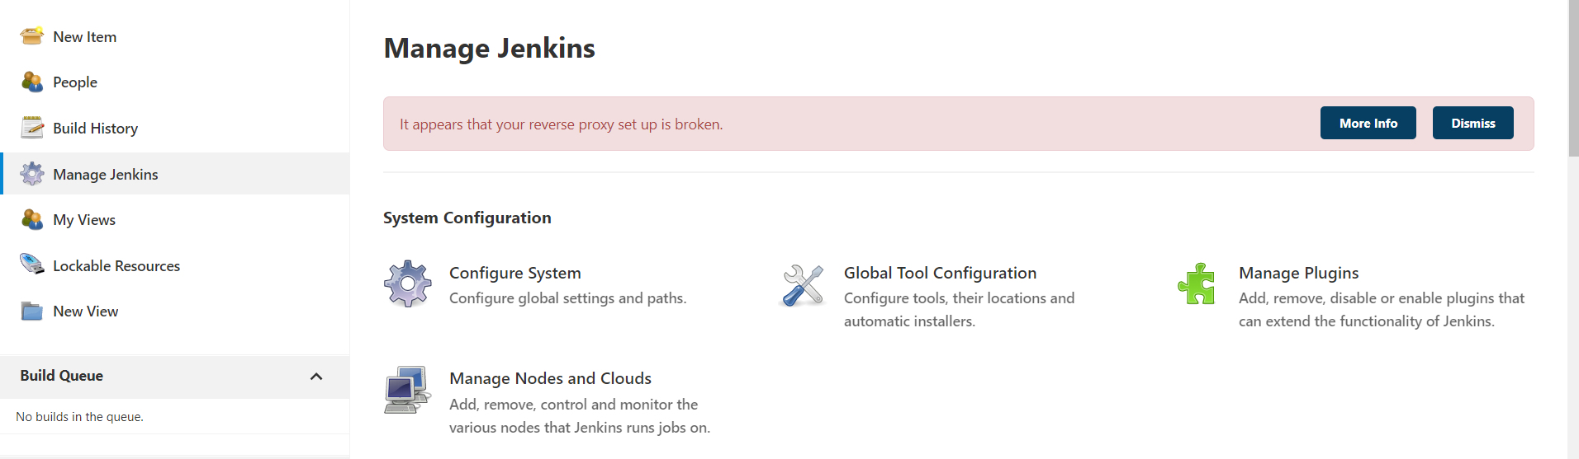
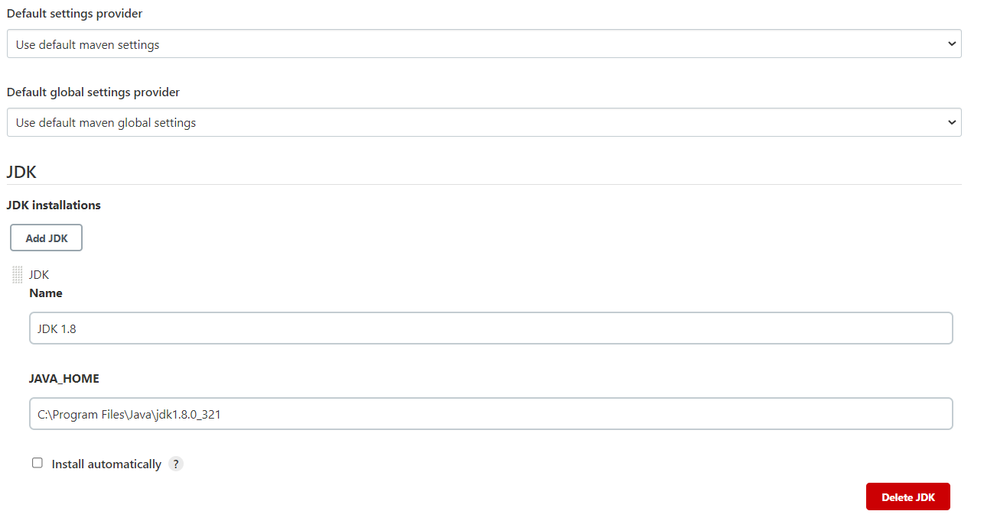
Maven setup in Jenkins.
Select Global Tool Configuration in Main Dashboard.
Add JDK information:

Slide 28
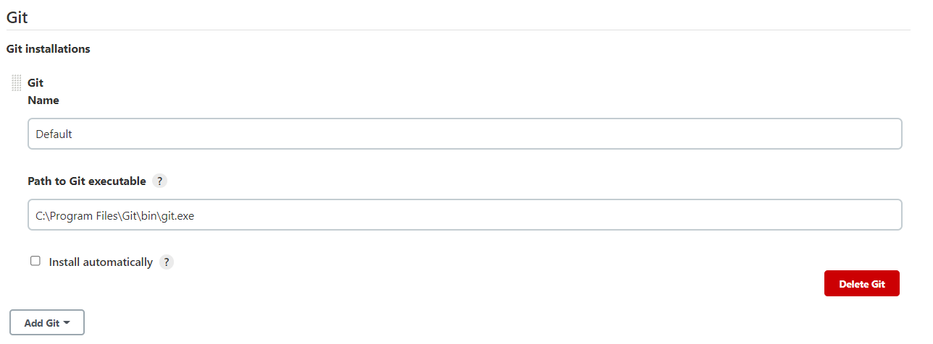
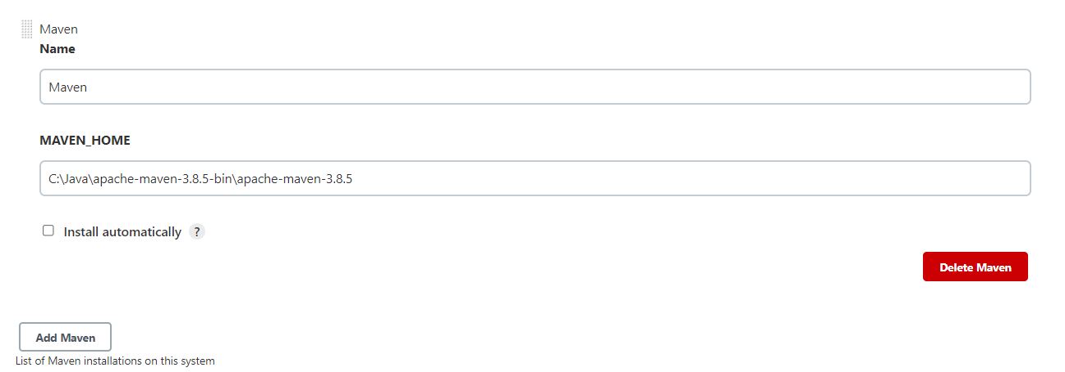
Maven setup in Jenkins.
Add git information:
Add Maven information:

Slide 29
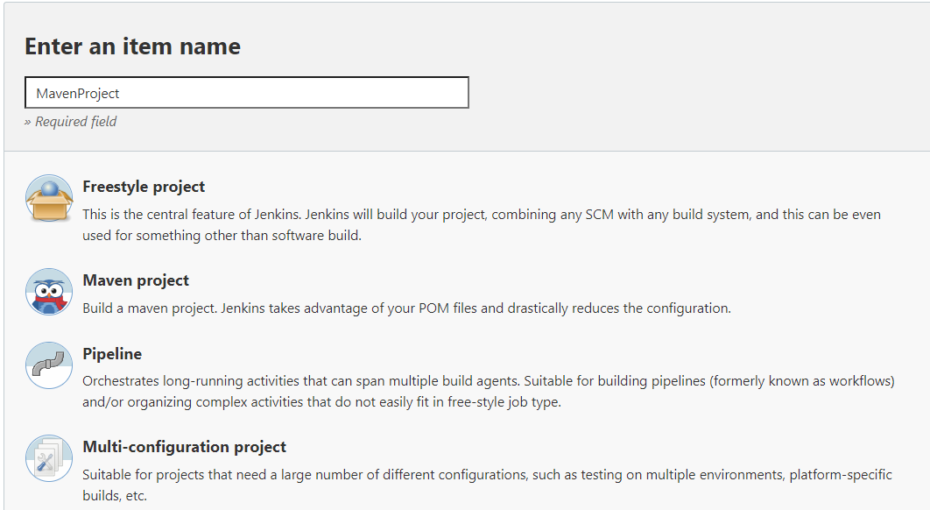
Maven setup in Jenkins.
If Maven is not seen as part of build then install maven plug-in by going to Manage Plugins –> Aavailable --> Entet Maven in find --> Select the Maven plugin and install it.
Select New Item from Dashboard and enter Name as MavenProject and Select Maven Project is the option.
Enter All the required information about enter pom.xml locaiton in Root POM and click on OK.

Slide 30
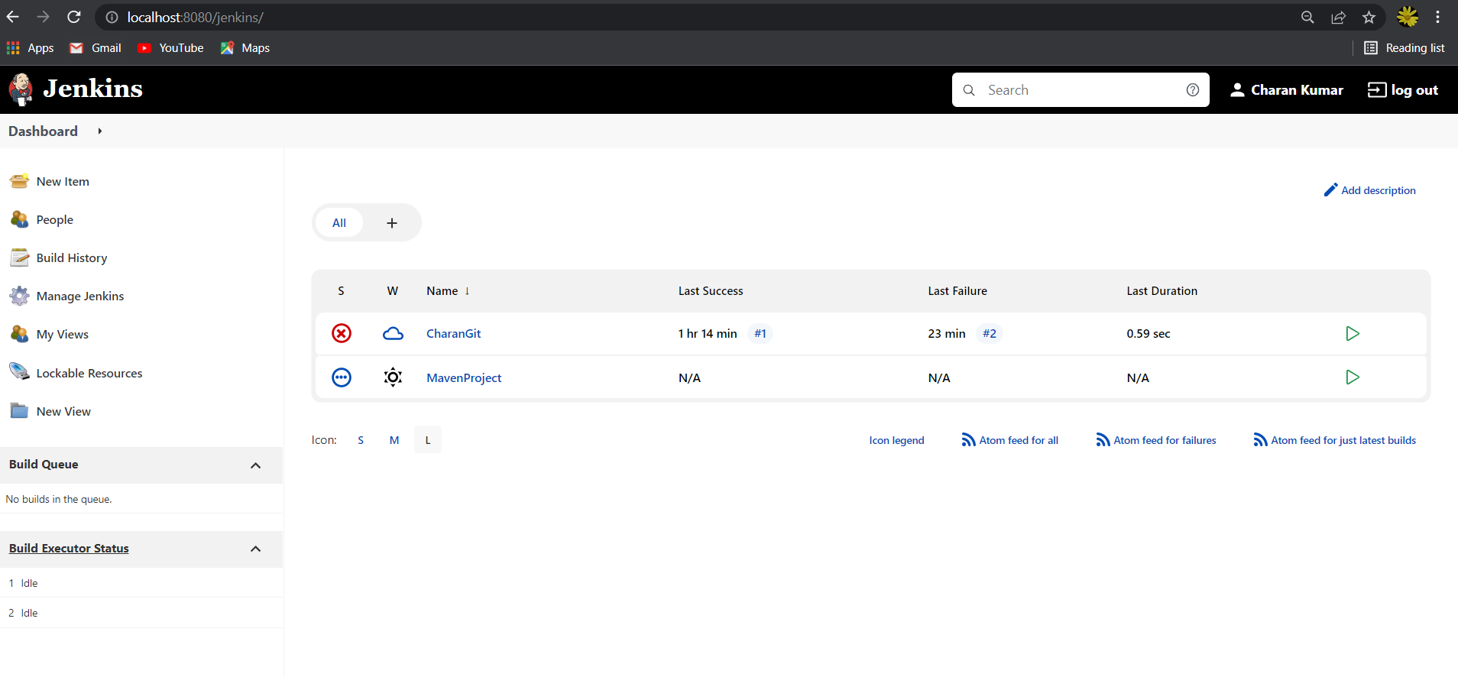
Jenkins Dashboard.
After adding the projects for Git and Maven, the dashboard looks like this:

Slide 31
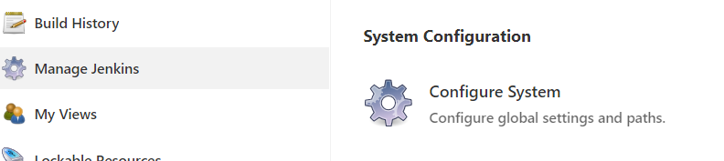
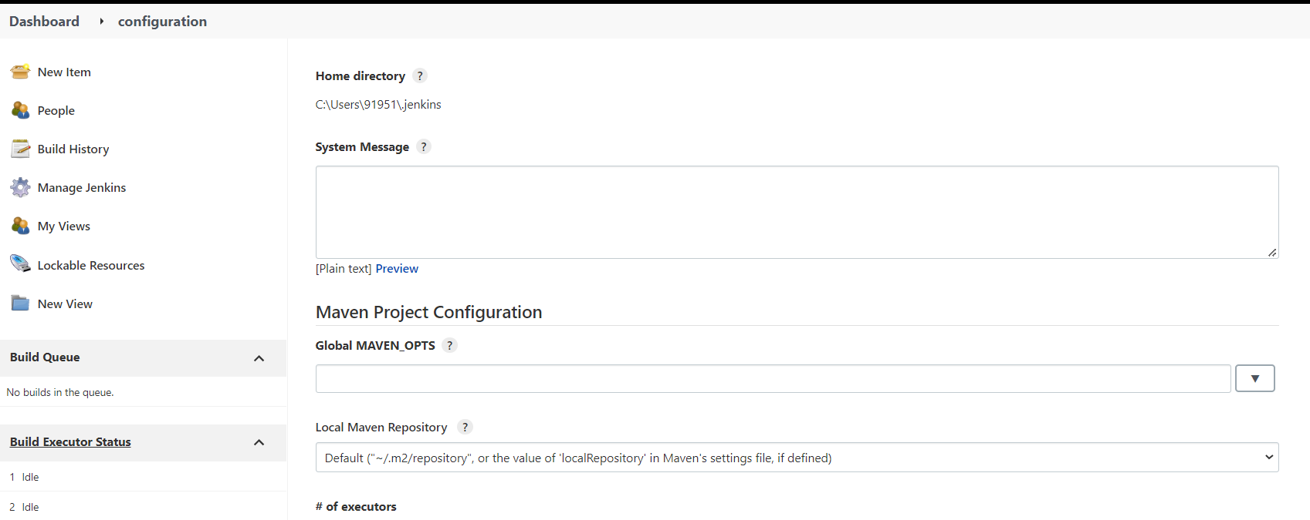
Jenkins Configuration.
From the dashboard, click on Manage Jenkins and select Configure System.
This has all the configuration information about Jenkins.

Slide 32
Jenkins Management.
When Manage Jenkins is clicked on the left hand side of the dashboard, following options are displayed.
(1)Configuration System – It is used to configure Jenkins Locaiton, Setting up variables, Setting up Email Servers and many more.
(2) Global Tool Configuration – It sets up the installed location for JDK, GIT and Maven.
(3) Manage Plugin – New Plugins can be added/deleted and updated.
(4) Manage Node and clouds – For the management of new Nodes.
(5) Security – Configure Global Security -
(6) Security – Manage Credentials -
(7) Security – Configure credential Providers.
(8) Security – Manage Users
(9) Status – System Information – Provides the environmental information like env variables etc., Helps for troubleshooting.
(10) Status – System Log – Logs the information from java.util.Logging.
(11) Status – Load Statiscs – Gives the information about how much the system is loaded.
(12) Status – About Jenkins.
(13) Manage Old Data.
(14) Some more tools and actoins.

Slide 33
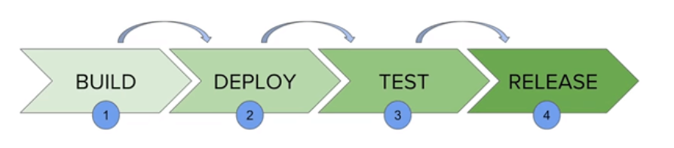
Jenkins - Pipeline
In Jenkins, a pipeline is a collection of events or jobs which are interlinked with one another in a sequence.
It is a combination of plugins that support the integration and implementation of continuous delivery pipelines using Jenkins.
These are phases of the build. i.e., the build the project, deploy on server, Test it with selenium and Release it to the customer. In each phase some action to be taken. A build script or Jenkins script file is created so that each phase action is taken and goes to the next action / next phase of action.
A pipeline can be created in the following manner.
Select the create a new job, give a name and select a pipeline.

Slide 34
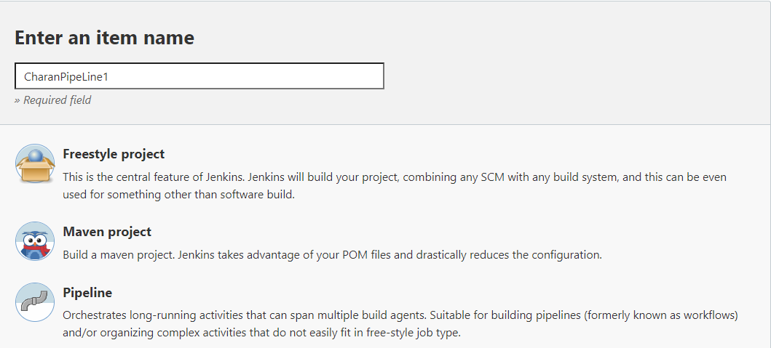
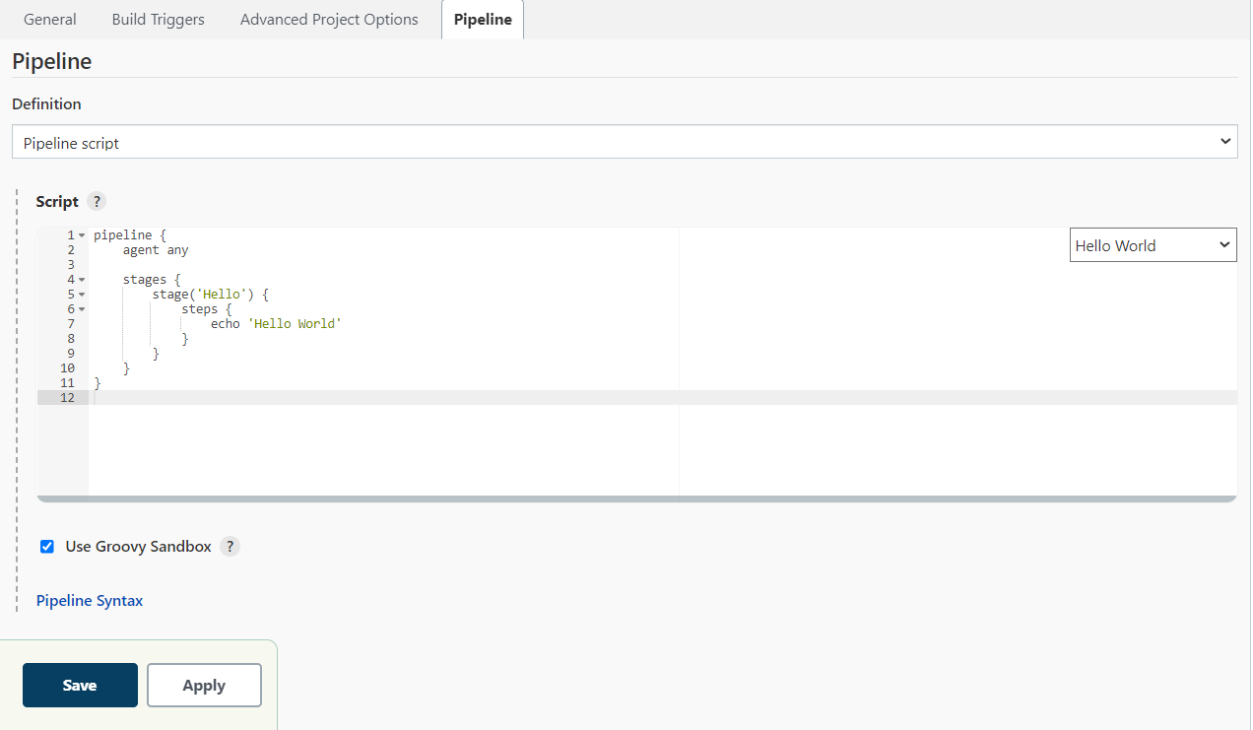
Jenkins - Pipeline
Jenkins pipeline script for hello world is given :

Slide 35
Jenkins - Pipeline
Format of the Jenkins pipeline file is
pipeline {
agent any
stages {
stage ('Build') {
...
}
stage ('Test') {
...
}
stage ('QA') {
...
}
stage ('Deploy') {
...
}
stage ('Monitor') {
...
}
}
}

Slide 36
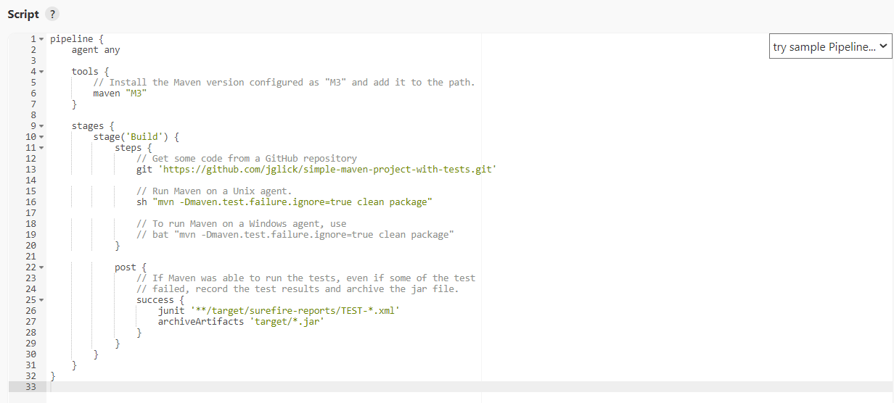
Jenkins - Pipeline
Sample build script for github and maven is

Slide 37
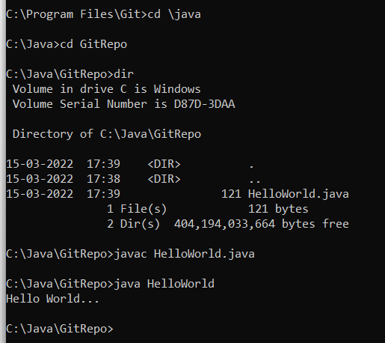
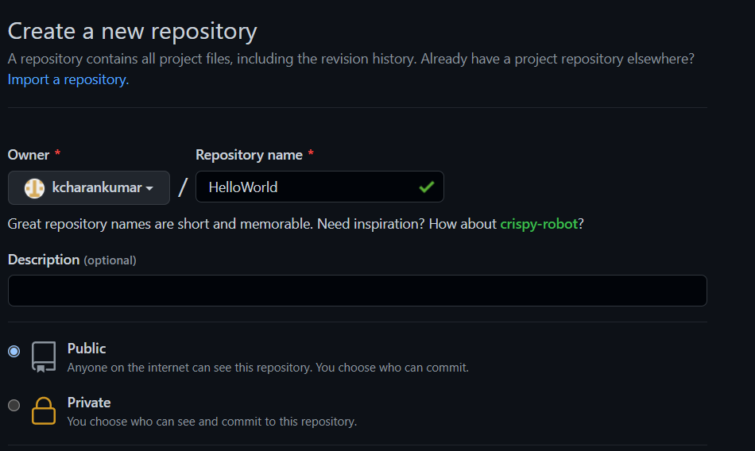
Jenkins – Build setup
Create a GitRepo directeory in Git.
Create HelloWorld.java and compile it.
Create a New Repository as HelloWorld in GitHub..

Slide 38
Jenkins – Build setup
Open the git_cmd and execute the following commands. This will create a repository, adds the files in the repository and pushes them to github.
Git init
Git status
Git add . --> Adds both the files in the repository
Git status
git config --global user.email "kcharankumar@gmail.com"
git config --global user.name "K.Charan Kumar"
Git commit -m “HelloWorld Program is added”
git remote add origin https://github.com/kcharankumar/HelloWorld.git
git push -u origin master

Slide 39
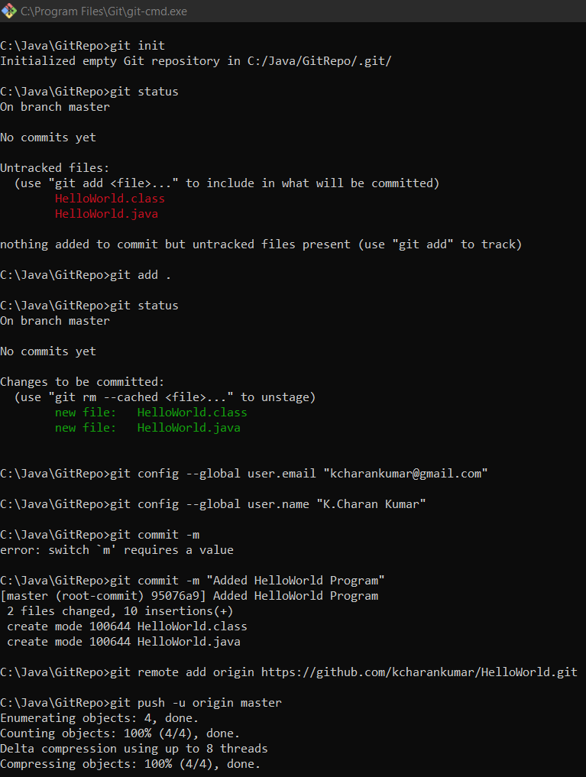
Jenkins – Build setup

Slide 40
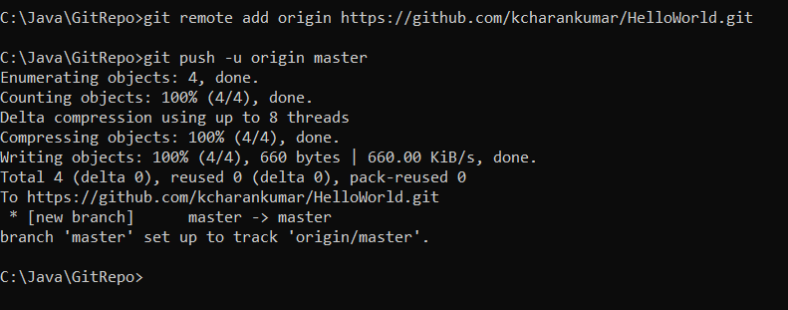
Jenkins – Build setup

Slide 41
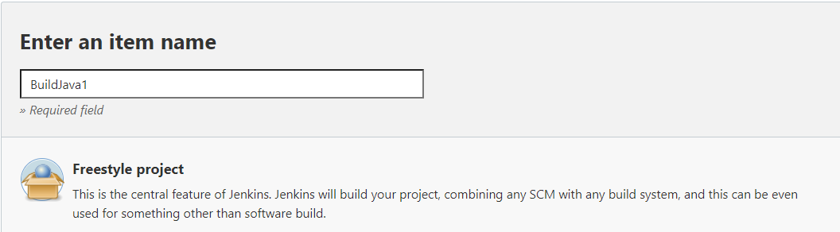
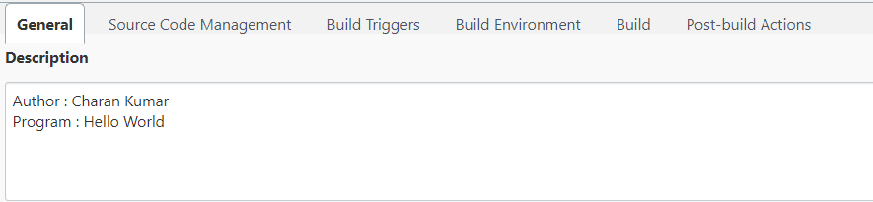
Jenkins – Build setup
From the jenkins dashboard, select New Item
Enter a name and select Free Style Project and click on OK.
Enter details in General Section :

Slide 42
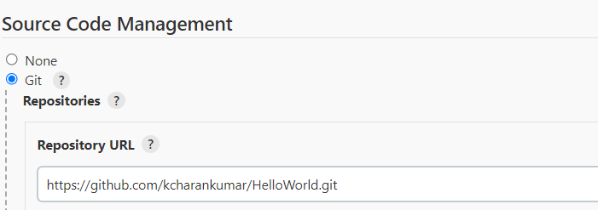
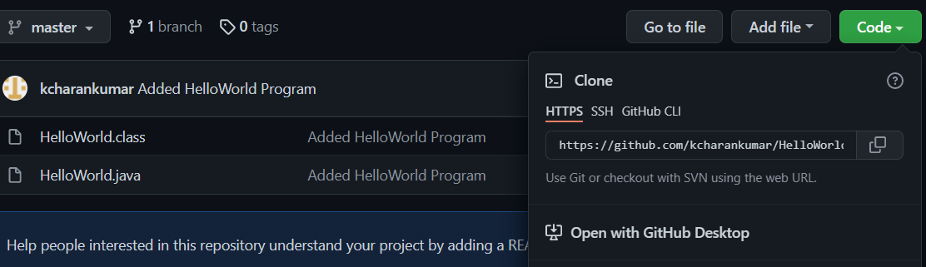
Jenkins – Build setup
Enter git details in Source Code Repositories.
Git location can be picked up from GitHub from here.

Slide 43
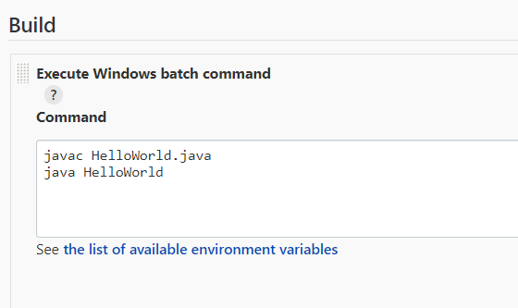
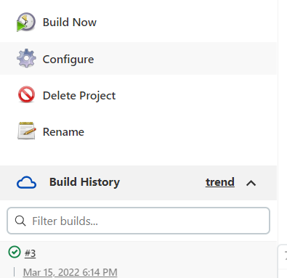
Jenkins – Build setup
Under Build --> Select Execute Windows Batch command and enter the following and click on Save and Apply.
From Dashboard of BuildJava Project, click on Build Now.
It will build and gives you the result.

Slide 44
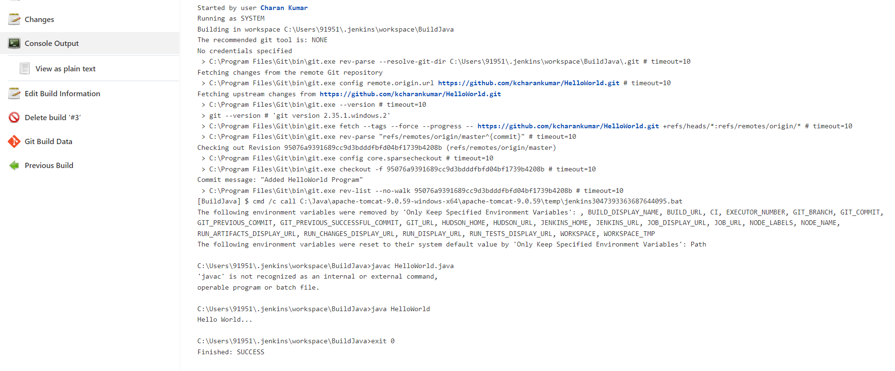
Jenkins – Build setup
After clicking on the link #3 or #2 or #1 as per the number of times the build is made,it opens another dashboard. In that select Console output. It shows the following.

Slide 45
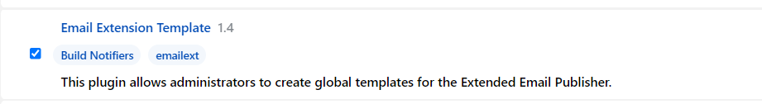
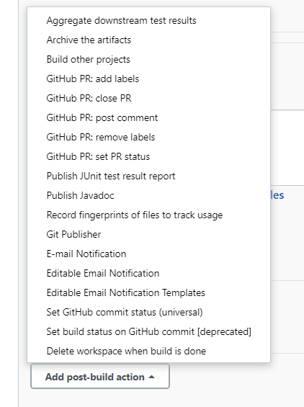
Jenkins – Notification
Email notification from Jenkins
1. Go to Manage Jenkins and click on Manage Plug-ins
2. Click on Available and enter Email in the search box and install the selected one.
Select the BuildJava Project --> Click on Configure --> select post build operations as Email Notification.

Slide 46
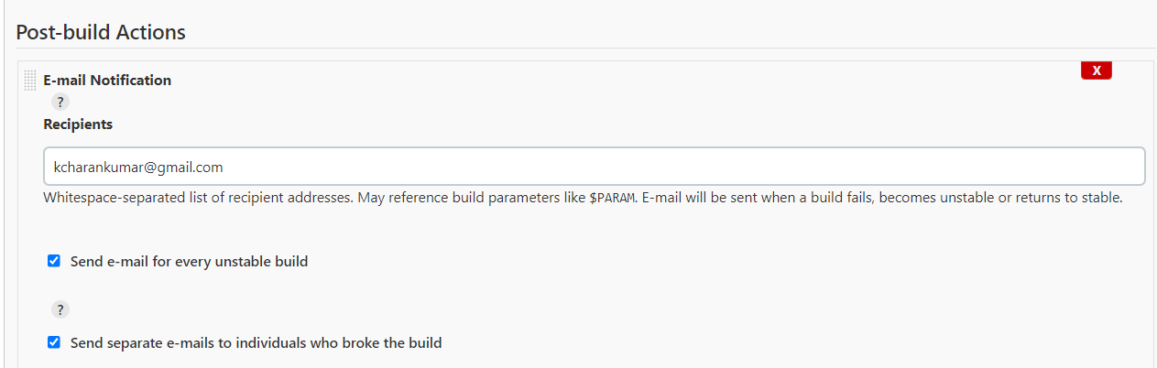
Jenkins – Notification
Enter the email id and click on when the build is broken and click on Apply and Save.

Slide 47
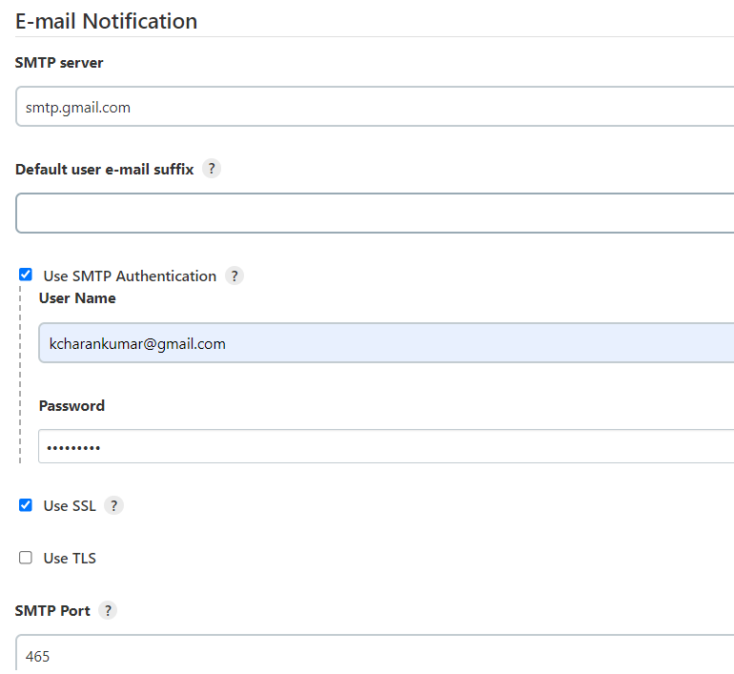
Jenkins – Notification
Click on Manage Jenkins from Dashboard --> Configure System.
Go to the section Email Notification --> click on Advanced and enter the following information.
SMTP Server : smtp.gmail.com
UserName : kcharankumar@gmail.com
Password : <password>
Use SSL : Check this.
Smtp port : 465

Slide 48
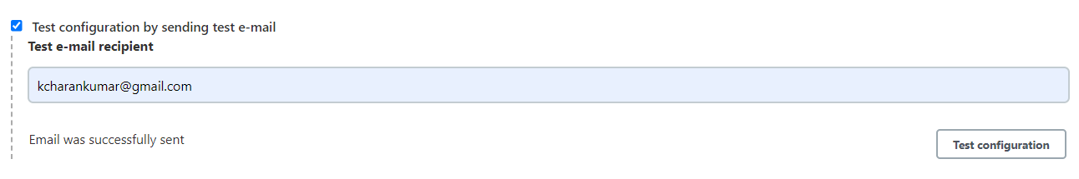

Jenkins – Notification
Click on test email notification. This will send test email to the given mail id.
Make HelloWorld.java generate errors and make the build fail in local git as
Removed the quotes in s.o.p.

Slide 49

Jenkins – Notification
Run the following git commands.
Git add HelloWorld.java
Git commit -m “Removed the quotes”
Git push -u origin master
Ensure the modified code is in github.

Slide 50


Jenkins – Notification
Remove the previously created HelloWorld.class:
Open Dashboard, click on BuildJava Project and click on Build Now.
Build Failed as shown in here.

Slide 51


Jenkins – Notification
Can click on the build link and click on Console Output. Following screen will be seen.
Email will be sent to the given email id:

