Slide 1
Web App Frameworks
Design Patterns (Part 2)
Jonathan McCarthy

Slide 2
Composite Pattern
Intent
Compose objects into tree structures to represent part-whole hierarchies. Composite lets clients treat individual objects and compositions of objects uniformly.
Motivation
When dealing with tree-structured data, programmers often have to discriminate between a leaf-node and a branch.
This can make code more complex and error prone.
The proposed solution is an interface that allows treating complex and primitive objects uniformly.
A composite is an object designed as a composition of one-or-more similar objects, all exhibiting similar functionality.
The Composite pattern describes how to use recursive composition so that clients don't have to make this distinction.
The key to the Composite pattern is an abstract class that represents both primitives and their containers.
It also declares operations that all composite objects share, such as operations for accessing and managing its children.

Slide 3
Composite Pattern
Applicability
Use the Composite pattern when:
You want to represent part-whole hierarchies of objects.
You want clients to be able to ignore the differences between compositions of objects and individual objects. Clients will treat all objects in the composite structure uniformly.

Slide 4
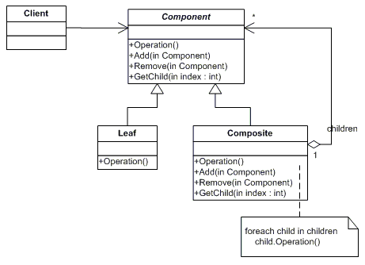
Composite Pattern
Structure

Slide 5
Composite Pattern - Participants
Component
declares the interface for objects in the composition.
implements default behaviour for the interface common to all classes, as appropriate.
declares an interface for accessing and managing its child components.
(optional) defines an interface for accessing a component's parent in the recursive structure, and implements it if that's appropriate.
Leaf
represents leaf objects in the composition. A leaf has no children.
defines behavior for primitive objects in the composition.
Composite (CompositeElement)
defines behavior for components having children.
stores child components.
implements child-related operations in the Component interface.
Client (CompositeApp)
manipulates objects in the composition through the Component interface.

Slide 6
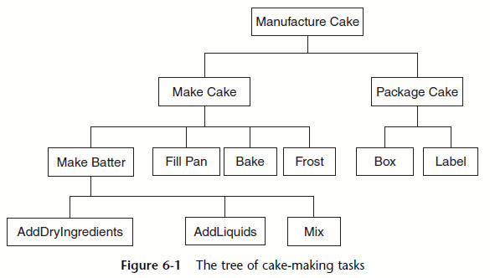
Composite Example

Slide 7
Composite Example
require 'pp'
class Task
attr_reader :name
def initialize(name)
@name = name
end
def get_time_required
0.0
end
end
Create a file named composite.rb, paste all the code from slide 7 to 13 into this file!!

Slide 8
Composite Example
class AddDryIngredientsTask < Task
def initialize
super('Add dry ingredients')
end
def get_time_required
1.0 # A minute to add flour and sugar
end
end

Slide 9
Composite Example
class MixTask < Task
def initialize
super('Mix that batter up!')
end
def get_time_required
3.0 # Mix for 3 minutes
end
end

Slide 10
Composite Example
class AddLiquidsTask < Task
def initialize
super('Add Liquids')
end
def get_time_required
4.0
end
end

Slide 11
Composite Example
class CompositeTask < Task
def initialize(name)
super(name)
@sub_tasks = []
end
def <<(task)
@sub_tasks << task
end
def [](index)
@sub_tasks[index]
end
def []=(index, new_value)
@sub_tasks[index] = new_value
end
def size
@sub_tasks.size
end
def remove_sub_task(task)
@sub_tasks.delete(task)
end
def get_time_required
time=0.0
@sub_tasks.each {|task| time += task.get_time_required}
time
end
end

Slide 12
Composite Example
class MakeBatterTask < CompositeTask
def initialize
super('Make batter')
self << AddDryIngredientsTask.new
self << AddLiquidsTask.new
self << MixTask.new
end
end

Slide 13
Composite Example
composite = CompositeTask.new('example')
composite << MixTask.new
pp composite
puts composite[0].get_time_required
composite[1] = AddDryIngredientsTask.new
pp composite

Slide 14
Questions
???

