Slide 1
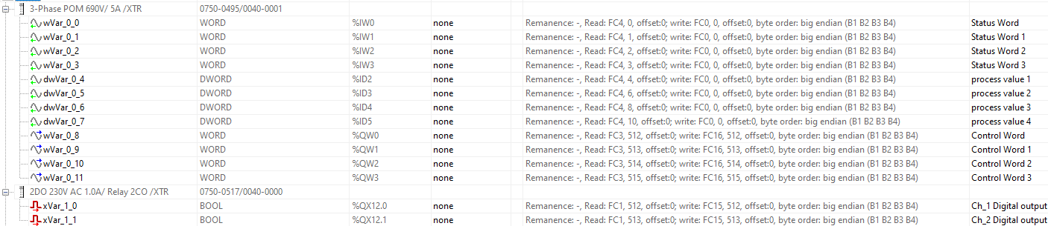

Slide 2
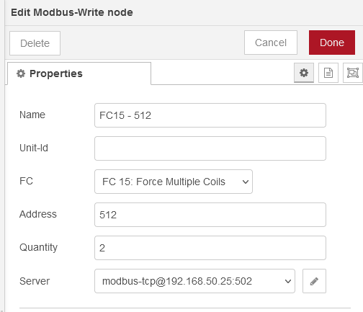
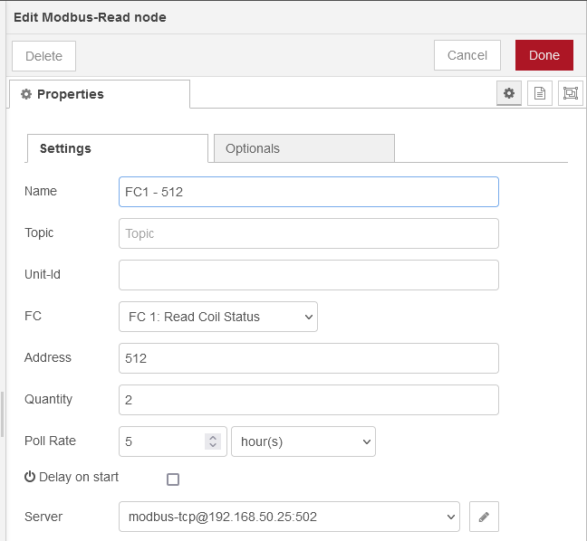
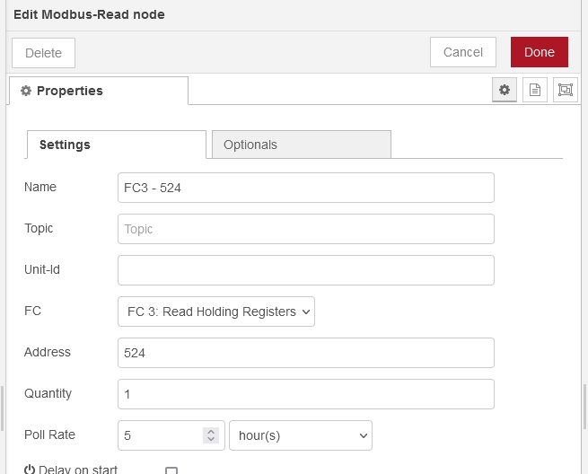
Modbus-Write
FC15, Address 512, Quantity 2
Modbus-Read
FC15, Address 512, Quantity 2
Modbus-Read
FC15, Address 512, Quantity 2
OR

Slide 3
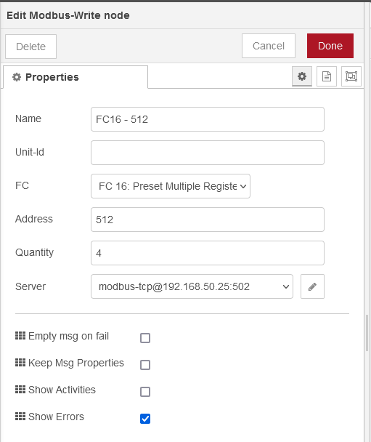
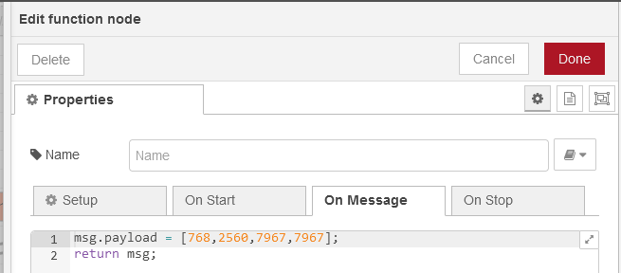

Modbus-Write
FC16, Address 512, Quantity 4
(STAT) (COM/RES)
(byte1) (byte0)
768
00000011 00000000
(COL_ID) (empty)
(byte3) (byte2)
2560
00001010 00000000
10 0
(MET_ID) (MET_ID)
(byte5) (byte4)
(31 – RMS Volts L1-L2) (31 – RMS Volts L1-L2)
(00011111) (00011111)
2560
(MET_ID) (MET_ID)
(byte7) (byte6)
(31 – RMS Volts L1-L2) (31 – RMS Volts L1-L2)
(00011111) (00011111)
31 31

Slide 4
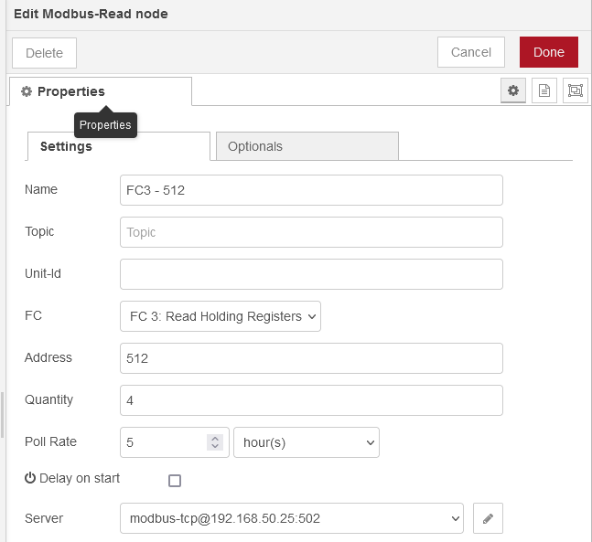
Modbus-Read
FC3, Address 512, Quantity 4
(STAT) (COM/RES)
(byte1) (byte0)
768
00000011 00000000
(COL_ID) (empty)
(byte3) (byte2)
2560
00001010 00000000
10 0
(MET_ID) (MET_ID)
(byte5) (byte4)
(31 – RMS Volts L1-L2) (31 – RMS Volts L1-L2)
(00011111) (00011111)
2560
(MET_ID) (MET_ID)
(byte7) (byte6)
(31 – RMS Volts L1-L2) (31 – RMS Volts L1-L2)
(00011111) (00011111)
31 31

Slide 5
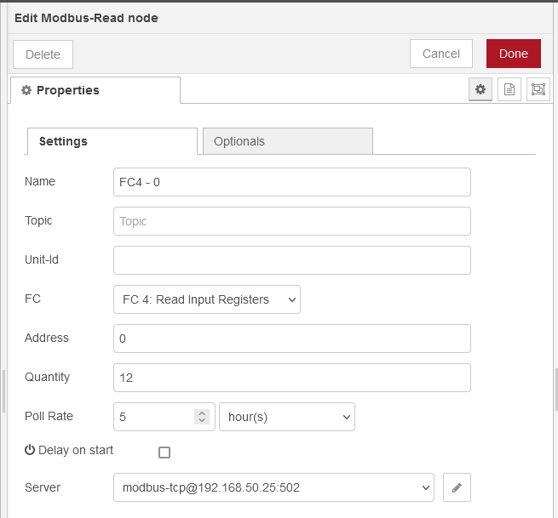
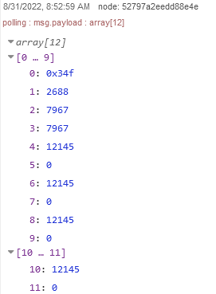
Modbus-Read
FC4, Address 0, Quantity 12
(STATUS)
(byte1) (byte0)
847
00000011 01001111
(STATUS)
(byte3) (byte2)
2688
00001010 10000000
(MET_ID1) (MET_ID2)
(byte5) (byte4)
00011111 00011111
31 31
(MET_ID3) (MET_ID4)
(byte7) (byte6)
00011111 00011111
31 31
(Process Value - MET_ID1)
(byte11) (byte10) (byte9) (byte8)
12145
121.45v
(Process Value - MET_ID2)
(byte15) (byte14) (byte13) (byte12)
12145
121.45v
(Process Value - MET_ID3)
(byte19) (byte18) (byte17) (byte16)
12145
121.45v
(Process Value - MET_ID4)
(byte23) (byte22) (byte21) (byte20)
12145
121.45v

