Slide 1
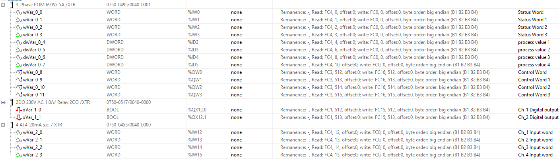

Slide 2
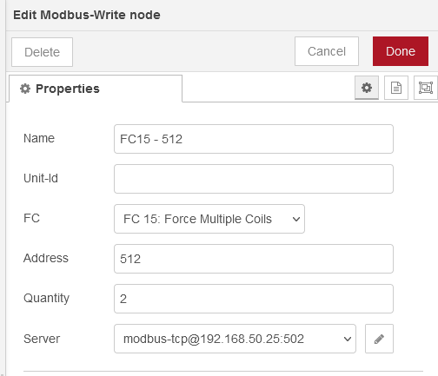
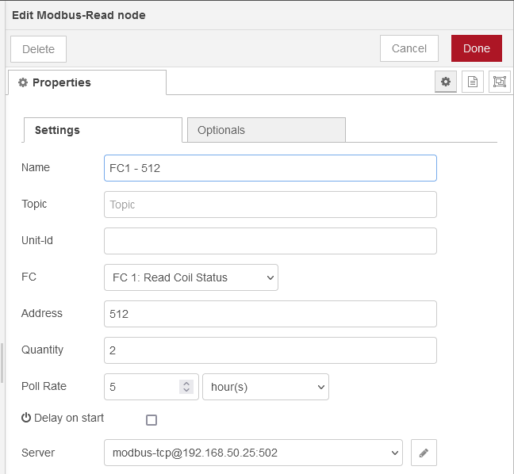
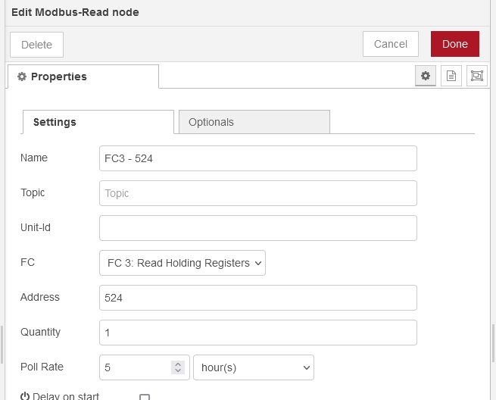
Modbus-Write
FC15, Address 512, Quantity 2
Modbus-Read
FC15, Address 512, Quantity 2
Modbus-Read
FC15, Address 512, Quantity 2
OR

Slide 3
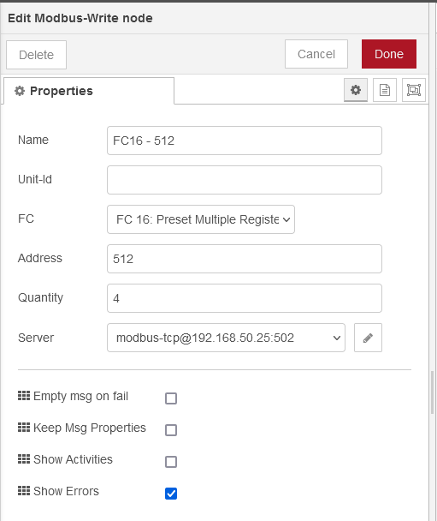
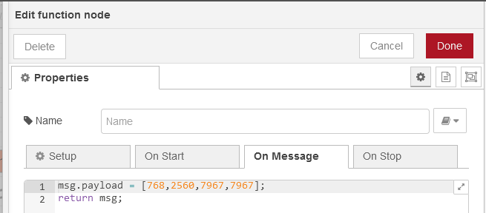

Modbus-Write
FC16, Address 512, Quantity 4
(STAT) (COM/RES)
(byte1) (byte0)
768
00000011 00000000
(COL_ID) (empty)
(byte3) (byte2)
2560
00001010 00000000
10 0
(MET_ID) (MET_ID)
(byte5) (byte4)
00011111 00011111
31 31
(MET_ID) (MET_ID)
(byte7) (byte6)
00011111 00011111
31 31

Slide 4
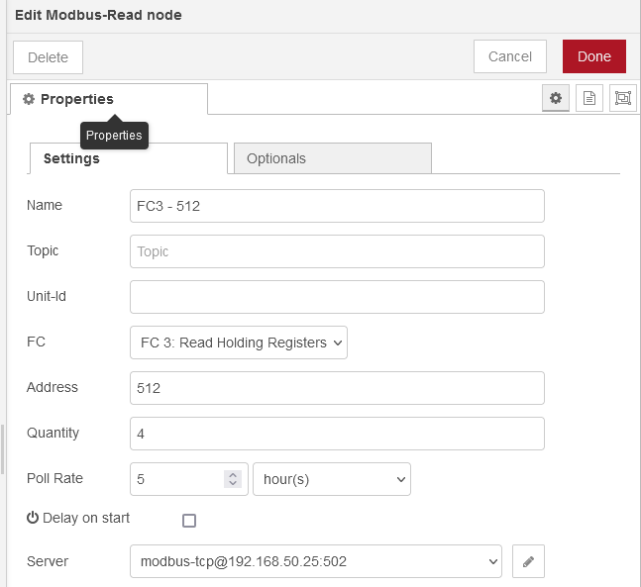
Modbus-Read
FC3, Address 512, Quantity 4
(STAT) (COM/RES)
(byte1) (byte0)
768
00000011 00000000
(COL_ID) (empty)
(byte3) (byte2)
2560
00001010 00000000
10 0
(MET_ID) (MET_ID)
(byte5) (byte4)
00011111 00011111
31 31
(MET_ID) (MET_ID)
(byte7) (byte6)
00011111 00011111
31 31

Slide 5
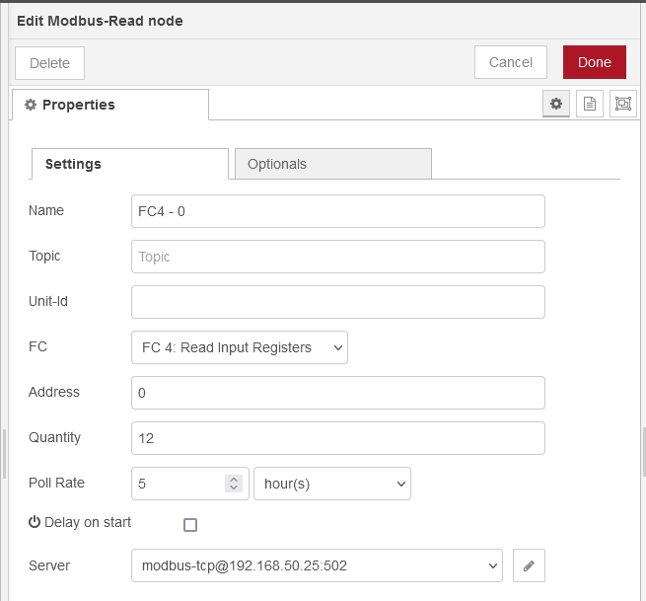
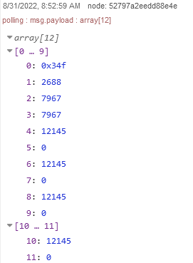
Modbus-Read
FC4, Address 0, Quantity 12
(STATUS)
(byte1) (byte0)
847
00000011 01001111
(STATUS)
(byte3) (byte2)
2688
00001010 10000000
(MET_ID) (MET_ID)
(byte5) (byte4)
00011111 00011111
31 31
(MET_ID) (MET_ID)
(byte7) (byte6)
00011111 00011111
31 31
(Process Value)
(byte11) (byte10) (byte9) (byte8)
12145
121.45v
(Process Value)
(byte15) (byte14) (byte13) (byte12)
12145
121.45v
(Process Value)
(byte19) (byte18) (byte17) (byte16)
12145
121.45v
(Process Value)
(byte23) (byte22) (byte21) (byte20)
12145
121.45v

