Slide 1
Academic or Student Registration and Information System (ARIS)

Slide 2
What are the functions of an ARIS?

Slide 3
What are the functions of an ARIS?
  The subscription function: (initial) registration of a student at the university for a given curriculum (field of study). Also: registration of professors and organizational units (faculties, institutes, laboratories, etc…).
  The study results or “student’s career” function: the “following” of the performance of the student during his period of study: registration of exam results.

Slide 4
What are the functions of an ARIS?
    The content supply or information function:
      Supply of information on the structure and content of a given field of study and the individual courses.
      Supply of personal data on students and staff (name, gender, birth date, address, expertise, etc…).
      Supply of management information and analysis (e.g. performance indicators by gender, age group, field of study, region, etc…).
    The support or logistics function: e.g.
      The management of payments of fees.
      The management of buildings (rostering of course rooms, students rooms).

Slide 5
Who are the users of an ARIS?

Slide 6
Who are the users of an ARIS?
  Students
  Central Administration (registrar)
  Decentral Administration
  Teachers

Slide 7
What should the users (be able to) do?
Users Functions | Students | Centr. Adm. | Dec. Adm. | Teachers
Subscription
Exam results
Information

Slide 8
What should the users (be able to) do?
Should students be able to subscribe themselves by means of the system or should the central or decentral administration do this?
  Is there a difference in this for the initial subscription and the subsequent subscriptions in the following years?
Who plays a role in the registration of the exam results?
  Teacher has to provide the mark.
  Decentral administration has to actually register the results in the system.
Should a user have the possibility to consult his/her exam results in the system at a given point of time?
Who plays a role in the provision of content information and which business rules applly to this? (info available before 1st of September)

Slide 9
Combining users and functions
What we did in the preceding exercise is combining or linking users with functions.
This is a form of analysing or structuring the reality covered by an ARIS, or to put it in a different way of modeling the reality.
For this modeling nowadays there are standardized tools and techniques available, of which the most useful and advanced is the UML, the Unified Modeling Language.

Slide 10
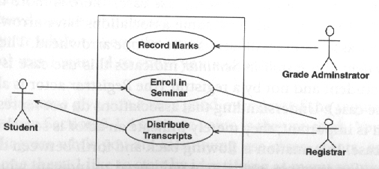
UML Use Case diagrams

Slide 11
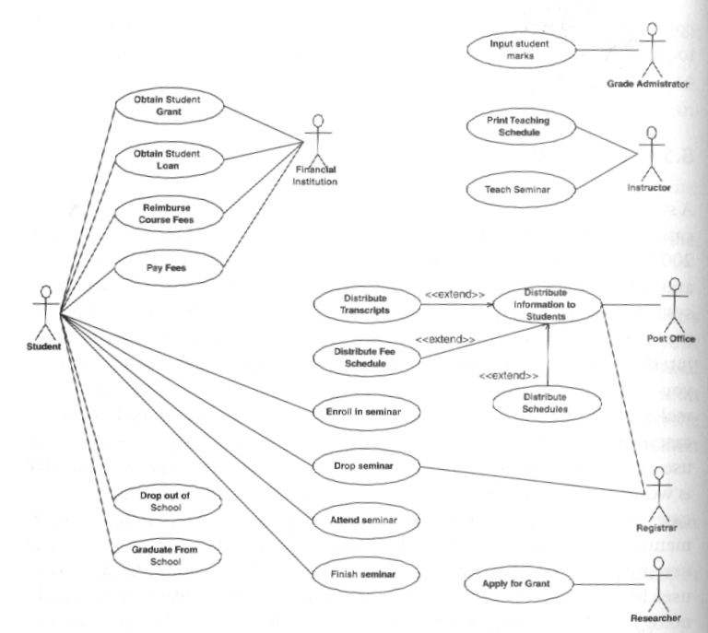

Slide 12
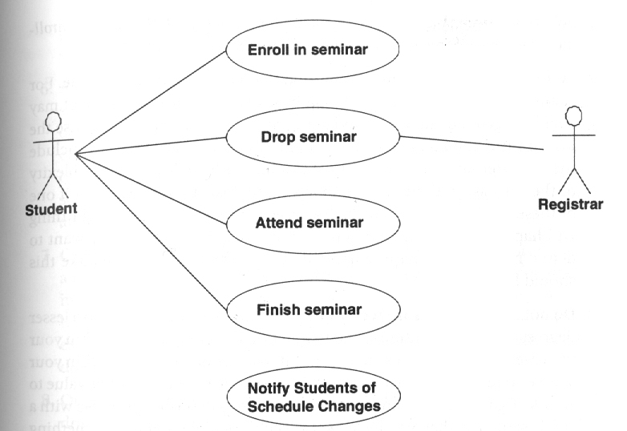
UML Use Case diagrams

Slide 13
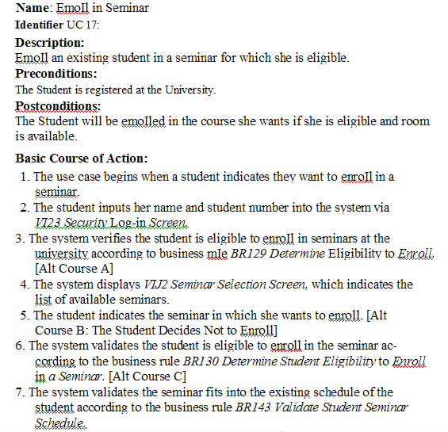

Slide 14
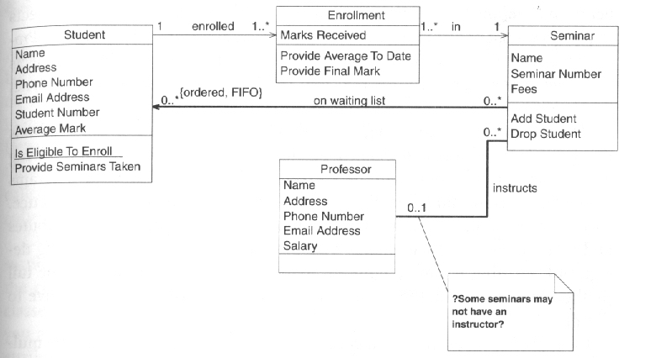
UML Class diagrams

Slide 15
The virtue of UML modeling
Provides a clear, efficient and concise way of communicating between developers and non-technical stakeholders (users, clients), but also between developers among themselves.
Integration of analysis and design on the one hand and production of documentation on the other.
Integration (gearing to one another) of analysis of the problem domain and the construction of programming classes and database structure.

Slide 16
Rules for development of (university) systems
Systems should be “Web-based” (browser-based).
Development should be “model-driven”.
Use of UML as the basic modeling technique and tools.
Use OO-programming for coding.
Use visual modelling and programming packages (Microsoft Visio, Eclipse, Borland Together, Jbuilder, etc..).
Use Relational Database Management System (RDBMS).
Use open source alternatives if available.
Adopt a realistic, flexible or “agile” way of working: let the result you have to / want to achieve be the major guidance and only apply techniques, procedures, tools etc… if really necessary.
Apply an iterative development strategy: do not wait until “the whole thing” is ready, but present finished modules as soon as possible and regularly to your clients.
Organize the development in a cooperative, nationwide setting or network.
Take time to get basic knowledge and insight in the reality of your problem domain and users and the major developments to be expected in the near future (e.g. the development “from paper to electronics” in the library world).

Slide 17
Functions in the ARIS of RU
How are the functions we distinguished realized within the framework of the Radboud University?
Subscription function: in ISIS (the student registration system). Initial subscription done by central administration, subsequent subscription can also be done by the students directly.
Study results function: in ISIS. Registration done by the decentralized administration (of the study).

Slide 18
Functions in the ARIS of RU
Content supply or information function :
  Curricula and course descriptions: in RUMBA, an application developed within the Faculty of Sciences. Information registered by decentralized administration.
  Management information: produced by ad hoc applications developed by the central unit for information supply (central administration).
Support or logistic functions:
  Management of fees: in financial system, linked to ISIS.
  Management of buildings: local applications.

Slide 19
Functions in the ARIS of RU
Conclusion:
Currently not fully integrated system, e.g. course and curricula content is outside the basic administrative student registration system (ISIS).
Partly web-based, partly not.
Therefore: new, integrated and fully web-based system will be implemented in the course of 2007 (Campus Solutions from ORACLE/Peoplesoft).

Slide 20
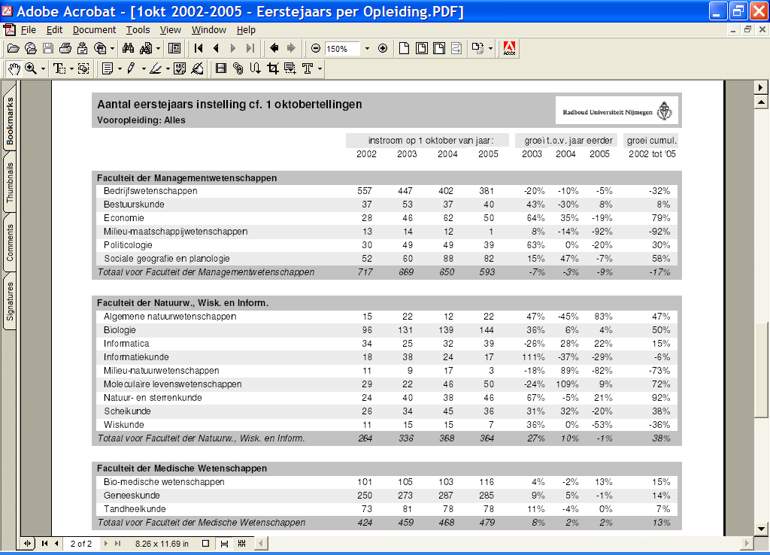

Slide 21
