Slide 1
Opus College - overview

Slide 2
OpusCollege - background
First project: ICT Capacity Building Mozambican Higher Education Institutions
Partners: RUG Groningen, UT Enschede, RU Nijmegen
Project goals:
  Help infrastructure with financial and material means
    Hardware -> servers
    Infrastructure -> networks
    Software -> opusCollege
  Capacity Building: build knowledge !!
    Competence Center (initially staffed by Mario, Stelio and Nelson)

Slide 3
OpusCollege – contents
Student administration system for higher education institutions
Storage of following data:
  Institutional units
  Staffmembers
  Studies & Subjects
  Students
  Exams

Slide 4
Institution
Has 1..*
Branch
Role
Has 1..*
has 1..*
Address
Has 1
Organizational
Unit
Opus User
has 1..*
Person
has 0..1
is 1..*
is authorised for 1..*
belongs to 1
Study
has 1..*
Contract
Staff Member
Student
concerns 1
has 1..*
has 1..*
Grade Type
Exam Result
Study plan
has 0..1
has 1..*
has *..*
has *..*
has 1..*
Subject Result
Subject Block
Study Year
taught by 1..*
has 0..*
has 1..*
Examination
Result
has 0..*
has 0..*
has 0..1
Legenda:
= Association from object
Subject
has 0..1
= Shortcut for an association from object
Examination
A
B
= Subclass from (A is a subclass from B)
has 1..*
(version 5 2007-10-30)

Slide 5
OpusCollege - techniques
HTML, Javascript
Java Web - JSP, JSTL
Java - Spring Framework
ORM - iBatis
database server – PostgreSQL
OSGi

Slide 6
Spring Framework:
Inversion of Control
Aspect Oriented Programming
Spring Framework

Slide 7
Inversion of Control
A.k.a.: Dependency Injection
Hollywood-principle: Don’t call us, we’ll call you: beans do not have to take care of everything themselves, the container provides services for the beans
Layer-structure with interfaces, loosely coupled through dependency injection :
  MVC with (constraint) JSP (or other client)
  (thin) Service Layer as façade
  Domain model in POJOs
  DAO for persistency

Slide 8
Aspect Oriented Programming
Used for:
  ‘crosscutting concerns’: services, that touch the entire application and therefore are repeated at all/many methods
  container services (for example logging, security, session mgt., transaction mgt.)

Slide 9
IOC + AOP > EJB + AS
Inversion of Control + Aspect Oriented Programming > Enterprise Java Beans + Application Server

Slide 10
Spring Framework (1)
Application Development Framework
Based on source code by Rod Johnson
Based on JavaBeans, IOC en AOP
OO is starting-point, not J2EE
Lightweight container for POJO-management
Embedded standard libraries and frameworks: for example hibernate, junit
Better exception handling
Standard services already configured: remoting, transaction mgt., security

Slide 11
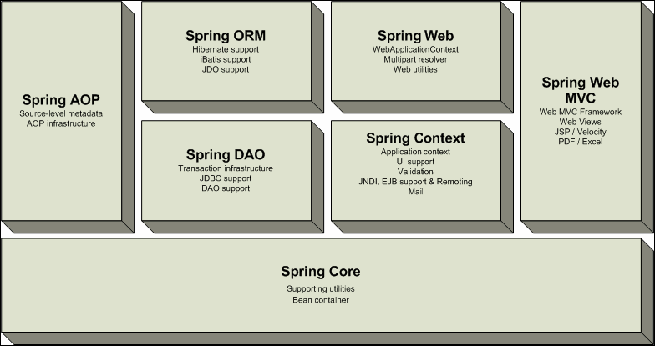
Spring Framework (2)

Slide 12
Spring Framework (3)
Coupling through ApplicationContext:
  Preloading of Singleton Beans
  Message Resource Handling
  Context Hierarchy
  Easy integration of AOP through BeanFactoryPostProcessor
  J2EE specific integration (with for example ServletContext)

Slide 13
Spring Web MVC
The model represents the data (a database or another backend-system)
The view is a visual representation of the model
The controller makes changes to the model

Slide 14
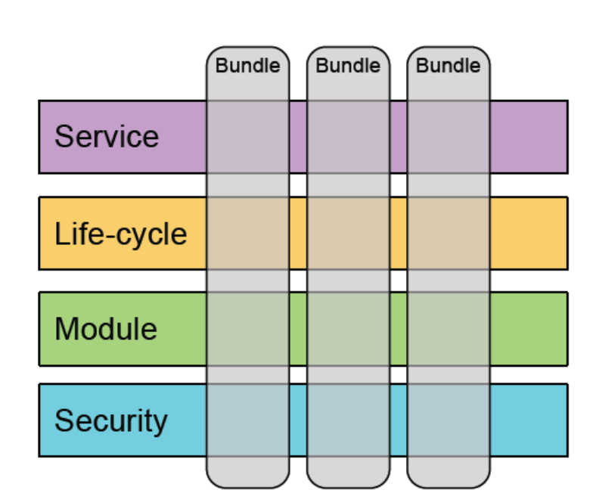
OSGi framework
OSGi = Open Services Gateway initiative
OSGi framework = Component based framework: components are called bundles
Layers:
  security layer
  module layer
  life-cycle layer
  service registry

Slide 15
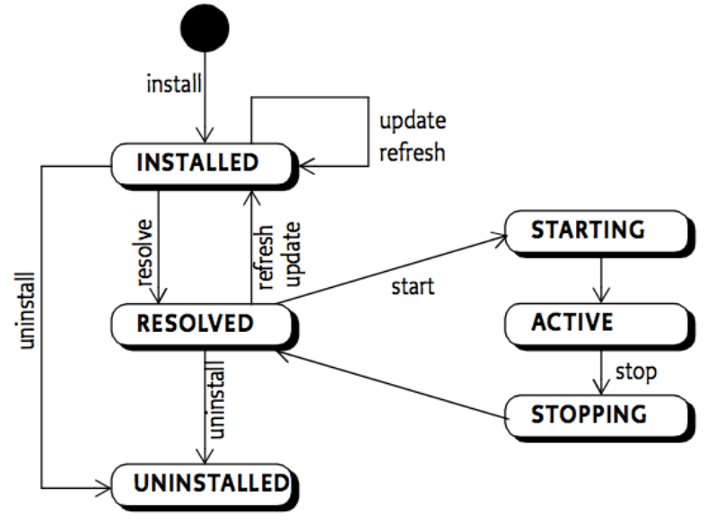
OSGi framework – life-cycle
OSGi-framework manages the life-cycle of bundles

Slide 16
OSGi based web applications – three strategies
OSGi container embedded in another container: OSGi Bridge Server (OBS)
  e.g. OSGi within Tomcat or Jetty
  controlled through a bridge servlet (for instance Equinox)
    front controller
    dispatches servlet requests to bundles
OSGi container with a http-container on top of it
  PAX Web solution: only have an OSGi runtime with an HTTP-container (Jetty) on top of it
OSGI container with all other services / servers / .. as bundles within it (complete Equinox solution)

Slide 17
OpusCollege -> choice
OSGI container with all other services / servers / .. as bundles within it (complete Equinox solution)

Slide 18
OpusCollege -> choice
Wait with implementation:
  Waiting for Apache Tomcat integration
  First implement first final core version
First steps already now:
  Start with structuring the application through several projects (modules): first one is Fees module
  Bind the projects together with Ant -> one WAR-file
  But: only small changes necessary for implementation as separate bundles

Slide 19
OpusCollege – structure
Several projects:
  1 or more modules: fee, scholarship, report, alumni
  1 core-project: college with all libraries
  1 target-project: opus / eSURA
All projects have their own build.xml

Slide 20
First ‘bundles’
Already active:
  Alumni Module
  Fees module
  Scholarship Module
  Report Module

Slide 21
iBatis framework (1)
Spring uses the DAO-pattern.
Spring provides DAO-interfaces for:
  JDBC
  Hibernate
  iBatis
  JDO
  Toplink
Connections through DataSourceFactory
Common exception handling
Use of Template Patterns (a.o. JdbcTemplate).

Slide 22
iBatis framework (2)
iBatis:
  Simpler than Hibernate, more advanced than JDBC
  Mapping of SQL queries to Objects and vice versa, including caching
  Version 1.3 (SqlMap) and 2.0 (SqlMapClient) supported by Spring through SqlMapClientTemplate

Slide 23
Questions
???

