Slide 1
Opus College - overview
Demo structure modules

Slide 2
OpusCollege - background
Project: ICT Capacity Building Mozambican Higher Education Institutions
Partners: RUG Groningen, UT Enschede, RU Nijmegen
Project goals:
  Help infrastructure with financial and material means
    Hardware -> servers
    Infrastructure -> networks
    Software -> opusCollege
  Capacity Building: build knowledge !!
    Competence Center in Maputo (staffed by Celso, Abdul, Stelio and Ambrosio)

Slide 3
OpusCollege – contents
Student administration system for higher education institutions
Storage of following data:
  Institutional units
  Staffmembers
  Studies & Subjects
  Students
  Exams

Slide 4
Institution
Has 1..*
Branch
Role
Has 1..*
has 1..*
Address
Has 1
Organizational
Unit
Opus User
has 1..*
Person
has 0..1
is 1..*
is authorised for 1..*
belongs to 1
Study
has 1..*
Contract
Staff Member
Student
concerns 1
has 1..*
has 1..*
Grade Type
Exam Result
Study plan
has 0..1
has 1..*
has *..*
has *..*
has 1..*
Subject Result
Subject Block
Study Year
taught by 1..*
has 0..*
has 1..*
Examination
Result
has 0..*
has 0..*
has 0..1
Legenda:
= Association from object
Subject
has 0..1
= Shortcut for an association from object
Examination
A
B
= Subclass from (A is a subclass from B)
has 1..*
(version 5 2007-10-30)

Slide 5
OpusCollege - techniques
HTML, Javascript
Java Web - JSP, JSTL
Java - Spring Framework
ORM - iBatis
database server – PostgreSQL
Recently implemented: OSGi

Slide 6
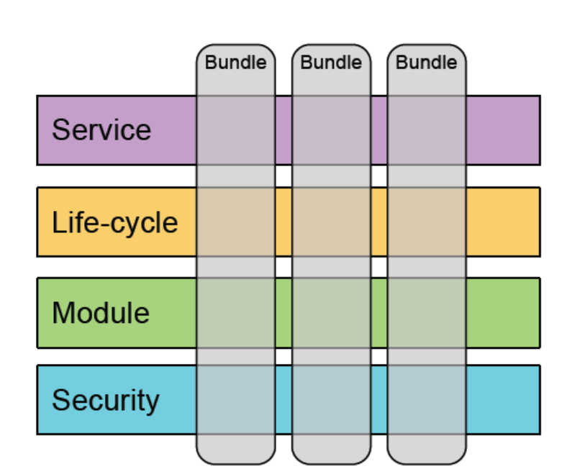
OSGi framework
OSGi = Open Services Gateway initiative
OSGi framework = Component based framework: components are called bundles
Layers:
  security layer
  module layer
  life-cycle layer
  service registry

Slide 7
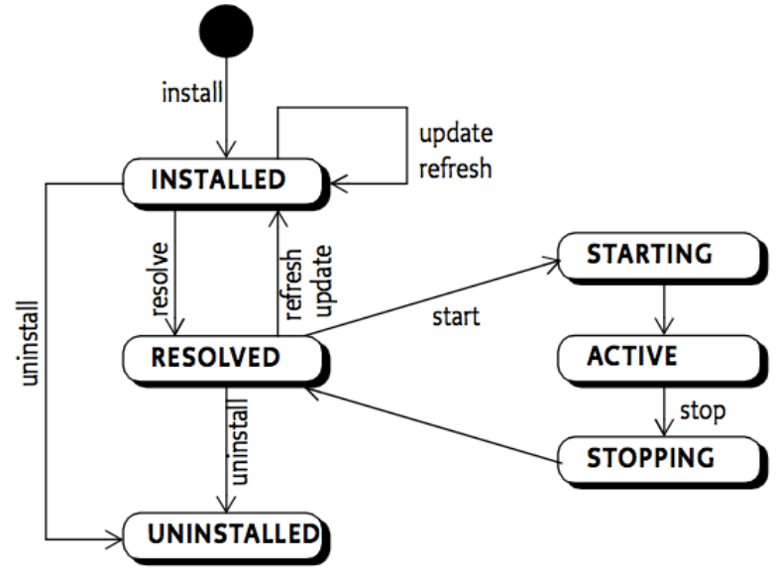
OSGi framework – life-cycle
OSGi-framework manages the life-cycle of bundles

Slide 8
OSGi based web applications – three strategies
OSGi container embedded in another container: OSGi Bridge Server (OBS)
  e.g. OSGi within Tomcat or Jetty
  controlled through a bridge servlet (for instance Equinox)
    front controller
    dispatches servlet requests to bundles
OSGi container with a http-container on top of it
  PAX Web solution: only have an OSGi runtime with an HTTP-container (Jetty) on top of it
OSGI container with all other services / servers / .. as bundles within it (complete Equinox solution)

Slide 9
OpusCollege -> choice
OSGI container with all other services / servers / .. as bundles within it (complete Equinox solution)

Slide 10
OpusCollege -> choice
Wait with implementation:
  Waiting for Apache Tomcat integration
  First implement first final core version
First steps already now:
  Start with structuring the application through several projects (modules): first one is Fees module
  Bind the projects together with Ant -> one WAR-file
  But: only small changes necessary for implementation as separate bundles

Slide 11
OpusCollege – new structure
Several projects:
  1 or more modules: fee, scholarship, report
  1 core-project: college with all libraries
  1 target-project: opus
All projects have their own build.xml

Slide 12
First ‘bundle’s
Already active:
  Fees module
  Scholarship Module
  Report Module

Slide 13
Demo structure modules

Slide 14
Questions
???

