Slide 1
OPUS-College
Student Information System
Current State of Affairs
(pre-milestone 3.1)

Slide 2
Purposes of this visit
Define the time frame and organization of the implementation phase of OPUS-College
Assess the skills of the local technical system administrators of OPUS-College.
Install the current version of OPUS-College and arrange the conversion of student and curriculum data already existing in the “old” system into the new OPUS-College.
Present the newly added features in OPUS, based on the requirement analysis of last April/May.
Discuss some requirements questions, among which the issue of the roles and priviliges of the various users of the coming OPUS-College system (i.e. Who can do and see what in OPUS?).

Slide 3
Planning of the OPUS-College implementation.
February 2011: start of the implemtation phase.
Installation of milestone 3.1. of OPUS, including the definitive version of the OPUS-College kernel and some of the additional functionality requested by CBU and UNZA.
1 week evaluation of the current changes with a group of selected users by the central project management.
After this there will be optionally (*) a training for the proposed local trainers from CBU / UNZA. The trained persons (trainers), 2 from CBU and 2 from UNZA, will be responsible for the broader users training within the university.
The “train the trainers” week will immediately be followed by a week in which the newly trained trainers will train a group of 3 to 5 future users of the system.

Slide 4
Planning of the OPUS-College implementation.
February-June 2011.
Testing of the milestone 3.1. version of OPUS by the selected and trained group of users (3 to 5) under supervision of the Functional System Administrator of OPUS-College. The latter will be responsible for a weekly report to the central management about the progress and results of the testing.

Slide 5
Planning of the OPUS-College implementation.
July 2011.
Installation by the central project management of the remaining modules requested by the Zambian universities.
1 week “train the (user) trainers” by the central project management.
The “train the trainers” week will immediately be followed by a week in which the newly trained trainers will train the testing group in the use of the new modules.

Slide 6
Planning of the OPUS-College implementation.
July – September 2011.
Testing of the full version of OPUS (milestone 3.2.), by the test group under supervision of the central functional manager of OPUS. The latter will report weekly to the central project management about the progress and results of the test.
October 2011.
Final installation of the system.
University-wide user training.
(Oct./Nov.) End of the implementation phase: the system now enters its production or structural phase and can be used for the administration of students, staff and study curriculum for the year 2012.

Slide 7
New features in OPUS-College
Cardinal Time Unit (CTU): The major time unit by which an organization (university, school) breaks down and organizes its study programs (curriculum). Examples of cardinal time units are: study year, semester or trimester. For instance: a bachelor has 6 cardinal time units in case semester is chosen as CTU.
Subject Block: a collection of subjects related one way or another. It is a concept to order and classify subjects. Examples: “Subject Block Compulsory Subjects CTU1”, but blocks can also be thematic, e.g. “Subject Block English Culture”.

Slide 8
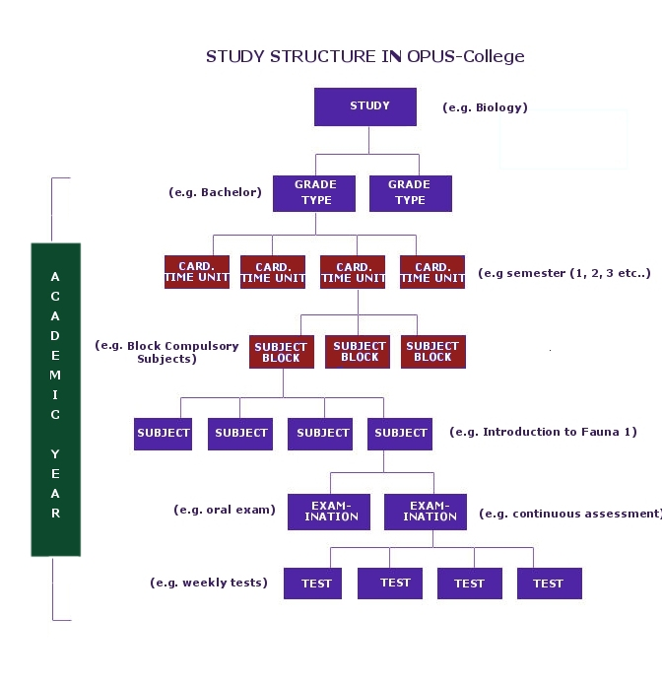

Slide 9
New features in OPUS-College
Study Plan – changed concept: the study plan concept depicts the new student's view in the OPUS-College system on his/her study program. More concrete the “study plan” screen shows the program(s) the student has followed / is following up and including the actual academic year. So it gives the actual study program(s) a student is taking as well as the study history of the student. As such the “study plan” replaces the old “study plan” concept and view. The former also included the program a student still had to take in the future beyond the next cardinal time unit.

Slide 10
New features in OPUS-College
“Academic year curriculum transition” function. This new function allows the copying of a whole study program for a given academic year to the next academic year (e.g. Copying the program for the bachelor Biology as it was in 2010 to 2011. This is a very important added value to OPUS-College to keep track and assure the correct history of a study. For instance: whatever change is made to the “Bachelor Biology” program in 2011, the authentic program for 2010 will still exist in its full, unchanged form in the OPUS-College database.
.

