Slide 1

OSGi

Slide 2
OpusCollege – contents
Student administration system for higher education institutions
Storage of following data:
  Institutional units
  Staffmembers
  Studies & Subjects/Courses
  Students
  Results

Slide 3
OpusCollege - techniques
HTML, Javascript
Java Web - JSP, JSTL
Java - Spring Framework
ORM - iBatis
database server – PostgreSQL
OSGi structure

Slide 4
OSGi
= Open Services Gateway initiative
Startlocations:
  http://www.osgi.org/
  http://www.osgi.org/About/Technology

Slide 5
OSGi Mission
“The OSGi Alliance is an open forum. Our mission is
to specify, create, advance, and promote an open
Service Platform for the delivery and management of
multiple applications and services to all types of
networked devices in home, vehicle, mobile and
other environments.”
Open architecture for development and deployment
manage large scaled services on small devices

Slide 6
OSGi Target groups
Set top boxes
Cars
Home gateways
Consumer electronics
Mobile phones
Network equipment
but also: modular applications

Slide 7
History of OSGi
initiated as standard embedded platform for the “home gateway”
Initially under JCP als JSR-8 (1999)
OSGi alliance, existing of a number of companies, with as mission:
  Maintain and publish the OSGi specification.
  Certification of implementations.
  Organising events.
Current versions:
  OSGi Service Platform Release 4.1 (2007)
  Core and Compendium Version 4.2 (2009)
  Enterprise Version 4.2 (2010)
  Core Version 4.3 (2011)

Slide 8
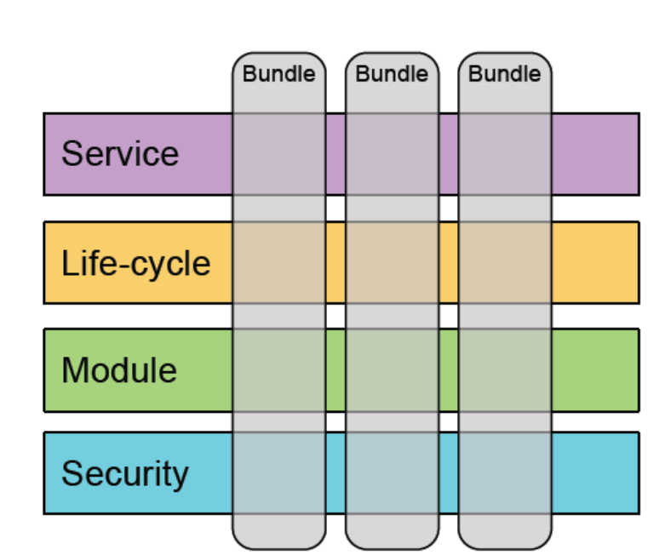
OSGi framework
Component based framework
Components are called bundles
Framework:
  security layer
  module layer
  life-cycle layer
  service registry

Slide 9
OSGi framework – security layer
Based on Java 2 security model
Possibility to sign bundles
Permission Admin service takes care of dynamical configuration

Slide 10
OSGi framework – module layer
Unit of modularisation is the bundle (JAR).
Bundle contains:
  Java packages (and resources)
  Manifest with:
    Name of the bundle
    Description and version number
    Name of the BundleActivator
    Classpath and native library path
    List of imports and exports
  OSGI-OPT directory with source code
Bundle decides which packages are publicly accessible (= exports) and which ones are not: registration of name + versionnumber
Bundle knows which external packages are needed (= imports): registration of name + version range

Slide 11
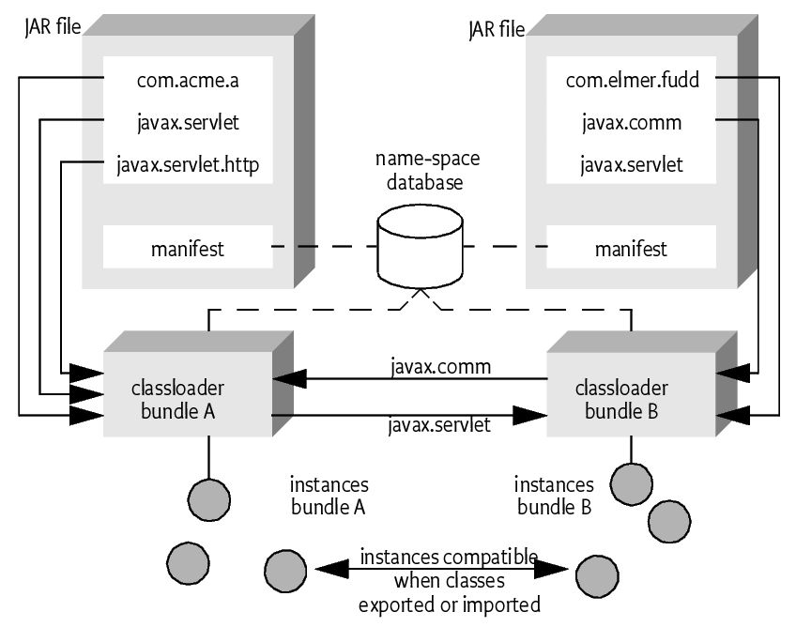
Bundle
Each bundle has:
own Classloader:
shared name-space for exported and imported classes
Bundle types:
Statical: imports and exports packages
Dynamic: registrates and uses services

Slide 12
Bundle Activator
Described in the manifest:
is instantiated by the framework as part of the lifecycle management
start() method allocates resources or starts a separate thread
stop() method stops the bundle
public interface BundleActivator {
public void start(BundleContext context) throws Exception;
public void stop(BundleContext context) throws Exception;
}

Slide 13
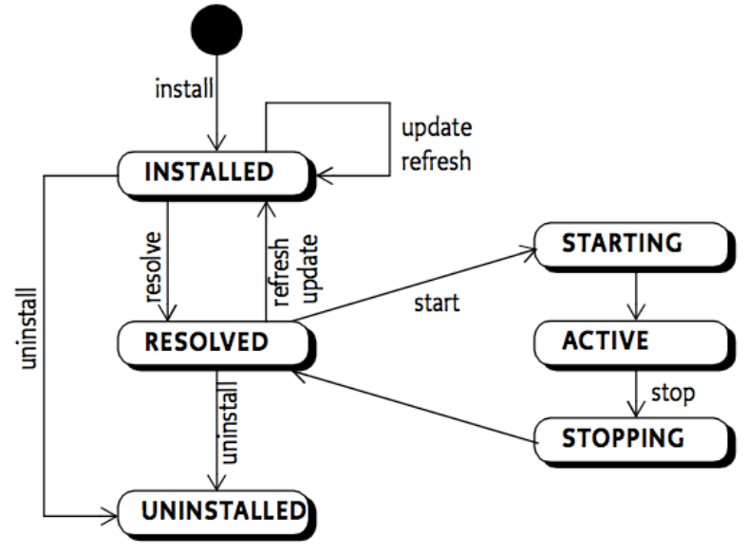
OSGi framework – life-cycle layer
Manages the life-cycle of bundles
BundleActivator start() and stop() hooks

Slide 14
OSGi framework – service layer
Bundles can registrate services:
  by name: net.luminis.DataStore
  Extended with properties: { type=file, atomic=no }
Bundles can use services
  through registration of a listener
  through dependency injection
  through declarative services

Slide 15
OSGi framework implementations and tools
Several open source implementations:
  Apache Felix (within GlassFish)
  Eclipse Equinox
  Gatespace Telematics' Knopflerfish
Eclipse IDE project support
  IDE/RCP is based on OSGi
  Bundles are called “plug-ins”
Maven 2 support
  Still in development, but already useful

Slide 16
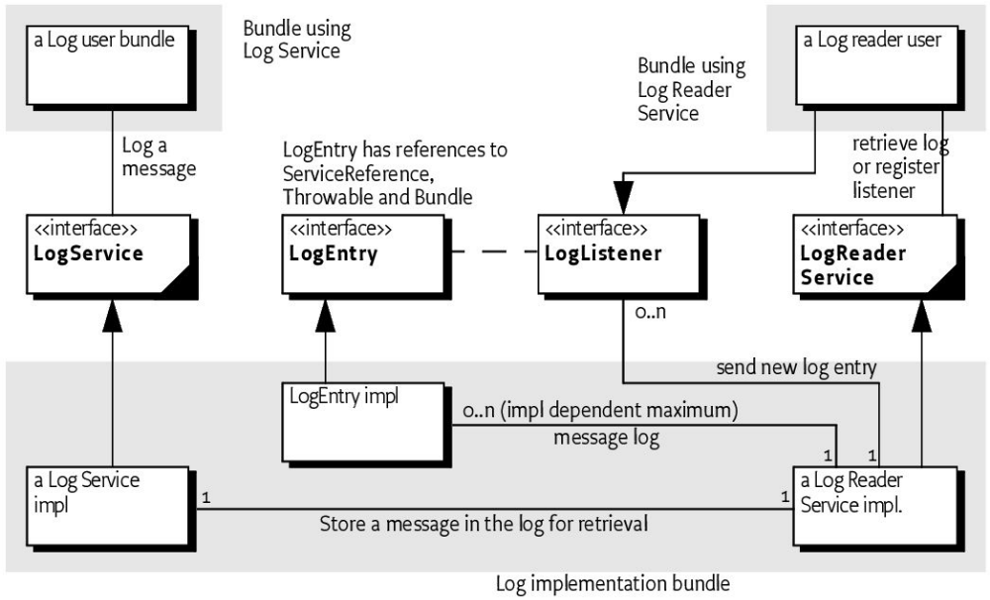
Example: log implementation bundle

Slide 17
Questions
???

