Slide 1
OpusCollege and the use of Spring and iBatis

Slide 2
Spring within OpusCollege:
Spring Framework
Inversion of Control
Aspect Oriented Programming

Slide 3
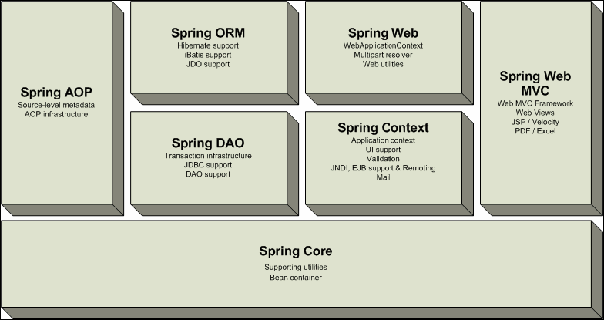
1. Spring Framework

Slide 4
Spring Framework
– used in OpusCollege:
Spring Core:
  Web.xml
  Dispatcher-servlet
Spring Context:
  Application-context (several files, clipped together in web.xml)
  Web-context (several files, clipped together in web.xml)
Spring DAO:
  JDBC configuration (jdbc.properties + META-INF/context.xml)
  DAO support
Spring ORM:
  iBatis support (SqlMapConfig.xml)
Spring Web MVC (package web and web-module)
Spring AOP (package util/LogTracer)
Spring Transaction Management (start in package service/StudyManager / transactionManager)

Slide 5
1. Spring Core
Web.xml
Dispatcher servlet: url-mapping and interceptors (front-controller-servlet.xml)
  All requests go to 1 (of the) DispatcherServlet(s).
  Every DispatcherServlet is defined in web.xml
  Every DispatcherServlet has a WebApplicationContext, default loaded from:
    /WEB-INF/<servlet-name>-servlet.xml.
  Functions of the DispatcherServlet:
    Maps request URL with the controller.
    Calls the controller.
    Receives ModelAndView object of the controller.
    Maps view name to a real view.
    Calls the view.

Slide 6
2. Spring Context
ApplicationContext:
  Configuration (see: applicationContext.xml)
    Preloading of Singleton Beans
    Message Resource Handling
    Easy integration of AOP through BeanFactoryPostProcessor
WebContext (see: web.xml)
Context Hierarchy (see: web.xml)

Slide 7
2. Spring Context
ApplicationContext:
  Bean-creation:
      Constructor-based: through the constructor
      Setter-based: through properties and dependencies
      Combination Constructor-based and Setter-based
  In OpusCollege: setter-based (see applicationContext-xxx.xml)

Slide 8
2. Spring Context
Inversion of Control A.k.a. Dependency Injection
Usage in OpusCollege :
  DAO for persistency (package data)
  Domain model in POJOs (package domain)
  Service Layer as façade (package service)
  MVC with (constraint) JSP (package web and web-module)

Slide 9
2. Spring DAO:
JDBC configuration
JDBC Configuration:
  Jdbc.properties
  META-INF/context.xml

Slide 10
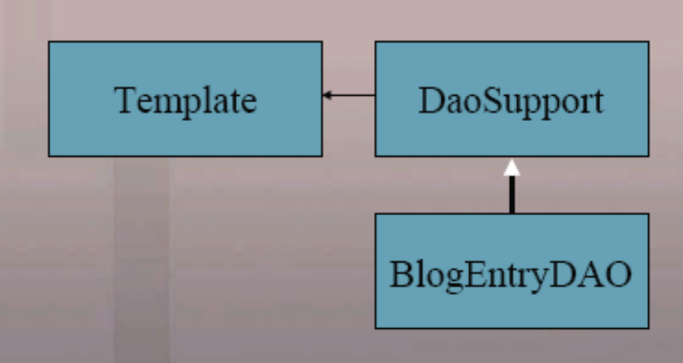
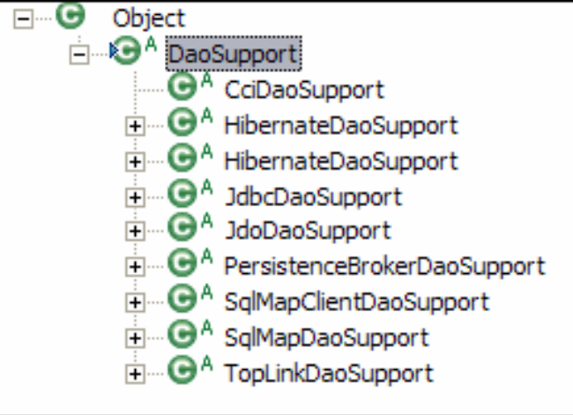
3. Spring DAO: DAO Support

Slide 11
3. Spring DAO: DAO Support
Spring provides DAO-interfaces for:
  JDBC
  Hibernate
  iBatis
  JDO
  Toplink
OpusCollege uses iBatis

Slide 12
4. Spring ORM: iBatis Support
iBatis:
  Simpler than Hibernate, more advanced than JDBC
  Mapping of SQL queries to Objects and vice versa, including caching
  Version 1.3 (SqlMap) and 2.0 (SqlMapClient) supported by Spring through SqlMapClientTemplate -> SqlMapClientDaoSupport

Slide 13
4. Spring ORM: iBatis Support
Spring Interface for iBatis SQLMaps -SqlMapClientTemplate:
  sqlMapClientTemplate.queryForObject(“getXById”, id)
  sqlMapClientTemplate.queryForList(“getXById”, id)
  sqlMapClientTemplate.update(“insertX”, x)
  sqlMapClientTemplate.delete(“deleteX” ,id)
SQL-maps:
  <!-- find all Students -->
  <select id="findAllStudents" parameterClass="map" resultClass="Student">
  select * from opuscollege.student
  INNER JOIN opuscollege.person ON opuscollege.student.personId = opuscollege.person.id
  ORDER BY lower(person.surnameFull)
  </select>

Slide 14
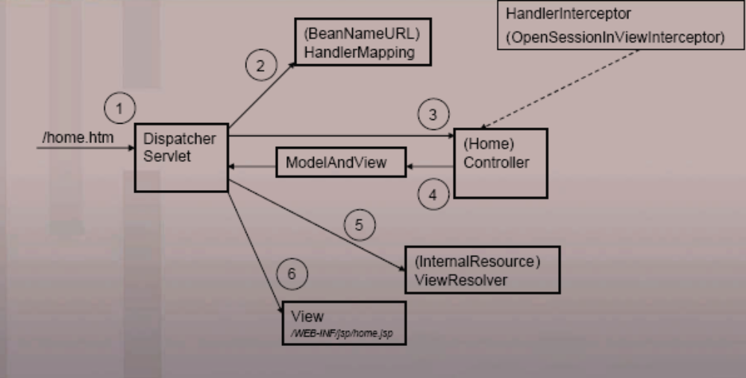
5. Spring Web MVC

Slide 15
5. Spring Web MVC
The model represents the data (a database or another backend-system)
The view is a visual representation of the model
The controller makes changes to the model

Slide 16
5. Spring Web MVC
OpusCollege - Integration with following ‘view technologies’:
  JSP & JSTL – the default provided by J2EE
  Javascript
  Excel/PDF – render view as document file
  JasperReports – reporting engine that can render to CSV
  HTML

Slide 17
5. Spring Web MVC
OpusCollege – use of Validator interface: validation of forms and so on (package validators)
In the case of an invalid validation a BindException occurs in Spring. For this purpose the Spring Taglib provides ‘spring:bind’

Slide 18
6. Spring AOP
i.e. Aspect Oriented Programming
Used for:
  ‘crosscutting concerns’: services, that touch the entire application and therefore are repeated at all/many methods
  container services (for example logging, security, session mgt., transaction mgt.)
In OpusCollege: logging (package config/LogTracer)

Slide 19
OpusCollege
– not Spring-specific
File-upload and -display (package web.util):
  Libraries Commons-io and commons-fileupload
Internationalization:
  Multi-lingual through localeChangeInterceptor (see: frontcontroller-servlet.xml)
Logging: log4j through AOP (config/LogTracer)

Slide 20
Questions
???

