Slide 1
Spring Dynamic Modules

Slide 2
Spring Dynamic Modules
Startlocation: http://www.springsource.org/osgi
Documentation: http://static.springsource.org/osgi/docs/1.2.1/reference/html/

Slide 3
Spring Framework and OSGi
Support for OSGi in the roadmap as off 2.1 RC1 (issue SPR-1802):
  Spring itself deployable as a set of bundles.
  Spring application context in a bundle.
  Integration of OSGi services and Spring's dependency injection, with proxy support
Natural enhancement to Spring: the simplicity and power of Spring … with the dynamic module system of OSGi

Slide 4
OSGi benefits for Spring
Strong Module foundation
  Partition a system into a number of modules: "bundles"
  Strict visibility rules
  Resolution process: satisfies dependencies of a module
  Understands versioning!
Spring manages the internal structure of each bundle
  One ApplicationContext per bundle
  Spring’s fine-grained component model
  General Spring middleware services
OSGi manages the overall collection of bundles and services at runtime

Slide 5
Benefits - Visibility
By default a bundle is a black box
completely protected
you can't see inside it, not even by reflection or any other classloading trickery
If you want to expose types to other bundles you must do so explicitly
A bundle can export one or more packages
  optionally with version information
Only exported packages are visible outside of the exporting bundle
  stops unintended coupling between modules
  enables independent development
  faster development cycles
  security

Slide 6
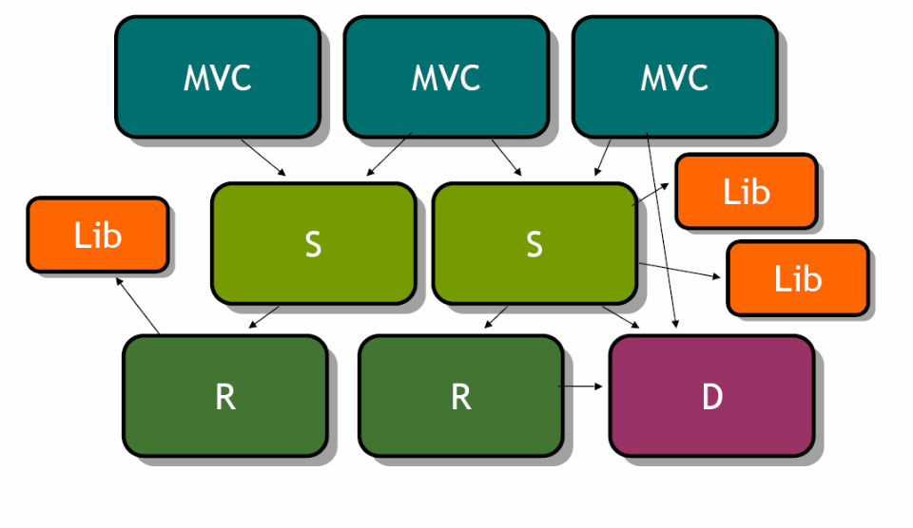
Benefits - Visibility
Each bundle is a segregated class space

Slide 7
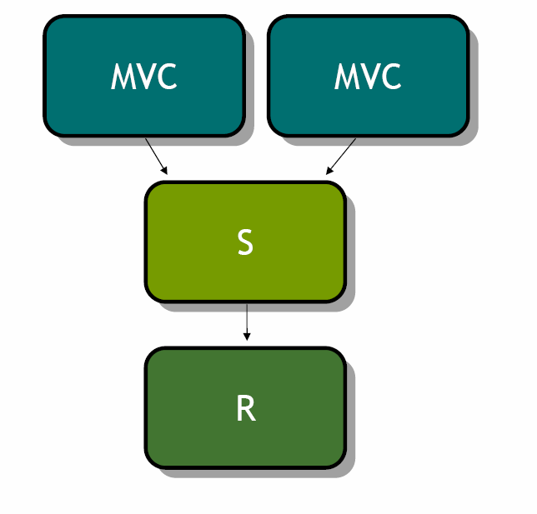
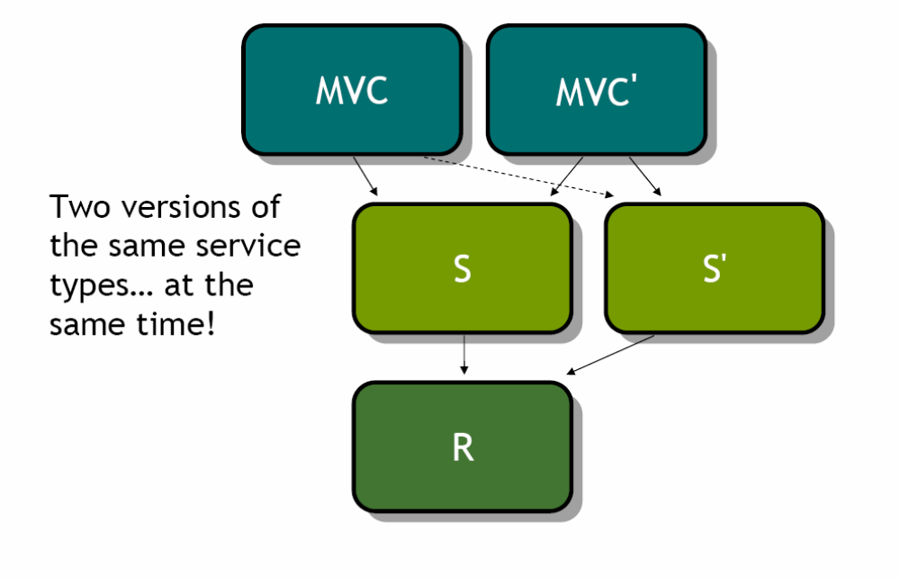
Benefits – Versioning support

Slide 8
Benefits
- Service oriented architecture
Bundles can publish services dynamically
Service Registry allows other bundles to find services and to bind to them
Services come and go at runtime, all taken care of for you

Slide 9
Benefits - Operational Control
See all modules and their status
  OSGi console
  JMX
Get information on wiring
modules can be
  installed
  started
  stopped
  uninstalled
  updated / refreshed
  All at runtime !

Slide 10
Spring-OSGi project: Goals
Use Spring container to configure modules (bundles)
Make it easy to publish and consume services
  across a number of bundles
Enable applications to be coded without dependency on OSGi APIs
  easy unit and integration testing
Provide the needed bundles and infrastructure to deploy OSGi based applications to application servers

Slide 11
Spring-OSGi project: Collaborators
Led by SpringSource / VMWare
Committers from BEA and Oracle also active on the project
Input to the specification and direction from
  OSGi Alliance (technical director and CTO)
  BEA, Oracle, IBM
  Eclipse Equinox
  Felix
  and many individuals

Slide 12
Spring Dynamic Modules for OSGi™ Service Platforms
Spring modules packaged as OSGi bundles
  spring-core
  spring-beans
  spring-aop
  etc.
All the necessary import and export package headers defined
Enables an OSGi application to import and use Spring packages and services
Currently done in Spring-OSGi project
  spring module jars will come this way "out of the box" in Spring 2.1

Slide 13
Creating a bundle application context
OsgiBundleXmlApplicationContext
  A Spring application context based on an OSGi bundle
  uses bundle context and classloader to load resources
  implements Spring's resource abstraction for OSGi
    relative resource paths resolved to bundle entries
    "bundle:" prefix for explicit specification
Possible to create a bundle application contextprogrammatically… …but you don't normally need to: Deploy the org.sfw.osgi.extender bundle
  acts like "ContextLoaderListener"
  automatically creates Spring application context inside a bundle when a bundle is started
    no code or dependence on Spring APIs required!

Slide 14
From jar file to Spring bundle…
Start with an ordinary jar file containing classes and resources for a module
  mymodule.jar
Add needed headers to META-INF/MANIFEST.MF
  Bundle-SymbolicName: org.xyz.myapp.mymodule
  Bundle-Version: 1.0
Use one of several existing tools to automatically calculate import and export headers
Place application configuration files in META-INF/spring folder
The extender bundle will detect that this bundle has "*.xml" resources in META-INF/spring and automatically build an application context using them
Possible to put configuration files in an alternate location specified by Spring-Context manifest header

Slide 15
OSGi based web applications – three strategies
OSGi container embedded in another container: OSGi Bridge Server (OBS)
  e.g. OSGi within Apache Tomcat 5.5.x/6.0.x or Jetty 6.1.8+/6.2.x
  controlled through a bridge servlet (for instance Equinox)
    front controller
    dispatches servlet requests to bundles
OSGi container with a http-container on top of it
  PAX Web solution: only have an OSGi runtime with an HTTP-container (Jetty 7) on top of it
OSGI container with all services / servers / .. as bundles within it
  Equinox solution
  Glassfish server with Apache Felix OSGi (http://glassfish.java.net/)

Slide 16
OSGi Bridge Server
Advantages:
  Easy to implement, based on existing applications
  Web-support for Apache Tomcat and Jetty: http://static.springsource.org/osgi/docs/1.2.1/reference/html/web.html. Install:
    spring-osgi-web.jar - Spring DM web support
    spring-osgi-web-extender.jar - Spring DM web extender
Disadvantages:
  Not really modular: 1 war-file for all ‘bundles’ of a web application

Slide 17
PAX
Startlocations:
  http://team.ops4j.org/wiki/display/ops4j/Pax
  http://team.ops4j.org/wiki/display/paxweb/Pax+Web
Advantages:
  Modular basis: OSGi container
Disadvantages:
  Limited possibilities: no services

Slide 18
OSGi container with bundles
Advantages:
  Strictly modular: libraries, servers, … are considered bundles
Disadvantages:
  Not explicitly for web: still problems to solve (tld-files, Web integration, …)
  Session management not trivial: over several bundles .. ??

Slide 19
Questions
???

