Slide 1
SMART RESUME SELECTOR

Slide 2
Presented By
MUHAMMED SHABEER M P
(MES21MCA-2027)
Product Owner
VASUDEVAN T V
Asst. Professor
MES College of Engineering, Kuttippuram
Date : 28.02.2023, Tuesday

Slide 3
TABLE OF CONTENTS
Introduction
Existing System
Proposed System
Module Description
System requirements
Data Flow Diagram
User Story
Product backlog
Project Plan

Slide 4
INTRODUCTION
Resumes plays an important role in the recruitment process, it decides the candidate’s first impression on the recruiter.
Resumes are a form of unstructured data, it is really hard to programmatically read a resume and extract information from it.
This system for automatically choose the right candidate for a right job profile which reduces the effort, time and extra cost spend. This system help to shortlist the candidate initially based on their resume for further process. It will automate the process of resume screening making it easy and time-efficient.
The resume is then converted into tokens which are compared with the defined array of information and skill sets as per the requirement. It focuses on matching occupational category and job requirements with the candidate resume which results in easy management.

Slide 5
EXISTING SYSTEM
In existing system resumes are evaluated and selected manually.
Manual evaluation and selection of resumes is a traditional method used by recruiters to identify suitable candidates for open positions. However, there are several problems associated with this approach.
One of the main challenges is the potential for bias. Recruiters may unintentionally favor candidates who share similar characteristics or backgrounds, such as gender, race, or educational background.
This can lead to a lack of diversity in the hiring process, and potentially exclude highly qualified candidates who do fit the recruiter's preferred profile.

Slide 6
PROPOSED SYSTEM
To overcome the Existing system problem or limitation we propose smart resume selector (SRS) in this paper that focuses on matching occupational category and job post requirement with the candidate resume which result in easy management and reducing time, effort and extra cost spent for this purpose.
In this proposed system we make use of Naïve bayes algorithm. Resumes are classified to various categories based on this algorithm. The implementation of this system will be done as a web application and it include mainly 3 modules.

Slide 7
The Admin module will contain the function such as verifying company, view feedbacks, view rating, view complaint and sent reply to the complaints.
The Company module contain the function for adding vacancies, sorting resumes, sent complaint etc.
The Candidate module include function like applying for vacancy and view them, uploading resume, give rating, sent complaint and view reply for the complaint and sent feedback.
The number of occupational categories can be changed as per the requirements.
Naïve bayes algorithm is implemented.
Ranking of resumes based on score

Slide 8
MODULE DESCRIPTION
Admin
Login
Verify company
View feedback
Add and manage carrier guidance
View rating
View complaint and send reply
View result

Slide 9
Company
Registration
Login
Add vacancies
Upload question
View result
View ranking
View feedback
Send compliant and view reply

Slide 10
Candidate
Registration
Login
View vacancy
Apply for vacancy
Upload resume
Send complaint and view reply
Attend test
Attend mock test
View mock test result View tips
View videos
Send feedback
View result
Give rating

Slide 11
Carrier guidance
Login
Add mock test details (question and answers)
Add and manage tips
View mock test result
Add and manage videos

Slide 12
SYSTEM REQUIREMENTS
HARDWARE REQUIREMENTS
• Processor : Intel Pentium and above
• RAM : 4GB or more
• Storage : 40 GB hard disk and above

Slide 13
SOFTWARE REQUIREMENTS
Operating System : Windows 10
Front End : HTML, CSS, JAVASCRIPT
Back End : MySQL
IDE : Jetbrains Pycharm
Web browser : Chrome, Explorer, Edge, …

Slide 14
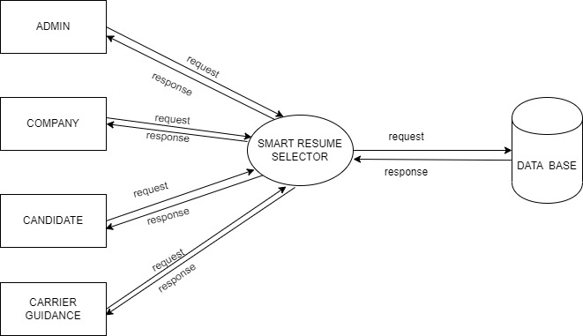
DATA FLOW DIAGRAM
LEVEL 0

Slide 15
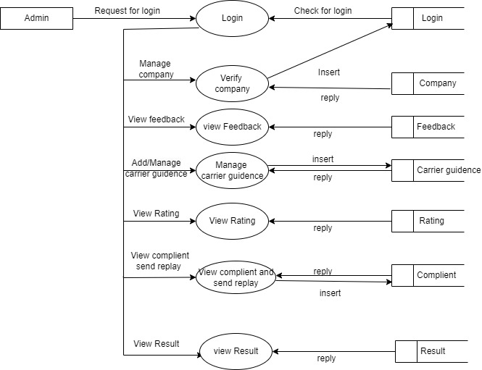
LEVEL 1 Admin

Slide 16
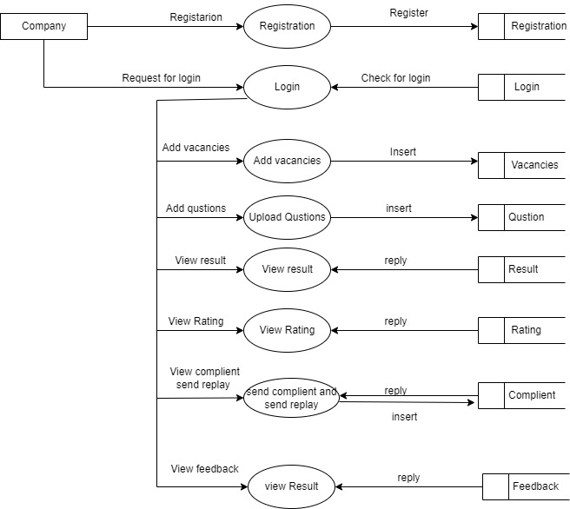
LEVEL 2 Company

Slide 17
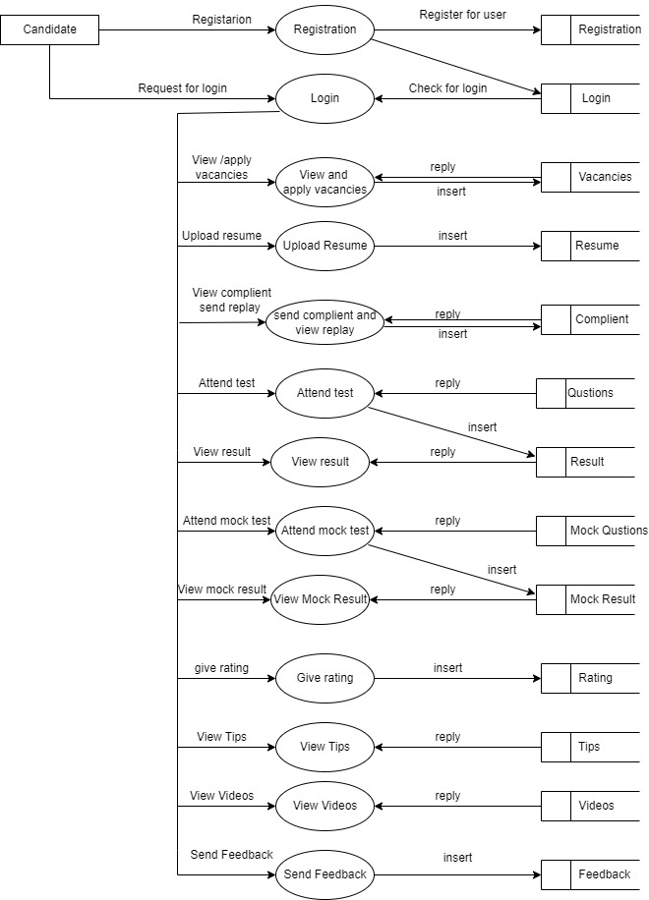
LEVEL 3
Candidate

Slide 18
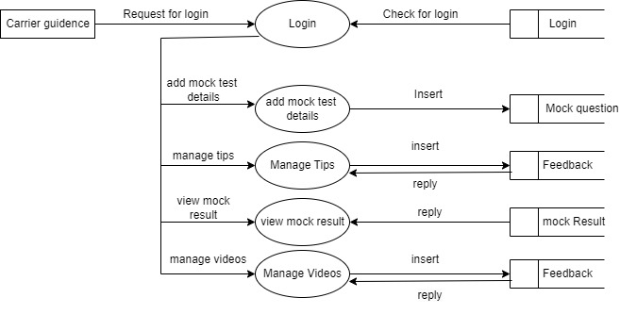
LEVEL 4 Carrier Guidance

Slide 19
USER STORIES
UserStory_ID | As a <type of user> | I want to | So that I can
1 | Admin | Login | Login successful with correct username and password
2 | Admin | Verify Company | Verify the company details and approve for login
3 | Admin | View feedback | View Feedback from candidate
4 | Admin | Manage carrier guidance | manage carrier guidance login privileges
5 | Admin | View rating | View rating from candidate
6 | Admin | View complaint and send reply | View complaint and send reply To candidate and company
7 | Admin | View result | View rank details and result Of candidates

Slide 20
UserStory_ID | As a <type of user> | I want to | So that I can
8 | Company | Registration | Create new Profile
9 | Company | Login | Login successful with correct username and password
10 | Company | Add vacancies | Upload job vacancies
11 | Company | Upload question | Upload Test question
12 | Company | View rating | View rating from candidate
13 | Company | Send complaint and view reply | send complaint and view reply From admin
14 | Company | View result | View Test result of candidates
15 | Company | View ranking | View rank of candidates

Slide 21
UserStory_ID | As a <type of user> | I want to | So that I can
16 | Candidate | Registration | Create new Profile
17 | Candidate | Login | Login successful with correct username and password
18 | Candidate | View vacancies | View Job vacancies
19 | Candidate | Apply for vacancies | Apply for job vacancies
20 | Candidate | Add resume | Upload resume
21 | Candidate | send complaint and view reply | send complaint and view reply From admin
22 | Candidate | Attend mock test | Attend mock test
23 | Candidate | Attend test | Attend test

Slide 22
UserStory_ID | As a <type of user> | I want to | So that I can
24 | Candidate | View mock test result | View mock test result
25 | Candidate | View test result | View test result
26 | Candidate | View tips | View tips from carrier guidance
27 | Candidate | View videos | View videos from carrier guidance
28 | Company | Send feedback | Send feedback
29 | Company | Give rating | Give rating

Slide 23
UserStory_ID | As a <type of user> | I want to | So that I can
30 | Carrier guidance | Login | Login successful with correct username and password
31 | Carrier guidance | Add mock test details | Add mock test details
32 | Carrier guidance | Add and manage tips | Manage tips
33 | Carrier guidance | Add and manage videos | Manage videos
34 | Carrier guidance | View mock test result | View mock test result

Slide 24
PRODUCT BACKLOG
UserStory_ID | Name | Priority
1 | Login for admin | High
2 | Verify Company | High
3 | View feedback | Medium
4 | Manage carrier guidance | Medium
5 | View rating | Medium
6 | View complaint and send reply | High
7 | View result | Low
8 | Company Registration | High
9 | Login for company | High
10 | Add vacancies | High

Slide 25
UserStory_ID | Name | Priority
11 | Upload Test question | High
12 | View rating | Low
13 | Send complaint and view reply | Medium
14 | View result | High
15 | View ranking | High
16 | Candidate Registration | High
17 | Login for candidate | High
18 | View vacancies | Medium
19 | Apply for vacancies | Medium
20 | Upload resume | High

Slide 26
UserStory_ID | Name | Priority
21 | send complaint and view reply | Low
22 | Attend mock test | Low
23 | Attend test | Medium
24 | View mock test result | Low
25 | View test result | Medium
26 | View tips | Low
27 | View videos | Low
28 | Send feedback | Low
29 | Send rating | Low
30 | Login for carrier guidence | Medium

Slide 27
UserStory_ID | Name | Priority
31 | Add mock test details | Low
32 | Manage tips | Low
33 | Manage Videos | Low
34 | View mock test result | Medium

Slide 28
PROJECT PLAN
User Story_ID | Sprint | StartDate | EndDate | Day | Status
1 2 3 4 5 6 7 8 9 | sprint1 | 07/02/2023 | 03/02/2023 | 21 | Planned
10 11 12 13 14 15 16 17 18 | Sprint 2 | 04/03/2023 | 25/03/2023 | 21 | Planned

Slide 29
User Story_ID | Sprint | StartDate | EndDate | Day | Status
19 20 21 22 23 24 25 26 | Sprint 3 | 02/04/2023 | 23/04/2023 | 21 | Planned
27 28 29 30 31 32 33 34 | Sprint 4 | 24/04/2023 | 15/05/2023 | 21 | Planned

Slide 30
Thank you

