Slide 1
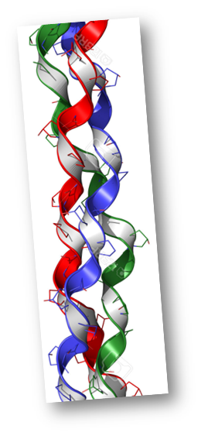


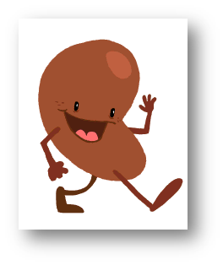
Made by:
Paula Bernardo
Mariluz Parejo
María Plaza
Cristina Rubio
21/02/2017

Slide 2

Index
Introduction
Objective
Explanation of the organ transplant database

Slide 3
Introduction
Organ donation and transplantation is offering thousands of people across the world a second chance for living.
It has improved a lot, but is still a challenge Organ rejection
DEFINITION
Surgical removal of a healthy organ from one person and its transplantation into another individual whose organ has failed or was injured. In most of the cases it becomes lifesaving.

Slide 4
Objective
Assignation organ patient needs to be done in a very fast way.
Organ out of the body lasts between 12 and 48 hours.
Time taken in the transplantation process is minimized.

Slide 5
Explanation of our database
It is capable of keeping track of the transplants that are being performed in a specific hospital.
Waiting list that takes into account:
- Blood type,
- Size of the organ,
- Time spent at the waiting list,
- Life expectancy
-Other medical criteria
Looking for compatibility

Slide 6
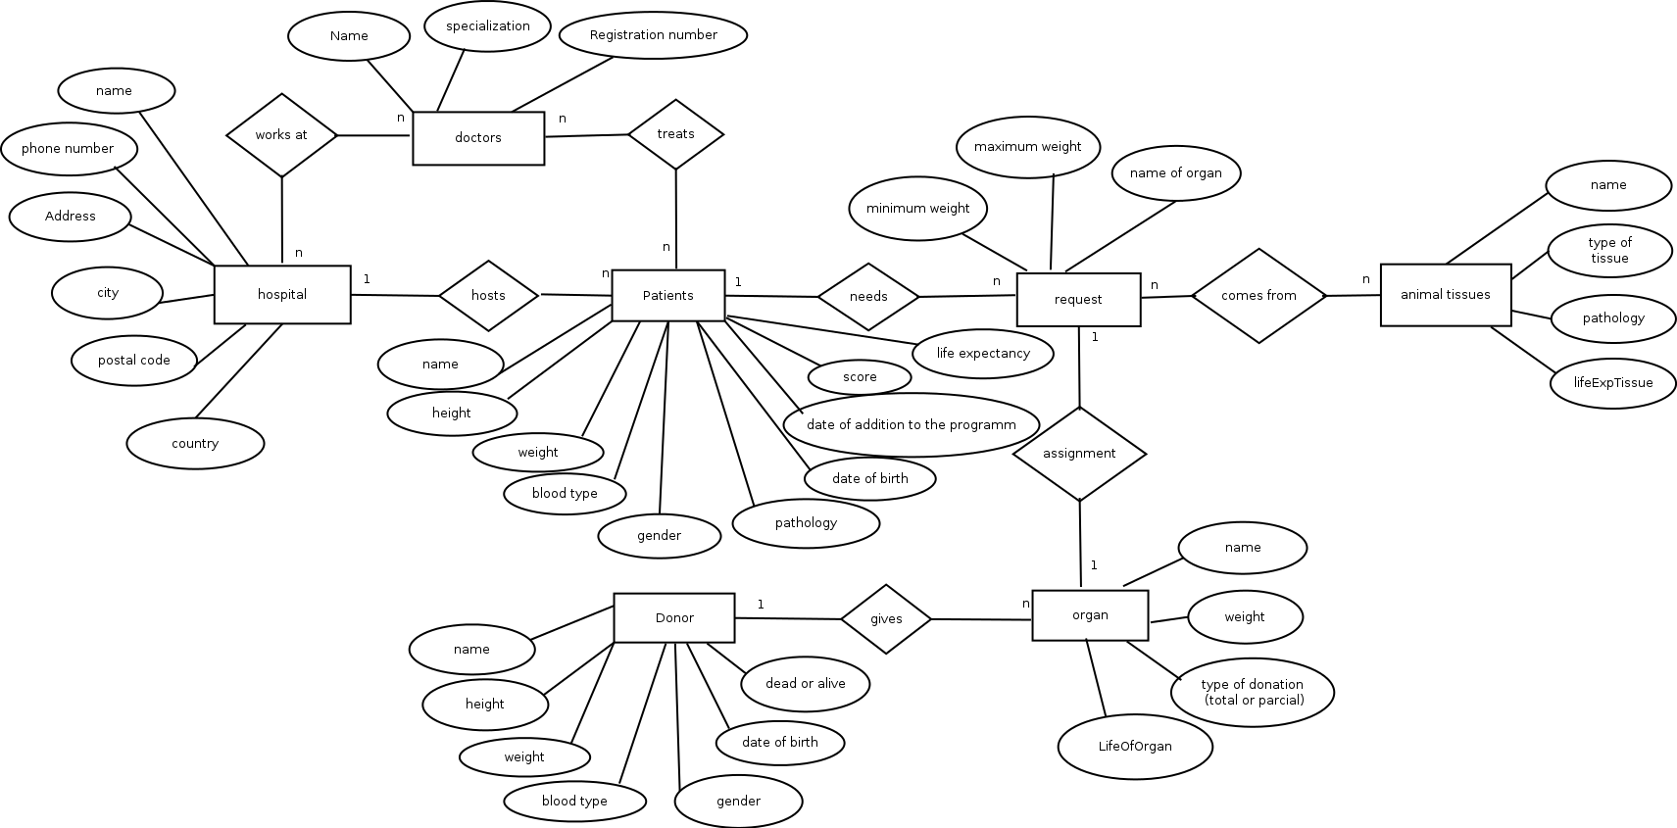
GENERAL VIEW OF THE DIAGRAM

Slide 7
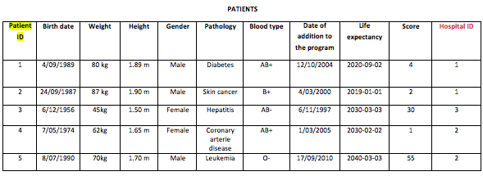
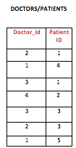
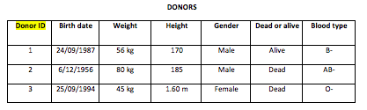

Slide 8
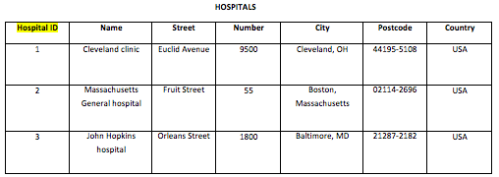
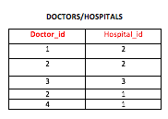


Slide 9
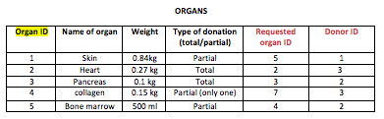
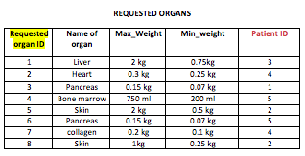

Slide 10
