Slide 1
German Neuroinformatics Node
Research Data Management, Hosting and Sharing
The GIN research data platform and associated tools
http://www.g-node.org

Slide 2

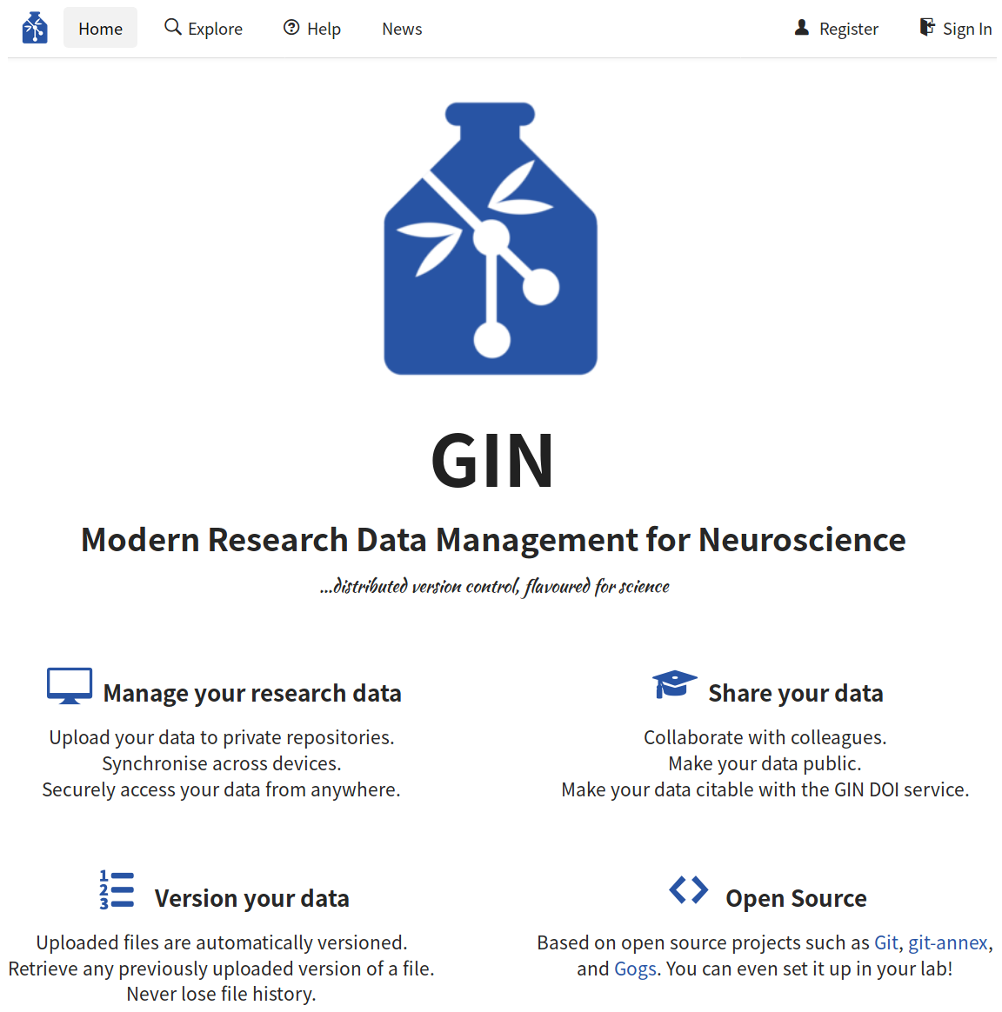
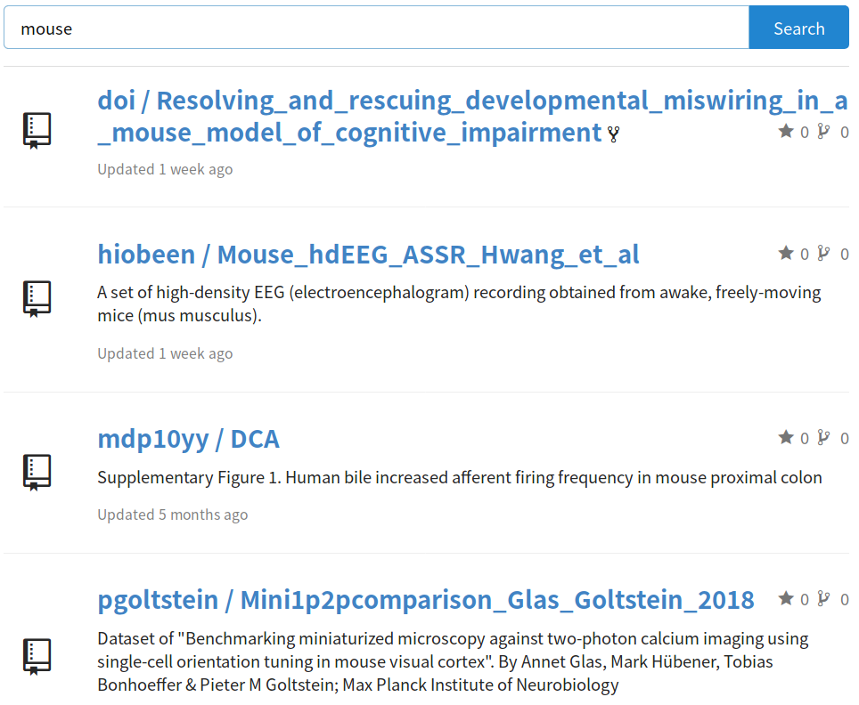
GIN - G-Node Infrastructure
Scientific data hosting service
https://gin.g-node.org

Slide 3



GIN - G-Node Infrastructure
Neuroscience data repository
recommended by:
Statistics
  3000+ repositories (~1200 public)
  ~2900 users
  62 TB of research data
https://gin.g-node.org

Slide 4
Using GIN
General features
  Github like service
    Public and private repositories
    Access control via user permissions, organizations and teams
    Issues, pull requests, wiki
  Platform independent data access
  Enables easy data publishing (DOI)
https://gin.g-node.org

Slide 5
Using GIN
General features
  Indexing and search of text file content
  Built-in file versioning
  Manual and automated workflow integration
  Specific handling of large files via git annex
    Handles large files better than git
    Enables to keep only required file content locally
https://gin.g-node.org

Slide 6
Using GIN
Handle collaboration
  Repositories and permissions
    add registered users to a repository
    Invite non-registered users by email address
    assign Read only; Write access; Admin access
  Organisations
    Create repositories using the organisation
    Create teams using the organisation
      assign read; write; admin; owners
      add registered users to teams
https://gin.g-node.org

Slide 7
Using GIN
Handling data using the web interface
    Upload files
    Create new folders and files
    Edit files online
    Delete files
    Download single files
    Download repository zip
      Download large file content separately
    Extensive user documentation
https://gin.g-node.org/G-Node/Info/wiki/Web+Interface
https://gin.g-node.org

Slide 8
Using GIN
Handling data using the
gin command line client
    Simplified git commands
      Download, upload
      Local user login
      Version control
      Local large file content handling
      Work with different remotes
      Work with different servers
      Extensive command help
    Full git and git annex commands supported
https://gin.g-node.org

Slide 9
Using GIN
Handling data using the
gin command line client
    Automatic ssh key session handling
    Automate workflows; integrate into scripts
    Handle large file content
      download only content required
      specify file size as large file content
    Available for all operating systems
    Beginner and advanced usage documentation
https://gin.g-node.org/G-Node/Info/wiki/GIN+CLI+Setup
https://gin.g-node.org/G-Node/Info/wiki/GIN+CLI+Usage+Tutorial
https://gin.g-node.org

Slide 10

Using GIN
Handling data using the datalad client
    Use the datalad client with GIN
    ssh upload and download supported
    Requires ssh key upload
    GIN specific how-to documentation
https://handbook.datalad.org/en/latest/basics/101-139-gin.html
https://gin.g-node.org

Slide 11

Features - Data Publication
Data publication
    Free data publication service
    Citable datasets (DOI)
    290+ published data sets
    Total published data size: 14TiB
    Free for all public repositories on gin
    Provide metadata about the dataset
    How-to documentation
https://doi.gin.g-node.org
https://gin.g-node.org/G-Node/Info/wiki/DOI
https://gin.g-node.org

Slide 12
Features - self-hosted GIN
Deploy own GIN instance
    Open source
    Docker deployment
      Pre-built Container available
      Build your own container
    Local or public
    Customizable look
      stylesheets
      templates
    Use gin command line client with all GIN instances
    Full installation documentation
https://gin.g-node.org/G-Node/in-house-gin
https://gin.g-node.org

Slide 13
Features – Repository validator
Repository validation service
    Companion service to gin
    Validate repository content
      BIDS repository format
      NIX neuroscience data file format
      odML metadata file format
    Login using gin credentials
    Validate any public GIN repository
    Set up automatic validation on upload to owned repository
    Link results badge on GIN repository
https://valid.gin.g-node.org
https://gin.g-node.org

Slide 14
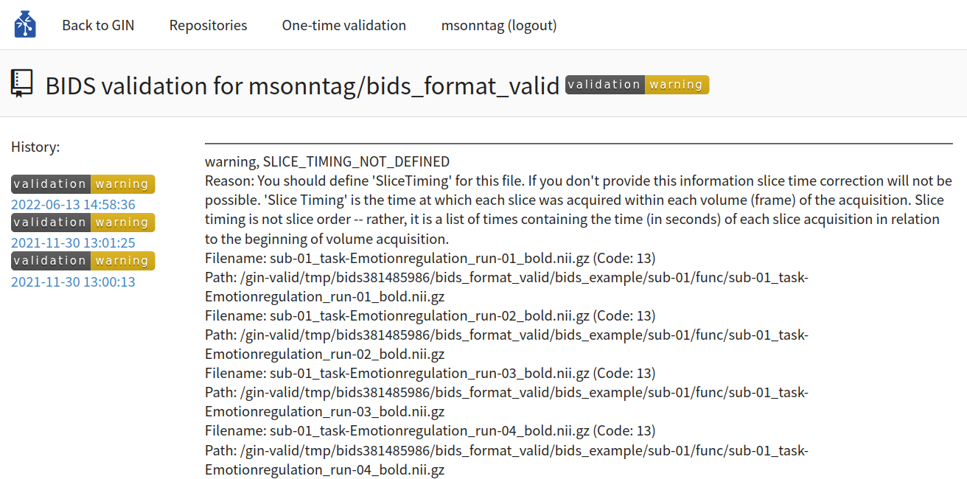
Features – Repository validator
Repository validation service
https://valid.gin.g-node.org
https://gin.g-node.org

Slide 15
Features – Repository validator
Repository validation service
    Submit custom validators
      Core code easy to extend
      Bash, python, npm scripts, executables
      Validator extension documentation
    Run your own validation server
      Open source
      Build on all platforms and deploy via docker
      Connect to GIN or to self-hosted GIN service
https://github.com/G-Node/gin-valid
https://gin.g-node.org

Slide 16
Resources
Linklist
https://gin.g-node.org
https://gin.g-node.org/G-Node/Info/wiki
https://doi.gin.g-node.org
https://gin.g-node.org/G-Node/Info/wiki/In+House
https://github.com/G-Node/gogs
https://gin.g-node.org/G-Node/in-house-gin
https://valid.gin.g-node.org
Get in touch
info@g-node.org
http://www.g-node.org

