Slide 1
14th Göttingen Virtual Meeting 2021
of the German Neuroscience Society
Efficient research data management for reproducible research, collaboration and data publication
GIN research data hosting service
NIX neuroscience data format
odML metadata format
Michael Sonntag
German Neuroinformatics Node

Slide 2

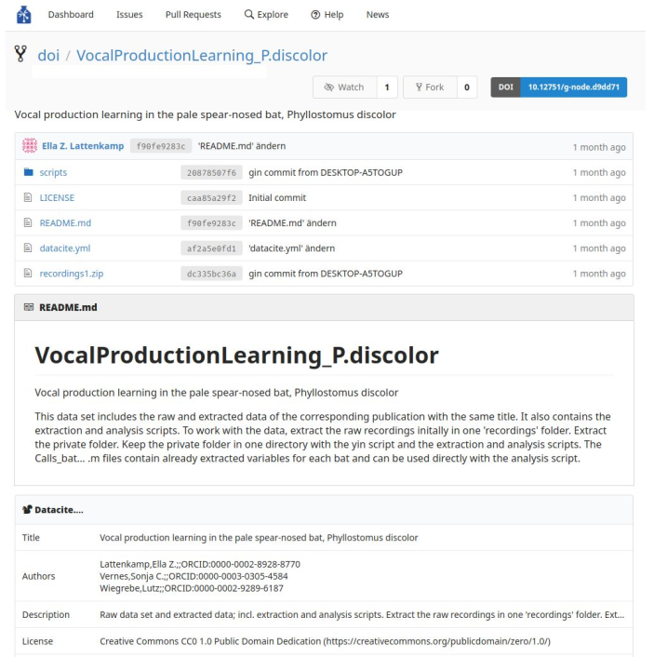



GIN - G-Node Infrastructure
Scientific data hosting service
Features
    Free to use
    Free storage for scientific data
    Collaborative repos/datasets
    Built in file versioning and retrieval
    Public/private repositories
    Web or command line access
    Self hosting local set up (lab or institution)
    Data publication (DOI) of public repositories
Service recommended by
https://gin.g-node.org

Slide 3

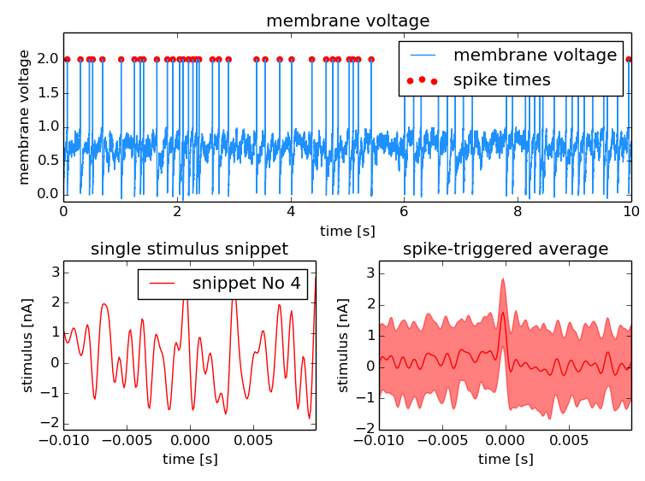

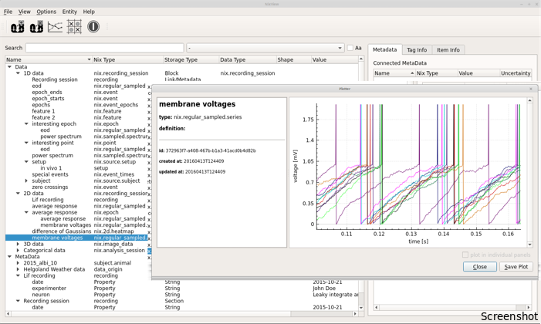

NIX and odML
Raw and analysed data in one NIX file
flexible data model for
diverse kinds of data
data and metadata in the
same file
descriptive association
between data and
metadata
ideal for workflow automation
rich ecosystem
  C++, Python, Matlab
  Graphical user interface
  Used in community libraries
http://neuralensemble.org/neo
http://bendalab.github.io/NixView
https://mne.tools
http://g-node.org/nix

Slide 4
Get in touch
Discover more on our Poster
  Efficient research data management for reproducible research, collaboration and data publication
email us at
info@g-node.org
Find out more about our projects
https://gin.g-node.org/Info/wiki
https://g-node.github.io/nix
https://g-node.github.io/python-odml
http://www.g-node.org

