Slide 1


Handling neuroscientific data with GIN
Present and Future
Michael Sonntag
sonntag@bio.lmu.de
German Neuroinformatics Node
Department Biology II
Ludwig-Maximilians-Universität München
Slides
https://gin.g-node.org/G-Node/PublicResources

Slide 2



A brief introduction to the G-Node
http://www.g-node.org
Thomas Wachtler
Funded by BMBF
Hosted at the Ludwig-Maximilians Universität München
Bernstein Network of Computational Neuroscience
Associated Node of the INCF
funded by

Slide 3
Development of Tools for Efficient Data Management
Well-defined data model for neuroscience data that accounts for all types of recorded data
Flexible methods for data annotation and metadata management that can be adapted to the requirements of the experiment and laboratory
Format and tools for integrated organization of data and metadata, including interfaces for common tools and languages, to facilitate data access, data management, and data analysis
Development and hosting of data management infrastructure
for collaboration and data sharing.

Slide 4



Development of Tools for Efficient Data Management
odML (open metadata Markup Language)
http://www.g-node.org/odml
NIX (Neuroscience Exchange format)
http://www.g-node.org/nix
GIN (G-Node Infrastructure services)
https://gin.g-node.org

Slide 5
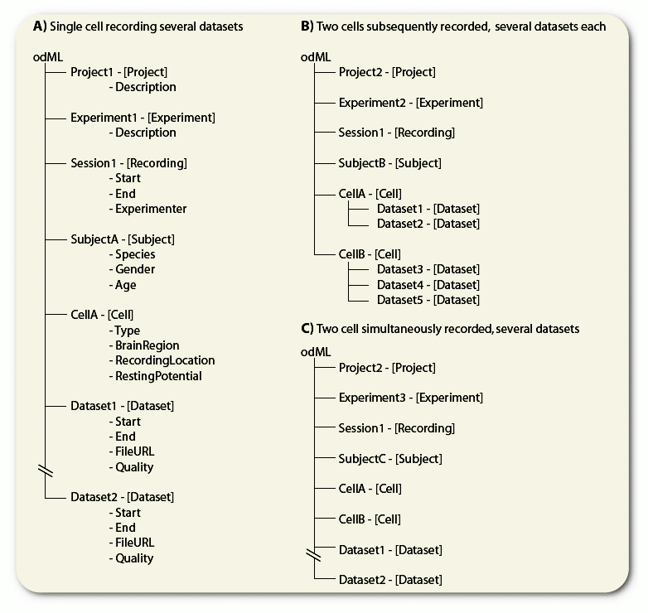
odML (open metadata Markup Language)
http://www.g-node.org/odml
• format: hierarchical structure of
key-value pairs: simple, flexible, inherently extensible ➔ can be adapted to the
specifics of the lab or experiment
• can carry any metadata
• machine write- and readable, facilitates
automated collection of metadata in the
laboratory
• community-driven standardization
through shared terminologies [1]
[1] https://github.com/G-Node/odml-terminologies
Grewe et al (2011) Front. Neuroinf. 5:16

Slide 6
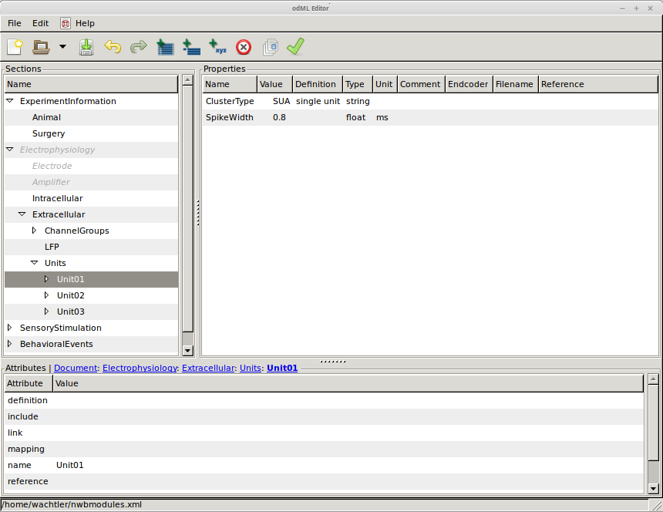


odML: Tools
http://www.g-node.org/odml
• Python core library [1]
enables integration into software tools
• odml-UI editor [2]
• odmltables plugin [3]
(by INM-6 FZ Jülich)
[1] https://github.com/G-Node/python-odml
[2] https://github.com/G-Node/odml-ui
[3] https://github.com/INM-6/python-odmltables

Slide 7
Latest odML format developments
http://www.g-node.org/odml
• streamlined data format (1.3 → 1.4)
• support for YAML and JSON
• export to RDF
• prototype odML flavoured Apache Jena Server
• “fuzzy queries”: experimental abstract SPARQL language

Slide 8
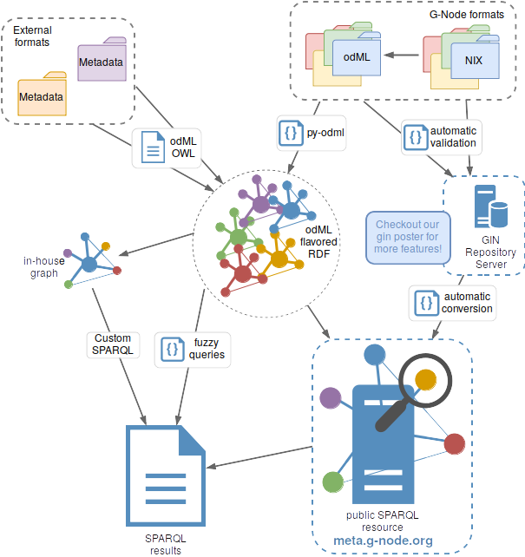
odML flavoured RDF workflow
http://www.g-node.org/odml
Joint project with the CRCNS
https://crcns.org/

Slide 9
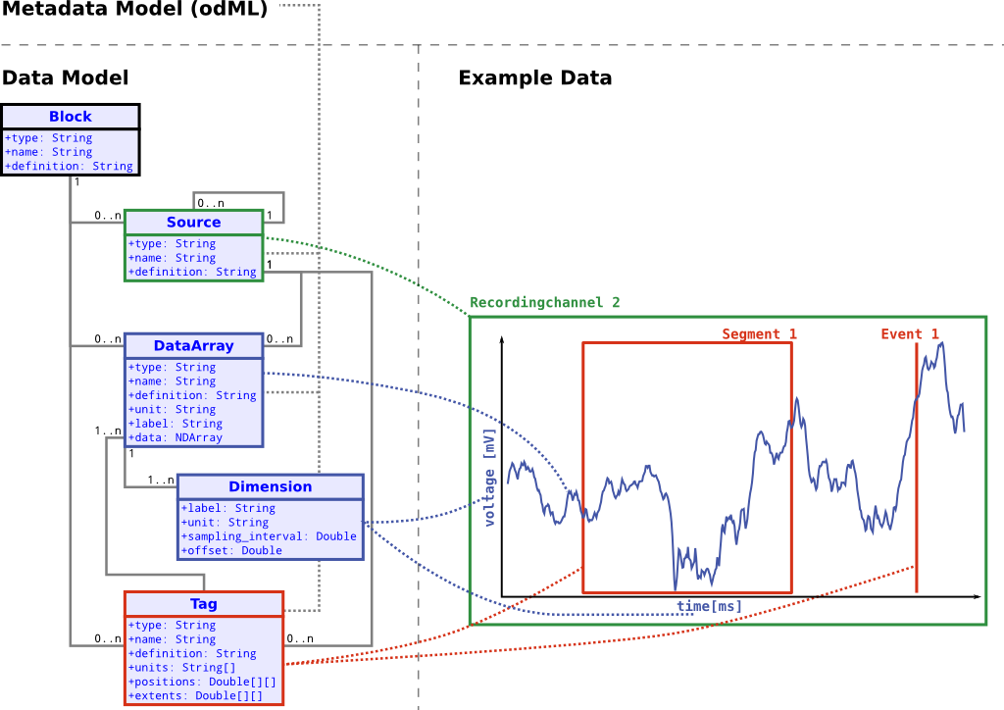
NIX – Format for integration of data and metadata
http://www.g-node.org/nix
• general data model (derived from Neo) to represent recorded data, derived data, relations of data
• flexible data model for metadata (odML) for comprehensive annotation of data
• file backend: HDF5 file format
- structure reflects data model, easy to understand
- other storage backends possible
• libraries for different languages
(C++, Python, Matlab, Java)

Slide 10
NIX – Format for integration of data and metadata
http://www.g-node.org/nix
• storage of n-dimensional data
• definition of regions of interest
• linkage of multiple steps of analysis
• storage of data annotation with
data

Slide 11
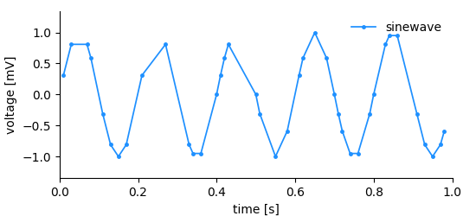
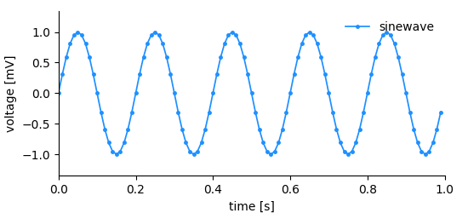
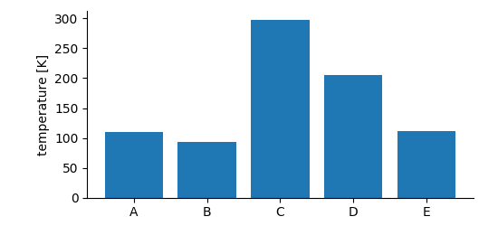
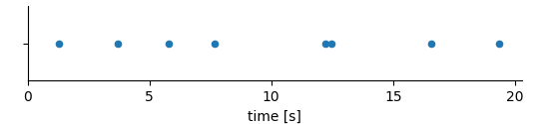
NIX features – Dimensions and tagging
Range dimension
Sampled dimension
Set dimension
Alias Range dimension
Features automatic SI unit conversion
http://www.g-node.org/nix

Slide 12
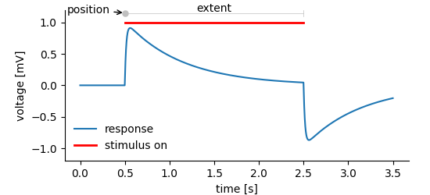
NIX features – Dimensions and tagging
http://www.g-node.org/nix

Slide 13
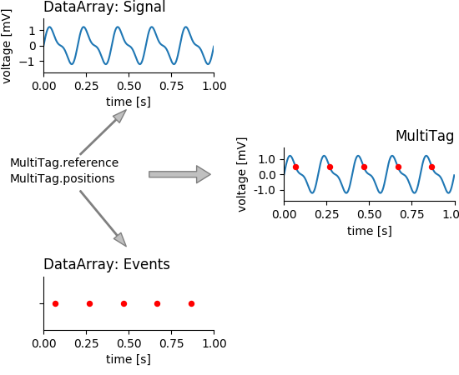
NIX features – Dimensions and tagging
http://www.g-node.org/nix

Slide 14

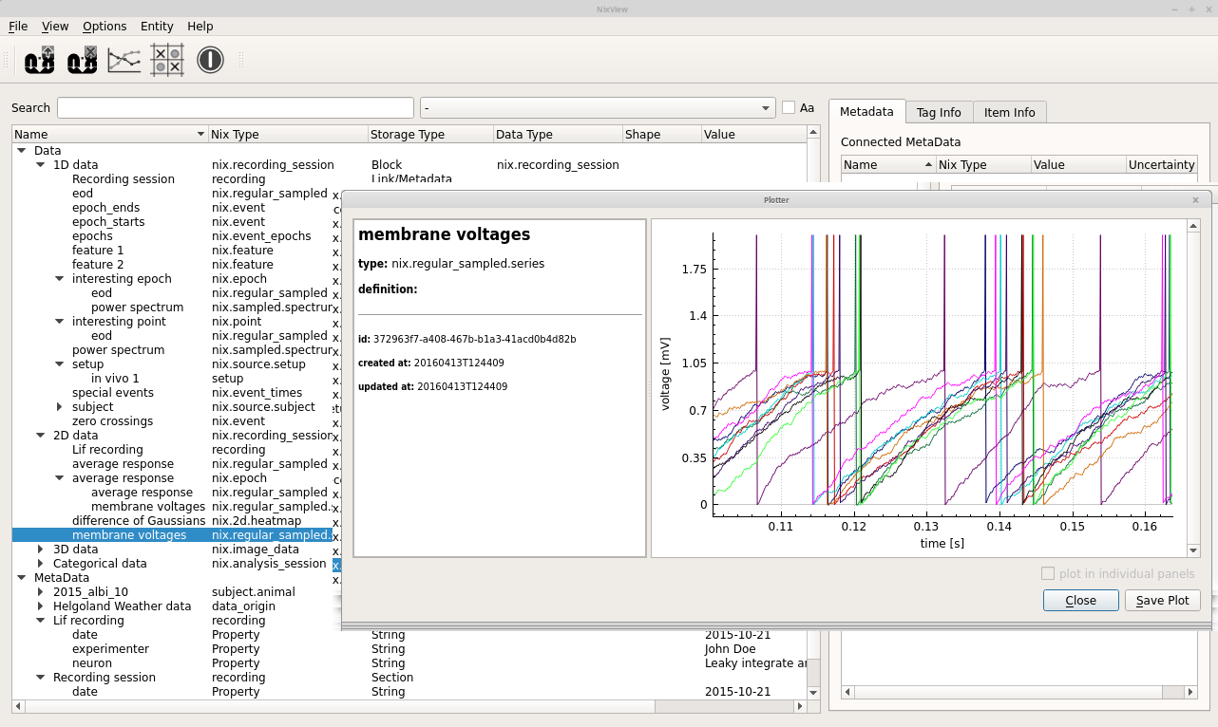
NixView
https://github.com/bendalab/NixView

Slide 15
Latest NIX developments
Pure Python implementation
Format consolidation NIX ↔ odML
Suite of tools for conversion [1]
Visualization tools easy integration into Jupyter notebooks [2]
[1] https://github.com/G-Node/nix-odml-converter
[2] https://github.com/G-Node/nixworks

Slide 16
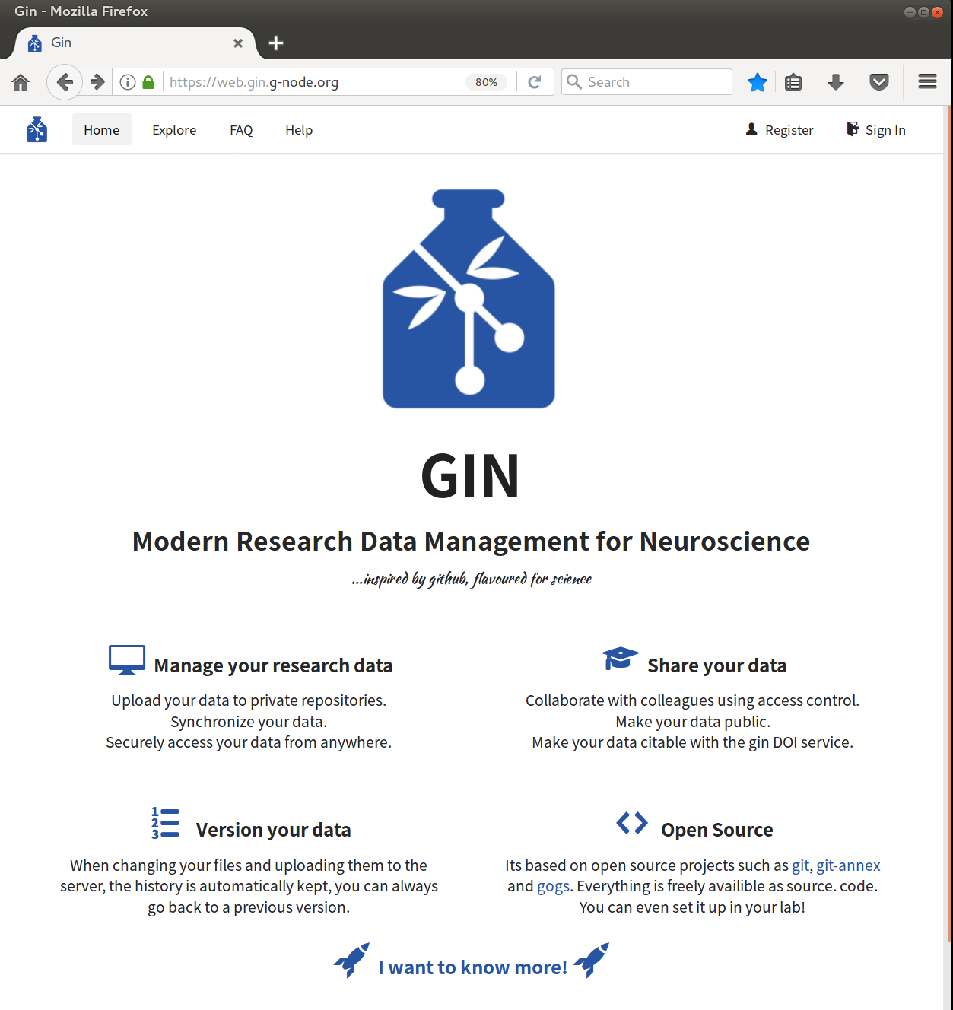
GIN: Services for Data Organization and Sharing
https://gin.g-node.org
Versioned management of data repositories (git)
Distributed data management via file or web browser, or command line client (analysis script integration)
Secure access and sharing
Services for search,
indexing, and
publication (DOI)
File type plugins
In house installation
Extensive usage documentation

Slide 17
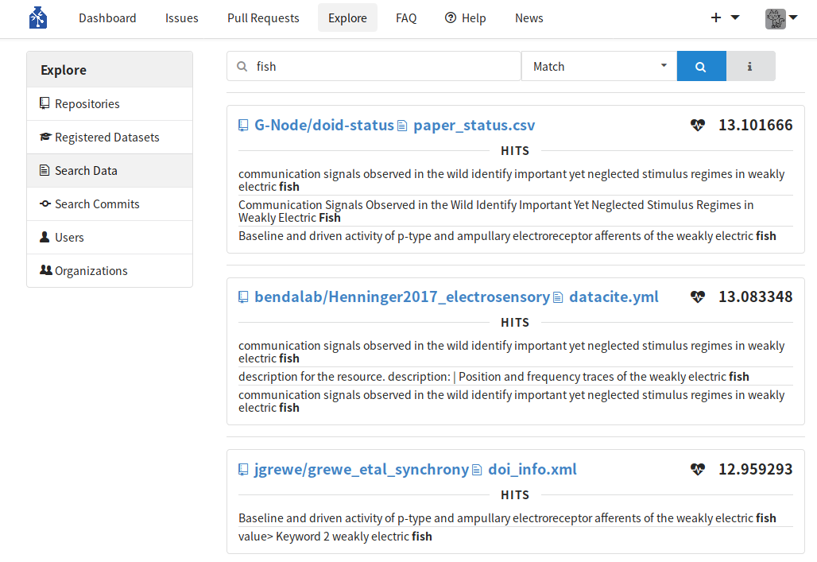
GIN: Services for Data Organization and Sharing
https://gin.g-node.org
Versioned management of data repositories (git)
Distributed data management via file or web browser, or command line client (analysis script integration)
Secure access and sharing
Services for search,
indexing, and
publication (DOI)
File type plugins
In house installation
Extensive usage documentation

Slide 18
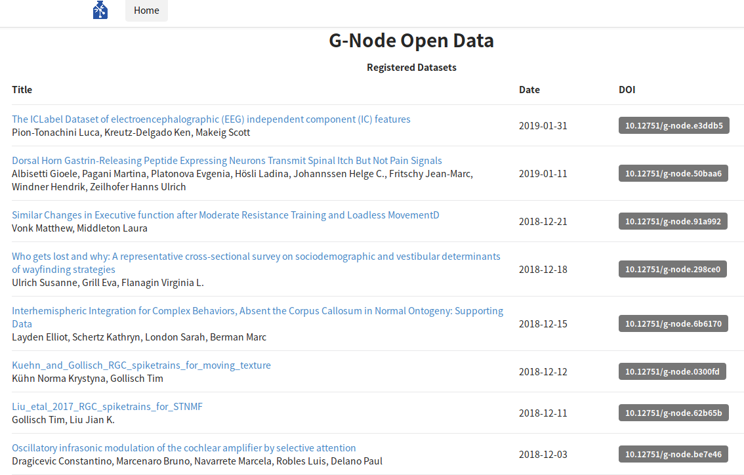
GIN: Services for Data Organization and Sharing
https://gin.g-node.org
Versioned management of data repositories (git)
Distributed data management via file or web browser, or command line client (analysis script integration)
Secure access and sharing
Services for search,
indexing, and
publication (DOI)
File type plugins
In house installation
Extensive usage documentation

Slide 19
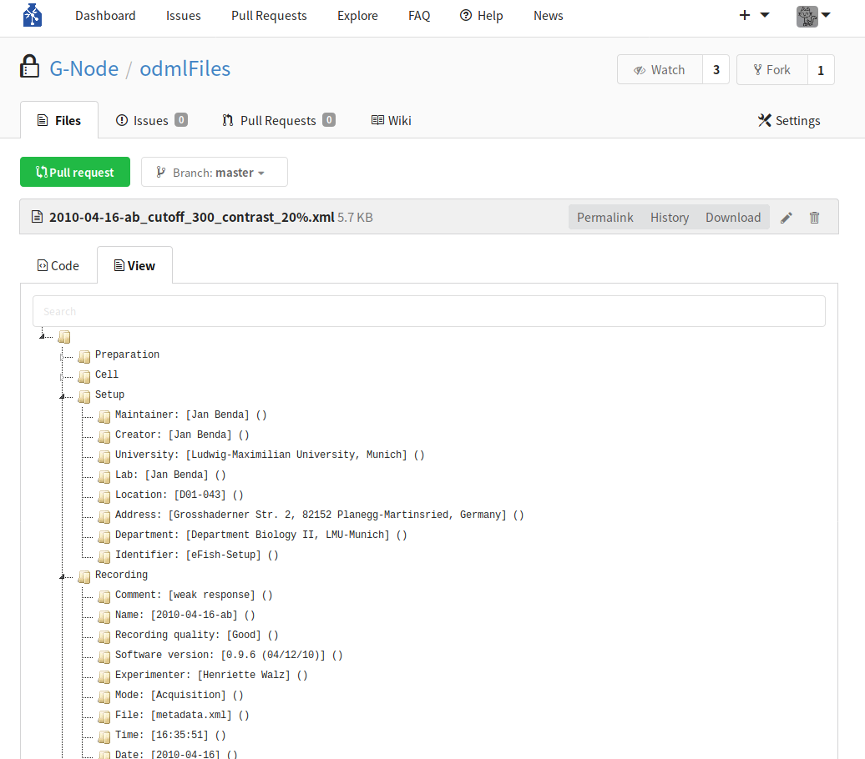
GIN: Services for Data Organization and Sharing
https://gin.g-node.org
Versioned management of data repositories (git)
Distributed data management via file or web browser, or command line client (analysis script integration)
Secure access and sharing
Services for search,
indexing, and
publication (DOI)
File type plugins
In house installation
Extensive usage documentation

Slide 20
GIN: Services for Data Organization and Sharing
https://gin.g-node.org
Versioned management of data repositories (git)
Distributed data management via file or web browser, or command line client (analysis script integration)
Secure access and sharing
Services for search,
indexing, and
publication (DOI)
File type plugins
In house installation
Extensive usage documentation
https://gin.g-node.org/G-Node/Info/wiki
/FaqTroubleshooting
/UsageTutorial
/Webinterface
/DOIfile
/GinCliRecipes
/InHouse

Slide 21
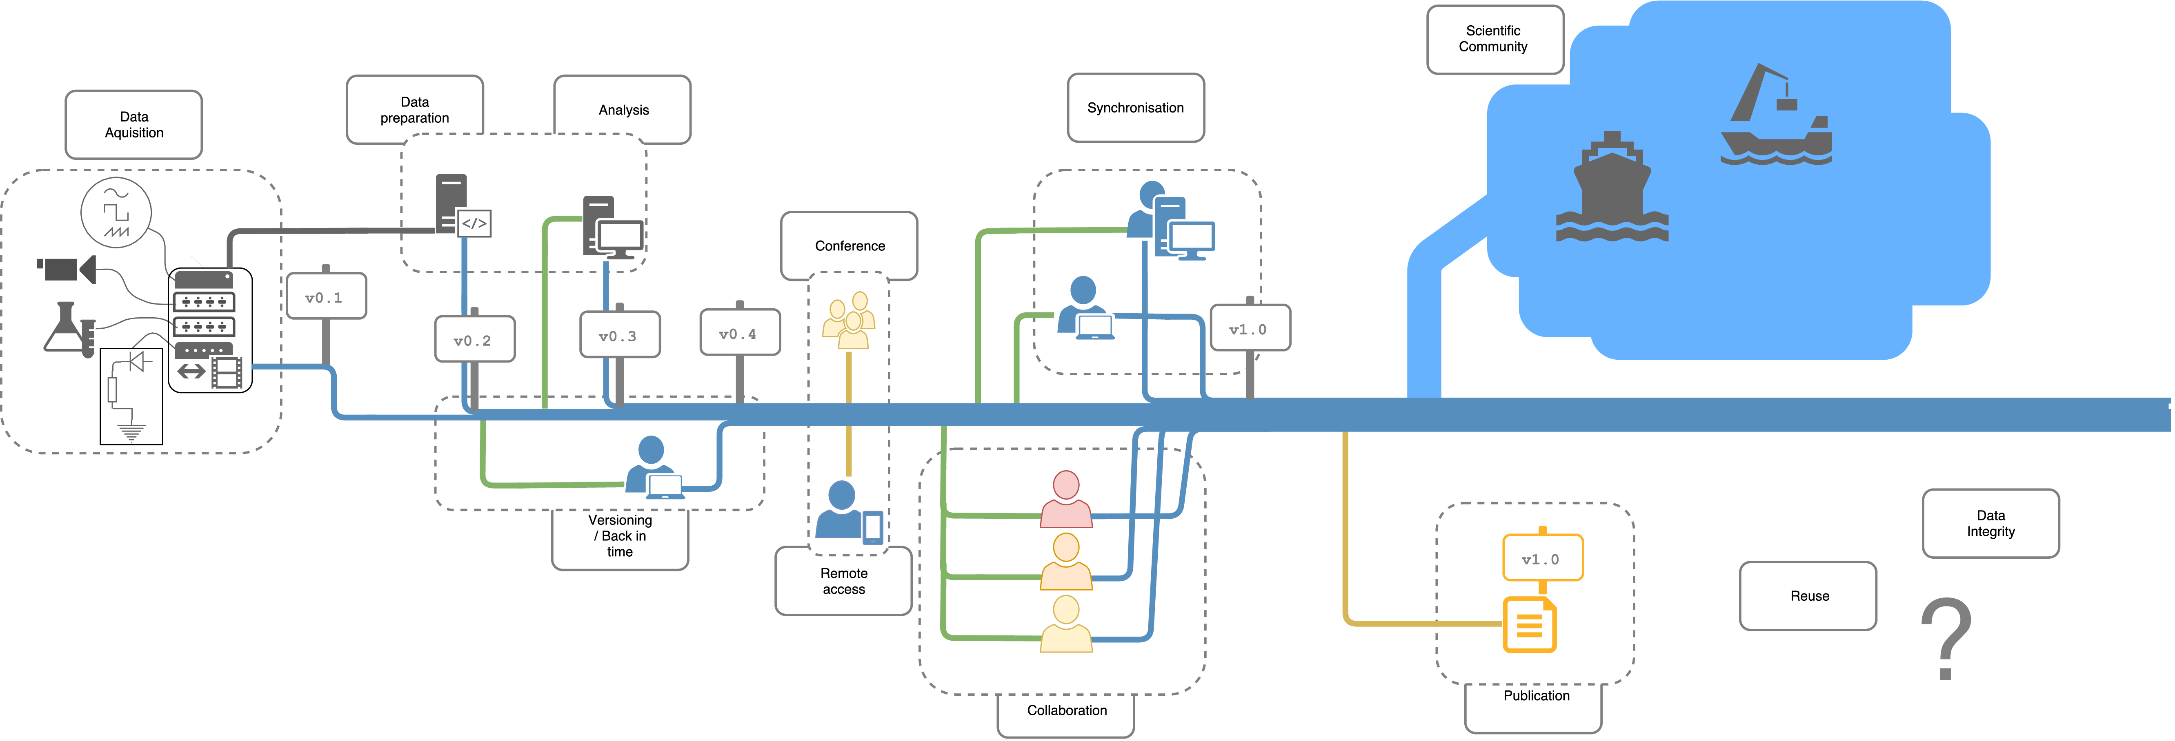
GIN: Services for Data Organization and Sharing
Supporting research data management through the entire data lifecycle
Data Acquisition
and Processing
Data
Analysis
Data Access and
Collaboration
Data
Publication
https://gin.g-node.org

Slide 22
GIN: Services for Data Organization and Sharing
Getting started and Outlook
Usage documentation at
  https://web.gin.g-node.org/G-Node/Info/wiki/
  https://web.gin.g-node.org/G-Node/Info/wiki/FaqTroubleshooting
GIN-UI; graphical command line client wrapper on Windows
Web GIN: odML integration
Web GIN: NIX integration (upcoming)
GIN microservice: Format validation service (prototype)
  BIDS, odML, NIX, [your format here]
GIN microservice: Continuous Integration service (upcoming)

Slide 23
Acknowledgments
G-Node Team
Achilleas Koutsou, Michael Sonntag, Jan Grewe,
Christian Kellner, Christian Garbers, Andrey Sobolev, Adrian Stoewer,
Andreas Herz, Willi Schiegel, Tiziano Zito
Collaborators, Contributors and Supporters
Hiroyuki Ai, Francesc Alted, Rembrandt Bakker, Jan Benda, Anubhav Chaturvedi,
Andrew Davison, Michael Denker, Markus Diesmann, Johannes Drever, Gaute Einevoll,
Felix Franke, Hagen Fritsch, Samuel Garcia, Daniel Gonzalez,
Sonja Grün, Michael Hanke, Hidetoshi Ikeno, Petr Jezek, Arvind Kumar,
Ajay Kumaraswamy, Yann Le Franc, Aljoscha Leonhardt, Philipp Meier, Balint Morvai,
Roman Moucek, Dipanjan Mukherjee, Matthias Munk, Martin Nawrot, Cristina Precup,
Robert Pröpper, Raphael Ritz, Jürgen Rybak, Michael Schmuker, Yaroslav Shalivskyy,
Julia Sprenger, Mehmet Süzen, Zbyszek Szmek, Christian Tatarau,
Alvaro Tejero Cantero, Kay Thurley, Lyuba Zehl
funded by

Slide 24
Get involved
Emails
dev@g-node.org
Questions
Chat
gnode.slack.com
Issues and Feature requests
github.com/G-Node
Data sharing and publication
gin.g-node.org
Slides
https://gin.g-node.org/G-Node/PublicResources

Slide 25
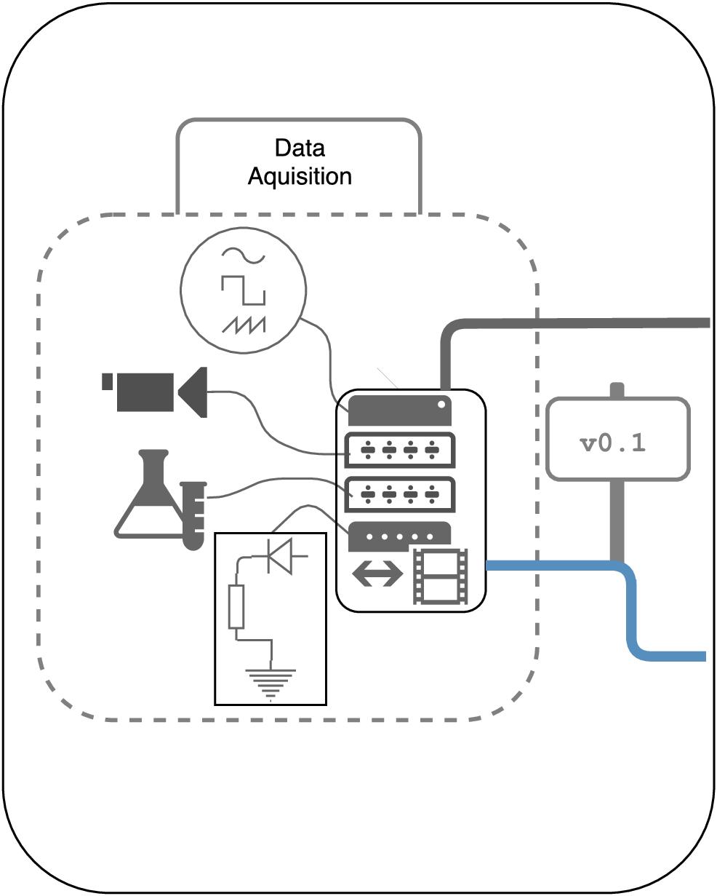
GIN: Services for Data Organization and Sharing
Supporting research data management through the entire data lifecycle
Data Acquisition
and Processing
• Versioning of datasets
from the beginning
• Workflow automation
• Immediate access for other lab members
• Manage data with minimal data transfer

Slide 26
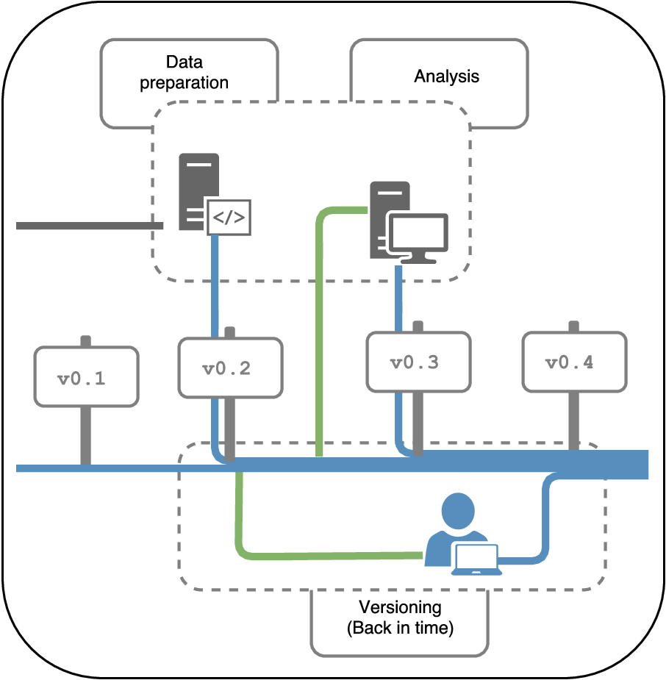
GIN: Services for Data Organization and Sharing
Supporting research data management through the entire data lifecycle
Data
Analysis
• Versioned analysis
workflows
• Working together on data analysis
• Keeping track of who did what
• Reverting changes,
Going back in time when necessary

Slide 27
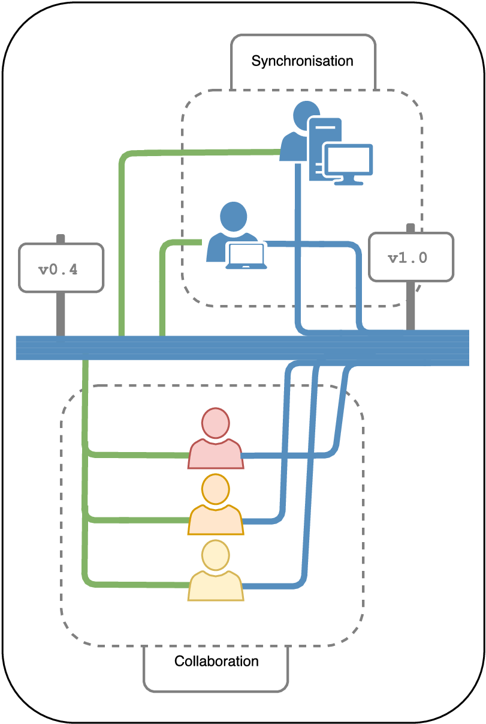
GIN: Services for Data Organization and Sharing
Supporting research data management through the entire data lifecycle
Data Access and
Collaboration
• Accessing your data from outside the lab
• Keeping datasets in sync at diferent places with minimal data duplication
• Working on datasets remotely while transfering data only when needed
• Access for remote collaborators

Slide 28
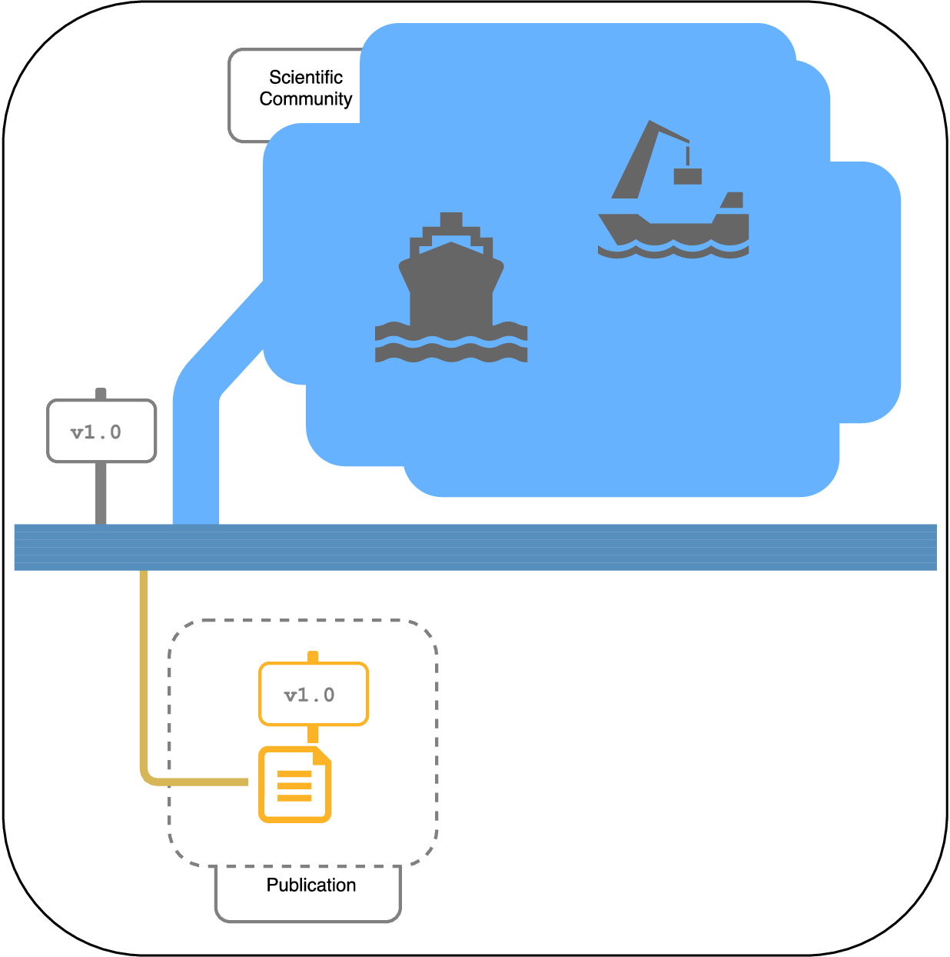
GIN: Services for Data Organization and Sharing
Supporting research data management through the entire data lifecycle
Data
Publication
• Indexing and data search
(gin.g-node.org/explore)
• Making data public with a mouse click
• Dataset publication
(supplemental datasets,
data publications)
• Citable datasets through Digital Object Identifiers (DOI)

