Slide 1

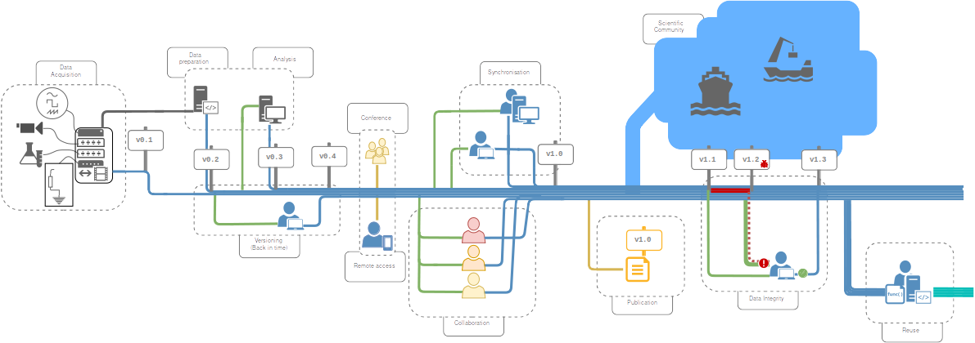
GIN - G-Node Infrastructure
Data management from acquisition to publication
https://gin.g-node.org

Slide 2
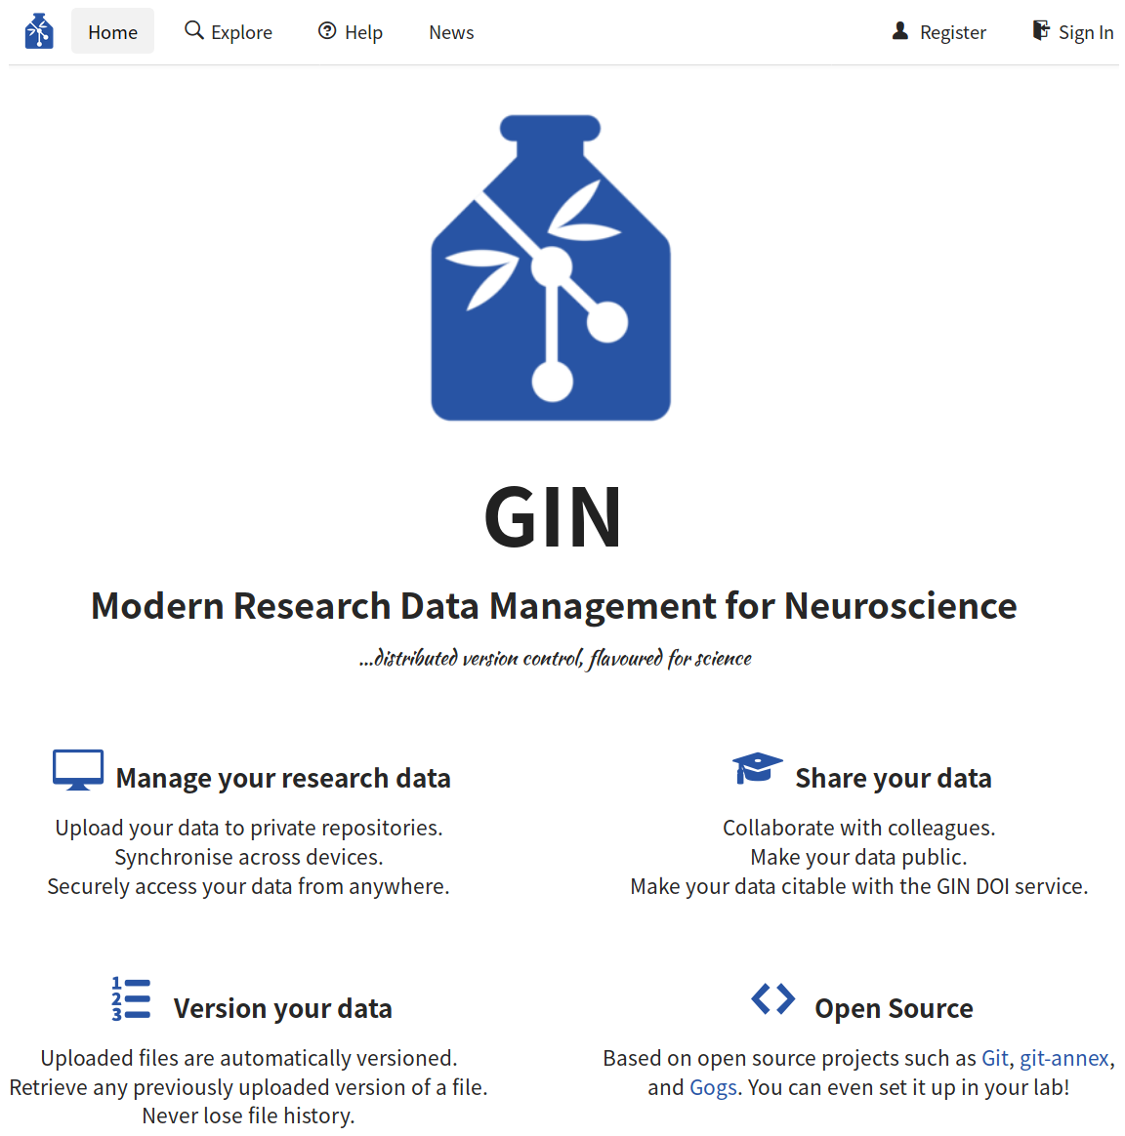
GIN - G-Node Infrastructure
Research data management platform
  location independent data access
  secure access and user management
  sharing and collaboration
  built-in versioning
  manual and automated workflow integration
  free storage for scientific data
  platform independent
https://gin.g-node.org

Slide 3




GIN - G-Node Infrastructure
Neuroscience data repository
recommended by:
Data publication
  free data publication service
  any public GIN repository
  citable datasets (DOI)
https://doi.gin.g-node.org
https://gin.g-node.org

