Slide 1
German Neuroinformatics Node
Research Data Management, Hosting and Sharing
GIN research data platform
NIX neuroscience data format
odML metadata format
http://www.g-node.org

Slide 2

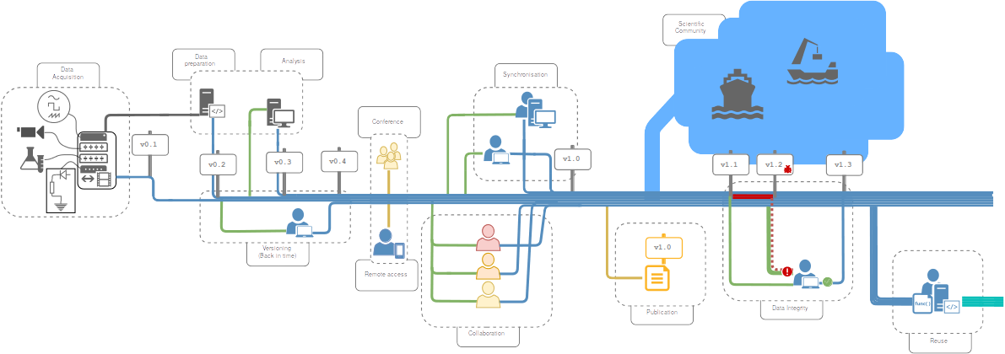
GIN - G-Node Infrastructure
Data management from acquisition to publication
https://gin.g-node.org

Slide 3
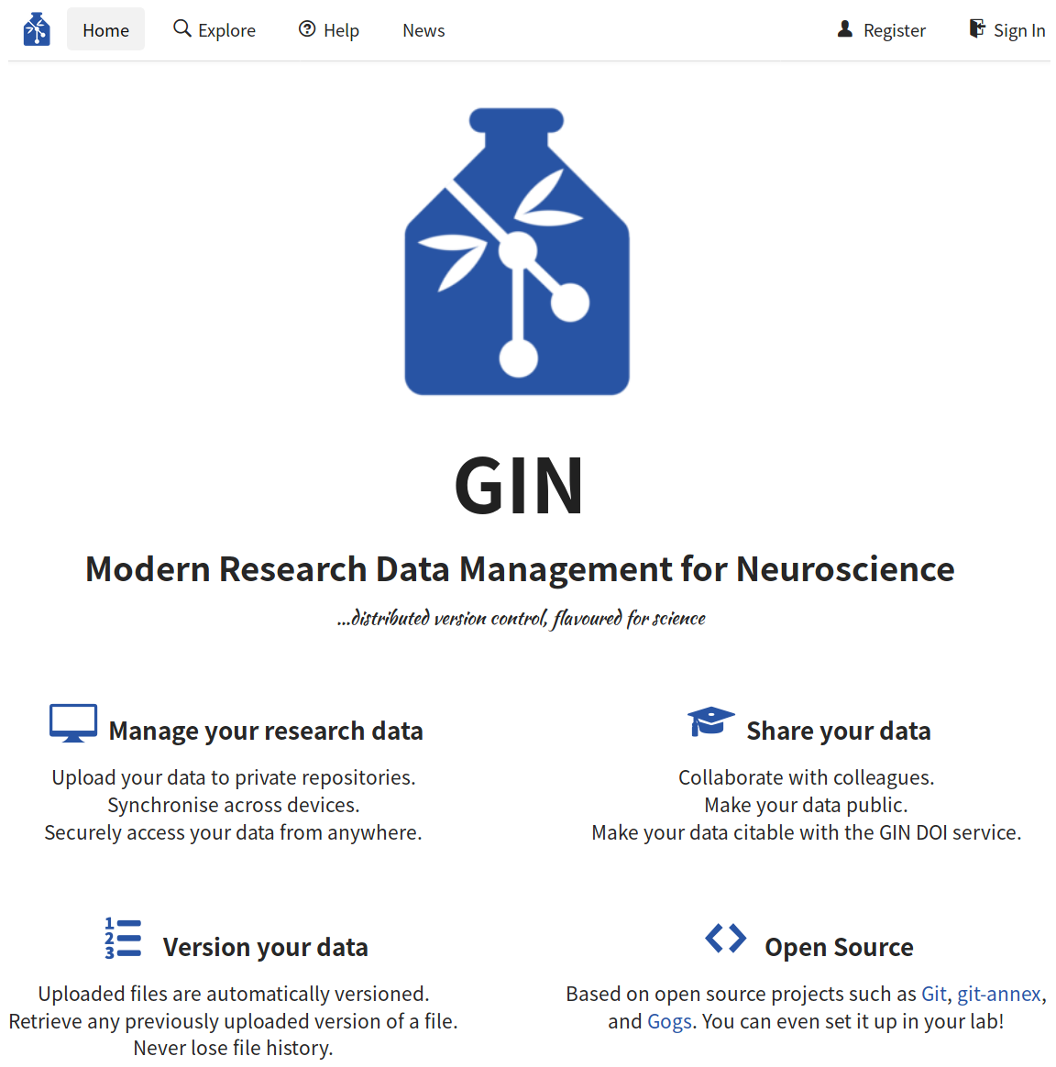
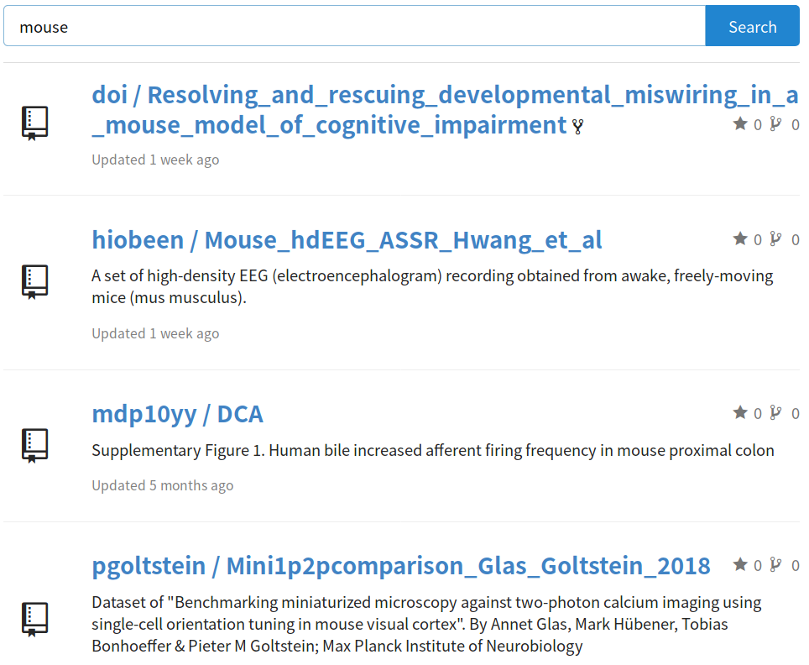
GIN - G-Node Infrastructure
Scientific data hosting service
https://gin.g-node.org

Slide 4
GIN - G-Node Infrastructure
Research data management services
  location independent data access
  secure access and user management
  sharing and collaboration
  built-in versioning
  manual and automated workflow integration
  free storage for scientific data
  platform independent
https://gin.g-node.org

Slide 5



GIN - G-Node Infrastructure
Neuroscience data repository
recommended by:
Statistics
  ~ 2000 repositories (800 public)
  ~ 2000 users
  40 TB of research data (all repositories)
https://gin.g-node.org

Slide 6

GIN Microservices
Publication
  free data publication service
  citable datasets (DOI)
  200 published data sets
  total published data size: 7.5TiB
Validation
  automated validation of new data
    BIDS, NIX, odML
    custom validators
https://doi.gin.g-node.org
https://valid.gin.g-node.org
https://gin.g-node.org

Slide 7

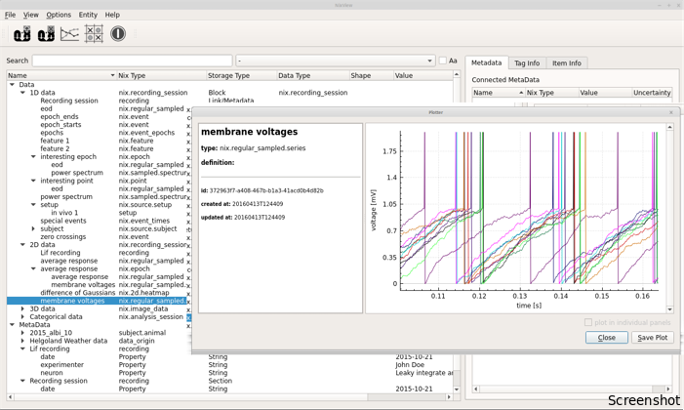
NIX - Neuroscience Exchange format
Open neuroscience file format
http://bendalab.github.io/NixView
http://g-node.org/nix

Slide 8
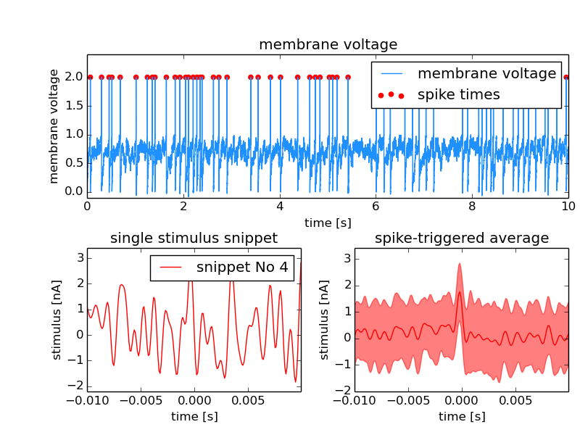
NIX overview
  flexible data model for
  various kinds of data
  data and metadata in the
  same HDF5 file
  descriptive association
  between data and
  metadata
  multiple language support
  and tools
  data compression
  stream-to-file
Raw and analyzed data in one file
http://g-node.org/nix

Slide 9
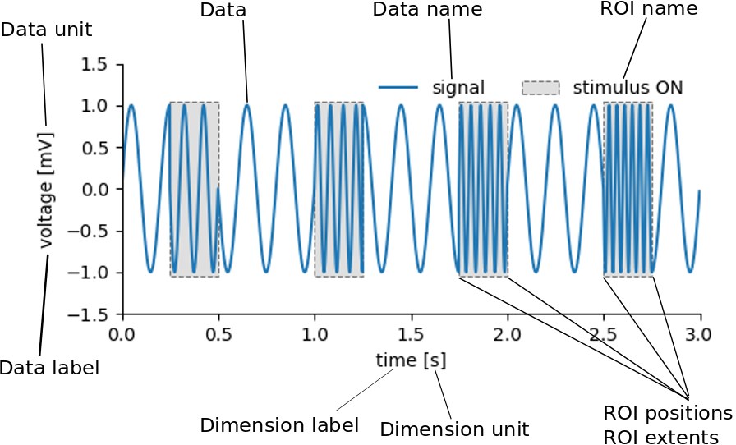
NIX overview
The fully annotated file contains all information required to understand and interpret the data and their properties.
http://g-node.org/nix

Slide 10


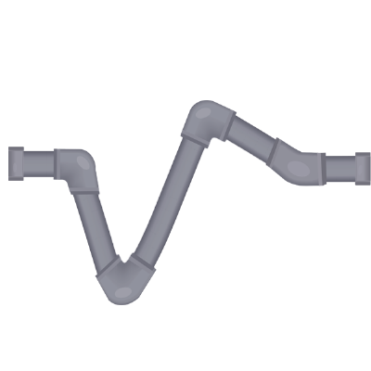
NIX interoperability
  Neo ephys format reader integration
  MNE - EEG/MEG data analysis and visualization
  Neurodata without borders (NWB) format
  SpikeInterface (Open ephys)
http://neuralensemble.org/neo
https://mne.tools
https://www.nwb.org
https://github.com/G-Node/nix-nwb
https://open-ephys.org/spikeinterface
http://g-node.org/nix

Slide 11

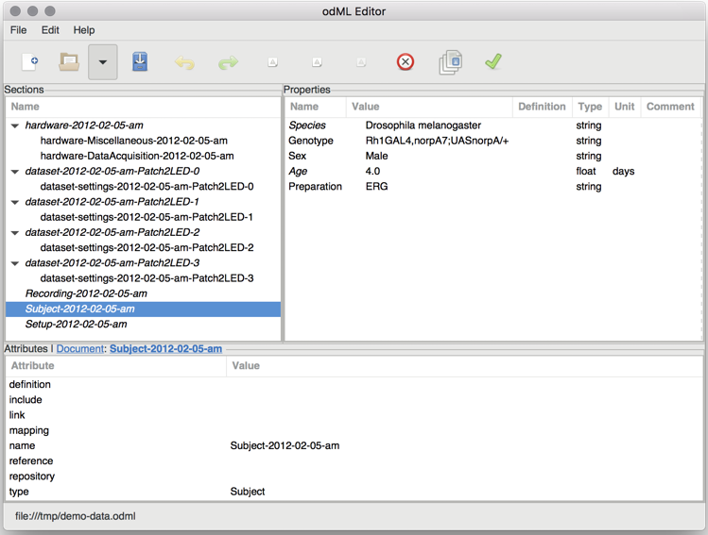
odML - open metadata markup language
open metadata file format
  store diverse metadata in a common format
  full metadata description with values, unit, uncertainty, comment and unique ID
  automate experiment documentation
  human and machine readable
  highly flexible
Grewe et al (2011), doi:10.3389/fninf.2011.00016
http://g-node.org/odml

Slide 12
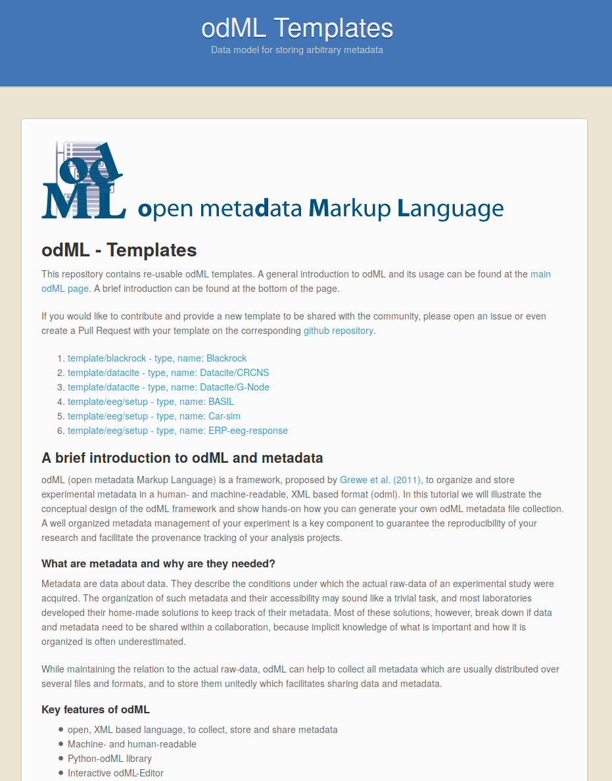
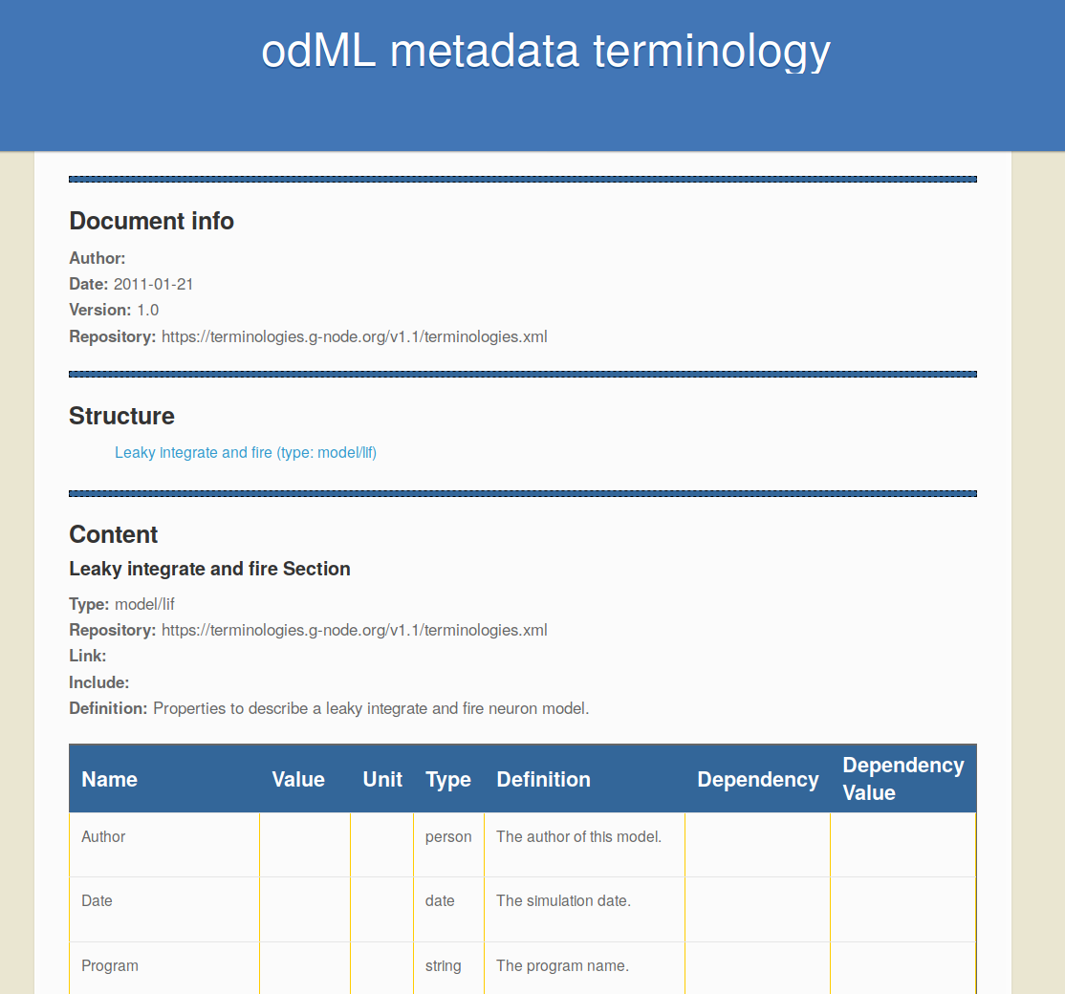
odML - templates and terminologies
Automate metadata collection
  terminologies: odML building blocks
  templates: reusable odML documents
https://terminologies.g-node.org
https://templates.g-node.org
http://g-node.org/odml

Slide 13
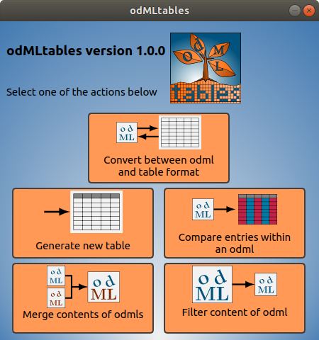

odMLtables
  odML ↔ spreadsheet conversion
  odML document filter
  odML filter content export
  data collision handling on files merge
  command line and GUI
Sprenger et al. (2019) doi: 10.3389/fninf.2019.00062
https://odmltables.readthedocs.io
http://g-node.org/odml

Slide 14
Get in touch
ask any question here at the booth
  Michael Sonntag
join our poster presentation
  #159, Collaboration and publication with the
  G-Node research data infrastructure services
  Thu, Sep 23, 18:00 – 19:15
email us at
info@g-node.org
http://www.g-node.org

