Slide 1

GIN: Open platform and services for efficient
research data management, collaboration and data publication
Achilleas Koutsou, Michael Sonntag, Jiří Vaněk, Thomas Wachtler
German Neuroinformatics Node, Department of Biology II
Ludwig-Maximilians-Universität München, Martinsried, Germany
https://gin.g-node.org

Slide 2
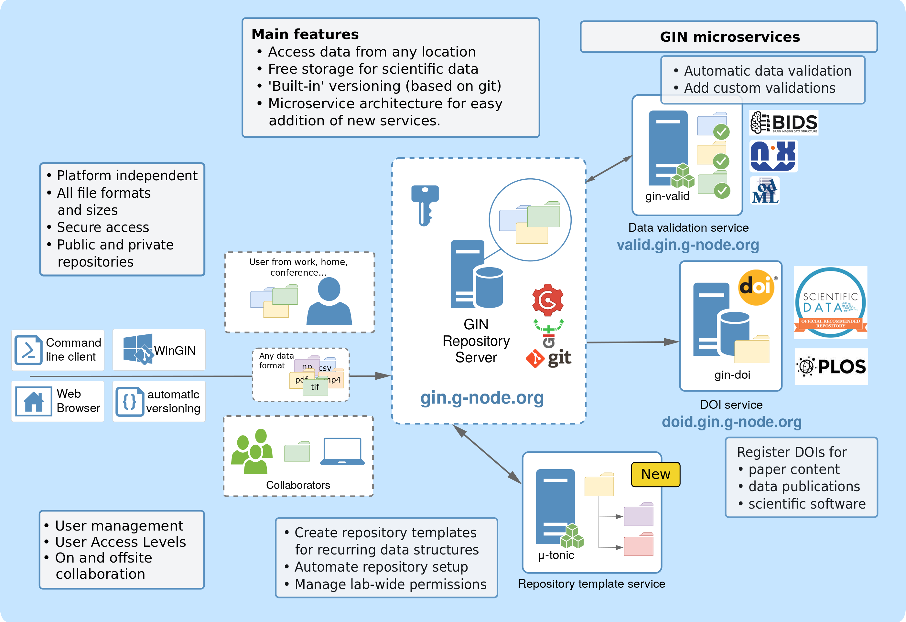
GIN ... G-Node Infrastructure
https://gin.g-node.org

Slide 3
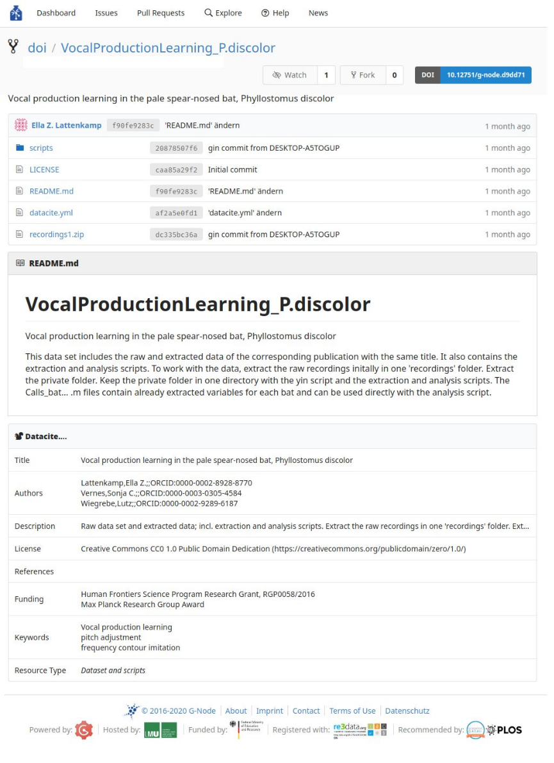



GIN datahosting
Free to use
Unlimited* storage
Collaborative repos/datasets
Public or private
Web or git/ssh uploads & downloads
Rendering for supported files
  Structured formats:
  odML, JSON, YAML, Markdown
  Media and documents:
  Images, Videos, PDF
Indexing and search for text and documents
Neuroscientific service recommended by
https://gin.g-node.org

Slide 4

GIN dataset publication
Neuroscientific service recommended by:
Statistics
  696 (284 public) total repositories
  402 users
  Data size (all repositories): 6.9T
https://gin.g-node.org

Slide 5

GIN Validation service
gin-doi
  71 published data sets
  Total published data size: 771G
gin-valid
  automatic file validation on new data on GIN
  call for validators!
gin-proc
  GSoC: google summer of code project
  prototype for data processing pipeline from GIN
https://doid.gin.g-node.org
https://valid.gin.g-node.org
https://gin.g-node.org

