Slide 1
German Neuroinformatics Node
Research Data Management, Hosting and Sharing
GIN research data hosting service
NIX neuroscience data format
odML metadata format
http://www.g-node.org

Slide 2

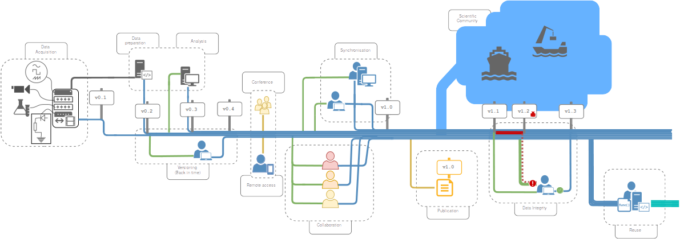
GIN - G-Node Infrastructure
Data management from acquisition to publication
https://gin.g-node.org

Slide 3
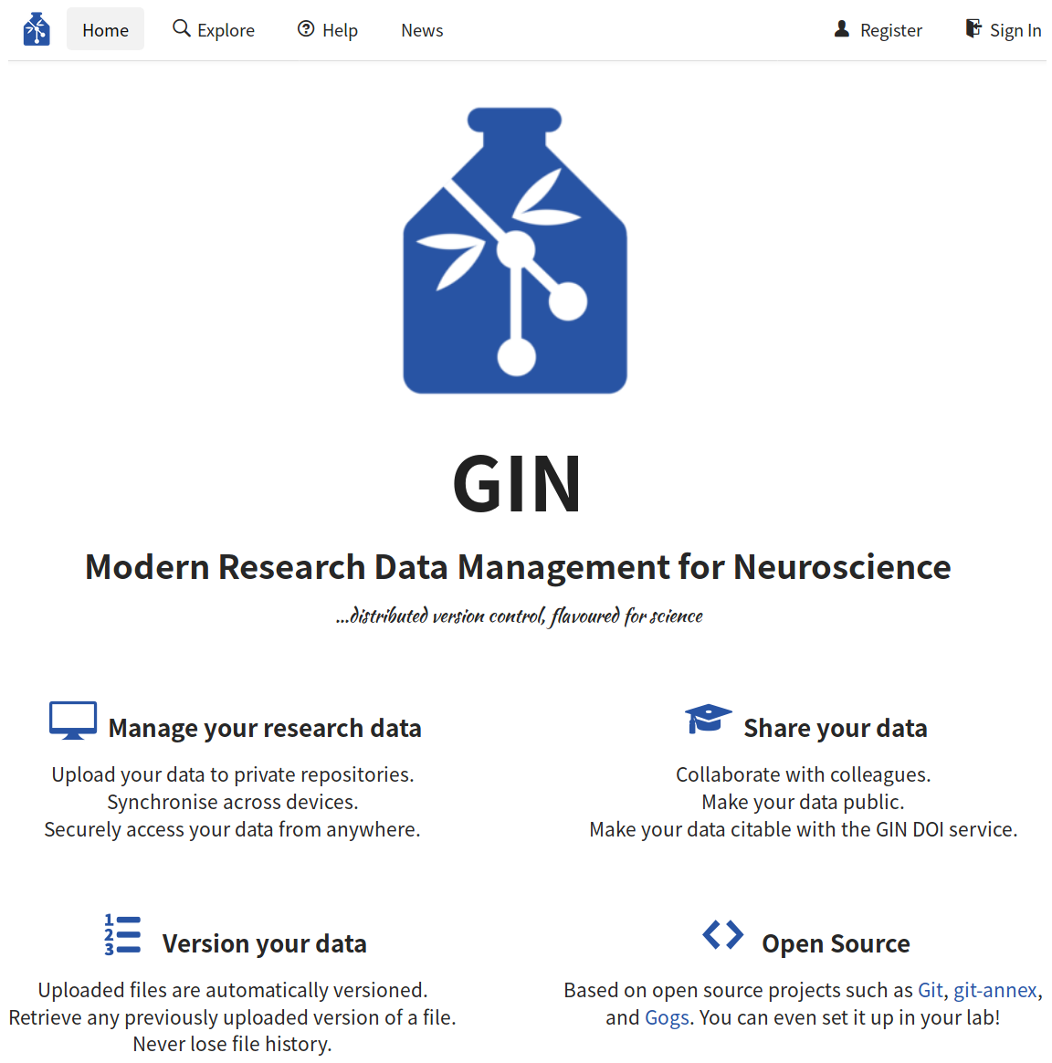
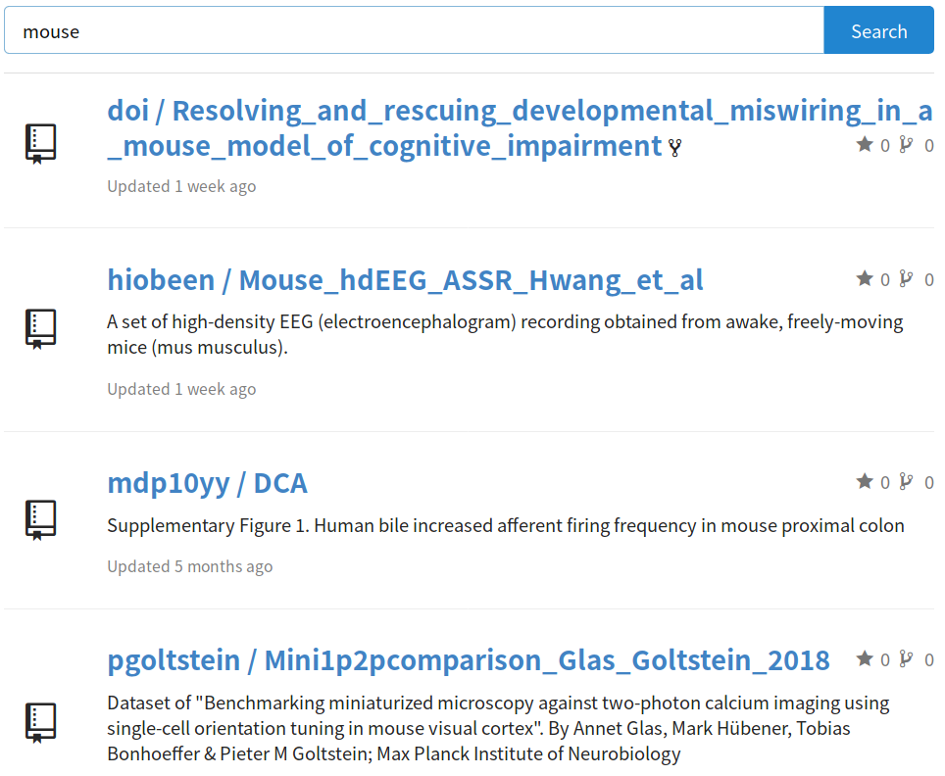
GIN - G-Node Infrastructure
Scientific data hosting service
https://gin.g-node.org

Slide 4
GIN - G-Node Infrastructure
Data hosting service
  Location independent data access
  Secure access and user management
  Sharing and collaboration
  Built-in file versioning and retrieval
  Manual and automated workflow integration
  Free storage for scientific data
  Platform independent
https://gin.g-node.org

Slide 5



GIN - G-Node Infrastructure
Neuroscientific service recommended by:
Statistics
  1195 repositories (459 public)
  1138 users
  Data size (all repositories): 13.17TiB
https://gin.g-node.org

Slide 6

GIN Microservices
gin-doi
  free data publication service
  112 published data sets
  Total published data size: 1.2TiB
gin-valid
  automatic file validation of new data on GIN
  submit and use custom validators
https://doid.gin.g-node.org
https://valid.gin.g-node.org
https://gin.g-node.org

Slide 7

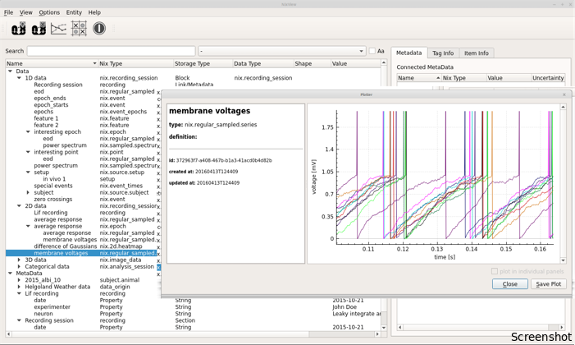
NIX - Neuroscience Exchange format
Open neuroscience file format
http://bendalab.github.io/NixView
http://g-node.org/nix

Slide 8
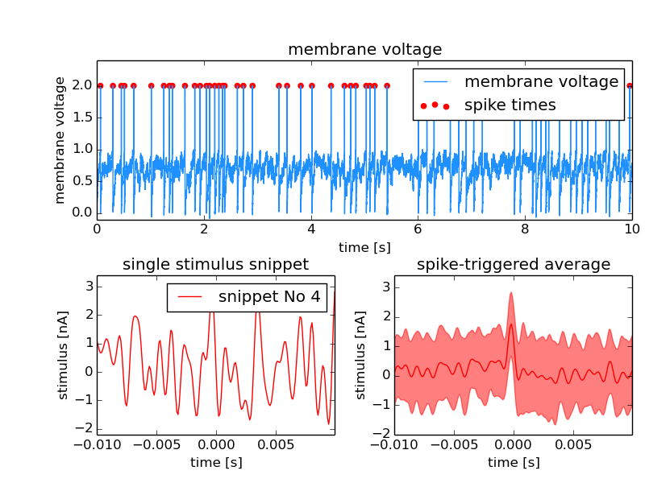
NIX overview
  Flexible data model for
  various kinds of data
  Data and metadata in the
  same HDF5 file
  Descriptive association
  between data and
  metadata
  Multiple language support
  and tools
Raw and analysed data in one file
http://g-node.org/nix

Slide 9
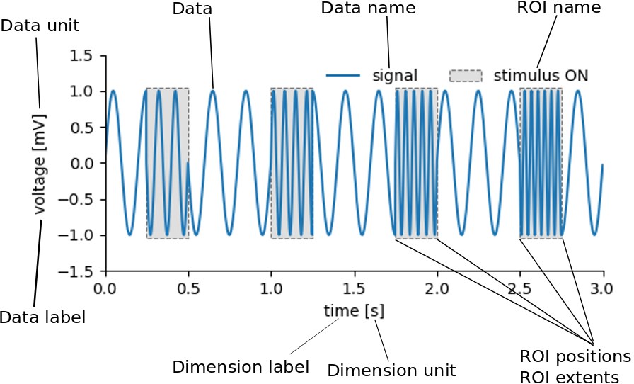
NIX overview
The fully annotated file contains all information required to understand and interpret the data and their properties.
http://g-node.org/nix

Slide 10


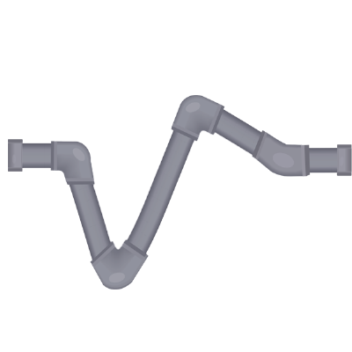
NIX interoperability
  NEO ephys format reader integration
  MNE - EEG/MEG data analysis and visualization
  Neurodata without borders (NWB) format
  SpikeInterface (Open ephys)
http://neuralensemble.org/neo
https://mne.tools
https://www.nwb.org
https://github.com/G-Node/nix-nwb
https://open-ephys.org/spikeinterface
http://g-node.org/nix

Slide 11

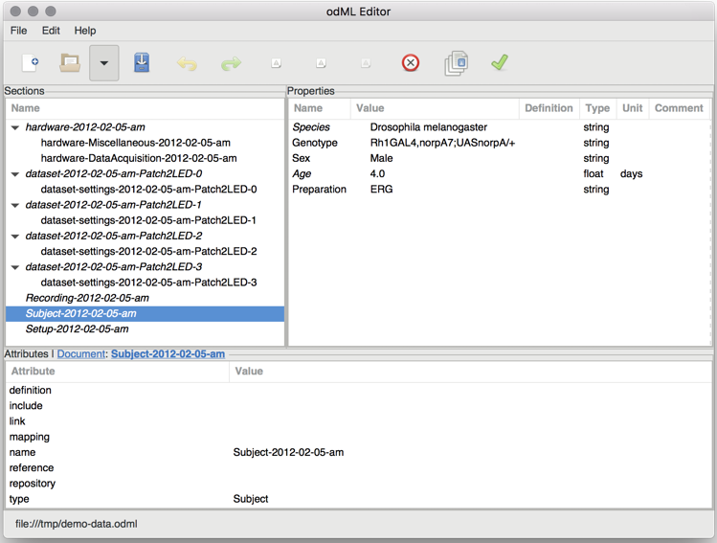
odML - open metadata markup language
open metadata file format
  store metadata in a common hierarchical format
  automate experiment documentation
  human and machine readable
  highly flexible
Grewe et al (2011), doi:10.3389/fninf.2011.00016
http://g-node.org/odml

Slide 12
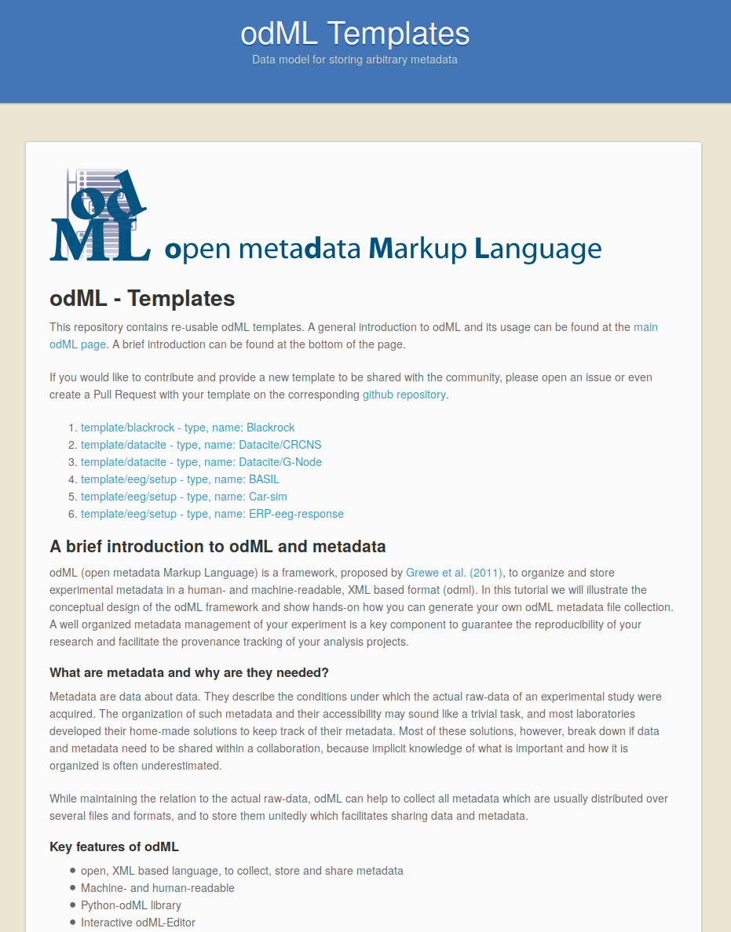
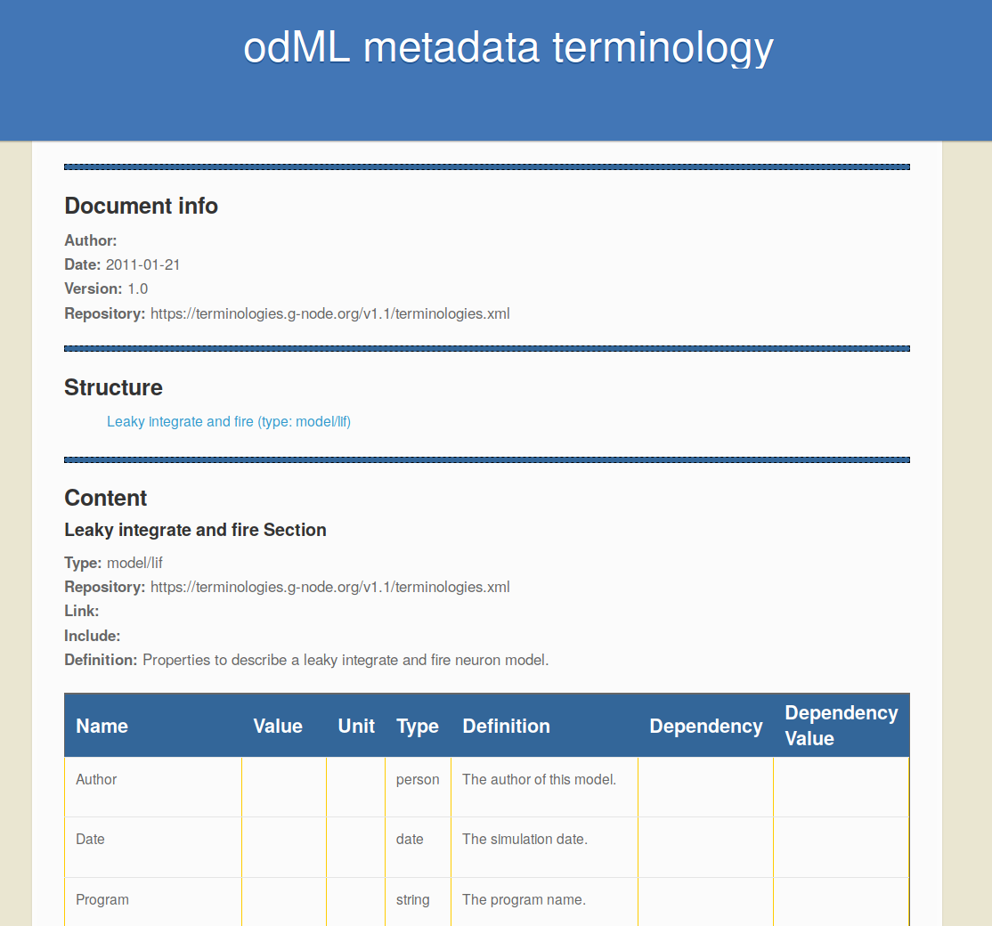
odML - templates and terminologies
Automate metadata collection
  terminologies: odML building blocks
  templates: reusable odML documents
https://terminologies.g-node.org
https://templates.g-node.org
http://g-node.org/odml

Slide 13
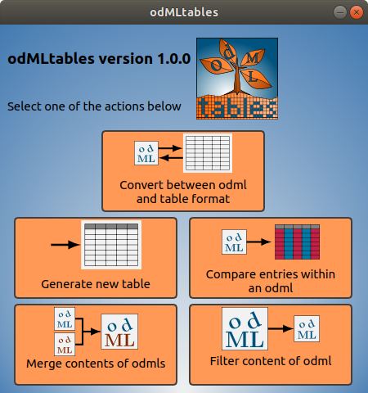

odMLtables
  odML ↔ table conversion
  odML document filter
  odML files comparison
  command line and GUI
Sprenger et al. (2019) doi: 10.3389/fninf.2019.00062
https://odmltables.readthedocs.io
http://g-node.org/odml

Slide 14
Get in touch
ask any question here at the booth
  Achilleas Koutsou, Michael Sonntag
join our poster presentation
  #77, Open tools and services for efficient data management, collaboration and data publication
  We, 30.09, 18:00 – 19:00
email us at
info@g-node.org
http://www.g-node.org

