Slide 1
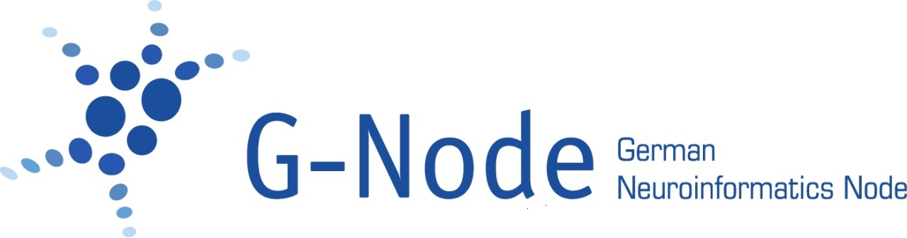
Handling neuroscientific data with GIN
Present and Future
Michael Sonntag
German Neuroinformatics Node
Department Biology II
Ludwig-Maximilians-Universität München

Slide 2


A brief introduction of the G-Node
Hosted by LMU, funded by BMBF
Focus on software tool development for
Storage ...
Annotation ... of neurophysiological data
Sharing ...
www.g-node.org

Slide 3
Development of Tools for Efficient Data Management
Well-defined data model for neuroscience data that accounts for all types of recorded data
Flexible methods for data annotation and metadata management that can be adapted to the requirements of the experiment and laboratory
Format and tools for integrated organization of data and metadata, including interfaces for common tools and languages, to facilitate data access, data management, and data analysis

Slide 4
Development of Tools for Efficient Data Management
Well-defined data model for neuroscience data that accounts for all types of recorded data
Flexible methods for data annotation and metadata management that can be adapted to the requirements of the experiment and laboratory
Format and tools for integrated organization of data and metadata, including interfaces for common tools and languages, to facilitate data access, data management, and data analysis

Slide 5

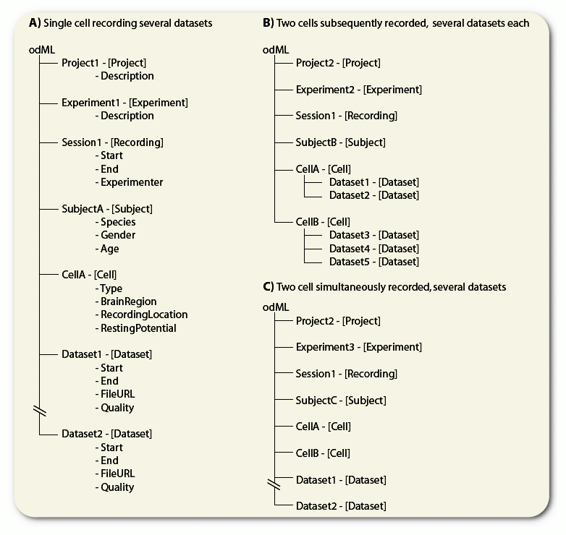
odML (open metadata Markup Language)
http://www.g-node.org/odml
• format: hierarchical structure of
key-value pairs: simple, flexible, inherently extensible ➔ can be adapted to the specifics of the lab or experiment
• can carry any metadata
• machine write- and readable, facilitates automated collection of metadata in the laboratory
• community-driven standardization
through shared terminologies
• tools available (libraries, editor, app)
Grewe et al (2011) Front. Neuroinf. 5:16

Slide 6
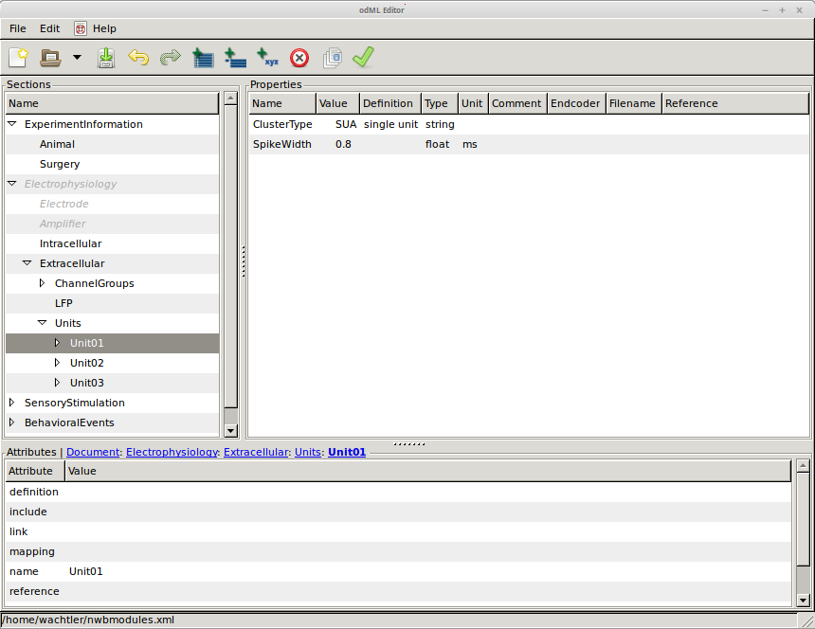


odML: Tools
http://www.g-node.org/odml
• Libraries for Python, Java, C++
enable integration into software tools
• odml-UI editor
• odmltables plugin
(by INM-6 FZ Jülich)
github.com/G-Node/python-odml
github.com/G-Node/odml-ui
github.com/INM-6/python-odmltables

Slide 7
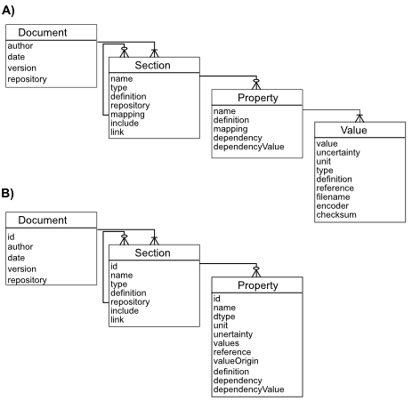
Latest odML format developments
http://www.g-node.org/odml
• streamlined data format
• support for YAML and JSON
• export to RDF
• prototype odML flavoured Apache Jena Server
• experimental abstract SPARQL language

Slide 8

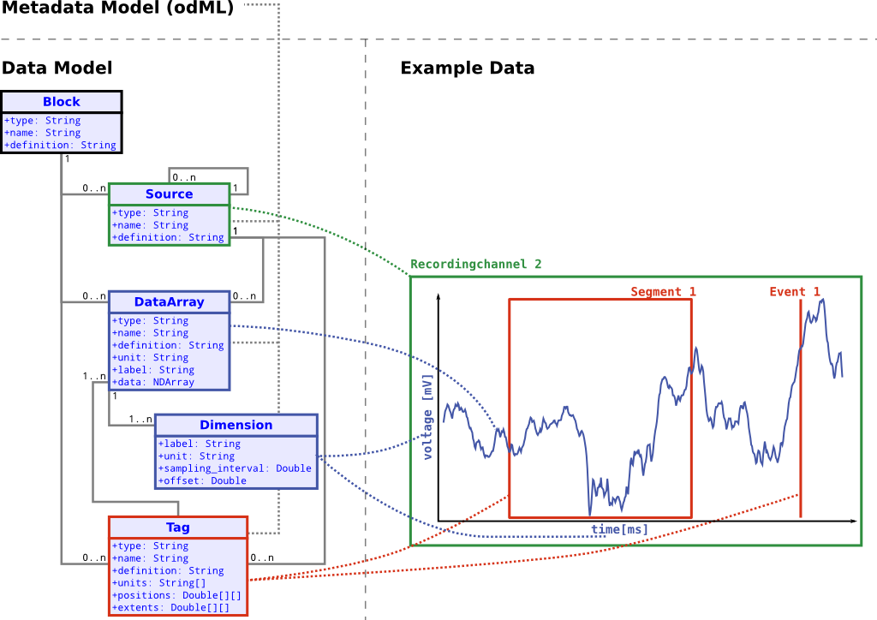
NIX – Format for integration of data and metadata
http://www.g-node.org/nix
• general data model (derived from Neo) to represent recorded data, derived data, relations of data
• flexible data model for metadata (odML) for comprehensive annotation of data
• file backend: HDF5 file format
- structure reflects data model, easy to understand
- other storage backends possible
• libraries for different languages
(C++, Python, Matlab, Java)

Slide 9
NIX – Format for integration of data and metadata
Metadata
(e.g., experimental conditions, ...)
Provenance
Recorded Data
(incl. type, units)
0.2
Epochs
Events
0.0
0
300
Dimension information
(type, unit, range, sampling)
http://www.g-node.org/nix

Slide 10

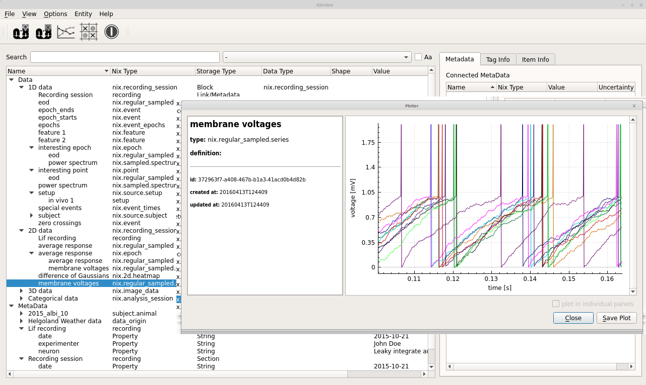
NixView
- format consolidation
- suite of tools for conversion[1]
- visualization tools easy integration into jupyter notebooks[2]
- NIXRawIO
[1] github.com/G-Node/nix-odml-converter
[2] github.com/G-Node/nixworks
Latest NIX developments
github.com/bendalab/NixView

Slide 11
Latest NIX developments
- format consolidation
- suite of tools for conversion[1]
- visualization tools easy integration into jupyter notebooks[2]
- NIXRawIO
[1] github.com/G-Node/nix-odml-converter
[2] github.com/G-Node/nixworks

Slide 12

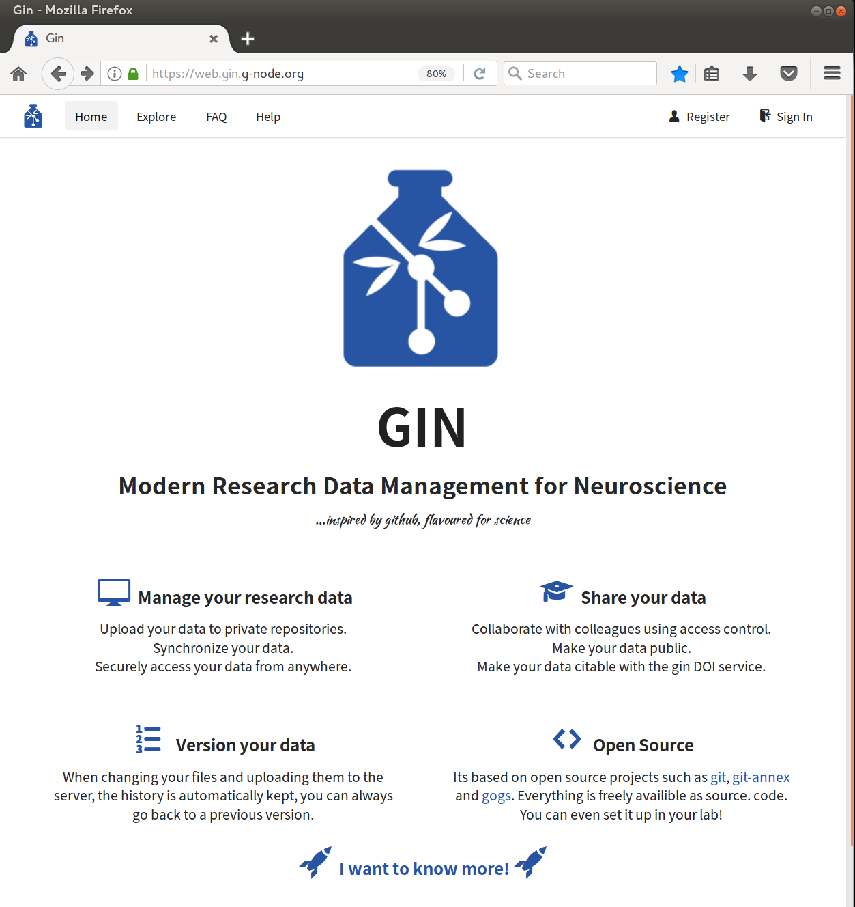
GIN: Services for Data Organization and Sharing
• Versioned management of data repositories (git)
• Distributed data management via file or web browser, or command line client (analysis script integration)
• Secure access and sharing
• Services for search,
indexing, and
publication (DOI)
• In house installation
http://gin.g-node.org

Slide 13
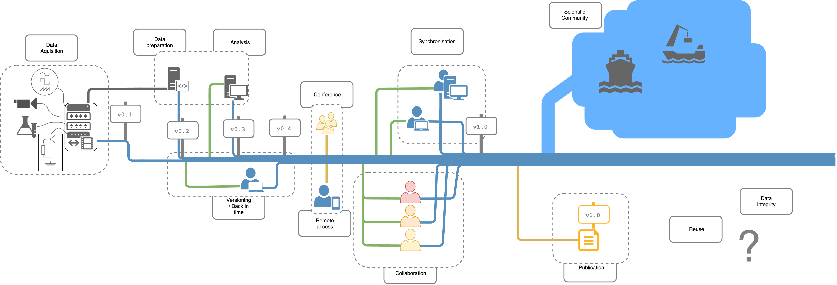
GIN: Services for Data Organization and Sharing
Supporting research data management through the entire data lifecycle
Data Acquisition
and Processing
Data
Analysis
Data Access and
Collaboration
Data
Publication
http://gin.g-node.org

Slide 14
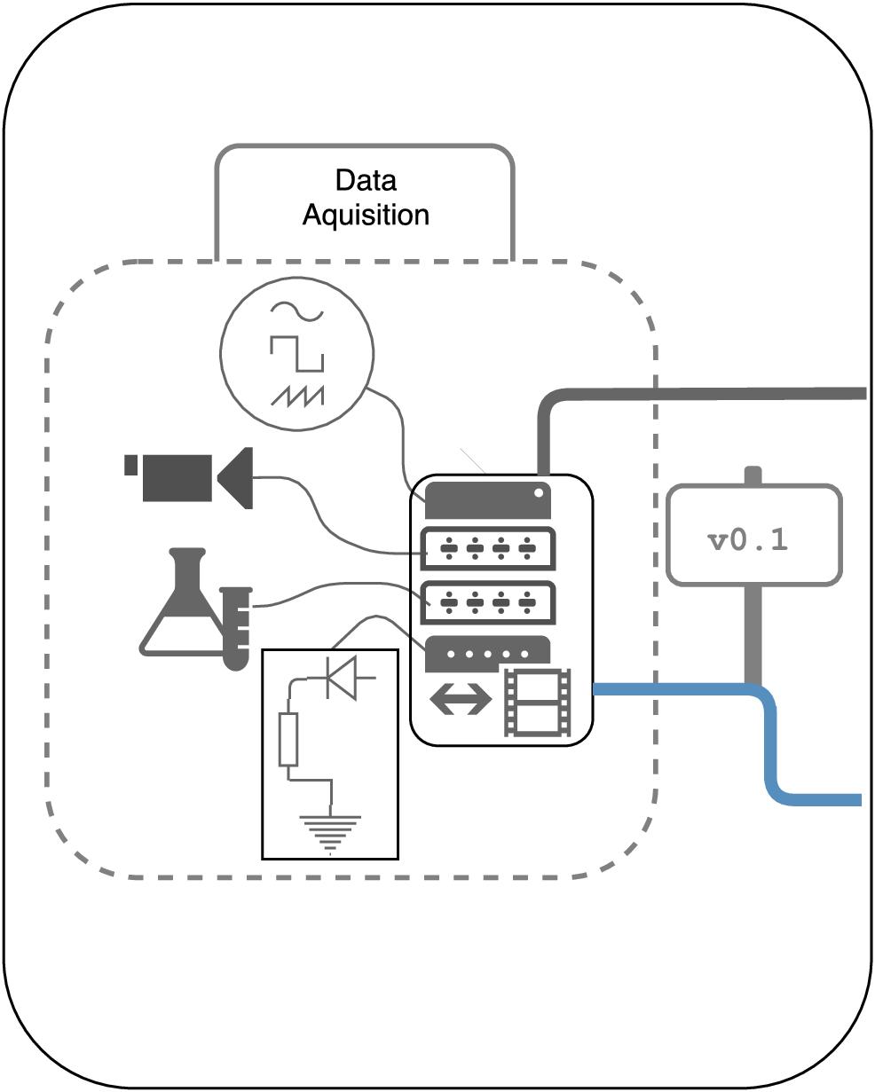
GIN: Services for Data Organization and Sharing
Supporting research data management through the entire data lifecycle
Data Acquisition
and Processing
• Versioning of datasets
from the beginning
• Keeping track of how dataset evolves
• Immediate access for other lab members
• Manage data with minimal data transfer

Slide 15
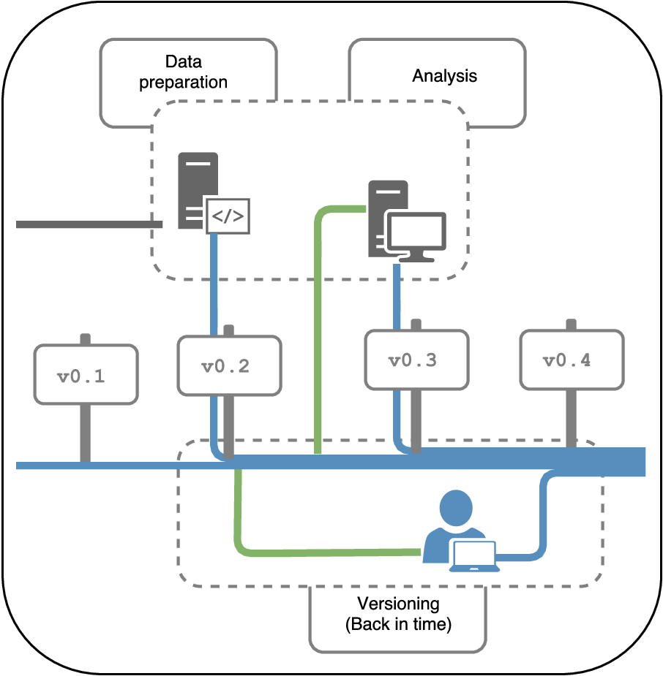
GIN: Services for Data Organization and Sharing
Supporting research data management through the entire data lifecycle
Data
Analysis
• Versioned analysis
workflows
• Working together on data analysis
• Keeping track of who did what
• Reverting changes,
Going back in time when necessary

Slide 16
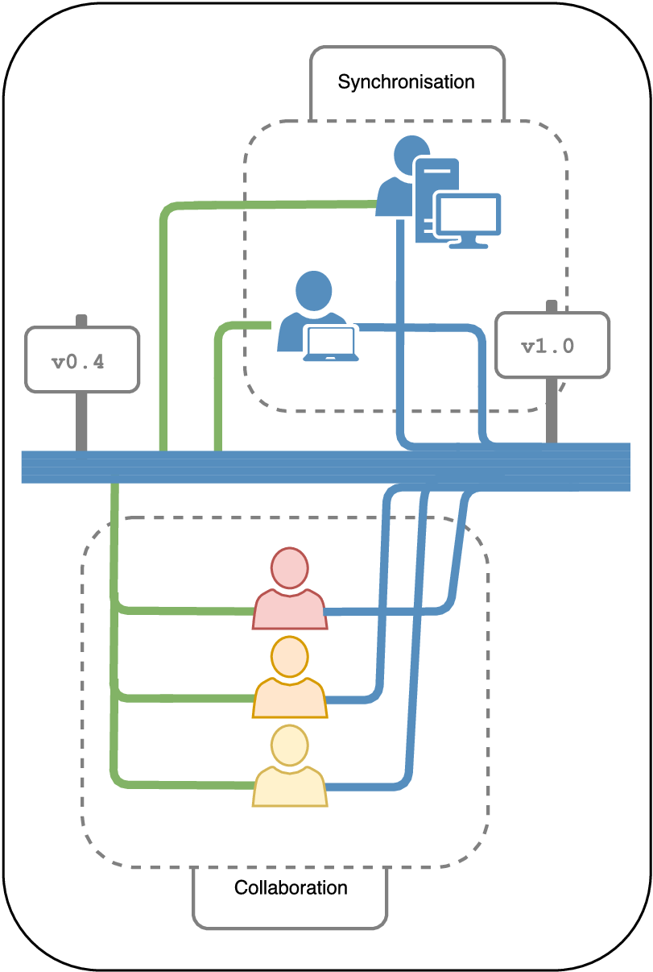
GIN: Services for Data Organization and Sharing
Supporting research data management through the entire data lifecycle
Data Access and
Collaboration
• Accessing your data from outside the lab
• Keeping datasets in sync at diferent places with minimal data duplication
• Working on datasets remotely while transfering data only when needed
• Access for remote collaborators

Slide 17
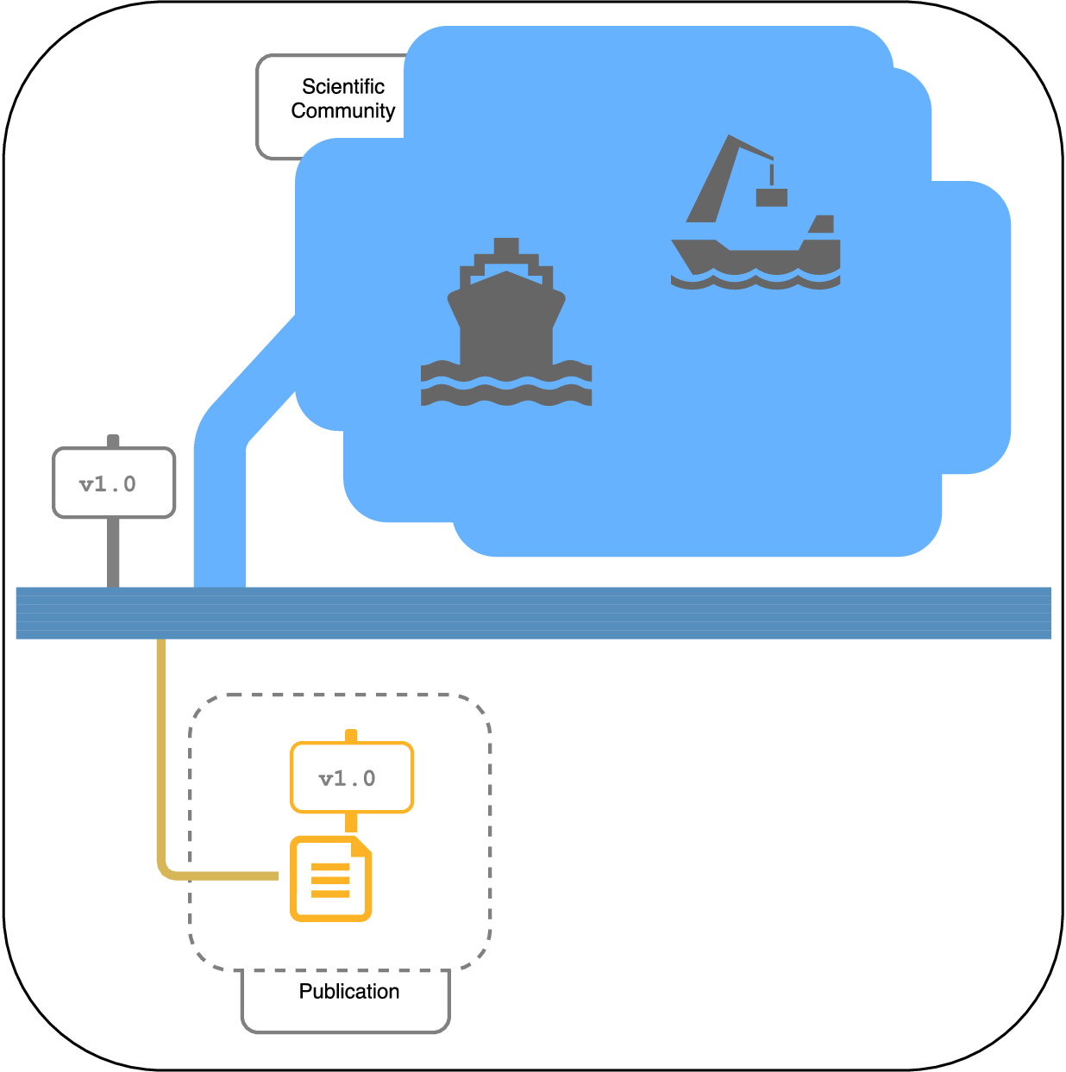
GIN: Services for Data Organization and Sharing
Supporting research data management through the entire data lifecycle
Data
Publication
• Indexing and data search
(gin.g-node.org/explore)
• Making data public with a mouse click
• Dataset publication
(supplemental datasets,
data publications)
• Citable datasets through Digital Object Identifiers (DOI)

Slide 18
GIN: Services for Data Organization and Sharing
Upcoming features
GIN client
- GIN-UI; graphical gin-cli wrapper on Windows
Web GIN features
- odML integration
- NIX integration (upcoming)
GIN microservice architecture
- Format validation service (prototype)
- Continuous Integration service (upcoming)

Slide 19
Acknowledgments
G-Node Team
Christian Garbers, Achilleas Koutsou, Michael Sonntag,
Jan Grewe, Christian Kellner, Andrey Sobolev, Adrian Stoewer,
Andreas Herz, Willi Schiegel, Tiziano Zito
Collaborators, Contributors and Supporters
Hiroyuki Ai, Francesc Alted, Rembrandt Bakker, Jan Benda, Anubhav Chaturvedi,
Andrew Davison, Michael Denker, Markus Diesmann, Johannes Drever, Gaute Einevoll,
Felix Franke, Hagen Fritsch, Samuel Garcia, Daniel Gonzalez,
Sonja Grün, Michael Hanke, Hidetoshi Ikeno, Petr Jezek, Arvind Kumar,
Ajay Kumaraswamy, Yann Le Franc, Aljoscha Leonhardt, Philipp Meier, Balint Morvai,
Roman Moucek, Dipanjan Mukherjee, Matthias Munk, Martin Nawrot, Cristina Precup,
Robert Pröpper, Raphael Ritz, Jürgen Rybak, Michael Schmuker, Mehmet Süzen,
Zbyszek Szmek, Christian Tatarau, Alvaro Tejero Cantero, Kay Thurley, Lyuba Zehl
funded by

