Slide 1
14th Göttingen Virtual Meeting 2021
of the German Neuroscience Society
Efficient research data management
for reproducible research, collaboration and
data publication
GIN research data hosting service
NIX neuroscience data format
odML metadata format
Michael Sonntag
German Neuroinformatics Node

Slide 2

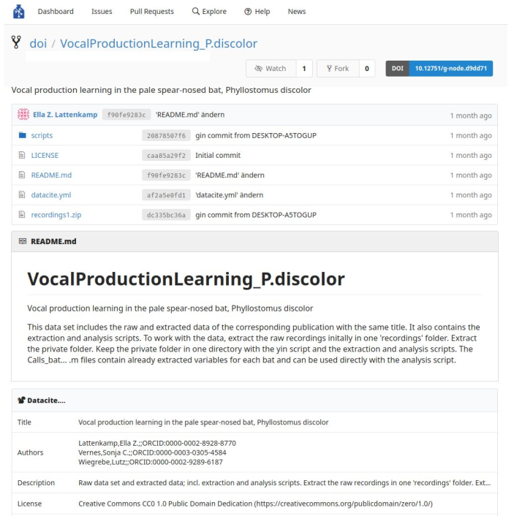



GIN - G-Node Infrastructure Services
Research data platform
Features
    Version control for data
    Secure access
    Convenient data sharing
    Public/private repositories
    Web or command line access
    Available for local set up
    Data publication (DOI)
Service recommended by
https://gin.g-node.org

Slide 3

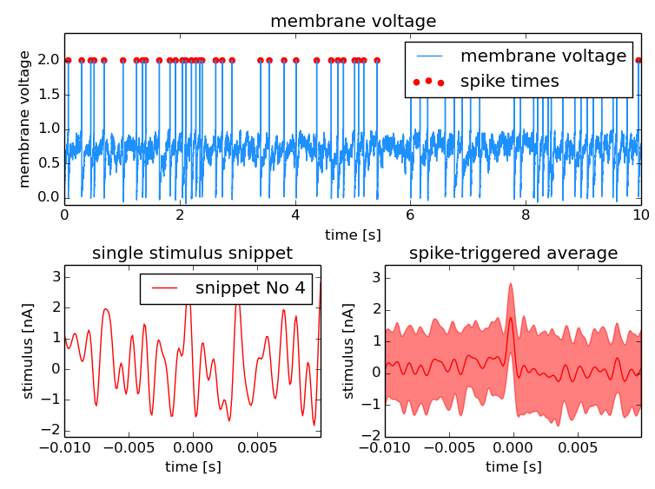

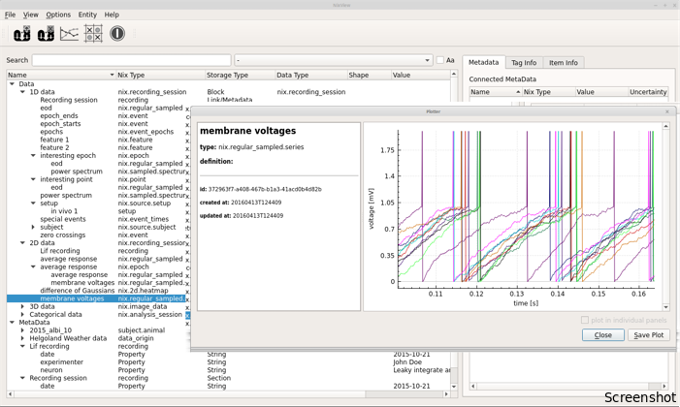

NIX and odML
Data and analysis results organized together in one NIX file
flexible data model for
various types of data
data and metadata in the
same file
descriptive association
between data and
metadata
ideal for workflow automation
rich ecosystem
  C++, Python, Matlab
  Graphical user interface
  Used in community libraries
http://neuralensemble.org/neo
http://bendalab.github.io/NixView
https://mne.tools
http://g-node.org/nix

Slide 4
Get in touch
Discover more on our Poster
  Efficient research data management for reproducible research, collaboration and data publication
email us at
info@g-node.org
Find out more about our projects
https://gin.g-node.org/Info/wiki
https://g-node.github.io/nix
https://g-node.github.io/python-odml
http://www.g-node.org

