Slide 1
G-Node highlights 2019
… and what they might do for you!
Michael Sonntag
LMU Munich, G-Node
sonntag@bio.lmu.de

Slide 2

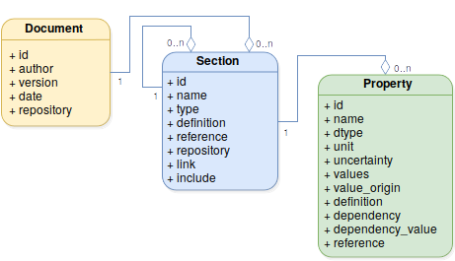
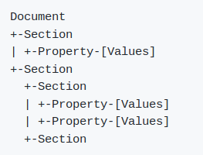
odML … overview
open metadata markup language
  store metadata in a common hierarchical format
  human and machine readable
    … automate experiment documentation
http://g-node.org/odml

Slide 3
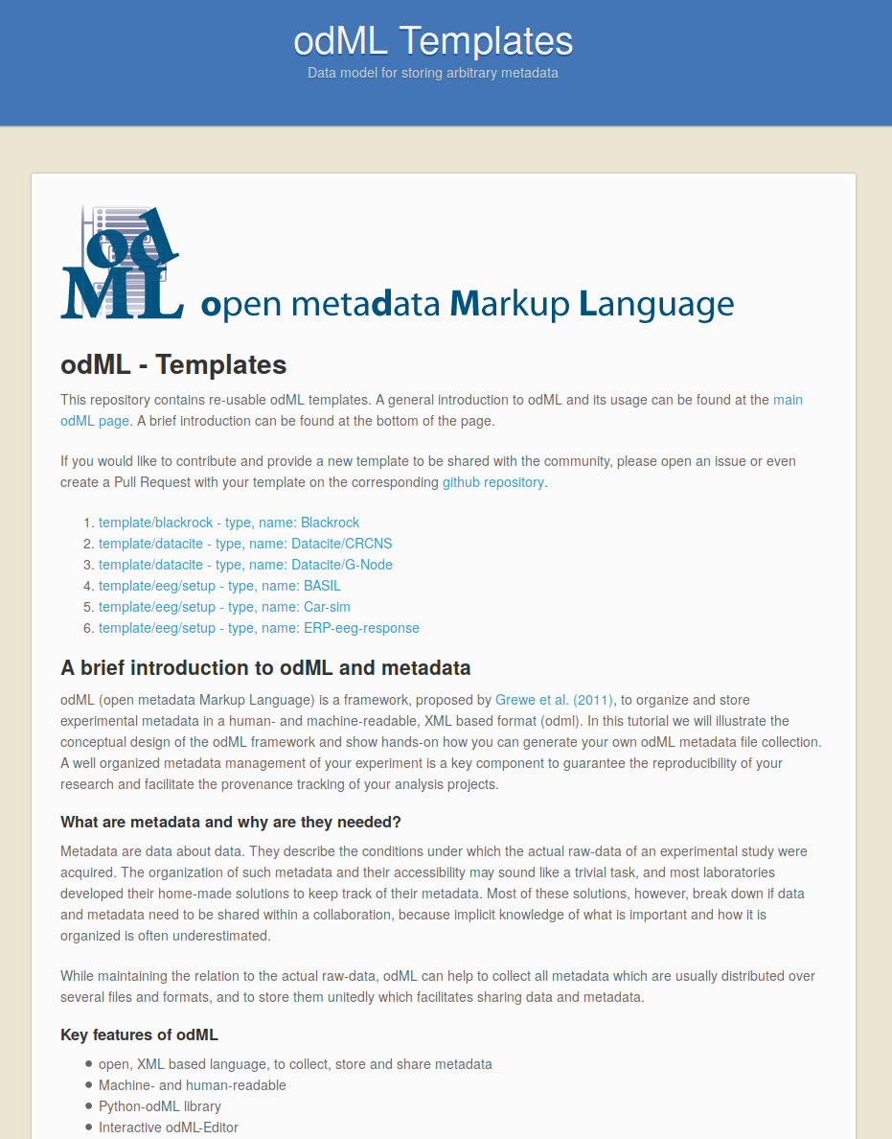
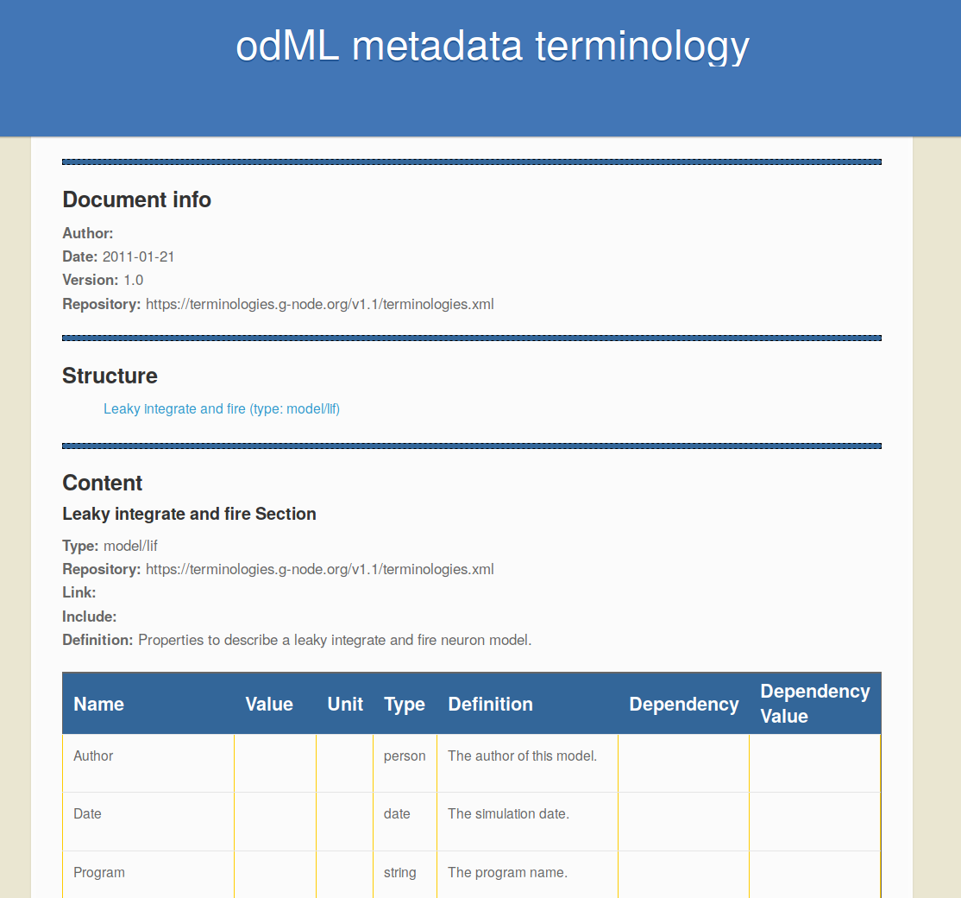
odML ... templates and terminologies
terminologies: odML building blocks
templates: reusable odML documents
https://terminologies.g-node.org
https://templates.g-node.org
http://g-node.org/odml

Slide 4
odML ... search across documents
Added support for RDF
  … format to create graph databases
Heterogeneous data in graph database
Search via SPARQL query language
Public server meta.g-node.org
  free to use and participate
  free to set up in-lab
https://meta.g-node.org
http://g-node.org/odml

Slide 5
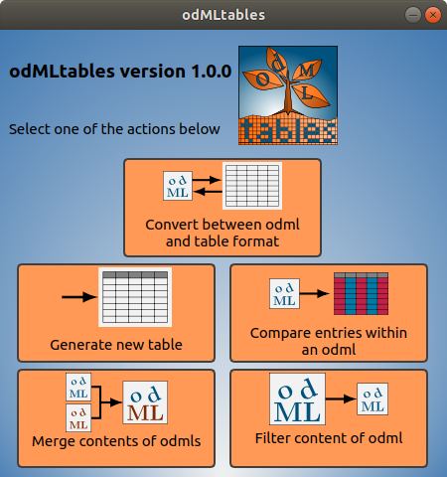
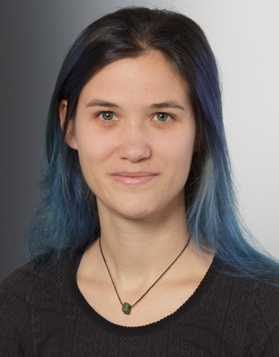
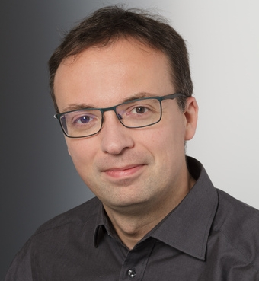
odMLtables
odMLtables: A User-Friendly Approach for Managing Metadata of Neurophysiological
Sprenger J, Zehl L, Pick J, Sonntag M, Grewe J, Wachtler T, Grün S and Denker M (2019).
Experiments. Front. Neuroinform. 13:62, doi: 10.3389/fninf.2019.00062
Julia Sprenger
FZ Jülich
Michael Denker
FZ Jülich
https://odmltables.readthedocs.io
http://g-node.org/odml

Slide 6
odMLtables
odMLtables features:
  command line and GUI
  odML document filter
  odML ↔ table conversion
  odML files comparison
https://odmltables.readthedocs.io
http://g-node.org/odml

Slide 7
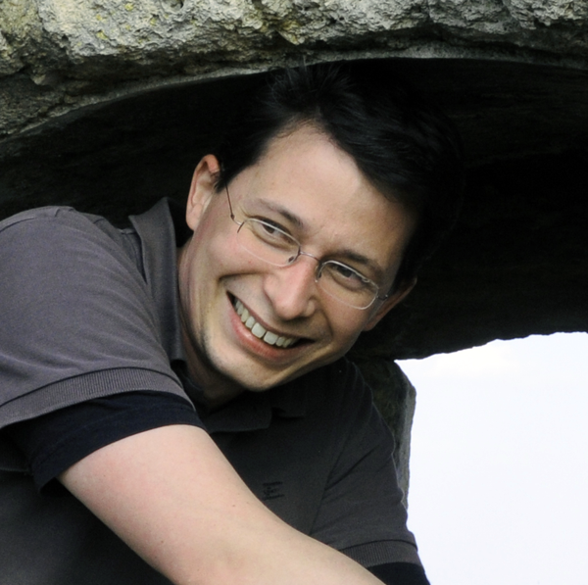
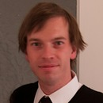
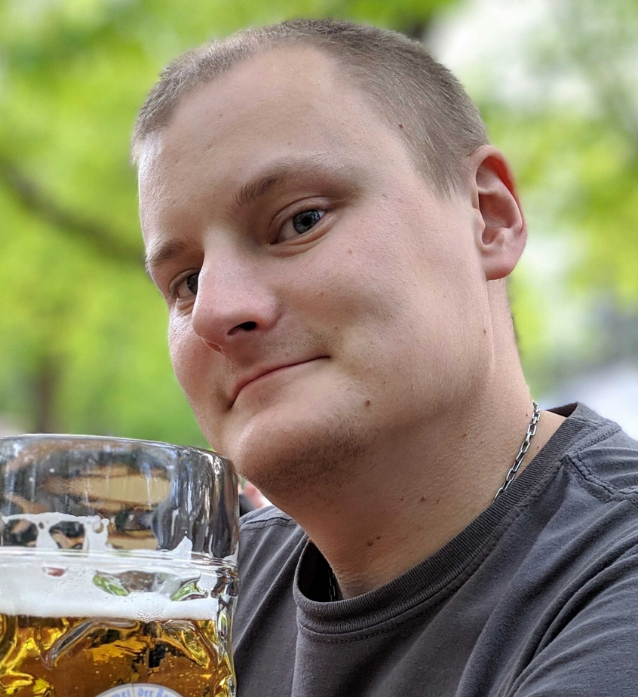
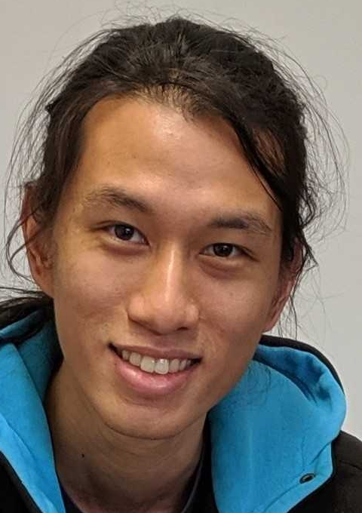
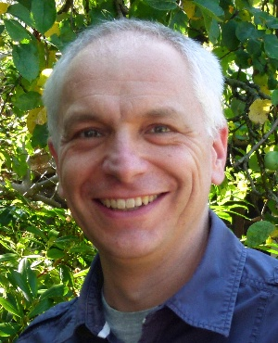
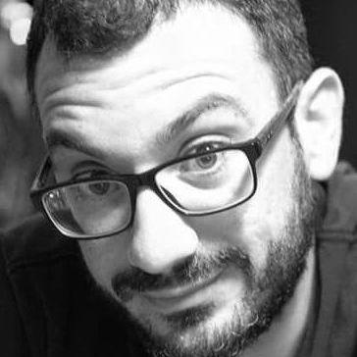
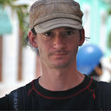
G-Node Contributors 2019
Star contributors 2019
Jan Grewe
Uni Tübingen
Christian Kellner
Red Hat Berlin
Jiří Vaněk
TU Pilzen
Chek Yin Choi
TUM
Julia Sprenger
FZ Jülich
Michael Denker
FZ Jülich
G-Node
Thomas Wachtler
LMU
Achilleas Koutsou
LMU
Michael Sonntag
LMU

Slide 8
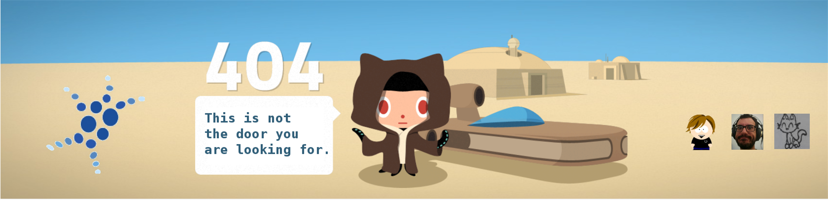
/dev/null
questions -> /dev/null
or
Room B01.064
always open (>10:00)
dev@g-node.org

