Slide 1

GIN: Open platform and services for efficient
research data management, collaboration and data publication
Achilleas Koutsou, Michael Sonntag, Jiří Vaněk, Thomas Wachtler
German Neuroinformatics Node, Department of Biology II
Ludwig-Maximilians-Universität München, Martinsried, Germany
https://gin.g-node.org

Slide 2
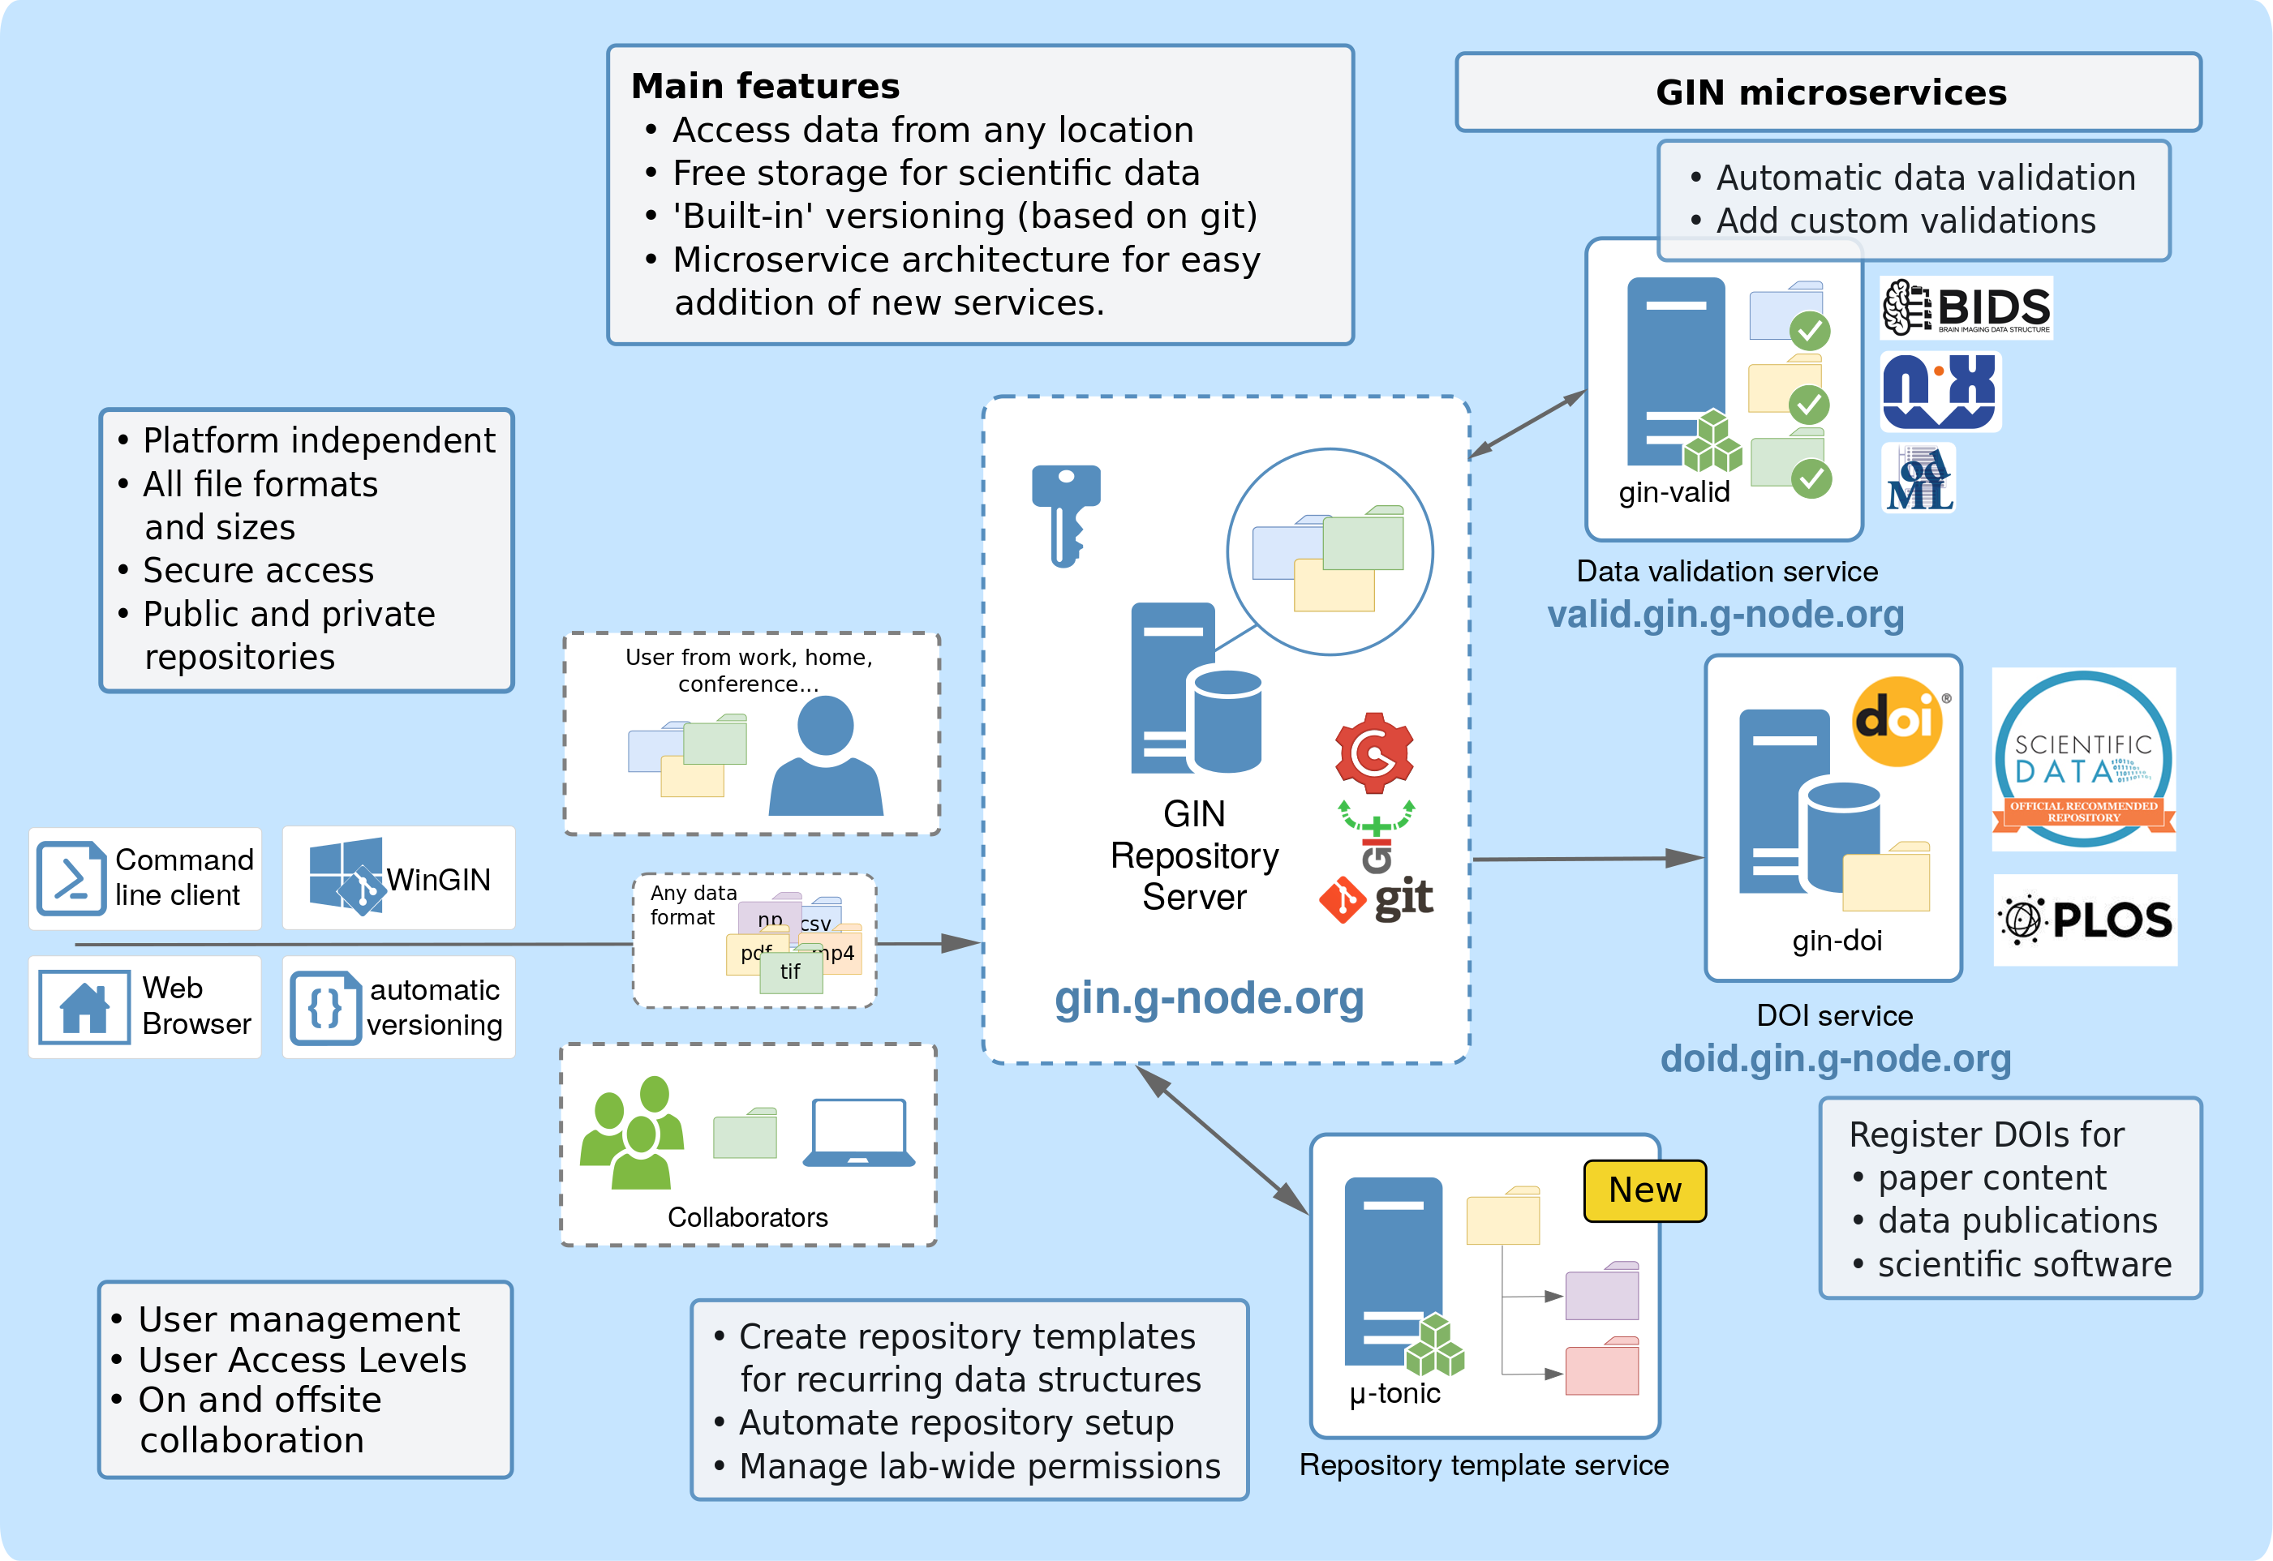
GIN ... G-Node Infrastructure
https://gin.g-node.org

Slide 3
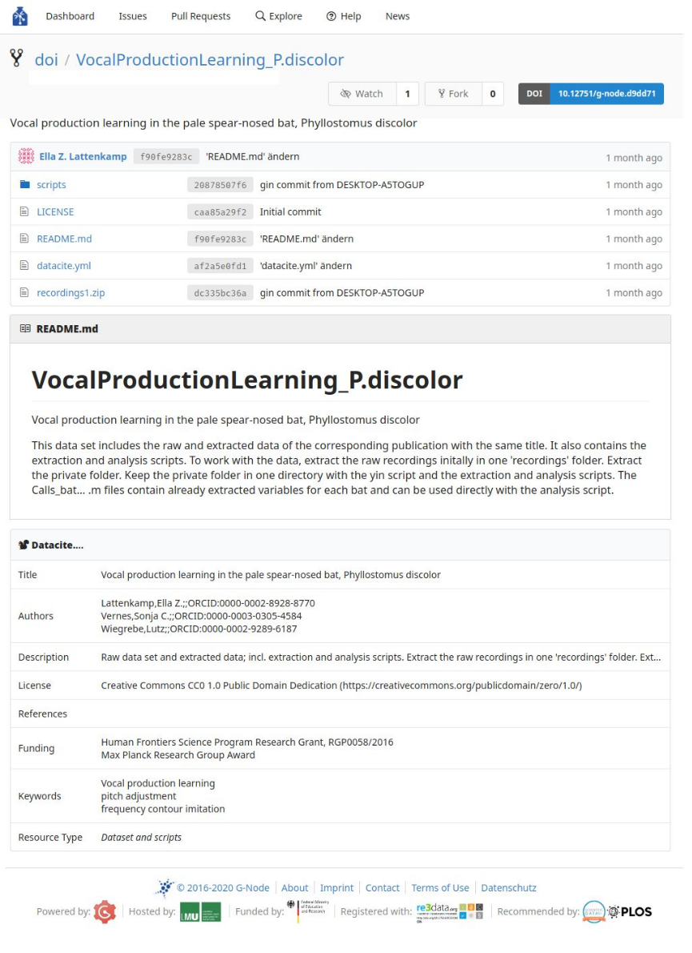



GIN datahosting
Free to use
Unlimited* storage
Collaborative repos/datasets
Public or private
Web or git/ssh uploads & downloads
Rendering for supported files
  Structured formats:
  odML, JSON, YAML, Markdown
  Media and documents:
  Images, Videos, PDF
Indexing and search for text and documents
Neuroscientific service recommended by
https://gin.g-node.org

Slide 4
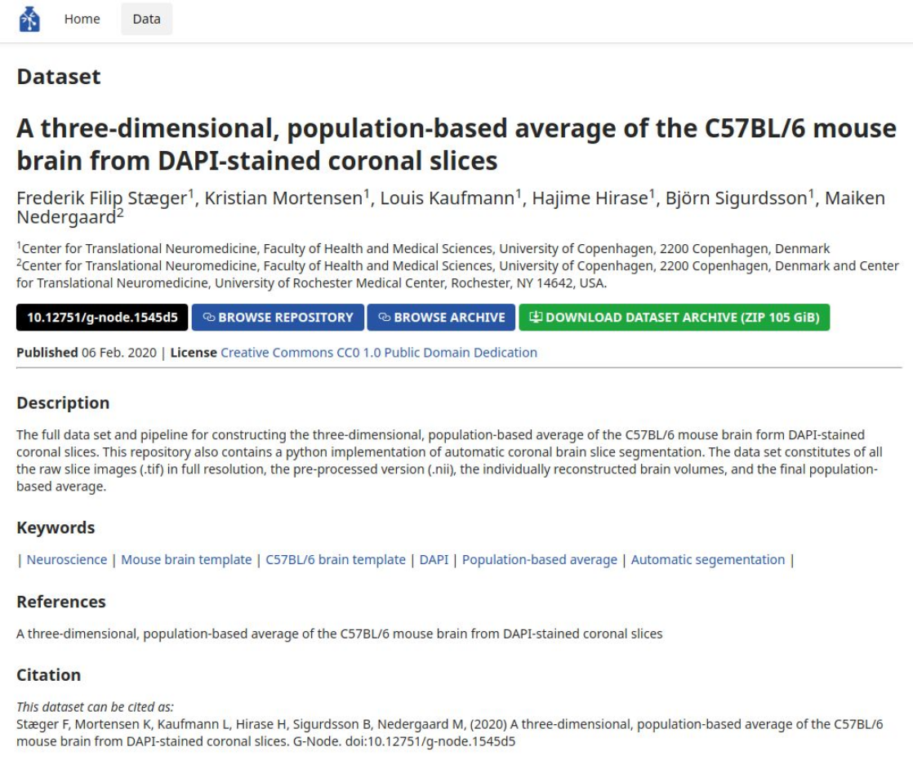

GIN dataset publication
Dataset publishing (DOI)
Publish datasets or code
hosted on GIN
Persistent identifier for
referencing
Permanent archive of
your data and/or code
https://gin.g-node.org

Slide 5
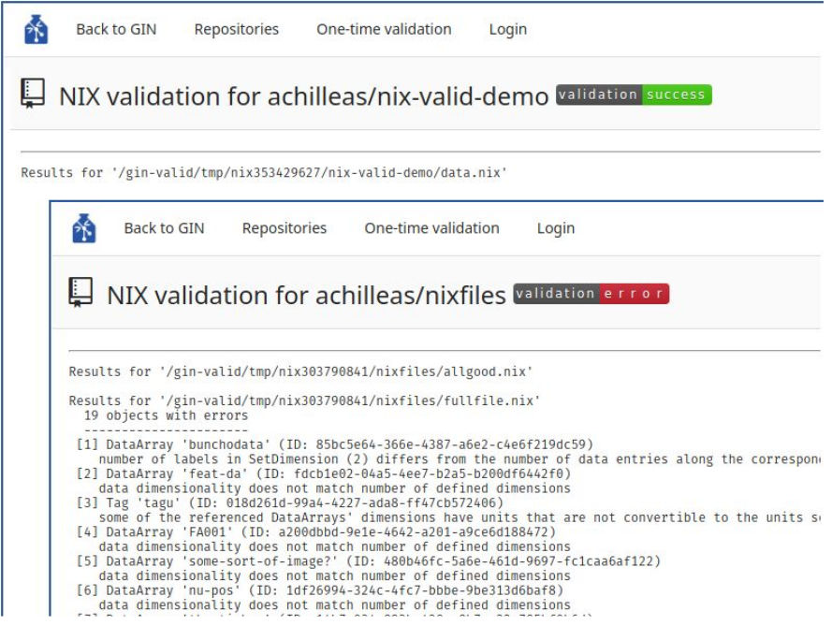
GIN Validation service
File validation service (beta)
Automatic validation of
NIX, odML, and BIDS files
in GIN repositories
Can be easily extended to support more formats
https://gin.g-node.org

