Slide 1
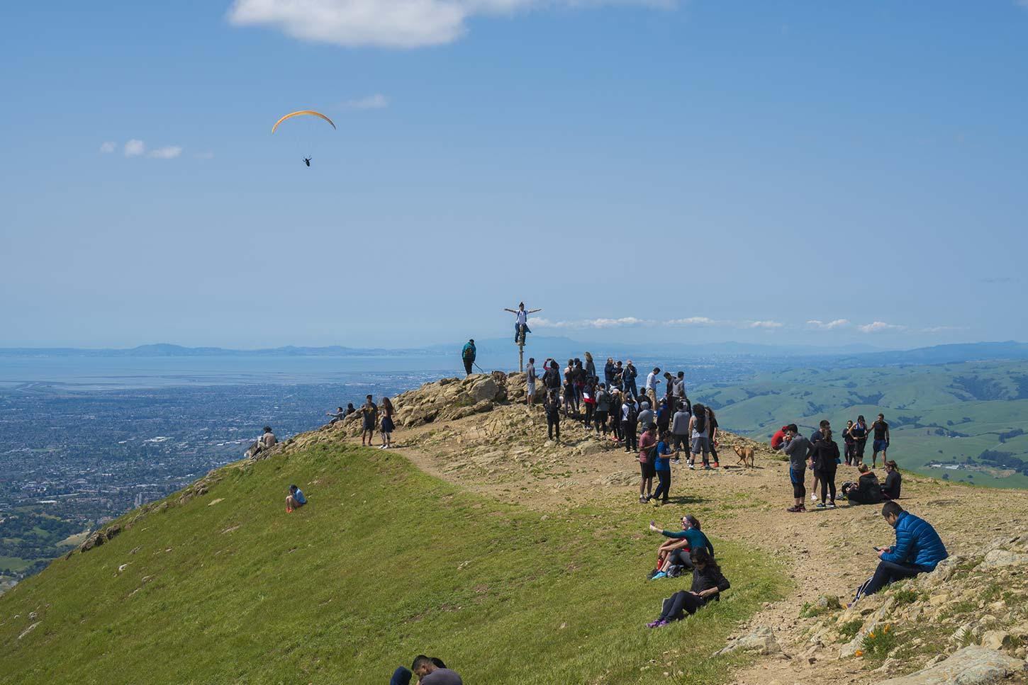
Container Orchestration with Kubernetes
by
Issac Lee
JiaoJiao Yang

Slide 2
Objectives
Introducing Docker and Kubernetes
Using Minikube to create a local development cluster
Using Kops to create a production cluster in AWS
Using Helm for Kubernetes package management

Slide 3
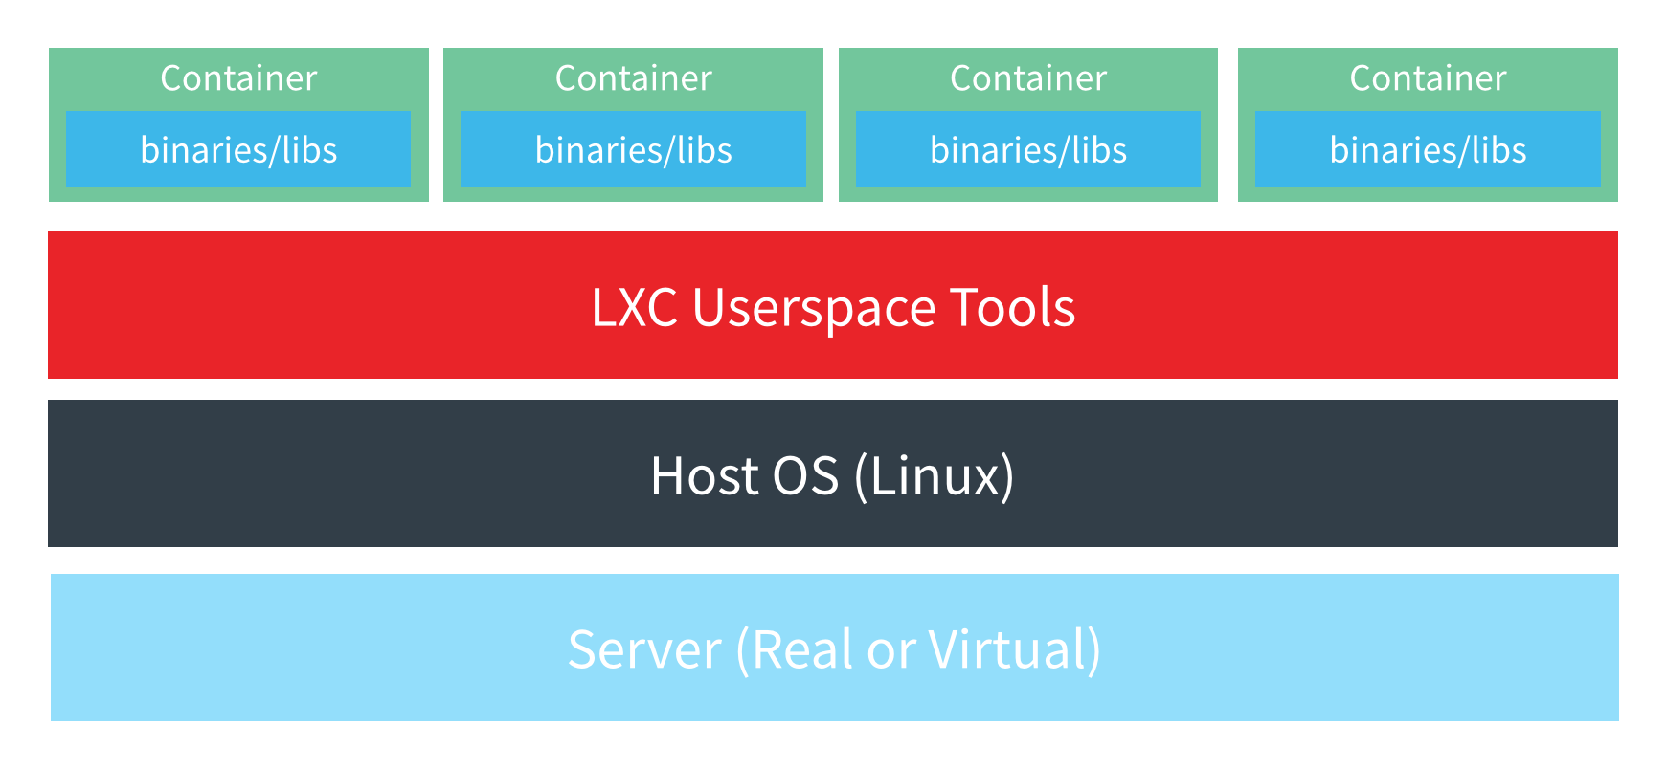
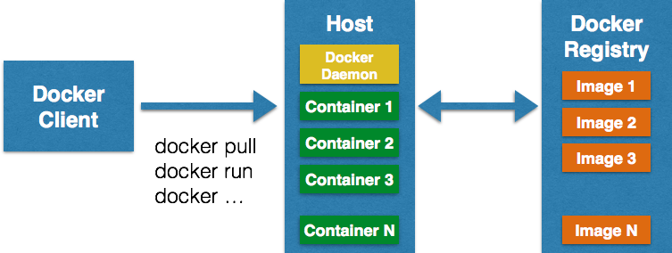
Docker Container
Container is a method to package an application so that it can be run with isolated dependencies.
It fundamentally changes the way software is built, packaged and deployed in a cloud native environment.
Docker is a container engine/daemonand client run on top of an operating system.

Slide 4
Dockerfile and Container Image
# Dockerfile
FROM ubuntu:16.04
RUN apt-get update \
&& apt-get install -y nginx
EXPOSE 80
CMD ["/usr/sbin/nginx", "-g", "daemon off;"]
# Container Image
ubuntu:16.04
Base Base Layer - FROM ubuntu:16.04
Layer 1 - RUN apt-get install -y nginx
(Read Only)
(Read Only)
Layer - FROM ubuntu:16.04
(Read Only)
(Read Only)
(Read Only)
Container Layer
(Read & Write)
Layer 1 - RUN apt-get install -y nginx
(Read Only)
Base Layer - FROM ubuntu:16.04
(Read Only)
Notes:
A container image is a package is created from a Dockerfile. A container image is composed of many layers. The first layer in the image is also called the base layer. Each layer is mapping with one command and this command is nothing but a file which will be stacked in this image. The all layers of container images are immutable or read only which means once created can’t be changed.

Slide 5
Running Containers Inside Virtual Machines
Virtual Machine
Virtual Machine
Virtual Machine
Container 1
Container 2
Container 3
Container 4
Container 5
Container 6
App 1
Docker
Docker
Operating System
Operating System
Operating System
Hypervisor
Infrastructure

Slide 6
Kubernetes (K8s)
An open source container orchestration platform for automating deployment, scaling, and management of containerized applications
Service Discovery
Load Balancing
Secrets/configuration/storage management
Health checks
Auto-[scaling/restart/healing] of containers and nodes
Zero-downtime deploys

Slide 7
Kubernetes Cluster and Components
Master Nodes/Control Plane
Worker Nodes
kube-controller-manager
cloud-controller-manager
kubelet
kubelet
kube-proxy
kube-proxy
Docker
Docker
kube-apiserver
kubelet
etcd
kube-scheduler
kube-proxy
Docker
Notes:
The API server is a component of the Kubernetes control plane
that exposes the Kubernetes API (kubectl)
Etcd is the key value store
The scheduler watches for newly created pods with no assigned node, and selects a node for them to run on.
Kube controller includes node, replication, endpoing, service account and token controllers
The kubelet takes a set of PodSpecs that are provided through various mechanisms and ensures that the containers described in those PodSpecs are running and healthy
kube-proxy maintains network rules on nodes. These network rules allow network communication to your Pods from network sessions inside or outside of your cluster.
The Docker container runtime is responsible for running containers

Slide 8
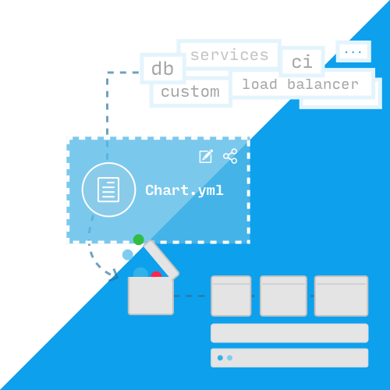
Helm
Helm is making it simple to package and deploy microservices on Kubernetes.
Define and manage complexity
Easy update and configuration
Simple to scale up and down
Version control and share

Slide 9
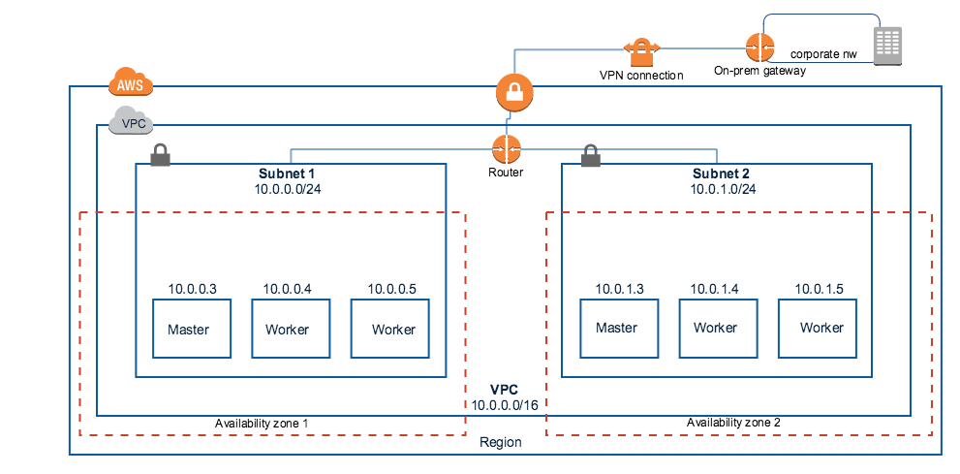
Kubernetes Cloud Deployment

Slide 10
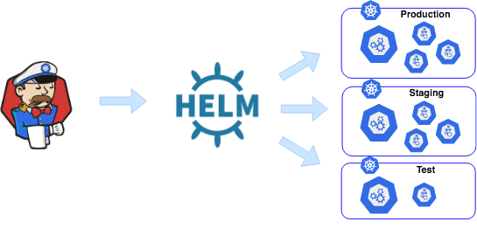

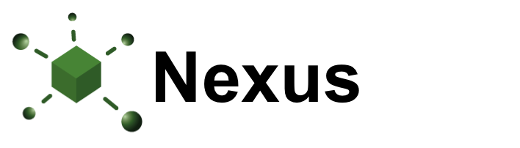
Kubernetes Application Deployment with Helm
Chart Repository
Docker Registry

Slide 11
Kubernetes On-Prem Deployment
Provision several Linux machines with a UNIX flavour
Install kubeadm
Make one of your machines the master (or the control plane)
Install a pod networking layer like Weave Net
Join the other nodes to the master

Slide 12
Labs
Application Deployment and Containerization
Using Minikube for Local Development and Testing
Creating Production Clusters using Kops
Managing Applications Deployment using Helm Charts

Slide 13
Lab Environment
AWS EC2 Instances
Control Machine - console[1:20]
Sandbox Machine - worker[1:20]
Web Integrated Development Environment (IDE)
http://console<n>.missionpeaktechnologies.com:8000
Username/Password: student<n>/student<n>
Labs - https://github.com/mpt-bootcamp/kubernetes/tree/master/docs
Slack - https://join.slack.com/t/mpt-bootcamp/shared_invite/enQtODA5NzkxNjA4NTMyLTAwZGFlOWU2MGI3YjIzYWViOTFlNzM2NmZmMTVhMjJjZTEyN2Q0M2QzYmI2YjE5YzU1YWQxNWJjNDU4NWY5MTM

