Slide 1


Software Dev. Projects
Project documentation
Bujar Mamudi
Yahya Kemal College
Fall 2012

Slide 2
Contents:
Introduction
Functional Requirements
Non-Functional Requirements
Use Case Model
Analysis, Specification, Design and Implementation
Installation Requirements
Conclusion
Appendix

Slide 3
Introduction ( 2-3 pages )
A brief outline of what you are going to do
You can expand these subsections:
1.1 PURPOSE OF THE SYSTEM
1.2 SCOPE OF THE SYSTEM
1.3 TARGET ENVIRONMENT
1.4 OBJECTIVES AND SUCCESS CRITERIA
1.5 DEFINITIONS, ACRONYMS, AND ABBREVIATIONS
1.6 OVERVIEW

Slide 4
Functional Requirements ( 2-3 pages )
define all the functionality provided by the system for all involved actors
You can expand these subsections:
2.1 ACTOR 1 ( example: ADMINISTRATOR)
2.2 ACTOR 2 ( example: USER)
…………………………………..
2.N ACTOR N ( ….. )

Slide 5
Non-Functional Requirements ( 2-3 pages )
discuss other constraints besides the desired functionality for the actors
You can expand these subsections:
3.1 USABILITY
3.2 RELIABILITY
3.3 PERFORMANCE
3.4 SUPPORTABILITY
3.5 IMPLEMENTATION
3.6 INTERFACE
3.7 PACKAGING
3.8 LEGAL

Slide 6
Use Case Model( 2-3 pages )
describe some scenarios and draw some use case models using UML.
You can expand these subsections:
4.1 SCENARIOS
4.2 USE CASES AND UML DIAGRAMS

Slide 7
Use Case Model( 2-3 pages )
Name | Browse Product
Actors | Sales assistant, Manager
Entry condition | This use case starts when the actor wants to search for product information.
Flow of events | Steps | Actions
 | 1 | The actor logins successfully.
 | 2 | The actor clicks the Browse button
 | 3 | A window form will appear showing browsing options
 | 4 | The actor will select a combination of browsing options and enter information according to selection
 | 5 | The actor presses the search button
 | 6 | A list of results is displayed
Exit Condition | This use case terminates when the actor has successfully found the product or decides to stop searching.
Exceptions | Error message is generated if no product is found.
Special Requirements | The product must exist in the database.

Slide 8
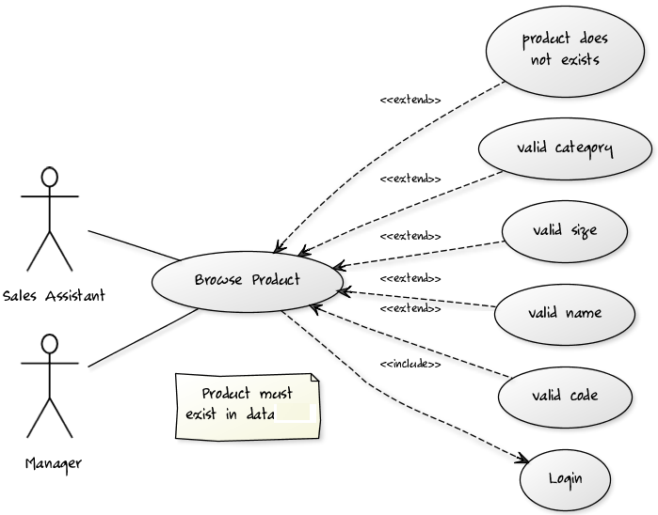
Use Case Model( 2-3 pages )
Figure 1: An UML diagram of the Use Case

Slide 9
Analysis Specification, Design and Implementation ( 10 - 30 pages )
Show the guts of the system using UML structure diagrams, behavior diagrams, and interaction diagrams.
You can expand these subsections:
5.1 ANALYSIS SPECIFICATION
5.2 SYSTEM ARCHITECTURE
5.3 ACCESS RIGHTS AND SECURITY
5.4 DATA STORAGE

Slide 10
Analysis Specification
Explain the design of the system as a group of interacting objects.
Include a representative sample of class diagrams and their description
Explain the elements of the GUI you have implemented
You can expand these subsections:
5.1.1 ANALYSIS MODEL
5.1.2 CLASS ANALYSIS
5.1.3 USER INTERFACE

Slide 11
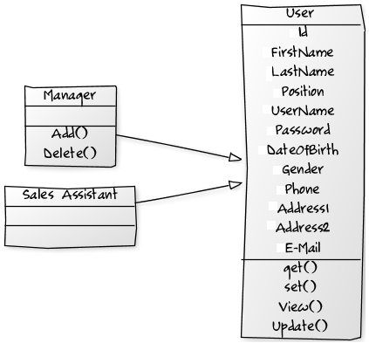
Class Diagrams
Class | Description
User | This class is the highest node in the hierarchy representing all users that access the system.
Sales Assistant | (Subclass of User) represents the basic users of the system with limited functionality.
Manager | (Subclass of User) represents the users that have full access rights to the system.

Slide 12
System architecture
Explain what software framework you have implemented in your project, discuss all layers of the structure of the framework you are using, show the main subsystems and their interactions.
You can expand these subsections:
5.2.1 LAYERED STRUCTURE
5.2.2 SUBSYSTEM DECOMPOSITION
5.2.3 HARDWARE/SOFTWARE MAPPING /
DEPLOYMENT DIAGRAM

Slide 13
System architecture
Explain what software framework you have implemented in your project, discuss all layers of the structure of the framework you are using, show the main subsystems and their interactions.
You can expand these subsections:
5.2.1 LAYERED STRUCTURE
5.2.2 SUBSYSTEM DECOMPOSITION
5.2.3 HARDWARE/SOFTWARE MAPPING /
DEPLOYMENT DIAGRAM

Slide 14
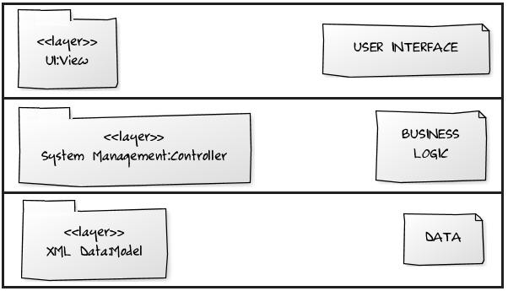
Layered Structure

Slide 15
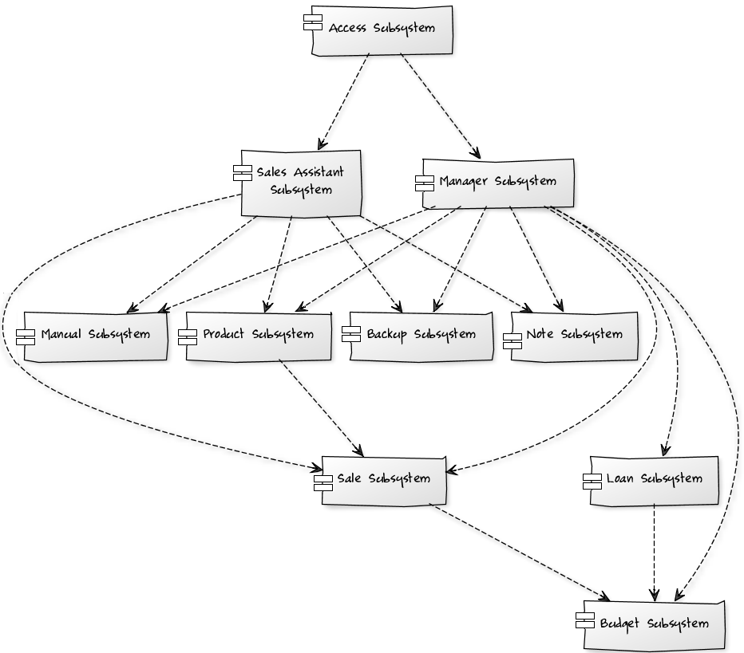
Subsystem Decomposition

Slide 16
Access rights and security
Explain how your system deals with security, include a table representing the access rights for each actor
You can expand these subsections:
5.3.1 SECURITY CONCERNS
5.3.2 ACCESS MATRIX

Slide 17
Access matrix
 | Sales Assistant | Manager
Access | Login Logout | Login Logout
Products | Add, View, Sell, Update | Add, View, Sell, Update, Delete
Sales | View | View, Update, Delete
Budget | - | View, Query
Backup | Yes | Yes

Slide 18
Data Storage
Explain how the system handles persistent data, include some diagrams/tables explaining the structure of your database.
You can expand these subsections:
5.4.1 DATABASE
5.4.2 DATABASE STRUCTURE DIAGRAM

Slide 19
Installation Requirements ( 1 page )
List the installation steps and procedures

Slide 20
Conclusion ( 5 – 20 pages )
sum up the work you have done, what functionality is missing, how you could improve the project further.
Include a representative number of screenshots of your working program, class diagrams, etc.
You can expand these subsections:
7.1 SCREENSHOTS

Slide 21
Appendix ( 1 page )
List the references and books used as resources in developing your project

Slide 22
Software Dev. Projects
?
?
?
?
?
Questions?
?
?
?
?
?
© 2012 Bujar Mamudi

