Slide 1

Classification of Transportation Methods Through Machine Learning
Presented by: Zach Barillaro, Daniel Laccitiello, Michael Pucci
Institution: Concordia University
Date: May 4, 2019

Slide 2
Initiative
As global warming continues to impact our daily lives, it is important to quantify where the city of Montreal stands in fossil fuel consumption within the transportation sector.
The information gathered can be used to put initiatives in place to lower fossil fuel consumption and green house gas emissions in the future.
ZDP looks to use empirical data extracted from Trajet Montreal and the Iteranum app to quantify the modes of transport used by Montrealer.

Slide 3
Methodology
Using geospatial data extracted from the Iteranum app, the goal was to build a classification model in determining the mode of transportation. The following was achieved by feature engineering metrics of each user’s trip. External data was used to enhance our predictive capabilities.
Two models were used throughout the duration of this task. The first model classified the data into 6 different modes of transportation. The second model classified modes of transportation into two subgroups, fossil fuel and non-fossil fuel methods.

Slide 4
Overview
Model Statistics | Values
Number of Trips | 9500
Training (%) | 70
Number of Classes (Model 1) | 6
Number of Classes (Model 2) | 2
Total Datapoints Used | 2,000,000
Number of Features Generated | 22
Model 1 Accuracy (%) | 75.6
Model 2 Accuracy (%) | 87.51

Slide 5
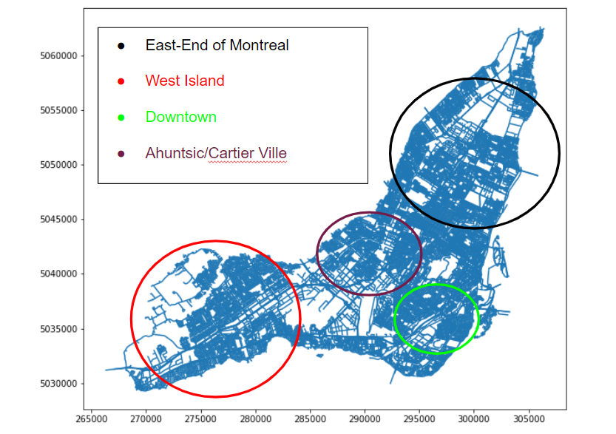
Breakdown of the City of Montreal

Slide 6
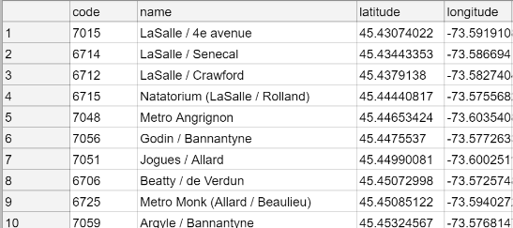
Bixi Data

Slide 7
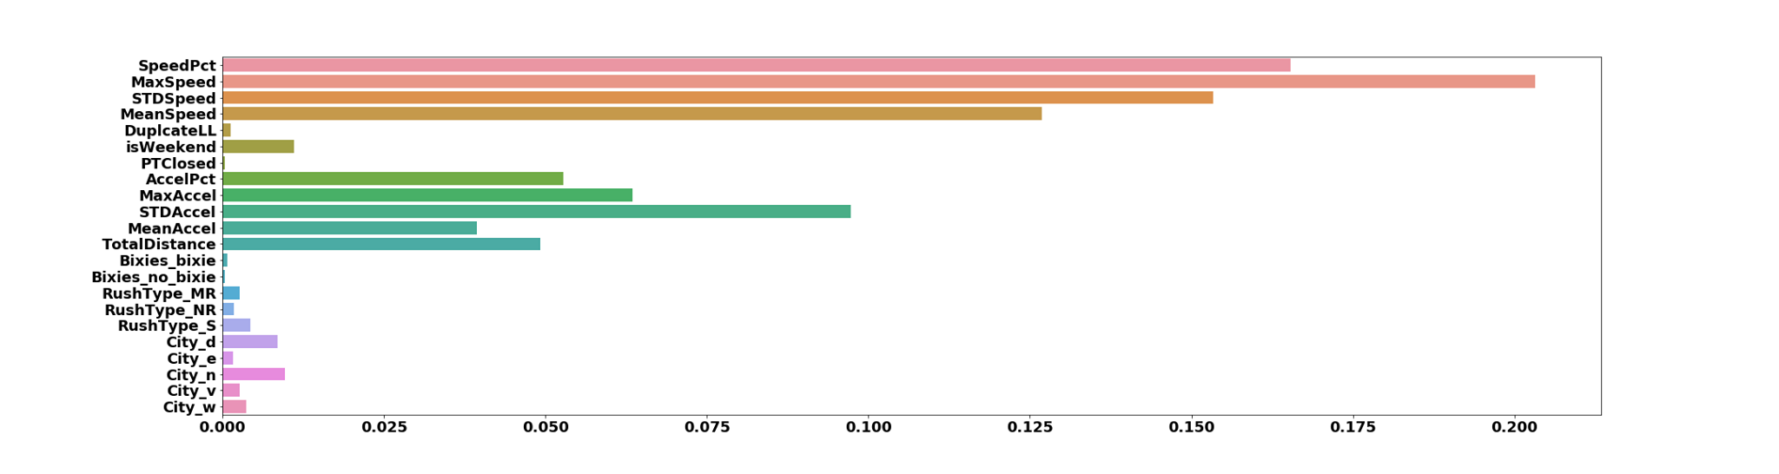
Feature Importances

Slide 8
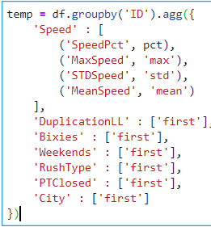

Slide 9
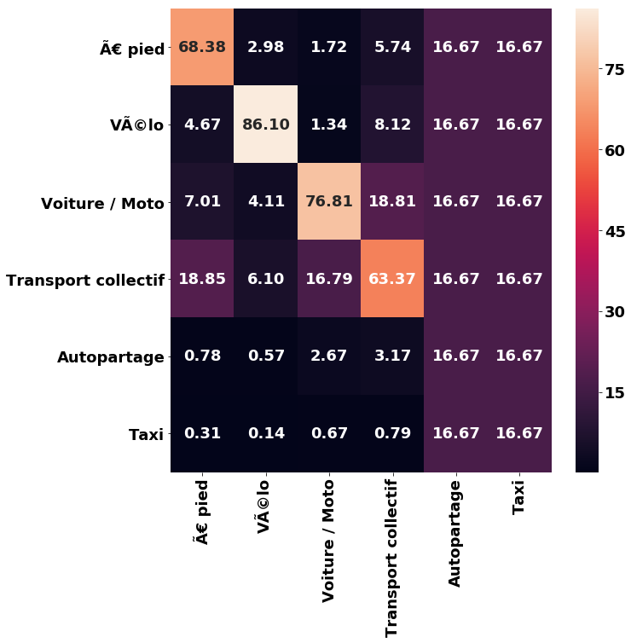

Slide 10
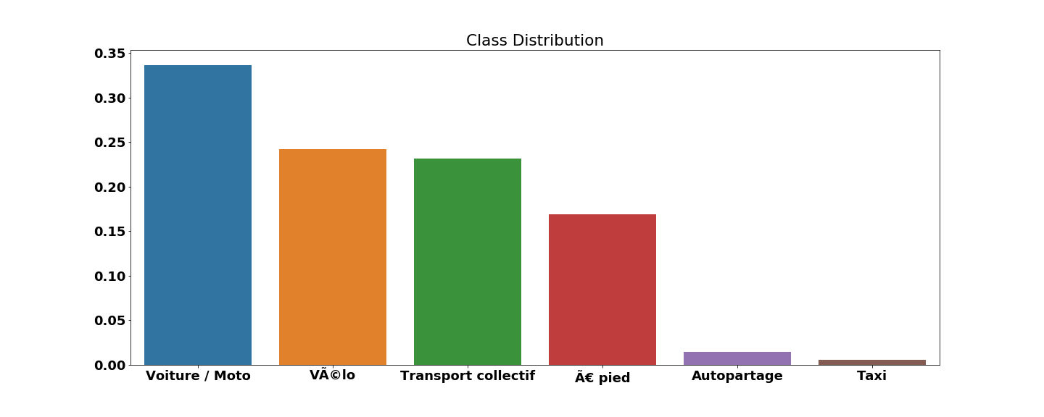
Distribution of Classes

Slide 11
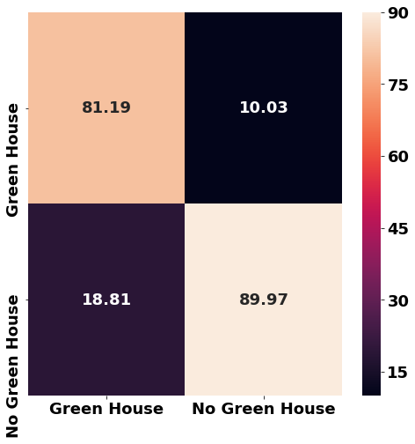

Slide 12
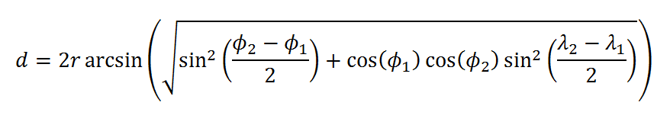
Contributors to the Solution Criteria
Algorithm used
The Random Forest algorithm was used for classification of each user’s mode of transport.
Implementing external data
Implemented geographical data as to the exact locations of where Bixi bike stations are located on the island of Montreal.
Used latitude and longitude to find central points in the city of Montreal. These points allowed us to create four distinct sections of the island.
Formula used
Haversine formula was used to convert the distance between latitudinal and longitudinal points into kilometers.

Slide 13
Metrics
Date | Time | Location | Speed | Acceleration
Weekend vs Weekday (I.E day classification) | Time of Day Classification (I.E. Morning, Noon, Afternoon, Evening and Night) | Which Part of the Montreal (Split into Four Parts: West Island, East End, Downtown, Northern Montreal | Average/Max Speed | Average/Max Acceleration
Insight Given
Generally No Traffic on weekends | Traffic Predictions | Bixi bike data and further insight into bicycle usage | Key identifier to which mode of transportation was used | Key identifier to which mode of transportation was used
Generally higher bicycle usage on weekends | Public Transit Operating Hours | Insight into which areas use which modes of transport most

Slide 14
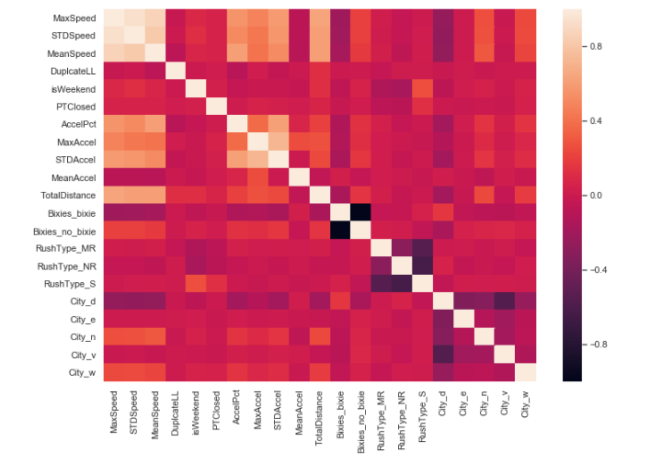
Correlation Heatmap between Predictors

