Slide 1
Making Trump Religious Again: Experiments with Deep Learning
Economics 213R
Brigham Young University 2018

Slide 2
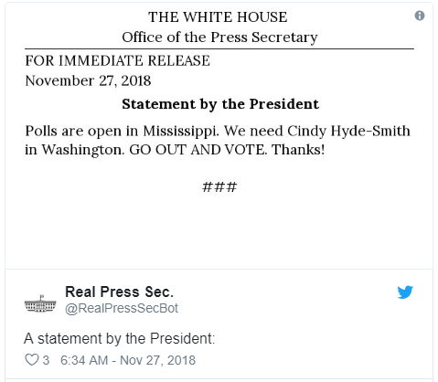
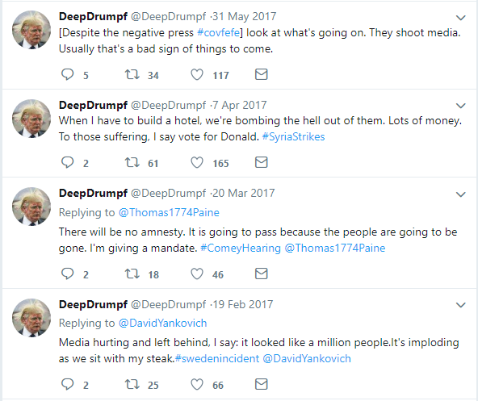
Motivation

Slide 3


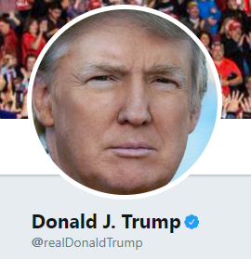

Goal
The Book of Trump
+
=

Slide 4
Data
Only used the Gospels (too many authors) minus verses that mention God or Jesus directly
Used webscraping and regular expressions to put the data into a txt file
Used all Trump tweets
Editing out filler words or blasphemic verses

Slide 5
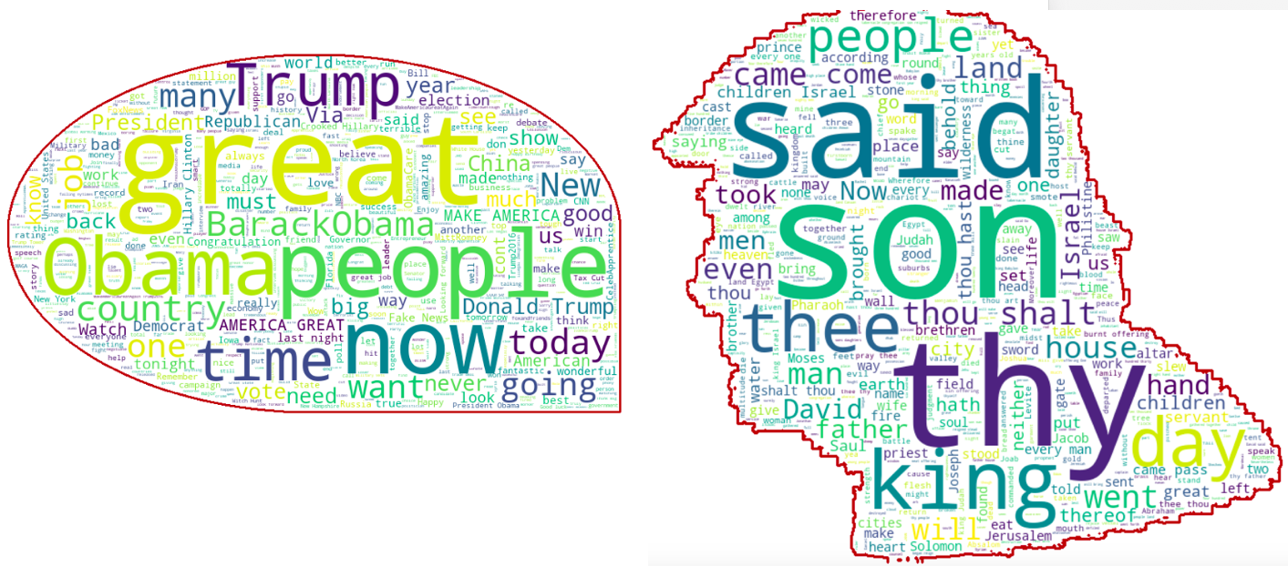

Slide 6
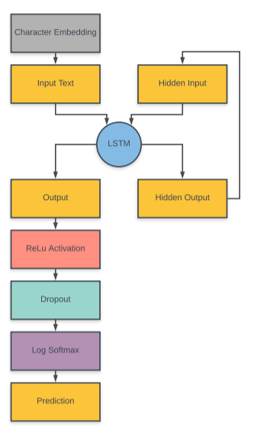

Slide 7
Tuning model
Each model was trained for about 200 epochs with a learning rate of .01.
Loss was computed using NLLLoss and the weights were updated using a SGD optimizer.
During training, we used random selections of 2,000 Tweets and 2,000 verses to create the proper blend
Equal number of verses as Trump tweets
Predictions were randomized from top 3 probabilities

Slide 8
Trump tweets

Slide 9
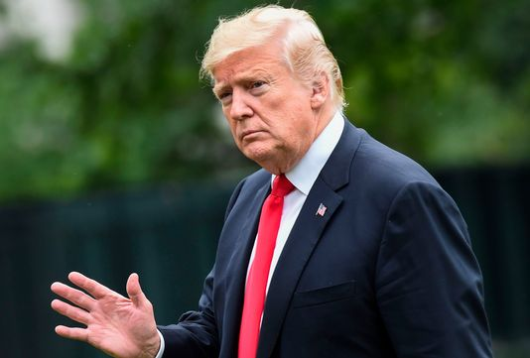
My announcement is totally inept!

Slide 10
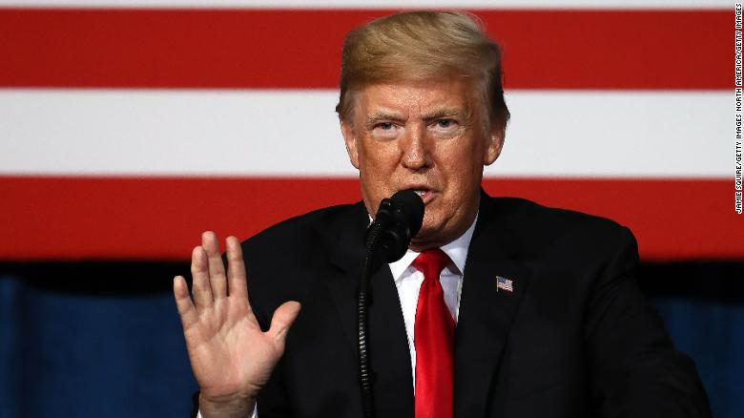
Obama is already having the market for charities which is ridiculous new is doing so poorly. I create a terrible deal with China promising his day. But in the real problem.

Slide 11
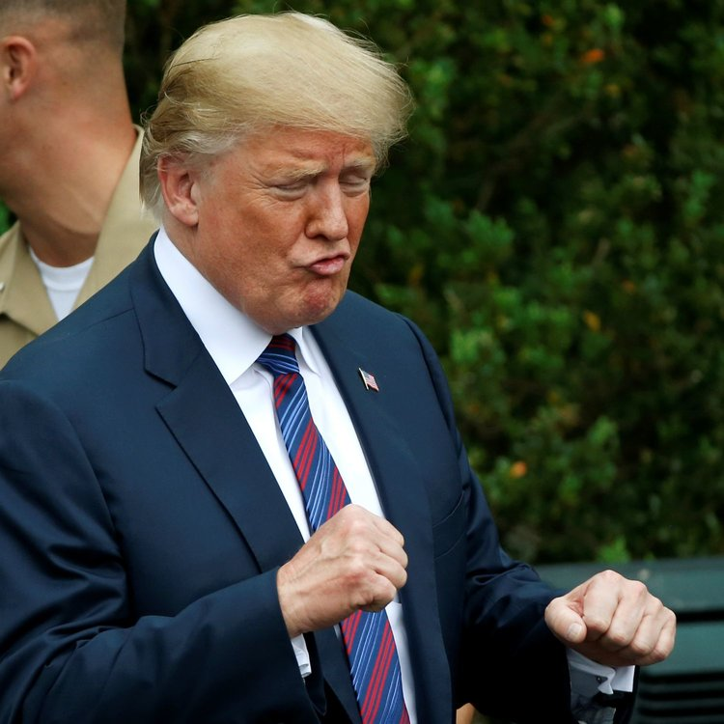
The failing New York Times is the best story by record record which is a total winner!
My interview with Chris Palm Beach Floridaons are now show states http://t.co/wworLLdTa'

Slide 12
Bible model

Slide 13

He entered into a ship, he had said unto them, I will give unto them his sheep, and plained him.'

Slide 14
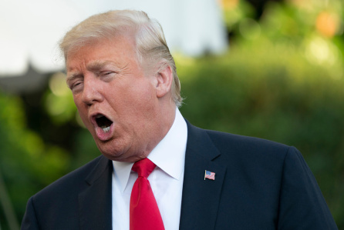
Then saith unto them, I know not what which is greater than these to the synagogue, and said, I will not believe

Slide 15
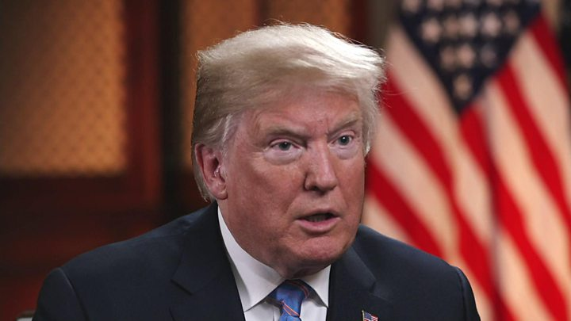
And now I am not of Juda, that the people that he did the treasure time, and buy fishes.

Slide 16
The book of trump
Combination model

Slide 17
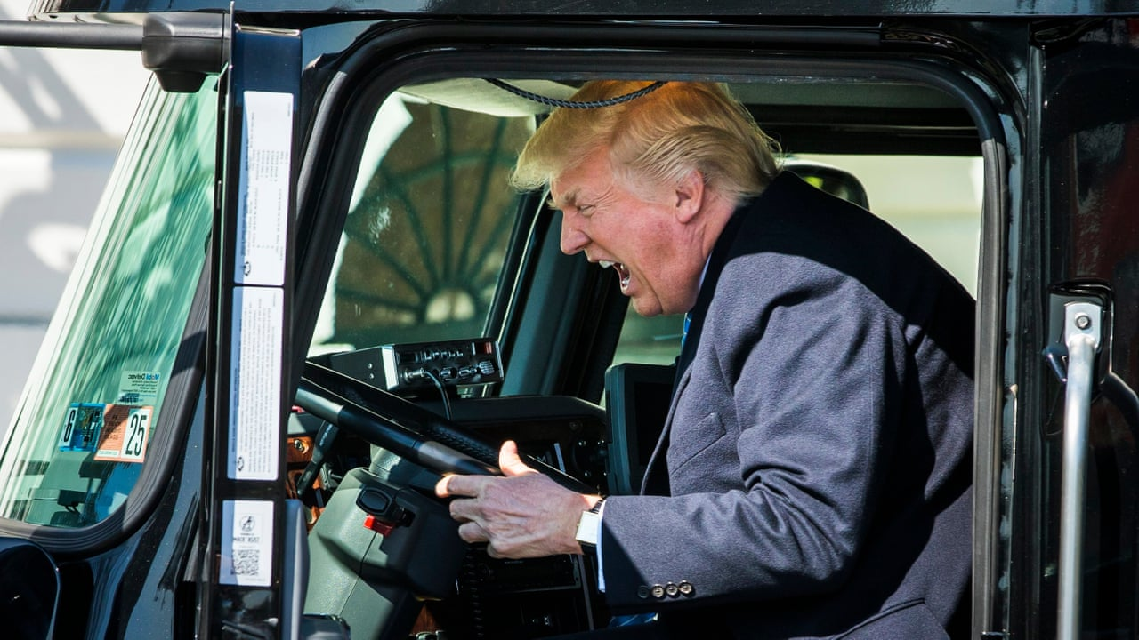
'My speech tonight will largely pain in the world. I said no matter I would have won.'

Slide 18
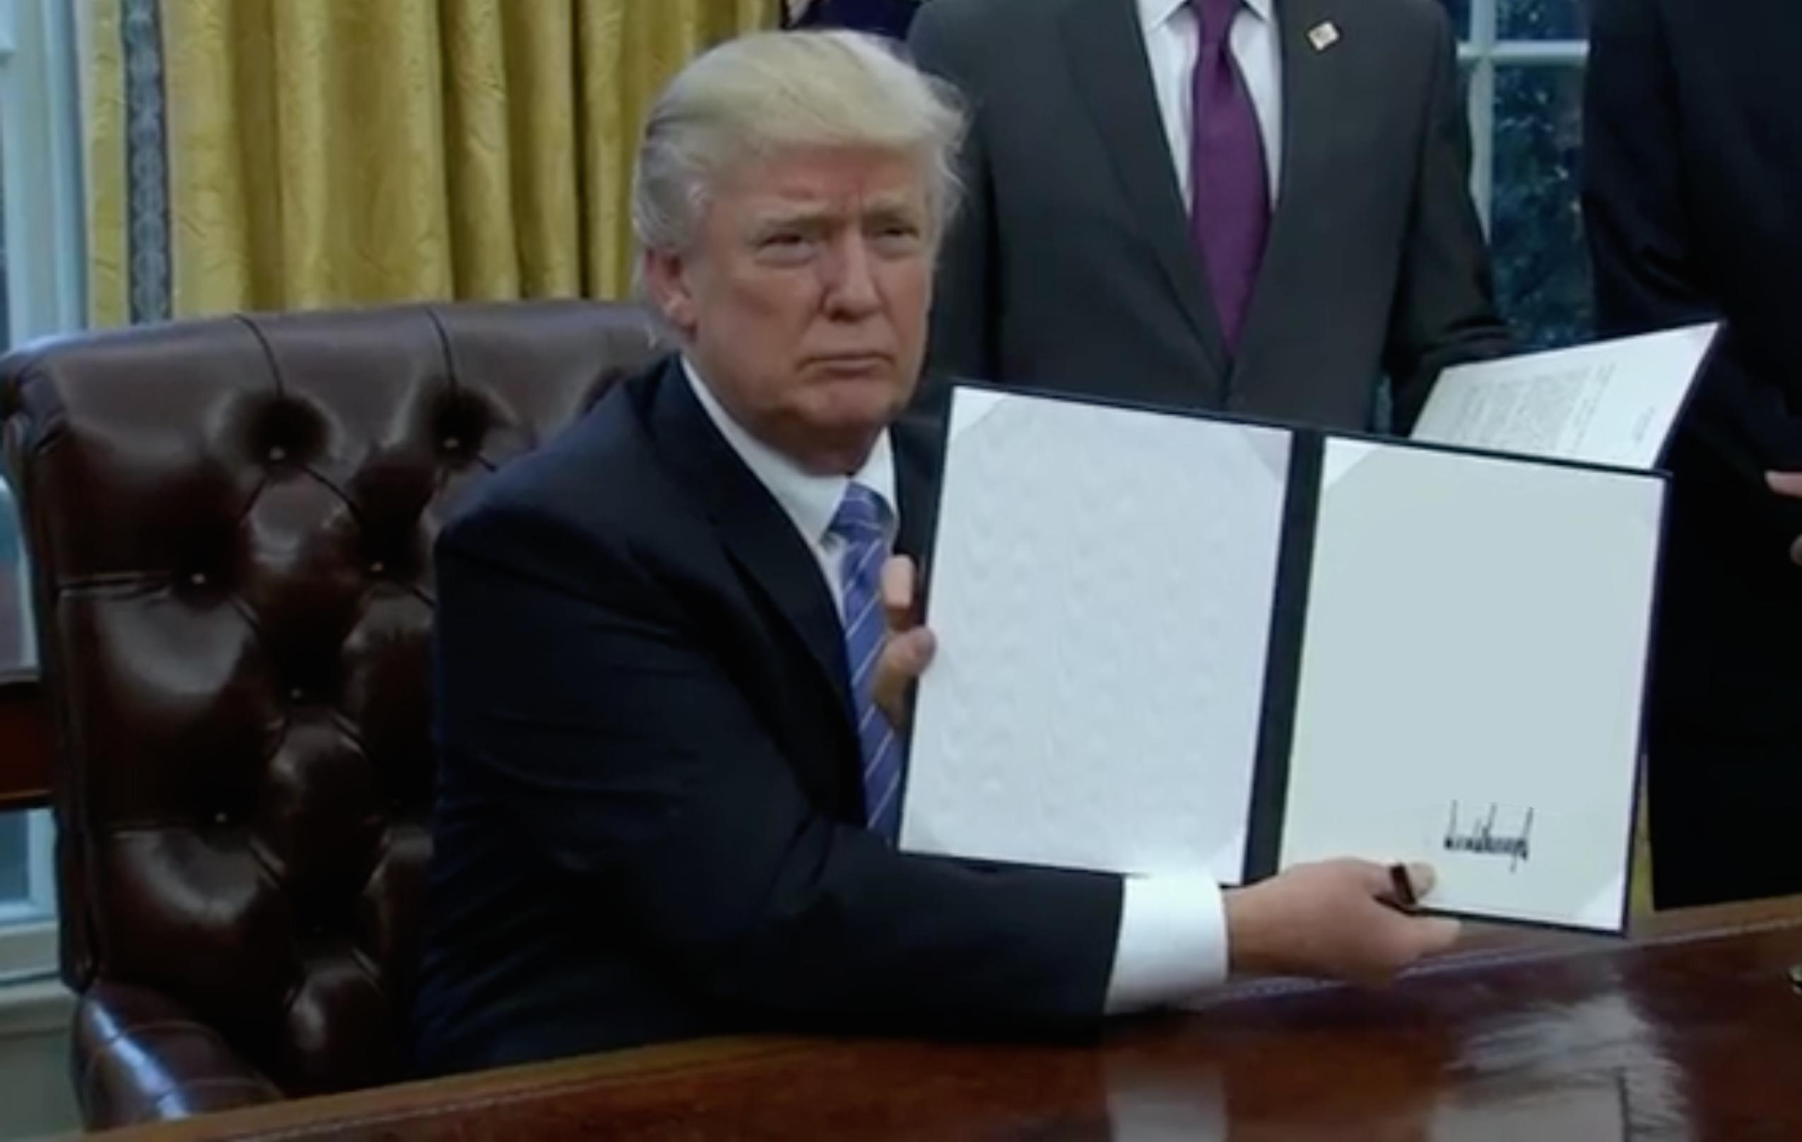
Obama before when the statement about his own hard work served you at the pressure for your way. Go with water by our best

Slide 19
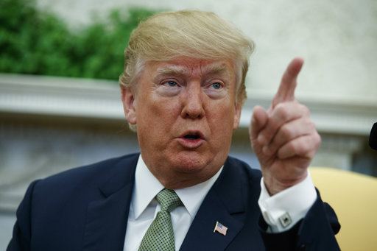
'The harder the bed for the people of the world we are leaders are perfected with me to take it is a complete weekend. It was great for a for by fantastic. -- Mark Twain'

Slide 20
Next steps
Going deeper
Different styles of Bible
Deploying model
Tweepy, Flask
Publish for funding

Slide 21
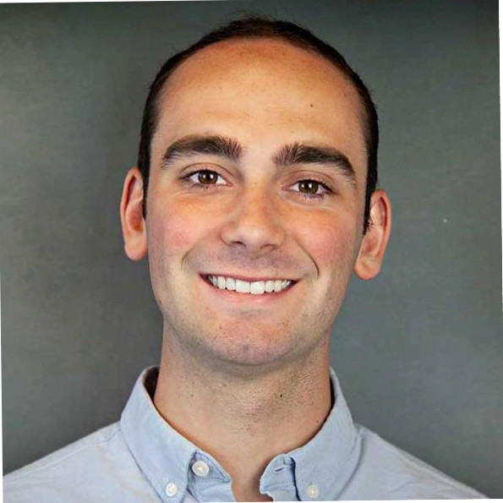
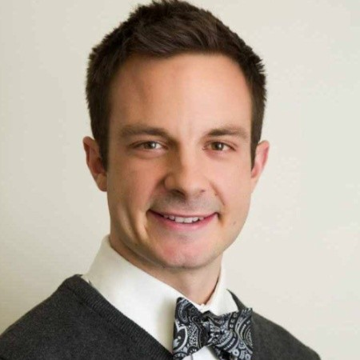
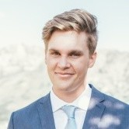
Nelson Griffiths
nelsongriffiths123@gmail.com
github.com/ngriffiths13
Mitchell Pudil
mitchellpudil3@gmail.com
github.com/mpudil
Hans Ringger
hmringger@gmail.com
github.com/hanselringger

