Slide 1

How Likely are You to Pass the TOEFL?
Mitchell Pudil

Slide 2
Background Info on the TOEFL
TOEFL is an English comprehension exam that foreigners take to be granted admission into universities in the U.S. Its sections include listening, reading, speaking, and writing.
Currently, the TOEFL uses a mixture between humans and computers to determine score.
However, there is no accurate computer-based method for students themselves to determine pre-exam whether they are likely to pass the written portion.

Slide 3

Data and Methods
Data: 200 TOEFL essays from students: 100 passed, 100 failed
  Note that the written portion is scored from 0 to 30, but unfortunately, we don’t have the data to distinguish precise scores
Overview of Methods
  Parse each essay into a dataframe of lemmas, parts of speech, and sentence structure. This includes:
    Part of speech and POS bigrams
    Sentence structure variables (Average length of word, sentence length, number of unique words)
    Hedging & boosting
    Top 5 specific words used to differentiate between high and low-scoring essays
  Visualize the above data: clusters, histograms, etc.
  Train/test validation using Random Forest. Understand most important features
  Create GUI that takes in student’s essay, parses it, and returns three things:
    If they are expected to pass & their probability of doing so (based on averages of trees in RF model)
    Top 3 most important grammatical/sentence structures the student can do to improve
    Graphs illustrating their comparison of the average exam passer for each item in (2)

Slide 4
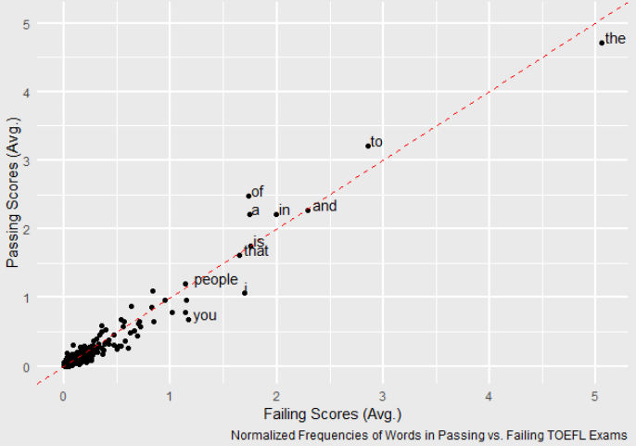
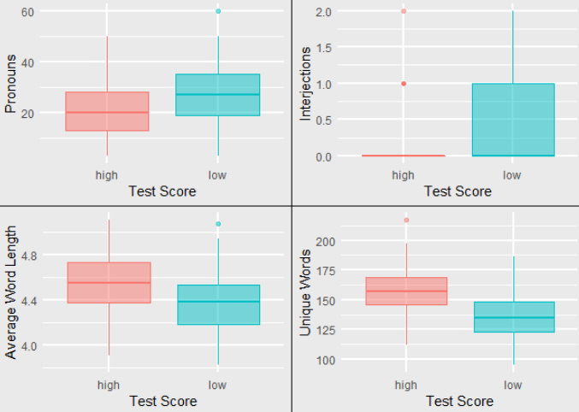
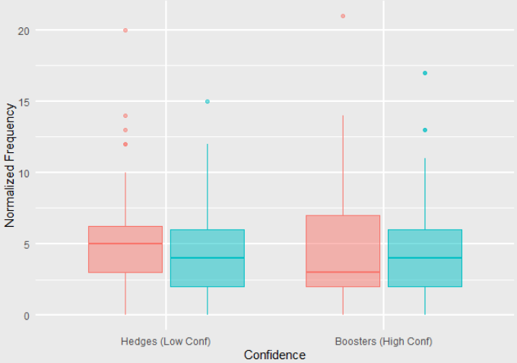
Data Summarization
Low-Scoring and High-Scoring Essays Vary in Word Usage
Parts of Speech and Sentence Structure Varies Between Low and High-Scoring essays
Lower-scoring essays use (slightly) more “high confidence” phrases.

Slide 5
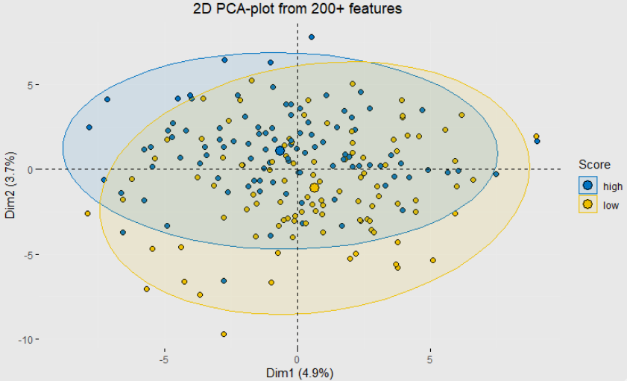
Model Analysis: Clustering via PCA

Slide 6
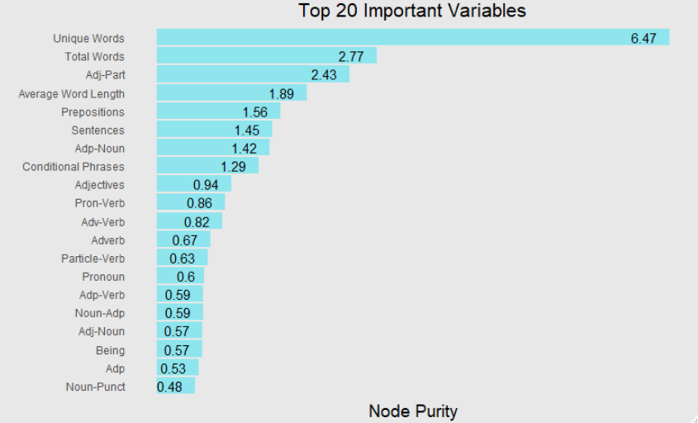
Model Analysis: Most Important Variables

Slide 7
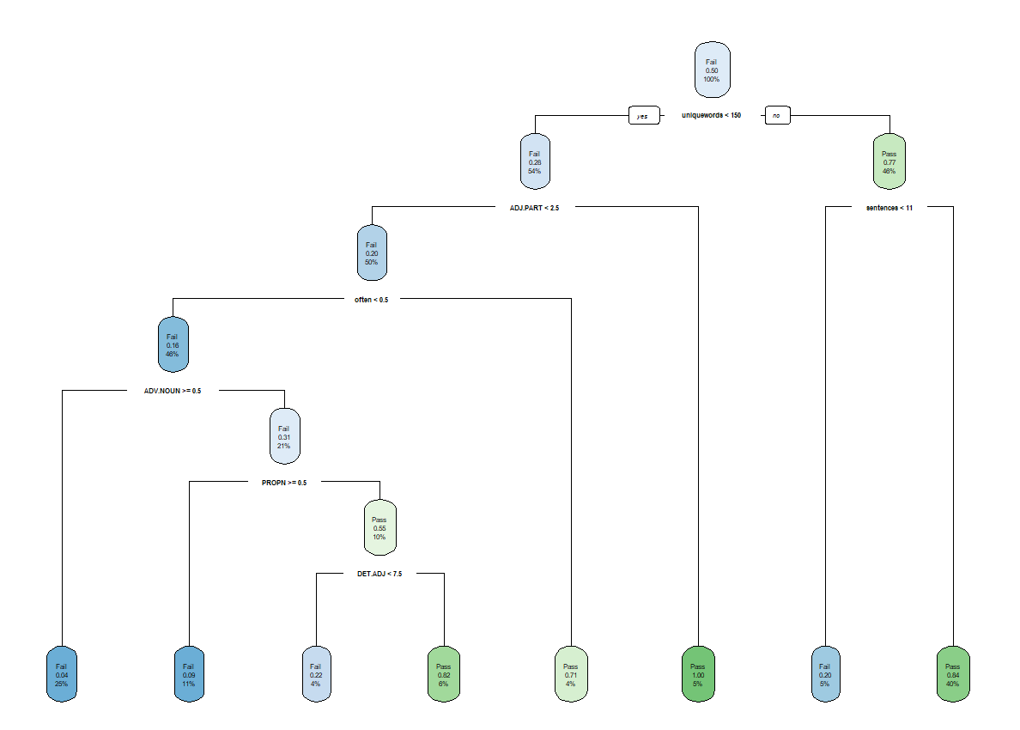
Model Analysis: Decision Tree

Slide 8
Model Analysis: Random Forest
Random Forest Test Predictions
True Value
Pass
Fail
27 | 7
2 | 24
Pass
Prediction
Fail
For regression version
RMSE: 2.96 (on test dataset)
Side Note: I’ve built a random forest from scratch in Python. See github.com/mpudil/random-forest

Slide 9
Algorithm for Determining Areas of Improvement
One feature of the app is the ability to show the top 3 most important areas for students to improve on.
The algorithm to determine this is:
  Scale all predictor variables to be in terms of percentiles
  Calculate the difference between the percentile of the feature of the essay in question and:
    1 if the variable was one that would be helpful in increasing chances of passing
    0 if the variable was one that would be detrimental to chances of passing
  Multiply (2) by the node purity
  Sort by (3) and take top 3 variables
  Produce graphs comparing their score for those variables against the average passer
This distance is calculated if feature results in lower score
Variable: Number of adjectives
0 percentile
e*
100 percentile
This distance is calculated if feature results in lower score

Slide 10
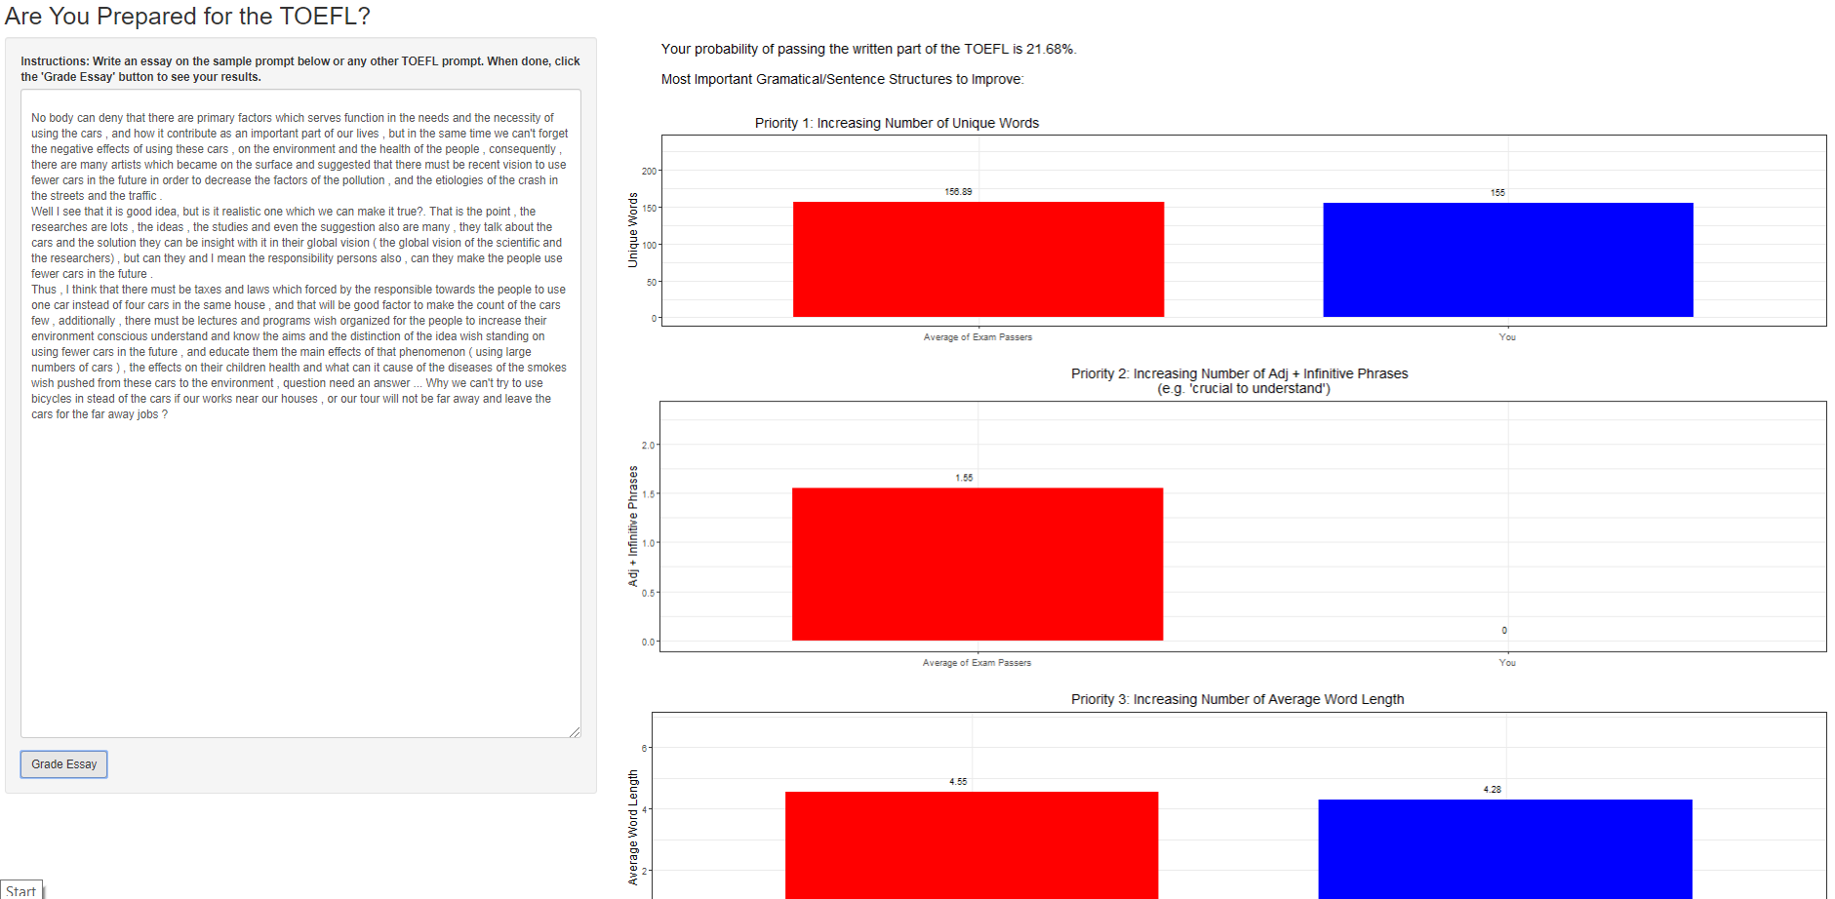

Slide 11
Next Steps and Other Projects
Next steps for this project
Make Shiny app into a website (currently working on package installation bugs)
Use DL/AI methods to analyze speech and gauge whether the individual would pass the spoken portion
Projects I’ve worked on in the past
www.github.com/mpudil/projects
Future projects/courses
Currently working with AphasiaBank to create re-classifications of aphasia using unsupervised ML
Coursera deep learning courses

Slide 12
Thank you!

