Slide 1
THEME: SOIL

Slide 2
What is soil?

Slide 3
Soil is a layer of loose and finely divided material that covers the earth’s crust/surface.
It is a mixture of air, water, humus, living organisms, and weathered rocks.

Slide 4
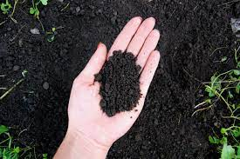
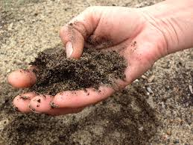
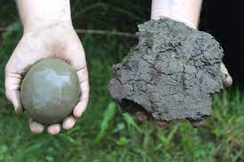
What are the main/basic types of soil?
A B C

Slide 5
Types of soil
Soils are classified by the proportion of the different sized particles they contain.
Loam soil: Found almost everywhere especially in gardens, near compost pits and dumping areas.
Sandy soil: Found on lake shores and hilly areas.
Clay: Found in swamps and anthills.

Slide 6
Compare the following properties/characteristics of the soil types:
Property/characteristic | Clay | Sand | Loam
Color (dark, light, grey, etc.)
Particle size (big, small, medium)
Texture (rough/coarse, smooth, soft/crumbly)

Slide 7
What materials make up soil?

Slide 8
Components or constituents of soil
Soil air.
Soil water
Mineral salts/inorganic particles
Humus/organic matter
Soil organisms

Slide 9
Soil air
Refers to gases occupying pore spaces among soil particles.
Consists of mainly carbon dioxide, nitrogen and oxygen gases.

Slide 10
Importance of soil air
Oxygen is used for respiration of plant roots and the soil organisms.
Oxygen is used for germination of seeds.
Oxygen is used for decay of plant and animal remains by microorganisms to form humus.
Carbon dioxide increases soil acidity which favours proper growth of some plants.
Carbon dioxide dissolves in water to form carbonic acid for weathering.
Nitrogen is converted into nitrates which is absorbed by the plants.

Slide 11
Finding out the percentage of air in soil
Apparatus and material used:
Two measuring cylinders
Soil sample
A stirrer
A beaker

Slide 12
Procedure
Measure a known volume of soil in a measuring cylinder.
Measure a known volume of water in another measuring cylinder.
Mix the soil and water together in one measuring cylinder
Stir the mixture until all the soil mixes with water.
Leave the mixture to settle until no more bubbles appear.
Read and record the final level of the mixture in the measuring cylinder.
Calculate the air content in terms of percentage

Slide 13
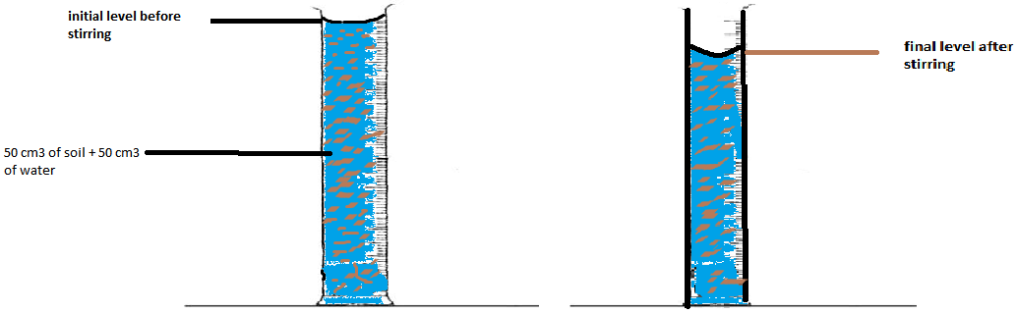
Set up of apparatus

Slide 14
Observation
Bubbles are seen coming off the mixture of water and soil.
Total volume of the mixture after stirring is less than sum of the volume of both water and soil before stirring
Conclusion
Soil contains air in the spaces among its particles.

Slide 15
Explanation
Soil has air spaces occupied by air. As water mixes with soil during stirring, the air is displaced out as air bubbles.
Treatment of results
Volume of soil = a cm³
Initial volume of water and soil = b cm³
Final volume of water and soil = c cm³
Therefore;
Volume of air in the soil = (b-c) cm³
% of air in the soil = (b-c) X 100
a

Slide 16
Worked examples
In an experiment, 50cm³ of soil was put in a cylinder and 50cm³ of water was added. The mixture was stirred and allowed to settle. The total volume after stirring was 90cm³.
State what was observed besides the total reduction in volume.
Explain why the final volume after stirring was not 100cm³.
Calculate the
volume of air in the soil sample
percentage of air in the soil sample.

Slide 17
2. In an experiment to determine the proportion of air in soil sample X, the following results were obtained:
Volume of dry soil = 200cm³
Volume of water added = 250cm³
Volume of mixture of soil + water after stirring = 400cm³
What was the volume of air in soil sample X?
What was percentage volume of air in soil sample X?

Slide 18
3. A 500 cm³ beaker was completely filled with soil. 400cm³ of water was poured into a large measuring cylinder.
The soil was added to water, the mixture was stirred gently and the final volume noted.
If the soil contained 30% by volume of air, what was the final volume?

Slide 19
Inorganic particles/matter
Are solid particles of varying sizes produced during the process of weathering.
Basing on sizes, they are classified as:
Soil particles | Diameter
Gravel (small stones). | Larger than 2mm
Coarse sand | 0.2mm - 2mm
Fine sand | 0.02mm - 0.2mm
Silt | 0.002mm - 0.02mm
Clay | Less than 0.002 mm

Slide 20
Importance of soil inorganic matter
Form the framework of the soil.
Provide a surface for attachment of plant roots hence providing support to the plants.
Have pore spaces which keep air and water used by soil organisms.
Contain mineral salts necessary for plant growth.

Slide 21
Finding out the different particle sizes in a soil sample
Materials:
Measuring cylinder
Soil sample
Water
Stirrer
Procedure
Half fill the measuring cylinder with a soil sample.
Add water to the soil in the measuring cylinder
Cover the top of the measuring cylinder and shake the mixture vigorously.
Leave the mixture to stand for 3 minutes and observe.

Slide 22
Observation
The particles arrange themselves according to their particle size where the heaviest settle at the bottom and the small and lightest at the top.

Slide 23
Conclusion
Soil is made up of different particles which vary in sizes and weights.
Note: The order in which soil particles settle in the demonstration above also shows the order of arrangement of soil layers.

Slide 24
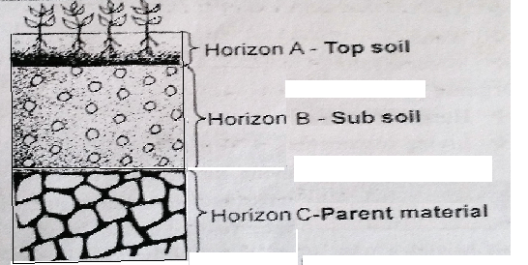

Slide 25
Soil water
Water in the soil is held around the soil particles by adhesive forces.
As plants use up the water, more water rises from deeper layers to the upper soil layers by a process called capillarity.
Soil which does not drain properly is said to be water logged and this results in the soil lacking enough air as water occupies the air spaces.
Ability of soil to hold water depends on its texture and structure.

Slide 26
Importance of soil water
It is a raw material for photosynthesis.
Makes plant cells turgid therefore providing support in non-woody plants.
Cools the plant during transpiration
A medium for transporting dissolved nutrients
Used for germination of seeds.
It dissolves nutrients absorbed by plants.

Slide 27
Aim: To determine amount of water in a soil sample
Materials and apparatus
Soil sample
Crucible/evaporating dish
Bunsen burner
Tripod stand
Thermometer
Stirring rod
Weighing scale

Slide 28
Procedure
Weigh an empty crucible and record its mass (a)g.
Put the soil sample and record the mass of the soil plus crucible(b)g.
Heat the soil in the crucible over a Bunsen burner flame until the soil is dry.
Cool and reweigh the dried soil and crucible then record the mass (c)g.
Note: The loss in mass of soil is due to loss of water in evaporation.
Calculate the percentage of water as follows:

Slide 29
Mass of crucible = (a) g
Mass of crucible + fresh soil = (b) g
Mass of crucible + dry soil = (c) g
Mass of fresh soil used = (b-a) g
Mass of dry soil = (c-a) g
→Mass of water in soil = mass of fresh soil used – mass of dry soil
=(b-a) g – (c-a) g
= (b-c) g
Percentage of water in the soil sample = Mass of water in soil x 100
Mass of soil sample
= (b-c) g x100
(b-a) g

Slide 30
Observation:
The mass of soil reduced after heating, and its crumb structure broke down to smaller particles.
Conclusion:
Soil contains water (moisture).

Slide 31
Qn. How can you determine the percentage of water in the soil?
Carry out the following activity in your groups and present your results to the class

Slide 32
The following are results from experiments to determine the amount of water is three different soil samples X, Y and Z
Calculate the mass of water in soil samples
X
Y
Z
Soil sample | X | Y | Z
Mass of dish (g) | 15 | 15 | 15
Mass of dish + fresh soil(g) | 50 | 50 | 50
Mass of dish + soil after drying(g) | 39 | 44 | 48

Slide 33
Calculate the percentage of water in soil samples
X
Y
Z
What type of soil do you think is represented by
X
Y
Z

Slide 34
A student wanted to determine the amount of water in a soil sample. The following results were obtained:
Mass of crucible = 15g
Mass of crucible + soil = 45g
Mass of crucible + soil after drying = 40g
Calculate:
Mass of soil sample used
Mass of water in the soil sample
Percentage of water in the soil sample.

Slide 35
2. Below are the results obtained by a student who was trying to find out the percentage of water in a soil sample.
Mass of crucible = 10 g.
Mass of soil + crucible before heating = 60 g.
Mass of soil + crucible after heating = 50 g.
Calculate
Mass of water in the soil used
Percentage of water in the soil used

Slide 36
3. Calculate the percentage water content of the soil sample, given the results below:
Mass of evaporating dish = 15g
Mass of evaporating dish + soil = 30g
Mass of evaporating dish + soil after heating to constant mass = 25g

Slide 37
Humus/organic matter
Humus is formed when remains of dead plant and animal materials decay.
Decay/decomposition occurs by the action of bacteria and fungi.
Humus is a dark sticky jelly-like substance that gives soil its dark colour.

Slide 38
Of what importance is humus in the soil?

Slide 39
Importance of soil humus
It binds soil particles together to form soil crumbs/lumps/aggregates.
Improves soil aeration
Improves soil drainage since it is spongy. This prevents water logging in the soil.
Improves the water holding capacity of the soil
Gives soil black color that increases absorption of heat into the soil.
It is a source of nutrients used by plants after it is completely decomposed.

Slide 40
How can you determine the percentage of humus in soil?

Slide 41
Aim: To determine the percentage of humus in a soil sample
Materials and apparatus
Soil sample
Crucible/evaporating dish
Bunsen burner
Tripod stand
Thermometer
Weighing balance

Slide 42
Procedure
Weigh a crucible and record its mass (P g).
Half fill the crucible with soil sample and record the mass of the soil plus crucible (Q g).
Dry the soil by heating over a Bunsen burner flame at about 100⁰C to a constant mass.

Slide 43
Cool and weigh the dried soil and crucible then record the mass (R g). [Why does the weight of soil reduce when dried?]
Heat the dried soil in the crucible to red hot for 30minutes. (note: the loss in mass of the dried soil is due to loss of humus).
Cool, weigh and record the final mass of the crucible plus soil (S g).

Slide 44
Calculate the percentage of humus as follows:
Mass of crucible = P g
Mass of crucible + soil = Q g
Mass of crucible + soil after heating to constant mass = R g
Mass of crucible + soil after heating to red hot = S g

Slide 45
Mass of soil used = (Q-P) g
Mass of dry soil = (R-P) g
Mass of soil after heating to red hot = (S-P) g
→Mass of humus in soil = mass of dry soil – mass of soil after heating to red hot
=(R-P) g – (S-P) g
= (R-S) g

Slide 46

Percentage of humus in the sample =
$$\frac{Mass of humus in soil}{Mass of soil sample }x100\%$$
= (R-S) g ₓ100
(Q-P) g

Slide 47
Examples
A pupil carried out an experiment about soil and obtained the following results:
Mass of crucible = 15g
Mass of crucible + fresh soil = 35g
Mass of crucible + dry soil = 30g
Mass of crucible + of soil after burning off humus (red hot) = 28g
Calculate the
Mass of humus in the soil sample
Percentage of humus in this soil sample.

Slide 48
2. A soil sample weighing 120g was heated in an oven kept at 100º C. The dry soil weighed 112g. The soil was then heated strongly to burn away humus. The weight of soil after all humus had burnt was 106g
a) Why was the soil not heated strongly at first?
b) What was the weight of humus in the soil?
c) Calculate the percentage of humus in the soil.
d) How many times was water more than humus?

Slide 49
Solution:
a) To dry the soil without losing the humus in it.
b) Weight of soil after burning humus = 106g
Weight of dry soil = 112g
Weight of humus = (112 – 106) = 6 g
c) Percentage of humus = 6 × 100
120
= 5%

Slide 50
Soil organisms
They are: microorganisms e.g. bacteria and fungi, and macro organisms e.g. rodents, nematodes, termites, ants, beetles, earthworms, etc.
Importance of living organisms in the soil
Bacteria and fungi break down /decompose dead organic matter.
Bacteria like Rhizobium fix atmospheric nitrogen into the soil.
Macro organisms improve soil aeration and drainage by burrowing into the soil.
Macro organisms mix soil components together.
Die and decompose to add humus in soil
Their wastes add manure to soil

Slide 51
Activity: Investigating the presence of microorganisms in soil.
Aim: to investigate the presence of living organisms in the soil.
Apparatus / material used.
2 mesh bags (muslin bags). - 2 conical flasks / test tubes.
Crucible
2 threads.
Lime water (Calcium hydroxide solution) or bicarbonate indicator.
2 corks.
Soil sample (top soil)
a Bunsen burner.

Slide 52
Procedure
Collect fresh top soil from the garden and divide it into 2 equal parts.
Heat one portion of the soil sample strongly in a crucible for 10 minutes.
Leave it to cool and tie it in a muslin bag using a piece of thread.
Tie the remaining portion of the fresh soil sample in another muslin bag.
Add equal amounts of lime water or bicarbonate indicator in the two conical flasks and then suspend the muslin bags with soil in the conical flasks as shown in the set up below.
Allow the conical flasks to stand for 3 hours and observe the appearance of lime water or bicarbonate.

Slide 53
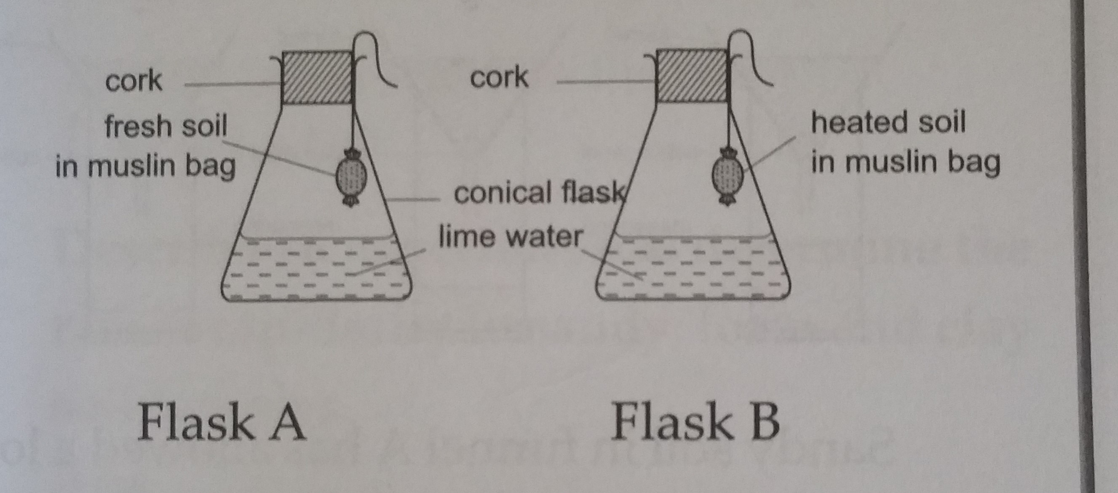

Slide 54
Observation
The lime water in flask A with fresh soil turns milky (or the bicarbonate indicator solution turns yellow ), while that in B with heated or baked soil remains colourless
Conclusion
Fresh soil contains living organisms.
Explanation
Lime water in flask A turned milky because presence of carbon dioxide produced by organisms during respiration.
Lime water in flask B remained colourless because living organisms are absent since they were killed during heating and therefore, no respiration took place.

Slide 55
PROPERTIES/CHARACTERISTICS OF SOIL
Physical properties of soil
Soil color
It is determined by the mineral present and humus: e.g. black is from humus, red from iron and aluminum oxide, and white from silicates.
Soil particle size
Rock particles are divided into varying sizes during weathering.
This affects other properties like aeration, drainage, e.t.c.

Slide 56
Soil texture
It is the smoothness or roughness of soil.
It is determined by the relative percentage of each particle size in a soil.
Clay soil feels smooth because of the small particles.
Sandy soil feels rough because of the big particles.
Soil porosity
Refers to spaces among soil particles
Sandy soil has large, loosely packed particles leading to large spaces among the soil particles and so most porous.
Clay soil has very small closely packed particles very small spaces among the soil particles thus least porous.
Loam soil is moderately porous.

Slide 57
Aeration
It is the amount of air present in a particular soil type.
Sandy soil has larger particles which are not closely packed hence it is the most aerated followed by loam and least in clay soil.
Drainage
It is the ability of water to drain/pass through the soil.
Water drains through sandy soil fastest, followed by loam and least in clay soil.
This is because sandy soil is the most porous of the soil types.
Drainage ensures that the soil is well aerated

Slide 58
Water retention
It is the ability of soil to hold water.
Clay soil has a highest water retention capacity, followed by loam and least in sandy soil.
This is because clay soil has small particles which offer a large surface area for water to cling on by adhesion forces.

Slide 59
Aim: To compare the drainage and retention of sandy, loam and clay soil samples.
Apparatus and materials used.
Loam soil, clay soil and sandy soil samples.
Three funnels.
Three filter papers/cotton wool.
Beakers.
A stop clock.

Slide 60
Procedure.
Place a filter paper in each filter funnel.
Place equal volumes of each soil type into the different funnels.
Place each funnel over a measuring cylinder.
Pour equal amounts of water into each type of soil at the same time and start the stop clock.
Leave the experiment to stand until water stops dripping from the soil samples.

Slide 61
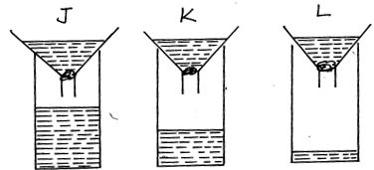

Slide 62
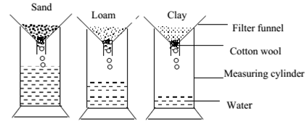
Set up of the apparatus

Slide 63
Observation
Highest amount of water is collected in the cylinder with sand soil, followed by loam soil and least in clay soil.
Conclusion
Sand soil has the highest drainage followed by loam and lastly clay.
Water Retention
The water that remains in the soil (in the funnel) represents water retention.

Slide 64
Activity: (a) In an experiment, 115 cm3 of water was added to two different soil samples A and B. The volume of water collected in the measuring cylinders at different time intervals are shown below:
Time in minutes | 5 | 10 | 15 | 20 | 25
Volume of water collected from soil sample A (cm³) | 5 | 8 | 10 | 15 | 20
Volume of water collected from soil sample B (cm³) | 10 | 15 | 20 | 40 | 70
Calculate the percentage amount of water retained at 25 minutes for each soil sample.
Suggest the type of soil represented by A and B. Give a reason for each of your suggestions.

Slide 65
(b) Why should farms have soils with proper water retention?
(c) Why should farms have soils with proper water drainage?

Slide 66
Soil capillarity.
It is the ability of water to rise from bottom layers of the soil to the top layers through soil particles.
How does loam, clay and sand soils differ in their capillarity abilities?

Slide 67
Activity : Comparing the capillarity of water of different soil samples
Aim: Experiment to demonstrate and compare capillarity in the soil types
Apparatus and materials
•3 identical long narrow glass tubes
•Glass trough or basin
•Cotton wool
•3 retort stands
•Dry samples of clay, loam and sandy soil.

Slide 68
Procedure
Close each of the lower ends of the three glass tubes with a plug of cotton wool.
Measure equal amounts of each soil sample and put in the respective glass tubes.
Support each of the glass tubes vertically using retort stands, with the ends plugged with cotton immersed in a glass trough which is half-filled with water at the same time.
Observe and measure the rise of water in each of the three glass tubes at regular intervals (e.g. 10mins).

Slide 69
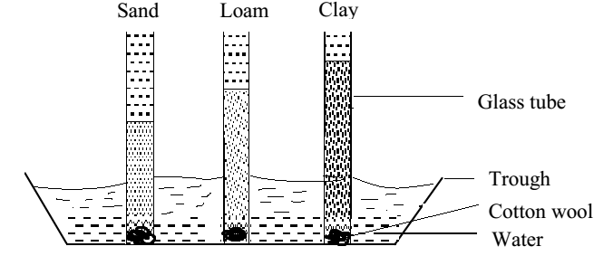
Set up of apparatus

Slide 70
Observation
Water rises very fast but stops at a low level in sandy soil.
Water rises slowly but continues to the highest level in clay soil.
In loam soil water rises moderately to a medium level.
Conclusion
Clay soil has the highest capillarity while sandy soil has the lowest capillarity and loam has the medium water capillarity.

Slide 71
Question:
How does size of particles influence/affect capillarity (rise of water)?
Notes:
Large particles are loosely packed, leaving large air spaces. Small particles are closely packed, providing more attachment surfaces for water.

Slide 72
Explanation
Water rises fastest in sandy soil at the start of the experiment because sandy soil has large air spaces among its particles which enable water to pass rapidly.
Water rises at the slowest rate in clay soil because of the smaller air spaces among the soil particles.
Clay soil has the highest capillarity because it has many, tiny and closely packed particles which present a large surface area over which water molecules adhere (cling/attach).

Slide 73
Discussion question:
What is the importance of capillarity in soil?
Notes:
Enables soil to retain water. Enables upward and horizontal movement of water.

Slide 74
Chemical properties of soil
Soil pH
pH is the measure of hydrogen ion (H+) concentration.
Soil pH is the measure of acidity or alkalinity of soil.
High hydrogen ion concentration results into low pH (High acidity).
Low hydrogen ion concentration results into high pH (low acidity).

Slide 75
How can you determine the pH of a soil sample?

Slide 76
Aim: An experiment to determine pH of a soil sample
Apparatus and materials
Soil sample, test tube, distilled water, universal indicator solution (or universal indicator paper), pH color chart.
Procedure
Put the soil sample into a test tube.
Add distilled water and 3 drops of universal indicator, and shake (or dip a piece of universal indicator paper).
Leave the mixture to settle and note the color change of the mixture (or indicator paper)
Match the color of the mixture with the color on the pH color chart.
Record the corresponding pH value.

Slide 77
pH influences the following:
Activity of soil microorganisms e.g. nitrogen fixing bacteria.
Availability of nutrients in soil.
Toxicity of mineral elements e.g. Aluminum becomes toxic at pH less than 5.
Type of plant that grows well in soil.

Slide 78
Soil Ph can be changed by applying:
Lime to raise pH
Sulphur and acidic fertilizers to lower pH
Basic fertilizers to raise pH

Slide 79
Activity of integration
Agriculture is the backbone of Uganda’s economy. However crops do well in some areas and poorly in others. This is a result of differences in properties of soil in different areas. You are the Agriculture Extension Officer with the task of educating a group of farmers on how to increase crop food production.
Task:
Write an essay to explain to them the different properties of soil, stating how each property affects crop growth so that they will be able to choose right places to grow crops.

Slide 80
Soil fertility, erosion and conservation
What is meant by fertile soil?
What are the features/characteristics of a fertile soil?
What are the causes of reduced soil fertility?

Slide 81
Soil fertility is the ability of soil to sustain plant growth by providing right amounts of plant nutrients and favorable chemical and physical conditions.
Features of fertile soil
Good depth to give strong anchorage to plants.
Good aeration to provide air for respiration of plant roots and soil organisms.
Good water retention to ensure adequate provide adequate water for plant growth.
Proper drainage ensures adequate air in the soil.
Correct pH that favors plant growth.
Adequate nutrients in forms absorbable by plant roots.

Slide 82
Reflect on this:
Explain why fertility may be low in clay soil.

Slide 83
Loss of soil fertility
Soil erosion: removal of top soil containing nutrients and soil particles.
Leaching: It is the washing down of soluble minerals from topsoil layers to bottom layers where plant roots cannot reach.
Soil exhaustion: It is the loss of soil fertility as a result of over utilization of mineral salts (nutrients) by crops.
It results from poor farming methods such as monoculture, over cultivation, over cropping etc.
Nutrient immobilization: use of nutrients by soil microorganisms, making them unavailable to plants.

Slide 84
Volatilization: Loss of nitrogen from the soil in gaseous form.
Soil compaction: Hardening of soil on the surface due to compression by heavy machinery, movement of animals and man on soil, etc.
Over use of chemical fertilizers: Leads to soil acidification and chemical burns to plants.
Poor disposal of plastics: Reduces soil aeration and drainage.

Slide 85
Soil erosion
What is soil erosion?
What are the causes of soil erosion?
What are the types of soil erosion?
What are the effects of soil erosion in your community?

Slide 86
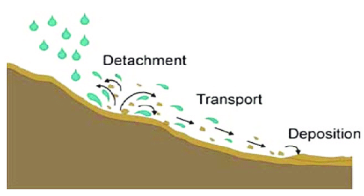
Soil erosion
It is the process by which top soil is removed and carried from one place and deposited in another place.
Top soil is carried by running water and wind, and deposited in a different place.

Slide 87
Causes of soil erosion
Slopes of land: The steeper the slope the greater the erosion.
Over grazing: Removes the grass covering the soil and open it to erosion.
Deforestation: Removes the trees covering the soil, exposing it to wind and water.
Bush burning: Removes the grass top cover, thus leaving the soil bare.
Ploughing down slopes: Accelerates water erosion.
Over cropping; exhausts the soil leading to loss of plant cover.
Over cultivation: loosens the soil making it easy to be eroded.

Slide 88
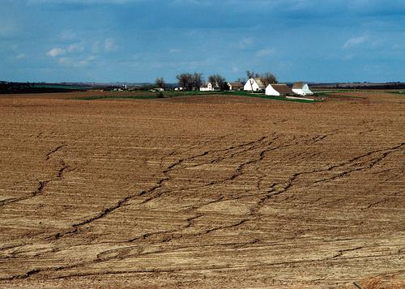
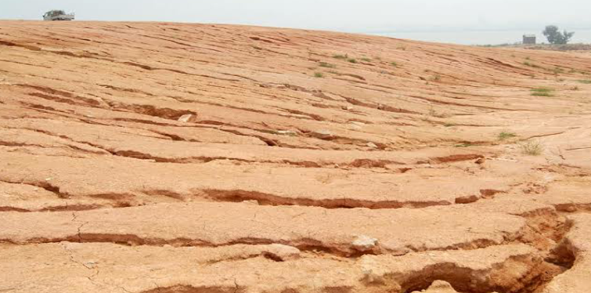
Types of soil erosion

Slide 89
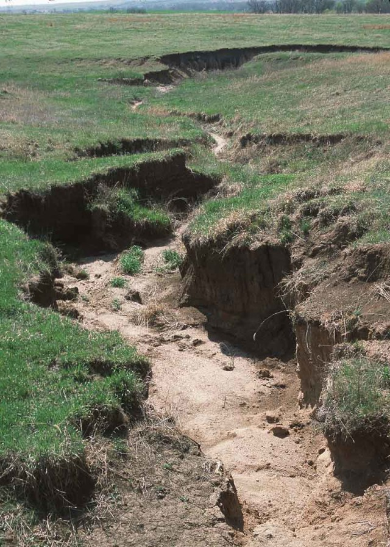
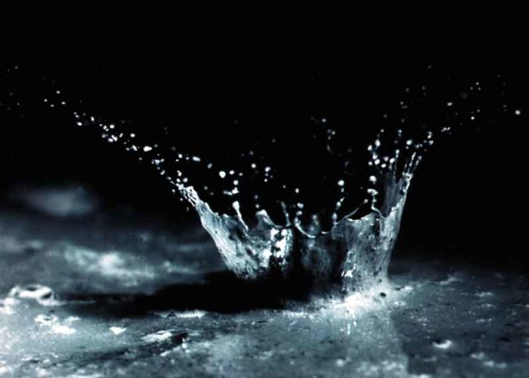

Slide 90
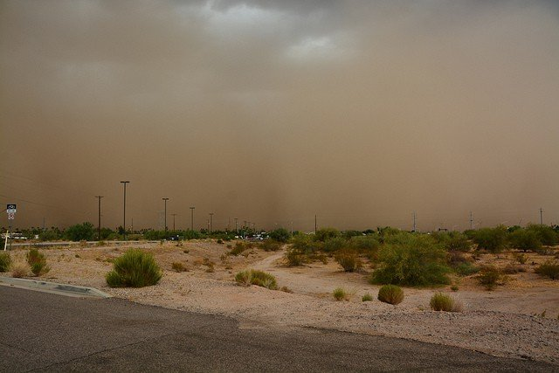

Slide 91
Soil erosion is categorized depending on the agent that causes it:
1. Water erosion
Removal of soil mass by running water, transporting and depositing in another area.
Forms are:
Sheet erosion: A thin fairly uniform layer of top soil is removed over the whole area by running water.
Rill erosion: Water creates small shallow channels called rills. Occurs when sheet erosion continues over a long time.
Gulley erosion: This results from rill erosion, when the channels widen and deepen to form gullies. The gullies hinder agricultural mechanization.
Splash erosion or raindrop erosion: This occurs when intense raindrops displace soil.

Slide 92
2. Wind erosion
This occurs when wind blows/carries away fine dry soil particles and deposit in different places.

Slide 93
Effects of soil erosion
Nutrients are carried away in the top soil.
Reduces soil depth causing plant roots to be exposed.
Some plants are buried in the soil carried in the surface run off.
Reduction in crop yield due to reduced soil fertility.
Flooding
Land slides
Water pollution

Slide 94
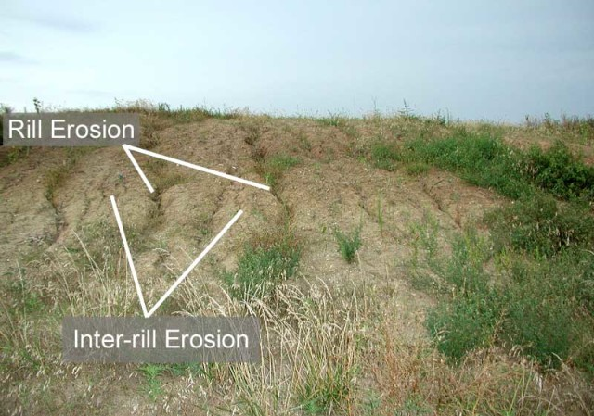
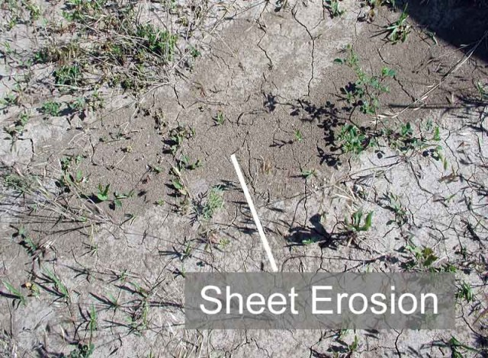

Slide 95
Explain how the following factors affect the rate of soil erosion
Terrain
Vegetation cover
Intensity of rainfall
Strength of wind

Slide 97
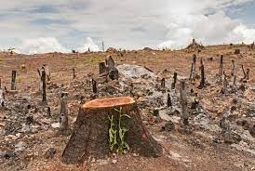
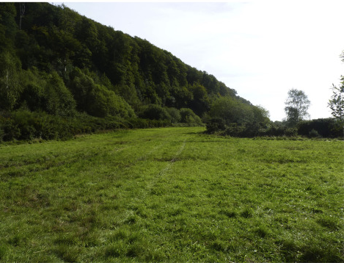
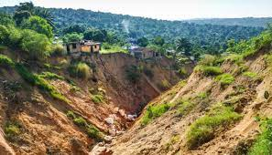

Slide 98
Methods of controlling soil erosion
Qn. How can soil erosion be controlled?

Slide 99
Afforestation
This is the planting of trees on a piece of land.
The trees are wind breakers, reduce the impact of falling rain drops on soil and their roots hold soil particles together, reducing the tendency of being eroded.
Contour ploughing/farming
Ploughing a long contour i.e. across a slope and not up and down
Or construction of ridges across the slope of the land to reduce speed of water runoff.

Slide 100
Terracing
Involves leveling parts of a slope to make it flat, forming a terrace where crops are grown.
Strip cropping
Different crops are planted in alternating rows/bands/strips across the slope. E.g. planting maize in one strip followed by cover crop like potatoes or grass.

Slide 101
Mulching
The covering of top soil with plant materials e.g. banana leaves, grass, etc.
Plant material used for mulching is called mulch.
Advantages of mulching
Controls soil erosion.
Increases water infiltration.
Mulches decompose to form humus.
Regulates soil temperature.
Conserves moisture in soil.
Kills annual weeds.

Slide 102
Disadvantages of mulching
May be breeding places for some pests and disease-causing organisms.
Mulch is susceptible to fire.
May be a source of weeds if the grass used as mulch reproduces vegetatively.
Expensive to apply in a big field.

Slide 103
Soil Conservation
Refers to the practices of maintaining soil fertility.
or
This is the protection and management of soil to maintain soil fertility.
Soil conservation methods aim at controlling soil erosion and conserving soil nutrients.
Qn. What are the methods used to conserve soil?

Slide 105
Methods of soil conservation
It includes all methods of controlling soil erosion and the following:
Activity
Name the method of soil conservation shown in each photo

Slide 106
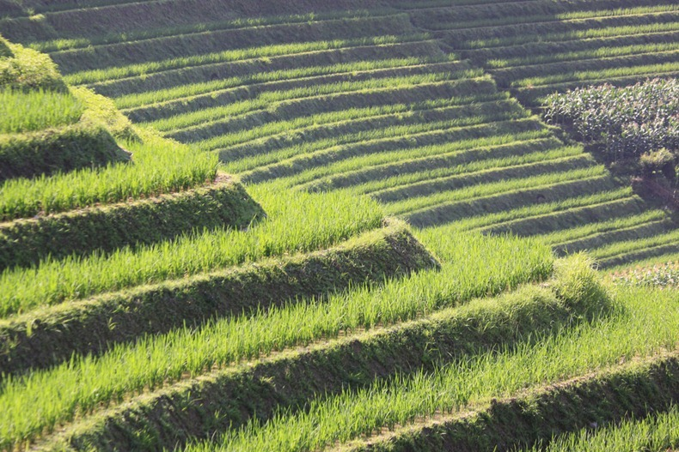

Slide 107
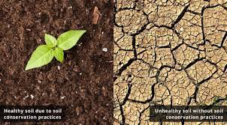

Slide 108
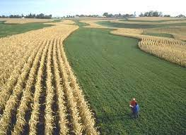

Slide 109
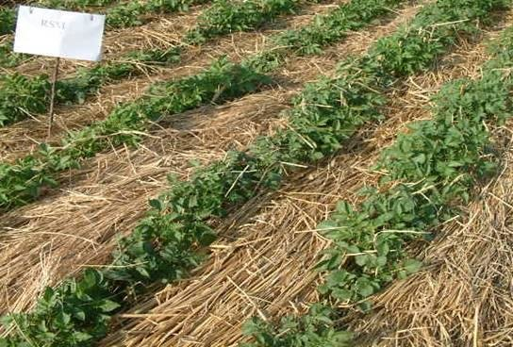

Slide 110
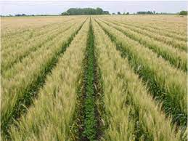

Slide 111
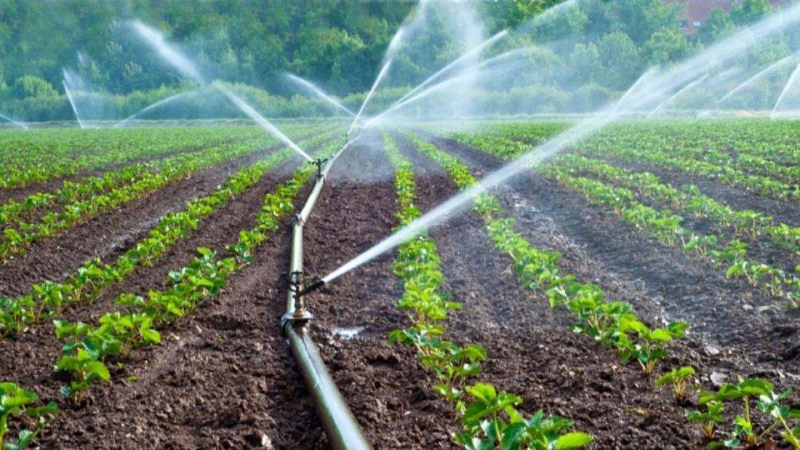

Slide 112
Crop rotation
This is the changing of crops that are grown on a piece of land season after season.
It enables balanced utilization of nutrients and breaks pest life cycles.
Legumes are included in a rotation cycle to add nitrogen in the soil.
Mixed cropping/Intercropping
This is the growing of different crops on the same piece of land, randomly or uniformly.
It makes usage of nutrients spread and stress on the soil is reduced.

Slide 113
Bush fallowing
Land is left uncultivated to rest and grow back to a bush.
Weeding
Removes unwanted plants (weeds) that would compete with plants for the available minerals and water in the soil.
Application of humus
This is done in form of manure.

Slide 114
Application of artificial fertilizers
Done in form of potassium sulphate, ammonium sulphate and calcium phosphate to add nitrogen, phosphorus and potassium to soil.
Irrigation
Improves the amount of water in the soil

Slide 115
Open discussion questions
1. What role do microorganisms play in soil fertility?
(Refer to roles of soil organisms in soil)
Nutrient recycling/decomposition
Clean the environment

Slide 116
2. In what ways may human activities:
(i) improve soil? (5 marks)
(ii) degrade soil? (5 marks)
3. Of what value is earthworms in maintaining soil in a condition suitable for crop growth? (4 marks)

Slide 117
In what ways may human activities:
(i) improve soil? (5 marks)
Crop rotation prevents soil exhaustion
Growing legumes add nitrogen to soil
Mulching controls soil erosion
Application of manure adds nutrients/improves soil structure
Addition of fertilizers adds nutrients to soil
Application of lime lowers soil pH
Terracing controls soil erosion
Strip cropping, contour ploughing controls soil erosion

Slide 118
(ii) degrade soil? (5 marks)
Over grazing leads to erosion
Monoculture leads to soil exhaustion
Excessive use of artificial fertilizers alters soil Ph
Ploughing down slopes accelerate erosion
Bush burning leads to erosion
Disposal of plastics reduces water infiltration and aeration

Slide 119
(d) Of what value is earthworms in maintaining soil in a condition suitable for crop growth? (4 marks)
By burrowing/forming tunnels; improves drainage; and aeration/porosity;
By feeding on dead plant materials; recycles nutrients/adds humus which soil texture;
Death and excretion; adds humus to soil.

Slide 120
NUTRIENT CYCLES
It is the circulation of nutrients in nature/living and non-living components of the environment.
Nutrient cycle is important because it changes nutrient elements into different forms/states that can be used by different forms of life on earth.
It also prevents the locking up of nutrients in a component of the environment.

Slide 121
NITROGEN CYCLE
What is the nitrogen cycle?
What is the importance of the nitrogen cycle?
What processes are involved in the nitrogen cycle?
What are the sources of nitrogen that get into the soil?
In what ways is nitrogen lost from the soil?
Of what use is nitrogen to plants?
What are the signs of nitrogen deficiency in plants?

Slide 122
Definition of nitrogen cycle
It is the circulation of nitrogen in nature/living and non-living components of the environment.

Slide 123
Importance of the nitrogen cycle
Nitrogen is converted to compounds that can be absorbed by plants.

Slide 124
Processes involved in the nitrogen cycle
Process | Definition | Bacteria involved
Nitrogen fixation | Conversion of atmospheric nitrogen (nitrogen gas) into nitrates. | Nitrogen fixing bacteria
Nitrification | Conversion of ammonia into nitrites, which is then oxidized to nitrates. | Nitrifying bacteria

Slide 125
Ammonification | Break down of remains of plants and animals to from ammonia. | Ammonifying/putrefying bacteria (and fungi)
Denitrification | Conversion of nitrates back to nitrites and finally to nitrogen gas. | Denitrifying bacteria
Assimilation | Use of nitrogen to form body tissues.

Slide 126
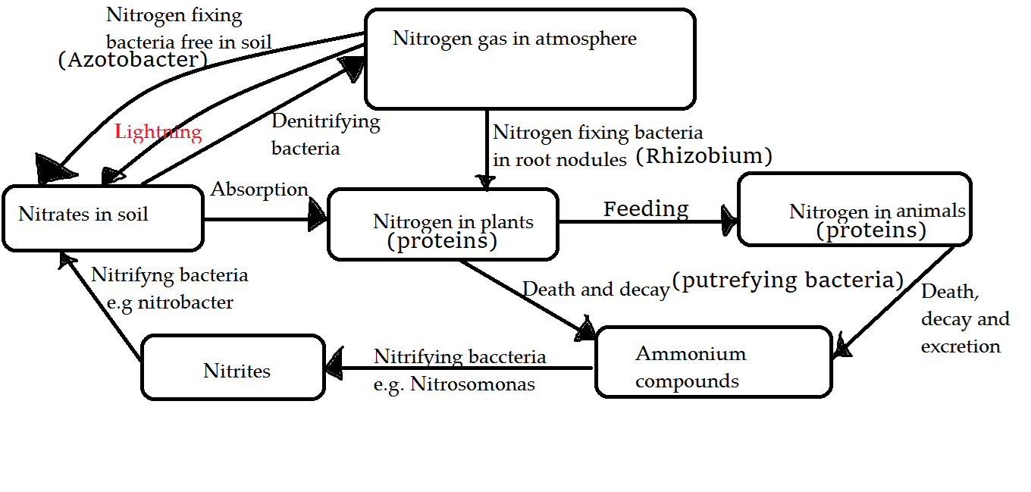

Slide 127
Description
Nitrogen is fixed into the soil by lightning, nitrogen fixing bacteria and use of fertilizers.
Plants absorb nitrogen in form of nitrates from the soil and use it to make proteins (assimilate the nitrogen).
Through feeding, animals obtain nitrogen from plants.
When plants and animals die, the organic matter is broken down by ammonifying/putrefying bacteria in a process called ammonification/putrefaction to form ammonium compounds.

Slide 128
The ammonium compounds are converted into nitrates through a process called nitration by nitrifying bacteria in two steps:
Bacteria of the genus Nitrosomonas convert ammonium compounds to nitrites.
Bacteria of the genus Nitrobacter convert the nitrites to nitrates.
Denitrifying bacteria break down nitrates to gaseous nitrogen through denitrification process.
The nitrogen is lost back into the atmosphere by volatilization.

Slide 129
Sources of Nitrogen
Artificial fertilizers e.g. Ammonium Sulphate.
Organic matter e.g. manure
Atmospheric nitrogen from lightning
Fixation by rhizobium and azotobacter bacteria.

Slide 130
Loss of nitrogen from the soil
Soil erosion.
Leaching.
Volatilization: Loss of nitrogen in gaseous form.
Immobilization: Use by micro-organisms.

Slide 131
Uses of Nitrogen to plants
Formation of plant proteins.
Formation of chlorophyll.
Rapid vegetative growth.
It increases the size of grains in cereal crops.

Slide 132
Deficiency symptoms
Yellowing of leaves i.e. loss of chlorophyll (chlorosis).
Stunted growth of plants.
Premature ripening of fruits and seeds.
Early flowering.
Reduced grain size of cereals.

Slide 133
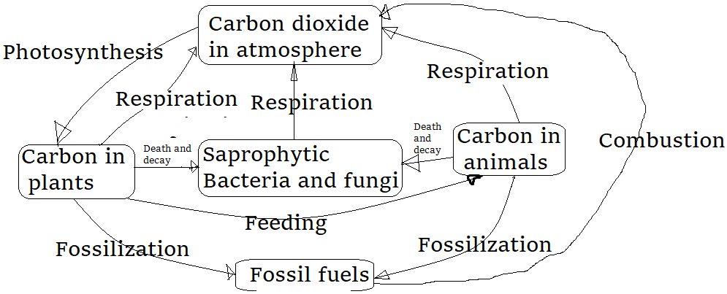
THE CARBON CYCLE

Slide 134
Activity of integration
Crop production in many parts of Uganda has dropped as a result of increased population and need for more grazing land. As a result, many farmers continuously cultivate their land, leading to soil erosion thus reducing soil fertility and crop yields.
Task:
As an agriculture extension worker in your village, write an essay advising the local farmers on ways that they can use to overcome this problem. Your essay should not exceed one page.

Slide 135
7. During this rainy season, there have been rampant cases of flooding around most parts of Uganda. In Nakawa division swampy places have shown the highest cases of this. Basing on your knowledge of biology suggest nature of soil in those areas and how they have caused floods.

Slide 136
NUTRITION: NUTRITION TYPES AND NUTRIENT COMPOUNDS
What is the meaning of nutrition?
Explain two main types of nutrition.
What is a food nutrient?
Identify different food nutrients, their food sources and importance in humans.
What is a balanced diet?

Slide 137
Nutrition is the process by which an organism obtains takes in and utilizes food nutrients in their bodies.
Types of nutrition
Nutrition is broadly classified into two types namely;

Slide 138
1. Autotrophic nutrition (auto: self, trophe: feeding)
A type of nutrition where an organism makes its own food/nutrients from simple inorganic molecules using some external source of energy.
The organisms are called autotrophs. e.g. green plants, algae and some bacteria.
Types of autotrophic nutrition
a) Photosynthesis: Organisms use sunlight energy.
Examples include; green plants, algae, photosynthetic bacteria.
b) Chemosynthesis: Organisms use energy from specific chemical reactions (oxidation of various inorganic compounds).
Examples include; chemosynthetic bacteria like Sulphur bacteria.

Slide 139
Autotrophs are referred to as producers because all other organisms depend on the food made by autotrophs either directly or indirectly.
2. Heterotrophic nutrition (hetero: other/different, trophe: feeding)
This is a type of nutrition where the organism feeds on already manufactured food by other organisms.
The organisms are called heterotrophs e.g. some bacteria, all animals, fungi and insectivorous plants.
It includes modes like holozoic nutrition, saprophytic nutrition, symbiosis, etc.

Slide 140
Nutrients found in food
Nutrients are chemical compounds found in food and required in the body for metabolism.
Metabolism refers to chemical processes in the body, e.g. production of energy (respiration).
Nutrients are also called chemicals of life.
The nutrients include;
Carbohydrates, proteins, lipids, mineral salts, vitamins, fiber and water

Slide 141
Food nutrients, sources and importance
1) Carbohydrates
A carbohydrate is made up of atoms of carbon, hydrogen and oxygen only.
They are the sugars (saccharides).
Sources are foods like: cereals, cassava, potatoes, sugars from juicy fruits, yams, bread, bananas, honey, milk, etc.

Slide 142
Types of carbohydrates
(a) Monosaccharides
These consist of one molecule of sugar. (mono = one, saccharide = sugar)
Examples:
(i) Glucose – in honey.
(ii) Fructose - juicy fruits.
(iii) Galactose – in milk.

Slide 143
Properties/characteristics of monosaccharides
Have sweet taste
Are soluble in water
Diffuse through a semi-permeable membrane
Are reducing sugars (change the colour of benedict’s solution(Cu (II) ions) from blue to orange (Cu (I)) when boiled)

Slide 144
(b) Disaccharides
These consist of two monosaccharide molecules. (di = two, saccharide = sugar)
They are formed when two monosaccharides combine by the process of condensation
Examples include:
(i) Sucrose: found in sugarcane, made up of glucose and fructose.
(ii)Maltose: found in germinating seeds, made up of two glucose molecules.
(iii) Lactose: found in milk made up of glucose and galactose.

Slide 145
Properties/characteristics of disaccharides
Have sweet taste
Soluble in water
Diffuse (slower than monosaccharides) across semi permeable membrane.
Are reducing sugars except sucrose which is a non-reducing sugar.
They are easily converted to simple sugars by hydrolysis or action of enzymes and dilute mineral acids.

Slide 146
(c) Polysaccharides
Are large molecules that consist of long chains of monosaccharides. (poly = many, saccharide = sugar)
They are formed by condensation of more than two molecules of monosaccharides.
Examples:
Starch; stored roots, underground stems and grains of plants.
Glycogen; stored in liver and muscles of animals.
Cellulose; in plant cell wall.
Chitin; in exoskeleton of arthropods and cell wall of fungi.

Slide 147
Properties of polysaccharides
Not sweet
Insoluble in water except glycogen which is slightly soluble.
They are large in size therefore cannot diffuse across a semi-permeable membrane.

Slide 148
Importance of carbohydrates in the diet
They are the main source of energy for metabolic processes.
Some form structures like cell wall in plants and chitin in arthropods and fungi.
They are energy reserve sources stored by plants in the form of starch and glycogen in animals.
Soluble sugars like glucose control osmotic balance in the body.

Slide 149
2. Proteins
A protein molecule consist of elements; carbon, hydrogen, oxygen and nitrogen, and sometimes phosphorus and sulphur.
The smallest unit of protein is called amino acid.
Food sources: legumes like beans; soya, peas and fish, eggs, cheese, milk, liver and meat.

Slide 150
Functions of proteins in the body
Growth through formation of new cells.
Repair of worn out tissues.
Oxidized (broken down) to release energy when glucose is in short supply.
Form structures like keratin found in nails, hair, hooves and beak of birds.
Formation of enzymes and hormones.
Used during blood clotting.
Forms antibodies and antigens.
Controls pH changes within blood plasma.

Slide 151
3. Lipids
These are fats and oils.
Lipids consist of elements; carbon, hydrogen and oxygen like in carbohydrates except that the proportion of oxygen is less than that of carbohydrates.
Oils are liquid at room temperature while fats are solid.
Food sources include: milk and its products, meat, groundnuts, simsim, coconuts, sunflower, palm and fish.

Slide 152
Functions of lipids
Insulate the body against heat loss.
Respired to produce energy in the body
Component of cell membranes
Source of metabolic water to desert animals
They are energy stores in the body (because excess carbohydrates are converted to fats and stored in adipose tissues under the skin).
Solvents for fat soluble vitamins i.e. vitamins A, D, E, K.
Note: lipids is the most abundant food hence no deficiency occurs

Slide 153
4. Vitamins
These are organic compounds required in small quantities for proper functioning of the body.
Are classified into two:
i) Water soluble vitamins: dissolve in water e.g. Vitamin B and C.
Fat soluble vitamins: dissolve in fats but not in water i.e. Vitamins A, D, E, and K.
Major food sources: fruits and vegetables, unpolished cereals, eggs, milk, liver.

Slide 154
Research:
Vitamin | Food source | Functions | Deficiency
K | Cabbage, spinach | Normal blood clotting | Prolonged bleeding

Slide 155
5. Mineral salts or mineral ions
(a) Macro-elements
They are required by the body in large quantities. E.g. nitrogen, sulphur, Calcium, Phosphorus, Sodium, Potassium, Iron and magnesium.
(b) Microelements/trace elements
They are needed in small quantities by organisms. E.g. Zinc, Cobalt, Manganese, Boron, chlorine.
Major food sources for mineral salts include: Fruits, vegetables, liver, eggs, table salt.

Slide 156
6. Water
Water is made up of elements hydrogen and oxygen.
It is a universal solvent because it dissolves most nutrients (for transportation).
Importance of water to plants
Raw material for photosynthesis
Cools plants during hot day by evaporating with some heat
Dissolves mineral salts and transport them to other parts of the plants
Dissolves manufactured food and transport it from leaves to other parts of the plant.
Used in germination of seeds
Important in fruits and seeds dispersal

Slide 157
Importance of water to animals
Cools the body of animal through evaporation, sweating in humans, and panting in dogs
Solvent that dissolves digested foods
Medium for transporting various secretions and substances around the body
Used for excreting waste products by kidney eg urea in urine

Slide 158
Forms various secretions in the body like gastric juice, pancreatic juice, hormones and enzymes
Provides turgidity of hydrostatic skeleton in some organisms.
Lubricates joints and the eyes.
Formation of plasma fluid.
Many animals and birds use it to wash away ectoparasites.

Slide 159
7. Roughages (dietary fiber)
It is indigestible.
Roughage is made of grain, fruit, roots and vegetable fibers.
Roughage adds bulk to the food thereby making digestion easy and avoids constipation.

Slide 160
Food tests
These are tests done with specific reagents and following specific procedures to find out whether certain food substance (or nutrient) is present in a given food sample.
Colour changes are observed and recorded for identification of the food type.

Slide 161
Test for carbohydrates
Test/ procedure | Observation | Conclusion/ Deduction
(a) Starch Put 1cm³ of substance in a test tube and add 2 drops of iodine solution | Turbid/colourless solution turns to black or blue-black solution | Starch present
 | Turbid/colourless solution turns to brown solution | Starch absent

Slide 162
(b)Reducing sugar Put 1cm³ of substance in a test tube and add 1cm³ of Benedict’s / Fehling’s solution and boil | Turbid/colourless solution turns to blue solution, green solution, yellow precipitate, orange precipitate and finally brown or red precipitate. | Reducing sugar present
 | Turbid/colourless solution turns to blue solution and persists. | Reducing sugar absent

Slide 163
(c)Non-reducing sugar Put 1cm³ of substance in a test tube and add 1cm³ of Hydrochloric acid, boil the mixture, and cool, add 1cm³ of sodium hydroxide solution followed by Benedict’s solution and boil. | Turbid/colourless solution turns to blue solution, green solution, yellow precipitate, orange, precipitate and finally brown or red precipitate. | Non-reducing sugar present
 | Turbid/colourless solution turns to blue solution and persists. | Non reducing sugar absent

Slide 164
Note
Hydrochloric acid is used to breakdown non reducing sugar(complex sugar) to reducing sugar.
Sodium hydroxide is used to neutralize the hydrochloric acid to form a neutral solution.

Slide 165
Test for proteins
Test /procedure | Observation | Conclusion/deduction
Biuret’s test Put 1cm³ of substance in a test tube and add 1cm³ of sodium hydroxide solution followed by 3 drops of copper (II) sulphate solution | Turbid/colourless solution turns to Purple (or violet) solution. | Proteins present
 | Turbid solution turns to blue solution | Proteins absent

Slide 166
Test for lipids
Test /procedure | Observation | Conclusion/deduction
(a)Emulsion test Put 1cm³ of substance in a test tube and add 1cm³ of ethanol and shake the mixture then follow by 1cm³ of water | Turbid/colourless solution turns to white emulsion. | Lipids present
 | Colourless solution remains colourless. | Lipids absent

Slide 167
(b) Translucent mark test Smear the substance on a dry filter paper and hold it against light. | Translucent/ grease spot formed | Lipid present
 | No translucent/ grease spot formed | Lipid absent

Slide 168
Test for vitamin C
Test /procedure | Observation | Conclusion/deduction
Put 1cm³ of DCPIP in a test tube and add the substance to be tested dropwise until there is no further change | The blue colour of DCPIP turns to colourless. | Vitamin C present
 | The blue colour of DCPIP persists/remains. | Vitamin C absent
DCPIP in full: Dichlorophenolindolphenol

Slide 169
Balanced diet
It is a diet containing all the necessary nutrients in the right amounts for normal functioning of the body.
A balanced diet differs slightly from one individual to another depending on age, sex and level of physical activity.
Imbalanced diet leads to malnutrition which shows through diseases like kwashiorkor, marasmus, obesity, etc.

Slide 170
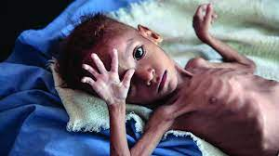
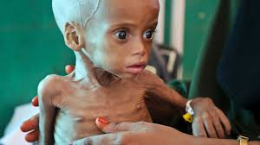
Malnutrition
Malnutrition refers to deficiencies, excesses, or imbalances in a person’s intake of energy and/or nutrients.

Slide 171
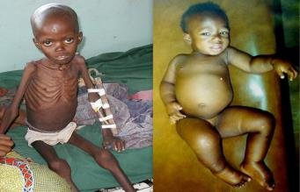

Slide 172
What are the common nutrient deficiency diseases and disorders?

Slide 173
Nutrient | Deficiency disease and symptoms
Carbohydrates | Marasmus General body weakness Eyes are white in color Hair on the head is brown and sparse, with unusual softness. Weight loss. Swollen lower parts of the body like stomach, feet, and sometimes cheek. Chronic diarrhea and fatigue. Too much carbohydrates cause obesity

Slide 174
Proteins | Kwashiorkor Stunted growth Pot belly General body weakness Sparse hair
Iron | Anaemia Tiredness, shortness of breath, chest pain and dizziness.
Iodine | Goitre A large swelling in the neck due to swollen thyroid gland, slow metabolism, slow growth.

Slide 175
Calcium Phosphorus Vitamin D | Rickets Weak and deformed bones. Weak teeth. Muscle cramps. Nervous disorders. Excessive bleeding minor injuries.
Vitamin B1 (Thiamine) | Beriberi Swollen legs, muscle wasting, slow heart rate
Vitamin C (ascorbic acid) | Scurvy Gum bleeding, brittle bones, delayed wound healing

Slide 176
Vitamin K | Excessive bleeding from minor injuries
Vitamin B2 Vitamin B12 | Pellagra Sores in mouth and tongue Cracked lips Eye irritation Dementia Skin lesions
Vitamin E | Sterility
Vitamin A | Night blindness Reduced immunity

Slide 177
Eating disorders
Obesity
Is a condition of excessive fat accumulation in the body that increases the risk of health problems.
Causes
Eating more carbohydrates than they are being used in the body. Excess carbohydrates eaten are converted to fats for storage.
Physical inactivity (sedentary lifestyle)
genetic make up (heredity)
hormonal disorder, medications, etc.

Slide 178
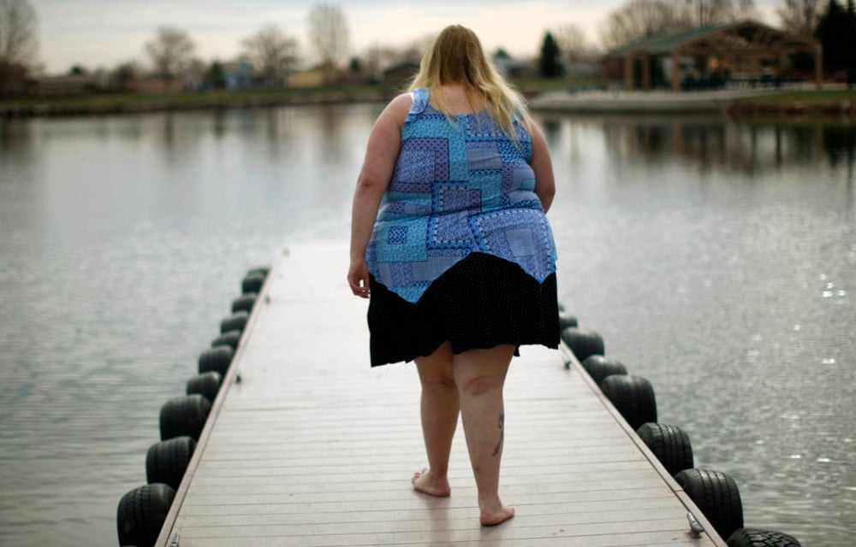
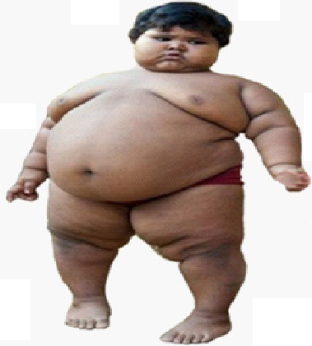
Dangers of overweight and obesity
Increased risk of developing diseases like
High blood pressure
Type 2 diabetes
Arthritis
Female infertility
Lower back pain
Heart diseases
Depression
Varicose vein
Sleep apnea
Acid reflux, etc

Slide 179
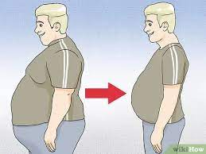
Managing/avoiding of obesity
Healthy diet: low carbohydrate diets.
Regular exercise to burn excess fats.
Stress management e.g. through counselling.
Medication e.g. appetite suppressants.
Surgery for class III obesity.

Slide 180
Body Mass Index (BMI)
It is a measure of body fat based on ratio of height to body weight.
Formula: weight in kilograms divided by the square of height in meters.
It is important for showing weight status of individuals.
BMI | Weight status
Below 18.5 | Underweight
18.5 – 24.9 | Healthy Weight
25.0 – 29.9 | Overweight
30.0 and Above | Obesity

Slide 181
Example: Weight = 68 kg, Height = 165 cm (1.65 m) Calculation: BMI = 68 ÷ (1.65)² = 24.98
Note: BMI for children and teens changes according to age and sex because the amount of body fat changes with age and the amount of body fat differs between girls and boys.

Slide 182
Bulimia
An eating disorder where a person eats unusually large quantities of food in a short period of time (binge)then gets rid of the food (purge) by ways such as self-induced vomiting, fasting, vigorous exercise, use of laxatives or diuretics.
It is considered a mental disorder.
Effects: Throat and stomach ulcers, tooth decay and cavities, fluctuation in weight, etc.
Management: Psychotherapy, Nutritional counseling, medication e.g. antidepressants, etc.

Slide 183
Anorexia
is an eating disorder where a person feels a need to keep their weight as low as possible and engages in self-starvation, extreme diets and extreme exercise to lose weight.
Signs/symptoms: missing meals, abnormal fear of being fat, weight loss, lack of menstrual periods (females), etc.
Associated problems: loss of fertility, low sex drive, osteoporosis, weak muscles, poor concentration and memory, weakened immune system, heart diseases, low blood pressure, etc.
Treatment: psychotherapy, restoring normal eating patterns, medicines.

Slide 184
Use of drugs to change body image
Occurs in people who are dissatisfied with their natural images.
Involves use of diet pills mostly by females, to attain slim shape.
Males use steroids to appear more masculine.
Diet pills can cause high blood pressure, fast heart rate, increased blood pressure and heart rate
insomnia (trouble sleeping)
nervousness
blurred vision
restlessness
Headache, etc

Slide 185
Size and self esteem
Self esteem is one’s own sense of personal worth or value.
Size affects one’s appearance and can affect one’s self esteem.
People with high self esteem accept and value themselves, are confident about themselves which make then beautiful/handsome and attractive regardless of their height, size and shape.

Slide 186
Activity of integration

Slide 187
MAJOR PLANT MINERALS
Several elements are necessary for normal plant growth and development.
Elements that are needed in large quantities are called macro elements.
The elements needed in small amounts for normal growth in plants are called trace elements or microelemets
The elements are absorbed as ions in solution from the soil by plant roots.

Slide 188
Macronutrient | Uses | Deficiency symptom
Nitrogen | Formation of amino acids (proteins), chlorophyll and co-enzymes. | Yellowing of leaves (chlorosis). Stunted growth.
Phosphorus | Part of nucleic acids, ATP and some proteins. | Small leaves, purple in color, poor root development.
Sulphur | Formation of some proteins | - Stunted growth - yellow patches on leaves
Iron | In the process of formation of chlorophyll, photosynthesis and respiration | Chlorosis, thin weak stems.
Potassium | Manufacture of carbohydrates, protein synthesis and activation of enzymes. | Yellowing of leaves (at margins and tips). Retarded growth.

Slide 189
Calcium | Formation of cell wall (middle lamella) | Poor development of root and shoot apices.
Magnesium | Chlorophyll formation and activator of many enzymes | Chlorosis of older leaves. Stunted growth.

Slide 190
Micronutrients | Uses | Deficiency symptom
Boron | Formation of cell walls when combined with calcium | -poor translocation. -death of roots and stem tips.
Chlorine | Used for photosynthesis | Stunted growth, chlorosis
Copper | Activates enzymes, necessary for photosynthesis and respiration. | Death of the main shoot.
Manganese | A catalyst in growth process, formation of oxygen during photosynthesis. | chlorosis
Zinc | Chlorophyll formation, respiration and nitrogen metabolism. | leaves fail to expand.

Slide 191
Activity of integration
Malnutrition is threatening to destroy a generation of children in Uganda. Whether poor or wealthy, children are malnourished for similar reasons. Other groups of people that suffer malnutrition in the country are pregnant women, breast feeding mothers and the elderly.
Task:
As a public health officer in the community where malnutrition is a big problem, design a flyer you can distribute to different households about categories of food for healthy diets.

Slide 192
NUTRITION IN GREEN PLANTS

Slide 193
Activity
In groups, use any reference material to research about:
1. The meaning of
Autotrophic nutrition
Heterotrophic nutrition
2. Why autotrophs referred to as providers of all food (producers) in the environment.
3. Meaning of Photosynthesis
4. Equation for photosynthesis.
5. Use the equation above to explain raw materials, conditions and products of photosynthesis.

Slide 194
Photosynthesis
Photo = light, synthesis = to make
Photosynthesis is the process by which green plants, some bacteria and algae manufacture organic food (glucose) from carbon dioxide and water using sunlight energy trapped by chlorophyll.
During photosynthesis, carbon dioxide and water combine to form glucose. Oxygen is given off as by-product.
The process takes place in the chloroplast.
Equation:

Slide 195

Equation:
Raw materials: carbon dioxide and water
Conditions: sunlight and chlorophyll.
The products: glucose and oxygen gas.

Slide 196
Importance of photosynthesis
It produces oxygen used by aerobic organisms.
Purifies the air by reducing level of carbon dioxide in the atmosphere (to reduce global warming)
It is a source of food for heterotrophic organisms.

Slide 197
Uses of products of photosynthesis
Glucose is converted to cellulose to build cell walls.
Glucose is a source of energy when respired.
Oxygen is used for respiration.
Excess glucose can be converted to fats and oils and starch, then stored.
Important note: Presence of starch in a leaf is shows that photosynthesis took place in the leaf.

Slide 198
Testing a leaf for starch
Materials:
Beaker
Tripod stand fitted with wire gauze
Test tubes
Droppers
White tiles
Razor
Ethanol
Iodine solution, heat source and green leaf

Slide 199
Procedure
Detach/remove a leaf from a plant which has been exposed to sunlight for at least 4hours.
Dip the leaf in boiling water for 5 minutes.
Transfer the leaf to a test tube containing alcohol and boil in water bath until the green colour disappears.
Wash the leaf with hot water and place it on a white tile/surface.
Apply two drops of iodine solution on the leaf.

Slide 200
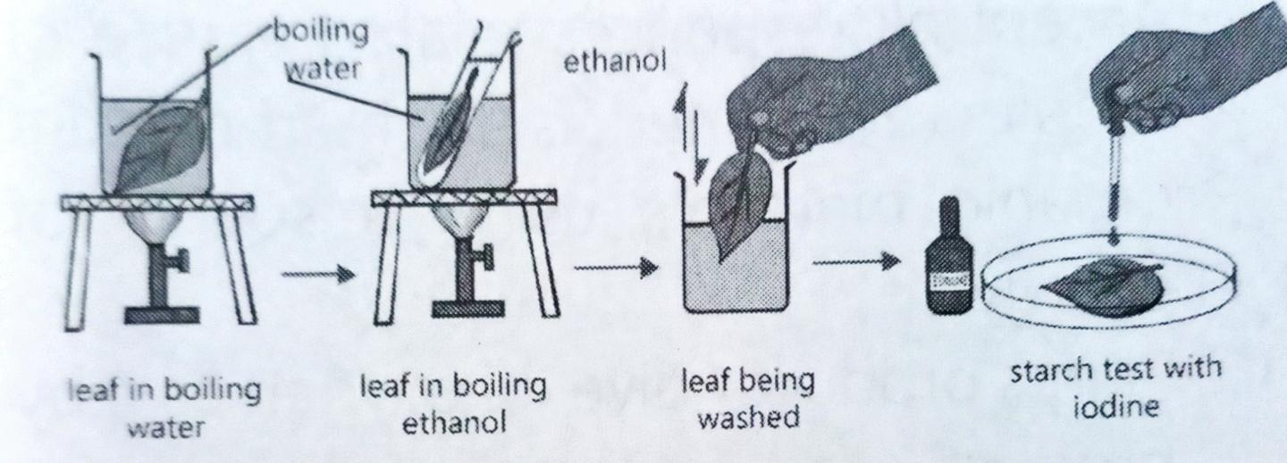

Slide 201
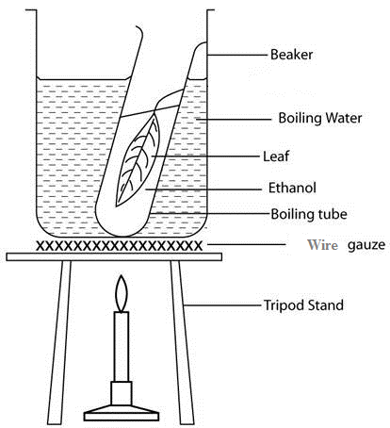
Set up of apparatus

Slide 202
Observation
On applying drop of iodine solution, it turns blue-black.
Conclusion
The leaf contains starch.

Slide 203
Explanation
Boiling in water denatures enzymes to prevent further chemical changes and also makes the leaf cells more permeable to iodine.
Ethanol decolorizes the leaf by dissolving out chlorophyll, making colour changes caused by interaction of starch and iodine much easy to observe. The ethanol makes the leaf brittle.
Washing it in hot water softens the leaf.
The blue-black colour confirms presence of starch in the leaf.

Slide 204
Rate of photosynthesis
Is the measure of how much glucose is manufactured by plants per unit time.
It is measured by following the amount of carbon dioxide used or oxygen produced per unit time by a plant.

Slide 205
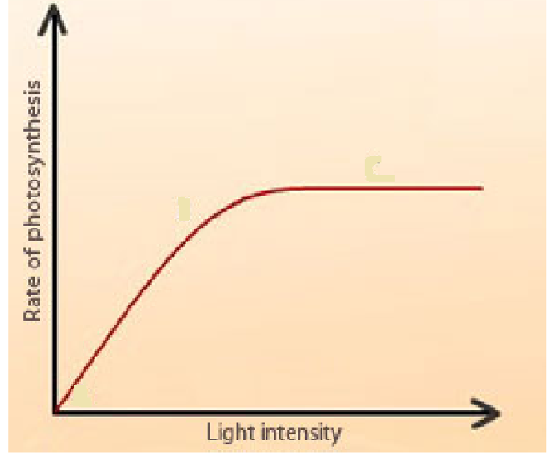
Factors that affect the rate of photosynthesis
Light intensity
Light provides energy that drives the process of photosynthesis.
A graph showing the effect of light intensity on rate of photosynthesis

Slide 206
Description
At the beginning, increase in light intensity leads to a rapid increase in rate of photosynthesis.
Later, the rate of photosynthesis becomes constant with further increase in light intensity.
Explanation
At the beginning, increase in light intensity leads to rapid increase in rate of photosynthesis because more light provides more energy which is absorbed by chlorophyll for the process of photosynthesis
Later, the rate of photosynthesis becomes constant because all the available chlorophyll is fully saturated with light and photosynthesis is at this time limited by some other factor such as availability of carbon dioxide, or amount of chlorophyll.

Slide 207
Finding out the effect of light intensity on rate of photosynthesis

Slide 208
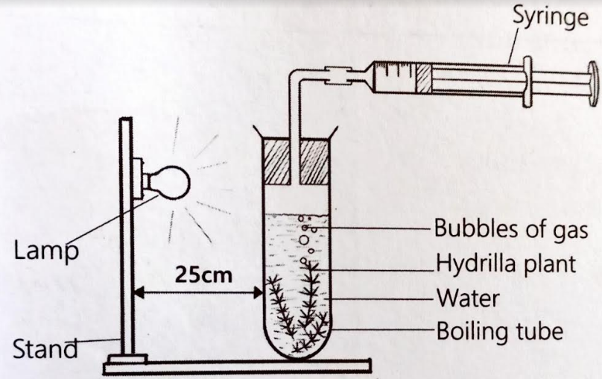

Slide 209
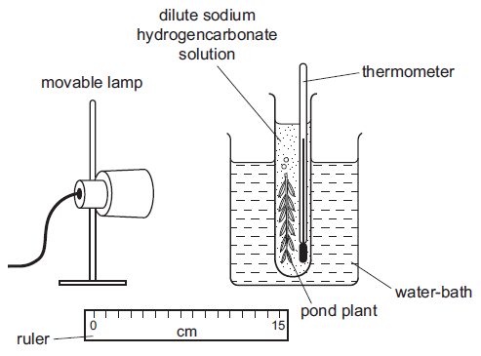

Slide 210
Procedure
Place a shoot of pondweed in a boiling tube containing water in which sodium hydrogen carbonate has been dissolved.
Place the lamp 10 cm from the pondweed.
Turn the lamp on and count and record the number of bubbles produced in one minute.
Repeat with the lamp at different distances from the pond weed.

Slide 211
Observation
Number of bubbles produced decreases when distance of the lamp to the pondweed increases.
Or
Number of bubbles produced increases when distance of the lamp to the pondweed decreases.
conclusion
Increase in light intensity increases the rate of photosynthesis.

Slide 212
Explanation
Increase in distance of the lamp from the pondweed leads to decrease in light intensity, hence the pondweed receives less energy for photosynthesis, leading to production of less oxygen as bi-product.

Slide 213
Note:
Temperature needs to be kept constant by placing the boiling tube in water bath maintained at an appropriate temperature.
Some oxygen dissolve in the water, some used by the plant for respiration.
Inaccurate counting of the number of bubbles can be corrected by counting the bubbles many times and getting the average number of bubbles at a given distance

Slide 214
Sample results:
Distance of lamp from pondweed | Number of bubbles produced per minute
10 | 67
20 | 62
30 | 52
40 | 31
50 | 14

Slide 215
Plot a graph to show how the number of bubbles produced per minute by the pond weed varies with distance of the lamp from the pond weed

Slide 216
Demonstrating that light is necessary for photosynthesis
Materials
Potted plant with leaves
Iodine solution
Razor blade
Aluminum foil/ black polythene
Ethanol
Dropper
Source of heat
Boiling tube
Water bath, white surface

Slide 217
Procedure
De-starch the potted plant by keeping in darkness for 48 hours.
Attach a piece of aluminum foil one leaf.
Place the plant in sun for at least 4 hours.
Test the leaf for starch immediately after this duration.

Slide 218
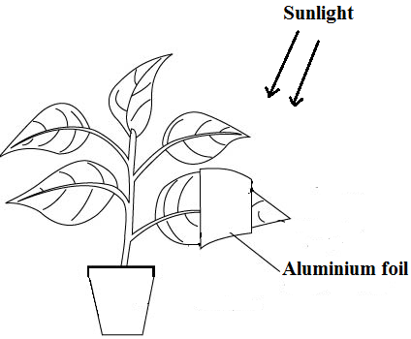
Set up of apparatus

Slide 219
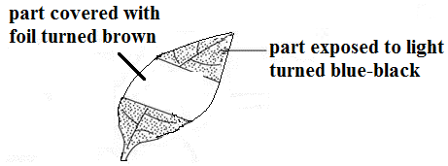
Observation
The part which was covered with aluminum foil turns brown while the uncovered part turns blue-black

Slide 220
Conclusion
Light is necessary for photosynthesis
NOTE:
Covered area did not have starch because light was prevented from reaching it by aluminum foil.
Before investigating the conditions necessary for photosynthesis to take place, the leaf must be de-starched first.
De-starching is the process of removing starch from plant leaves by keeping it in darkness for at least 2 days.
During de-starching, starch is converted to glucose and respired by the plant or converted to sucrose translocated to other parts of the plant.

Slide 221
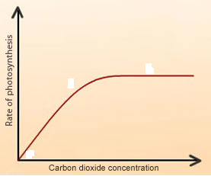
2. Carbon dioxide concentration
Carbon dioxide is a raw material for photosynthesis.
A graph showing the effect of carbon dioxide on rate of photosynthesis

Slide 222
Description
At the beginning, the rate of photosynthesis increases rapidly as carbon dioxide concentration increases.
Later, the rate of photosynthesis remains constant as carbon dioxide concentration increases.
Explanation
At the beginning, the rate of photosynthesis increases with increase in carbon dioxide concentration because increase in carbon dioxide concentration provides more raw material for photosynthesis
Later, the rate of photosynthesis becomes constant because all the cells that are photosynthesizing are fully saturated with carbon dioxide.

Slide 223
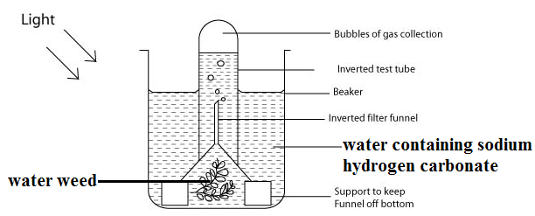
Finding out the effect of changing carbon dioxide concentration on rate of photosynthesis

Slide 224
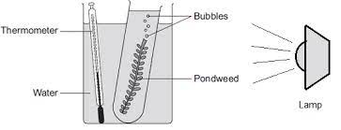

Slide 225
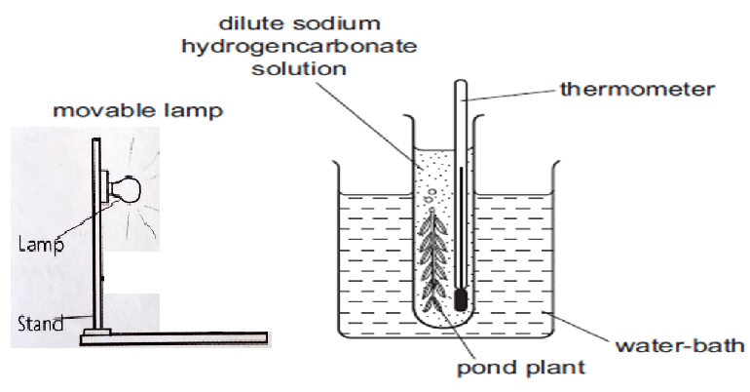

Slide 226
Procedure
Assemble three sets of apparatus as shown above.
Maintain all the setups at the same constant temperature.
Add 0.1% sodium hydrogen carbonate in set up 1, 0.3% sodium hydrogen carbonate to set up 2 and 0.5% sodium hydrogen carbonate to test set up 3.
Observe and record the number of bubbles produced per minute at each concentration of sodium hydrogen carbonate.

Slide 227
Observation
Increase in carbon dioxide concentration leads to increase in number of bubbles produced by the pond weed.
Conclusion
Increase in carbon dioxide concentration leads to increase in rate of photosynthesis.

Slide 228
To demonstrate that carbon dioxide is necessary for photosynthesis
Materials
Conical flasks
Clamp
Potted plant
Soda lime (potassium hydroxide)
Sodium bicarbonate
Corks
Vaseline,
Test tube
Beaker
Iodine solution
Water bath
White tile
Beaker
Bunsen burner.

Slide 229
Procedure
De-starch a well-watered potted plant by keeping it in a dark place for at least 24hours.
Using a cork, enclose one leaf in a conical flask containing soda lime, label it A.
Enclose another leaf in another conical flask but with sodium bicarbonate, and label it B.
In both cases apply Vaseline at the neck of the flask to avoid passage of air to the flasks.
Leave the set up in sunlight for at least 4 hours and test the leaves for starch.

Slide 230
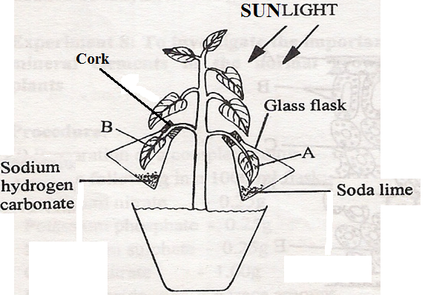
Set up of apparatus

Slide 231
Observation
On addition of iodine solution to leaf from conical flask B, it turned blue-black while that from A turns brown.
Conclusion
Carbon dioxide is necessary for photosynthesis.
Explanation
-In conical flask A, soda lime absorbs all carbon dioxide within the conical flask hence there was no photosynthesis due to lack of carbon dioxide.
-In B carbon dioxide was available from the decomposition of sodium hydrogen carbonate which led to photosynthesis.

Slide 232
3. Chlorophyll concentration
High chlorophyll concentration traps more light energy leading to increased rate of photosynthesis.
Low chlorophyll concentration traps less light energy leading to decreased rate of photosynthesis

Slide 233
Demonstrating that chlorophyll is necessary for photosynthesis
Materials
Beaker
Tripod stand,
wire gauze,
Bunsen burner,
test tube,
dropper,
a plant with variegated leaf,
Iodine solution, white tile.

Slide 234
Procedure
De-starch a plant which bears variegated leaves by keeping it in a dark cupboard for three days.
Expose the plant to sunlight for at least 4 hours.
Pick a variegated leaf from the plant and trace the outline for green and non-green parts on a paper carefully.
Test the leaf for starch and compare the green and non-green parts with the result.

Slide 235
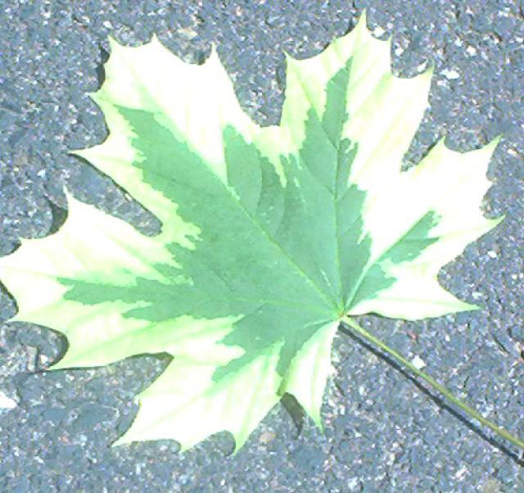

Slide 236
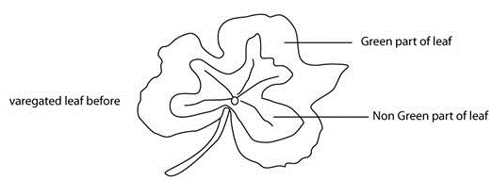

Slide 237
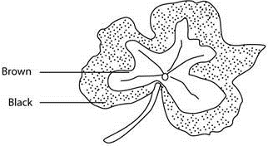
Observation
Originally green parts turned to blue-black, while in the non-green parts turned brown.

Slide 238
Conclusion
Chlorophyll is necessary for photosynthesis.
Explanation
The parts that turned blue-black produced starch because it contained chlorophyll and was originally green in colour.
In non-green parts no photosynthesis took place because it never contained chlorophyll, thus in those parts iodine retained its brown colour.

Slide 239
4. Temperature
Photosynthesis is an enzyme-controlled process.
Temperature influences the activities of the enzymes responsible for photosynthesis.

Slide 240

Graph showing effect of temperature on rate of photosynthesis

Slide 241
Trend/description of the graph
From 0ºC to 10ºC, the rate of photosynthesis increases gradually.
From 10ºC to 40ºC, the rate of photosynthesis increases rapidly to a maximum.
From 40ºC to 60ºC, the rate of photosynthesis decreases rapidly.

Slide 242
Explanation of the graph
From 0ºC to 10ºC, the rate of photosynthesis increases slowly because low temperature inactivates the enzyme (The enzyme is inactive at low temperature).
From 10ºC to 40ºC, the rate of photosynthesis increases rapidly/fast to a maximum, because the enzyme is activated.
From 40ºC to 60ºC, the rate of photosynthesis decreases rapidly/fast, because the enzyme is denatured due to very high temperature.

Slide 243
Activity: design an experiment to demonstrate the effect of change in temperature on rate of photosynthesis

Slide 244
Set three sets of apparatus shown below
Maintain the water baths at different temperatures of 10ºC, 30ºC and 60ºC respectively.
Observe and record the number of bubbles produced per minute over five minutes.

Slide 245
Conclusion
Increase in temperature up to 30ºC leads to an increase in number of bubbles produced. Increase in temperature to 60ºC leads to a decrease in the number of bubbles produced.
Explanation
At 10oC the temperature is low, making the enzymes responsible for photosynthesis inactive, hence there is a low rate of photosynthesis, producing few bubbles.
At 30oC, enzymes responsible for photosynthesis are activated, photosynthesis occurs at a high rate, producing many bubbles.

Slide 246
5.Availability of water
Water is a raw material for photosynthesis, therefore more water in the soil increases rate of photosynthesis.

Slide 247
Limiting factors in photosynthesis
A limiting factor is an environmental factor whose absence or limited/short supply restricts/slows down the rate of a life process.
Example:
In darkness (at night), light intensity is the limiting factor in photosynthesis, if the other factors are available.
If the light intensity is increased, the rate of photosynthesis increases.
The point at which a factor stops to limit photosynthesis is called saturation point.

Slide 248

A to B:light intensity is the only limiting factor.
B to C: light intensity and other factors are limiting factors.
C to D: light intensity is not a limiting factor, other factors are.
Point C: saturation point .

Slide 249

Graph showing effect of increasing light intensity on rate of photosynthesis at two different temperatures of 15ºC and 25ºC
Limiting factor: Temperature
Reason: increasing temperature from 15ºC to 25ºC leads to increase in rate of photosynthesis.

Slide 250

Graph showing effect of increasing light intensity on rate of photosynthesis at two different concentrations of carbon dioxide of 1% and 0.04%

Slide 251

The leaf as an organ for photosynthesis A drawing of the vertical section through a leaf

Slide 252


Slide 253
Adaptations of leaves for photosynthesis
Leaves are thin to reduce distance of diffusion of carbon dioxide and light to photosynthesizing cells.
Leaves are broad and flat to increase surface area for trapping sunlight and absorbing carbon dioxide.
Leaves are arranged into a mosaic to avoid overlapping and trap maximum sunlight.
Leaves are numerous to increase surface area for photosynthesis.

Slide 254
Have veins, with xylem for transporting water and mineral salts, and phloem for transporting manufactured food.
Leaves have numerous stomata for efficient exchange of gases.
The palisade mesophyll cells contain numerous chloroplasts, containing chlorophyll which traps sunlight.
Have water proof cuticle to prevent them from desiccation/drying up during photosynthesis.

Slide 255
Spongy mesophyll has plenty of air spaces for free circulation of air.
Upper epidermis has thin and transparent cuticle to allow penetration of light.

Slide 256
Task
a) Relate the external structures of the leaf to their function
b) Relate the internal structures of the leaf to their function

Slide 257
Activity of integration

Slide 258
NUTRITION IN MAMMALS
Animals are heterotrophic.
They ingest and digest food.
Digestion is speeded by enzymes.
Activity
What is an enzyme?
How are enzymes named?
Name some enzymes in the human digestive system and state the function of each.
What are the properties/characteristics of enzymes?

Slide 259
ENZYMES
An enzyme is a biological catalyst produced by body cells to speed up the rate of chemical reactions in the body.
Enzymes catalyze reactions of substances called substrates.
Types of enzymes
Intracellular enzymes: are enzymes which work inside cells where they are produced. E.g., catalase and respiratory enzymes.
Extracellular enzymes: are enzymes that work outside the cells that produce them. Examples include; most digestive enzymes such as amylase, pepsin and lipase.

Slide 260
Naming enzymes
Enzymes are named by adding the suffix ‘ase’ at the end of the name of the substrate acted upon. Examples;
Enzyme | Substrate broken down
Lipase. | Lipids.
Proteases | Proteins. Examples: pepsin, trypsin, etc. are proteases
•Maltase | maltose.
Sucrase. | sucrose

Slide 261
Lactase | lactose.
Peptidase | peptides
Cellulase | cellulose.
Amylase | Starch (amylose)

Slide 262
Enzyme | Location/secretion | Reaction catalyzed
Ptyalin/salivary amylase | Saliva from salivary glands in the mouth | Starch to maltose
Renin | Gastric juice from gastric glands of the stomach | Coagulates casein to caseinogen
Pepsin |  | Proteins to peptides
Trypsin |  | Peptides to amino acids

Slide 263
Pancreatic amylase | Pancreatic juice from the pancreas, into the duodenum | Starch to maltose
Pancreatic lipase |  | Lipids to fatty acids and glycerol
Maltase | Intestinal juice (succus entericus) from ileum walls | Maltose to glucose
Sucrase |  | Sucrose to glucose and fructose
Lactase |  | Lactose to glucose and galactose
Peptidase (erepsin) |  | Peptides to amino acids

Slide 264
Properties/characteristic of enzymes
They are proteins in nature.
They speed up rates of chemical reactions as they are catalysts.
They are specific in action i.e. each enzyme acts only on a particular substrate. For example, amylase works on starch only and no other substrate.

Slide 265
Enzymes work best under a narrow range of pH of the medium.
Enzymes remain unchanged at the end of a reaction, ie they can be used over and over again.
They work effectively in small quantities.

Slide 266
They are soluble enabling them to speed up reactions in fluid medium
They are activated by activators and inhibited by such e.g. cyanide
They are denatured at high temperatures.
They catalyze reversible reactions.

Slide 267
How do enzymes work?

Slide 268

Each substrate and enzyme have a definite shape.
Only substate with the right shape can fit into the active site of an enzyme.
If the right substrate fits in the enzyme active site, the product is formed.
The enzyme remains unchanged after the reaction.

Slide 269
Factors that affect enzyme activity
pH of the medium
Each enzyme works best within a narrow range of pH.
Enzyme activity is reduced or stopped completely if placed in a medium whose pH is below or beyond its optimum pH.
This is because the enzyme becomes denatured (shape of the enzyme active site is altered) by breaking of hydrogen bonds at the active site.

Slide 270

Graph showing the effect of pH on the rate of enzyme activity

Slide 271
Demonstrating that Ph affects enzyme activity
Requirements:
Hydrogen peroxide solution
1M sodium hydroxide solution
1M hydrochloric acid
Water
Knife
3 test tubes
Ruler

Slide 272
Procedure
Peel the fresh irish potato and cut out three cubes of equal sizes, each measuring 1cm x 1cm x 1cm.
Label three test tubes A, B and C and to each, add 2cm³ of hydrogen peroxide solution
Add 1cm³ of sodium hydroxide solution to test tube A, 1cm³ of hydrochloric acid solution to test tube B and 1cm³ of water to test tube C.
Add one cube of irish potato to each test tube.

Slide 273

Set up of apparatus

Slide 274
Observation
Test tube A: Slow effervescence (production of bubbles)/few bubbles given off.
Test tube B: No effervescence (no bubbles given off)
Test tube: Rapid effervescence occurred (Many bubbles produced)
Conclusion:
The pH of the medium affects the activity of an enzyme.

Slide 275
Or
Apparatus and materials
3 test tubes
Measuring cylinder
Egg albumen suspension
1% pepsin solution
2M hydrochloric acid
2M sodium hydroxide solution
Water bath
Thermometer
Labels

Slide 276
Procedure
Label three test tubes as 1, 2, and 3.
Pour 2cm³ of egg albumen suspension into each of the test tubes.
Add 1cm³ of distilled water to test tube 1, 1cm³ of 2M hydrochloric acid to test tube 2, and 1cm³ of 2M sodium hydroxide solution to test tube 3.
Add 1cm³ of pepsin solution into each test tube.
Place the test tubes in a water bath maintained at 37ºC for 30 mintues.

Slide 277

Set up of apparatus

Slide 278
Observation
Test tube 1: The solution remains turbid.
Test tube 2: The turbid solution turns to colorless solution.
Test tube 3: The solution remains turbid.
Conclusion
The pH of the medium affects the activity of an enzyme.
Question: why are the set ups maintained at 37ºC?

Slide 279

b) Temperature
Graph showing the variation of rate of enzyme activity with temperature

Slide 280
Trend/description of the graph
From 0ºC to 10ºC, the rate of enzyme activity increases gradually.
From 10ºC to 40ºC, the rate of enzyme increases rapidly to a maximum.
From 40ºC to 60ºC, the rate of enzyme activity decreases rapidly.

Slide 281
Explanation of the graph
From 0ºC to 10ºC, the rate of enzyme activity increases slowly because low temperature inactivates the enzyme (The enzyme is inactive at low temperature).
From 10ºC to 40ºC, the rate of enzyme activity increases rapidly/fast to a maximum, because the enzyme is activated.
From 40ºC to 60ºC, the rate of enzyme activity decreases rapidly/fast to zero, because the enzyme is denatured

Slide 282
Experiment to show that enzyme activity is affected by temperature
Apparatus and materials
Three test tubes
Three plastic beakers
Iodine solution
1% Starch solution
Amylase enzyme solution
Hot water
stop clock
ice cubes

Slide 283
Procedure
Label three test tubes A, B, and C.
Add 2cm³ of 1% starch solution to each test tube.
Place test tube A in a beaker containing ice cubes/very cold water, test tube B in a water bath maintained at 35ºC and test tube C in a water bath maintained at 60ºC.
Add 1cm3 of amylase solution to each test tube.
Leave the set up to stand for 30 minutes and after, test for the presence of starch in the contents of each test tube using iodine.

Slide 284

Set up of apparatus

Slide 285
Observation
Solution in test tube A: turns blue-black(because starch is present).
Solution in test tube B: turns brown (because starch is absent).
Solution in test tube C: turns blue-black (because starch is present).
Conclusion
Enzyme activity is affected by temperature.

Slide 286
Explanation
At low temperature of 0°C the enzyme was inactive; starch was not digested/broken down (starch present).
The enzyme is active at an optimum temperature of 35°C, starch was broken down.
And at high temperature the enzyme was denatured hence starch was not digested.

Slide 287
c) Enzyme concentration
At a constant concentration of substrate, the rate of an enzyme-controlled reaction increases with increase in concentration of enzyme because increasing the enzyme concentration increase the chance of substrates and enzymes to collide and form enzyme-substrate complex, and then it becomes constant at a point when all substrates are being worked on.

Slide 288

Graph showing variation of the rate of enzyme catalyzed reaction with enzyme concentration

Slide 289
d) Substrate concentration
For a constant concentration of enzyme, the rate of enzyme-controlled reaction increases with increasing substrate concentration because increasing the substrate concentration increase the chance of substrates and enzymes to collide and form enzyme-substrate complex, and then becomes constant at a point when all enzyme active sites are occupied.

Slide 290
e) Presence of inhibitors
Presence of inhibitors, reduce enzyme activity by deforming the enzyme, for instance by blocking the active site hence rendering the enzyme useless e.g. cyanide is respiratory poison.

Slide 291
f) Presence of enzyme activators
These are co-enzymes and co-factors. They are non-protein substances.
Co-enzymes are inorganic in nature while co-factors are organic in nature.
The presence of enzyme activators increases the rate of enzyme activity on a substrate.

Slide 292
The mammalian teeth
Teeth are bony structures found in the mouth; firmly fixed in the jaws from where they grow.
Externally, each tooth consists of a crown, neck and root.
Types of mammalian teeth
What are the different types of mammalian teeth?
What are the functions of the various types of the mammalian teeth?
How are the teeth adapted to their functions?

Slide 293



Slide 294
Type of tooth | Function
Incisor tooth | Cutting and biting food
Canine tooth | Piercing and tearing flesh
Premolar tooth | Chewing, grinding/crushing food
Molar tooth

Slide 295
Structure of mammalian teeth
1. Incisor tooth
Characteristics:
Has chisel-shaped (wedge-shaped) crown with sharp, flat cutting edge
Have single root
Has narrow dental canal

Slide 296


Slide 297

Drawing of external side/lateral view of incisor tooth

Slide 298

2. Canine tooth
Characteristics
The crown is sharp and pointed or conical.
Has single root
Has narrow dental canal

Slide 299

A drawing of external lateral/side view of canine tooth

Slide 300

3. Premolar tooth
Characteristics
Has wide/broad crown
Has ridges and cusps at the top of the crown, for grinding food.
Dentine more exposed at the top
Has wide dental canal
Has two roots

Slide 301

Drawing of external lateral/side view of pre-molar tooth

Slide 302

4. Molar tooth
Characteristics
Has a wide/broad crown
Has ridges and cusps at the top of the crown, for grinding food.
Dentine more exposed at the top
Has wide dental canal
Have 3 (or 4) roots.

Slide 303
Drawing of external lateral/side view of molar tooth

Slide 304
Adaptations of the different types of teeth
Type of tooth | Adaptation
Incisor tooth | Sharp chisel-shaped crown for cutting food
Canine tooth | Sharp pointed crown for tearing flesh
Premolar tooth | Two roots for firm anchorage into the jaw bone. Broad crown to increase surface for grinding food. Has cusps and ridges to increase friction for grinding food.
Molar tooth | Three roots for firm anchorage into the jaw bone. Broad crown to increase surface for grinding food. Has cusps and ridges to increase friction for grinding food.

Slide 305

Internal structure of the tooth
A drawing of longitudinal section through incisor tooth

Slide 306

Drawing of longitudinal section of molar tooth

Slide 307
Parts of the tooth and their functions
1. Crown
Used to break down food into small particles during chewing, grinding and cutting.
It consists of;
a) Enamel
It is the hardest substance in the body, made up of calcium phosphate
It is used for strengthening the tooth to enable it grind and cut.

Slide 308
b) Dentine
It is fairly hard.
It is used to strengthen the tooth.
2. Pulp cavity
It is the living part of the tooth containing blood vessels and nerve endings.
It provides sensitivity to the tooth
3. Neck
It is the junction between the crown and the root.

Slide 309
4. Root
It fixes the tooth in the Jaw bone
5. Blood vessels
Supply the tooth with nutrients and oxygen.
6. Nerve endings
For sensitivity of tooth as they detect changes in temperature and pressure in the tooth

Slide 310
Dentition and dental formula
Dentition
There are two types:
Heterodont dentition: there are different kinds of teeth each having a particular role to play in the feeding process e.g. in mammals.
Homodont dentition: The teeth of are all alike i.e. similar in shape and carryout the same function e.g. reptiles and amphibians.

Slide 311
Dental formula
It is the formula indicating number and positions of each type of teeth in half of upper jaw and half of lower jaw.
It shows the adaptation of animal to a particular diet.
The number of teeth in the upper jaw is written above that of the lower jaw.
The different types of teeth are represented by letters i.e.
Incisors (I), Canines (C), Premolars (Pm), Molars (M)

Slide 312


Slide 313

Examples:

Slide 314


Slide 315
Adaptation of teeth to diet of the animals
a) In most herbivores:
Lack upper incisors, but have a horny pad used for pressing and cutting grass.
Have sharp lower incisors for cutting grass.
Canines may be absent leaving a gap called diastema which increases the gap for the tongue to manipulate food.
Have long muscular tongue for rolling grass
Premolars and molars are broad with many cusps for grinding food.
Jaws can move sideways, back and forward to increase grinding.

Slide 316


Slide 317


Slide 318
b) Most carnivores:
Have small and sharp incisor for removing flesh from bones.
Canines are long and pointed for; holding, stabbing or piercing and killing prey, and defense.
Have carnassial teeth made of the first molars on the lower jaws and last pre-molars on the upper jaws used for cutting and crushing bones, and scrapping off meat from bones

Slide 319


Slide 320


Slide 321
Oral Hygiene
Involves taking proper care of the teeth, gums, tongue and inner lining of the mouth.
What are the benefits of maintaining good oral hygiene?
What are the consequences of poor oral hygiene?
In practice, how do you maintain good oral hygiene?

Slide 322
Benefits of good oral hygiene
To prevent dental diseases.
To prevent tooth loss.
To prevent bad breath.
To have strong teeth.
To have bright and confident smile.
Consequences of poor oral hygiene
Dental diseases.
Tooth loss when extracted.
Bad breath.
Weak teeth.

Slide 323
Maintaining good oral hygiene
Visit dentist regularly at least once in three month to check on status of your teeth
Avoid eating too much sugary foods as they support growth of bacteria that cause tooth decay.
Avoid using teeth for opening bottles
Clean your teeth regularly especially after meals, at least twice a day to remove microbial plaque.
Change the tooth brush every three month because new tooth brush removes plaque more than an old one with worn out bristles.

Slide 324
Avoid foods which are too cold or too hot. May cause expansion and contraction of tooth and may crack.
Include phosphorus, calcium, vitamins A and C in your diet for healthy growth of gums and teeth.
Use tooth paste containing fluorine as it strengthens the enamel and reduces amount of acid produced by bacteria.
Use mouth guard to protect the teeth during athletics.
Avoid tobacco and alcohol because the cause stains and oral cancer.

Slide 325
Common dental diseases
1. Tooth decay
Also known as dental caries or dental cavities
This is rotting of teeth caused by acids produced by bacteria (located in dental plaque) that ferment the sugars left in between teeth or on surfaces of the teeth.
The acid corrodes the enamel up to pulp cavity causing bleeding and pain.
Treatment at early stages can be by filling the cavity or tooth extraction at advanced stages.

Slide 326


Slide 327


Slide 328
2. Gum disease (periodontal disease)
It is caused by bacteria in the mouth which infect tissue surrounding the tooth, causing inflammation around the tooth.
(i) Gingivitis
It is the early stage of gum disease.
The gum becomes swollen, red and may bleed.
(ii) Periodontitis (pyorrhea)
It is the later stage of gum disease.
The gums pull away from the tooth and bacteria damages the fibers that hold the teeth onto the jaws, and the tooth is loosely attached and may fall off.
Gum disease is controlled by good oral hygiene and scaling by dentists.

Slide 329


Ginivitis Periodontitis

Slide 330
Mammalian Digestive System
The digestive system is made up of the alimentary canal and the associated organs.
The alimentary canal/gut is a long muscular tube that extends from the mouth to the anus.
It is tubular to allow passage of food.
It has associated organs and glands that are capable of digestion, absorption and egestion.
Draw the human digestive system from a suitable text book

Slide 331


Slide 332
Part of alimentary canal | Structure and Function
Mouth | Has teeth for physical digestion. Has a tongue that rolls food into bolus. Has salivary glands that secrete saliva to lubricate food. Saliva contains enzyme salivary amylase that catalyzes the chemical digestion of starch into maltose.
Oesophagus | Has muscular wall that facilitate transport of food to the stomach through peristalsis.

Slide 333
Stomach | Stores and churns food. Has gastric glands that produce gastric juice which contains: Pepsin: catalyzes digestion of proteins to peptides.. HCl: activates enzymes pepsinogen to pepsin and prorenin to rennin, kills germs, provides an optimum acidic medium for pepsin and stops action of salivary amylase. Mucus protects stomach wall from HCl and pepsin. Renin coagulates milk proteins.
Liver | Destroys worn out/old red blood cells. Produces bile juice. Stores vitamins and Iron Detoxifies poison Produces heat due to various chemical processes taking place in it. Forms new red blood cells

Slide 334
Gall bladder | Stores and releases Bile into the duodenum
Pancreas | Produces and secrets pancreatic juice that contains enzymes, into the duodenum. Pancreatic juice contains hydrogen carbonate ions to neutralize the stomach acid and sets alkaline p H, optimum for action of pancreatic enzymes.
Duodenum | Bile juice emulsify fat. Pancreatic lipase; catalyzes breakdown of lipids to fatty acids and glycerol. Pancreatic amylase; catalyzes breakdown of the remaining starch from digestion in the mouth into maltose. Trypsin; catalyzes breakdown of proteins to peptides.

Slide 335
Ileum | Its wall produce of intestinal juice called succus entericus which contains enzymes that complete digestion. Maltase; catalyzes breakdown of maltose into glucose. Peptidase (or erepsin); catalyzes breakdown of peptides into amino acids Sucrase; catalyzes breakdown of sucrose into glucose and fructose Lactase; catalyzes breakdown of lactose to glucose and galactose

Slide 336
Large intestine | Colon absorbs water. Rectum stores remaining undigested food (faeces).
Anus | An opening for egestion when the anal sphincter muscles relax.

Slide 337
Digestion of food
Digestion is the breaking down of large/complex insoluble food particles into smaller, soluble and absorbable particles.
Foods go through: ingestion, digestion, absorption, assimilation and egestion of indigestible materials.

Slide 338
Basic types of digestion
a) Physical/mechanical digestion: breakdown of food substances by teeth (means of biting, cutting, grinding), muscular contractions (churning), coagulating and emulsifying.
Does not result in changing chemical nature of the food.
b) Chemical digestion: breakdown food by digestive enzymes into simpler molecular forms.
Results in changing chemical nature of the food.

Slide 339
Which food substance is digested in the mouth?

Slide 340
Experiment to determine the food substance chemically digested in the mouth
Apparatus and materials
Saliva
10% Starch solution
Beaker
Benedict’s solution
Measuring cylinder
2 test tubes
Water bath
Thermometer

Slide 341
Procedure
Label two test tubes A and B.
Pour 2cm³ of starch solution into each of the two test tubes.
Add 1cm³ of saliva into test tube A, and 1cm³ of water into test tube B.
Place both test tubes in a water bath maintained at 37ºC to 40ºC for 20 minutes.
After the 20 minutes, add 2cm³ of Benedict’s solution into each test tube and boil.

Slide 342

Set up of apparatus

Slide 343
Observation
Test tube A: turbid solution turns to blue solution, green solution, yellow precipitate and orange precipitate.
Test tube B: turbid solution turns to blue solution and persists.
Conclusion
Test tube A contains reducing sugars because starch is digested by an enzyme in saliva into reducing sugars.

Slide 344
The process of digestion
In the mouth
Food is chewed/masticated by the teeth, to increase surface area for efficient enzyme action.
Saliva from salivary glands lubricates food and provide suitable pH for enzyme salivary amylase/ptyalin.
Enzyme salivary amylase catalyzes the breakdown of starch into maltose.
Food is rolled into bolus by the tongue, and moved through the oesophagus by peristalsis.

Slide 345


Slide 346
In the stomach
Food (bolus) enters the stomach through the cardiac sphincter.
Gastric glands (in the stomach walls) secrete gastric juice that contains; water, hydrochloric acid, pepsin, rennin and mucus.
Stomach muscles contract and churn the food with gastric juice to form a semi solid called chyme
Pepsin catalyzes breakdown of proteins into peptides.
Rennin coagulates soluble milk protein called caseinogen into insoluble proteins called casein which can then be acted on by pepsin.

Slide 347
In the duodenum
Bile is released from the gall bladder through the bile duct.
Bile salts emulsify fats (breakdown the large fat drops into tiny droplets which can mix better with water to create an emulsion) increasing surface area for action of lipase
Pancreatic juice containing the following enzymes is releases from the pancreas through the pancreatic duct.
Pancreatic lipase; catalyzes breakdown of lipids to fatty acids and glycerol.
Pancreatic amylase; catalyzes breakdown of the remaining starch from digestion in the mouth into maltose.
Trypsin; catalyzes breakdown of proteins to peptides.

Slide 348
In the ileum
Intestinal juice called succus entericus containing the following enzymes is produced.
Maltase; catalyzes breakdown of maltose into glucose.
Peptidase (or erepsin); catalyzes breakdown of peptides into amino acids
Sucrase; catalyzes breakdown of sucrose into glucose and fructose
Lactase; catalyzes breakdown of lactose to glucose and galactose.
The food containing the soluble end products of digestion, ready for digestion is called chyle.

Slide 349
Describe the digestion process that occurs when a person eats
i. Starchy food e.g., posho.
ii. Proteins e.g., beef.

Slide 350
Absorption of digested food
Absorption is the process by which digested food materials enter the blood stream.
This takes place in the ileum.
The ileum has villi which suits it for absorption.

Slide 351




Slide 352

A drawing of a villus
(Introduction to biology page 89, fig 18.7)

Slide 354
Fatty acids and glycerol are absorbed into the lacteal of the villus.
The lacteals join up to form the lymphatic system carrying these food materials and distributing them to all parts of the body.
Glucose, Amino acids and Fructose pass into the blood capillaries of the villus.
The blood capillaries join up to form the Hepatic portal vein which transport these nutrients to the liver

Slide 355
Adaptations of ileum/ small intestine for absorption of digested food
Ileum is very long to provide a large surface area for absorption of food.
Its walls are folded to give large surface area for absorption of food.
Its inner lining contains many villi which increase the surface area for absorption of food.
Each villus contains many microvilli which further increase the surface area for absorption of food

Slide 356
Villi contain numerous blood capillaries which transport absorbed food (glucose, vitamins, amino acids, fructose, etc.).
Villi contain lacteal which transport absorbed fatty acids and glycerol to the lymphatic system.
Villi have thin walls (epithelium) to reduce distance to capillaries and lacteal.

Slide 357
Assimilation of food
After absorption, food is transported to cells and assimilated.
Assimilation is the utilization of absorbed food nutrients in the metabolic processes of the body
Glucose
Used in respiration to release energy
Excess glucose is converted to glycogen and stored in the liver and muscles.
Excess glucose is converted to fat and stored under the skin and delicate organs like liver, heart, and kidney

Slide 358
Amino acids
Growth and repair of damaged tissues.
Used in protein synthesis e.g. formation of hormones, enzymes and antibodies.
Excess amino acid is deaminated (amino groups removed) leading to formation of urea. Urea is excreted via kidney in form of urine.
Used for respiration in absence of glucose and fats.

Slide 359
Fatty acids and glycerol (Lipids)
Are stored under skin in adipose tissues for insulating the body against heat loss.
Are stored around delicate organs like intestine, liver, heart, kidney and lung to cushion the organs against friction.
In condition of lack of glucose, they are used for respiration

Slide 360
Vitamins and mineral salts
Some are stored in the liver (e.g. iron and fat soluble vitamins: A, D, E, K)
Note: vitamins, mineral salts and water do not undergo digestion.

Slide 361
Nutrition in a mould
Fungi, like bread mould, Rhizopus, are saprophytic.
Saprophytic nutrition (saprophytism) is a method of feeding where organisms obtain nutrients in solution form from dead decaying organic matter.
When feeding, the fungus grows branches/hyphae of mycelium called rhizoids which penetrate the food substrate eg bread
At the ends of the rhizoids, extracellular digestive enzymes are secreted into the food substrate

Slide 362

The food material is dissolved and broken down into absorbable units.
The nutrients are absorbed by the rhizoids.

Slide 363


Slide 364


Slide 365
Advantages of saprophytic nutrition
Recycling of nutrients by breaking organic matter into simpler substances that can be absorbed by plants.
Cleaning the environment by decomposing litter

Slide 366
Extracellular and intracellular digestion
Extracellular digestion is where food is broken down outside the cell. E.g. in human beings, bacteria and fungi, etc..
Intracellular digestion is where food is broken down inside the cell, .e.g. in protozoans.

Slide 367
Similarities between extracellular and intracellular digestion
Both involve enzymes
Both break down complex compounds to simple compounds.

Slide 368
Differences between extracellular and intracellular digestion
Extracellular digestion | Intracellular digestion
It takes place in the lumen of the alimentary canal and on decaying organic matter | Takes place in the food vacuoles of cell
Both mechanical and chemical digestion occur | Only chemical digestion occur
Alimentary canal glands secret enzymes into the lumen | Lysosomes secret enzymes into the food vacuole

Slide 369
Nutrients are absorbed into blood stream | Nutrients diffuse directly into the cytoplasm
A complex process involving many organs | A simple process
Organs and glands are involved | Lysosomes are involved
Ingestion occur through mouth | Ingestion occur through phagocytosis

Slide 370
Activity of integration
Your are served, cassava and pasted meat for lunch at school. Most students feel sleepy in the afternoon for a few hours, after which they concentrate well in class. Some learners question why they feel sleepy. As a student of Biology, you understand that a lot of body energy is diverted to the process of digestion.
Task:
Write an account of the digestion process undergone by the major food values in the lunch served.

