Slide 1
TAX COMPLIANCE
TAX COMPLIANCE

Slide 2
LEARNING OUT COMES THE LEARNERS SHOULD BE ABLE TO;
Define tax compliance
Explain the factors affecting tax compliance
Demonstrate the elements of tax compliance
Explain the advantages of tax compliance
Suggest ways of improving tax compliance

Slide 3
TAX COMPLIANCE
Is the degree to which the tax payers meet their tax obligation as set out in the appropriate regulatory provisions
Tax payers are considered to be tax compliant when they make timely, proper and accurate declarations to the tax authority and also settle their tax liabilities voluntarily. So tax compliance can be assessed basing on
Declaration of the tax base; do the tax payers make proper and accurate declaration to the tax authorities?

Slide 4
Tax compliance is based on
Declaration of the tax base; do the tax payers make proper, and accurate declarations to the tax authorities?
How the taxes are paid , are they paid voluntarily or not/coerced
The time when tax is paid ( As expected , earlier or later than expected)

Slide 5
FACTORS INFLUENCING TAX COMPLIANCE
Simple tax laws that are easy to be understand by the tax payers lead to more tax compliance than the laws that are complicated
Simple procedures of paying taxes increase tax compliance e.g e-payment while complicated procedures discourage tax compliance
The tax rates , low tax rates encourage tax compliance than high tax rates
Fair taxes encourage tax compliance than those that are un fair
The quality of tax administration . Tax administrators who have professionalism , integrity and customer care promote tax compliance among tax payers

Slide 6
c
The popularity of the government and quality of governance ; unpopular or corrupt government discourage tax compliance yet the one that is popular and not corrupt encourages
The quality of business management . Tax payers who keep proper records are more tax compliant than those who do not keep records
Financial positions of the tax payer. Individuals and firms with limited finance tend to low levels of tax compliance than those with adequate funds
Levels of tax education, higher levels of tax education increases awareness and tax compliance whereas low levels of tax education leads to non-compliance

Slide 7
ELEMENTS OF TAX COMPLIANCE. IN GROUPS EXPLAIN THE FOLLOWING ELEMENTS OF TAX COMPLIANCE
ELEMENTS OF TAX COMPLIANCE
REGISTRATION
FILING TAX RETURNS
RECORD KEEPING
DECLARATION
PAYMENTS

Slide 8
NON TAX COMPLIANT
When tax payers are not willing to declare their tax base to the tax authorities, do not want to pay voluntary or pay in time we refer to them as NON-TAX COMPLIANT

Slide 9
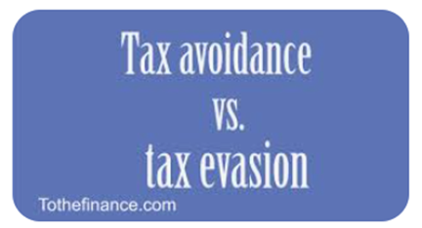
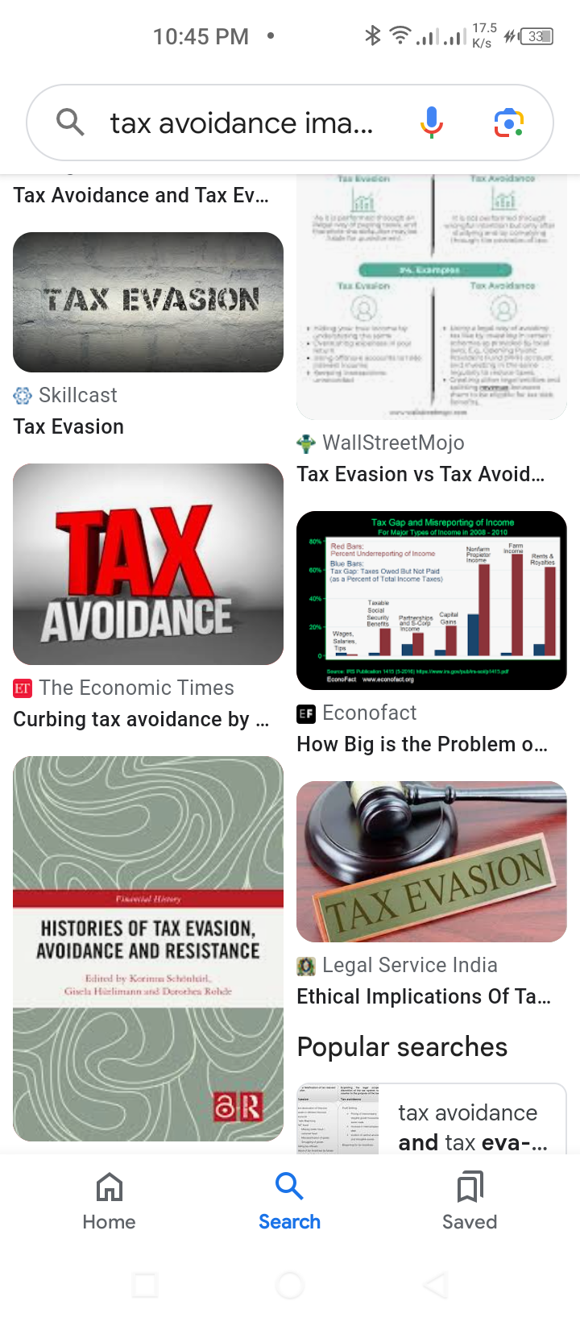
Indicators of non-tax compliance
Tax evasion ; this is the deliberate refusal to pay tax
Tax avoidance ; this involves taking advantages of the tax loopholes with in the tax system to reduce or dodge the tax liabilities

Slide 10
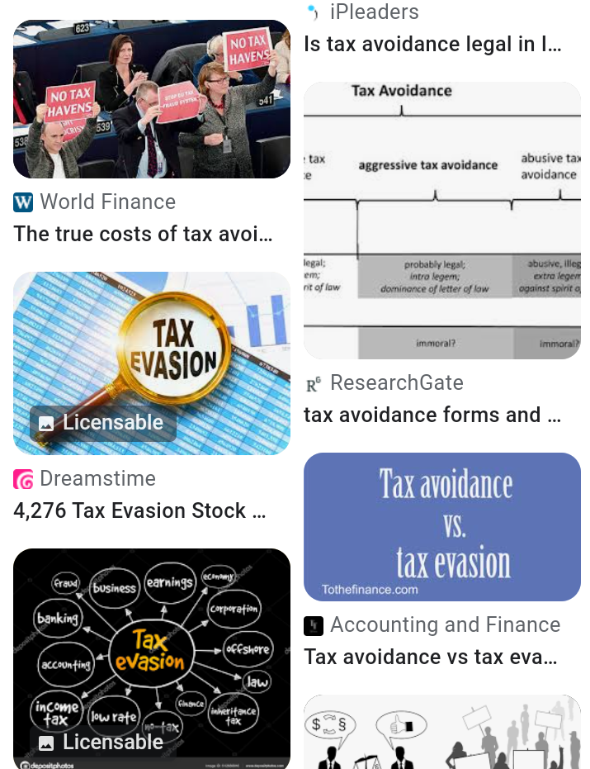
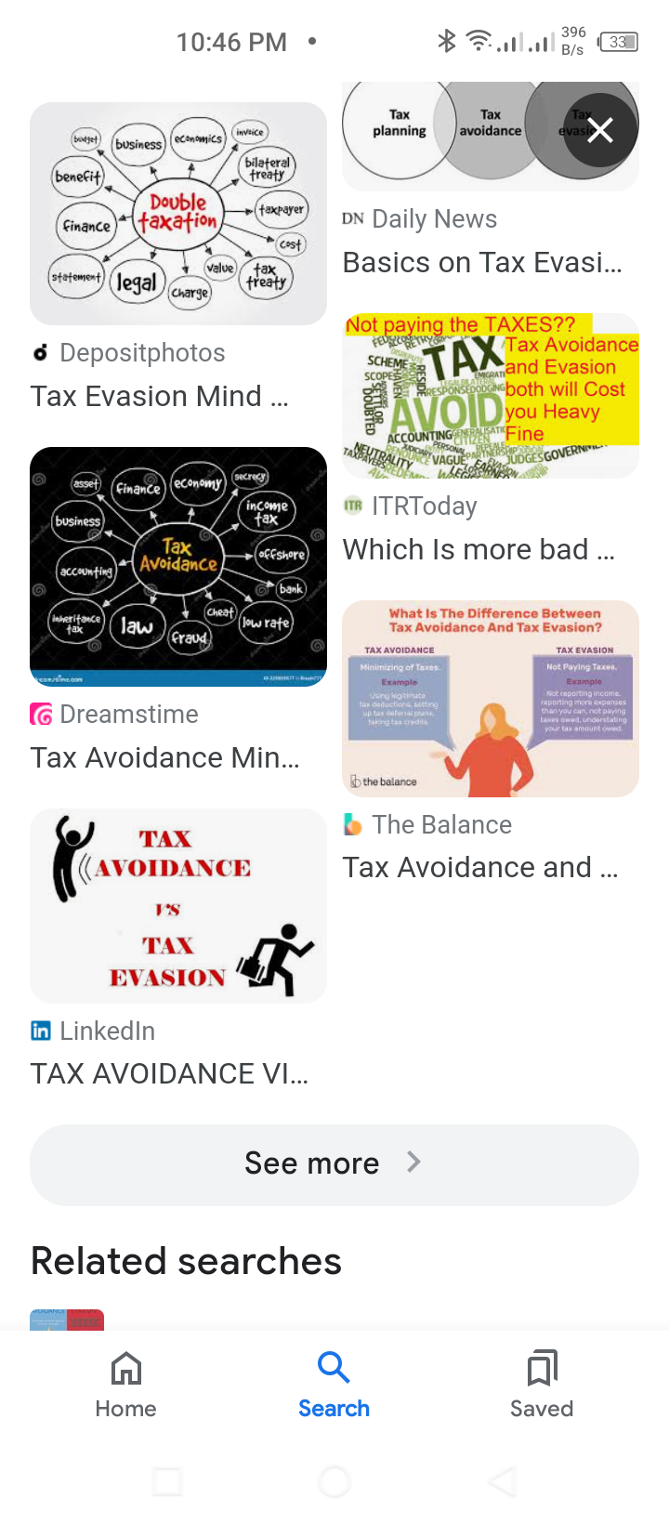

Slide 11
ADVANTAGES OF TAX COMPLIANCE
INCREASSES GOVERNMENT REVENUE
REDUCES THE COST OF TAX ADMINISTRATION
ENABLES FASTER CLEARANCE OF GOODS
PROMOTES CONTINUITY IN BUSINESS ACTIVITIES
EASES ACQUISITION OF CONTRACTS
EARNS THE TAX PAYER A GOOD REPUTATION
REDUCES THE COST OF DOING BUSINESS AS NO PENERITIES ARE APPLIED
TAX EXEMPTIONS ARE AT TIMES GIVEN TO COMPLIANT TAX PAYERS

Slide 12
MEASSURES FOR IMPROVING TAX COMPLIANCE
CARRYING OUT TAX EDUCATION; This helps in sensitizing the public about the importance of paying tax
CHARGING LOW TAX RATES; Low tax rates pose low tax burden and therefore high tax compliance among tax payers
MAKING TAX LAWS SIMPLE AND CLEAR; This ensures proper understanding and interpretation of the tax laws by both the tax payers and tax collectors

Slide 13
1v; reducing the level of corruption among tax officials and tax payers; v. improving tax administration; A high level professionalism , integrity and customer care by the tax authorities will encourage tax compliance
V1 COLLECTING TAXES AT A CONVENIENT TIME WHEN THE
TAX PAYERS GET REVENUE FROM THEIR ACTIVITIES
V11 ; PUNISHING ALL TAX EVADERS ; this can be done by taking
them to courts of law , Imprisonment , paying fines and

Slide 14
V11. recognizing and rewarding those who are tax compliant
V111. PUBLISING THE SHAME LIST IN PUBLIC NEWS
PAPERS OR ON TELEVISIONS OF THOSE WHO ARE
NOT COMPLIANT
1X; GIVING PREFERENCIAL TREATIMENT TO THOSE WHO
ARE TAX COMPLIANT
X; GIVING TAX EXEMPTIONS TO THE TAX COMPLIANTS

Slide 15
Discussion questions
What factors that determine tax compliance in Uganda
Describe the elements of tax compliance
What are the benefits of tax compliance
Explain how tax compliance in Uganda can be increased

Slide 16
BASIC TAX COMPUTATION
LEARNING OUTCOMES
THE LEARNER SHOULD BE ABLE TO;
DEMOSTRATE HOW TO CALCULATE BASIC TAXES

Slide 17
TERMS COMMONLY USED IN TAX COMPUTATION
GROSSS INCOME; this is the total amount of money one gets in a year. It can be from , business, employment or from property including the exempt income
CHARGEABLE INCOME; This is a person’s total income for a year after deducting business expenses and losses. CHARGEABLE INCOME = GROSS INCOME – BUSINESS EXPENSES

Slide 18
WITHHOLDING TAX
This is a form of income tax that is deducted at source by one person effecting payment to another person. The person making payment is obliged to withhold tax and is referred to as a WITHHOLDING AGENT and the person receiving payments from which tax is required to be paid is the PAYEE

Slide 19
TAX BASE; these are the items or economic activities subject to a tax
TAX RATES; this is the unit charge it can be expressed in terms of percentages or in shillings
TAX LIABILITIES; This is the actual amount of money paid as tax.
TAX LIABILITY = TAX BASE X TAX RATES

Slide 20
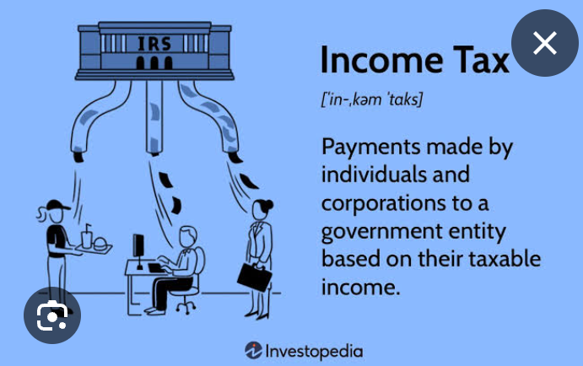
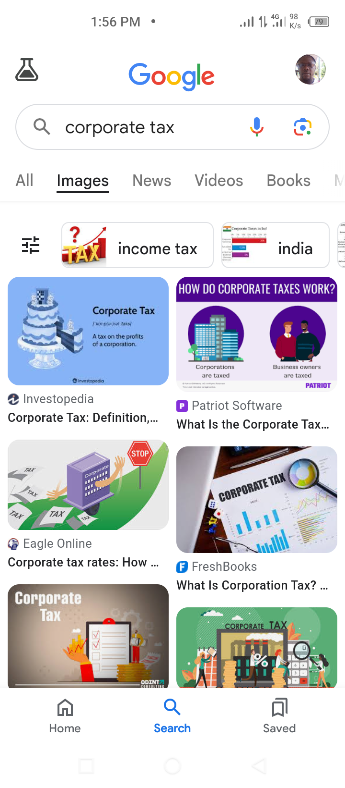
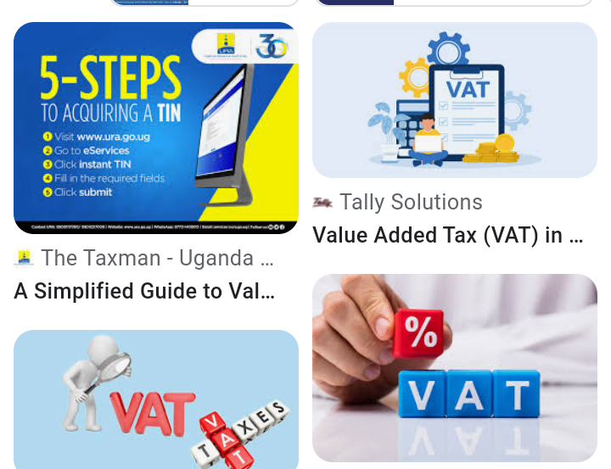
BASIC TAXES
INDIVIDUAL INCOME TAX
COOPERATE TAX
RENTAL INCOME TAX
VALUE ADDED TAX (VAT)

Slide 21
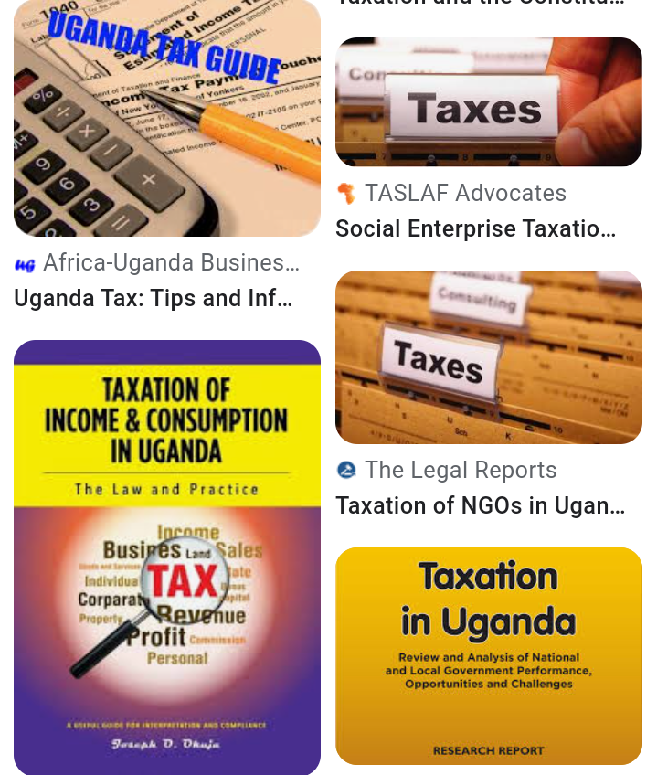
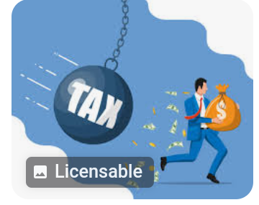
INDIVIDUAL INCOME TAX
This is a tax imposed on a person's chargeable income at specific rates. All people involved in business are required to pay income tax

Slide 22
Computation of individual income tax
The following people ware employees of DIGIDA SIMPLE EATS LIMITED in 2023 the employees were getting gross income and allowable expenses as follows
no | Names | Gross income (shs) | Allowable expenses (shs)
1 | WAAKO | 75,000,000 | 50,000,000
2 | ELIJAH | 5,000,000 | 500,000
3 | CAROL | 10,000,000 | 5,000,000
4 | REBECCA | 17,000,000 | 2,000,000
5 | ISAAC | 136,000,000 | 10,000,000

Slide 23
Determine their chargeable income and using the table bellow calculate their income tax
 | ANNUAL CHARGEABLE INCOME | TAX RATE (BRACKET)
1 | Not exceeding shs 2,820,000 | Nil
2 | Exceeding shs 2,820,000 but not Exceeding shs 4,020,000 | 10% of the amount by which chargeable income exceeds shs 2,820,000
3 | Exceeding shs 4,020,000 but not Exceeding shs 4,920,000 | Shs 120,000 plus 20% of the amount by which chargeable income exceeds shs 4,020,000
4 | Exceeding shs 4,920,000 | Shs 300,000 plus 30% of the amount by which chargeable income exceeds shs 4,920,000 When the chargeable income of an individual exceeds shs 120,000,000 an additional 10% chargeable on he amount by which chargeable income exceeds shs 120,000,000

Slide 24
Waako’s chargeable income
Chargeable income = GROSS INCOME – ALLOWABLE EXPENSES
Chargeable income = 75,000,000 – 50,000,000
Chargeable income = shs 25,000,000

Slide 25
Waako’s income tax payable income tax payable = chargeable income x individual tax rate
WAAKO falls in the 4 fourth category of exceeding shs 4,920,000 and the applicable rate is 30% of the amount by which chargeable income exceeds shs 4,920,000 plus shs 300,000
Tax payable = 300,000 + (25,000,000 – 4,920,000) x 30%
= 300,000 + 20,080,000 x 30%
= 300,000 + 6,024,000
Individual income tax payable = shs 6,324,000

