Slide 1
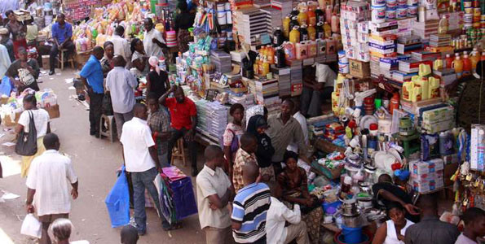
Business start up process

Slide 2
Sub-topics IN BUSINESS START UP PROCESS
STEPS IN STARTING A BUSINESS
SOURCES OF BUSINESS FINANCE
SAVINGS AND INVESTIMENT
LOCATION OF A BUSINESS v

Slide 3
Competen cy;
By the end of this chapter the learners should be able to understand the steps involved in starting up a business , save money and invest in a profitable venture

Slide 4
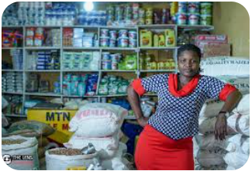
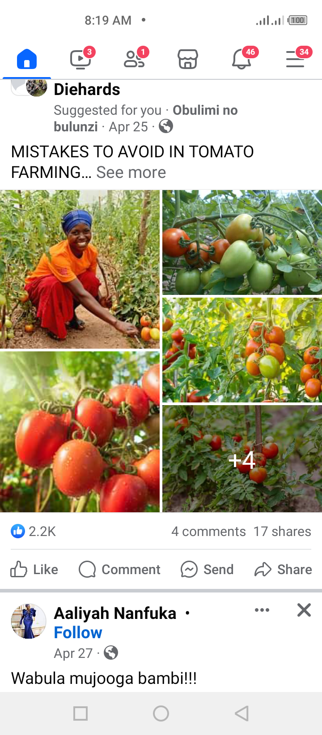
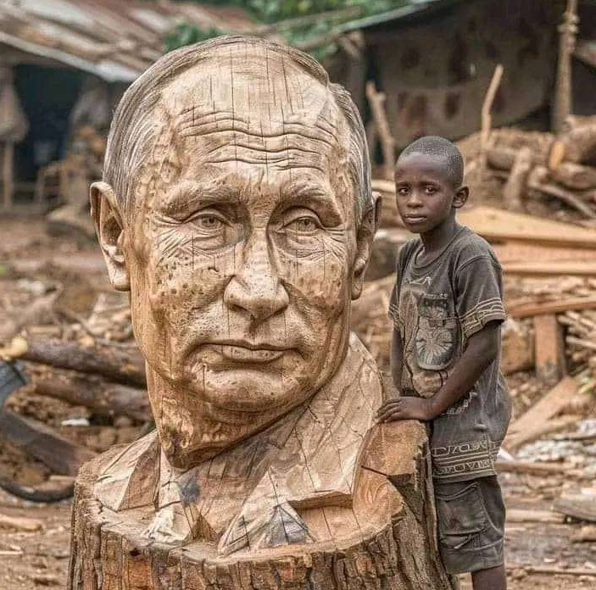
STEPS IN STARTING UP A BUSINESS

Slide 5
Learning outcomes the learners should be able to
Identify the factors that enable an individual to start up a business , including some basic principles of effective record keeping
Apply the correct steps in starting up a business which will eventually lead to developing a business plan
Prepare a budget , recognizing its values to business development

Slide 6
FACTORS THAT ENABLE AN INDIVIDUAL TO START UP A BUSINESS
Personal interest in the business
Technical skills for the business
Presence of government support in terms of tax incentives and subsidies
Presence of market for the products
Inspirational from successful business role models

Slide 7
Cont.
High degree of creativity and innovation of an individual
Presence of raw materials/ in puts to use in the business
Presence of well developed infrastructure e.g roads,
Security in the area
Availability of power/ electricity
Presence of labour

Slide 8
Steps in starting a business
Identifying potential business opportunity
Selecting a suitable business opportunity
Carrying out Market survey for the selected business opportunity
Preparing a business plan
Mobilizing the necessary resources

Slide 9
CONT.
Completing all the legal requirements before business starts
Selecting the location
Preparing a marketing plan
Launching the enterprise
Managing the business operations
QN. MENTION THE SOURCES OF BUSINESS FINANCE

Slide 10

TASK
IN GROUPS DISCUSS THE FACTORS THAT INFLUENCED KAKIRA SUGAR FACTORY TO BE LOCAED IN JINJA
GIVE REASSONS WHY MORE FACTORIES WERE ATTRACTED TO THAT AREA

Slide 11
SOURCES OF BUSINESS FINANCE LEARNING OUT COMES
THE LEARNERS SHOULD BE ABLE TO
IDENTIFY DIFFERENT SOURCES OF BUSINESS FINANCE
ASSESS THE BENEFISTS AND CHALLLENGES OF EACH SOURCE OF BUSINESS FINANCE

Slide 12

SOURCES OF BUSINESS FINANCE
1; PERSONAL SAVINGS | 2; DONATIONS | 3; INHERITANCE | 4; BORROWING
5; PROFITS | SOURCES OF BUSINESS FINANCE |  | 6;SHARES
7; BONDS | 8; SALE OF PROPETY | 9; PRIZES AND REWARDS | 10; FAMILY CONTRIBUTIONS

Slide 13

ACTIVITY / ASSINGNMENT
1. Visit the business community around your home and ask them as to how they raised the start up capital
2. Give the benefits of the sources mentioned above
3. What challenges are associated to the source of capital mentioned

Slide 14

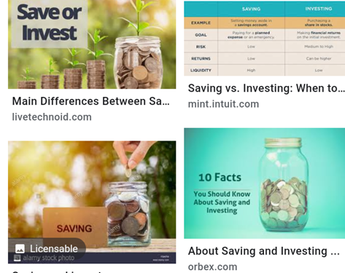
Savings and investment

Slide 15
LEARNING OUT COMES ; THE LEARNER SHOULD BE ABLE TO
Compare and contrast the factors that determine savings and investments
Identify the purpose for and form of savings
Understand how to prepare a savings plan, including how spread sheet , books and a calculator are used
Identify factors to consider before taking an investment

Slide 16
SAVING, IS THE RESERVING OF PART OF ONE’S INCOME FOR FUTURE USE
INVESTING
IS PUTTING ONE’S SAVINGS IN ANOTHER INCOME GENERATING ACTIVITY(STARTING UP A BUSINESS)
OR BUYING PRODUCTIVE RESOURCE LIKE LAND, COMMERCIAL VEHICLES

Slide 17
FACTORS THAT DETERMINE SAVINGS
AVAILABILITY OF FINANCIAL INSTITUTIONS
KNOWLEDGE OF THE SAVINGS CULTURE
CLEAR GOALS FOR SAVINGS
HIGH MOTIVATION FOR SAVING
AVIALABILITY OF EMPLOYMENT OPPORTUNITIES
HIGH LEVELS OF INFLATION HIGH LEVELS LOWER SAVINGS
GOVERNMENT POLICY ON SAVINGS (NSSF, PAYE)

Slide 18
Cont.
LEVEL OF CONSUMPTION , HIGH CONSUPTION LOW SAVINGS
LEVEL OF INCOME HIGH INCOME HIGH SAVING (leaving other factors constant)
CONFIDENCE ABOUT THE FUTURE CERTAINTY

Slide 19
Factors that limit savings
Low levels of income
Ignorance about the benefits of savings
Low desire to save
Unfavorable government policies
Political instability
Low levels of investment in the country

Slide 20
cont
High illiteracy levels
Limited banking facilities
High cost of living
Value of money in a country

Slide 21
FACTORS THAT DETERMINE INVESTIMENT
AVAILABILITY OF INVESTMENT OPPORTUNITIES
FAVOURABLE GORVENMENT POLICIES ON INVESTMENT
DETERMINATION TO WORK
SECURITY IN THE AREA /COUNTRY

Slide 22
CHARACTERISTICS OF PEOPLE WHO SAVE
They are careful in spending
They have high motivation in saving and investing
They tend to look at and take up each opportunity
They forego a lot of things
They lead a simple life
They are hard working
They are always of the look out for investment opportunities

Slide 23
Characteristics of people who consume most of their income
They are extravagant
They live a luxurious life
They have low desire to save
They have no investment plans for the future
They tend to be unstable whenever they earn income
They always have debts to pay

Slide 24
REASONS FOR MAKING SAVINGS AND INVESTMENTS INCLUDE
AS A PRECAUTION FOR THE FUTURE NEEDS
FOR TRANSACTIONS
SELF EMPLOYMENT
EXPLOITATION OF IDLE RESOURCES
EMPLOYMENT OF OTHERS
UTLIZATION OF RESOURCES
TO IMPROVE THE EQUITY OF THE AVAILABLE ITEMS
TO INCREASE INCOME

Slide 25
FORMS OF SAVINGS
BY OPENING UP A BANK ACCOUNT AND DEPOSIT YOUR SAVINGS THERE
BY BUYING PROPERTIES LIKE LAND,BUILDINGS
INVESTING IN BUSINESS
BUYING SHARES

Slide 26
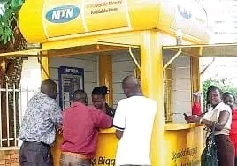
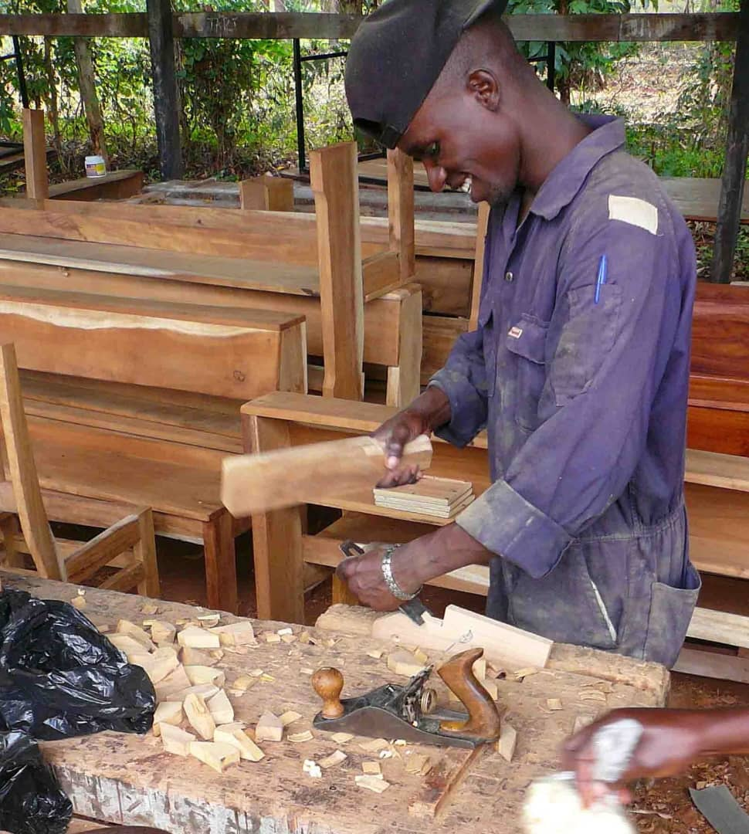
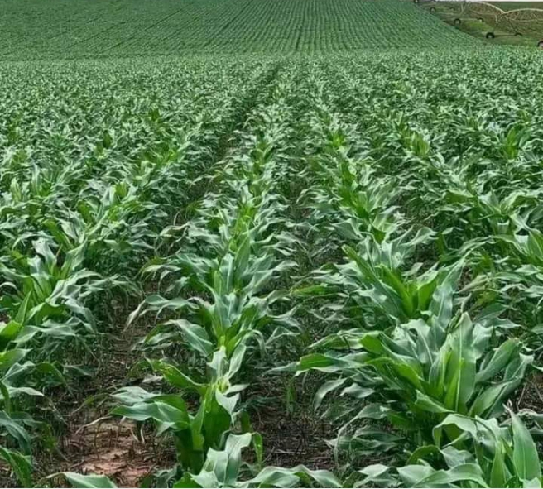
DIFFERENT INVESTIMENTS

Slide 27
SAVING PLAN; MAKING PLANS FOR SAVING
IDENTIFY A NEEDS
SET SAVING TARGETS
PRIORITIZE THE NEEDS
FIND OUT THE COST OF EAHCH NEED
FIND OUT THE TOTAL COST
CARRY OUT REVIEW OF PRIORITIZATION

Slide 28

LOCATION OF A BUSINESS;
THIS REFERS TO THE SETTING UP OF A BUSINESS IN APERTICULAR AREA

Slide 29
FACTORS INFLUENCING LOCATION OF A BUSINESS
MARKET
SOURCE OF RAW MATERIAS
ACCESSIBILITY TO TRANSPORT AND COMMUNICATION NET WORK
PRESENCE OF LAND
PRESENCE OF LABOUR
PRESENCE OF POWER / ELECTRICITY

Slide 30
PRESENCE OF ADEQUANTE POWER SUPPLY
PRESENCE OF WATER
SECURITY
PRESENCE OF OTHER SUPPORT SERVICES

Slide 31
TRY THIS , YOU WILL BE AN INVESToR
CHOOSE HOW THE SAVING OF INCOME CAN BE
MAKE THE SAVINGS
START INVESTING
QUN; AT HOME MAKE A SAVING PLAN ON HOW TO RAISE RESOURCES TO START UP A BUSINESS.
START SAME SAVINGS
DECIDE ON THE POSIBLE INVESTMENT FOR THE SAVINGS

Slide 32
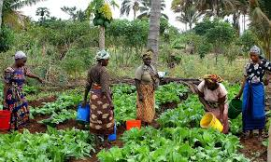
Savings invested in agribusiness

