Slide 1
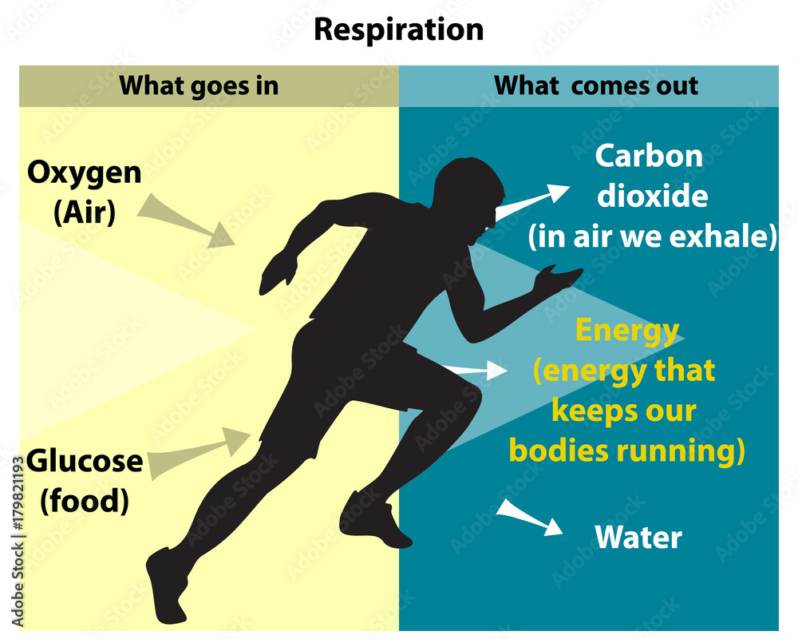
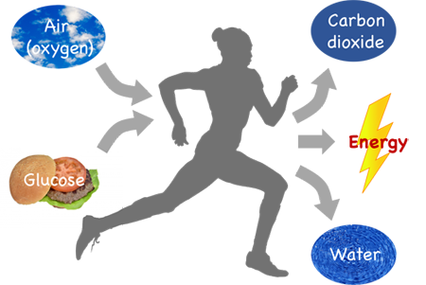
CELLULAR/TISSUE/INTERNAL RESPIRATION

Slide 2
Outline for reading
Importance of respiration
The process and site of aerobic respiration
The relationship between plants and animals in relation to aerobic respiration and photosynthesis
Circumstances in which organisms including humans use anaerobic respiration
Outline the process of anaerobic respiration
Carry out investigations to find the products of anaerobic respiration in plants and animals
Some applications of anaerobic respiration in everyday life
Compare aerobic with anaerobic respiration

Slide 3

Definition:
It is the chemical breakdown of complex organic food substances/respiratory substrates inside living cells to release energy.
Think about: How different is tissue respiration from:
Gaseous exchange?
Breathing?
Notes:
Gaseous exchange: Diffusion of respiratory gases across gas exchange surface.
Breathing: Active process of bringing respiratory medium (air) to the respiratory surface through muscular contractions and relaxations.

Slide 4
It is a process controlled by enzymes.
Energy released is temporarily stored in form of a chemical compound known as Adenosine Triphosphate (ATP).
Heat energy is also produced.
Respiratory substrates are organic substances which are broken down inside living cells to release energy.
Glucose is the main respiratory substrate.
Others respiratory substrates are lipids and proteins.

Slide 5
Types of respiration
Aerobic respiration: takes place in presence of oxygen
Anaerobic respiration: takes place in absence of oxygen

Slide 6
Importance of tissue respiration
It produces energy in cells used for;
Active uptake of mineral salts from the soil and active transport of substances across membranes.
Muscular contraction for movement and locomotion.
Cell division (formation of new cells) to cause growth.
Regulation of body temperature by production of heat.
Transmission of nerve impulses in response to stimuli.
Repair of worn out tissues.
Synthesis of proteins.
Synthesis of nucleic acids. (e.g. DNA & RNA), etc.

Slide 7
Respiration failure
Lung diseases (e.g. COPD), drowning, chocking, electric shock, damage to the tissues and ribs around the lungs etc. impair gas exchange.
Respiratory poisons (e.g. cyanide) prevent respiratory enzymes from working.

Slide 8
Effects of respiration failure
Shortness of breath
Fatigue
Rapid breathing
Increased heart rate
Headache
Unconsciousness/Fainting
Heart failure
Death at the extreme

Slide 9

How can you help a friend who has drowned in water and has failed to breathe?
Why should you ensure that most pesticides are kept out of rich of children?
After a hard physical activity, we feel hungry. Explain why?
Notes:
Mechanical ventilation using respirators and mouth-to-mouth resuscitation
Pesticides can be respiratory poisons.
We breath faster/heavily during and after exercise, supplying more oxygen to body cells therefore food is broken down faster to release energy, hence feeling hungry.

Slide 10
AEROBIC RESPIRATION
It is the chemical breakdown of glucose in the presence of oxygen to release energy
It takes place both in cytoplasm and mitochondria of the cell.
The organisms that respire aerobically are called aerobes
It takes place through a series of enzyme controlled reactions.

Slide 11
✓ During glycolysis, which occurs in the cytoplasm of the cell, cells break glucose down into pyruvate, a three-carbon compound. After glycolysis, pyruvate is broken down into a two-carbon molecule called acetyl-coA.
✓ After pyruvate is converted to acetyl-coA, cells use the Krebs cycle (which occurs in the matrix of the mitochondrion) to break down acetylcoA into carbon dioxide.
✓ During oxidative phosphorylation, which occurs in the inner membrane or cristae of the mitochondrion), cells transfer energy from the breakdown of food to

Slide 12
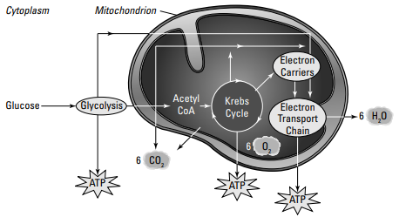

Slide 13
The process of aerobic respiration
It is a complex process summarized as below:
1. Glycolysis
Occurs in the cytoplasm.
No oxygen is required (anaerobic).
Glucose molecule broken down into 2, producing 2ATP molecules.
2. Kreb’s cycle
Occurs inside the mitochondrion.
Oxygen is required.
Produces 2ATP molecules.

Slide 14
3. Electron transfer chain
Occurs inside the mitochondrion (on inner surface membranes called cristae).
Requires oxygen.
Produces 34 ATP molecules.

Slide 15
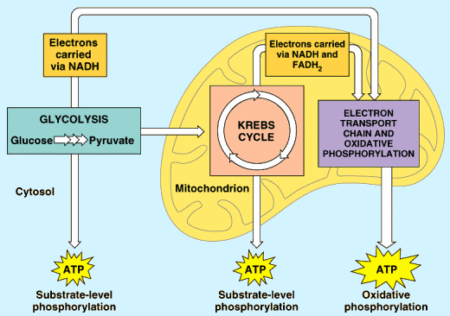

Slide 16
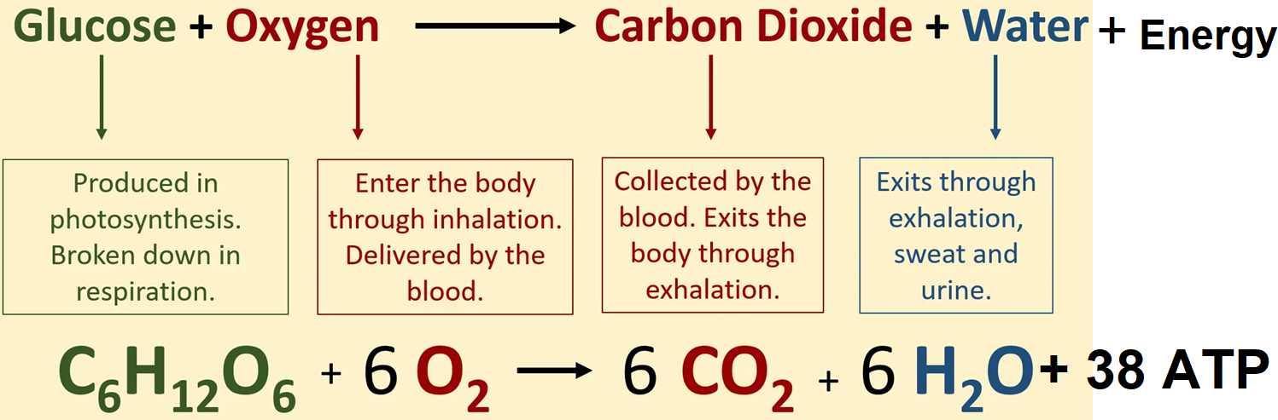
The aerobic respiration equation
It occurs in a series of steps, the overall equation is as below:

Slide 17
From the equation above:
Reactants: glucose and oxygen
Products: carbon dioxide, water and energy

Slide 18
Experiment to show that heat energy is produced during respiration
Materials and apparatus
2 thermometers.
2 vacuum flasks
Bean seeds.
Heat source
Sodium hypochlorite (or formaldehyde)

Slide 19
Procedure
Soak bean seeds in water for 24 hours after which divide the seeds into two equal portions.
Boil one portion for 10 minutes to kill the seeds.
Soak both the boiled and unboiled seeds in formaldehyde/sodium hypochlorite solution.
Place unboiled beans in vacuum flask A and the boiled beans in vacuum flask B.

Slide 20
Insert a thermometer in each flask and close the mouth of each flask with cotton wool.
Take note of the initial reading of the thermometer.
Leave the set up for at least three (3) days as you record the temperature readings at regular intervals of time.

Slide 21
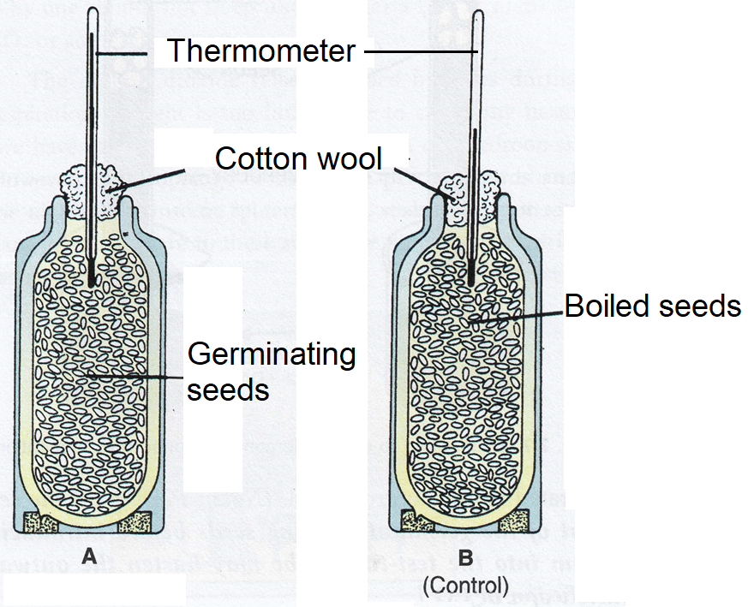
Set up of apparatus

Slide 22
Observation
There is an increase in thermometer reading in flask A but that in flask B temperature remains constant.
Conclusion
Germinating seeds produce heat during aerobic respiration

Slide 23

Analysis
1. Give reason a reason for the observation in each flask.
3. Why was the following used in the experiment?
Thermometer
Vacuum flasks
Formaldehyde
Cotton wool
4. Why is a control set up important?
Notes:
Measure temperature changes
Prevent heat loss/gain from the environment
Prevent decomposition of seeds due to bacterial/fungal activity.
Allow circulation of gases.
A control set is used for comparison and provide a basis for drawing conclusion.

Slide 24
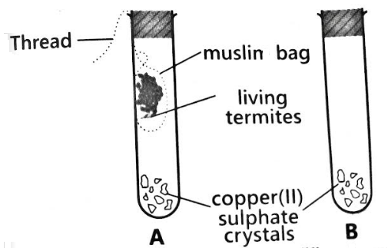
Activity: Study the set up below carefully

Slide 25
a. Fill the table below:
Set up | Observation
 | At the start | After 30 minutes
A
B
b. What conclusion can you draw from the experiment above?
c. What other reagent can be used instead of copper(II)sulphate crystals?

Slide 26
Investigating that food releases energy when oxidized. Q. Can oxidation of ground nut seeds release energy to boil water?
Materials required:
Test tube
Thermometer
Heat source
Water
Heat source
Ground nut seeds

Slide 27
Procedure
Add 4cm³ of water in a test tube and clamp it to a retort stand.
Record the initial temperature of the water (T₁)and mass of the nut (m).
Using a mounted needle, hold the nut over a Bunsen burner flame until it catches fire and keep away the Bunsen burner
Hold the burning nut under the test tube of water until it stops burning.
Record the maximum temperature reached by the water (T₂).

Slide 28
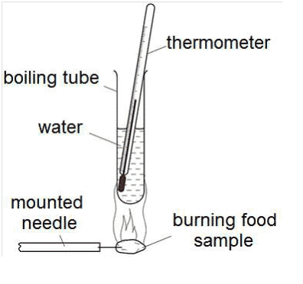

Slide 29
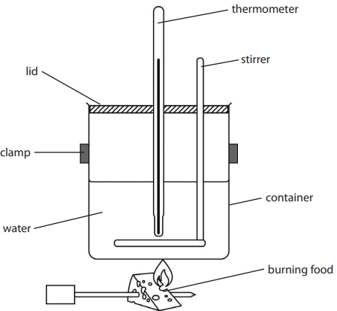

Slide 30
Data and observation
Mass of water in grams | Starting temperature of water/ºC | Final temperature of water/ºC
The energy content of the burnt food is calculated using the formula:
Energy in joules = Mass of water x Specific heat capacity of water x change in temperature.

Slide 31
Discussion:
Why was the Bunsen burner kept away from the test tube?
Where did the energy to
Start the burning of the nut come from?
Raise the temperature of water come from?
3. Did all the energy released from the nut reach the water? Explain.
4. How can this experiment be improved be more accurate?
Notes:
To ensure that the only heat reaching the test tube is from the burning seed.
a) from heat provided by the Bunsen burner
b) From food stored in the seed
3. No. Heat energy is lost to the air and some absorbed by the glass of the test tube
4. Carry out the experiment in a vacuum chamber
Using a very thin glass tube
Use dry seed/food that can easily burn

Slide 32
Relationship between photosynthesis and aerobic respiration
Photosynthesis only occurs in plants whereas aerobic respiration occurs in both plants and animals.
Photosynthesis and aerobic respiration complement each other (one provides what the other lacks).
Photosynthesis produces oxygen and glucose which are used in aerobic respiration whereas aerobic respiration produces carbon dioxide and water which are used in photosynthesis
During the day, plants carry out both photosynthesis and respiration. At night photosynthesis does not occur but respiration occurs.

Slide 33
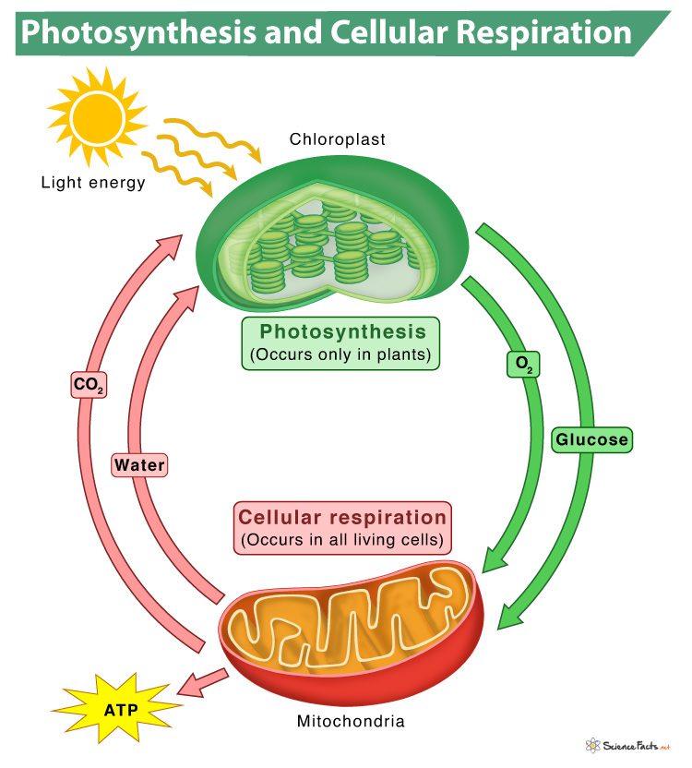

Slide 34
Photosynthesis and aerobic respiration form a cycle that keeps the level of oxygen and carbon dioxide fairly constant.

Slide 35
Similarities between photosynthesis and aerobic respiration
Both are controlled by enzymes.
Both involve conversion of energy from one form to another through a series of reactions.
Both require initial input of energy.
Both occur in living cells

Slide 36
Differences between photosynthesis and aerobic respiration
Aerobic respiration | Photosynthesis
Occurs in all organisms | Occurs only in photoautotrophs
Glucose and oxygen are reactants | Carbon dioxide and water are reactants
No sunlight required (Occurs all the time) | Requires sunlight (occurs during day time)
Oxygen is used | Oxygen is produced
Water is produced | Water is used
Food is broken down | Food is made
Energy is produced | Energy is used

Slide 37
Relationship between plants and animals
DEBATE
MOTION: PLANTS AND ANIMALS CAN LIVE AND SURVIVE ENITRELY INDEPENDENT OF EACH OTHER

Slide 38
Interdependency of plants and animals
Plants produce oxygen used by animals. Animals exhale carbon dioxide used by plants for photosynthesis.
Animals need plants for food and shelter.
Plants need animals for seed dispersal and pollination.
Some animals eat plants.
When animals die and decompose, the plants use the nutrients that were deposited back into the soil from the decomposing organism.
Forests and wetlands filter water so it is clean, and animals need clean water to drink.

Slide 39
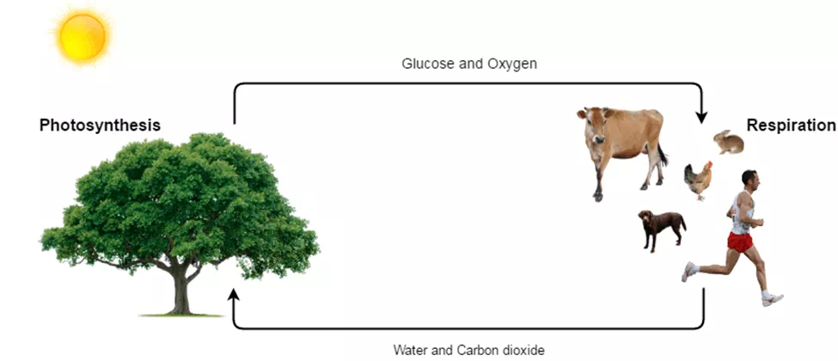

Slide 40
Why is it important to have plants around the homestead?
Why is it dangerous to have plants indoors?

Slide 41
ANAEROBIC RESPIRATION
This is the breakdown of glucose in the absence of oxygen to release energy.
It is also known as fermentation.
It occurs only in the cytoplasm of the cell.
Organisms that respire anaerobically are called anaerobes.
Anaerobic respiration occurs in plants, fungi, animals and some bacteria.

Slide 42
Types of anaerobes
Incomplete or facultative anaerobes; can respire both in the presence or absence of oxygen.
Complete or obligate anaerobes; can only survive in the absence of oxygen. Presence of oxygen become poisonous to them.

Slide 43
Conditions where organisms use anaerobic respiration
Both animals and plants respire anaerobically, when subjected to conditions of little or no oxygen supply.
In plants:
Roots growing in water logged soils since water-logged soils lack adequate oxygen.
In animals:
During intense muscular activity like sprinting, boxing, weight lifting, etc. as oxygen supply to the muscles is not enough to meet body demands.
Endoparasites such as tapeworms and roundworms live in areas such as gut which contain inadequate oxygen.

Slide 44
Process of anaerobic respiration
It occurs in cytoplasm of the cell.
It involves glycolysis which results in production of two ATP molecules, hydrogen atoms and pyruvate from one glucose molecule.
The pyruvate undergoes fermentation which can be alcoholic or lactic acid (lactate) fermentation

Slide 45
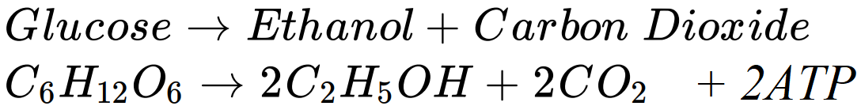
(a) Alcoholic fermentation
This occurs in yeast and plants.
Produces ethanol (alcohol), carbon dioxide and energy.

Slide 46

(b) Lactic Acid Fermentation
This occurs in animals.
It produces lactic acid (lactate) and energy only.

Slide 47
Lactic Acid:
Builds up in muscles and blood during vigorous exercise
When lactic acid accumulates in a muscle during intense exercise, it causes pain (cramps), fatigue, and stiffness. This results in the muscle not contracting efficiently. Therefore, lactic acid must be broken down as soon as possible after the exercise.
The heart, liver and kidneys need extra oxygen to eliminate it, which causes you to continue breathing heavily after exercise.
The extra oxygen is called the oxygen debt.

Slide 48
Latic acid is removed by:
continuation of deeper and faster breathing to supply oxygen for aerobic respiration of lactic in the liver
continuation of fast heart rate to transport lactic acid in the blood from the muscles to the liver

Slide 49
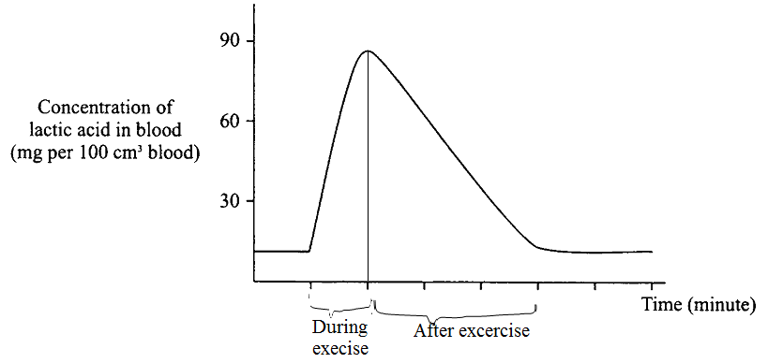
Graph showing change in lactic acid concentration during and after exercise

Slide 50

Explanation
Under normal activity/at rest, there is low concentration of lactic acid in blood.
Lactic acid concentration increases rapidly during exercise until the end, because of increased rate of anaerobic respiration caused by little oxygen supply to meet body demands. Therefore, glucose is partially broken down to release energy and lactic acid which accumulates leading to rapid increase in its level.
After the exercise, lactic acid concentration in the muscles reduces gradually, because lactic acid is being oxidized/broken down to CO2, H2O and more energy in the liver as more oxygen is taken in by breathing deeply.

Slide 51
Disadvantages of Anaerobic Respiration
Produces little energy per glucose molecule than aerobic respiration. Absence of oxygen leads to partial breakdown of food hence energy is locked up in the intermediate substances formed (ethanol or lactic acid).
Produces poisonous substances like lactic acid that can damage cells if allowed to accumulate.

Slide 52
Fermentation in yeast
Experiment to show that yeast cells produce carbon dioxide during anaerobic respiration
Materials
Yeast suspension, Glucose solution, Cooking oil/ paraffin, Lime water, Delivery tube, Test tubes, Pipette, Cork/rubber

Slide 53
Procedure
Boil some water to expel all the dissolved oxygen.
Allow the boiled water to cool while covered to prevent entry of oxygen.
Use the boiled water to make a solution of glucose and a suspension of yeast.
Put the glucose solution and yeast suspension in a test tube label it A
Add a layer of paraffin to prevent entry of oxygen from atmosphere to the mixture.
Fit a glass delivery tube to connect test tube A to another test tube containing lime water.

Slide 54
Set up another experimental set up (control) using boiled/ killed yeast and label the set up B
Leave the set up for 3o minutes and observe the lime water.

Slide 55
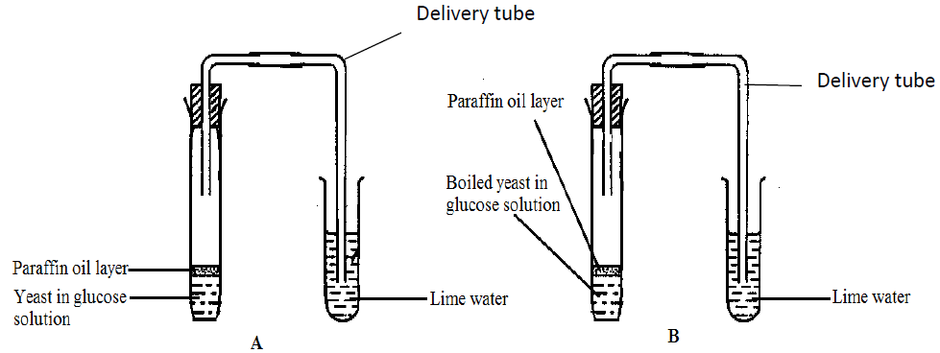
Set up

Slide 56
Observation
Bubbles seen in set up A.
No bubbles in B.
The lime water in set up A turns milky while that in set up B remains colourless.
Conclusion
Carbon dioxide is produced during anaerobic respiration by yeast.

Slide 57
Discussion Questions
a. Why is the test tube in set up A be warmed?
b. Explain your observations above.

Slide 58
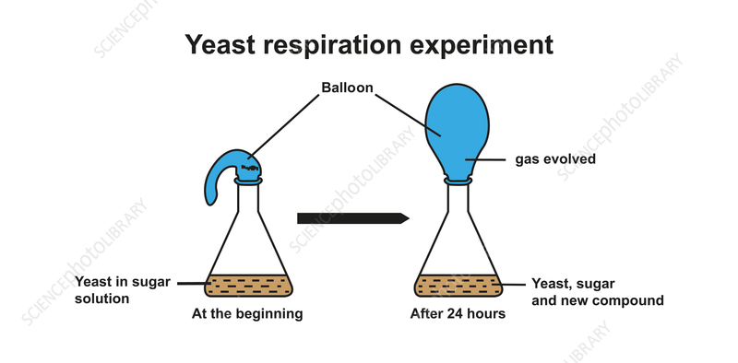
Study the set up below

Slide 59
Task:
1. Identify the:
Gas evolved
New compound
2. Basing on the results, explain the role of yeast in
Baking
Brewing

Slide 60
Experiment to demonstrate anaerobic respiration in germinating seeds
Materials and apparatus
Pyrogallic acid or Potassium pyrogallate
Test tube
Formalin or sodium hypochlorite
Soaked bean seeds
Boiling tube
Water
Lime water
Heat source
Two beakers
Thermometer
Thread

Slide 61
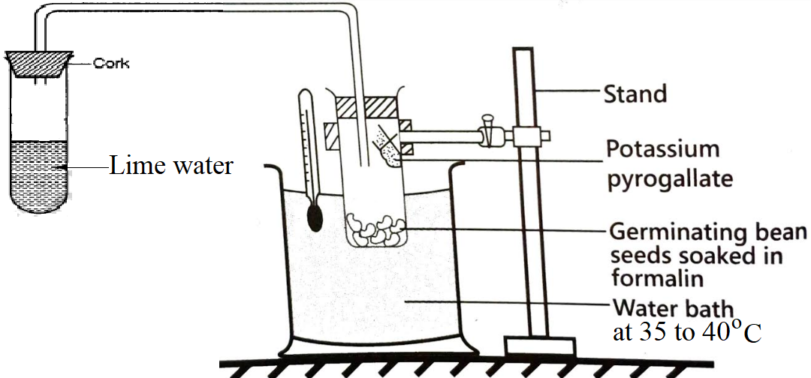
Set up

Slide 62
Set up a control experiment using boiled seeds washed in formalin.
Data and observations
Qn. What conclusion can you make from the experiment above?
Apparatus | Content of boiling tube | Content of test tube
Control set up
Test experiment set up

Slide 63
Analysis
1.Why are seeds soaked in formalin at the start of the experiment?
2.Which seeds germinated and which ones did not? Why?
3.Why was potassium pyrogallate used in setup?
4. State the importance of the water bath in the experiment?
5. Why do some seeds germinate in water logged soils?
6. How was accuracy of results ensured in the experiment?

Slide 64
ACTIVITY
The below shows the number of the times a boy could raise a 300g weight with his index finger during three successive one-minute tests with no rest periods in between.
a) How does the number of times the weight was raised vary with tests?
b) Suggest an explanation for the results obtained.
c)If the boy was to conduct a fourth test, how do you think the values would be like? Why?
 | First test | Second test | Third test
Number of times raised | 98 | 82 | 71

Slide 65
d)How does conducting strenuous exercise for a longer period of time affect your body?

Slide 66
Applications of Anaerobic Respiration in Everyday Life
Commercial brewing to produce alcohol by fermentation.
Baking of bread as production of CO₂ by yeast cells, expand the dough.
Production of biogas (mixture of methane gas and carbon dioxide used as fuel)
Sewage treatment.
Production of dairy products eg yoghurt, cheese, ghee, butter and sour milk
Manufacture medicine e.g. penicillin.
Manufacture of some organic acids.
Production of silage (fermented green forage stored in airtight silos)

Slide 67
Comparison of Aerobic and Anaerobic respiration
Aerobic respiration | Anaerobic respiration
It occurs in presence of oxygen | It occurs in absence of oxygen
It occurs in the mitochondria | It occurs in cytoplasm
One molecule of glucose produces 38ATP molecules (more energy) | One molecule of glucose produces 2ATP molecules (less energy)
Its products are water, carbon dioxide, and ATP (energy) | Its products are carbon dioxide and ethanol in plants and yeast or lactic acid in animals
It involves glycolysis, Krebs cycle and oxidative phosphorylation | It involves glycolysis and fermentation
There is complete oxidation of glucose | There is incomplete oxidation of glucose

Slide 68
Similarities
Both occur in living cells
Both release energy
Both use glucose as respiratory substrate.
Both involve enzymes
Both produce carbon dioxide

Slide 69
