Slide 1
GASEOUS EXCHANGE

Slide 2
Explain why multicellular organisms need specialized systems for gaseous exchange.
Identify adaptations of gas exchange surfaces/respiratory surfaces.
Draw and label the structure of the human respiratory system.
Explain the mechanism of gaseous exchange in humans.
Conduct experiments to analyze inhaled and exhaled air
Explain the variation in the percentage composition of gases in inhaled and exhaled air
Design an experiment to demonstrate that the tar in cigarette smoke is so damaging to the gas exchange surfaces in the lungs.

Slide 3
The dangers of smoking and air pollution to gas exchange surfaces in the lungs
causes, symptoms and treatment of diseases (bronchitis, emphysema, lung cancer, throat cancer, and chronic cough) associated with respiratory organs in humans

Slide 4
Definition
This is the process by which respiratory gases (oxygen and carbon dioxide) move between the external medium (environment) and body cells across a respiratory surface membrane.
Or:
It is the process by which respiratory gases, oxygen and carbon dioxide, diffuse to and from body cells across the respiratory surface.

Slide 5
Gaseous exchange occurs by the process of diffusion across the respiratory surface.
This is because there is a steep concentration gradient of the respiratory gases between the body cells and the respiratory medium.
A respiratory surface/ gaseous exchange surface is the site/part of the body where gaseous exchange takes place.
A respiratory medium is the environment/surrounding from which oxygen is obtained and carbon dioxide released during gaseous exchange.
The respiratory media are air and water.

Slide 6
Activity: Complete the table below
Organism | Respiratory medium | Respiratory organ | Respiratory surface
Amoeba
Earth worm
Insect
Fish
Tadpole
Amphibians
Plants
Mammals, reptiles and birds

Slide 7
Type of organism | Respiratory medium | Respiratory organ | Respiratory surface
Amoeba | Water | none | Cell membrane
Insects | Air | Tracheal system | Tracheoles
Earth worm | Air/water | skin | Skin surface
Fish | Water | Gill | Gill filaments
Amphibians (frog and toad) | Air and water | Skin | Moist skin surface
 |  | Lungs | Alveoli
 |  | Mouth/buccal cavity | Lining of mouth cavity
Tadpole | Water | External gills | Gill filaments
Mammals | Air | Lungs | Alveoli
Birds | Air | Lungs | Alveoli
Plants | Air | Leaves, stems and roots | Cell membranes of Spongy cell, cortex cell and root hair cells

Slide 8
Importance/necessity for gaseous exchange
Provision of cells with oxygen for respiration
Removal of carbon dioxide from body cells to prevent accumulation to toxic levels.
Provision of plants with carbon dioxide for photosynthesis.

Slide 9
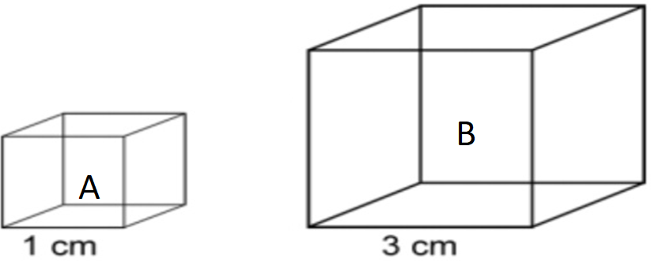
Surface area to volume ratio and gaseous exchange
Q. How does surface area to volume ratio affect gaseous exchange/diffusion?
Activity: Use the cubes below to fill the table that follows

Slide 10
 | Cube A | Cube B
Surface area
Volume
SA:V
1. Assuming the cubes were organisms, with reasons,
Which one would represent a
unicellular organism?
multicellular organism?
b) In which cube would oxygen diffuse
Fastest?
Slowest?
Notes:
A: unicellular and oxygen diffuses fastest because it has a large SAVR.
B: multicellular and oxygen diffuses slowest because it has small SAVR.

Slide 11
c) Which one would
Require a specialized gaseous exchange system?
Not require a specialized gaseous exchange system?
Give reasons for your answers in (i) and (ii)

Slide 12
Why multicellular organisms need specialized systems for gaseous exchange
Multicellular organisms are large and have small surface area to volume ratio; therefore the distance travelled by respiratory gases is too long; such that diffusion is slow and less efficient supply and remove respiratory gases to and from their body cells respectively.
This challenge is solved by having a specialized gaseous exchange system.

Slide 13
Characteristics/qualities of a good respiratory surface
Highly folded to increase the surface area for diffusion of respiratory gases.
Well vascularized/supplied with blood capillaries to transport gases rapidly and to create a high/steep diffusion gradient.
Thin surface membrane to reduce distance for diffusion of gases.
Moist to dissolve the respiratory gases so that diffusion occurs in solution.
Well ventilated to maintain high concentration gradient that favors diffusion of gases.
Permeable to allow diffusion of respiratory gases.

Slide 14
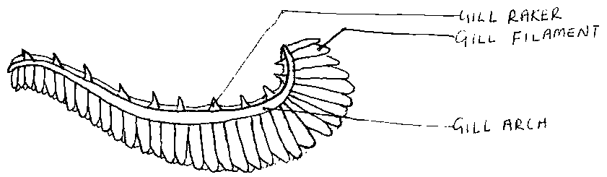
Q. Describe the features that enable the fish gill to carry out gaseous exchange?

Slide 15
Adaptations of gills for gaseous exchange
Have numerous gill filaments; increasing surface area for gaseous exchange.
Gill filaments have thin walls; to reduce distance for diffusion of gases.
Gill filaments are densely supplied with blood capillaries; for quick transportation of respiratory gases.
Gill filaments are sub-divided into gill lamellae; to increase their surface area for gaseous exchange.
Gill bar is rigid/strong; to support gill filaments.
Has gill rakers for removing solid particles in water.
Has gill slits; to ease ventilation.

Slide 16
Flow of blood in the gill filaments is opposite in direction to flow of water over them (counter current flow) to maintain high concentration gradient for diffusion.

Slide 17
Gaseous exchange in human being
Respiratory organ: lungs
Respiratory surface: alveoli
Respiratory medium: air

Slide 18
Human respiratory system
Task:
Draw and label the structure of the human respiratory system.

Slide 19
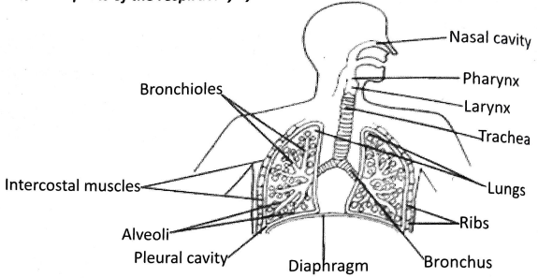

Slide 20
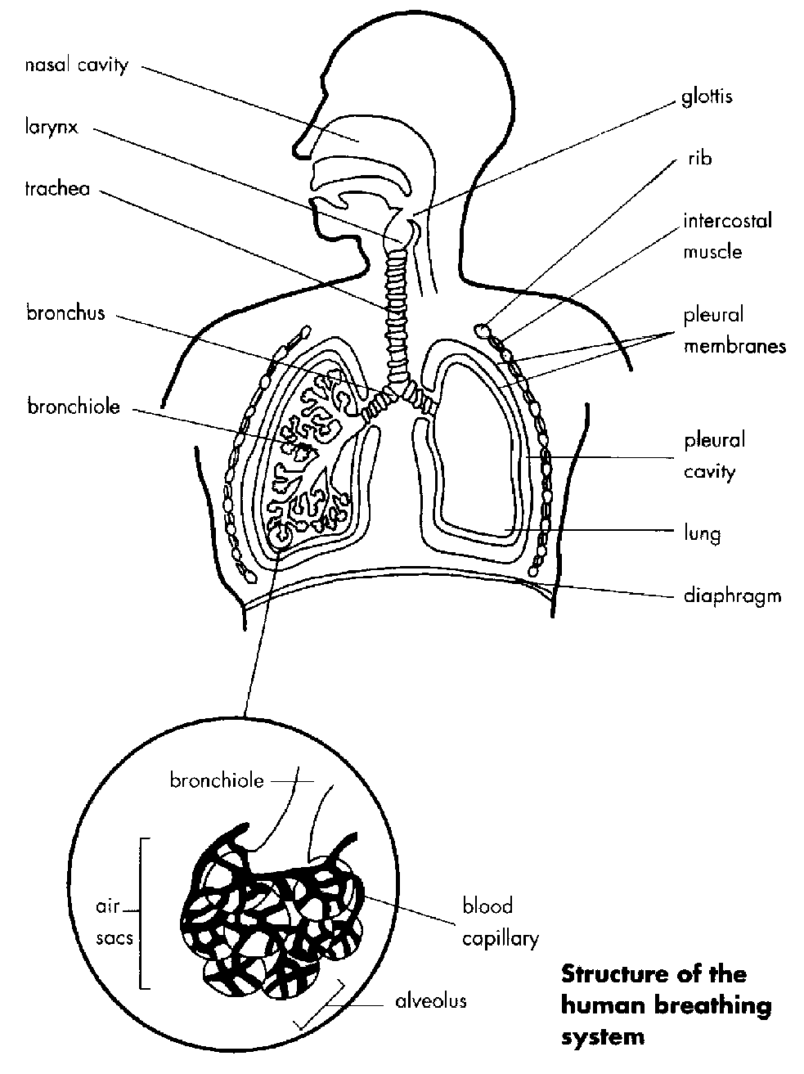
A drawing of the human respiratory system.

Slide 21
Functions of parts
Nostrils: passage of air from atmosphere. Has cilia and mucus to trap dust.
Larynx: production of sound and passage of air into the trachea.
Epiglottis: covers the larynx during swallowing, preventing passage of food into the trachea.
Trachea: allows passage of air into the bronchi. Has cilia and mucus to trap foreign particles.
Bronchi: passage of air from trachea into the lungs.
Bronchioles: passage of air into the alveoli.

Slide 22
Alveoli: Gaseous exchange surfaces.
Lung: organ for gaseous exchange
Diaphragm: controls volume of chest cavity.
Intercostal muscles: move the rib cage up and down by contracting and relaxing.
Pleural membrane: contains pleural fluid in its cavity.
Pleural cavity: filled with pleural fluid which reduce friction during breathing.

Slide 23
Adaptations of the lungs for gaseous exchange/as respiratory organs
They are spongy and elastic to allow large volume of air in and out.
Have numerous alveoli that increase surface are for gaseous exchange.
Each alveolus has a dense network of blood capillaries for quick transportation of oxygen to maintain a steep diffusion gradient.
The alveoli have moist surfaces which enables gases to dissolve into solution for easy diffusion.
The air passage is maintained open by the rings of cartilage which prevents it closing up when pressure inside them falls allowing continuous flow of air.
They are covered by pleural membranes which produce pleural fluid which lubricates the lungs to reduce friction during ventilation.

Slide 24
Mechanism of breathing/ventilation in human being
Inspiration/breathing in | Expiration/breathing out
External intercostal muscles contract | External intercostal muscles relax
Internal intercostal muscles relax | Internal intercostal muscles contract
Rib cage moves up and outwards | Rib cage moves down and inwards
Diaphragm muscles contract and diaphragm flatten | Diaphragm muscles relax and diaphragm assume dome shape/arches upwards

Slide 25
Volume of thoracic cavity increases | Volume of thoracic cavity decreases
Lungs expands and volume increases | Lungs return to original volume
Air pressure in lungs decreases | Air pressure in lungs increases
Air moves into the lungs through the nostrils, trachea, bronchi, and bronchioles until it reaches the alveoli. | Air moves out of the lungs from the alveoli via bronchioles, bronchi, trachea and the nostrils to the atmosphere.

Slide 26
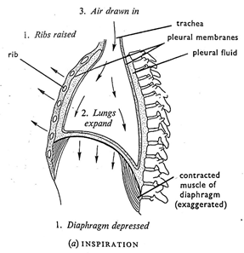

Slide 27
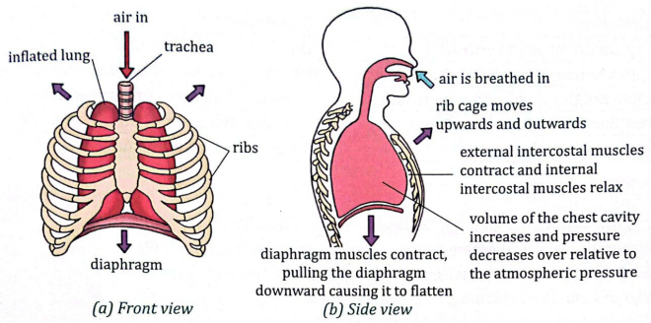

Slide 28
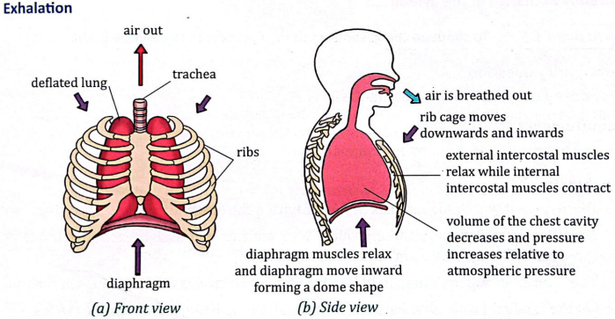

Slide 29
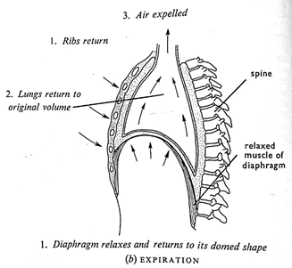

Slide 30
Demonstrating breathing mechanism in man using a model
Materials:
Bell jar/cut plastic bottle with a rubber stopper, two balloons, a glass Y-tube, a sheet of rubber, rubber bands or strings
Procedure:
Tie two balloons to the Y-tube then insert them in the bell jar using a cork.
Tie a rubber sheet which has been tied with a small thread in the center at the wide edge of the bell jar.
To demonstrate inspiration, pull the rubber sheet downwards using the thread.
To demonstrate expiration, release the thread.

Slide 31
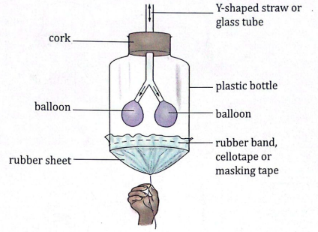

Slide 32
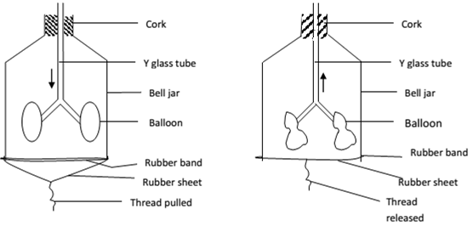

Slide 33
Observations
Balloons inflate and enlarge on pulling down the rubber sheet.
Balloons deflate on releasing the thread /pushing the rubber sheet upwards.

Slide 34
Explanation
Pulling the rubber sheet downwards | Releasing/Pushing the rubber sheet upwards
Volume of space in the bell jar increases. Pressure inside the bell jar decreases below atmospheric pressure. Air enters into the balloons through the Y-tubes; Balloons get inflated | Volume of space in the bell jar decreases. Pressure inside the bell jar increases above atmospheric pressure. Air leaves the balloons to the atmosphere through the Y-tubes; Balloons get deflated

Slide 35
Relating the model parts to human respiratory system
The Y- tube represents the trachea and bronchi.
Balloons represent lungs.
The rubber sheet represents the diaphragm.
The bell jar represents the ribcage and the space between it represents thoracic cavity

Slide 36
Q. Why doesn’t the model above accurately represent the human respiratory system?

Slide 37
Intercostal muscles are not represented.
Alveoli are not represented.
The wall of the bell jar is rigid while the thoracic wall/ribs are movable.
The rubber sheet is not dome shaped at rest like the diaphragm.
Lungs fill almost fill the chest cavity, unlike the balloons.
Glass tube (Y-tube) lacks rings of cartilage.

Slide 38
Gaseous exchange at the alveolus
In the alveoli, gaseous exchange takes place by diffusion. The lining of the alveoli is covered with a film of moisture.
Air taken into the alveolus during inspiration has high oxygen concentration and low carbon dioxide concentration whereas blood reaching alveolus has low concentration of oxygen and high carbon dioxide concentration.
Oxygen in the inspired air in alveolar cavity dissolves in the layer of moisture lining the inner surface of the alveolus and diffuses across the alveolar epithelium, into the red blood cells in the blood capillaries, and is transported to tissue cell as oxyhaemoglobin.

Slide 39
CO2 produced by respiring tissues diffuse from tissue cells across the walls of the capillaries into the blood plasma and is transported to the lungs. On reaching the lungs, CO2 diffuses across the capillary wall and epithelium wall of the alveoli into the alveolar space and exhaled/expired/breathed out.

Slide 40
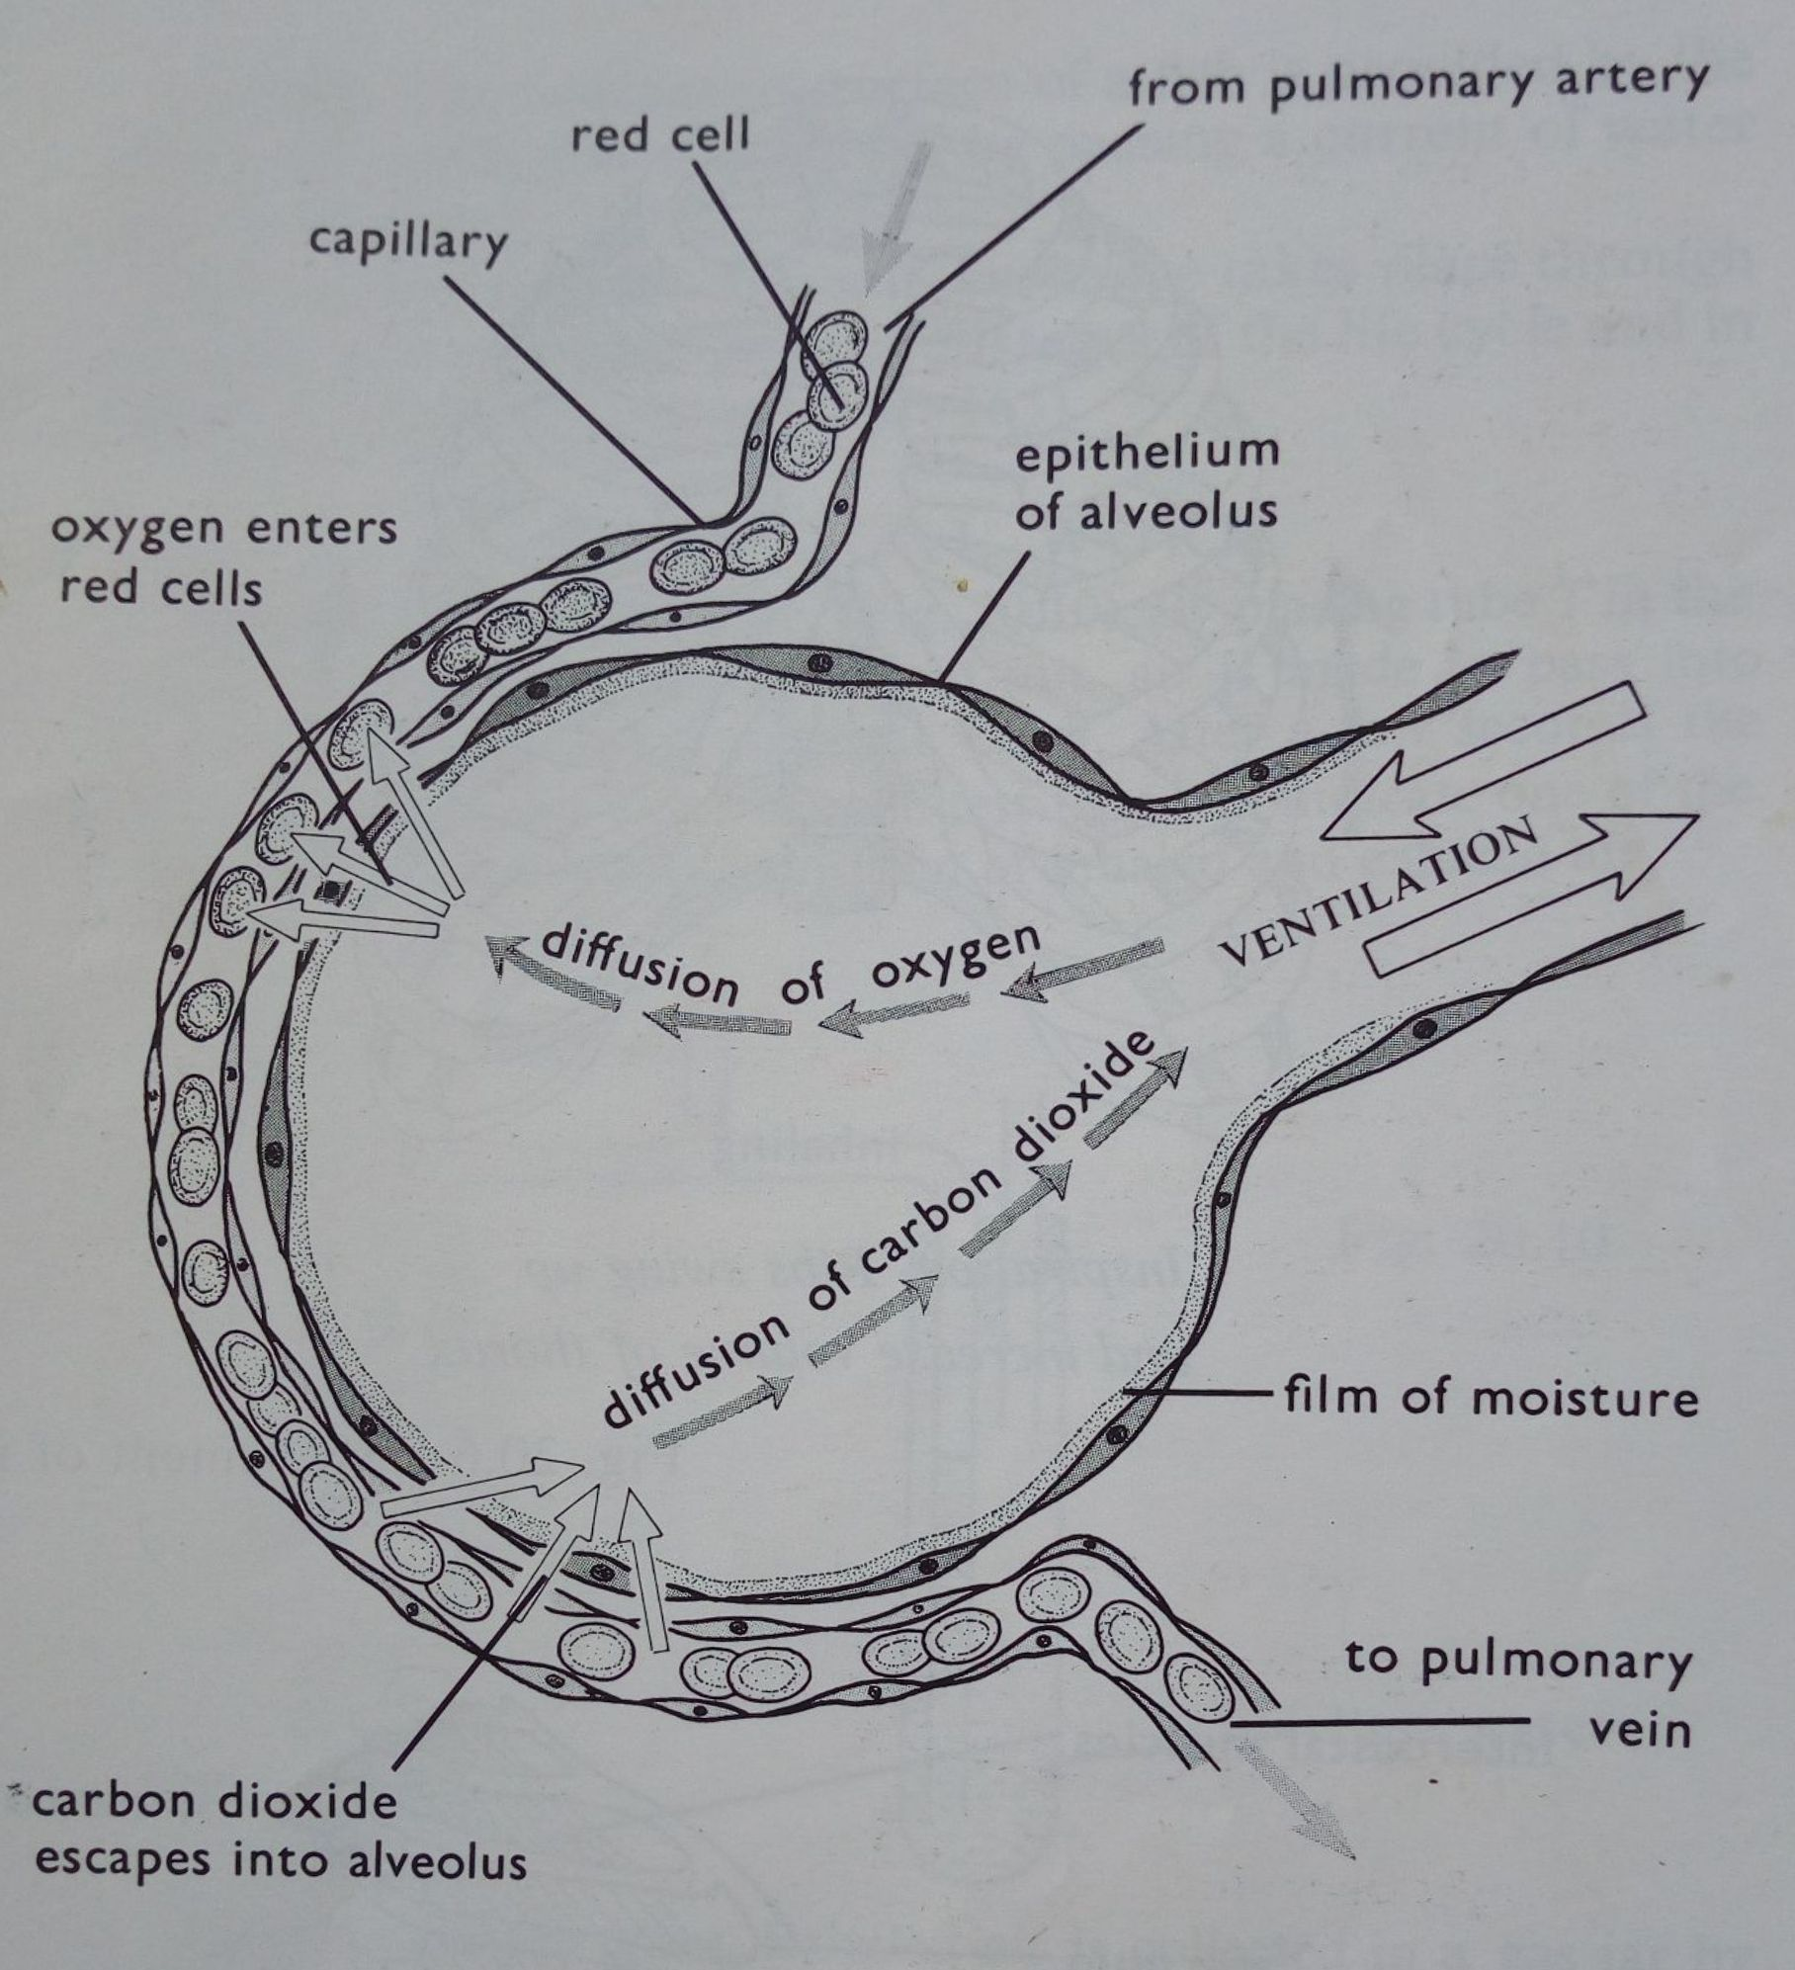

Slide 41
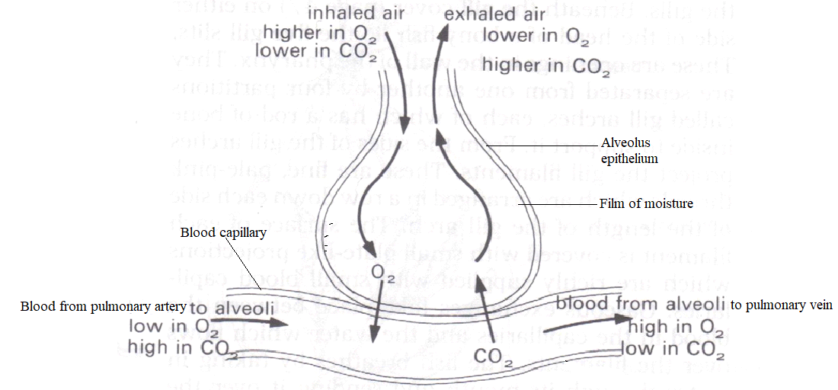

Slide 42
Adaptations of the alveoli for gaseous exchange
They are numerous to provide large surface area for gaseous exchange.
Have rich blood supply/dense network of blood capillaries; to quickly transport oxygen and carbon dioxide to maintain high diffusion gradient.
Have moist surfaces; to dissolve gases for easy transportation in solution.
Have thin membrane/epithelium; that provide shorter distance for diffusion of gases.

Slide 43
Discussion
Distinguish between breathing and gaseous exchange
The walls of the alveolus is moist and can expand and contract. Explain what would happen if the alveoli walls lost their elasticity and moisture.
Explain what would happen if a person sustains an injury that renders the epiglottis functionless.
How do the following affect breathing rate in man
Exercise
Altitude
Weight
Environment temperature
Notes:
Breathing is an active process of moving air/water to and from the respiratory surface whereas gaseous exchange is a passive process involving the passage of respiratory gases across respiratory surfaces/gaseous exchange surfaces.

Slide 44
Composition of inspired and expired air
1. Oxygen
Comparing amount of oxygen in exhaled and inhaled air
Requirements
Stop watch, 2 transparent beakers/gas jars, match box, 1 straw
Procedure
Allow an empty beaker to stand in the open for 2 minutes and cover it with a glass plate. Use the air in the beaker as a sample of inhaled air.
Light a candle and place it in the beaker of inhaled air.
Record the length of time the candle burns in the inhaled air.

Slide 45
Using a straw, blow air into the second beaker continuously for about two minutes, and immediately cover it with a glass plate.
Light a candle and place it in the beaker of exhaled air.
Record the length of time the candle burns in the exhaled air.

Slide 46
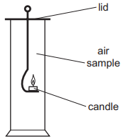

Slide 47
Results
Conclusion
Exhaled air contains ______________ oxygen than inhaled air
Discussion
Which candle stays lit for a longer period? why?
Why did both candles continue brining for some time inside both jars?
How can the results in the experiment be improved?
Air | Time the candle stays lit
Exhaled air
Atmospheric/inhaled air
Notes:
a) One enclosed in atmospheric air. b) Each jar contains some O2 which supports burning until it is used up. C) using straws to blow air into the jars, collecting exhaled air under water to avoid contamination.

Slide 48
2. Water vapour
Finding out whether exhaled air contains water vapour
Requirements
2 mirrors/glasses, tissue paper, anhydrous copper(II)sulphate/anhydrous cobalt chloride paper, cold tap water.
Procedure
Place the mirrors/glasses under cold tap water and wipe the surfaces dry using tissue paper.
Hold one mirror/glass about 3cm form your mouth and gently breath out for two minutes.
Place anhydrous copper (II) sulphate on the mirror surface.

Slide 49
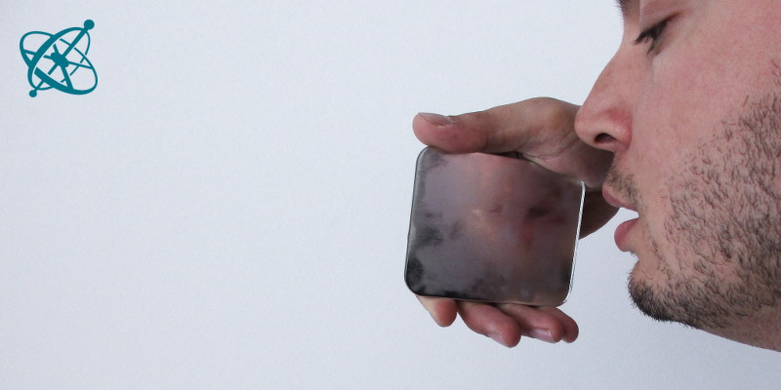

Slide 50
Observation
The mirror becomes misty/foggy and image become blurred
White anhydrous copper (II) sulphate becomes blue.
Conclusion
Exhaled air contains high moisture content.
Qn. What causes the changes observed?
Additional activity
Hold the second mirror/glass about 3cm form your mouth and gently breath in.
Qns.
State what is observed.
State the difference in the first mirror and second mirror. Give a reason.
Notes:
blue cobalt chloride paper turns to pink

Slide 51
3. Carbon dioxide
Comparing amount of oxygen in exhaled and inhaled air
Requirements: 2 transparent plastic bags, 2 threads, lime water or bicarbonate indicator.
Procedure
Pour 50cm³ of lime water into one plastic bag.
Fill the plastic bag with atmospheric air and tie the mouth of the plastic bag tightly using a piece of thread.
Shake it well and observe the changes in the lime water.
Pour 50cm³ of lime water into the second plastic bag.
Blow the plastic bag with your exhaled air and tie the mouth of the plastic bag tightly using a piece of thread.
Shake it well and observe the changes in the lime water.
Notes:
Bicarbonate indicator turns from pink to yellow

Slide 52
Observation
Conclusion
Atmospheric/inhaled air has ______________________ carbon dioxide than exhaled air.
Qns:
Why was lime water added to the plastic bags?
Why is it unhealthy to hold your breath for a long time?
Plastic bag | Initial appearance | Final appearance
Filled with atmospheric air | Colorless
Filled with exhaled air | Colorless

Slide 53
4. Nitrogen
It is the most abundant gaseous component of air
It is inert and not used in cellular respiration.
Its composition may vary in exhaled and inhaled air due to changes in amounts of other gaseous components of air. E.g., it may be higher in exhaled air than in inhaled air due to reduction in amount so oxygen in exhaled air.

Slide 54
Comparison of percentage composition by volume of inhaled and exhaled air
Component | Inhaled air (%) | Exhaled air (%)
Carbon dioxide | 0.03 | 4
Oxygen | 21 | 16
Nitrogen | 79 | 79
Water vapour | Variable | Saturated

Slide 55
Explanations
Observation | Explanation
Percentage of carbon dioxide in inhaled air is lower than in exhaled air | Tissue respiration in cells produce carbon dioxide which diffuse into the alveolar air and is exhaled.
Percentage of oxygen in the inhaled air is higher than in exhaled air | Oxygen is produced by plants during photosynthesis into the atmosphere which is inhaled. Some of the inhaled O2 diffuses into blood capillaries for use in respiration making exhaled air to have less O2 than inspired air.

Slide 56
Percentage of water vapour in expired air is normally higher than that of inspired air. However, the amount of water vapour in inhaled air is variable | The amount of water vapour is more in expired air because water is formed during tissue respiration and some of which diffuses into alveolar air which is expired. The amount of water vapour in inhaled air is variable because it depends on the humidity of the atmosphere
Percentage of nitrogen in inspired/inhaled air is the same as in exhaled air | Nitrogen is neither used nor produced by cells because it’s an inert gas.

Slide 57
Does inhaled and exhaled air differ in temperature?
Yes/no? Why?

Slide 58
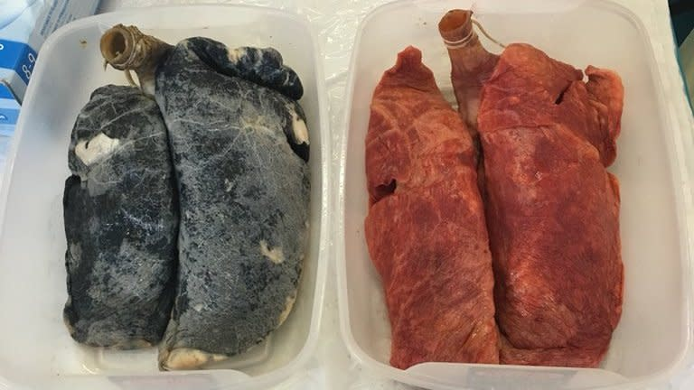
Dangers of Smoking and Air Pollution on Gas Exchange Surfaces in the Lungs
Cigarette smoking

Slide 59
Cigarette smoke contains many dangerous substances including nicotine, tar and carbon monoxide
Nicotine
It is a highly addictive chemical found in tobacco products.
It is rapidly absorbed into the blood stream and quickly reaches the brain, leading to a feeling of pleasure, satisfaction and reward, hence creating a dependency.
Leads to increased heart rate and reduction in diameter of arterioles.
Increases risk of heart diseases.

Slide 60
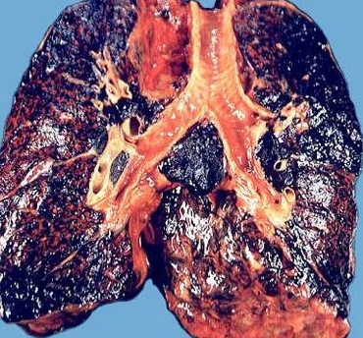
(ii) Tar

Slide 61
It is a thick sticky substance produced when tobacco is burned.
It causes cancer (carcinogenic)
Destroys cilia that move mucus and foreign particles out of the lungs.
Irritate the lungs leading to increased mucus production in the air pathways, blocking it.
Coats inner surface the alveoli reducing permeability to respiratory gases.
Reduces lung elasticity causing alveoli to burst, reducing surface area for gas exchange.

Slide 62
(iii) Carbon monoxide
Combines irreversibly/permanently with hemoglobin in inside red blood cells, making hemoglobin (red blood cells) unable to carry oxygen.
The inability of blood to carry away oxygen from the respiratory surface also reduces oxygen concentration gradient leading to reduced diffusion of oxygen into blood.
Therefore body cells do not receive oxygen required for respiration.
It is also linked to heart diseases.

Slide 63
Demonstrating the effect of cigarette smoke on the respiratory system
Materials and apparatus
Cigarettes
white cotton wool,
universal indicator solution/ blue litmus indicator/ hydrogen carbonate indicator
U-Shaped tube, filter pump
test tube, rubber stopper, retort stand and clamp, rubber connecters, thermometer.

Slide 64
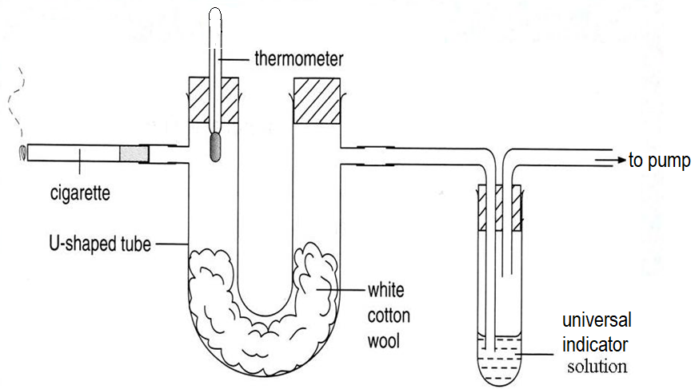
Set up of apparatus

Slide 65
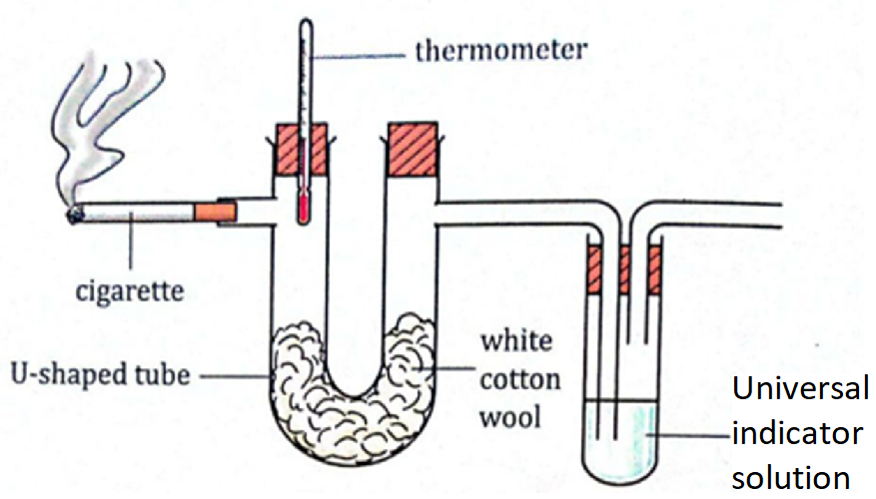

Slide 66
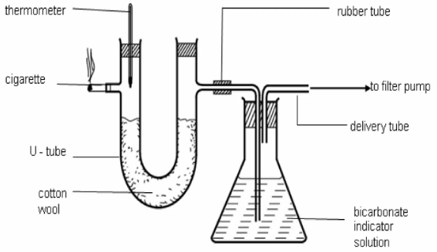

Slide 67
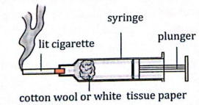

Slide 68
Procedure
Set up apparatus as shown in the figure above.
Light up the cigarette and turn on the filter pump to suck the smoke.
Observe and record changes in the temperature, white cotton wool and universal indicator solution.
Observations
Part of apparatus | Observed change
Universal indicator solution
White cotton wool
Thermometer reading
Notes:
Thermometer - The temperature increases. White cotton wool - Changes to yellow/brown/black. Indicator solution - Changes from green to yellow.

Slide 69
Analysis
Which part of the respiratory system is represented by cotton wool and universal indicator solution?
Which components of cigarette caused the observed changes?
What does the change in colour of the indicator solution show about cigarette smoke?
What is the relationship between the number of cigarettes smoked and the observation of the cotton wool?
What can you conclude about the effects of cigarette smoking?

Slide 70
Cotton wool: alveoli/lungs, Indicator: Film of moisture on alveolar epithelium
Increased temperature: high heat content, Black cotton wool: tar, Yellow indicator: carbon dioxide
Change in colour of indicator shows that cigarette smoke is acidic.
As number of cigarette smoked increases, the lungs get darker/more stained
Cigarette smoke contain heat that increases the temperature of the lungs, tar that blackens the lung , and acidic gases that corrode lung cells

Slide 71
(b) Air pollution
It is the contamination of air by chemical, physical or biological agents.
Air pollutants include: dust particles, pollen, sulphur dioxide, nitrogen dioxide, sulphur dioxide, carbon monoxide, methane, ozone, etc
Outdoor air pollution result from both natural and human activities that produce air pollutants e.g. release of industrial fumes, using old auto mobiles, mining, etc.
Indoor air pollution can result from burning fuels used for cooking and lighting, using pesticides/insecticides, tobacco smoking, release of chemicals from building materials, air conditioners, etc. in poorly ventilated rooms.
Notes:
Natural sources of pollutants: pollen grains in air, volcanic eruption, dust from desert

Slide 72
Air pollutants:
Damage cilia lining the respiratory tract.
Coat surfaces of alveoli making them less permeable to respiratory gases.
Stimulate mucus secreting cells to produce more mucus that blocks the respiratory tract.

Slide 73
Diseases associated respiratory system in humans
Bronchitis: inflammation and excessive build-up of mucus in the air way (trachea, bronchi and bronchioles)
Causes | Symptoms | Treatment
Viruses and bacteria. Cigarette smoking (tar) Marijuana Air pollutants like dust, smoke and toxic gases Acid reflux | Coughing up thick mucus (sputum) Fatigue Shortness of breath Chest discomfort Slight fever and chills Wheezing, runny, blocked nose and sinuses | Taking cough suppressants Anti-inflammatory medications Use of bronchodilators. Use a humidifier. Antibiotics.

Slide 74
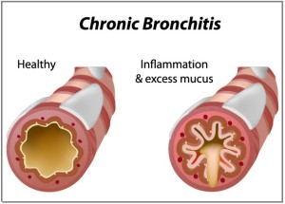

Slide 75
Emphysema: damage to the walls of the alveoli
Causes | Symptoms | Treatment
Irritants like tobacco smoke, marijuana smoke, and other air pollutants Respiratory infections | Shortness of breath Long term cough Wheezing Increased production of mucus | Bronchodilators to relieve coughing and breathing problems. Taking antibiotics Anti-inflammatory medications

Slide 76
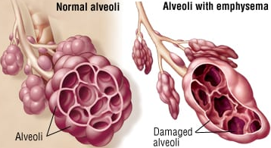

Slide 77
Lung cancer: uncontrolled division of cells in the lungs leading to tumors
Causes | Symptoms | Treatment
Smoking tobacco Exposure to radioactive substances such as arsenic, uranium, Lead, etc and radiations like x-rays | Coughing up blood or phlegm Chest pain Wheezing Shortness of breath Fatigue and weakness Weight loss Loss of appetite | Surgery to remove tumor from the lung Chemotherapy Radiotherapy Immunotherapy

Slide 78
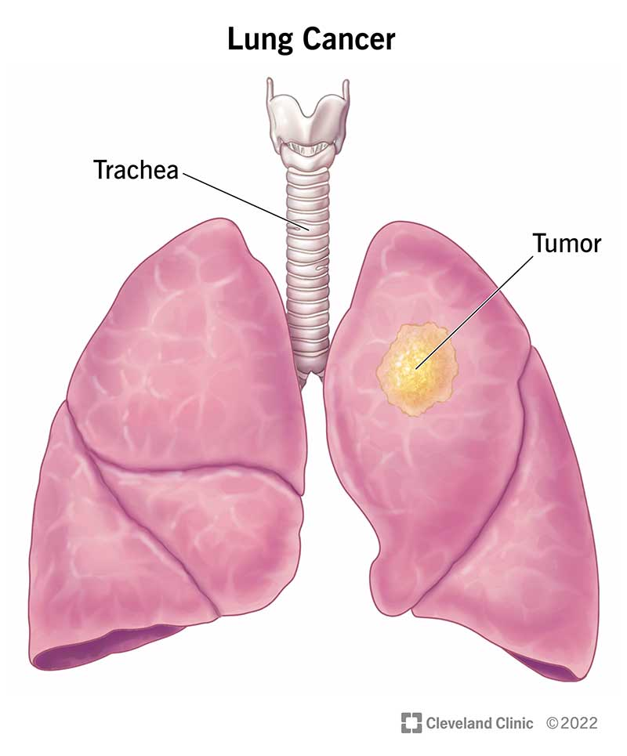
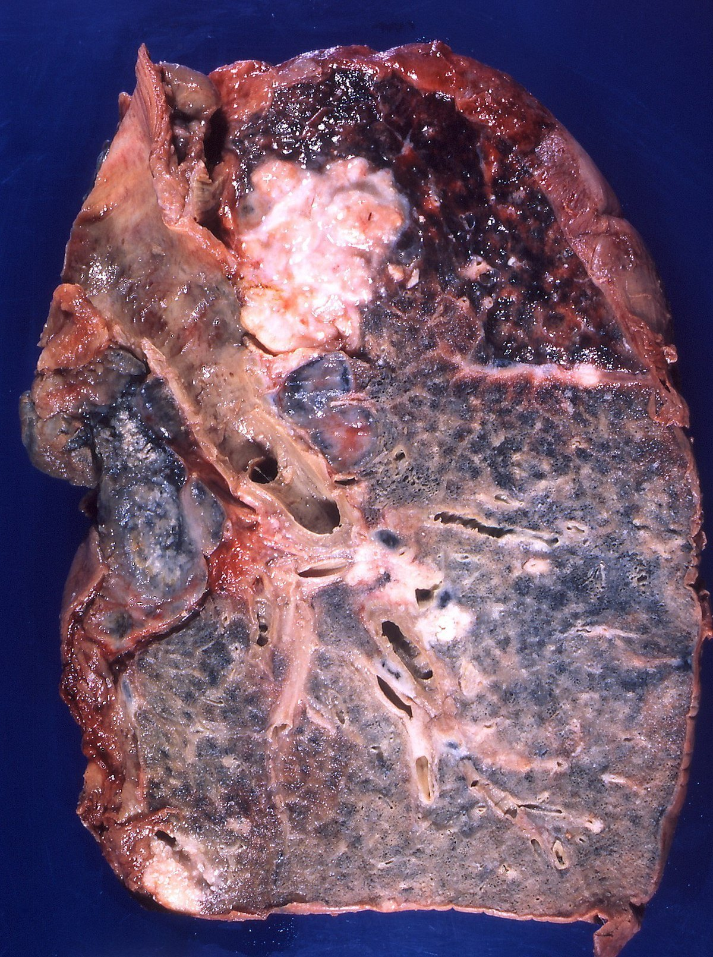

Slide 79
Chronic cough: cough that lasts more than eight weeks in adults and four weeks in children
Cause | Symptoms | Treatment
Smoking tobacco Asthma Respiratory tract infection, e.g. tuberculosis, whooping cough Postnasal drip Acid reflux | High fever Coughing up blood Coughing up phlegm/sputum Shortness of breath Frequent coughing Weight loss Fatigue Chest pain | Elevating the head during sleep Treating underlying conditions Avoid irritants like smoke or strong odors. Antibacterials or antivirals for respiratory tract infections

Slide 80

Chronic obstructive pulmonary disease (COPD) refers to a group of diseases that includes chronic bronchitis and emphysema.

Slide 81
Activity of integration
A teenager who doesn’t smoke hangs out with a gang of boys who smoke. How can you convince him to leave the gang?

Slide 82
Artificial Respiration/Artificial Ventilation
This is a medical technique used to assist a person to breathe when he/she is unable to breathe.
A person may fail to breathe naturally due to injury, sickness, medical procedure, etc.

Slide 83
How to carry out artificial ventilation
There are two major methods of artificial respiration namely
(i) Mechanical ventilation
This involves using a machine called a ventilator which is connected to the patient’s airway through a tube to deliver oxygen to patient’s lungs. It is commonly used in intensive care units of hospitals.

Slide 84
(ii) Manual resuscitation/rescue breathing/mouth-to-mouth resuscitation
It involves a person blowing air into the patient’s mouth while maintaining an open airway of the patient.
It is used when a person has stopped breathing.

Slide 85
Procedure
Place the person on his/her back on a firm flat surface. Clear any obstacles on the mouth of the victim
Tilt the victims head slightly backwards to open his/her airways by lifting his/her chin while pushing down the forehead.
Pinch the victims nose shut with your fingers. Take a normal breath. Cover the victim’s mouth with your mouth creating an air-tight seal.
Give a breath that last about one second makes his/her chest rise visibly
Remove your mouth to allow his/her chest fall.

Slide 86
After giving 2 rescue breaths, switch to chest compressions at a rate of 100-120 compressions per minute with adequate depth
After about one minute, give another 2 rescue breaths and switch to compressions of about 30 compressions per minutes.
Continue switching rescue breath with chest compressions until the victim starts to breath.

