Slide 1
Final 360: Checkers
Group: Mathew Puryear & Dulce palacios

Slide 2
Project Description: Checkers (OOP)
Turn-based checkers
8 x 8 board
64 Pieces (32 Red & 32 Black)
Artificial Intelligence as possible competition
Possible Pieces:
Regular
King

Slide 3
Rules of Game:
Goal: Capture all of opponent’s pieces or trap them.
Turn-Based:
A “normal” checker can only move forward and may not land on a square that is occupied by another piece.
A “kinged” checker is able to move forward and back.
Valid Jumps:
Checker must be diagonal to opponent and have an empty square to land on.

Slide 4
Rules of Game (Cont.)
Winner of Game:
Whoever captures all of their opponent’s checkers or have blocked them from making any moves
”Kinged”
Once a ”normal” checker piece reaching the opposite end of the board, it becomes a King checkers piece.

Slide 5
Classes
Game
Board
Piece
Player
Move
Extends:
JPanel
Implements:
ActionListener
MouseListener

Slide 6
Classes (Cont.): Game
This public class is responsible for managing the rules of the game and the rest of the classes.
Member Data:
Private JFrame
Private JPanel (buttonPanel, gamePanel)
Private Board
Private Boolean (gameOver)
Private Player
Private Int (selectedR , selectedC)
Private JLabel
Private MoveSequence

Slide 7
Classes (Cont.): Game
Methods:
Game() – Constructor
startGame() – Game initializer called in constructor
clickSquare(int, int) – Checks for valid selected square/checker
makeMove(Move) – Makes move on board
gameOver (String) – Handles game over
Overwritten Methods:
paintComponent(Graphics) – From Jpanel
Draws everything on screen
actionPerformed(ActionEvent) – From ActionListener
Handles button click
mousePressed(MouseEvent) – From MouseListener
Handles mouse click

Slide 8
Classes (Cont.): Board
This public class is responsible for the creation and modification of a two-dimensional array of Pieces
Member Data:
Public static final Int – For number of rows and columns
Private Piece [] [] – Make up the board

Slide 9
Classes (Cont.): Board
Methods:
Setup() - Initializes the board and determines which squares are empty or have a checker piece
Getter and Setters:
getPiece(int, int) – Returns Piece at location of row and column
setPiece (int, int, Piece) – Takes in row, column and Piece and replaces the current element, if any, in the array with new Piece.
getBoard() – Returns whole Piece array that represents the board
movePiece(Move) – Handles move of Piece in the array
getValidMoves(Player) – Returns sequence of valid moves.
canJump (int, int, int, int, int, int, Player) – Takes in the location that the Piece will move from, location of place it will jump over and the place it will jump to and returns true if it is a valid jump.
getValidJumps(int, int, Player) – Returns sequence of valid jumps.

Slide 10
Classes (Cont.): Piece
This public class is responsible for holding the attributes of the “checkers.”
Member Data:
String color – Stores the color of the checker piece
String type - Stores the type of checkers piece
Setter and Getters:
isPlayer(Player) – Returns color that represents the player.
isRed() – Returns true/false if the Piece is red.
isBlack() – Returns true/false if the Piece is black.
isEmpty() – Returns true/false if the Piece is empty.
isKing() – Returns true/false if the Piece is king.
getType() – Returns the type of the Piece.
getColor() – returns the color of the piece
getColorType – Returns the color and type of piece concatenated.

Slide 11
Classes (Cont.): Player
This class is responsible for storing the attributes of a player.
Member Data:
String color – Represents the Player by its color (Red / Black)
Boolean isAI – Returns true/false depending whether Player is Artificial Intelligence.
Getter and Setters:
getColor() – Returns color of Player
isRed() – Returns true / false if Player is red
isBlack() – Returns true / false if Player is black

Slide 12
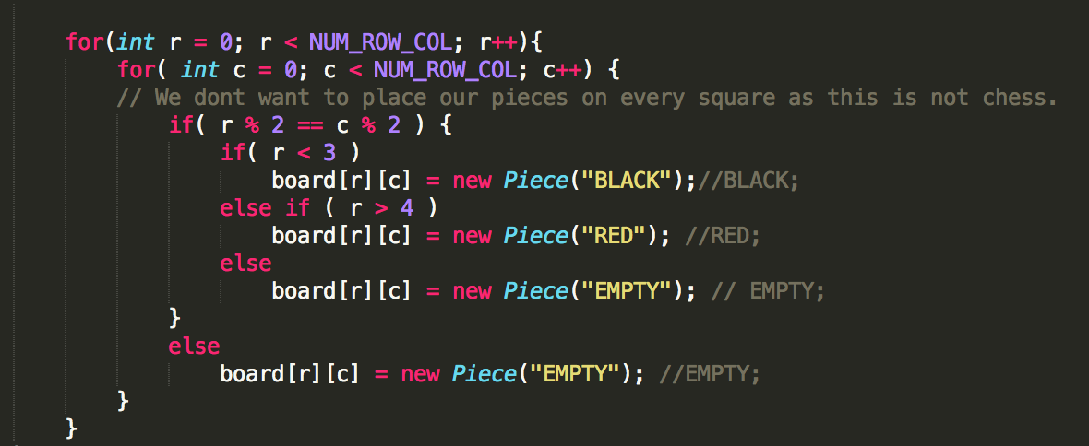
Algorithms: Displaying the Board

Slide 13
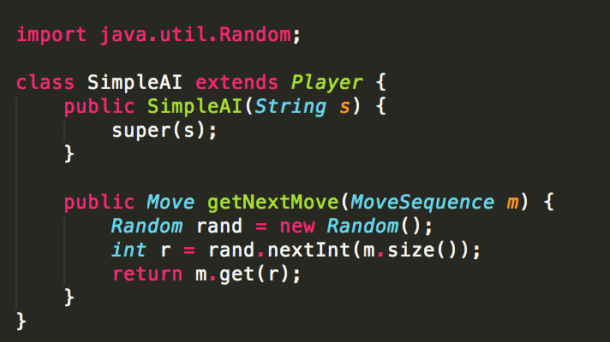
Algorithms (Cont.): Artificial Intelligence

Slide 14
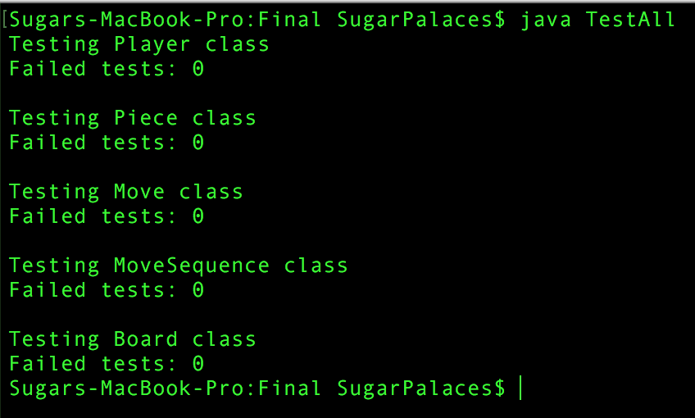
Test Classes
PlayerTest.java
PieceTest.java
MoveTest.java
MoveSequenceTest.java
BoardTest.java

