Slide 1

PageRank
Implementation
Data Science and Scientific Computing - University of Trieste
Information Retrieval Final Project
A.Y. 2023-2024
Student: Mattia Pividori

Slide 2

The Datasets
For this project, we will utilize two distinct datasets:
Dataset 1: Seventh Graders (SG) is a small dataset representing a directed network, capturing interactions among 29 seventh-grade students from a school in Victoria. Students were asked to nominate their preferred classmates. Each node signifies a student and an edge from one node to another indicates that the student chose the other as a preferred classmate. Summary measures: |V |=29, |E |=376
Source: http://konect.cc/networks/moreno_seventh
Dataset 2: Wikivitals (WV) is a larger dataset comprising Level 4 Vital articles from the English Wikipedia, with directed links between them. The dataset includes 6,829,273 articles, organized into five levels of vitality. Level 1 contains the ten most vital articles, expanding in subsequent levels. The dataset consists of four subfiles: Adjacency (edges between articles as a sparse matrix |V|x|V|), Names (titles of Wikipedia articles |V|x1), Labels (category numbers for each page |V|x1) and Label names (names of the 11 categories |11|x1). Summary measures: |V |=10,011, |E |=824,999
Source: https://netset.telecom-paris.fr/pages/wikivitals.html

Slide 3
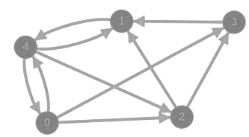
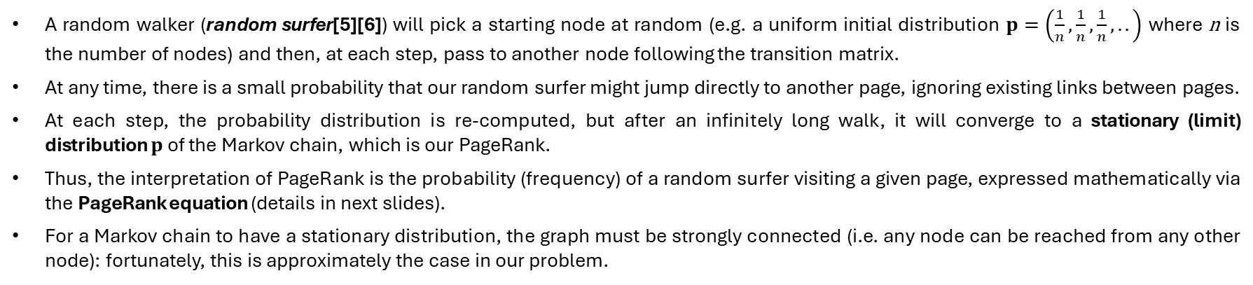
Basic Idea
The web can be represented as a directed graph with nodes as web pages and edges as links. PageRank’s goal is to determine the importance of each page by assigning a rank to each web page.
The PageRank problem can be interpreted as a Markov chain, where transition probabilities between web pages are given by an initial distribution and a transition matrix that considers existing edges.
A random walker (random surfer[5][6]) will pick a starting node at random (e.g. a uniform initial distribution $p=\left(\frac{1}{n},\frac{1}{n},\frac{1}{n},..\right)$ where n is the number of nodes) and then, at each step, pass to another node following the transition matrix.
At any time, there is a small probability that our random surfer might jump directly to another page, ignoring existing links between pages.
At each step, the probability distribution is re-computed, but after an infinitely long walk, it will converge to a stationary (limit) distribution $p$ of the Markov chain, which is our PageRank.
Thus, the interpretation of PageRank is the probability (frequency) of a random surfer visiting a given page, expressed mathematically via the PageRank equation (details in next slides).
For a Markov chain to have a stationary distribution, the graph must be strongly connected (i.e. any node can be reached from any other node): fortunately, this is approximately the case in our problem.

Slide 4



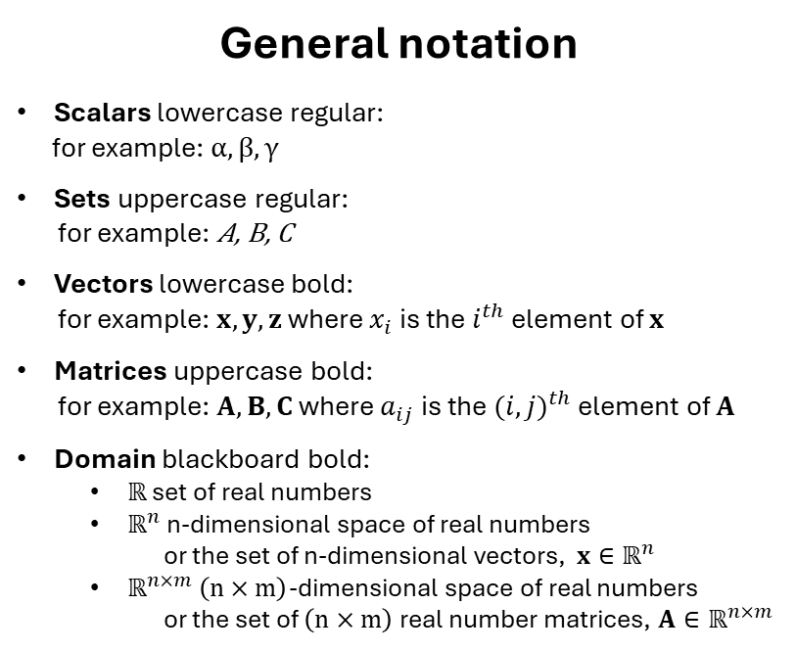
Definitions & Notation
Basic definitions
Adjacency Matrix A: let $G=(V,E)$ be a simple digraph, where $V=\left\{v_{1}, v_{2}, …v_{n}\right\}$ are the vertices (nodes). Once nodes are ordered from $v_{1}$ to $v_{n}$, then the $\left(n×n\right)$ matrix $A$ whose elements are given by:
$$a_{ij}=\left\{\begin{aligned} 1 if \left(v_{i},v_{j}\right) ϵ E \\ 0 otherwise\end{aligned}\right.$$
is the adjacency matrix of graph $G$ representing the connections between n nodes in the graph.
Diagonal matrix D is a matrix in which all off-diagonal entries are zero, i.e. $∀i,j ε\left\{1, 2, …n\right\},i≠j⟹d_{ij}=0.$ A well-known property of diagonal matrices which will save us from explicit matrix inversion, is that: ${D\left(d_{1},…,d_{n}\right)}^{−1}=D(d_{1}^{−1},…,d_{n}^{−1})$.
Row-normalized adjacency matrix $\hat{A}$: for each edge $u→v_{ }ϵ E,\hat{A}=\frac{1}{O_{u}}$ where $O_{u}$ is the set of out-neighbors of $u$. If $D$ is the diagonal matrix whose $u^{th}$ entry corresponds to $O_{u}$ (defined as the out-degree of u), then $\hat{A}:=D^{−1}A$ where $D^{−1}$is the inverse of $D$ (row-stochastic transition matrix).
General notation
Scalars lowercase regular:
for example: $α,β,γ$
Sets uppercase regular:
for example: $\text{A}\text{, }\text{B}\text{, }\text{C}$
Vectors lowercase bold:
for example: $x, y, z$ where $x_{i}$ is the $i^{th}$ element of $x$
Matrices uppercase bold:
for example: $A, B, C$ where $a_{ij}$ is the ${(i,j)}^{th}$ element of $A$
Domain blackboard bold:
$ℝ$ set of real numbers
$ℝ^{n}$n-dimensional space of real numbers
or the set of n-dimensional vectors, $x∈ℝ^{n}$
$ℝ^{n×m} \left(n×m\right)$-dimensional space of real numbers
or the set of $\left(n×m\right)$real number matrices, $A∈ℝ^{n×m}$

Slide 5
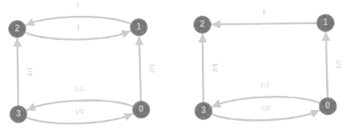
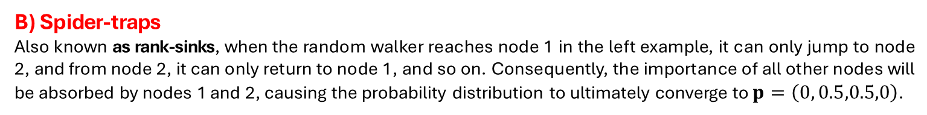
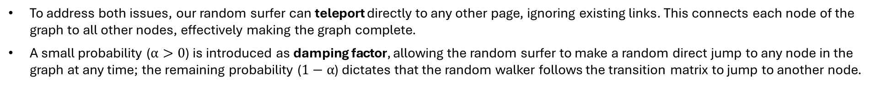
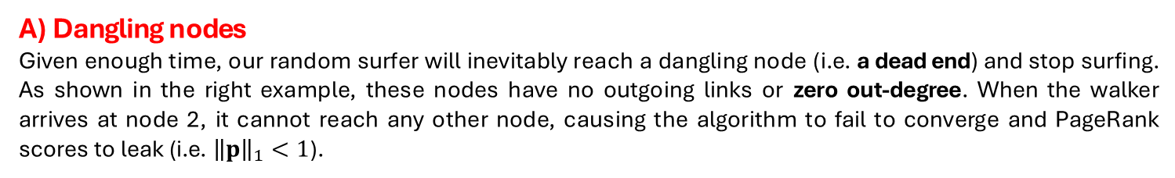
Teleportation & Damping Factor
The basic model previously outlined already addresses some of the most common problems encountered in PageRank calculation due to the intrinsic structure of web-directed graphs:
A) Dangling nodes
Given enough time, our random surfer will inevitably reach a dangling node (i.e. a dead end) and stop surfing. As shown in the right example, these nodes have no outgoing links or zero out-degree. When the walker arrives at node 2, it cannot reach any other node, causing the algorithm to fail to converge and PageRank scores to leak (i.e. ${\left\|p\right\|}_{1}<1$).
B) Spider-traps
Also known as rank-sinks, when the random walker reaches node 1 in the left example, it can only jump to node 2, and from node 2, it can only return to node 1, and so on. Consequently, the importance of all other nodes will be absorbed by nodes 1 and 2, causing the probability distribution to ultimately converge to $p=\left(0, 0.5,0.5,0\right)$.
To address both issues, our random surfer can teleport directly to any other page, ignoring existing links. This connects each node of the graph to all other nodes, effectively making the graph complete.
A small probability ($α>0$) is introduced as damping factor, allowing the random surfer to make a random direct jump to any node in the graph at any time; the remaining probability ($1−α$) dictates that the random walker follows the transition matrix to jump to another node.

Slide 6
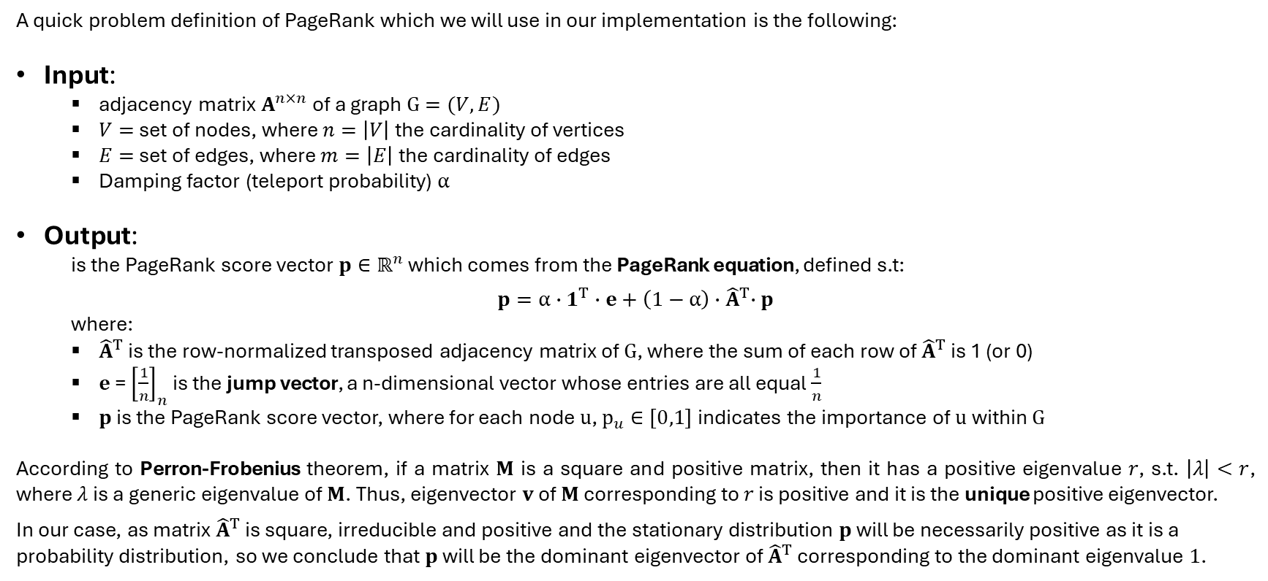
Problem Definition
A quick problem definition of PageRank which we will use in our implementation is the following:
Input:
adjacency matrix $A^{n×n}$of a graph $G=(V,E)$
$V=$ set of nodes, where $n=\left|V\right|$ the cardinality of vertices
$E=$ set of edges, where $m=\left|E\right|$the cardinality of edges
Damping factor (teleport probability) $α$
Output:
is the PageRank score vector $p∈ℝ^{n}$ which comes from the PageRank equation, defined s.t:
$$p=α∙1^{T}∙e+\left(1−α\right){∙\hat{A}}^{T}∙p$$
where:
${\hat{A}}^{T}$is the row-normalized transposed adjacency matrix of $G$, where the sum of each row of ${\hat{A}}^{T}$ is 1 (or 0)
$e$ = ${\left[\frac{1}{n}\right]}_{n}$ is the jump vector, a n-dimensional vector whose entries are all equal $\frac{1}{n}$
$p$ is the PageRank score vector, where for each node $u$, $p_{u}∈\left[0,1\right]$indicates the importance of $u$within $G$
According to Perron-Frobenius theorem, if a matrix $M$ is a square and positive matrix, then it has a positive eigenvalue $r$, s.t. $\left|λ\right|<r$, where $λ$ is a generic eigenvalue of $M$. Thus, eigenvector $v$ of $M$ corresponding to $r$ is positive and it is the unique positive eigenvector.
In our case, as matrix ${\hat{A}}^{T}$ is square, irreducible and positive and the stationary distribution $p$ will be necessarily positive as it is a probability distribution, so we conclude that $p$ will be the dominant eigenvector of ${\hat{A}}^{T}$ corresponding to the dominant eigenvalue $1$.

Slide 7


PageRank as Power Iteration
In general, Power iteration is an eigenvalue algorithm that from a diagonalizable matrix $A$, calculates $λ$ (the greatest eigenvalue of $A$, in absolute value) plus a nonzero vector $v$ (the corresponding eigenvector of $λ$), according to $A ∙v=λ∙v$.
The algorithm usually starts with $b_{0}$ (a random vector) and then follows the recurrence relation $b_{k+1}=\frac{Ab_{k}}{\left\|Ab_{k}\right\|}$so that at every iteration $k$, $b_{k}$ is multiplied by $A$and normalized. Assuming (I) $A$has an eigenvalue >> in magnitude than its other eigenvalues and (II) $b_{0}$ having a nonzero component in the direction of an eigenvector associated with the dominant eigenvalue, then a subsequence $(b_{k})$ converges to an eigenvector associated with the dominant eigenvalue.
Similarly, the PageRank score vector $p$ is obtained by iteratively solving the PageRank algorithm, thanks to Perron-Frobenius theorem which states eigenvalue 1 is its largest eigenvalue and the associated eigenvector is a unique stochastic eigenvector (proof in [3]):
Algorithm ITERATIVE_PAGERANK($\hat{A}$, $α$, $ε$, max_iter)
$t←0;$
$e←\frac{1}{n}1$, $p←0 or \frac{1}{n}1;$
for $t≤max⁡_iter$ do:
$p′←\left(1−α\right){∙\hat{A}}^{T}∙p;$
$d←$ ${{\left\|p\right\|}_{1}−\left\|p′\right\|}_{1}$;
$p^{′}←p^{′}+d∙e$;
$δ←{\left\|p^{′}−p\right\|}_{1}$;
$p←p′;$
$t←t+1;$
if $δ<ε$: stop;
return $p$;

Slide 8
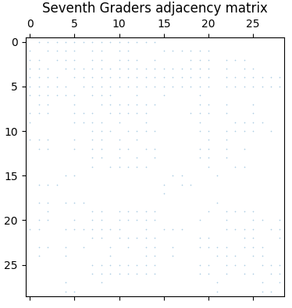
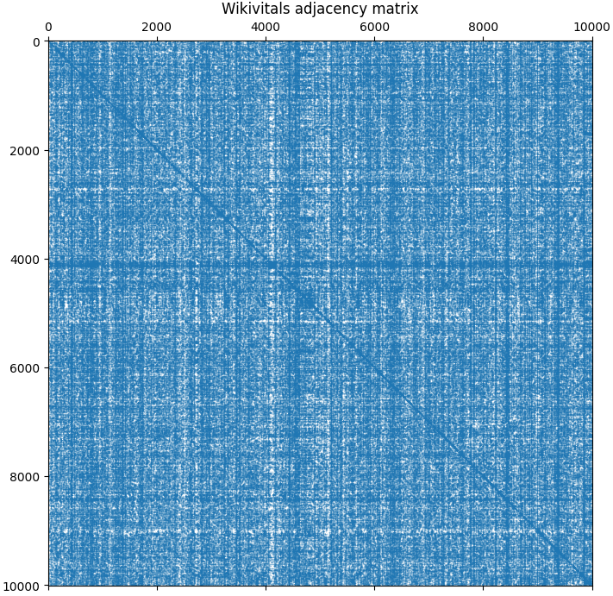
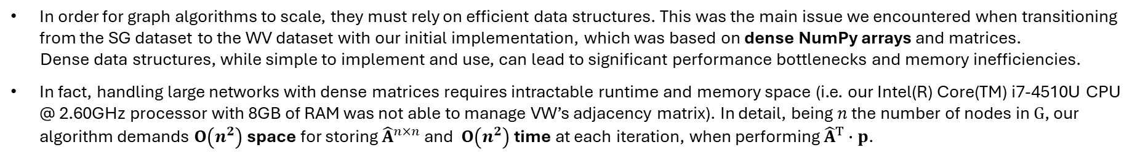

Problem of Dense Matrices
In order for graph algorithms to scale, they must rely on efficient data structures. This was the main issue we encountered when transitioning from the SG dataset to the WV dataset with our initial implementation, which was based on dense NumPy arrays and matrices.
Dense data structures, while simple to implement and use, can lead to significant performance bottlenecks and memory inefficiencies.
In fact, handling large networks with dense matrices requires intractable runtime and memory space (i.e. our Intel(R) Core(TM) i7-4510U CPU @ 2.60GHz processor with 8GB of RAM was not able to manage VW’s adjacency matrix). In detail, being $n$ the number of nodes in $G$, our algorithm demands $O\left(n^{2}\right)$ space for storing ${\hat{A}}^{n×n}$ and $O\left(n^{2}\right)$ time at each iteration, when performing ${\hat{A}}^{T}∙p$.
Real-world networks are usually extremely sparse, with$m≪n^{2}$ and densities typically below ${10}^{−5}$, so that edges are often proportional to nodes (i.e. $m=c∙n$). Being 99.99% of elements equal to 0, it is far more efficient not to store them explicitly in memory, thus reducing time and space complexities to $O\left(m\right)$[4].
To verify if all the above is applicable also to our datasets, we first try to visualize the adjacency matrices to inspect the sparsity pattern of both using matplotlib (see plots on the right).
Secondly, we define a measure of sparsity which indicates the portion of empty space in our $n×n$ adjacency matrices as $sparsity=(1−density)=\left(1−\frac{m}{n^{2}}\right)$: it measures 55.29% for SG and 99.18% for WV.
We conclude that both matrices, especially VW, are sparse. To address this, we are considering a second implementation more suitable for sparse matrix representations, such as those provided by the scipy.sparse module¹, which allows us to optimize both memory usage and computational efficiency.
¹ https://docs.scipy.org/doc/scipy/reference/sparse.html

Slide 9
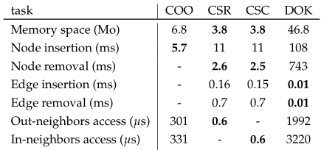
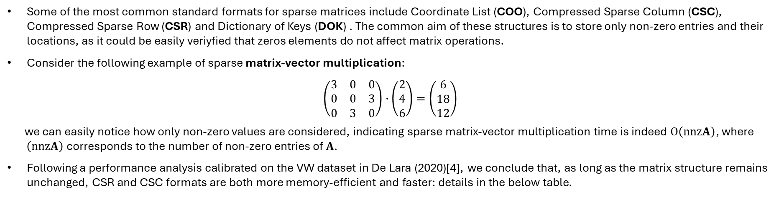
The Sparse Matrix .csr Format
Some of the most common standard formats for sparse matrices include Coordinate List (COO), Compressed Sparse Column (CSC), Compressed Sparse Row (CSR) and Dictionary of Keys (DOK) . The common aim of these structures is to store only non-zero entries and their locations, as it could be easily veriyfied that zeros elements do not affect matrix operations.
Consider the following example of sparse matrix-vector multiplication:
$$\left(\begin{matrix}3 & 0 & 0 \\ 0 & 0 & 3 \\ 0 & 3 & 0\end{matrix}\right)∙\left(\begin{matrix}2 \\ 4 \\ 6\end{matrix}\right)=\left(\begin{matrix}6 \\ 18 \\ 12\end{matrix}\right)$$
we can easily notice how only non-zero values are considered, indicating sparse matrix-vector multiplication time is indeed $O\left(nnzA\right)$, where $\left(nnzA\right)$ corresponds to the number of non-zero entries of $A$.
Following a performance analysis calibrated on the VW dataset in De Lara (2020)[4], we conclude that, as long as the matrix structure remains unchanged, CSR and CSC formats are both more memory-efficient and faster: details in the below table.
Our choice for the second implementation of Pagerank algorithm thus falls on the Scipy Compressed Sparse Row (CSR) format² which uses three arrays to represent the matrix: one for the non-zero values, one for the column indices and one for the row pointers.
CSR reduces memory usage and enables efficient matrix-vector multiplication operations, which are crucial for the iterative PageRank algorithm. Our empirical tests demonstrate that this allows us to handle WV's adjacency matrix effectively. Furthermore, the sparse implementation consistently exhibits significantly lower runtime on the WV dataset (~1s versus ~100s).
² https://docs.scipy.org/doc/scipy/reference/generated/scipy.sparse.csr_matrix.html

Slide 10
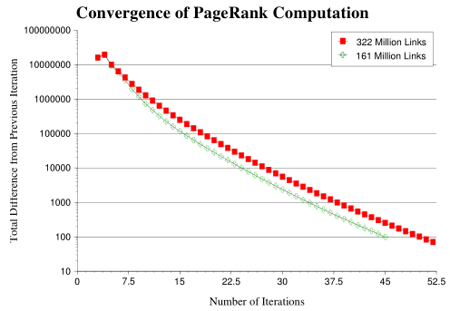
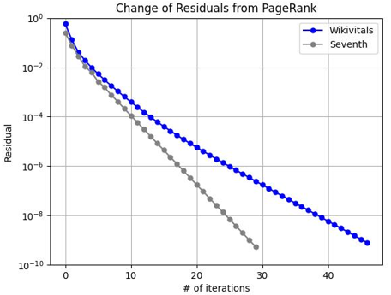
Solution Checks (I)
Once the iteration stops, we verify the effectiveness of our implementation along three dimensions:
1
Monitor residuals magnitude
Residual size ($δ$ between current/previous PageRank score vectors) after final iteration to fall below $ε$, the tolerance set in input:
→ in our case $ε={10}^{−9}$ is respected in both implementations ($δ$ is ${\text{\sim }5.39×10}^{−10}$ and ${\text{\sim }7.87×10}^{−10}$, respectively);
2
Observe monotonic decrease
Residuals plot to show a trend of residuals decreasing monotonically as iterations increase, implying convergence of PageRank score vector (where theoretically for $n→∞, δ→0$):
→ below on the left residuals plot in original Pagerank [5], on the right plot for our implementations, both show monotonicity;

Slide 11

Solution Checks (II)
3
Assess solution convergence
A last check we implemented on the solution obtained for $p$, is to verify if the PageRank score vector $p_{iter}$resulting from the iteration method converged to the true PageRank value $p_{true}$
Being this already theoretically proven [3], we will focus on validating the result empirically, with focus on our two datasets;
The first step is the derivation of the closed form for the original PageRank equation:
$$p=α∙e+\left(1−α\right){∙\hat{A}}^{T}∙p⟺p−\left(1−α\right){∙\hat{A}}^{T}∙p=α∙e⟺\left(I−\left(1−α\right){∙\hat{A}}^{T}\right)∙p=α∙e⟺p=α∙{\left(I−\left(1−α\right){∙\hat{A}}^{T}\right)}^{−1}∙e$$
in which $I$ is the n-dimensional identity matrix.
We can thus proceed to compute $p_{true}$ or the exact solution for PageRank: this usually is done just for small graphs, due to the intractability of matrix inversion in large graphs, which is the main reason why iterative computation of $p_{true}$ is the common implementation.
In our implementation, the sizes of our two datasets are sufficiently small to allow us first to compute the exact solutions, and then measure their difference ($error$) with $p_{iter}$ by means of L1 norm:
$$error={\left\|p_{true}−p_{iter}\right\|}_{1}$$
The $error$ we estimated is ~$5.96×{10}^{−10}$ and ~${1.23×10}^{−11}$ respectively, for SG and for the WV dataset.
Finally, notice that this inspection is different from previous ones, as residuals were just the difference between consecutive score vectors.

Slide 12

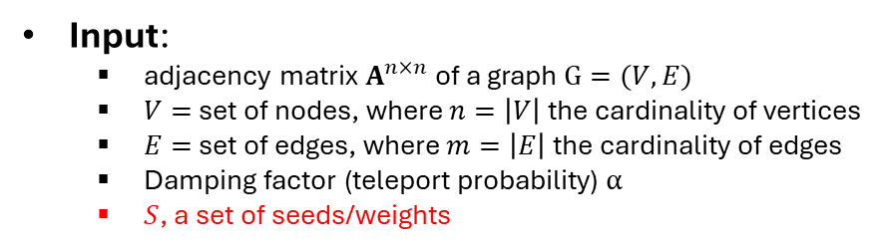
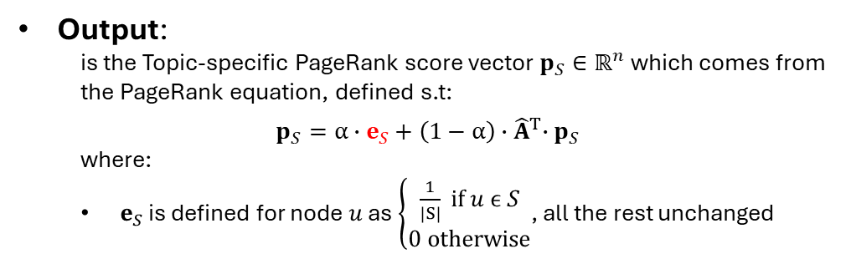
Topic-specific PageRank
Finally, we also implement a Topic-specific version of PageRank, which may also be used as a Personalized PageRank where the aim is to rank nodes with respect to given topics (or seed nodes), resulting in a biased ranking as seed nodes should score higher than others:
Input:
adjacency matrix $A^{n×n}$of a graph $G=(V,E)$
$V=$ set of nodes, where $n=\left|V\right|$ the cardinality of vertices
$E=$ set of edges, where $m=\left|E\right|$the cardinality of edges
Damping factor (teleport probability) $α$
$S$, a set of seeds/weights
Output:
is the Topic-specific PageRank score vector $p_{S}∈ℝ^{n}$ which comes from the PageRank equation, defined s.t:
$$p_{S}=α∙e_{S}+\left(1−α\right){∙\hat{A}}^{T}∙p_{S}$$
where:
$e_{S}$ is defined for node $u$ as $\left\{\begin{aligned}\frac{1}{\left|S\right|} if u ϵ S \\ 0 otherwise\end{aligned}\right.$, all the rest unchanged
Algorithm:
Algorithm ITERATIVE_PAGERANK_TS ($\hat{A}$, $S, α$, $ε$, max_iter)
$t←0;$
${ e}_{S}←\frac{1}{\left|S\right|}∀ u_{i} ϵ S$ otherwise $e_{u_{i}}=0$,${ p}_{S} ←0 or \frac{1}{n}1;$
for $t≤max⁡_iter$ do:
$p_{S}′←\left(1−α\right){∙\hat{A}}^{T}∙p_{S};$
$d_{s}←$ ${{\left\|p_{S}\right\|}_{1}−\left\|p_{S}′\right\|}_{1}$
$p_{S}′←p_{S}′+d_{s}∙e_{S}$
$δ←{\left\|{p_{S}}^{′}−p_{S}\right\|}_{1}$;
$p_{S}←p_{S}′;$
$t←t+1;$
if $δ<ε$: stop;
return $p_{S}$;

Slide 13
References
[1] https://towardsdatascience.com/pagerank-algorithm-fully-explained-dc794184b4af
[2] https://medium.com/@TadashiHomer/understanding-and-implementing-the-pagerank-algorithm-in-python-2ce8683f17a3
[3] https://malchiodi.di.unimi.it/archive/link-analysis/pagerank-convergence-proof.pdf
[4] De Lara N. Algorithmic and Software Contributions to Graph Mining. Data Structures and Algorithms [cs.DS]. Institut Polytechnique de Paris, 2020.
[5] Page L., Brin S., Motwani R., et al. The PageRank Citation Ranking: Bringing Order to the Web. In: Proc. of the 7th International World Wide Web Conf. 1998.
[6] Brin S., Page L. The Anatomy of a Large-Scale Hypertextual Web Search Engine. Computer Networks and ISDN Systems, 1998, vol. 30, no. 1-7, pp. 107-117.

