Slide 1

Angular
The Framework Everyone Loves to Hate
Ivan Stepić
Senior Lead Engineer

Slide 2
Introduction
Single page
Second most popular
Deliver app-like experiences
Extends HTML vocabulary
Why to choose Angular for enterprise apps?

Slide 3
A Little bit of history
Angular 1.x released in October 2010 is now rebranded as just AngularJS
Angular 2 this is the new rewriten version released on September 2016
Angular 3 was never released.
Angular 4 was released on March 2017
Angular 5 was released on November 2017
Angular 6 was released on May 2018
Angular 7 was released on October 2018
Angular 8 was released on May 28 2019
(we will call all 2+ versions simple Angular)

Slide 4
Angular Features
Typscript
Modules
Components
Data binding
Directive
Pipes
Services
Observables(rxJS)
Dependency Injection
Routing
Lifecycle Hooks
Testability…

Slide 5



Slide 6
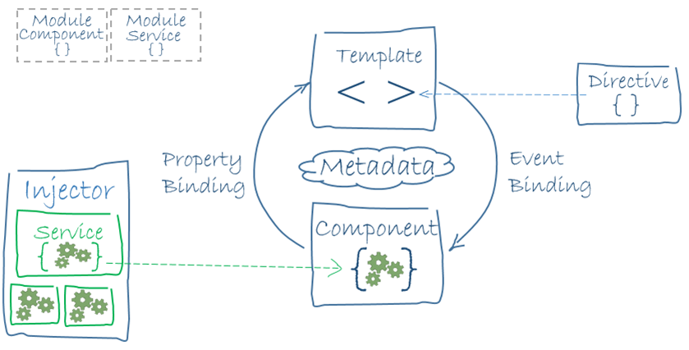
Angular Features
Typscript
Modules
Components
Data binding
Directive
Pipes
Services
Observables
Dependency
Injection
Honorable mentions

Slide 7
Typescript
Angular 2+ is written in Typescript
Created by Microsoft and used by Angular team for building Angular 2+.
TypeScript = ES6 JS + Extras
All JavaScript is valid TypeScript
Transpile down to JavaScript
All major FE IDEs have rich support
Browsers does not support TS, transpile down to JavaScript
Safe automatic refactoring, autocomplete and code navigation, typos caught at compilation time
Class-based OO, with inheritance, private members, interfaces and modules

Slide 8
Angular Features
Typscript
Modules
Components
Data binding
Directive
Pipes
Services
Observables
Dependency
Injection

Slide 9
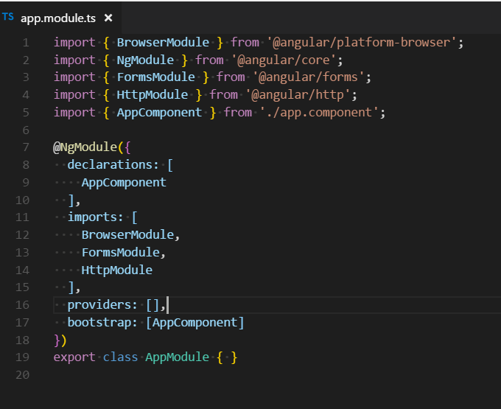
Modules
Help organize an application into cohesive blocks of functionality
AppModule - the application root module
Many Angular libraries are modules
Lazy loading

Slide 10
Angular Features
Typscript
Modules
Components
Data binding
Directive
Pipes
Services
Observables
Dependency
Injection
Honorable mentions

Slide 11
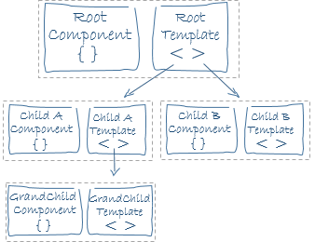
Components
Component 1
Enables extension of HTML through custom tags
Directive
1
Component
2
Directive
2
Component
3

Slide 12
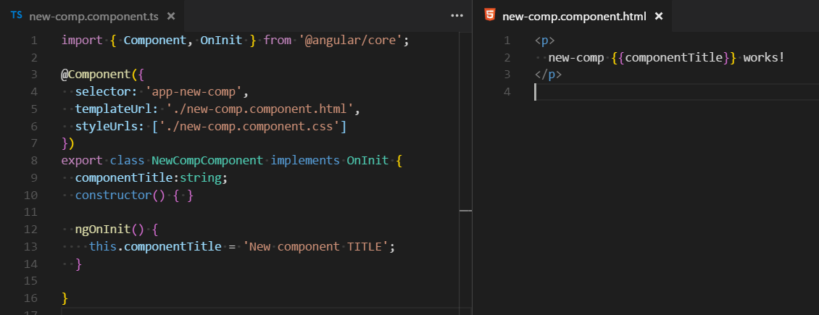
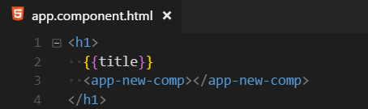
Components

Slide 13
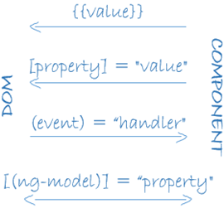
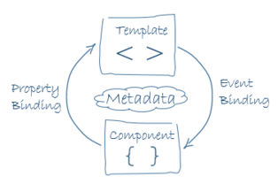
Components Data binding
Way how to show data from component to DOM
1-way
<div [style.width.%]="value“></div>
<div>{{value}}</div>
Events
<div (click)=“eventHandler() “></div>
2-way
<div [(ngModel)]=“value“></div>

Slide 14
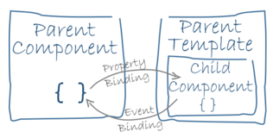
Components Nested component
@Input – allows data to flow from parent to child
<child-cmp [inputProp]=“parent.value“>
</child-cmp>
@Output – custom events for passing data from child to parent
<child-cmp (childEvent)=“parentEventHandler() “>
</child-cmp>

Slide 15
Angular Features
Typscript
Modules
Components
Data binding
Directive
Pipes
Services
Observables
Dependency
Injection
Honorable mentions

Slide 16
Directives
An HTML element or attribute that is used to enhance and extend standard HTML
Components ☺ – directive with a template
<app-new-comp></app-new-comp>
Structural directives – changes structure of the view
NgFor, NgIf, NgClass
<div *ngIf="someExperssion"></div>
Attribute directives – modifies the behavior of an element
<div myHighlight></div>

Slide 17
Angular Features
Typscript
Modules
Components
Data binding
Directive
Pipes
Services
Observables
Dependency
Injection
Honorable mentions

Slide 18
PIPES
Give us possibility to transform data
Build in
DatePipe, UpperCasePipe, LowerCasePipe, CurrencyPipe, and PercentPipe
<p>Today is {{ currentDate | date:“dd.MM.yy" }} </p>
<p>Today is {{ someString | uppercase }} </p>
Custom

Slide 19
Angular Features
Typscript
Modules
Components
Data binding
Directive
Pipes
Services
Observables
Dependency
Injection
Honorable mentions

Slide 20
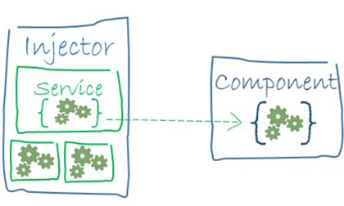
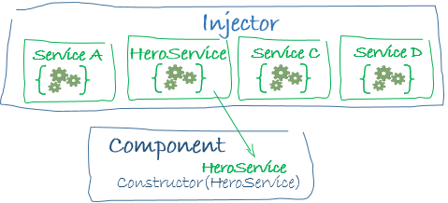
Services
Used to encapsulate logic that can be used across multiple components
Injector
Dependency injection
Component or application level injections

Slide 21
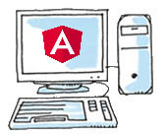
Services HTTP, Observables
Communication between Server and Front end app
Observable – async stream of data, allows subscription
Support multiple providers
Can be canceled
Can be mapped, filtered
HTTP request
API server
HTTP response as
Observable

Slide 22
Angular Features
Typscript
Modules
Components
Data binding
Directive
Pipes
Services
Observables
Dependency
Injection
Honorable mentions

Slide 23
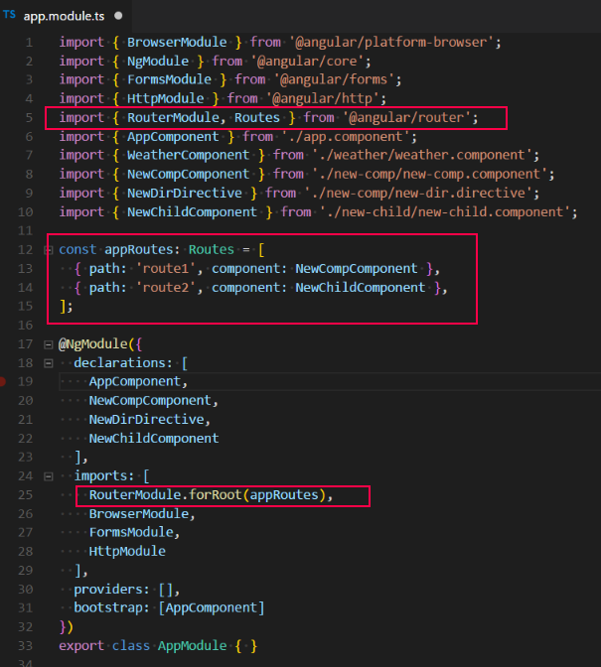

Routing
Router service – injected on application level
<base href=“/”> add it into index.html
RouterModule
<router-outlet></router-outlet>
Any component can be showed at specific route

Slide 24
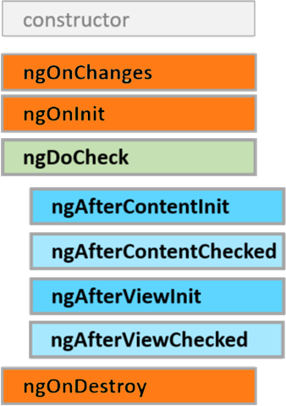
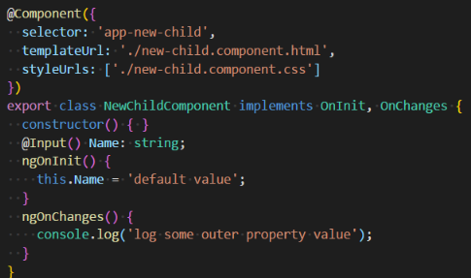
Lifecycle Hooks
Lifecycle is managed by Angular
Lifecycle hooks
Directive has the same set of lifecycle hooks, minus the hooks that are specific to component content and views.

Slide 25
Angular Initial Setup
Choose IDE (Visual Studio Code, WebStorm, Atom…)
Install Node.js
Angular Starting up
angular.io
Angular CLI – Front end only
Nx - monorepo

Slide 27

Questions???!??

